Slide 1
Graphs and Digraphs
Chapter 16

Slide 2
Chapter Contents
16.1 Directed Graphs
16.2 Searching and Traversing Digraphs
16.3 Graphs

Slide 3
Chapter Objectives
Introduce directed graphs (digraphs) and look at some of the common implementations of them
Study some of the algorithms for searching and traversing digraphs
See how searching is basic to traversals and shortest path problems in digraphs
Introduce undirected graphs and some of their implementations

Slide 4
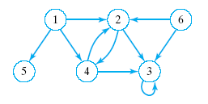
Directed Graphs
Similar to a tree
Consists of a finite set of elements
  Vertices or nodes
Together with finite set of directed
  Arcs or edges
  Connect pairs of vertices

Slide 5
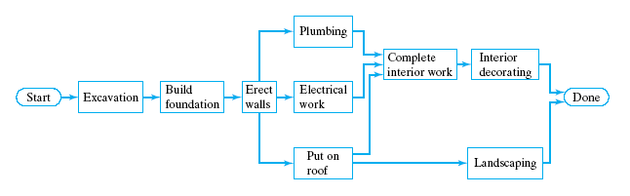
Directed Graphs
Applications of directed graphs
  Analyze electrical circuits
  Find shortest routes
  Develop project schedules

Slide 6
Directed Graphs
Trees are special kinds of directed graphs
  One of their nodes (the root) has no incoming arc
  Every other node can be reached from the node by a unique path
Graphs differ from trees as ADTs
  Insertion of a node does not require a link (arc) to other nodes … or may have multiple arcs

Slide 7
Directed Graphs
A directed graph is defined as a collection of data elements:
  Called nodes or vertices
  And a finite set of direct arcs or edges
  The edges connect pairs of nodes
Operations include
  Constructors
  Inserts of nodes, of edges
  Deletions of nodes, edges
  Search for a value in a node, starting from a given node

Slide 8
Graph Representation
Adjacency matrix representation
  for directed graph with vertices numbered
  1, 2, … n
Defined as n by n matrix named adj
The [i,j] entry set to
  1 (true) if vertex j is adjacent to vertex i
  (there is a directed arc from i to j)
  0 (false) otherwise

Slide 9
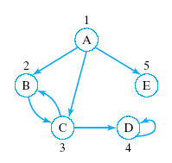
Graph Representation
columns j
 | 1 | 2 | 3 | 4 | 5
1 | 0 | 1 | 1 | 0 | 1
2 | 0 | 0 | 1 | 0 | 0
3 | 0 | 0 | 0 | 1 | 0
4 | 0 | 0 | 1 | 0 | 0
5 | 0 | 0 | 0 | 0 | 0
Entry [ 1, 5 ] set to true
Edge from vertex 1 to vertex 5
rows i

Slide 10
Graph Representation
Weighted digraph
  There exists a "cost" or "weight" associated with each arc
  Then that cost is entered in the adjacency matrix
A complete graph
  has an edge between each pair of vertices
  N nodes will mean N * (N – 1) edges

Slide 11
Adjacency Matrix
Out-degree of i^{th} vertex (node)
  Sum of 1's (true's) in row i
In-degree of j^{th} vertex (node)
  Sum of the 1's (true's) in column j
What is the out-degree of node 4?
What is the in-degree of node 3?

Slide 12
Adjacency Matrix
Consider the sum of the products of the pairs of elements from row i and column j
Fill in the rest of adj ²
adj
adj ²
 | 1 | 2 | 3 | 4 | 5
1 | 0 | 1 | 1 | 0 | 1
2 | 0 | 0 | 1 | 0 | 0
3 | 0 | 0 | 0 | 1 | 0
4 | 0 | 0 | 1 | 0 | 0
5 | 0 | 0 | 0 | 0 | 0
 | 1 | 2 | 3 | 4 | 5
1 |  |  | 1
2
3
4
5
This is the number of paths of length 2 from node 1 to node 3

Slide 13
Adjacency Matrix
Basically we are doing matrix multiplication
  What is adj ³?
The value in each entry would represent
  The number of paths of length 3
  From node i to node j
Consider the meaning of the generalization of adj ^{n}

Slide 14
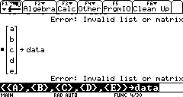
Adjacency Matrix
Deficiencies in adjacency matrix representation
  Data must be stored in
  separate matrix
  When there are few edges the matrix is sparse
  (wasted space)
data =

Slide 15
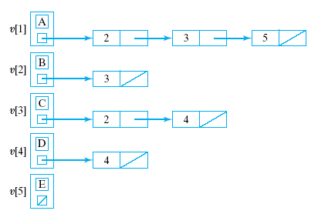
Adjacency-List Representation
Solving problem of wasted space
  Better to use an array of pointers to linked row-lists
This is called an
Adjacency-list
representation
View source code
for class template

Slide 16
Searching a Graph
Recall that with a tree we search from the root
But with a digraph …
  may not be a vertex from which every other vertex can be reached
  may not be possible to traverse entire digraph
  (regardless of starting vertex)

Slide 17
Searching a Graph
We must determine which nodes are reachable from a given node
Two standard methods of searching:
  Depth first search
  Breadth first search

Slide 18
Depth-First Search
Start from a given vertex v
Visit first neighbor w, of v
Then visit first neighbor of w which has not already been visited
etc. … Continues until
  all nodes of graph have been examined
If dead-end reached
  backup to last visited node
  examine remaining neighbors

Slide 19
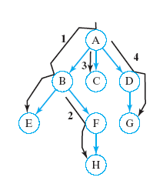
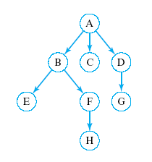
Depth-First Search
Start from node 1
What is a sequence of nodes which would be visited in DFS?
Click for answer
A, B, E, F, H, C, D, G

Slide 20
Depth-First Search
DFS uses backtracking when necessary to return to some values that were
  already processed or
  skipped over on an earlier pass
When tracking this with a stack
  pop returned item from the stack
Recursion is also a natural technique for this task
Note: DFS of a tree would be equivalent to a preorder traversal

Slide 21
Depth-First Search
Algorithm to perform DFS search of digraph
1.
Visit the start vertex, v
2.
For each vertex w adjacent to v do:
If
w
has not been visited,
apply the depth-first search algorithm
with
w
as the start vertex.
Note the recursion

Slide 22
Breadth-First Search
Start from a given vertex v
Visit all neighbors of v
Then visit all neighbors of first neighbor w of v
Then visit all neighbors of second neighbor x of v … etc.
BFS visits nodes by level

Slide 23
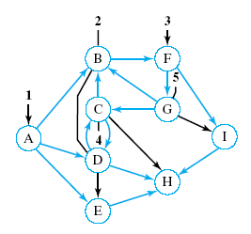
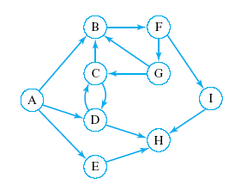
Breadth-First Search
Start from node containing A
What is a sequence of nodes which would be visited in BFS?
Click for answer
A, B, D, E, F, C, H, G, I

Slide 24
Breadth-First Search
While visiting each node on a given level
  store it so that
  we can return to it after completing this level
  so that nodes adjacent to it can be visited
First node visited on given level should be
First node to which we return
What data structure does this imply?
A queue

Slide 25
Breadth-First Search
Algorithm for BFS search of a diagraph
Visit the start vertex
Initialize queue to contain only the start vertex
While queue not empty do
  Remove a vertex v from the queue
  For all vertices w adjacent to v do:
  If w has not been visited then:
    Visit w
    Add w to queue
  End while

Slide 26
Graph Traversal
Algorithm to traverse digraph must:
  visit each vertex exactly once
  BFS or DFS forms basis of traversal
  Mark vertices when they have been visited
Initialize an array (vector) unvisited
unvisited[i] false for each vertex i
While some element of unvisited is false
  Select an unvisited vertex v
  Use BFS or DFS to visit all vertices reachable from v
  End while

Slide 27
Paths
Routing problems – find an optimal path in a network
  a shortest path in a graph/digraph
  a cheapest path in a weighted graph/digraph
Example – a directed graph that models an airline network
  vertices represent cities
  direct arcs represent flights connecting cities
Task: find most direct route (least flights)

Slide 28
Paths
Most direct route equivalent to
  finding length of shortest path
  finding minimum number of arcs from start vertex to destination vertex
Search algorithm for this shortest path
  an easy modification of the breadth-first search algorithm

Slide 29
Shortest Path Algorithm
Visit start and label it with a 0
Initialize distance to 0
Initialize a queue to contain only start
While destination not visited and the queue not empty do:
  Remove a vertex v from the queue
  If label of v > distance, set distance++
  For each vertex w adjacent to v
  If w has not been visited then
    Visit w and label it with distance + 1
    Add w to the queue
    End for
  End while

Slide 30
Shortest Path Algorithm
If destination has not been visited then display "Destination not reachable from start vertex"
else
Find vertices p[0] … p[distance] on shortest path as follows
  Initialize p[distance] to destination
  For each value of k ranging from
  distance – 1 down to 0
  Find a vertex p[k] adjacent to p[k+1] with label k
  End for
Note source code of Digraph Class Template,
Fig. 16.1
View program to find shortest paths in a network, Fig. 16.2

Slide 31
NP-Complete Problems
Nondeterministic polynomial problems
  Problems for which a solution can be guessed, then checked with an algorithm
  Algorithm has computing time O(P(n)) for some polynomial P(n)
Contrast deterministic polynomial (or P) problems
  Can be solved by algorithms in polynomial time

Slide 32
NP-Complete Problems
These are applied to shortest path problems
  Example is traveling salesman problem
  Find route to all destinations with least cost
NP-Complete problems
  If a polynomial time algorithm that solves any one of these problems can be found
  Then the existance of polynomial time algorithms for all NP problems is guaranteed

Slide 33
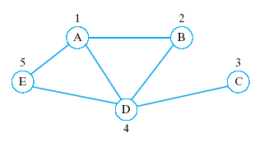
Graphs
Like a digraph
  Except no direction is associated with the edges
  No edges joining a vertex to itself allowed

Slide 34
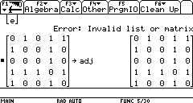
Undirected Graph Representation
Can be represented by
  Adjacency matrices
Adjacency matrix will
always be symmetric
  For an edge from i to j, there must be
  An edge from j to i
  Hence the entries on one side of the matrix diagonal are redundant
Since no loops,
  the diagonal will be all 0's

Slide 35
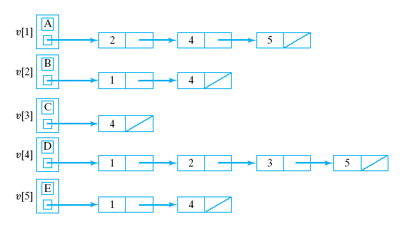
Undirected Graph Representation
Given
Adjacency-List
representation

Slide 36
Edge Lists
Adjacency lists suffer from the same redundancy
  undirected edge is repeated twice
More efficient solution
  use edge lists
Consists of a linkage of edge nodes
  one for each edge
  to the two vertices that serve as the endpoints

Slide 37
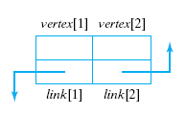
Edge Nodes
Each edge node represents one edge
  vertex[1] and vertex[2] are vertices connected by this edge
  link[1] points to another edge node having vertex[1] as one end point
  link[2] points to another
  edge node having
  vertex[2] as an
  endpoint

Slide 38
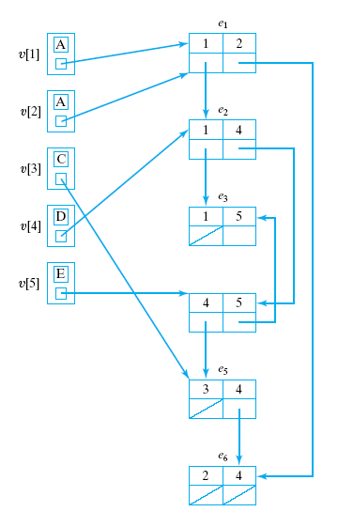
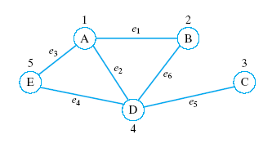
Edge List
Vertices have
pointers to one
edge

Slide 39
Graph Operations
DFS, BFS, traversal, etc. are similar as those for digraphs
Note class template Graph, Fig. 16.4
  Uses edge-list representation of graphs as just described

Slide 40
Connectedness
Connected defined
  A path exists from each vertex to every other vertex
Note the isConnected() function in Graph class template
  Uses a DFS, marks all vertices reachable from vertex 1
View program in Fig. 16-5
  Exercises this function

