Slide 1
COP5339 Object-oriented software design
Prof. Eduardo B. Fernandez
(Eduardo Fernandez Buglioni)
fernande@fau.edu
http://faculty.eng.fau.edu/fernande/

Slide 2
What is O-O design?
Design of software based on data together with their operations (objects), not on data transformations
Objects model the aspects of the real world which are of interest in some context
Can be used for designing applications, system programs, hardware, database modeling, web-based systems, cyber-physical systems; that is, almost every kind of software

Slide 3
Why OO?
OO brings design quality: correctness, flexibility, reusability, reliability, security, traceability, understandability.
It is a seamless approach, the same concepts are used in all stages (good for traceability).
The Procedural (Structured analysis and design) approach doesn't scale for complex systems. Data coupling makes changes affect many modules. Discontinuity from analysis to design models. No inheritance or polymorphism (little reusability).
Origins : DBMS, AI, PLs, modular design (D.L.Parnas)
OO brings along a change in the times spent at each stage, analysis and design become more important, coding becomes less important (and simpler)

Slide 4
COP5339
Prereqs.:Data Structures and some knowledge of C++ or Java
Catalog description: Complex systems can only be built using a systematic approach based on abstraction. We study the use of the object-oriented methodology for conceptual modeling, design, and implementation of complex software systems.
Textbook:Object-Oriented Analysis and Design with Applications (Addison-Wesley Object Technology Series) by Grady Booch, Robert A. Maksimchuk, Michael W. Engle, Bobbi J. Young, Jim Conallen, Kelli A. Houston Third Edition, Addison-Wesley Professional 2007

Slide 5
Me
Instructor: Dr. Eduardo B. Fernandez, Professor of Computer Science and Engineering
Office address: EE417
Office hours: WF 9:30-12:20
fernande@fau.edu
http://faculty.eng.fau.edu/fernande
Telephone: 561-297-3466 (only for emergencies)

Slide 6
About me
Professor of Computer Science at Florida Atlantic University, Boca Raton, FL., USA since 1984
At IBM for 8 years (L.A. Scientific Center).
Wrote the first book on database security (Addison-Wesley, 1981).
Author of many research papers and two books on patterns
Consultant to IBM, Siemens, Lucent, Huawei,…
MS EE Purdue U, PhD CS UCLA
Currently collaborates with Japanese, French, Chilean, and other international groups

Slide 7


Slide 9
Grading
Three assignments: 25 % each
Final exam: 25 %
Relative grading, no ranges or curves

Slide 10
Course objectives
Develop an understanding of conceptual modeling of software systems
Understanding of how the stages of the development of software systems fit together
Become proficient in the use of UML for handling complexity and nonfunctional requirements
Understanding of the importance of non-functional requirements, especially security and reliability.
Become proficient in converting models into code (C++ and Java)

Slide 11
Myths
If I know C++ or Java I know OO. Many people just do procedural programming using classes.
OO requires using Java or C++ . No, you can do OO even in Assembly language, it is a style, not a language
OO programming is a matter of good coding, no need for models. Only if your applications are simple and never require extensions or changes.
SQA (Software Quality Assessment) will solve all software development problems.-- Counting errors helps for planning new projects but
doesn't help in the current one.
-- OO will solve all software development problems. No, but it is the best way we have now.
-- XML, AOP, and components make OO unnecessary. They are
complementary approaches, they do not replace OO.
-- Now we can reuse everything. Well, it is not so easy.
-- We just need a good tool and UML. Neither is useful if you don't understand object-oriented concepts.

Slide 12
Outline
1. Motivation and basic concepts: software engineering, Model-based and model-driven development.
2. Objects, classes, inheritance, associations. Reusability.
3. Requirements: Use cases
4. Analysis: domain models, conceptual modeling of systems, analysis patterns;
adding formality: OCL
5. Design: nonfunctional objectives, design patterns. Security patterns. Java
implementation of patterns.
6. Usability. Building GUIs in Java

Slide 13
…and even more
7. Dynamic modeling. Object behavior. Interaction diagrams: sequence and collaboration diagrams. State diagrams: statecharts. Activity diagrams.
8. Software architecture. Styles and patterns: Pipes and Filters, SOA, and Message-Oriented Architectural patterns: Broker, Model-View-Controller.
9. Implementation: Using C++ and Java to implement OO systems. Comparison of languages.
10. Testing. JUnit and other patterns. Testing along the lifecycle.
11. Process aspects. The Rational Unified Process. Value of model-based and model-driven development. Agile processes.

Slide 14
Some useful links
General: http://www.objenv.com/cetus/software.html (about 20,000 links about all aspects of OO)
Unly until 1996 but still useful
Patterns: http://www.hillside.net/patterns
Conferences, books, events,…
OMG UML standard:
http://www.uml.org/
Satandards, tutorials, papers,…
Rational (IBM subsidiary): https://www.ibm.com/software/rational
IBM’s tools and products

Slide 15
The Nature of Software...
Software is intangible
Hard to understand development effort
Software is easy to reproduce
Cost is in its development
in other engineering products, manufacturing is the costly stage
The industry is labor-intensive
Hard to automate

Slide 16
The Nature of Software ...
Untrained people can hack something together
Quality problems are hard to notice
Software is easy to modify
People make changes without fully understanding them
Software does not ‘wear out’
It deteriorates (erodes) by having its design changed:
erroneously, or
in ways that were not anticipated, thus making it more complex

Slide 17
The Nature of Software
Conclusions
Much software has poor design and is getting worse
Demand for software is high and rising
Software complexity is increasing
We are in a perpetual ‘software crisis’
We have to learn to ‘engineer’ software

Slide 18
Software complexity
Embedded systems
The average device now has one million lines of code, and that number is doubling every two years.
Aerospace
A modern passenger jet, such as a Boeing 777, depends on 4 million lines of code. Older planes such as a Boeing 747 had only 400,000 lines of code.

Slide 19
Types of Software...
Custom
For a specific customer
Generic
Sold on open market
Often called
COTS (Commercial Off The Shelf)
Shrink-wrapped
Embedded
Built into hardware
Hard to change

Slide 20
What is Software Engineering?...
The process of solving customers’ problems by the systematic development and evolution of large, high-quality software systems within cost, time and other constraints
Other definitions:
IEEE: (1) the application of a systematic, disciplined, quantifiable approach to the development, operation, maintenance of software; that is, the application of engineering to software. (2) The study of approaches as in (1).
The Canadian Standards Association: The systematic activities involved in the design, implementation and testing of software to optimize its production and support.

Slide 21
What is Software Engineering?…
Solving customers’ problems
This is the goal of software engineering
Sometimes the solution is to buy, not build
Adding unnecessary features does not help solve the problem
Software engineers must communicate effectively to identify and understand the problem

Slide 22
What is Software Engineering?…
Systematic development and evolution
An engineering process involves applying well understood techniques in a organized and disciplined way
Many well-accepted practices have been formally standardized
e.g. by the IEEE or ISO
Most development work is evolution

Slide 23
What is Software Engineering?…
Large, high quality software systems
Software engineering techniques are needed because large systems cannot be completely understood by one person
Teamwork and co-ordination are required
Key challenge: Dividing up the work and ensuring that the parts of the system work properly together
The end-product must be of sufficient quality

Slide 24
What is Software Engineering?
Cost, time and other constraints
Finite resources
The benefit must outweigh the cost
Others are competing to do the job cheaper and faster
Inaccurate estimates of cost and time have caused many project failures

Slide 25
Software Quality...
Usability
Users can learn it and fast and get their job done easily
Efficiency
It doesn’t waste resources such as CPU time and memory
Reliability
It does what it is required to do without failing
Maintainability
It can be easily changed
Reusability
Security—assets must be protected

Slide 26
Activities Common to Software Projects...
Requirements and specification
Includes
Domain analysis
Defining the problem
Requirements gathering
Obtaining input from as many sources as possible
Requirements analysis
Organizing the information
Requirements specification
Writing detailed instructions about how the software should behave

Slide 27
Activities Common to Software Projects...
Design
Deciding how the requirements should be implemented, using the available technology
Includes:
Systems engineering: Deciding what should be in hardware and what in software
Software architecture: Dividing the system into subsystems and deciding how the subsystems will interact
Detailed design of the internals of a subsystem
User interface design
Design of databases

Slide 28
Activities Common to Software Projects
Modeling
Creating representations of the domain or the software
Use case modeling
Structural modeling
Dynamic and behavioural modeling
Programming
Quality assurance
Reviews and inspections
Testing
Deployment
Managing the process

Slide 29
Object-Oriented Software Engineering
Chapter 2:
Review of Object Orientation

Slide 30
2.1 What is Object Orientation?
Procedural paradigm:
Software is organized around the notion of procedures
Procedural abstraction
Works as long as the data is simple
Adding data abstractions
Groups together the pieces of data that describe some entity
Helps reduce the system’s complexity.
Such as Records and structures
Object oriented paradigm:
Organizing procedural abstractions in the context of data abstractions

Slide 31
Object Oriented paradigm
An approach to the solution of problems in which all computations are performed in the context of objects.
The objects are instances of classes, which:
are data abstractions
contain procedural abstractions that operate on the objects
Represent entities
A running program can be seen as a collection of objects collaborating to perform a given task

Slide 32
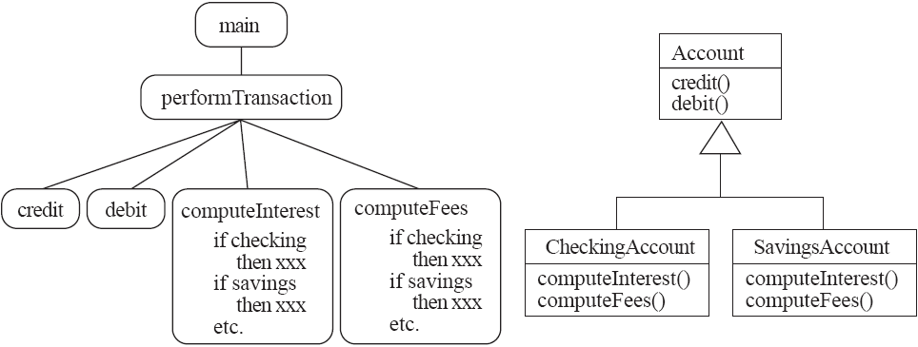
A View of the Two paradigms

Slide 33
2.2 Classes and Objects
Object
A chunk of structured data in a running software system
Has properties
Represent its state
Has behaviour
How it acts and reacts
May simulate the behaviour of an object in the real world

Slide 34
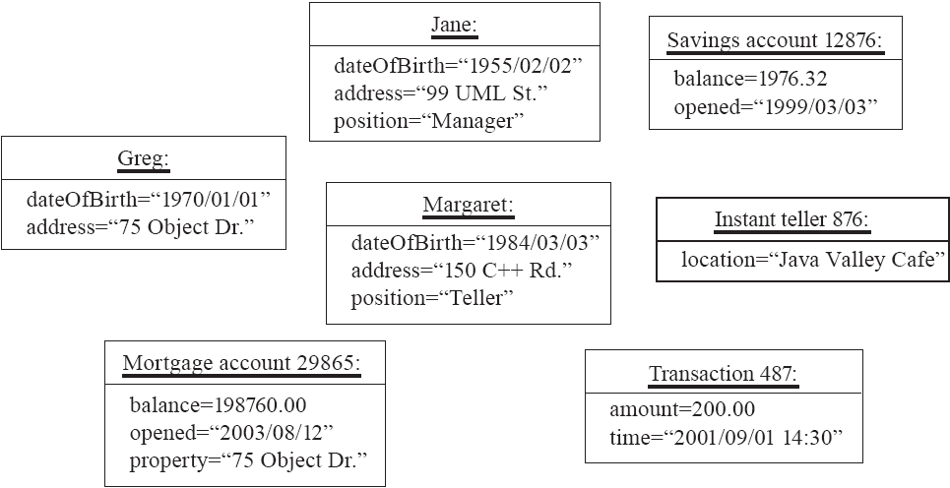
Objects

Slide 35
Views of an object
A conceptual unit-- a semantic entity that has relevance in some context
A data structure with some predefined operations (data view)
A state machine --some variables keep state, operations may change state
A server that offers some operations that can be invoked by client processes– an object has responsibilities with respect to the other objects

Slide 36
Classes
A class:
A unit of abstraction in an object oriented (OO) program
Represents similar objects
Its instances
A kind of software module
Describes its instances’ structure (properties)
Contains methods to implement their behaviour

Slide 37
More on classes
A class is a set of similar objects and is a type (prototype) for objects (instances)
Thinking in terms of information, a class defines the intent, objects define the extent.
Class structure: name attributes (data) operations or methods (behavior) constraints
We use as notation the Unified Modeling Language (UML). UML is a language for the specification, construction, and documentation of software, conceptual actions, and hardware. It is the standard language of the OMG (www.omg.org)

Slide 38
Is Something a Class or an Instance?
Something should be a class if it could have instances
Something should be an instance if it is clearly a single member of the set defined by a class
Film
Class; instances are individual films.
Reel of Film:
Class; instances are physical reels
Film reel with serial number SW19876
Instance of ReelOfFilm
Science Fiction
Instance of the class Genre.
Science Fiction Film
Class; instances include ‘Star Wars’
Showing of ‘Star Wars’ in the Phoenix Cinema at 7 p.m.:
Instance of ShowingOfFilm

Slide 39
Naming classes
Use capital letters
E.g. BankAccount not bankAccount
Use singular nouns
Use the right level of generality
E.g. Municipality, not City
Make sure the name has only one meaning
E.g. ‘bus’ has several meanings

Slide 40
2.3 Instance Variables
Variables defined inside a class corresponding to data present in each instance
Also called fields or member variables
Attributes
Simple data
E.g. name, dateOfBirth
Associations
Relationships to other important classes
E.g. supervisor, coursesTaken
More on these in Chapter 5

Slide 41
Variables vs. Objects
A variable
Refers to an object
May refer to different objects at different points in time
An object can be referred to by several different variables at the same time
Type of a variable
Determines what classes of objects it may contain

Slide 42
Class variables
A class variable’s value is shared by all instances of a class.
Also called a static variable
If one instance sets the value of a class variable, then all the other instances see the same changed value.
Class variables are useful for:
Default or ‘constant’ values (e.g. PI)
Lookup tables and similar structures
Caution: do not over-use class variables

Slide 43
2.4 Methods, Operations and Polymorphism
Operation
A higher-level procedural abstraction that specifies a type of behaviour
Independent of any code which implements that behaviour
E.g. calculating area (in general)

Slide 44
Methods, Operations and Polymorphism
Method
A procedural abstraction used to implement the behaviour of a class
Several different classes can have methods with the same name
They implement the same abstract operation in ways suitable to each class
E.g. calculating area in a rectangle is done differently from in a circle

Slide 45
Polymorphism
A property of object oriented software by which an abstract operation may be performed in different ways in different classes.
Requires that there be multiple methods of the same name
The choice of which one to execute depends on the object that is in a variable
Reduces the need for programmers to code many if-else or switch statements

Slide 46
2.5 Organizing Classes into Inheritance Hierarchies
Superclasses
Contain features common to a set of subclasses
Inheritance hierarchies
Show the relationships among superclasses and subclasses
A triangle shows a generalization
Inheritance
The implicit possession by all subclasses of features defined in its superclasses

Slide 47
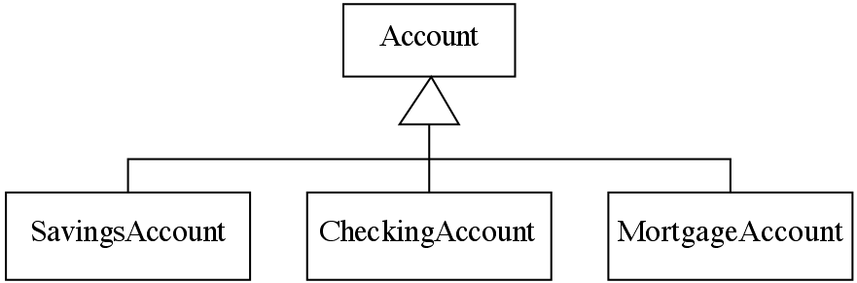
An Example Inheritance Hierarchy
Inheritance
The implicit possession by all subclasses of features defined in its superclasses

Slide 48
The Isa Rule
Always check generalizations to ensure they obey the isa rule
“A checking account is an account”
“A village is a municipality”
Should ‘Province’ be a subclass of ‘Country’?
No, it violates the isa rule
“A province is a country” is invalid!

Slide 49
A possible inheritance hierarchy of mathematical objects

Slide 50
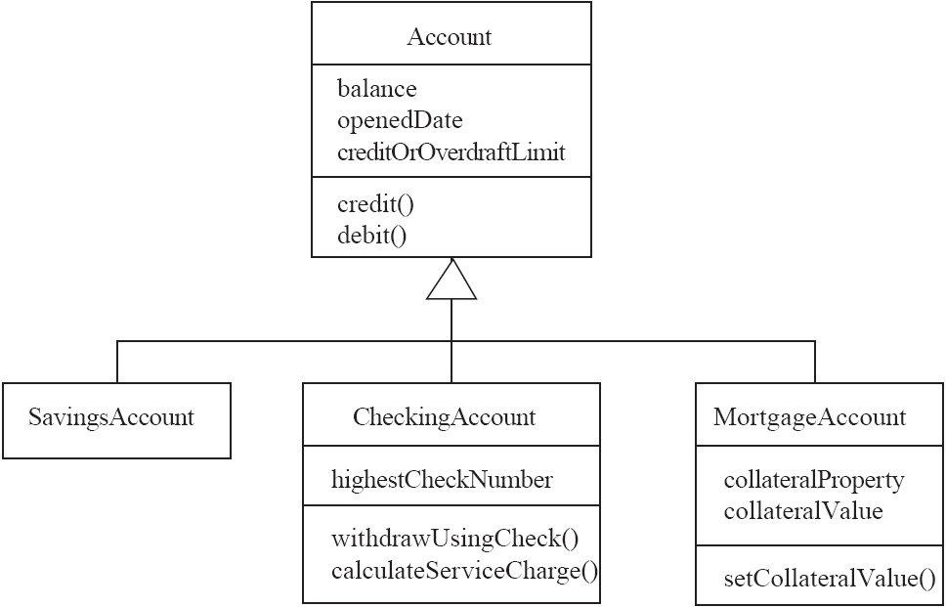
Make Sure all Inherited Features Make Sense in Subclasses

Slide 51
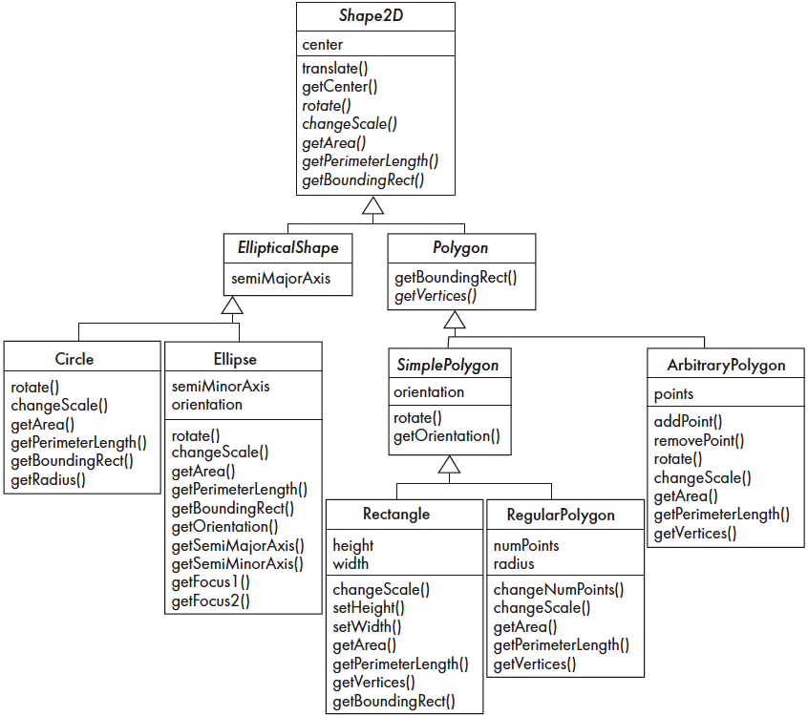
2.6 Inheritance, Polymorphism and Variables

Slide 52
Some Operations in the Shape Example

Slide 53
Abstract Classes and Methods
An operation should be declared to exist at the highest class in the hierarchy where it makes sense
The operation may be abstract (lacking implementation) at that level
If so, the class also must be abstract
No instances can be created
The opposite of an abstract class is a concrete class
If a superclass has an abstract operation then its subclasses at some level must have a concrete method for the operation
Leaf classes must have or inherit concrete methods for all operations
Leaf classes must be concrete

Slide 54
Overriding
A method would be inherited, but a subclass contains a new version instead
For restriction
E.g. scale(x,y) would not work in Circle
For extension
E.g. SavingsAccount might charge an extra fee following every debit
For optimization
E.g. The getPerimeterLength method in Circle is much simpler than the one in Ellipse

Slide 55
How a decision is made about which method to run
1. If there is a concrete method for the operation in the current class, run that method.
2. Otherwise, check in the immediate superclass to see if there is a method there; if so, run it.
3. Repeat step 2, looking in successively higher superclasses until a concrete method is found and run.
4. If no method is found, then there is an error
In Java and C++ the program would not have compiled

Slide 56
Dynamic binding
Occurs when decision about which method to run can only be made at run time
Needed when:
A variable is declared to have a superclass as its type, and
There is more than one possible polymorphic method that could be run among the type of the variable and its subclasses

Slide 57
2.7 Concepts that Define Object Orientation
The following are necessary for a system or language to be OO
Identity
Each object is distinct from each other object, and can be referred to
Two objects are distinct even if they have the same data
Classes
The code is organized using classes, each of which describes a set of objects
Inheritance
The mechanism where features in a hierarchy inherit from superclasses to subclasses
Polymorphism
The mechanism by which several methods can have the same name and implement the same abstract operation.

Slide 58
Other Key Concepts
Abstraction
Object -> something in the world
Class -> objects
Superclass -> subclasses
Operation -> methods
Attributes and associations -> instance variables
Modularity
Code can be constructed entirely of classes
Encapsulation
Details can be hidden in classes
This gives rise to information hiding:
Programmers do not need to know all the details of a class

Slide 59
Properties of an object(based on its language representation):
Abstraction (conceptual modeling power) --only relevant aspects
Encapsulation (reliability,security) --access only through predefined operations
Information hiding (reusability) --implementation is not shown to client programs
Inheritance (reusability, classification) --a subclass inherits attributes and operations
Polymorphism (simplicity, performance)--several versions of an operation
Concurrency (real-time and high performance) --multiple execution threads
Persistence (databases)--data persists after execution

