Slide 1
Object-Oriented Software Engineering
Chapter 5:
Modelling Interactions and Behaviour

Slide 2
5.1 Interaction Diagrams
Interaction diagrams are used to model some of the dynamic aspects of a software system
They help you to visualize how the system runs.
An interaction diagram is often built from a use case and a class diagram.
The objective is to show how a set of objects accomplish the required interactions with an actor.

Slide 3
Interactions and messages
Interaction diagrams show how a set of actors and objects communicate with each other to perform:
The steps of a use case, or
The steps of some other piece of functionality.
The set of steps, taken together, is called an interaction.
Interaction diagrams can show several different types of communication.
E.g. method calls, messages send over the network
These are all referred to as messages.

Slide 4
Elements found in interaction diagrams
Instances of classes
Shown as boxes with the class and object identifier underlined
Actors
Use the stick-person symbol as in use case diagrams
Messages
Shown as arrows from actor to object, or from object to object

Slide 5
Creating interaction diagrams
You should develop a class diagram and a use case model before starting to create an interaction diagram.
There are two kinds of interaction diagrams:
Sequence diagrams
Communication diagrams

Slide 6
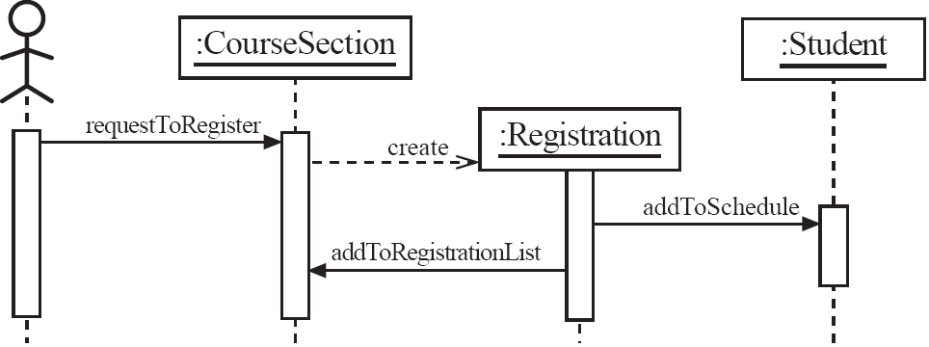
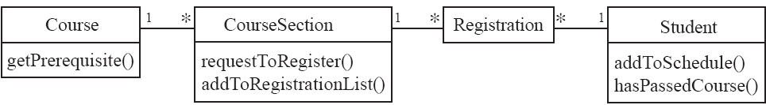
Sequence diagrams – an example

Slide 7
Sequence diagrams
A sequence diagram shows the sequence of messages exchanged by the set of objects performing a certain task
The objects are arranged horizontally across the diagram.
An actor that initiates the interaction is often shown on the left.
The vertical dimension represents time.
A vertical line, called a lifeline, is attached to each object or actor.
The lifeline becomes a broad box, called an activation box during the live activation period.
A message is represented as an arrow between activation boxes of the sender and receiver.
A message is labelled and can have an argument list and a return value.

Slide 8
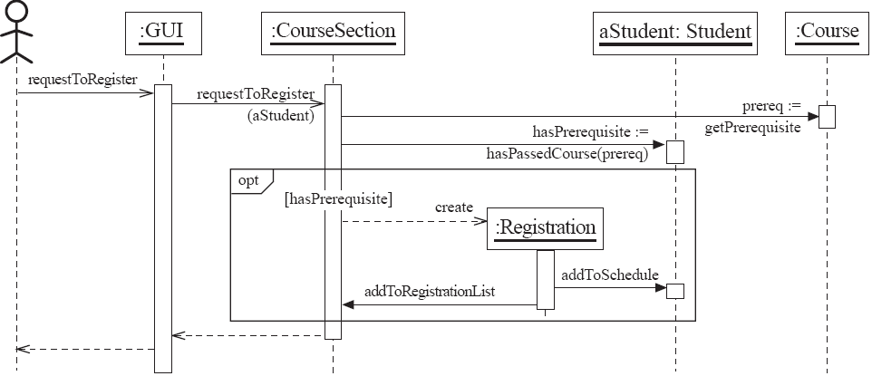
Sequence diagrams – same example, more details

Slide 9
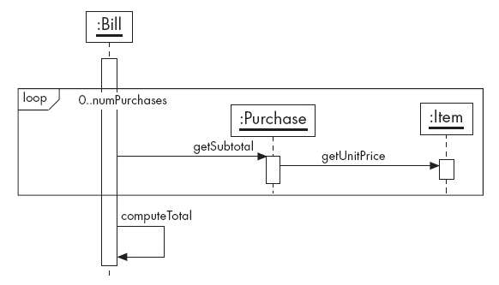
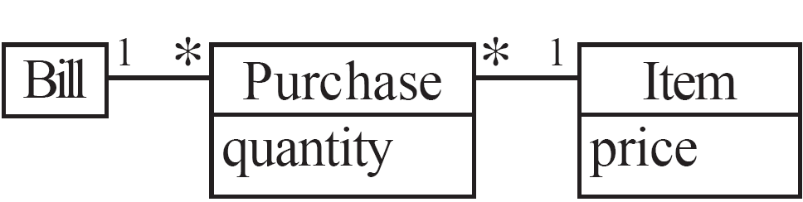
Sequence diagrams – an example with replicated messages
An iteration over objects is indicated by an asterisk preceding the message name

Slide 10
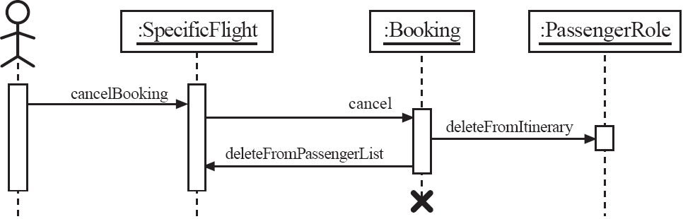
Sequence diagrams – an example with object deletion
If an object’s life ends, this is shown with an X at the end of the lifeline

Slide 11
Communication diagrams – an example

Slide 12
Communication diagrams
Communication diagrams emphasise how the objects collaborate in order to realize an interaction
A communication diagram is a graph with the objects as the vertices.
Communication links are added between objects
Messages are attached to these links.
Shown as arrows labelled with the message name
Time ordering is indicated by prefixing the message with some numbering scheme.

Slide 13
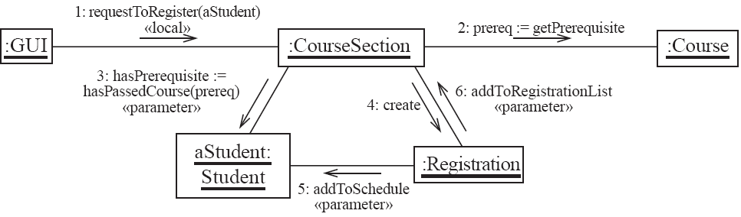
Communication diagrams – same example, more details

Slide 14
Communication links
A communication link can exist between two objects whenever it is possible for one object to send a message to the other one.
Several situations can make this message exchange possible:
1. The classes of the two objects have an association between them.
This is the most common case.
If all messages are sent in the same direction, then probably the association can be made unidirectional.

Slide 15
Other communication links
2. The receiving object is stored in a local variable of the sending method.
This often happens when the object is created in the sending method or when some computation returns an object .
The stereotype to be used is «local» or [L].
3. A reference to the receiving object has been received as a parameter of the sending method.
The stereotype is «parameter» or [P].

Slide 16
Other communication links
4. The receiving object is global.
This is the case when a reference to an object can be obtained using a static method.
The stereotype «global», or a [G] symbol is used in this case.
5. The objects communicate over a network.
We suggest to write «network».

Slide 17
How to choose between using a sequence or communication diagram
Sequence diagrams
Make explicit the time ordering of the interaction.
Use cases make time ordering explicit too
So sequence diagrams are a natural choice when you build an interaction model from a use case.
Make it easy to add details to messages.
Communication diagrams have less space for this

Slide 18
How to choose between using a sequence or communication diagram
Communication diagrams
Can be seen as a projection of the class diagram
Might be preferred when you are deriving an interaction diagram from a class diagram.
Are also useful for validating class diagrams.
Useful to estimate traffic between classes
Useful to calculate path times. Find times to get some result.

Slide 19
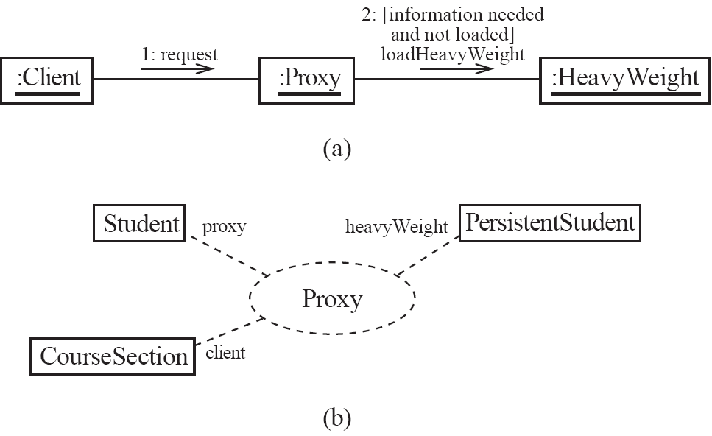
Communication diagrams and patterns
A communication diagram can be used to represent aspects of a design pattern

Slide 20
An old assignment
The sequence diagram below describes the scenario to borrow a copy from the library system. Now that you have the class diagram of the Library (see answer to Question 2 of Assignment 2) you can build a detailed sequence diagram using objects from these classes.
Draw an equivalent communication diagram.
Draw a state diagram for a DVD. When we acquire a new DVD we need to classify it. After that, it is made Rentable and if borrowed it becomes Rented. When returned it becomes available again. After the DVD is damaged we remove it from circulation.
Can you find a pattern here? Describe the idea.

Slide 21
Assignment 3 diagram
UC Borrow a paid copy
<<actor>>
:Customer
:System
rentCopy(title, account)
checkFines(account)
chargeCopy(copy,
account)
chargeCust(copy, amount)
payRentalFee(account)

Slide 22
5.2 State Diagrams
A state diagram describes the behaviour of a system, some part of a system, or an individual object.
At any given point in time, the system or object is in a certain state.
Being in a state means that it is will behave in a specific way in response to any events that occur.
Some events will cause the system to change state.
In the new state, the system will behave in a different way to events.
A state diagram is a directed graph where the nodes are states and the arcs are transitions.

Slide 23
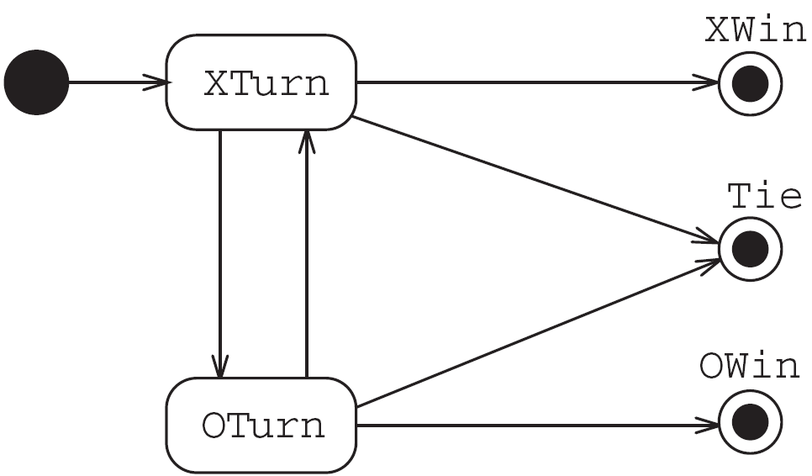
State diagrams – an example
tic-tac-toe game (also called noughts and crosses)

Slide 24
States
At any given point in time, the system is in one state.
It will remain in this state until an event occurs that causes it to change state.
A state is represented by a rounded rectangle containing the name of the state.
Special states:
A black circle represents the start state
A circle with a ring around it represents an end state

Slide 25
Transitions
A transition represents a change of state in response to an event.
It is considered to occur instantaneously.
The label on each transition is the event that causes the change of state.

Slide 26
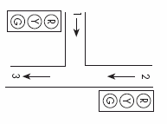
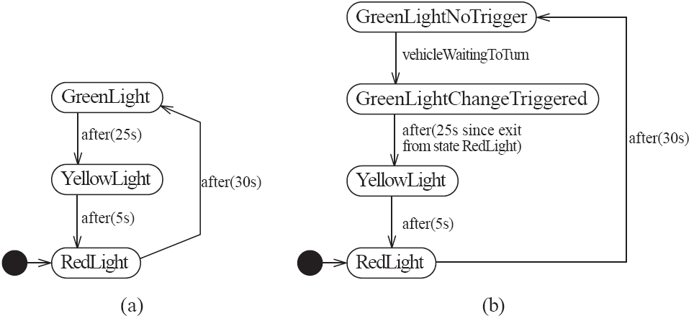
State diagrams – an example of transitions with time-outs and conditions

Slide 27
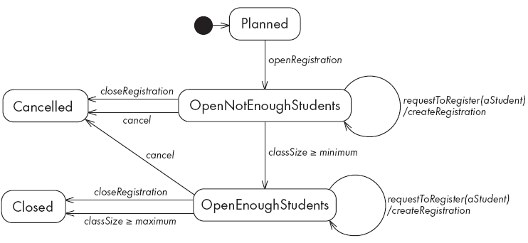
State diagrams – an example with conditional transitions and actions

Slide 28
Activities in state diagrams
An activity is something that takes place while the system is in a state.
It takes a period of time.
The system may take a transition out of the state in response to completion of the activity,
Some other outgoing transition may result in:
The interruption of the activity, and
An early exit from the state.

Slide 29
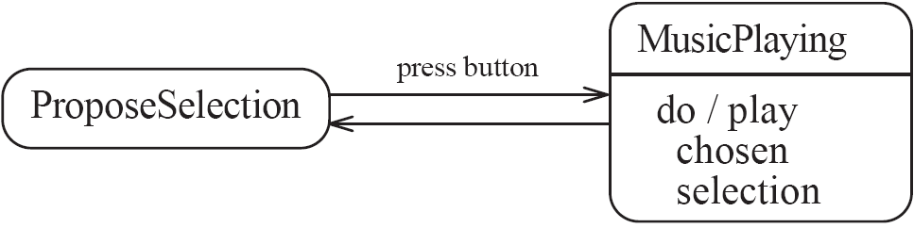
State diagram – an example with activity

Slide 30
Actions in state diagrams
An action is something that takes place effectively instantaneously
When a particular transition is taken,
Upon entry into a particular state, or
Upon exit from a particular state
An action should consume no noticeable amount of time

Slide 31
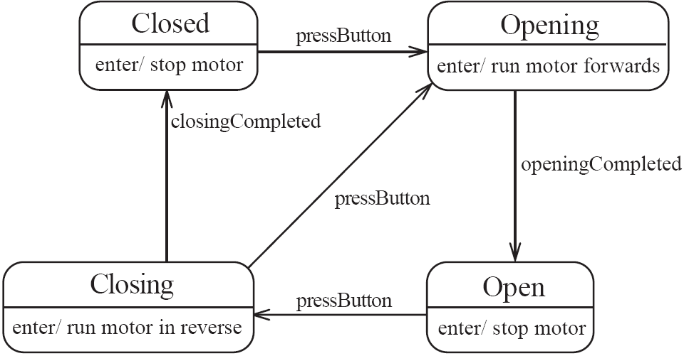
State diagram – an example with actions

Slide 32
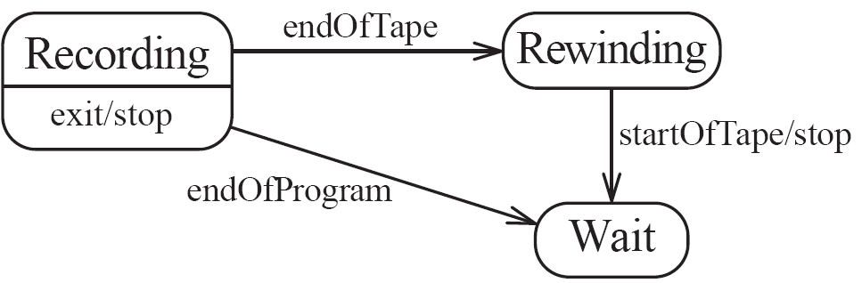
State diagrams – another example

Slide 33
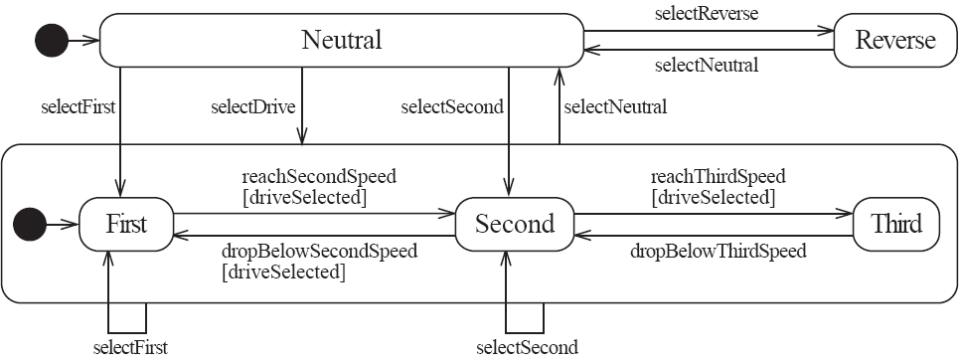
Nested substates and guard conditions: Car transmission
A state diagram can be nested inside a state.
The states of the inner diagram are called substates.

Slide 34
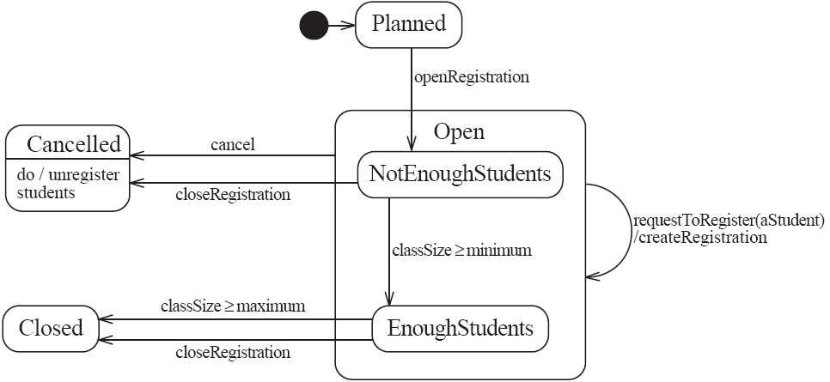
State diagram – an example with substates

Slide 35
5.3 Activity Diagrams
An activity diagram is like a state diagram.
Except most transitions are caused by internal events, such as the completion of a computation.
An activity diagram
Can be used to understand the flow of work that an object or component performs.
Can also be used to visualize the interrelation and interaction between different use cases.
Is most often associated with several classes.
One of the strengths of activity diagrams is the representation of concurrent activities.

Slide 36
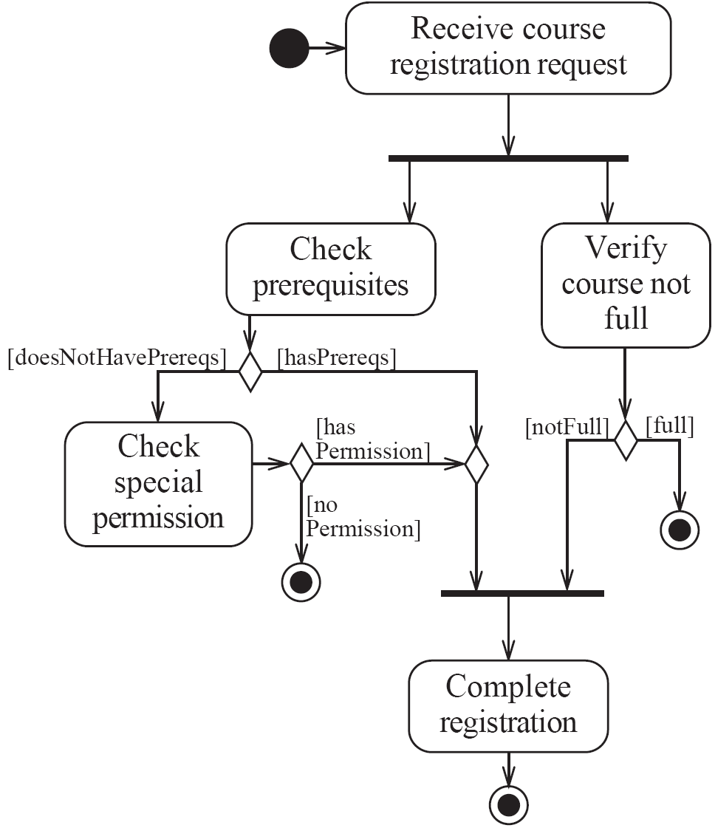
Activity diagrams – an example

Slide 37
Representing concurrency
Concurrency is shown using forks, joins and rendezvous.
A fork has one incoming transition and multiple outgoing transitions.
The execution splits into two concurrent threads.
A rendezvous has multiple incoming and multiple outgoing transitions.
Once all the incoming transitions occur all the outgoing transitions may occur.

Slide 38
Representing concurrency
A join has multiple incoming transitions and one outgoing transition.
The outgoing transition will be taken when all incoming transitions have occurred.
The incoming transitions must be triggered in separate threads.
If one incoming transition occurs, a wait condition occurs at the join until the other transitions occur.

Slide 39
Swimlanes
Activity diagrams are most often associated with several classes.
The partition of activities among the existing classes can be explicitly shown using swimlanes.

Slide 40
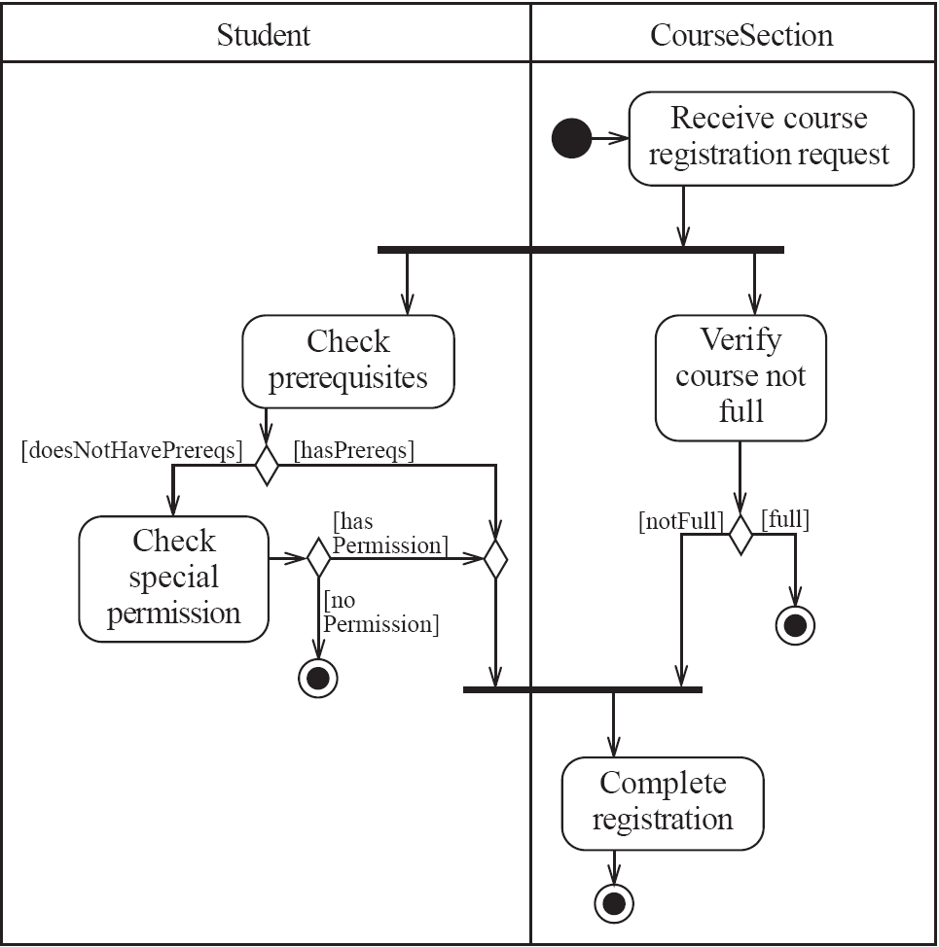
Activity diagrams – an example with swimlanes

Slide 41
5.4 Implementing Classes Based on Interaction and State Diagrams
You should use these diagrams for the parts of your system that you find most complex.
I.e. not for every class
Interaction, activity and state diagrams help you create a correct implementation.
This is particularly true when behaviour is distributed across several use cases.
E.g. a state diagram is useful when different conditions cause instances to respond differently to the same event.

Slide 42
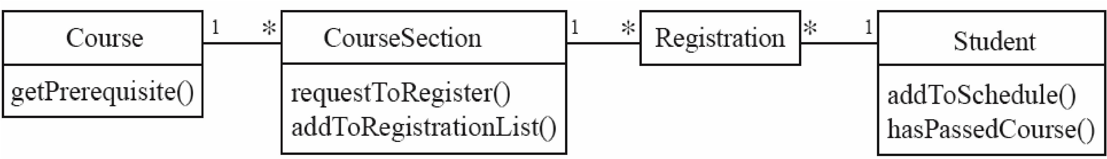


Example

Slide 43
Example: The CourseSection class
States:
‘Planned’:
closedOrCancelled == false && open == false
‘Cancelled’:
closedOrCancelled == true &&
registrationList.size() == 0
‘Closed’ (course section is too full, or being taught):
closedOrCancelled == true &&
registrationList.size() > 0

Slide 44
Example: The CourseSection class
States:
‘Open’ (accepting registrations):
open == true
‘NotEnoughStudents’ (substate of ‘Open’):
open == true &&
registrationList.size() < course.getMinimum()
‘EnoughStudents’ (substate of ‘Open’):
open == true &&
registrationList.size() >= course.getMinimum()

Slide 45
Example: The CourseSection class
public class CourseSection
{
// The many-1 abstraction-occurrence association (Figure 8.2)
private Course course;
// The 1-many association to class Registration (Figure 8.2)
private List registrationList;
// The following are present only to determine the state
// (as in Figure 8.19). The initial state is 'Planned‘
private boolean open = false;
private boolean closedOrCanceled = false;

Slide 46
Example: The CourseSection class
public CourseSection(Course course)
{
this.course = course;
registrationList = new LinkedList();
}
public void openRegistration()
{
if(!closedOrCanceled) // must be in 'Planned' state
{
open = true; // to 'OpenNotEnoughStudents' state
}
}

Slide 47
Example: The CourseSection class
public void closeRegistration()
{
// to 'Canceled' or 'Closed' state
open = false;
closedOrCanceled = true;
if (registrationList.size() < course.getMinimum())
{
unregisterStudents(); // to 'Canceled' state
}
}
public void cancel()
{
// to 'Canceled' state
open = false;
closedOrCanceled = true;
unregisterStudents();
}

Slide 48
Example: The CourseSection class
public void requestToRegister(Student student)
{
if (open) // must be in one of the two 'Open' states
{
// The interaction specified in the sequence diagram of Figure 8.4
Course prereq = course.getPrerequisite();
if (student.hasPassedCourse(prereq))
{
// Indirectly calls addToRegistrationList
new Registration(this, student);
}
// Check for automatic transition to 'Closed' state
if (registrationList.size() >= course.getMaximum())
{
// to 'Closed' state
open = false;
closedOrCanceled = true;
}
}
}

Slide 49
Example: The CourseSection class
// Private method to remove all registrations
// Activity associated with 'Canceled' state.
private void unregisterStudents()
{
Iterator it = registrationList.iterator();
while (it.hasNext())
{
Registration r = (Registration)it.next();
r.unregisterStudent();
it.remove();
}
}
// Called within this package only, by the constructor of
// Registration to ensure the link is bi-directional
void addToRegistrationList(Registration newRegistration)
{
registrationList.add(newRegistration);
}
}

Slide 50
8.5 Difficulties and Risks in Modelling Interactions and Behaviour
Dynamic modelling is a difficult skill
In a large system there are a very large number of possible paths a system can take.
It is hard to choose the classes to which to allocate each behaviour:
Ensure that skilled developers lead the process, and ensure that all aspects of your models are properly reviewed.
Work iteratively:
Develop initial class diagrams, use cases, responsibilities, interaction diagrams and state diagrams;
Then go back and verify that all of these are consistent, modifying them as necessary.
Drawing different diagrams that capture related, but distinct, information will often highlight problems.

Slide 51
BorrowingCard
Catalog
number
Copy
addCard()
1..* has 1
Patron
0..* borrows 0..*
shelf
row
state
name
address
contains
addPatron()
addCopy()
setState()
borrowCopy()
returnCopy()
repairCopy()
discardCopy()
getShelf()
getRow()
0..*
Account
1 hasAn 1
*
Title
Author
number
copyLimit
Refers to
numOfCopies
“ 0..*
Biography
Dates
0..* 1
create()
delete()
Freeze()
unfreeze()
get_copyLimit()
get_account()
set_copyLimit()
addTitle()
removeTitle()
Individual
Corporate
typeOfMedia
Transaction
number
date
dateDue
Book
Record
AudioCassette
Video
coverType
numPages
numTracks
length
length
addTransaction()
setDateDue()
getTrans()
BorrowedHistory
Borrow
Return
{ return -> forAll (r) |
ActualReturnDate > dateDue implies fine = ‘F’ }
1
totalNumCopies
*
ActualReturnDate
CalcFine()
addCopy()
Class Diagram for Library Circulation V2

Slide 52
IBM Hardware Hackathon
For the second year in a row, IBM BlueMix will be sponsoring the Make FAU: IoT Hardware Hackathon to take place during Engineers Week on February 22-23. Participating students will receive free hardware to prototype and develop their designs, as well as training from IBM engineers on using BlueMix web services for the Internet of Things (IoT). The first training session and orientation meeting is this Friday, February 3 from 4-6pm in Engineering East, Room 106. There will be cash prizes for the 1st, 2nd and 3rd place winners.
Jessica Hibberd, M.Ed., jlewis92@fau.edu, 561.297.2049

Slide 53
Global Coffee Hour
FAU students, faculty, and staff are invited to attend the on Wednesday, February 1 from 10 a.m. to 11:15 a.m. in Student Services, Room 222 – above the Breezeway Food Court on the Boca Raton campus.
Discussion topics:
· Updates on entry restrictions and maintaining legal status in the U.S.
· Coping with stress in uncertain times: tips and resources
Facilitators:
· Dr. Blaise Amendolace, Interim Clinical Director, Counseling & Psychological Services
· Mr. Aaron Blumberg, Immigration Attorney
· Dr. Mihaela Metianu, Executive Director, Center for Global Engagement
· Dr. Steven Roper, Executive Director, Peace, Justice & Human Rights

Slide 54
Security group meeting today
Wednesday, February 1st, at 2:00 pm in EE405
Analyses of recent computer attacks
Colin Callahan
Abstract
There has been recently a variety of security attacks that have resulted in the leakage of millions of user records. While the victims talk of “sophisticated attacks” we will show that instead the attacks have been relatively simple and have succeeded because of the poor defenses of the institutions involved. In particular, we describe the attacks to Anthem (medical records), the two attacks to Yahoo, the attack to the World Bank, and the attack to Sony Movie Division. We will also show how they could have been prevented.
This is the DIS work of one of my students.

Slide 55
Exercise
In a hospital patients can be in-patients or out-patients.
In-Patients are assigned fixed locations (shared or private rooms).
Each patient has a primary doctor and optionally some advisory doctors assigned to them.
Nurses are assigned to specific patient rooms and to shifts (three per day).
Each shift has a leader nurse.
Nurses and some doctors are employees of the hospital, other doctors have admitting rights but don’t work at the hospital.

Slide 56
Exercise 2
Draw a class diagram to extend the hospital model:
Patients have one medical record that describes their medicines and treatments
Doctors can prescribe treatments and medicines for their own patients
Doctors belong to departments which are part of the hospital. The departments correspond to specialties such as cardiology, obstetrics,...
Departments have a director who must be a medical doctor
Add some attributes in each class.
I will show the solution on Friday

Slide 57
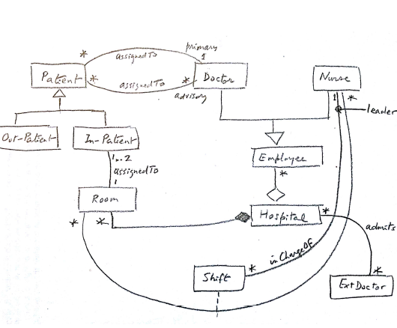
Solution

Slide 58
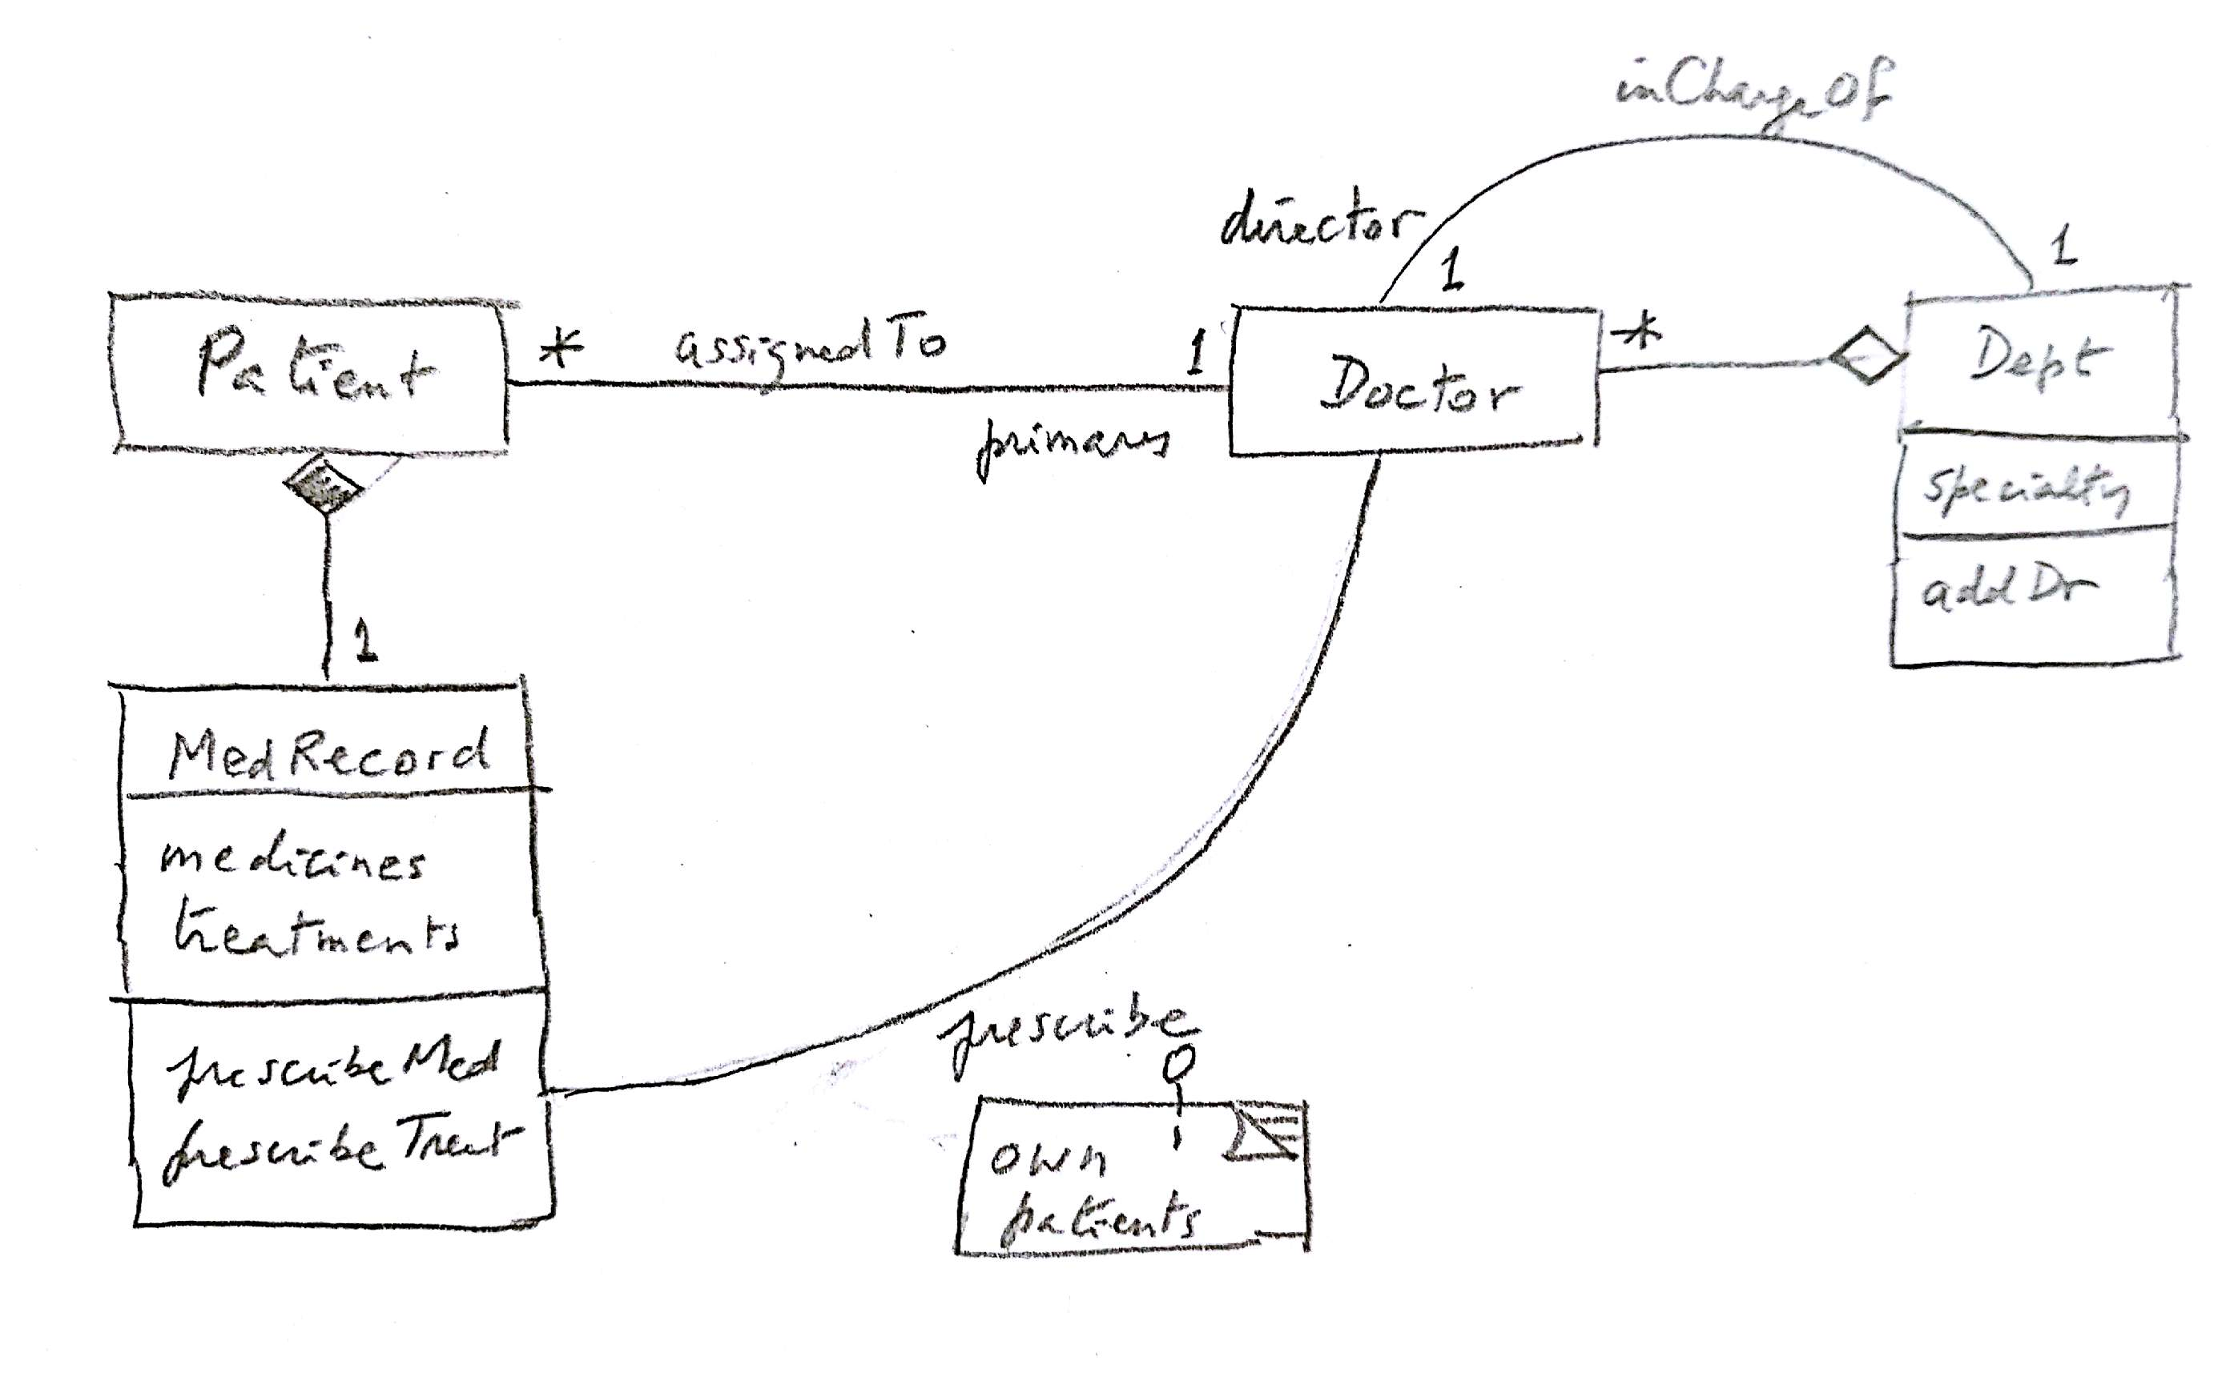
Solution to Exercise 2

Slide 59
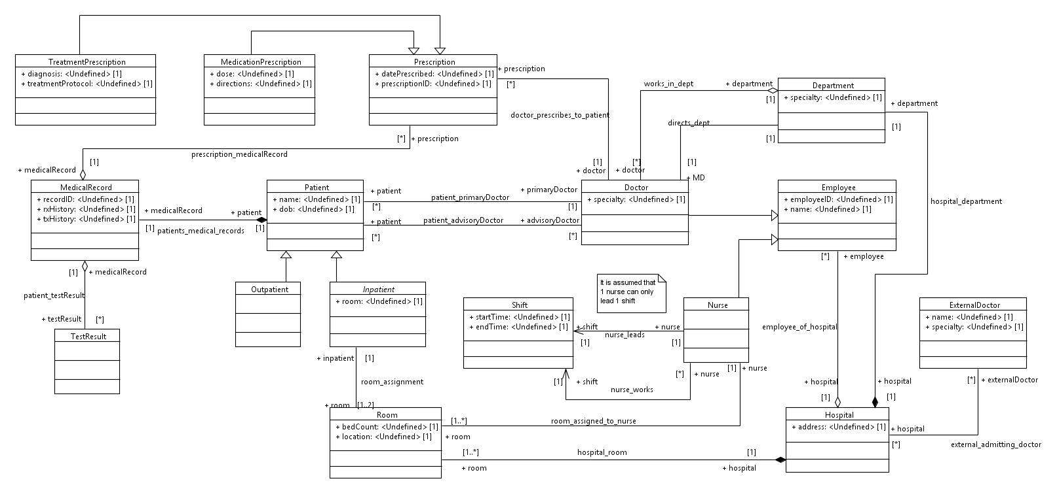
A student model

Slide 60
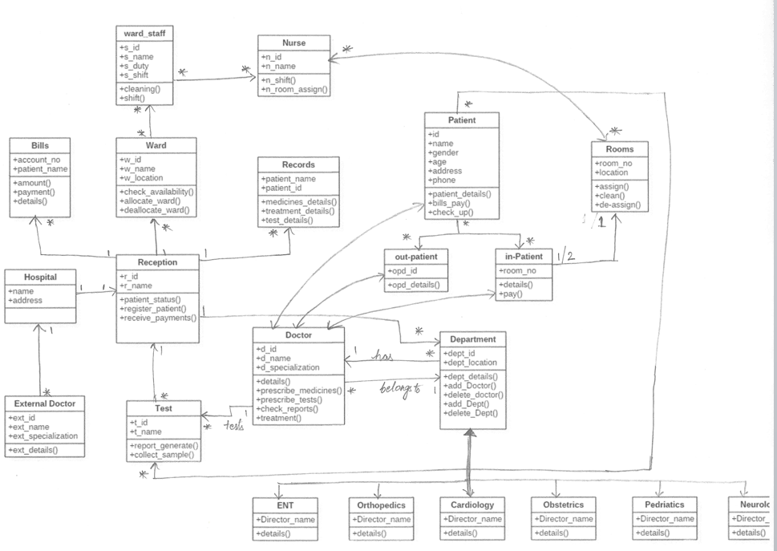

Slide 61
Assignment 1 (due Sun Feb19)
1.Draw a UML class diagram for a commercial port where:
--ships arrive to deposit and load containers
--containers have known dimensions and weight
--containers are loaded and unloaded using cranes
--each crane has a list of operators qualified to drive them
--ships belong to different companies and have known capacities (number of containres that can carry)
--cranes have upper limits on the weights they can handle
--containers are assigned to specific port locations (places in warehouses)
2. Draw a sequence diagram to load a container from a warehouse location
3. Draw a state diagram for a crane

Slide 62
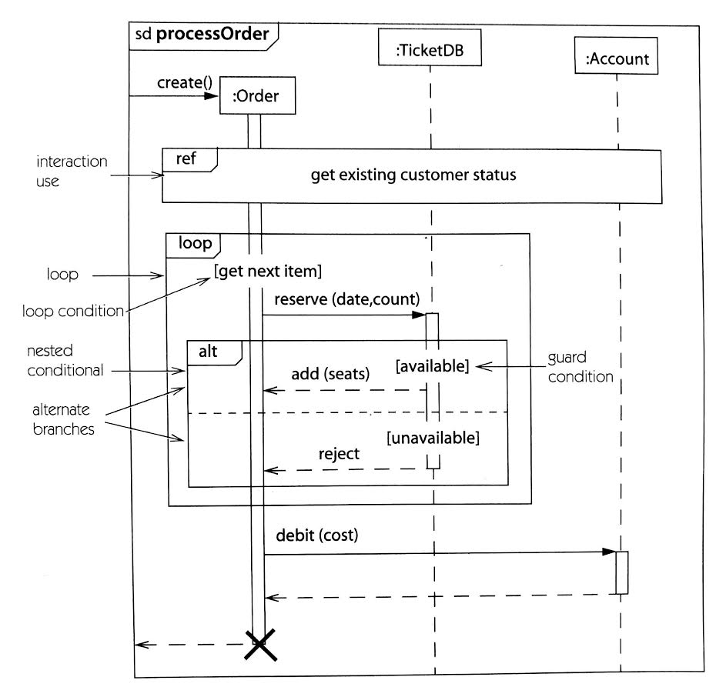
Summary of sequence diagrams

Slide 63
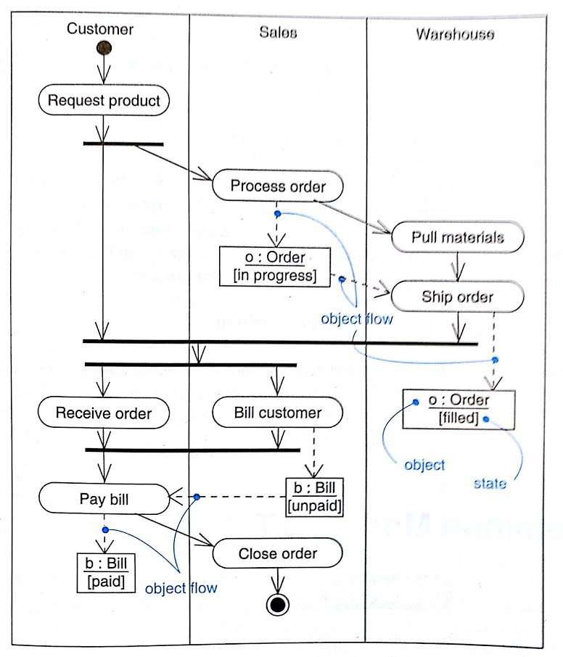
Activity diagram with swimlanes and data

Slide 64
Digital sound recorder
An electronic appliance to record and play back speech. The messages are recorded using a built-in microphone and stored in a digital memory. The user can play back messages through a speaker.
Ivan Porres, Johan Lilius, "Digital sound recorder" http://tucs.fi/publications/view/?pub_id=tPoLi99a

Slide 65
Context diagram
Time
Next second
Digital Sound Recorder
Record
Sensors/Actuators
System
Message, set
+Buttons
Alarm, set time
+Microphone
Play message
+Screen
Beep alarm, show
+Speaker
User
time
+Battery Level Meter
Interfaces
Power
-Analog To Digital
-Digital To Analog
-Digitral To Digital
Battery

Slide 66
Events
A second passes: update internal clock, check alarm, update clock display
User presses a command button: Show task progress display, start recording or playing back a message
Enter standby mode: switch off display
Low battery alarm: warn user, stop current task

Slide 67
Model management
Package: A grouping of related model elements
Packages own elements
Elements are other packages or classes
Basis for configuration control, storage, and access control
Useful to delimit work scope and to describe subsystems

Slide 68
Subsystems in the sound recorder

Slide 69
Use cases for sound recorder

Slide 70
Use cases
Record a message
The user selects a message slot from the message directory and presses the ‘record’
button. If the message slot already stores a message, it is deleted. The system starts
recording the sound from the microphone until the user presses the ‘stop’ button, or the
memory is exhausted.
Playback a message
The user selects a recorded message slot and then presses the ‘play’ button. If th
message slot contains a recorded message then it is played trough the speaker until its
end or until the user presses the stop button.
Delete a message
The user selects a used message slot and then presses the ‘delete’ button. The message
is permanently deleted from the memory and its memory space is recycled.
Set the alarm time
The user can switch on and off the alarm and set the time when the alarm will sound.
This is done by selecting the different options of the alarm menu.

Slide 71
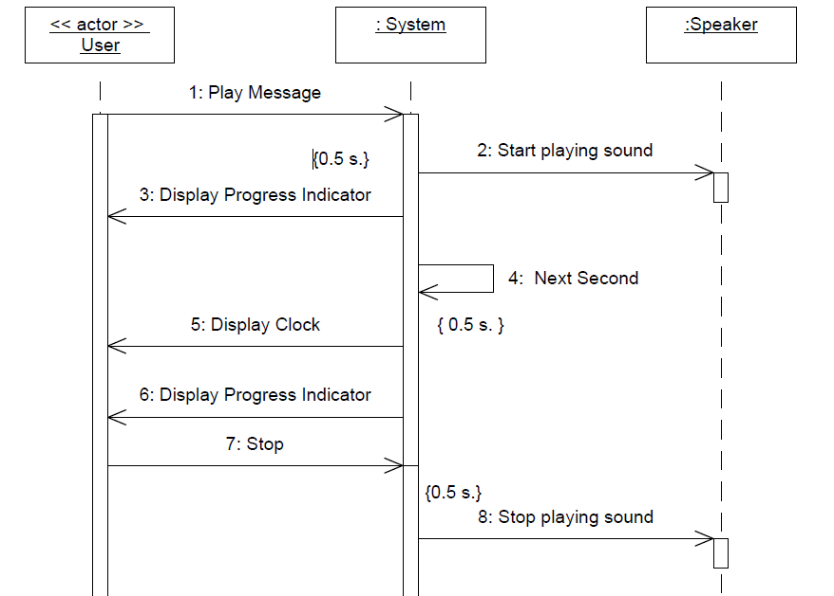

Slide 72
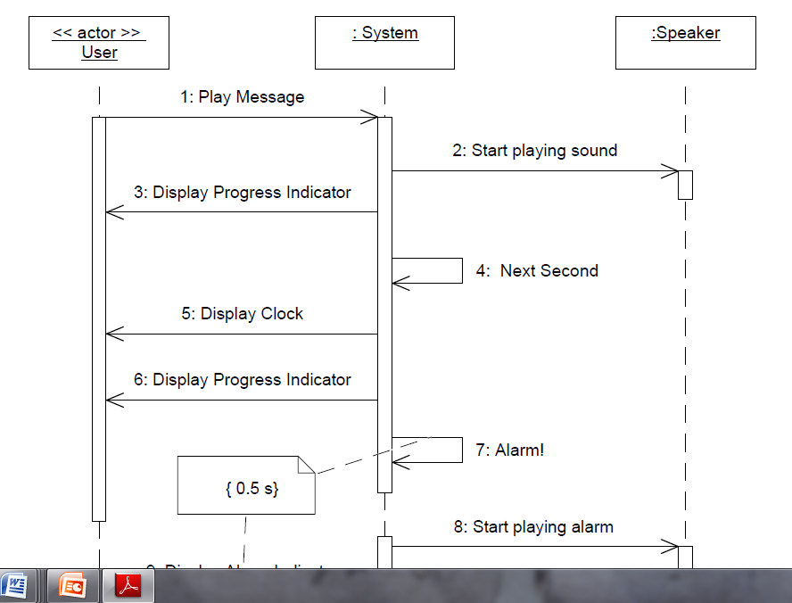

Slide 73
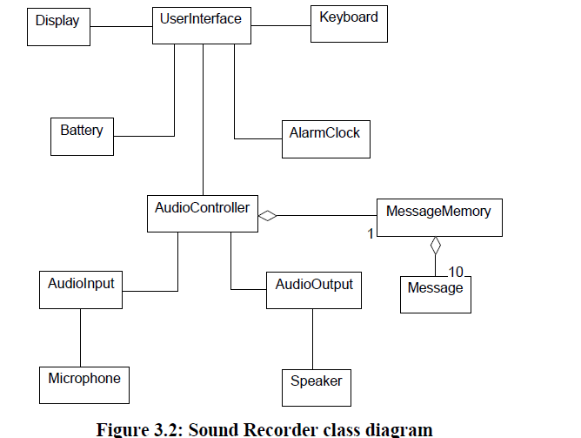

Slide 74
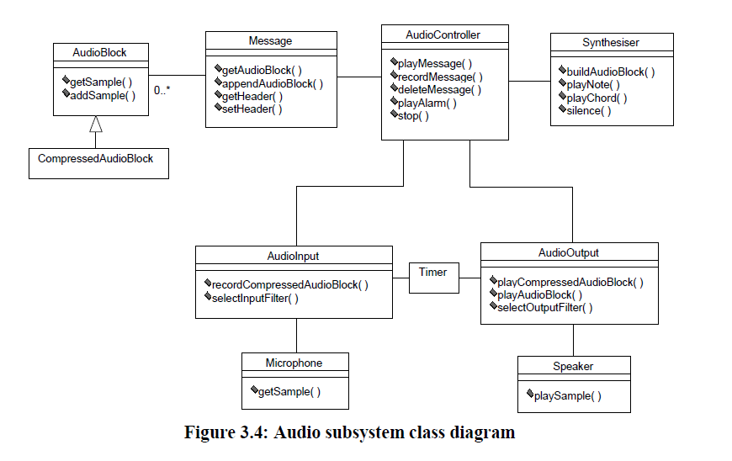

Slide 75
Statechart for AudioInput
Idle
Recording
GetCompressedAudioBlock
(a:
AudioBlock
)
OnEntry:StartDMA
DMA
EndOfTransfer
Compress
On Exit:Notify!

Slide 76
Sequence and collaboration diagrams
Two types of Object Interaction diagrams
Description of scenarios or event traces
Several sequence/collaboration diagrams describe a use case
One diagram for normal scenario and several for exceptional conditions
Can indicate timing constraints

Slide 77
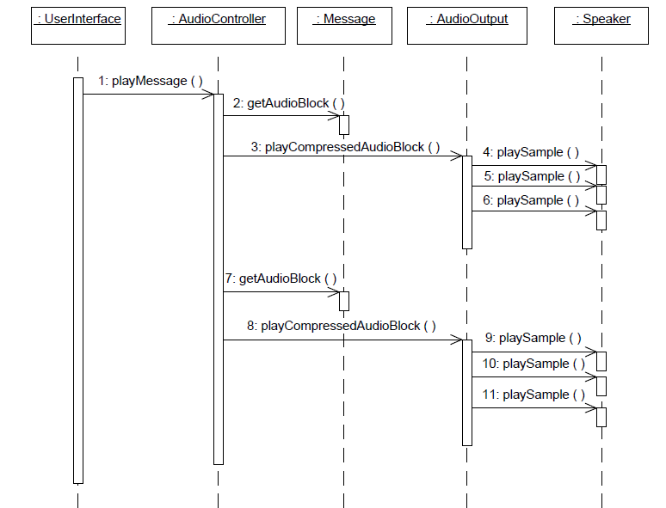
Play message sequence diagram

Slide 78
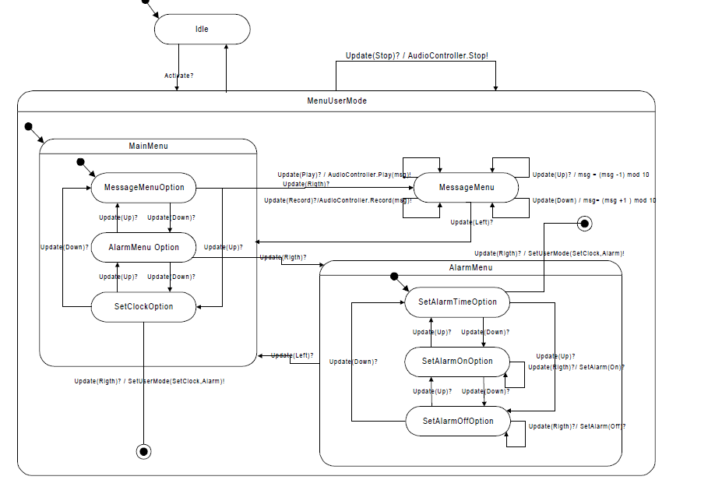

Slide 79
Collaboration diagram for scheduler

Slide 80
Example: Soccer World Cup
Your company was awarded a contract to develop software to handle the coming Soccer World Cup.
In this competition, teams represent countries and are made up of 22 players. Countries qualify from zones, where each zone can be simple or composed of other subzones. In the finals 32 countries play in 8 series of four countries each. The first two of each series play elimination games to define the World champion. Here we need to keep track of the teams that play in a given zone, of game results, and of team places, to know who will be in the finals.
Each team plays a given number of games in a specific city at specific dates, this is the Game Schedule. Referees from different countries are assigned to scheduled games. Referees for a game must not be from countries playing in the game.
Games are played at stadiums. A game is first Scheduled, it is then inPlay, and finally Completed. When completed, we post the final score. The schedule of games and game results should be available through the Internet.

Slide 81
More
Hotel reservations for the teams must be made in the city where they will play at the appropriate dates. A reservation is first Created, then Confirmed, and is Completed when the hotel room is actually used. An Organizing Committee assigns referees, makes hotel reservations, and takes care of other organizational aspects.
Fans can reserve seats for games in advance. They can buy the corresponding tickets through the Internet or in ticket offices. Tickets bought through the Internet are mailed to the buyers. Reservations for tickets can be cancelled. Institutions can reserve and buy blocks of tickets. When tickets for a game are exhausted, new buyers are put in a FIFO queue for possible tickets becoming available. There are different categories of tickets, with different prices.

Slide 82
Main Use cases for the World Cup example
UC 1: Game scheduling.
UC 2: Referee assignment
Scorekeeping /statistics
Hotel reservations
Hotel stays
Expenses
Facilities

Slide 83
Use case
The Use cases help us to find analysis patterns that may be useful. For example, hotel reservations and hotel stays together correspond to the entity reservation/use pattern. With a little more thinking we can also discover that referee assignment fits also a reservation pattern.
A description of a Use case is given below.
UC i : Game scheduling
Actors: Planning Committee
Preconditions: Tean pairings have been done and cities have been assigned
Description: Assign a game to a city and schedule a date and time within restrictions.
[È1: no appropriate scheduling is possible]
Postconditions: A game has been scheduled at a given time and date in a specific city.
We can define sequences of Use cases. Possible sequences are : UC 1, UC 2

Slide 84
Hotel reservation

Slide 85
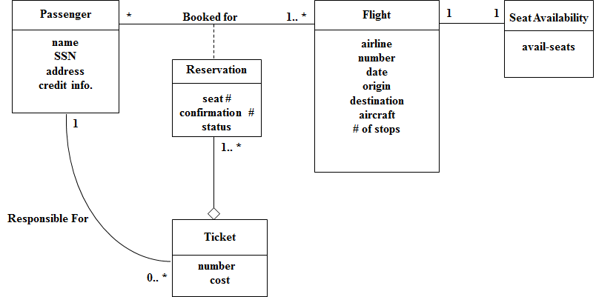
Reservation pattern

Slide 86
Class diagram 1: Lodging Management
Organizing_ Committee
1


 reserves

Lodging_
Organizing_ Committee
Room_Class

Reservation
0...1
Team
stays in 
Room


Country
Stay


Referee
stays in 

Host_Country
Stay

Reservation Analysis Pattern
City
1..2

Hotel

Slide 87
Represents
0…1
Team
Hotel
2
*
*
Reservation
Qualifying Unit
22
3
Player
Plays at
City
1
*
Country
Zone
2
PlaysIn
4
1
1
Represents
3
*
*
*
Referee
Game
*
Assignment
5

Slide 88
Administrative
Units
Employees
Assignment to Units
Patients
Hospital
Staff
Assignment to Patients

Slide 89
Activity diagram
Receive
Order
Multiple Trigger
for each line item on order
*
Cancel
Order
Authorize
Payment
Check
Line Item
[failed]
[succeeded]
[in stock]
Assign to
Order
Synchronization Condition
[need to
reorder]
[stock assigned to
all line items and
payment authorized]
Reorder
Item
Dispatch
Order

Slide 90
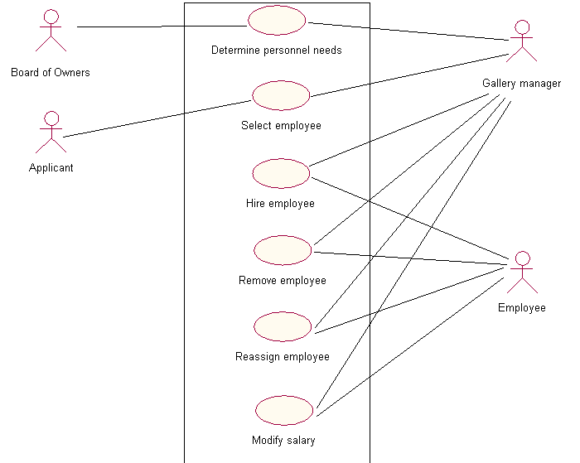

Slide 91
UC3: Hire an Employee
Actors: Gallery Manager, Applicant
Precondition: Suitable applicant has been selected.
Postcondition: A new employee has been added to the gallery; he/she has been assigned a position, a salary, and a place of work.
Description:
1. Manager offers job to the applicant
2. Applicant accepts the job.
3. Manager adds the employee to the gallery.
4. Manager assigns a position to the employee.
5. Manager assigns salary to the employee.
6. Manager finds a suitable place and assigns it to the employee.
Alternate flows:
Employee rejects the offer.

Slide 92
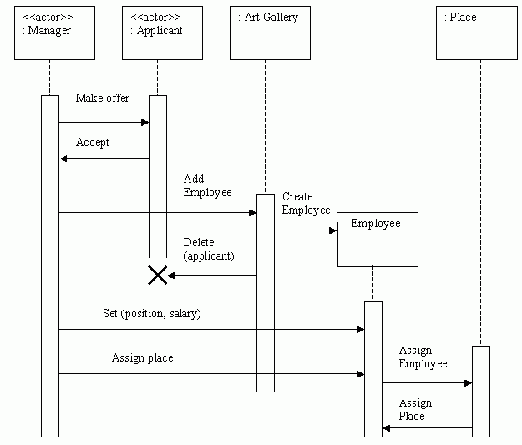

Slide 93
Board
Manager
Applicant
Employee
:Applicant
Determine
need
Job
Decision
Select
Employee
Accept
Set up
Employee
:Employee
Reject
Offer
Activation

Slide 94
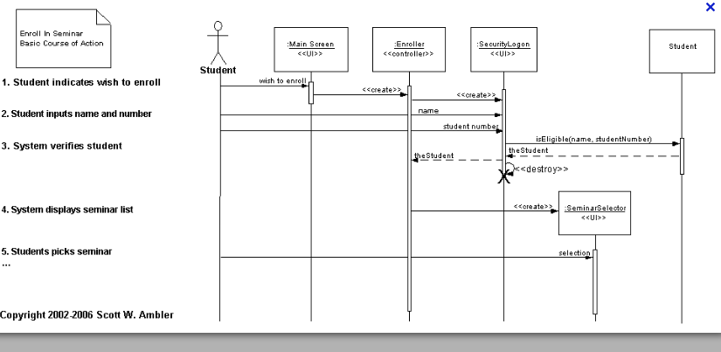

Slide 95
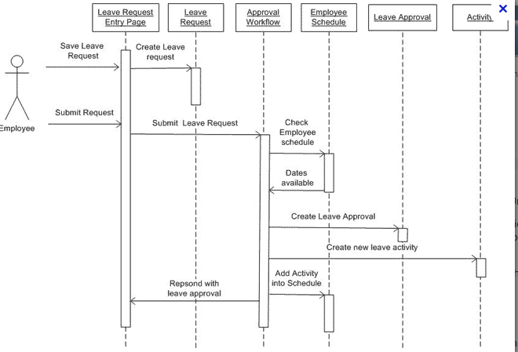

Slide 97
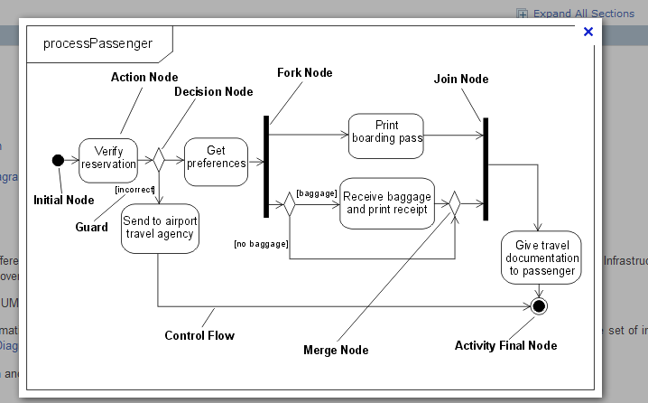

Slide 98
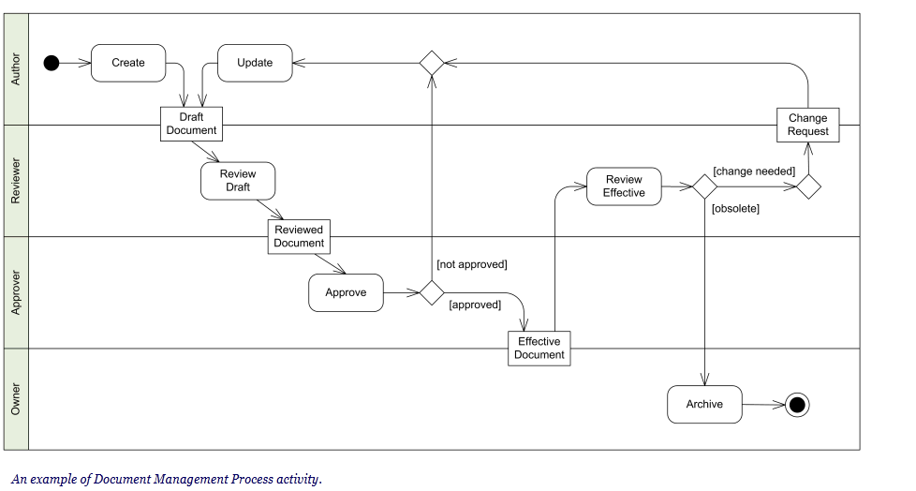

Slide 99
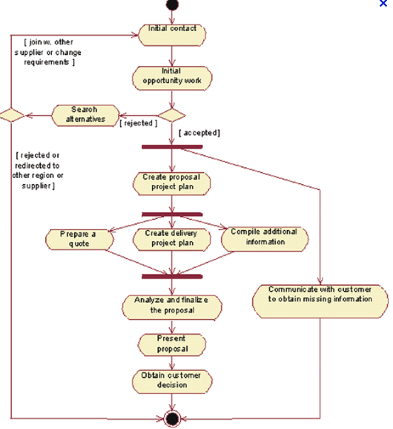

Slide 100
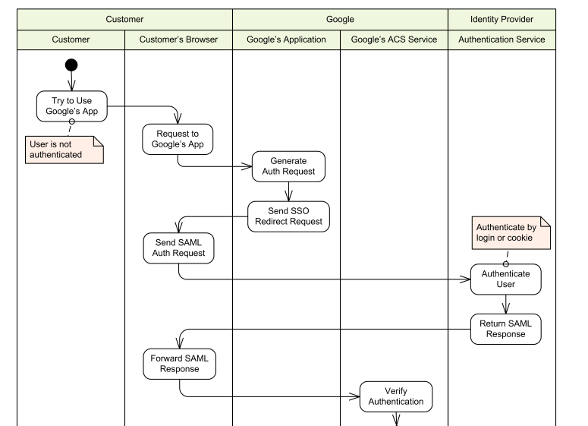
Single sign on (SSO) for Google apps

Slide 101
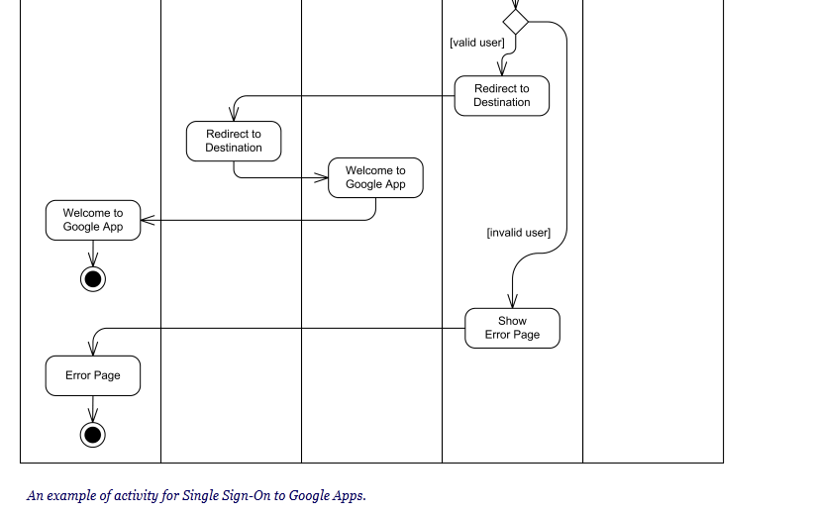

Slide 102
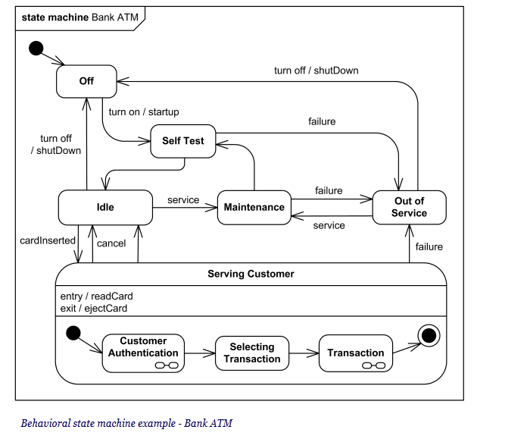

Slide 103
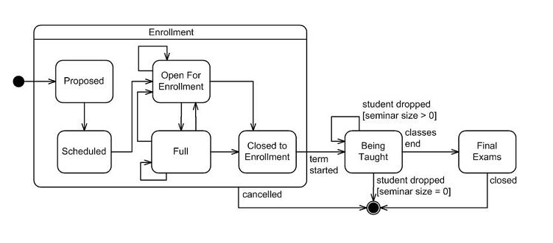

Slide 104
