Slide 1
Object-Oriented Software Engineering
Chapter 6: Patterns

Slide 2
Patterns
A pattern is a solution to a recurrent problem in a specific context
Idea comes from architecture of buildings (C. Alexander)
Applied initially to software and then extended to other domains
Appeared in 1994 and are slowly being accepted by industry

Slide 3
Value
Reusable solutions, but maybe not directly, usually require tailoring
Encapsulate experience and knowledge of designers (best practices)
Free of errors after a while
Need to be catalogued to be useful
Used as guidelines for design
Good to evaluate systems and standards
Useful for teaching

Slide 4
Pattern template (description)
Intent: summary of the solution (what problem is solved by the pattern)
Context:
The general situation in which the pattern applies
Problem:
A short sentence or two describing the problem being solved
Forces:
The issues or concerns to consider when solving the problem
Solution:
The recommended way to solve the problem in the given context.
‘to balance the forces’
Implementation: hints for implementing the pattern
Known uses: Three uses in real systems (generic solution)
Consequences: Advantages and disadvantages of the solution
Related patterns: Patterns that solve a similar problem or are complementary to this pattern.

Slide 5
Types of patterns
Analysis patterns—describe conceptual solutions, independent of any implementation
Design patterns—describe how to improve code by separating parts of classes or adding new functions
Architectural patterns—describe global aspects of a system
Security and reliability patterns—describe mechanisms to stop attacks or avoid failures
Idioms or code patterns—how to improve code in a specific language
Process patterns—how to organize the software process
Misuse patterns—how an information misuse is performed
Pedagogical patterns—how to teach some concept or topic

Slide 6
Using the patterns
Catalogs of patterns are not enough, designers must be given guidance in their use
There are many patterns (growing in number) and the task of selecting them gets harder
A first approach is to classify the patterns according to some criteria
Then we must develop a methodology (process) to apply them during the software lifecycle

Slide 7
Analysis patterns
M. Fowler, Analysis patterns – Reusable object models, Addison-Wesley, 1997.
Describe conceptual aspects of applications based on their semantics
Used to describe requirements to help understand precisely a problem (sometimes called Requirements patterns)
Should not include solution aspects so as not to constrain the designers
Typically two or three classes

Slide 8
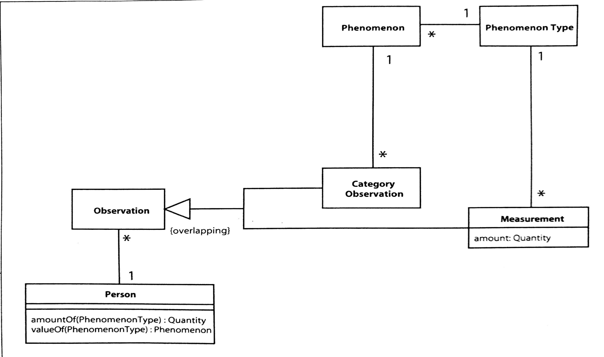
A Fowler’s analysis pattern

Slide 9
Domain conceptual model
We can build a conceptual model using analysis patterns
Using Semantic Analysis patterns is more efficient (correspond to a few use cases)
We can apply patterns to enforce the needed policies in the conceptual model
All the applications derived from this model will enforce the policies

Slide 10
Semantic Analysis Patterns (SAPs)
It is a pattern that describes a small set of coherent Use Cases that together describe a basic generic application
The Use Cases are selected in such a way that the application can fit a variety of situations
An instance of a SAP is produced in the usual way: Use Cases, class and dynamic diagrams, etc. We select the Use Cases in such a way that they leave out aspects which may not be transportable to other applications.
We saw an example in Chapter 4 (Admissions)
Another example: Patient records

Slide 11
Patient Treatment Records Pattern T. Sorgente, E B.Fernandez, and M. M. Larrondo-Petrie, "Analysis patterns for patient treatment", Procs. of the Pattern Languages of Programs Conference (PLoP) 2004 , http://hillside.net/plop/2004/papers/tsorgente0/PLoP2004_tsorgente0_0.doc
Intent--Describes the process of keeping the information for admitting, assigning assets, and treating a patient in a hospital.
Context--A medical facility that offers patient treatment. The facility may be a hospital that is a member of a medical group.
Problem--In order to treat patients properly, patient records and assignment of assets to patients need to be organized, maintained, and managed efficiently and accurately.

Slide 12
Use cases for this SAP

Slide 13
Forces
Patients may receive treatment from various doctors and nurses of the hospital and we need to keep track of all treatments by all medical employees.
Patients may return to the hospital and we need to relate new treatments to past treatments.
There may be different types of patients that we need to classify.
Patients may not be responsible for their decisions or their expenses, we need somebody responsible for the patient.
Medical institutions have a variety of employee jobs, a variety of buildings, and other assets. It is important to keep track of all this.
In a medical institution employees and physical assets change frequently, and this information needs to be recorded and kept accurate.
We need to assign the proper personnel and physical facilities to patient treatment and to do this we need a systematic categorization of these assets.
We need to keep track of all asset assignments at any moment.
Patients receive treatment for various ailments in different areas of a hospital and we need to keep track of all treatments in all locations of a hospital.

Slide 14
Solution
Maintain a medical history for each patient. This medical history typically contains insurance information and a record of all treatments within the medical group.
If the patient is new to the medical group a patient record and medical history will be created upon admission. If the patient has been treated in any facility within the medical group there will be an existing patient record and a medical history, which may need to be updated.
A treatment instance is created for all patients admitted and updated throughout the patient’s stay. The treatment instance will subsequently be added to the patient medical record upon patient discharge.
A person or guardian is responsible for each patient.
We classify patients into inpatients and outpatients.
Use cases realized by this pattern include Assign a Guardian, Modify Medical History, and Admit a New Patient.

Slide 15
Solution: class diagram for component pattern

Slide 16
Class diagram for Patient Treatment Rrecord

Slide 17
UC Admitting a new patient

Slide 18
Solution: Dynamics--UC: Discharge a patient

Slide 19
Statechart for Treatment History

Slide 20
Consequences
This pattern has the following advantages:
We can keep any relevant information about patients.
A unique treatment instance is created for each hospital stay. This instance keeps track of the actions performed as part of the patient treatment.
Each treatment instance is added to a medical history. This allows relating new treatments to old ones.
We can classify patients according to the type of treatment needed.
Each patient has a guardian to make decisions and handle expenses.
The pattern has the following liabilities:
The pattern does not describe standard admission documents, such as Admission record, Discharge record, and others. These vary in different institutions and must be added according to requirements.

Slide 21
Last sections of template
Known Uses
Any hospital or clinic maintains patient records. For example, if a patient visits the Boca Raton Community Hospital for the third time there will be a record of previous visits.
Related patterns
Repair Pattern – A patient enters a hospital for “repair”, assignment is made for the repair and a record is kept [Fer00, Fer01]. Models for health systems that include similar requirements and complement these models are presented in [hl7] and [jah].
SiGCli- A pattern language for rehabilitation clinics management [Paz04] – Intended to follow and report the actions of a person who looks for rehabilitation treatment. This language includes an Identity Patient pattern to describe patients and some other aspects.

Slide 22
In summary
Domain models are built in advance to cover a range of topics
Applications start from use cases extracted from documents or users or customers or plans
All the facts in the use cases must be reflected in analysis class and sequence models (conceptual models)
Conceptual models are validated against requirements, they must cover every fact in the use cases
Analysis conceptual models are refined into design models that consider software aspects
Design models must carry on all facts present in the analysis models
Design models are refined into code

Slide 23
Design patterns
E. Gamma, R. Helm, R. Johnson, J. Vlissides. Design Patterns: Elements of Reusable Object-Oriented Software, Addison-Wesley, Boston, Mass., 1994
Describe a recurrent design in object-oriented programming
Include only proven designs, solutions are not new but presented in a new way
C. Alexander: “Every pattern describes a problem which occurs over and over again and then describes the core of the solution in such a way that you can use this solution a million times over , without ever doing the same thing twice”.

Slide 24
Types of design patterns
Creational—concerned with object creation
Creational class patterns defer some part of object creation to subclasses, while creational object patterns defer it to another object
Structural—deal with the composition of classes and objects
Structural class patterns use inheritance to compose classes, while structural object patterns describe ways to assemble objects
Behavioral—characterize the ways in which classes and objects interact and distribute responsibility
Behavioral class patterns use inheritance to describe algorithms and flow of control, while behavioral object patterns describe how a group of objects cooperate to perform a task that no single object can perform alone

Slide 25
Key Creational Patterns Design Pattern Name | Approximate Design Purpose Satisfied by this Pattern | Example Application Purpose Satisfied by this Pattern | Outline of the Design Pattern
 |  | Design for the following requirements without repeating code unnecessarily. Make the design easy to change.
Factory | Create objects at runtime with flexibility that constructors alone cannot provide. | From a single version of control code, generate mail messages tailored to various customers. | Create desired objects by using methods that return the objects.
Abstract Factory | Create coordinated families of objects at runtime, chosen from a set of styles. | Display a kitchen layout, allowing the user to select a style at runtime. | Encapsulate each family in a class whose methods return objects in that style.
Prototype | Create an aggregate object in which selected parts are essentially copies. | Display a kitchen layout, allowing the user to select at runtime a type of wall cabinet, or a type of floor cabinet etc. | Create the objects of the type by cloning a prototype.
Singleton | Ensure that a class has at most one instantiation, accessible throughout the application. | Build an application to evaluate the results of a lab experiment. Ensure that there is exactly one Experiment object at runtime, and ensure that it can be accessed by any method in the application. | Make the constructor private and obtain the unique object by means of a public method that returns it.

Slide 26
Key Structural Patterns Design Pattern Name | Approximate Design Purposes Satisfied by this Pattern | Example of Design Purposes Satisfied by this Pattern: | Summary of the Design Pattern
 |  | Design for the following requirements without repeating code unnecessarily. Make the design easy to change.
Composite | Represent a tree of objects. Allow client code to access uniform functionality distributed in the subtree rooted by any node. | Represent the organization chart of a company. Allow client code to call printOrganization() on any Employee object, printing the names of the employee and all subordinates, if any. Allow the addition and removal of subtrees at runtime. | Have composite objects aggregate other composite objects.
Decorator | Allows objects and functionality to be added to an object at runtime. | Allow the user of an online clothing store to see an image of himself dressed in a variety of clothes. | Link the objects using aggregation.
Adapter | Allow an application to make use of external (e.g., legacy) functionality. | Design a loan application from scratch, but allow it to use any vendor’s classes that compute monthly payment calculations. | Introduce an inherited intermediary class relating the application and the class with desired functionality.
26

Slide 27
Design Pattern Name | Approximate Design Purposes Satisfied by this Pattern | Example of Design Purposes Satisfied by this Pattern: | Summary of the Design Pattern
 |  | Design for the following requirements without repeating code unnecessarily. Make the design easy to change.
Façade | Manage software architectures involving large numbers of classes. | Design the architecture of a student loan software application so that one group of developers can concentrate on the loan option database, another on the user interface (simultaneously), and a third on payment calculations. Minimize coordination problems. | For each package, introduce an object which is the sole access to objects within the package.
Flyweight | Obtain the benefits of having a large number of individual objects without excessive runtime space requirements. | We want to be able to visualize a room with stenciling. There are five stencil patterns but thousands of potential stencil marks on the walls. This might be easy to do if each mark were a separate object, but we can’t afford the memory required, and it’s impractical to name all of these separate objects. | Share objects by parameterizing the methods with variables expressing the context.
Proxy | Some methods are remote, or require lots of resources to execute (time or space). Ensure that they can be executed, but no more often than necessary. | Assume that rendering an image consumes a significant amount of time and space because the image data has to be read from a file, fill a buffer, and then be rendered. If the buffer is already filled by a previous invocation of the method, then invoking the function should not repeat this step. | Introduce a class standing between the requesting methods and the resource.
27

Slide 28
Behavioral Design Patterns: Name | Design Purposes Satisfied by this Pattern | Example of Design Purposes Satisfied by this Pattern: | Summary of the Design Pattern
 |  | Design for the following requirements without repeating code unnecessarily. Make the design easy to change.
Chain of Responsibility | We want a collection of objects to exhibit functionality. At design time we want to be able to easily add or delete objects that handle all or part of the responsibility. | Design a GUI for a web application to view automobiles with requested color etc. The display is dynamic, depending on the model etc. chosen. Reuse the GUI parts among the displays. | Link objects to each other via aggregation. Each performs some of the work, and then calls on the next object in the chain to continue the work.
Command | Make the execution of operations more flexible. For example, enable “undoing.” | Allow users of an application to retract their last four decisions at any time (the “undo” problem) | Capture each command in a class of its own.
Interpreter (see section 17.8.1) | Parse an expression. | Design an application that takes as input an order for a network of PC’s, expressed in a standard syntax. The output consists of instructions for assembling the network. (see section 17.8.1.5) | Introduce a class to capture expressions, and allow expression classes to aggregate expression classes.
Mediator (see above) | Capture the interaction between objects without having them reference each other (thus permitting their reuse). | Build an application that estimates the amount of time required to bring ships into and out of a harbor, and to transport them to dry dock for maintenance: But ensure that the Ship and Tugboat classes can be reused separately. | Capture each interaction in a separate class, which aggregates the objects involved.
28

Slide 29
Approximate Design Pattern Name | Design Purposes Satisfied by this Pattern | Example of Design Purposes Satisfied by this Pattern: | Summary of the Design Pattern
 |  | Design for the following requirements without repeating code unnecessarily. Make the design easy to change.
Observer | A set of objects depends on the data in a single object. Design a way in which they can be updated when that single object changes attribute values. | Keep management, marketing and operations departments up to date on sales data. Each of these departments has different requirements for the data. | Capture the data source as a class. Allow it to loop through the observer objects, calling an update() method.
State | At runtime, vary the effect of invoking an object’s methods depends upon the object’s state. | Customers fill out an order form on a web site, and then hit the “enter” button. The result must depend upon the state of the form data: “Product Information Complete,” “Personal Information Incomplete,” “Credit Check In Progress” etc. | Aggregate a class representing the state with operative method doAction(): Subclasses effect the required actions of substates with their own versions of doAction().
Template | Allow an algorithm to execute partial variants at runtime. | Organize the huge number of traffic light algorithms in a city by arranging them into a few basic forms, with variants tailored to specific locations. | Have a base class contain an overall method, but with function calls where variability is needed. Have subclasses implement these function calls to capture the required variability.
29

Slide 30
Composite
Composite allows a group of objects to be treated in the same way as a single instance of an object. The intent of composite is to "compose" objects into tree structures to represent part-whole hierarchies. Composite lets clients treat individual objects and compositions uniformly.
It is a design, architectural, and analysis pattern
The idea is that something can be simple or composite. A composite in turn it can be composed of simple or composite parts
This defines a recursive hierarchy that can continue to any number of levels.

Slide 31
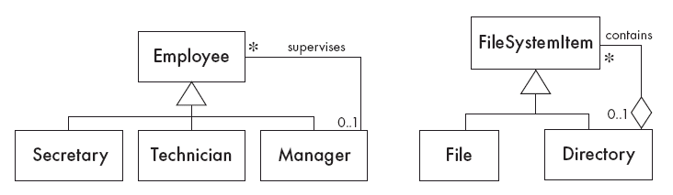
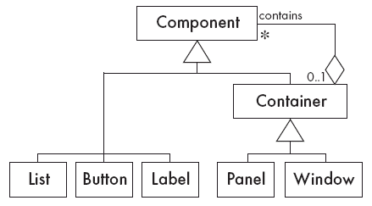
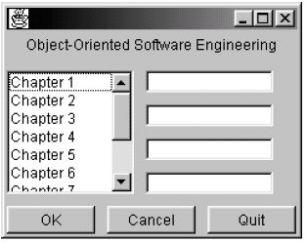
Examples of Composite
Solution:

Slide 32
The Singleton Pattern
Context:
It is very common to find classes for which only one instance should exist (singleton)
Problem:
How do you ensure that it is never possible to create more than one instance of a singleton class?
Forces:
The use of a public constructor cannot guarantee that no more than one instance will be created.
The singleton instance must also be accessible to all classes that require it

Slide 33
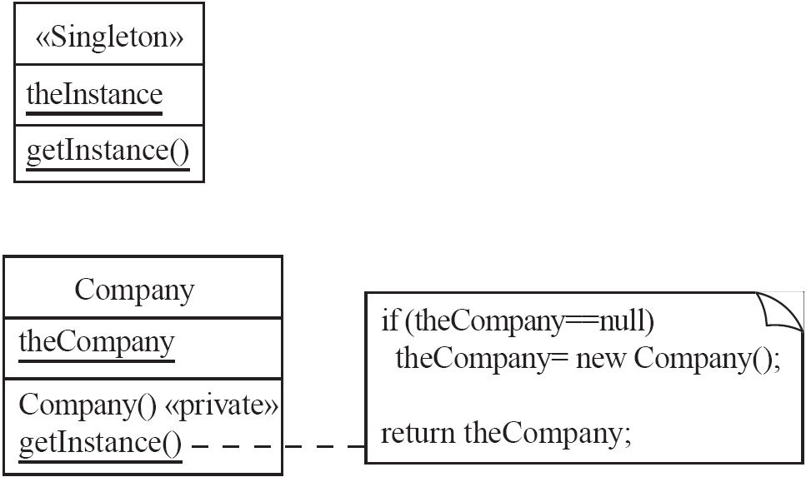
Singleton (object creational)
Solution:

Slide 34
Singleton
Design Purpose
Ensure that there is exactly one instance of a class S. Be able to obtain the instace from anywhere in the application.
Design Pattern Summary
Make the constructor of S private; define a private static attribute for S of type S; define a public accessor for it.
34

Slide 35
Singleton: Class Model
Client
Singleton Design Pattern
MyClass
getSingletonOfMyClass(): MyClass
singletonOfMyClass
«static»
1
35

Slide 36
The Singleton Design Pattern -- applied to MyClass
Define a private static member variable of MyClass of type MyClass
private static MyClass singletonOfMyClass = new MyClass();
Make the constructor of MyClass private
private MyClass() { /* …. constructor code …. */ };
Define a public static method to access the member
public static MyClass getSingletonOfMyClass()
{
return singletonOfMyClass;
}
36

Slide 37
Assignment Delivery
Deadline Sunday Feb 19 by midnight
Send assignment to fernande@fau.edu
with a copy to the TA Sahar Sohangir
ssohangir2014@fau.edu
One file named XYAssig1COP5339, where XY are your initials
Only Word or pdf files
Put your name in the assignment
No verbose descriptions

Slide 38
The Façade Pattern (object structural)
Context:
Often, an application contains several complex packages.
A programmer working with such packages has to manipulate many different classes
Problem:
How do you simplify the view that programmers have of a complex package?
Forces:
It is hard for a programmer to understand and use an entire subsystem
If several different application classes call methods of the complex package, then any modifications made to the package will necessitate a complete review of all these classes.

Slide 39
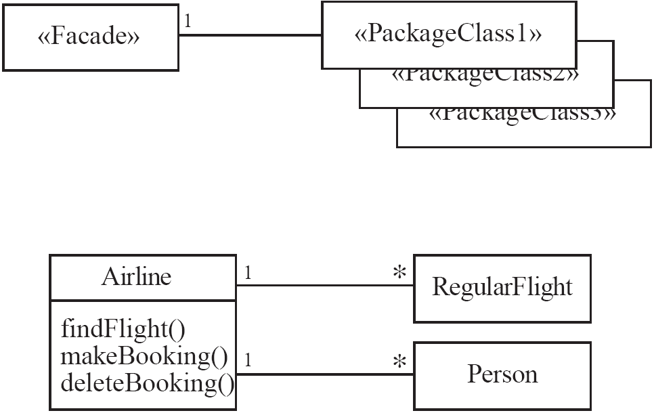
Façade
Solution:

Slide 40
Façade
Intent: Provide a unified higher-level interface to a set of interfaces in a subsystem.
Applicability: Use Façade when you want to provide a simple interface to a complex object-oriented subsystem or you want an entry point to a layer in a layered system.

Slide 41
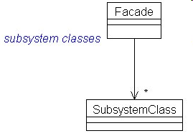
Façade class diagram

Slide 42
Consequences
Shields clients of details from subsystem units
Units in the subsystems can vary without affecting clients
Can improve security and reliability by hiding implementation details

Slide 43
Facade
Design Purpose
Provide an interface to a package of classes
Design Pattern Summary
Define a singleton which is the sole means for obtaining functionality from the package.
Notes: the classes need not be organized as a package; more than one class may be used for the façade.
43

Slide 44
Facade Design Pattern Structure
1
Façade
«exposed»
cMethodOfFacade()
Client
2
C
«not exposed»
myCMethod()
44

Slide 45
Facade Design Pattern Structure
1
Façade
«exposed»
cMethodOfFacade()
Client
«not exposed»
This call replaced by 1 & 2.
Client can’t reference C
2
«not exposed»
C
«not exposed»
myCMethod()
«not exposed»
«not exposed»
«not exposed»
45

Slide 46
Sequence Diagram for Façade
:Client
singleton
:Facade
:C
cMethodOfFacade()
myCMethod()
(return if any)
(return if any)
46

Slide 47
Using Façade for Architecture of a Video Game
MyGameEngine
MyGame
«facade»
MyGameCharacters
MyGameCast
«facade»
MyGameEnvironment
MyGameEnvironment
«facade»
47
© 2010 John Wiley & Sons Ltd.

Slide 48
The Observer Pattern (object behavioral)
Context:
When an association is created between two classes, the code for the classes becomes inseparable.
If you want to reuse one class, then you also have to reuse the other.
Problem:
How do you reduce the interconnection between classes, especially between classes that belong to different modules or subsystems?
Forces:
You want to maximize the flexibility of the system to the greatest extent possible

Slide 49
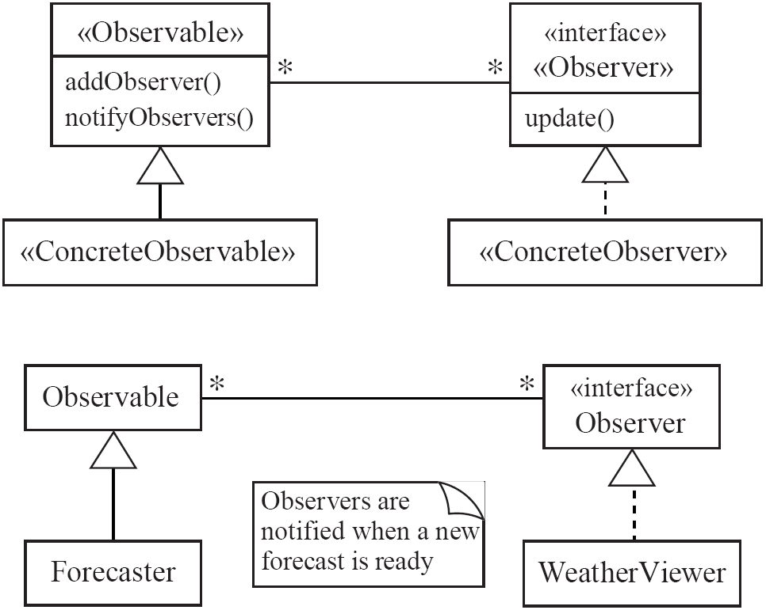
Observer
Solution:

Slide 50
Observer
Design Purpose
Arrange for a set of objects to be affected by a single object.
A set of objects observe the changes of another object
Design Pattern Summary
The single object aggregates the set, calling a method with a fixed name on each member.
50

Slide 51
Observer Design Pattern
Server part
Client part
Source
notify()
Observer
update()
Client
1
1..n
2
for all Observer’s o:
o.update();
ConcreteObserver
observerState
update()
ConcreteSource
state
3
51

Slide 52
Observer Applied to International Hamburger Co.
Server part
Client part
Client
1..n
Source
notify()
Observer
update()
SeniorManagement
forecast
update()
Headquarters
demand
Marketing
marketingDemand
update()
doDisplay()
if( abs( hq.demand - marketingDemand ) > 0.01 )
{ marketingDemand = hq.getDemand();
doDisplay();
}
52

Slide 53
I/O Example for Mutual Fund Observer Example
Note: HiGrowthMutualFund starts with 3 shares of Awesome, assumes price of 1.0, and has non-Awesome holdings totalling 400.0
Note: MedGrowthMutualFund starts with 2 shares of Awesome, assumes price of 1.0, and has non-Awesome holdings totalling 300.0
Note: LoGrowthMutualFund starts with 1 shares of Awesome, assumes price of 1.0, and has non-Awesome holdings totalling 200.0
Enter 'quit': Any other input to continue.
go on
Enter the current price of Awesome Inc. in decimal form.
32.1
Value of Lo Growth Mutual Fund changed from 201.0 to 232.1
Value of Med Growth Mutual Fund changed from 302.0 to 364.2
Value of Hi Growth Mutual Fund changed from 403.0 to 496.3
Enter 'quit': Any other input to continue.
go on
Enter the current price of Awesome Inc. in decimal form.
21.0
Value of Lo Growth Mutual Fund changed from 232.1 to 221.0
Value of Med Growth Mutual Fund changed from 364.2 to 342.0
Value of Hi Growth Mutual Fund changed from 496.3 to 463.0
Enter 'quit': Any other input to continue.
53
© 2010 John Wiley & Sons Ltd.

Slide 54
Observer Example: Mutual Funds
Observable
notifyObservers()
Observer
update( Observable, Object )
MutualFund
value
numAwesomeShares
Setup
LongTermMutualFund
….
update(…)
AwesomeInc
price
Client
MediumTermMutualFund
….
update(…)
HiGrowthMutualFund
….
update(…)
Java API Class
Developer Class
Key:
54

Slide 55
Observer in the Java API
Observable
notifyObservers()
Observer
update( Observable, Object )
MyConcreteObserver
observerState
update(…)
MyObservable
subject
Key:
Java API Class
Developer Class
55

Slide 56
The Adapter Pattern (class, object structural)
Context:
You are building an inheritance hierarchy and want to incorporate it into an existing class.
The reused class is also often already part of its own inheritance hierarchy.
Problem:
How to obtain the power of polymorphism when reusing a class whose methods
have the same function
but not the same signature
as the other methods in the hierarchy?
Forces:
You do not have access to multiple inheritance or you do not want to use it.

Slide 57
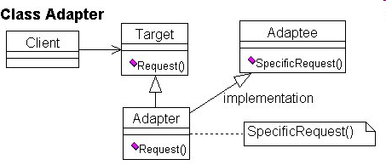
Class Adapter

Slide 58
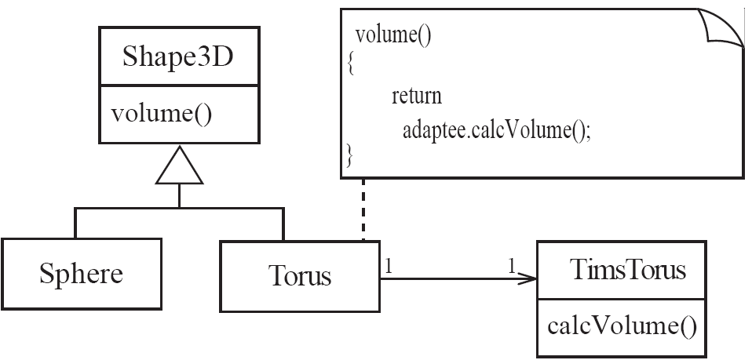
Class Adapter
Example:

Slide 59
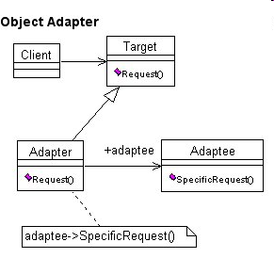
Object adapter

Slide 60
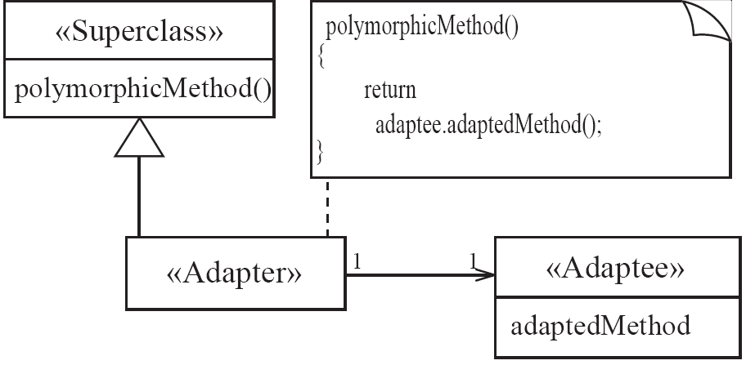
Object Adapter
Solution:

Slide 61
The Proxy Pattern (object structural)
Context:
Often, it is time-consuming and complicated to create instances of a class (heavyweight classes).
There is a time delay and a complex mechanism involved in creating the object in memory
Problem:
How to reduce the need to create instances of a heavyweight class?
Forces:
We want all the objects in a domain model to be available for programs to use when they execute a system’s various responsibilities.
It is also important for many objects to persist from run to run of the same program

Slide 62
Proxy
Provide a surrogate or placeholder for another object to control access to it
A Remote Proxy provides a local representation of a remote object
A Virtual Proxy creates expensive objects on demand
A Protection Proxy controls access to the original object
A smart reference is a pointer that performs additional actions

Slide 63
Proxy
Proxy
UML Model (PepperSeed package)

Slide 64
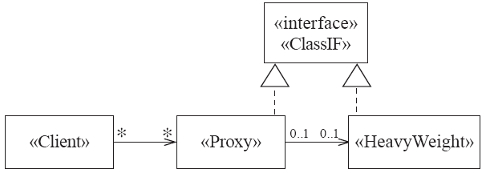
Proxy
Solution:

Slide 65
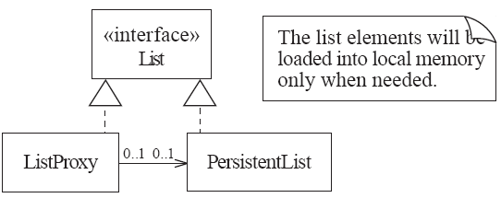
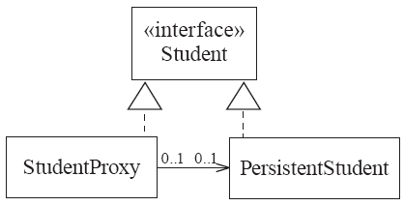
Proxy
Examples:

Slide 66
Bridge (object structural)
Decouple an abstraction from its implementation so that the two can evolve independently.
This is a basic pattern for components and web services
Example: a web service has an XML wrapping and an implementation written in any language

Slide 67
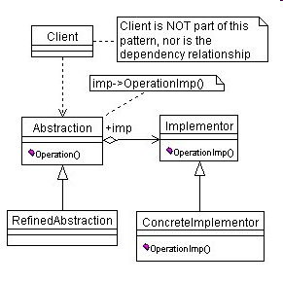
Bridge class diagram

Slide 68
Consequences
The Abstraction and the Implementation can be extended independently
The implementation can be dynamic, i.e, configured or changed at run time.
Hiding implementation improves security and reliability

Slide 69
Researchers of models and model-driven design
Jordi Cabot: Researcher and entrepreneur on software engineering, specially on software modeling, UML, MDE and related topics. Check http://jordicabot.com and http://modeling-languages.com
Research Professor at Internet Interdisciplinary Institute, the Research
center of the Open University of Catalonia (UOC), Barcelona, Spain
Richard Paige: Professor of Enterprise Systems, Department of Computer Science, University of York, Deramore Lane, York, YO10 5GH United Kingdom email: first name dot last name at york dot ac dot uk
http://www-users.cs.york.ac.uk/~paige/
Alfonso Pierantonio: Associate Professor. Dipartimento di Ingegneria e Scienze dell'Informazione e Matematica Via Vetoio - I-67100 L'Aquila (Italy), Email: alfonsodi.univaq.it
http://www.di.univaq.it/home.php?users_username=alfonso

Slide 70
Another UML tool
Lucidchart
https://www.lucidchart.com/pages/landing/uml_diagram_tool?utm_source=modeling_languages&utm_medium=cpc&utm_campaign=uml_diagram_tool

Slide 71
UML textbooks
UML @ Classroom: An Introduction to Object-Oriented Modeling (Undergraduate Topics in Computer Science) 2015th Edition
by Martina Seidl (Author), Marion Scholz (Author), Christian Huemer (Author), Gerti Kappel (Author) & 1 more
S. Ambler, “The elements of UML 2.0 style”
C. Larman, Applying UML and Patterns: An Introduction to Object-Oriented Analysis and Design and Iterative Development (3rd Ed.),
Prentice Hall, 2004

Slide 72
Mediator (Object behavioral)
Define an object that encapsulates how a set of objects interact
Promotes loose coupling by keeping objects from referring to each other
This definition actually means that a centralized class is to be used for interaction between two different classes. This will receive the input from one class and pass it to the other class, for whom it was intended. And the response from the other class will be returned to the first class, from where the process started. So it results in a request-response system between the classes.
This also results in a system where multiple classes from the sources can interact with multiple classes on the destination end and thus result in a loosely coupled system.

Slide 73
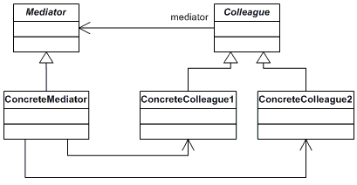
Mediator class diagram

Slide 74
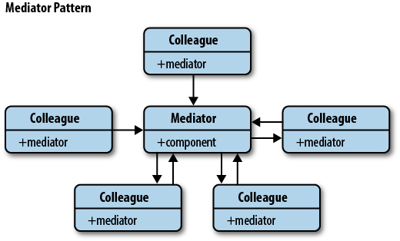
Mediator object diagram

Slide 75


Example of Behavioral Design Goal: Port Traffic
obstacles
Algorithms express mutual behavior
to drydock →
berth
berth
75

Slide 76
Avoiding Dependencies
Harbor Application
×
1
1..n
Ship
Tugboat
Customs application: reuse Ship alone
Ship
Longshoreman
76

Slide 77
Core Mediator Concept Applied to The Harbor Problem
Ship
LeavingPort
estimateTime()
Tugboat
77
© 2010 John Wiley & Sons Ltd.

Slide 78
Applying the Mediator Design Pattern to The Harbor Problem
PortMission
estimateTime()
Vessel
Mediator base class
Ship
Tugboat
EnteringPort
estimateTime()
LeavingPort
estimateTime()
BeingMaintained
estimateTime()
78
© 2010 John Wiley & Sons Ltd.

Slide 79
The Abstract Factory Pattern (Object creational)
Context:
A reusable framework needs to create objecs; however the class of the created objects depends on the application.
Problem:
How do you enable a programmer to add new application-specific class into a system built on such a framework?
Forces:
We want to have the framework create and work with application-specific classes that the framework does not yet know about.
Solution:
The framework delegates the creation of application-specific classes to a specialized class, the Factory.
The Factory is a generic interface defined in the framework.
The factory interface declares a method whose purpose is to create some subclass of a generic class.

Slide 80
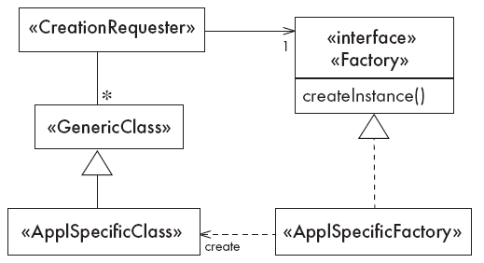
The Abstract Factory Pattern
Solution

Slide 81
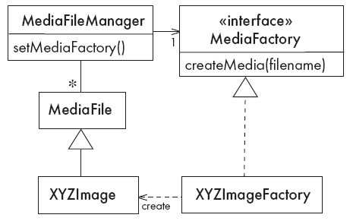
The Abstract Factory Pattern
Example

Slide 82
Design Purpose
Abstract Factory
“Provide an interface for creating families of related or dependent objects without specifying their concrete classes.”*
* Gamma et al
82
© 2010 John Wiley & Sons Ltd.

Slide 83
KitchenViewer Interface
Wall
cabinet
menu

Counter
display area
styles
Floor
cabinet
Modern
Classic
Antique
Arts & Crafts
83

Slide 84
KitchenViewer Example
Wall cabinets
Floor cabinets
Countertop
Modern
Classic
Antique
Arts & Crafts
84

Slide 85

Selecting Antique Style
Modern
Classic
Antique
Arts & Crafts
85

Slide 86
KitchenViewer Without Design Patterns
Client
renderKitchen()
Kitchen
WallCabinet
FloorCabinet
ModernWallCabinet
AntiqueWallCabinet
ModernFloorCabinet
AntiqueFloorCabinet
86

Slide 87
The Abstract Factory Idea
KitchenStyle
getWallCabinet()
getFloorCabinet()
WallCabinet
FloorCabinet
…
AntiqueWallCabinet
…
AntiqueFloorCabinet
ModernKStyle
getWallCabinet()
getFloorCabinet()
AntiqueKStyle
getWallCabinet()
getFloorCabinet()
FloorCabinet getFloorCabinet()
{ return new ModernFloorCabinet(); }
FloorCabinet getFloorCabinet()
{ return new AntiqueFloorCabinet(); }
87

Slide 88
Abstract Factory Design Pattern Applied to KitchenViewer
Client
renderKitchen( KitchenStyle )
KitchenStyle
getWallCabinet()
getFloorCabinet()
Kitchen
getWallCabinet()
getFloorcabinet()
WallCabinet
FloorCabinet
ModernWallCabinet
ModernKStyle
getWallCabinet()
getFloorCabinet()
AntiqueWallCabinet
AntiqueKStyle
getWallCabinet()
getFloorCabinet()
ModernFloorCabinet
AntiqueFloorCabinet
88

Slide 89
Abstract Factory Design Pattern
Client
doOperation( Style myStyle )
Style
getComponentA()
getComponentB()
Collection
ComponentA
ComponentB
Style1ComponentA
Style1
getComponentA()
getComponentB()
Style2ComponentA
Style2
getComponentA()
getComponentB()
Style1ComponentB
Style2ComponentB
89

Slide 90
Abstract Factory Design Pattern Alternative
Client
doOperation()
Style
getComponentA()
getComponentB()
Collection
getComponentA()
getComponentB()
ComponentA
ComponentB
Style1
getComponentA()
getComponentB()
Style1ComponentA
Style2ComponentA
Style2
getComponentA()
getComponentB()
Style1ComponentB
Style2ComponentB
90

Slide 91
State
Design Purpose
Cause an object to behave in a manner determined by its state.
Design Pattern Summary
Aggregate a State object and delegate behavior to it.
91

Slide 92
State Design Pattern Basic Structure:
doRequest() behaves according to state of Target
Client
{ targetState.handleRequest(); }
Target
doRequest()
targetState
TargetState
handleRequest()
1
92

Slide 93
State Design Pattern Class Model
Client
Target
doRequest()
targetState
TargetState
handleRequest()
1
TargetState1
handleRequest()
TargetState1
handleRequest()
TargetState1
handleRequest()
93

Slide 94
State Design Pattern Structure:
doRequest() behaves according to state of Target
Client
{ targetState.handleRequest(); }
Target
doRequest()
targetState
TargetState
handleRequest()
1
TargetStateA
handleRequest()
TargetStateB
handleRequest()
. . . . . .
94

Slide 95
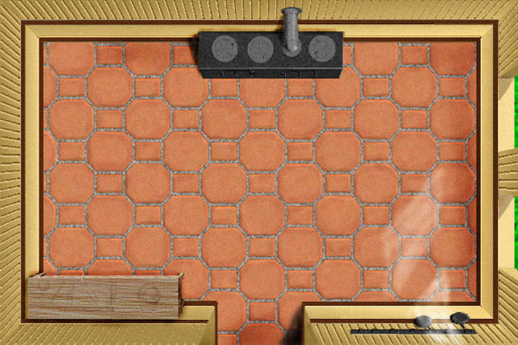

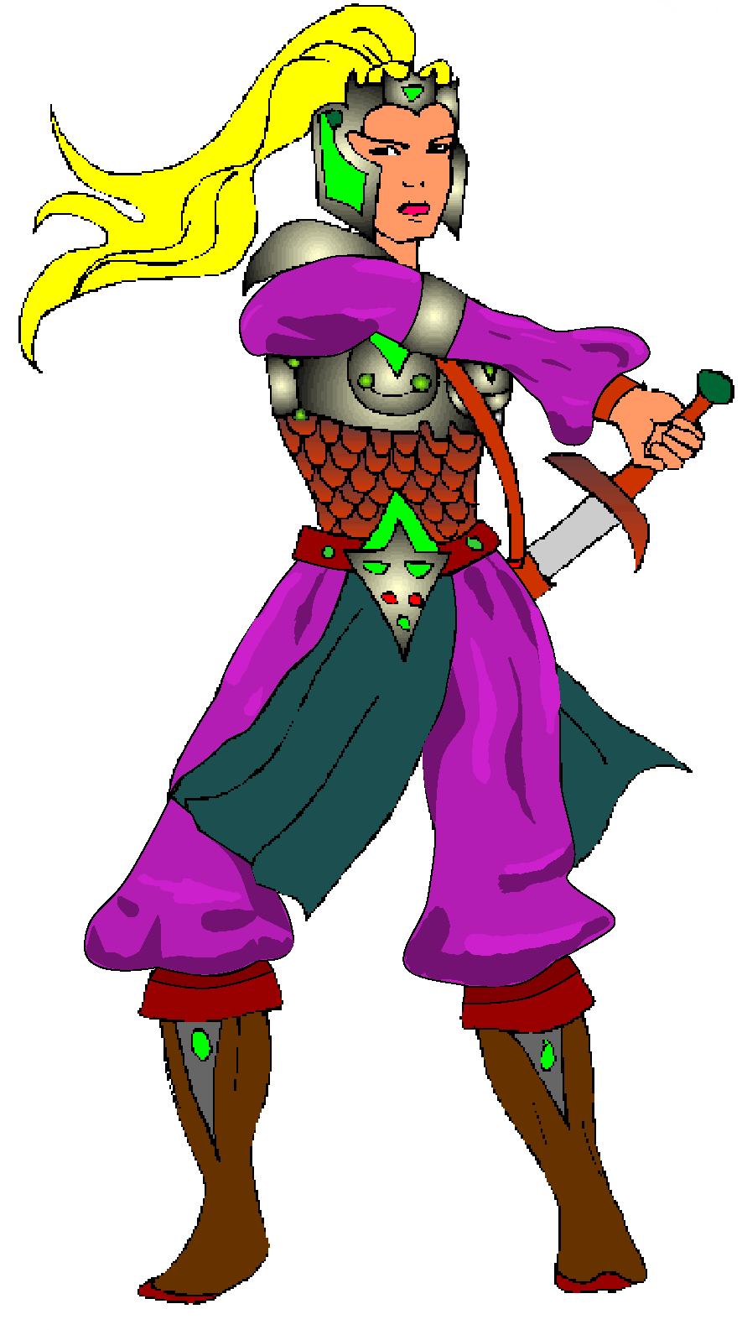
GUI For a Role-Playing Video Game
Set Characteristics
Courtesy Tom VanCourt and Corel
95

Slide 96
State Design Pattern Applied to Role-Playing Game
MyGame
setCharacteristics()
state
MyGameState
handleClick()
{
state.handleClick();
}
SettingUp
handleClick()
Waiting
handleClick()
SettingCharacteristics
handleClick()
Engaging
handleClick()
{
showWindow();
…. // more
}
{
showWindow();
…. // more
}
{ // already responding
… // display message
}
{ // do nothing
… // display message
}
96
© 2010 John Wiley & Sons Ltd.

Slide 97
Decorator
Intent:
Attach additional responsibilities to an object dynamically. Decorators provide a flexible alternative to subclassing for extending functionality
Benefits:
allows you to vary the behavior of a class independent of its context, greater flexibility than inheritance-based behavioral extensions reduces subclassing
Liabilities
may be difficult to debug because of the number of similar classes results in many small objects looking very similar

Slide 98
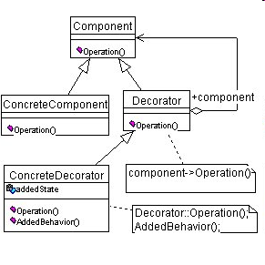
Class diagram of Decorator

Slide 99
Classes
Component—defines an interface that allows to add dynamically responsibilities to objects
Concrete Component—A specific type of component
Decorator—Contains a ref to a Component object and defines an interface that conforms to Component ‘s interface
Concrete Decorator—adds responsibilities to the Component

Slide 100
Chain of Responsibility
Avoid coupling the sender of a request to its receiver by giving more than one object a chance to handle the request. Chain the receiving objects and pass the request along the chain until an object handles it.

Slide 101
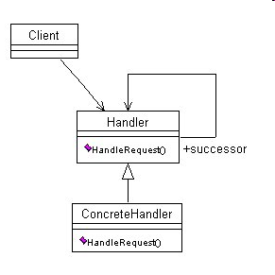
Class diagram of Chain of Responsibility

Slide 102
Classes
Handler—defines an interface for handling requests; implements a successor link
ConcreteHandler—handles request if possible; if not, it passes it to its successor
Client—initiates request

Slide 103
Architectural patterns
Apply to architectural units
F. Buschmann, R. Meunier, H. Rohnert, P. Sommerlad, and M. Stal, Pattern-oriented software architecture, J. Wiley, 1996. The famous POSA book.

Slide 104
Relationship between architectural patterns

Slide 105
Architectural patterns in their layers
Layers
Facade
Reflection
Application
Conceptual
Model
interact
transformInterface
distribute
objects
consume/provideServices
implement
business
model
Model View
Controller
Adapter
Broker
Enterprise
Component
Framework
Web
Services
mapObjects
accessRemote
objects
Relational
Database
Mapping
Proxy
Client
Dispatcher
Server
establish
Connection
support
Software
Communication
Operating
System
Channel

Slide 106
The Layers pattern
Its main idea is the decomposition of a system into hierarchical layers of abstraction, where the higher levels use the services of the lower levels
The operations in level i are implemented in terms of the operations in level i-1
It is more than a pattern, it is a fundamental architectural principle, used in operating systems, networks, applications, and all kind of software
Context. A complex system that requires decomposition.
Problem. Systems where all modules call any other module and where high-level aspects are mixed with low-level aspects are hard to understand, hard to modify, and hard to test. Complex systems require a systematic and organized structure.
Solution. Build a hierarchy of layers where Layer i depends on Layer i-1.

Slide 107
Abstraction provides information hiding
client
Layer i
Layer i - 1

Slide 108
Typical architectural layers

Slide 109
Layered Architecture of a game
3D engine layer
Role-playing game layer
«uses»
Characters
RolePlayingGame
Layout
«uses»
Application layer
Encounter
Characters
Encounter
Environment
Encounter Game
© 2010 John Wiley & Sons Ltd.

Slide 110
Architecture of Eclipse 1: Overall
Plug-In Development Environment
⇓
depends on
Java Development Tools
⇓
Adapted from “Contributing to Eclipse” p5
Platform
© 2010 John Wiley & Sons Ltd.

Slide 111
Known uses
A common variant or concrete version of the Layers pattern is the Three-tier architecture
This includes: a presentation layer (user/application interfaces), a business layer (global enterprise model), a storage layer (mappings to databases)
In addition to modularity and well-defined interfaces, the three-tier architecture is intended to allow any of the three tiers to be upgraded or replaced independently as requirements or technology change
Variations of this architecture can be found in [Bai97] [Tib98]. Also used are Four-tier architectures or even N-tier or multitier architecture [Sim09, wik].

Slide 112
UC: request data or service in a 3-Tier pattern
:Client
:Presentation
:Business
:Data
requestAccess()
processRequest
authorizeAccess()
getAccessSupport()
returnResults()
grantAccess()
applyRules
grantAccess()
doTask()
processTask
callOperation()
applyRules /
processTask()
doProcedure()
returnResults()
processData
returnResults()
returnResults()

Slide 113
Broker
The Broker structures distributed systems with separate components that interact by remote service calls. A broker coordinates communications, including forwarding requests and sending back results and exceptions.
Forces
Components should be able to access remote services in a location-transparent way.
Components may need to be exchanged, added, or removed at execution time.
Implementation details should be hidden from the users of components and services.

Slide 114
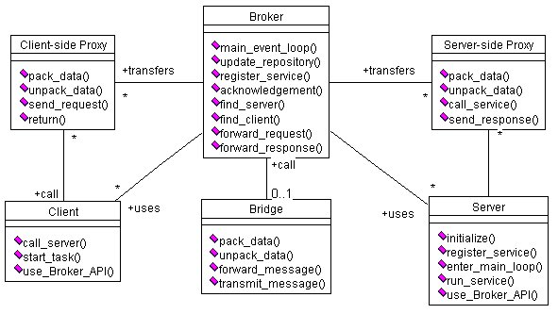
Class diagram of Broker

Slide 115
UCs: Register and Request Service

Slide 116
Known uses
CORBA
IBM’s SOM/DSOM
Microsoft’s DCOM, .NET Remoting
Sun’s RMI
This pattern (and the Layers and Lookup patterns) are used in the Bluetooth specification

Slide 117
Consequences
Advantages
Remote objects or units can be accessed transparently, as if they were local
Changeability and extensibility of components
Interoperability between different Broker systems
Portability of a broker system because low level details are hidden from users
Reusability
Liabilities
Error handling
Lower fault tolerance
Restricted efficiency
Testing and debugging

Slide 118
Model View Controller
Divides an interactive application into a Model with the core functionality and data, Views (observers)that display information to the user, and Controller to let the user apply changes to the model
Example: Sales figures displayed in bar charts, pie charts, tables, and different languages

Slide 119
MVC intent
The model contains the core functionality and data. Views display information to the user. Controllers handle user input. Views and controllers together comprise the user interface. A change-propagation mechanism ensures consistency between the user interface and the model.

Slide 120
MVC Problem
User interfaces are especially prone to change requests. When you extend the functionality of an application, you must modify menus to access these new functions.
A customer may call for a specific user interface adaptation, or a system may need to be ported to another platform with a different ‘look and feel’ standard.
Even upgrading to a new release of your windowing system can imply code changes.
The user interface platform of long-lived systems thus represents a moving target.

Slide 121
Forces
The same information is presented differently in different windows, for example, in a bar or pie chart.
The display and behavior of the application must reflect data manipulations immediately.
Changes to the user interface should be easy, and even possible at run-time.
Supporting different ‘look and feel’ standards or porting the user interface should not affect code in the core of the application.

Slide 122
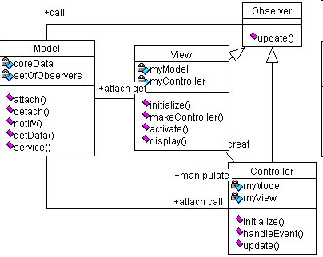
MVC class diagram

Slide 123
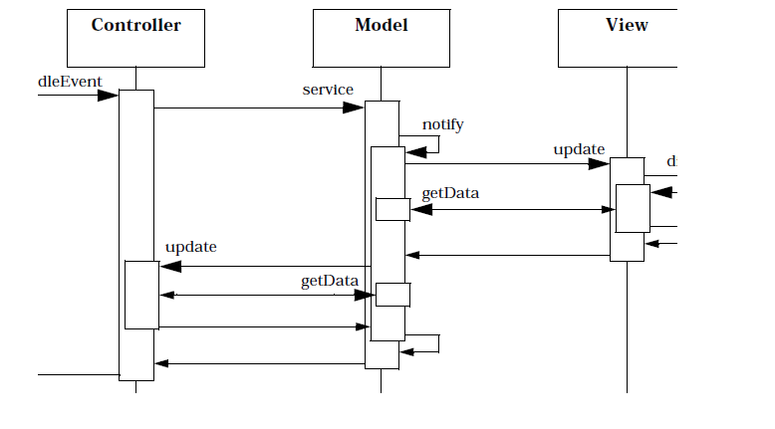
Propagating an event

Slide 124
MVC in the web
The model is the information in an application or the database
The controller is an instance of ASP or JSP that assembles information from the application or database
The views are the browser interfaces that are used to access data

Slide 125
Pipes and Filters
Many applications process or transform a stream of data
Such applications are organized as a sequence of different stages, which may be independent enough to be simultaneously carried out
The value of this organization is due to several reasons: every component performs specialized functions over the data stream, the global architecture requires this flow, or the whole system performs its functionality in a more efficient and flexible way
Every time the data reaches a different stage, different functions may be applied at that stage but in its most common form, the filtering just applies automatic, predefined data transformations
In some applications, the pipeline implements a business process where the transformations may include operations applied interactively by people : a pipeline of workers processing tax returns.

Slide 126
Pipe and Filter Architectures
stream >
filter
pipe
filter
filter
filter
filter
pipe
filter
< stream
© 2010 John Wiley & Sons Ltd.

Slide 127
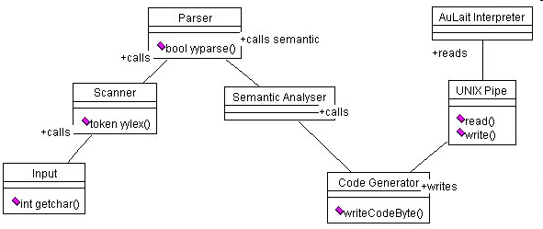
Example (www.vico.org)

Slide 128
Forces
Due to regulatory constraints, work changes, or efficiency, some documents may need extra stages or skip stages. We need to be able to reconfigure the number or order of the steps and the types of steps
Nonadjacent processing steps do not share information
Some steps could be performed in parallel.

Slide 129
Known uses
UNIX made the Pipes and Filters pattern popular with the command shells and filter programs. (Bach, M.J., The Design of the UNIX Operating System, Prentice Hall, 1986.)
CMS Pipelines extends the operating systems of the IBM mainframes thus supporting the Pipes and Frame architectures. (Hartmann, J., C. Reichetzeder, and M. Varian, CMS Pipelines, http://www.akhwien.ac.at/pipeline.html
LASSPTools is a toolset for numerical analysis and graphics. LASSPTools contains filter programs that may be combined using UNIX pipes. (Sethna, J., LASSPTools: Graphical and Numerical Extensions to Unix, http://www.lassp.cornell.edu/LASSPTools/LASSPTools.html
Microsoft’s BizTalk Server 2004 [Biz]. BizTalk Server 2004 can implement Pipes and Filters. In addition to security features that are provided by the transport, such as encryption when using HTTPS, BizTalk Server 2004 provides security at the message level. BizTalk Server 2004 can receive decrypted messages and validate digital signatures that are attached to these messages. Similarly, it can encrypt messages and attach digital signatures to messages before sending them.

Slide 130
More known uses
Some tax offices implement a human pipeline to process tax returns. Workers may check different aspects of a tax return either manually or using computers
Cocoon. The Apache Cocoon is a web development framework using components. It can be used to build XML pipelines, in which security restrictions can be added.

Slide 131
Related patterns
Intercepting Filter
Secure Pipes and Filters: E.B.Fernandez and J. L. Ortega-Arjona, "The secure Pipes and Filters pattern", Procs.of the Third Int Workshop on Secure System Methodologies using Patterns (SPattern 2009).
http://www.matematicas.unam.mx/jloa/publicaciones/PipesFiltersMay22-09.pdf
The Layers pattern provides better error handling but it is not as flexible; it really has different purposes

Slide 132
Blackboard
Many applications, such as problem solving, image processing, feedback control, or even some web applications, are developed based on a central information repository, composed of (a) a blackboard, which contains a centralized data structure, (b) several other independent components, known as knowledge sources, which are capable of reading, processing, and updating the data elements of the blackboard, and (c) the control, which is in charge of monitoring the blackboard and synchronizing the access of the knowledge sources
This organization is used due to: every knowledge source performs specialized functions over the data, the global architecture or organization requires a centralized control so that state and consistency can be assured, or the whole system needs to perform its functionality in a more efficient and flexible way
Operations on the data do not have a fixed precedence, that is, operations can be carried out in any order, coordinated by the central controller.

Slide 133
Example
Suppose we are developing an application for a law firm
The conduction of a case requires inputs from many data sources: lawyers, witnesses, defendants, etc. Court appearances are scheduled according to court and lawyer availability. All this makes the sequence of actions rather unpredictable.
A blackboard can be used to conduct a case, where immediate results of court appearances and case strategy are kept for analysis and updating by lawyers.
The data handled is very sensitive and access to it needs to be controlled. If we are not careful we might end up with invalid data or data will leak to our opponent, which will hurt our chances of winning the case (security to be seen later).

Slide 134
Forces
The sequence of activities or operations over data is usually unpredictable
The number of knowledge sources might be hard to predict and they can be added or removed dynamically
We may need to try different strategies and we need to be able to exchange the operations applied to the blackboard
We may need to backtrack and redo some steps in a different way

Slide 135
Object diagram of Blackboard

Slide 136
Known uses
In a web Wiki, knowledge sources are actually humans, whose role within the Wiki could be “reader”, “editor”, or “admin”. The Wiki should actually function like a blackboard, whose secure use requires that users are always authenticated, and access is controlled according to their roles within the Wiki system.
Two designs for applications that may use this pattern include a travel booking system, a law firm [Fer07], and a Java-based knowledge processing and agent programming software framework [Tar02].
Variant: The Reflective Blackboard pattern [Sil02]

Slide 137
Interaction and components
We need ways to interact with the application and we can use the MVC pattern that we saw earlier for this purpose
Once we have the basic structures for distribution we need to complement them with aspects such as activation, lookup, and views
Activation improves the performance of servers while lookup is needed for client location-transparent communication
We start with an example.

Slide 138
Example
The MVC can be combined with the Broker to be used to interact with distributed systems
The next figure shows a banking application with distributed observers (OCA stands for Open Checking Account).Customers own Accounts. Customers interact through the OCA view and its corresponding controller.
The Broker uses two proxies to allow remote interaction

Slide 140
Analysis of the bank architecture
This is a remote object style, where objects are represented by proxies
It is also an example of a remote MVC pattern, where the views and controllers are remote with respect to their model
An ATM system would have a similar architecture

Slide 141
Activator
Intent: Implements efficient on-demand activation and deactivation of services.
Forces
Access to services must be as efficient and fast as possible.
Some services are rarely used.
Activation and deactivation must be transparent to the clients.
Solution
Separate service usage from lifecycle aspects, activate and deactivate services on demand. Figure 5.2 shows the class diagram for this pattern. A Client acquires services through the Activator and then uses them directly. The Activator uses an Activation Table to activate the requested services if they are currently inactive. The Activation table may contain information such as the class name of the service, its status (activated or not), and other details.

Slide 142
Activator class diagram

Slide 143
Known uses
Implementations of CORBA ORBs.
Jini
Microsoft’s DCOM and .NET.
Java’s RMI.
Web servers use this pattern to start services when HTTP requests arrive.

Slide 144
Lookup
Intent: Describes how to find and retrieve initial references to distributed objects and service
Forces
Availability. A client should be able to find on demand what distributed objects or services are available.
Independence. A client should be able to find initial references on their own.
Location transparence. A client should be able to find initial references for objects or services without knowing or caring about their locations.
Context
Distributed systems where clients need to locate services transparently.

Slide 145
Lookup II
Variants
Several Lookup services can form a federation.
Lookup services can be replicated to provide fault-tolerant Lookup services.
Services and objects can be replicated to provide fault-tolerant services and objects. The Lookup service then holds multiple registrations for a given service or object.
The Locate and Track pattern [Coh00] is an extension used in wireless systems where the physical location of the objects is important.

Slide 147
Known uses
Bluetooth [Gok].
CORBA’s Name Service
The Java Native Directory Interface (JNDI)
Jini [Kir00]
Microsoft’s Universal Plug and Play [Wis00]
The Domain Name Service (DNS) of the Internet.

Slide 148
Publish Subscribe
Intent: Decouple the publishers of events from those interested in the events (subscribers).
Problem: Having each client call a publisher is inefficient and non-scalable. Also, more than one client could be interested in the events.
The number of clients is dynamic
Solution
Use an event channel (a queue) where publishers send their events and interested subscribers can receive the events. For event transmission it is possible to use push and pull approaches

Slide 149
Distributed P/S
E.B. Fernandez and A.V. Uzunov, “Secure middleware patterns”, 4th International Symposium on Cyberspace Safety and Security (CSS 2012), Melbourne, Australia, Dec. 12-13, 2012.
Intent: In a distributed system, decouple the publishers of events from those interested in the events (subscribers).
Context: Distributed applications using web services, as well as related services such as directories, databases, security, and monitoring. There may be also other types of components (J2EE, .NET). There may be different standards applying to specific components and components that do not follow any standards.
Problem: Having each client call a publisher to find out if they have something of interest to them is inefficient and non-scalable. Also, more than one client could be interested in the same events. How do we organize publishers and subscribers in a more efficient way?

Slide 150
Solution
Use an event channel where publishers send their events and interested subscribers can receive the events. Subscribers register for the events on which they are interested.
Structure Subscribers can register to receive specific events. Their conditions are described in the class Subscription. The Channel represents different ways of publishing events.
Dynamics The next figure shows a sequence diagram for the use case Publish Event. Other use cases include Register Subscriber and Remove Subscriber.

Slide 151
Dist. P/S class diagram

Slide 152
UC: Publish an event

Slide 153
Implementation
For event transmission it is possible to use push and pull approaches
The event channel can be any type of asynchronous channel and may use an ESB.
Subscribers usually receive only a subset of the total messages published. The process of selecting messages for reception and processing is called filtering. There are two common forms of filtering: topic-based and content-based [wik].
An example of implementation is given in [Rou02].

Slide 154
Known uses
The IBM MQSeries provides guaranteed, once-only delivery of messages between IT systems. It can connect different types of platforms, including those from IBM, Microsoft, Sun, and HP using a variety of communications protocols
Software AG has an Integrator Server that distributes documents using a Broker as publishing channel
Oracle uses Publish/Subscribers in conjunction with their database architectures

Slide 155
Variants
If we add security mechanisms we can define a Secure Publish/Subscribe; which uses the secure Channel pattern for event channel, uses RBAC pattern for control of contents, provides mutual authentication, and includes logging.
[Cor06] describes variants based on the type of service provided: topic-based, content-based, concept-based, and type-based.
We can also define a P/S focusing on its functional or conceptual aspects, not in its software realization as we have done here. That is an style.

Slide 156
Advantages
Interoperability. Because of its decoupling effect, this pattern allows the interaction of any type of publishers and subscribers.
Freedom: Subscribers only need to register to receive some events; after this they can go on their own businesses and they are notified when there is something new.
Dynamicity: We can add or remove subscribers at any time. Subscribers can also change their interests by changing their type of subscription.
Scalability: The number of subscribers can be extended by just extending the subscriber list as far as we have appropriate communication channels for the events.

Slide 157
More advs.
Loose coupling: Publishers can work without knowledge of their subscriber details and vice versa. As far as their interfaces remain constant, both can change independently.
Location Transparency: Neither subscribers nor publishers need to know each other’s locations, a lookup service can find their locations.
Security: if events are sensitive we can encrypt the event channel. We can also use digital signatures for authenticity. See the description of the Secure P/S variant.
Selectivity: it is possible for the clients to select the published events according to different criteria, e.g., topic-based, content-based, concept-based, and type-based [Cor06].
Role changing: Publishers and subscribers may be just roles that can be taken by any entity.

Slide 158
Liabilities
There is some overhead in the event structure,, i.e. a tight coupling of subscribers to their publishers would have better performance at the cost of flexibility.
There may be coordination problems because of the decoupling.

Slide 159
Difficulties and Risks When using Patterns
Patterns are not a panacea:
Whenever you see an indication that a pattern should be applied, you might be tempted to blindly apply the pattern.
This can lead to unwise design decisions .
Resolution:
Always understand in depth the forces that need to be balanced, and when other patterns better balance the forces.
Make sure you justify each design decision carefully.

Slide 160
Difficulties and Risks When Using Patterns II
Developing patterns is hard
Writing a good pattern takes considerable work.
A poor pattern can be hard to apply correctly
Resolution:
Do not write patterns for others to use until you have considerable experience both in software design and in the use of patterns.
Take an in-depth course on patterns.
Iteratively refine your patterns, and have them peer reviewed at each iteration.

Slide 161
The Abstraction-Occurrence Pattern
Context:
Often in a domain model you find a set of related objects (occurrences).
The members of such a set share common information
but also differ from each other in important ways.
Problem:
What is the best way to represent such sets of occurrences in a class diagram?
Forces:
You want to represent the members of each set of occurrences without duplicating the common information

Slide 162
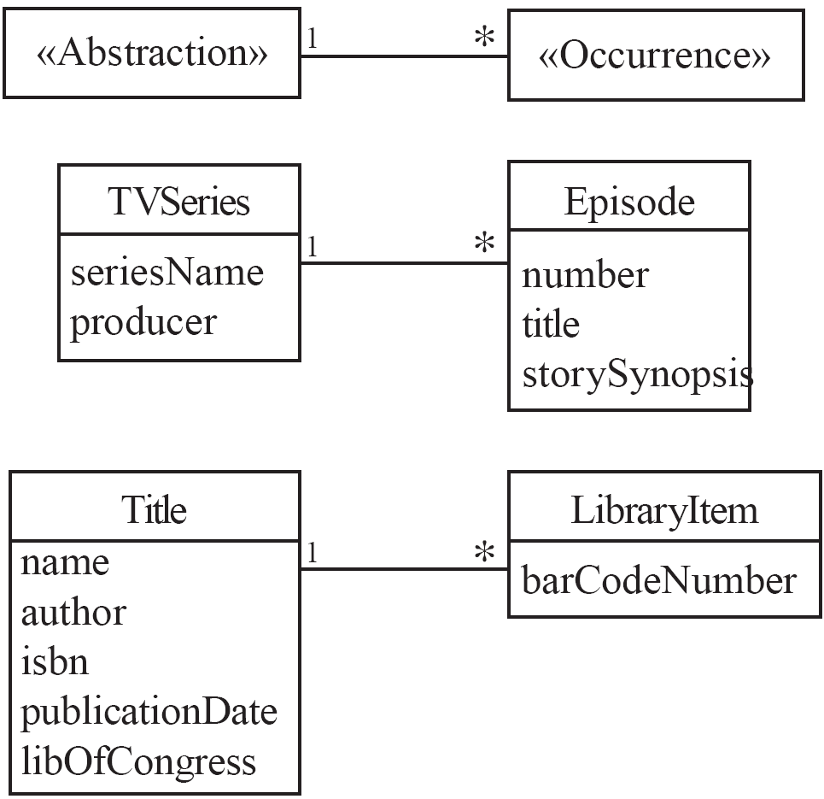
Abstraction-Occurrence
Solution:

Slide 163
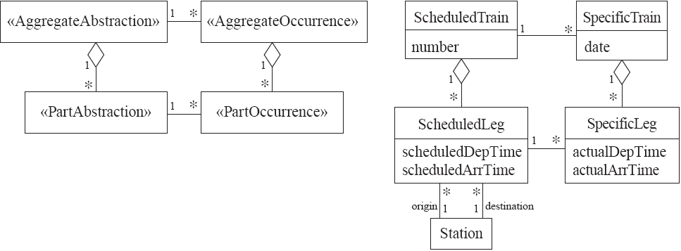
Abstraction-Occurrence
Square variant

Slide 164
The Player-Role Pattern
Context:
A role is a particular set of properties associated with an object in a particular context.
An object may play different roles in different contexts.
Problem:
How do you best model players and roles so that a player can change roles or possess multiple roles?

Slide 165
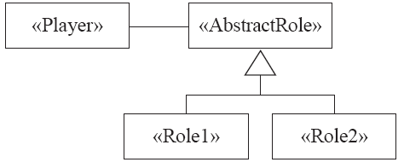
Player-Role
Forces:
It is desirable to improve encapsulation by capturing the information associated with each separate role in a class.
You want to avoid multiple inheritance.
You cannot allow an instance to change class
Solution:

Slide 166
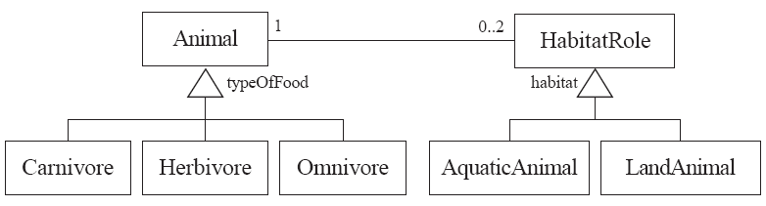
Player-Role
Example 1:

Slide 167
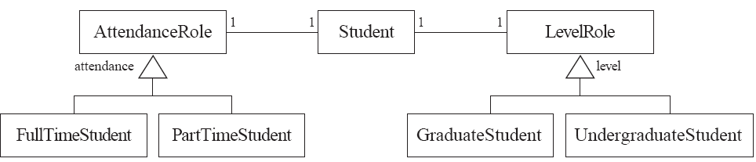
Player-Role
Example 2:

Slide 168
The Delegation Pattern
Context:
You are designing a method in a class
You realize that another class has a method which provides the required service
Inheritance is not appropriate
E.g. because the isa rule does not apply
Problem:
How can you most effectively make use of a method that already exists in the other class?
Forces:
You want to minimize development cost by reusing methods

Slide 169
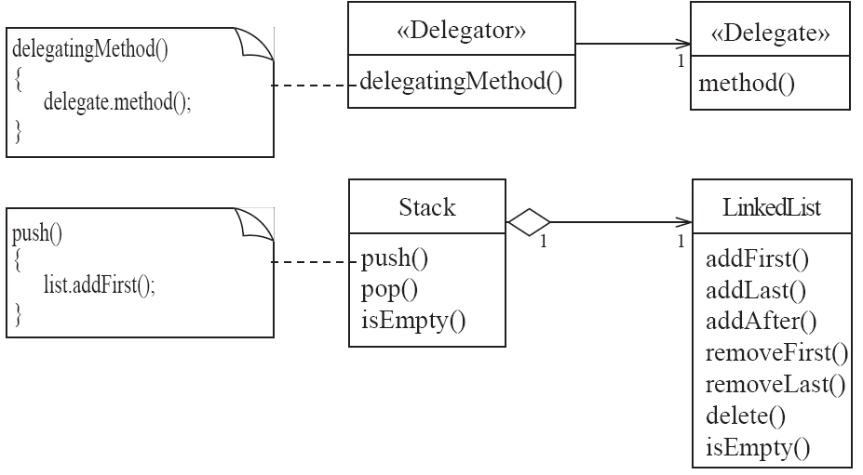
Delegation
Solution:

Slide 170
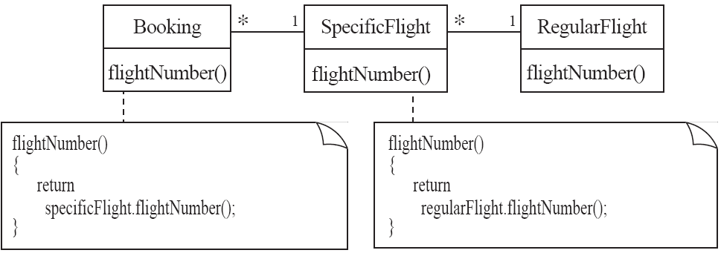
Delegation
Example:

Slide 171
The Immutable Pattern
Context:
An immutable object is an object that has a state that never changes after creation
Problem:
How do you create a class whose instances are immutable?
Forces:
There must be no loopholes that would allow ‘illegal’ modification of an immutable object
Solution:
Ensure that the constructor of the immutable class is the only place where the values of instance variables are set or modified.
Instance methods which access properties must not have side effects.
If a method that would otherwise modify an instance variable is required, then it has to return a new instance of the class.

Slide 172
The Read-only Interface Pattern
Context:
You sometimes want certain privileged classes to be able to modify attributes of objects that are otherwise immutable
Problem:
How do you create a situation where some classes see a class as read-only whereas others are able to make modifications?
Forces:
Restricting access by using the public, protected and private keywords is not adequately selective.
Making access public makes it public for both reading and writing

Slide 173
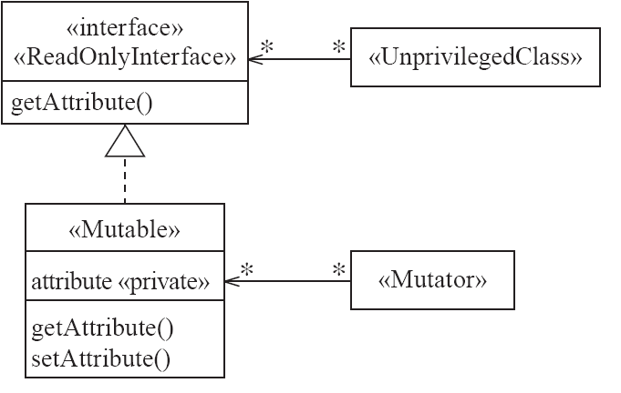
Read-only Interface
Solution:

Slide 174
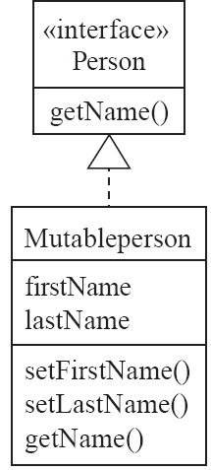
Read-only Interface
Example:

Slide 175
Using the observable layer
1. Create a class that implements the Observer interface.
2. Register it as an observer of the Observable:
public MessageHandler(Observable client)
{
client.addObserver(this);
...
}
3. Define the update method in the new class:
public void update(Observable obs, Object message)
{
if (message instanceOf SomeClass)
{
// process the message
}
}

Slide 176
Dirk Riehle’s experience in using patterns
In three companies: UBS, Skyva, Bayave
Five projects
Dominant use: communication between developers
Second use: implementation of software
Third use: documentation
Misconceptions: a design pattern is not a design or code template

Slide 177
Doug Schmidt use of patterns
A Family of Design Patterns For Flexibly Configuring Network Services in Distributed Systems. Proceedings of the International Conference on Configurable Distributed Systems, Annapolis, Maryland, May 6--8, 1996. This paper describes a family of design patterns that enhance the flexibility and extensibility of communication software by permitting network services to evolve independently of the strategies used to passively initialize the services. The paper focuses on how the implementation of the Acceptor pattern in ACE was improved by applying patterns from ``Gang of Four'' Design Patterns Catalog such as Factory Method, Strategy, Bridge, and Abstract Factory.
Experience Using Design Patterns to Develop Reusable Object-Oriented Communication Software. Communications of the ACM (Special issue on Object-Oriented Experiences), October 1995, ACM.This paper summarizes the lessons learned while applying a design pattern-based reuse strategy on production large-scale distributed communications systems.
Experience Using Design Patterns to Evolve Communication Software Across Diverse OS Platforms. Proceedings of the 9th European Conference on Object-Oriented Programming held in Aarhus, Denmark on August 7-11, 1995. (with Paul Stephenson) This paper documents experience gained using design patterns to port systems software between UNIX and Windows NT on a telecommunication switch management project at Ericsson/GE Mobile Communications.

