Slide 1
Chapter 8 Non-Functional Requirements

Slide 2
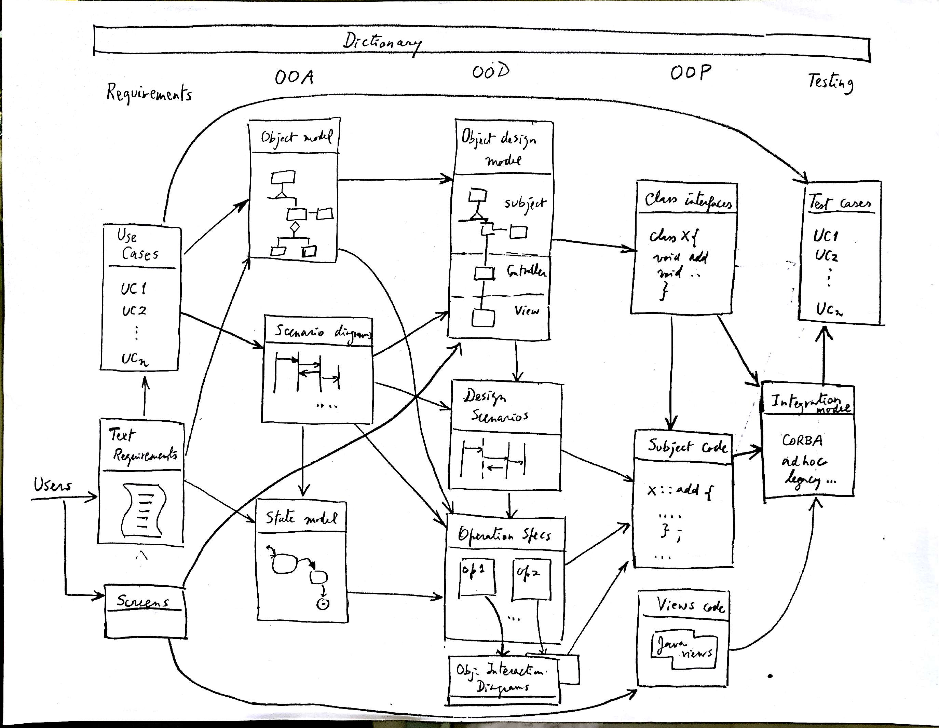

Slide 3
Assignment 2
The attached figure describes a modified model of the Port of Assignment 1 (no Company but Location). We want to extend this conceptual model by adding patterns to describe a software implementation. We need to add the following functions:
F1:Operators who can also be Location Assigners for containers
F2: Operators can control cranes remotely using an appropriate interface, which can be in any language
F3: Ship and container information will be stored in a database that has its own interface different from the names used in this model
F4: Warehouses have nested locations: sections within sections, which can be simple or composite.
F5: We are dealing with only one port and there should be only one instance of it in the model
F6: Some containers have fragile contents and need to be handled differently
F7:Tug boats are assigned to incoming ships to guide them to their berths
F8: Operators indicate malfunctions in a centralized repository
Show new classes in color or with double borders. Break up the model if needed for visibility.

Slide 4
Port
1
*
ShipStay
*
1
Ship
name
load/unload
stayAt
name
location
date
country
1
Responsible
For
*
*
*
*
Operator
Crane
Warehouse
Container
id
id
id
id
name
max_weight
size
*
*
*
weight
qualifiedFor
*
1
Location
number
1
storedAt

Slide 5
Assumptions
The same tugboat is assigned to a ship for arriving and leaving
The berths are part of the port and we don’t keep track of them
We ignore interfaces to the repository
Container type is only known at run time

Slide 6
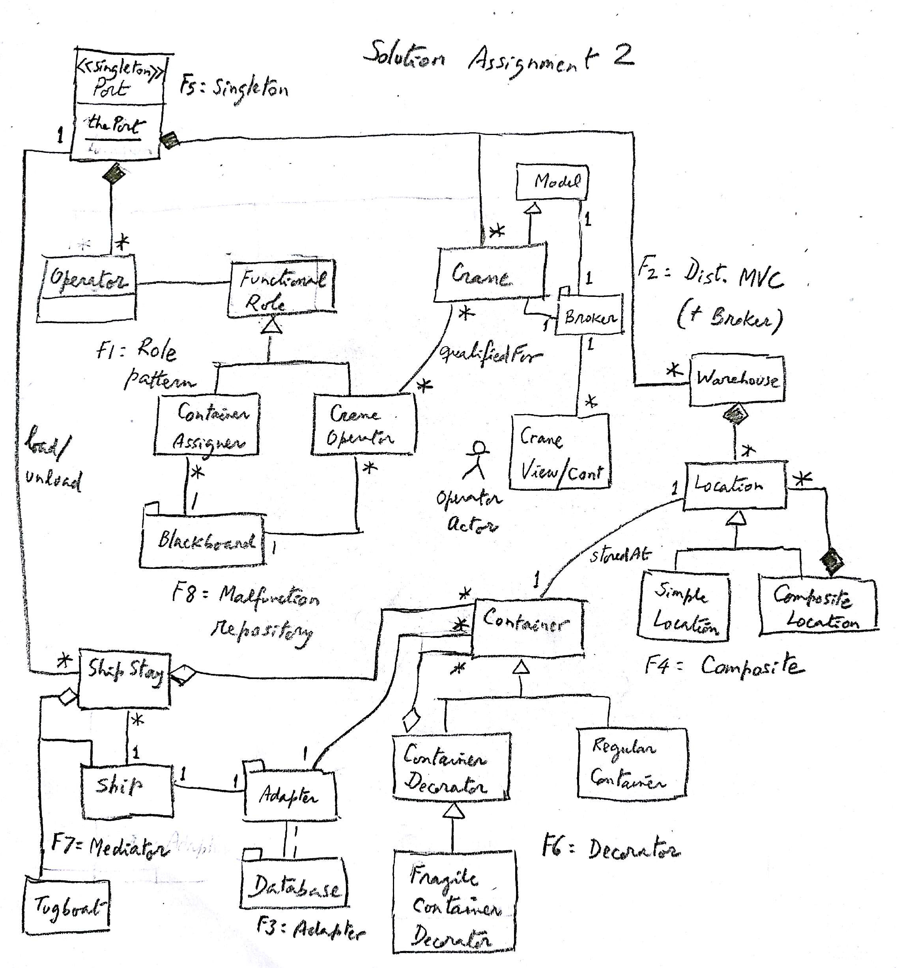

Slide 7
Value of information
We rely on information for our credit, health, professional work, business, education,…
Data is valuable for individuals and institutions
This value attracts criminals, terrorists, and vandals
Illegal access (reading, modification, or destruction) to information can produce serious problems

Slide 8
Do we have a problem?
Almost every week we have a major security incident.
Companies: Target, Sony (twice), Home Depot, Goodwill, JP Morgan, Chick-fil-A, Neiman Marcus, Michaels, Yahoo (twice)…
Government: IRS, DOE, OPM,…
Physical systems: German steel mill, Stuxnet
Medical systems and devices: several, e.g. Anthem
Point of sale: Target, Michaels, Home Depot, …

Slide 9
Costs of a data breach
An attack on Google cost that company about $500,000 in 2005.
In a recent study, the average cost of a data breach for a company was $3.75 M in 2014, and the average cost for each stolen or lost record was $154.
Done by Ponemon Institute, sponsored by IBM

Slide 10
The security problem
Unauthorized data disclosure (confidentiality or secrecy).
Unauthorized data modification (integrity). May result in inconsistencies or erroneous data. Data destruction may bring all kinds of losses.
Denial of service—Users or other systems may prevent the legitimate users from using their system. Denial of service is an attack on the availability of the system.
Lack of accountability—Users should be responsible for their actions and should not be able to deny what they have done (non-repudiation).

Slide 11
The meaning of security
Security implies providing these objectives in the presence of attacks
Security requires technical, managerial, and physical countermeasures (defenses)
We only consider technical aspects here
A related aspect is privacy, a legal and ethics concern

Slide 12
Countermeasures (defenses)
Identification and Authentication (I&A)—Identification is a user or system action where the user provides an identity. Authentication implies some proof that a user or system is the one he/it claims to be. The result of authentication may be a set of credentials, which later can be used to prove identity and may describe some attributes of the authenticated entity
Authorization and Access control (A & A)—Authorization defines permitted access to resources depending on the accessor (user, executing process), the resource being accessed, and the intended use of the resource. Access control requires some mechanism to enforce authorization
Logging and Auditing (L&A)—Implies keeping a log of actions that may be relevant for security. These functions can be used to collect evidence for prosecution (forensics) and to improve the system by analyzing why the attack succeeded.
Hiding of information—It is usually performed by the use of cryptography but steganography is another option.The idea is to hide the information in order to protect it.
Intrusion detection—Intrusion Detection Systems (IDS) alert the system when an intruder is trying to attack the system.

Slide 13
Basic secure architecture
Authentication must happen first
Authorization rules define what is allowed or not allowed (who can see what and how)
Lower architectural levels enforce authentication and authorization
Cryptography protects messages in transit and stored data, and provides non-repudiation and authentication
Logging for later auditing

Slide 14
Need for a holistic view
Need for a holistic view, not disjoint pieces. Disjoint mechanisms cannot prevent threat that are combinations of legal actions
Security should be based on institution policies
Methods based on local protection, e.g., cryptography , are very important to enforce the high-level restrictions but are not adequate in isolation.
Code-based security is incomplete, security is a systems problem
Notes:
Without institution policies security is hopeless. In that case security will become a series of patches and isolated measures with enormous holes in between.
This is the case of many places now.

Slide 15
Related aspects
Assurance is a measure of the trust we put on a system as being able to provide the required degree of security
Risk analysis is the study of possible attacks and their impact in terms of money and time. We need it to perform some risk analysis in order to decide on the investment on systems and personnel to provide security. In particular, we need to enumerate the threats to the system to know how much effort and money we should invest to make the system secure
Governance refers to the responsibilities of the institution directors to define policies and regulations to handle their information. Typically directors focus on increasing the value of their assets but don’t pay much attention to their security.

Slide 16
Related topics
Reliability and fault tolerance—Controlling the effect of accidental errors (see Chapter 10)
Dependability—confidence that the system will follow its specifications
Survivability—ability to provide service in the presence of disruptions
Privacy—an individual right, not a technical issue, but enforced by technical means

Slide 17
Attacks and defenses
The generic attacks are realized in two basic ways: by direct attacks from a person trying to exploit a vulnerability or flaw in the system, or using malware, software that contains code that exploits one or more of these flaws
Security defenses may operate in one or more of three modes and we need to combine them:
Prevent or mitigate an attack. Prevention means completely stopping the attack while mitigation implies partial defense or reducing its effects
If we cannot stop or mitigate the attack, at least we should be able to know that an attack is happening, i.e., we should detect the attack. Detection is also useful to stop an attack because it can alert other mechanisms to take action
After the attack has happened we need to have ways to recover from its effects and analyze it so we can improve the system

Slide 18
Security environments or contexts
Early systems were isolated and single user --few security problems
Mainframes brought many users but we knew them (registered)—complexity and attacks increased
Distributed systems increased the problem by scattering the users

Slide 19
Environments II
The Internet opened up our systems to unknown users—exponential growth in attacks
Wireless devices increase the problem because of their number and ubiquity
The widespread use of sensors will make security even worse
The cloud brings new problems

Slide 21
Threats
We need to understand the threats to the system to decide how to defend it
Excess of security mechanisms results in loss of performance, extra complexity, and higher costs
The objective is to provide an appropriate defense according to the value of our assets

Slide 22
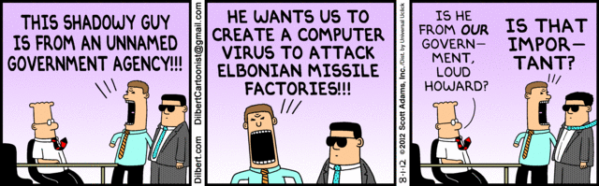

Slide 23
Types of Threats
Direct attacks to the operating system
Direct attacks to the database system
Directs attacks to the application
Denial of service
Almost no attacks to the messages in the network
Malware: Trojan horses, viruses, worms
Repudiation

Slide 24
Definitions
A vulnerability is a situation or state that may be exploited by an attack: code flaws, configuration errors, incorrect rules,…
A threat is a potential attack
An attack is an attempt to misuse the system
A defense (safeguard, countermeasure) is a way to block or reduce an attack
A misuse is a violation of a security property (confidentiality, integrity, availability)

Slide 25
Types of misuse
The outcome of a misuse can be loss of confidentiality or integrity, theft of services, or denial of service.
An attack has a perpetrator, who has a motivation or goal.
The attack has a method of operation to accomplish a mission with respect to a target (modus operandi).
The damage of a mission can be loss of assets, money, lives

Slide 26
Attackers
Insiders -- A good number of attacks to a system come from insiders
Hackers -- Usually try to show off their ability by penetrating systems
Spies -- Industrial or government espionage
Organized crime—a large number of attacks
Terrorists—attacks to infrastructure systems

Slide 27
Attack stages
Preparation—Information gathering, scanning, planting malicious code, masquerading (spoofing)
Activation—perpetrator-controlled, timed, victim activated
Mission—active (affects integrity and availability), and passive misuse (eavesdropping, inference), denial of service

Slide 28
Attack stages
<<actor>>
:Attacker
target1:
:Data
target2:
prepare Attack
activate Attack
read
modify/destroy
propagate

Slide 29
Distributed Denial of Service (DDoS)
The Attacker penetrates a system as an operations base
From there, other systems are penetrated and special programs are inserted, these systems become slaves or zombies or bots
The attacker commands the slaves to send streams of messages to the victim clogging its web site

Slide 30
Distributed Denial of Service attack

Slide 31
Why possible?
Poor security in many sites (OS flaws, weak passwords…)
Poor configuration control
Features of TCP/IP protocol: 3-way handshake to assign connection numbers, handling of very long or very short packages (SYN-flooding)
Echo mode in UDP

Slide 32
Big DDoS Attack http://www.nytimes.com/2016/10/22/business/internet-problems-attack.html?action=click&contentCollection=Movies&module=Trending&version=Full&region=Marginalia&pgtype=article
Major websites were inaccessible to people across wide swaths of the United States on Friday after a company that manages crucial parts of the internet’s infrastructure said it was under attack.
Users reported sporadic problems reaching several websites, including Twitter, Netflix, Spotify, Airbnb, Reddit, Etsy, SoundCloud and The New York Times.
The company, Dyn, whose servers monitor and reroute internet traffic, said it began experiencing a distributed denial-of-service attack just after 7 a.m. Reports that many sites were inaccessible started on the East Coast, but spread westward in three waves as the day wore on and into the evening.
The attack appears to have relied on hundreds of thousands of internet-connected devices like cameras, baby monitors and home routers that have been infected — without their owners’ knowledge — with software that allows hackers to command them to flood a target with overwhelming traffic.

Slide 33
More http://www.bbc.com/news/technology-37738823
Security firm Flashpoint said it had confirmed that the attack used botnets infected with the "Mirai" malware.
Many of the devices involved come from Chinese manufacturers, with easy-to-guess usernames and passwords (often “admin” or “12345” or even, yes, “password”) that cannot be changed by the user - a vulnerability which the malware exploits.
Mirai scours the Web for IoT (Internet of Things) devices and then enlists the devices in attacks that hurl junk traffic at an online target until it can no longer accommodate legitimate visitors or users.
The owner of the device would generally have no way of knowing that it had been compromised to use in an attack.

Slide 34
New way to attack and new targets
DDoS attacks are typically aimed at a single website. Friday's attack on Dyn, which acts as a directory service for huge numbers of firms, affected several of the world's most popular websites at once.
The use of internet-connected home devices to send the attacking messages is also a relatively new phenomenon, but may become more common.
The Mirai software used in these attacks was released publicly in September - which means anyone with the skill could build their own attacking botnet.
Jeff Jarmoc, head of security for global business service Salesforce, pointed out that internet infrastructure is supposed to be more robust:
"In a relatively short time we've taken a system built to resist destruction by
nuclear weapons and made it vulnerable to toasters,"

Slide 35
http://www.nytimes.com/2016/10/23/us/politics/a-new-era-of-internet-attacks-powered-by-everyday-devices.html?hp&action=click&pgtype=Homepage&clickSource=story-heading&module=first-column-region&region=top-news&WT.nav=top-news&_r=0
Such assaults are the reason so many companies are pushing at least parts of their infrastructure to cloud computing networks, to decentralize their systems and make them harder to attack.

Slide 36
Malicious code
Trojan Horses—A Trojan Horse is an apparently useful program that has harmful hidden functions
Viruses – A virus is a program that attaches itself to another program, propagates, and usually causes some data destruction.
Worms—A worm is a program that propagates itself without infecting the host.

Slide 37
More varieties
Spyware—collect passwords, credit card numbers, or general info. (adware)
Spam—wholesale sending of messages, can be used to propagate viruses
Phishing messages—enticing users to disclose information

Slide 38
More varieties
Some malware are combinations of the basic types and can combine worms with spam or spyware, these are called blended threats
A zero-day attack is an attack that takes advantage of a vulnerability just discovered (maybe only by the hacker) and for which there is no patch or detection method yet.
Rootkit: Any software that takes control of an operating system, allowing illegal administrative functions. They alter parts of the operating system kernel and hide their presence.
A bot or zombie is a computer that can be controlled by another through the introduction of a Trojan Horse or another type of malware.

Slide 39
Threat/Misuse patterns
Describe threats and misuses from the point of view of the attacker.
They use sequence diagrams (and more) to describe how an attacker performs a misuse, they describe attack scenarios
The pattern tries to show how the attacker works (modus operandi) so we can apply defenses to stop it
The objects in the sequence diagram represent architectural units of the target system
A misuse pattern indicates what security mechanisms are needed as countermeasures and where to collect evidence of the attack.
We wrote some misuse patterns for clouds

Slide 40
Architectural layers
User interfaces
User Applications:
SaaS
financial manufacturing
student registration
DBMS
SQL
..
NoSQL
..
OS utilities Media Player Browser
PaaS
OS kernel
processes memory
device control file system
distribution middleware services
Networking
IaaS
Hardware: Processors Storage I/O devices

Slide 42
Assignment 3 (due April 16)
Continue with the class model of Assignment 2 (without the patterns).
We need to add security constraints such that crane operators must be authenticated and can only operate the cranes for which they are authorized. Write the constraints in OCL and show in the UML model how to enforce these constraints using views.
Add safety constraints in OCL such that cranes cannot carry containers that weigh more than their limits and cannot accelerate beyond their limits.
Write a Java or C++ program to load a container in a ship. Use the attached sequence diagram as a guide.

Slide 43
Port
1
*
ShipStay
*
1
Ship
name
load/unload
stayAt
name
location
date
country
1
Responsible
For
*
*
*
*
Operator
Crane
Warehouse
Container
id
id
id
id
name
max_weight
size
*
*
*
weight
qualifiedFor
*
1
Location
number
1
storedAt

Slide 44
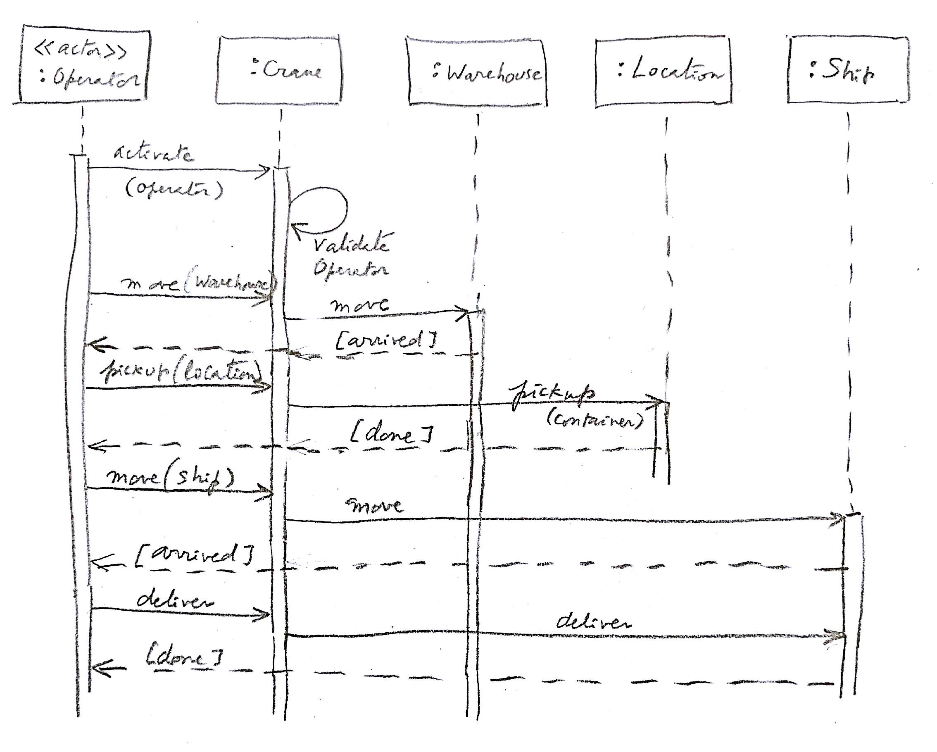

Slide 45
Policies
Institution policies
Security policies
Example

Slide 46
Need for policies
The policies of an institution define its way of accomplishing its objectives
Security policies define a way to protect its information applying principles
Without policies we don’t know what we should protect
Policies can be realized by tactics applied to the system architecture

Slide 47
Some security policies
Open/closed systems--In a closed system everything is forbidden unless explicitly allowed
Need-to-know (Least privilege)-- Give enough rights to perform duties
Information belongs to the institution versus private ownership
Authorization-- access types, small units of access

Slide 48
Security policies II
Obligation—What has to be done before accessing data
Separation of duty—Separate critical functions into parts to be done by different people or systems
Content-dependent access control—Access decision are based on the values of the data
Authenticate all transactions—needed for accountability and access control

Slide 49
Use of policies
Secure systems must be closed but sometimes open access to information is more important, e.g., libraries, data warehouses, …
The least privilege principle must be applied with an appropriate granularity, many attacks happen because of too many rights

Slide 50
Example of university policies
An instructor can look at all the information about the course he is teaching.
An instructor can change the grades of the students in the course he is teaching
A student may look at her grades in a course she is taking
The department head can add/delete course offerings
The registrar can add/delete students from course offerings
Faculty members can look at information about themselves

Slide 51
From policies to models
Models make precise the policy requirements
Models can be formal (based on mathematics) or semi-formal
UML is a semiformal model
It can be made more formal by using OCL (Object-Constraint Language)
We will see models for Authentication, Authorization, and Logging

Slide 52
Authentication
Before they can perform any activities in the system both users and systems must identify themselves and be authenticated.
Identification and Authentication (I&A) use some kind of protocol to establish identity.
I&A is the basis for authorization and for logging, it provides accountability.
Once verified, the system may provide a proof of authentication and a handle (reference) to the user’s account. For example, IBM’s z/OS provides an accessor environment element (ACEE), which follows the authenticated process during its execution
Approaches for authentication can be of four types:
Something the user knows. Passwords are the most common example of this type.
Something the user has. Typically a smart card.
Something the user is. A body feature of the user, e.g. her fingerprints, is used to authenticate the user.
Where the user is. The location of the user is enough to grant him access.

Slide 53
More secure authentication
Smart cards, where a card with some processing power is used to establish the connection. Smart cards use a PIN provided by the user and other information such as date, time, or name of the user to send an encrypted message to the system (typically some Authentication Server). Only if the system can decipher the message the user is connected.
The card must be tamper-resistant to prevent a person who steals the card from finding the PIN in the card. Given that these cards have a significant amount of memory there have been proposals about including in them financial, health, and employment information about their owners, although this may bring additional privacy problems [She02]. Passports are another example.
Biometrics. This is the use of some unique personal characteristic, e.g., fingerprints, retina scan, face contour, face recognition, signature dynamics [Jai00]. This can be a more secure approach but it is more expensive and slower than the other two [Mil94].
Fingerprint recognition security has been put in doubt, people leave their fingerprints in many places and gummy fingers appear to fool most systems [Mat02].
After September 11 this approach has become considerably more popular. This popularity has also been helped by the lower cost of some of these approaches.

Slide 54
Authentication hierarchy

Slide 55
Class diagram of Authenticator

Slide 56
Authenticating a user

Slide 57
Authorization and Logging
After a user is recognized as a legitimate user she is admitted to the system.
For the user to access specific resources (memory, files, I/O devices) or data items she needs authorization rights.
For every access (read or writes) to data a Logging system records the data item accessed, the time, the type of access, and the user who performed the access.
The log can be audited later to check the proper use of the data.

Slide 58
Classification of authorization models
Multilevel --users and data are assigned security levels
Access matrix -- subject has specific type of access to data objects
Mandatory --access rules defined only by administrators
Discretionary -- users own data and can grant access to other users

Slide 59
Access matrix authorization rules
Basic rule ( s, o, t ) , where s is a subject (active entity), t is an access type, and o is an object
Extended rule ( s, o , t , p,f) , where p is a predicate (access condition or guard) and f is a copy flag
This, and the other models, can be described by OO patterns

Slide 60
Authorization pattern

Slide 61
Authorization mapping

Slide 62
Reference Monitor
Each request for resources must be intercepted and evaluated for authorized access
Abstract concept, implemented as memory access manager, file permission checks, CORBA adapters, etc.

Slide 63
Reference Monitor idea

Slide 64
Enforcing access control

Slide 65
Role-Based Access Control
Users are assigned roles according to their functions and given the needed rights (access types for specific objects)
When users are assigned by administrators, this is a mandatory model
Can implement least privilege and separation of duty policies
Reduces number of rules

Slide 66
Basic RBAC pattern

Slide 68
Multilevel model
In this model users and data are assigned classifications or clearances
Classifications include levels (top secret, secret,…), and compartments (engDept, marketingDept,…)
For confidentiality, access of users to data is based on rules defined by the Bell-LaPadula model, while for integrity, the rules are defined by Biba’s model
3/30/2017
68

Slide 69
Summary of models
Most commercial systems use RBAC: Oracle, DB2, Apache, Windows, Solaris,…
Access matrix is useful for specialized applications with not many users
Multilevel models are only used in very-high security systems and to structure software

Slide 70
Security Logger and Auditor
Intent
How can we keep track of user’s actions in order to determine who did what and when?
Log all security-sensitive actions performed by users and provide controlled access to records for Audit purposes.
Variants
Most systems have a System Logger, used to undo/rollback actions after a system crash. That type of Logger has different requirements but sometimes is merged with the Security Logger [SAP01]. System logs are of interest to system and database administrators, while security logs are used by security administrators, auditors, and system designers.
Another variant could include the automatic rising of alarms by periodic examination of the Log, searching records that match a number of rules that characterize known violations. For example, Intrusion Detection Systems use this variant.
We can also add logging for reliability, to detect accidental errors.

Slide 71
Class diagram of Logger/Auditor

Slide 72
Databases
Databases are the persistent storage of the system
They are the most critical part of the system in that information is a basic asset of an institution
Because of that they are the final target of hackers
An attacker looking for money can get millions of data items that can be used or sold
A terrorist can disrupt may activities by modifying a database
A cloud may contain many databases for different institutions and it is a big target

Slide 73
Security in DBMSs
In most cases, a DBMS is implemented on top of an operating system and relies on its security features
Low level security issues such as: protection of memory buffers, or separation between various threads of control are delegated to the OS, and the DBMS is not concerned with them
In addition, most DBMSs rely on the OS for user authentication, although some products (e.g. Oracle) provide their own authentication methods.

Slide 74
Views
A view enables users (or groups of users) to access only a portion of the database, thus providing both convenience and security
A view also enables conversion of logical data types into language-dependent data types depending on the host language in which the view is embedded
In all SQL based systems, a view can be defined using the standard SQL syntax.
Since all SQL syntax is available to the definer of a view, a view may be very complex.
It's important to note though that a view is only a "window" on the database, and does not exist as a physical table. Thus the view has to be retrieved with every access, and therefore is always up-to-date.

Slide 75
Privileges (rights)
Select - the right to read all columns of the object, including columns added later by an SQL Alter Table command.
Insert - the right to insert new values (tuples) into all columns of the object. If the object is a View, restrictions apply on what can be inserted, but this is dependent on the view definition and not on the authorization.
Update - the right to update all columns of the object with options similar to those of Insert.
Delete - the right to delete rows from an Object. In addition, there are two new privileges:
Usage - the right to use the current definition in other definitions.
Reference - the right to use the object in specifying Integrity constraints of other objects. Again, a specific column may be specified.

Slide 76
Transmission of information
To send information to other sites we set up a communication channel
The messages in transit can be attacked and must be protected
The usual way to protect messages is through cryptography
Cryptography is also useful to protect databases and for authentication

Slide 77
Secure Systems Research Group Talk Wednesday, March 29, EE405, 2:00-3:30
“Towards a Security Reference Architecture for Cyber-Physical Systems”,
Virginia Romero
Abstract–Cyber Physical Systems (CPS) are physical entities whose operations are monitored, coordinated, controlled and integrated by a computing and communication core. Security for these systems requires solutions that are robust to threats, especially when securing critical infrastructures. Secure systems need to be built in a systematic way, where security and safety are not just add-ons or built in a piece-meal fashion but are able to handle their complexity in a safe and secure holistic way. All lifecycle stages and all architecture levels need to be considered. The only way to provide this unification in the presence of a myriad of implementation details of the component units, is to use abstraction. In particular, we can apply abstraction through the use of patterns and Reference Architectures (RA). The use of Reference Architectures and patterns is a powerful way to organize and describe security and other non-functional aspects and they have the potential to unify the design of the computational, communication, and control aspects of CPSs. In this talk we provide a survey of the current CPS Reference Architectures that will be used as a preamble to define a threat model and a Security Reference Architecture (SRA) to build safe and secure CPS systems.
Virginia Romero is a PhD candidate in the College of Engineering and Computer Science at Florida Atlantic University. She has a MS in Computer Engineering from Florida Atlantic University and a BS in Computer Science from The University of Tennessee. She is an experienced project manager with over fifteen years dedicated to research and analysis, resource management, budgeting, forecasting and project team coordination for different technology areas for Techno-Transfers of Florida, her own computer consulting firm. Previously, she worked for IBM, Honeywell and Siemens as a Research and Development Software Architect, she designed, implemented, managed, reviewed and provided technical guidance for all stages of the software development cycle, from requirements to design, to implementation to testing through system integration and customer support.

Slide 78
Trip next week
Vancouver, BC, Canada
IEEE Int. Conf. on Cloud Engineering (IC2E) 2017, April 4-8, 2016.
Present tutorial on security patterns to build cloud systems
Classes will be taught by Madiha Syed, PhD Candidate
She will cover Implementation in Java

Slide 79
Cryptography
Cryptography is the study of message concealment
Cryptanalysis is the study of how to discover the encrypted message.
Cryptology includes both
Cryptanalysis is difficult and requires good mathematical knowledge, so you don’t see many hackers trying to break codes. The equivalent to hackers are now scientists employed by a government or organized crime.

Slide 80
Cryptography value
Authentication—Can authenticate the identity of users, transactions, and systems.
Protection of messages—Can protect the secrecy of a message and prevent illegal modification. Cannot protect against destruction of the message.
Protection of software and data—Can protect the confidentiality of them although not avoid their destruction. For example, passwords can be encrypted.

Slide 81
Cryptography value II
Digital signatures—Can authenticate the origin of a message.
Nonrepudiation—A user that signed or otherwise authenticated a document using cryptography cannot deny having sent it.

Slide 82
Certificates
To make sure that public keys are valid, and to prevent the "man in the Middle" attacks, one uses the notion of Certificates. Certificates use the following principles: The public keys are normally registered with a certification authority (CA). This authority distributes certificates, which are public keys with the signature of the CA. There are authentication and attribute certificates. Attribute certificates assert that certain properties are true of the owner of some authentication certificate. Attribute certificates are also used in SSL and other protocols.

Slide 83
Certificate contents
Version – which version of the standard
Serial number – unique, used for Revocation
Algorithm Id – which algorithm is used for the signature
Issuer – the CA issuing the certificate
Period of validity
The subject – attributes describing the subject (name, position, etc.)
Public key – of the subject
Signature – of the above by the private key of the CA

Slide 84
Networks
Networks provide communication with other nodes
Usually networks are used to remotely attack a node but there can be also insider attacks
Messages in transit can be attacked although they are a meager booty for an attacker
We need to build secure channels between nodes to avoid these attacks
Usually we defend with crytography

Slide 85
Secure channels
3/30/2017
85

Slide 86
IPsec
IPsec defines security protocols for the IP layer and can be used with TCP or UDP. It provides for confidentiality, authentication, and key management. It can also be used to build VPNs (see later).
Its advantages include being transparent to applications and to users because it is below the transport layer.
Two protocols provide security: an authentication protocol using the message header (AH) and an encryption/authentication protocol, the Encapsulation Security Payload (ESP).

Slide 87
SSL/TLS
SSL (Secure Sockets Layer) was developed by Netscape to provide message con­fidentiality and integrity. SSL has now been replaced by TLS (Transport Layer Security) which is standardized by the IETF.
Both SSL and TLS are transport layer subprotocols: They encrypt the traffic between two communicating applications. SSL/TLS is positioned just above TCP. In many cases it is used to encrypt communication between a Web browser and a Web server.
However, its application is not restricted to the Web — in principle it is possible to use it between any two parts of a communicating application. It is, for example, also often used between an email client and an email server
SSL/TLS is a two-layer protocol. The SSL/TLS Record Protocol is responsible for encryption between the two endpoints of the communications channel. The SSL/TLS Handshake Protocol authenticates the parties who will be communicating, and negotiates an encryption algorithm and keys to use during communication.

Slide 88
TLS (SSL) protocol pattern

Slide 89
Boundary
We can protect our node by placing boundary mechanisms
Firewalls filter traffic
Intrusion Detection Systems alert the system to ongoing attacks

Slide 90
Firewalls
Firewalls control access from networks to internal systems (boundary protection)
Network layer firewall (packet filter) --analyzes packets
Application layer firewall -- uses application proxies
Stateful firewall-- keeps the state of connections
3/30/2017
90

Slide 91
Network layer firewall
3/30/2017
91

Slide 92
Application (Proxy) layer firewall
Uses security proxies to represent services
A variety of the Proxy pattern
Prevents direct access to ports
Analyzes application commands
Keeps logs for later auditing
Poor scalability
Complex if no proxies are available
3/30/2017
92

Slide 93
Application layer firewall
3/30/2017
93

Slide 95
Intrusion Detection Systems (IDSs)
Statistical anomaly detection --based on profiles of normal user and system behavior. Events that deviate from this behavior are considered suspicious. The profiles are built from past audit logs.
Rules-based detection -- based on sequences of events (attack signatures), that correspond to known types of attack.
3/30/2017
95

Slide 97
Use of IDSs
Only alert of attacks, cannot stop them
Cannot detect some types of attacks
Based on “normal” behavior (hard to define, many false positives) or “complete” catalog of attacks (needs constant update)
3/30/2017
97

Slide 98
Secure software development lifecycles
We must use a secure development cycle to build applications
Microsoft introduced their SDL a few years ago with good results. The apply it to all their products. Based on code checking to detect vulnerabilities.
Adobe, Cisco, and others have their own secure methodologies
Several research projects use model-driven security, e.g. UMLSec, Secure UML, Secure Tropos, Eduardo Fernandez-Medina,…
We produced a secure development methodology based on patterns
We have a catalog of about 100 patterns, given as a tutorial in conferences and short courses in universities
Extension to reliable systems

Slide 99
Secure systems development methodology
Apply security principles throughout the whole software lifecycle
Use of object-oriented design and RBAC
Use cases define rights for roles
Patterns build a secure conceptual model
Multilayer architecture extends the model to the lower architectural levels

Slide 100
Secure lifecycle

Slide 101
Use patterns at all levels
Patterns for models define the highest level
At each lower level we refine the model patterns to consider the specific aspects of each level
Patterns for file systems, web documents, cryptography, distributed objects, J2EE components
Code may need verification but the design controls most of their bad actions

Slide 102
Trip next week
Vancouver, BC, Canada
IEEE Int. Conf. on Cloud Engineering (IC2E) 2017, April 4-8, 2016.
Present tutorial on security patterns to build cloud systems and participate in Containers workshop
Classes will be taught by Madiha Syed, PhD Candidate
She will cover Implementation in Java

Slide 103
Cloud ecosystems
Ecosystems were initially defined from a biological perspective: systems formed by the interaction of a community of organisms with their physical environment
The term was later applied to software systems: “a collection of software systems, which are developed and co-evolve in the same environment”
Another definition: the expansion of a software product line architecture to include systems outside the product which interact with the product
An ecosystem is advantageous to suppliers who can offer a larger variety of products or services, and to consumers who can find more products to help them reach their business goals
Several companies are developing ecosystems around their products, e.g. Cisco, Apple, and Microsoft.
In cloud ecosystems their complementary systems may not be produced by the same vendor and may use different protocols although able to interact with other products in the ecosystem.

Slide 104
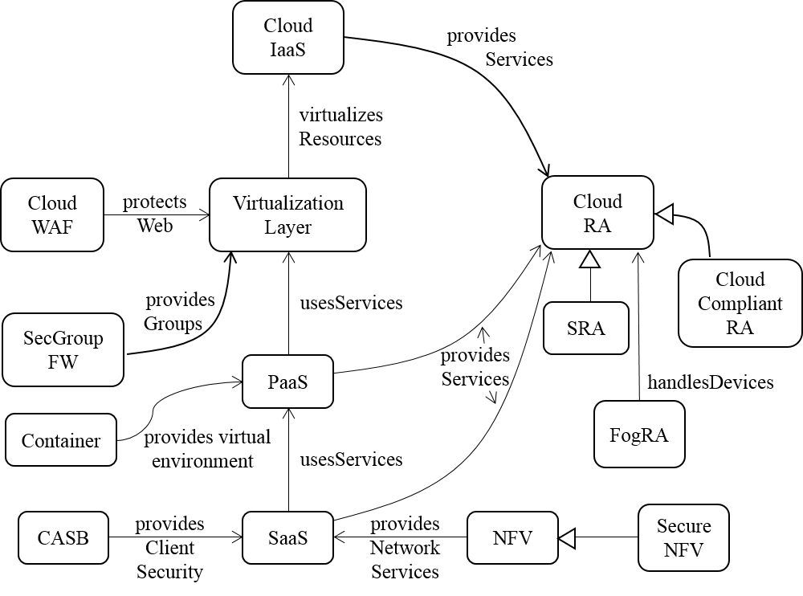
Pattern Diagram of Cloud Ecosystem

Slide 105
The core pattern of this ecosystem is the Cloud Reference Architecture (Cloud RA) .
Addition of security patterns to a Cloud RA converts it into a Cloud Security RA (Cloud SRA). The Cloud SRA includes security patterns for Authentication, Authorization, and Logging, among others, which can help control known threats to the cloud
Patterns that describe how regulations apply to the Cloud RA are included in the Cloud Compliant RA
Other components of the ecosystem include the service layers of a cloud, IaaS, PaaS and SaaS .
Network Functions Virtualization (NFV) is a network architecture where network functions are provisioned in software using virtualization.
Filtering functions are provided by Cloud Web Application Firewalls (Cloud WAF) and Security Group Firewalls (SecGroup FW).
Cloud Access Security Brokers (CASBs) are security enforcement points between consumers and service providers that apply security controls to access cloud services, usually SaaS services.
Recent entities that have been added to this ecosystem include containers and fog computing.

Slide 106
Reference architectures
A Domain Model (DM) is a model of an area of knowledge, e.g. financial systems, and has no software concepts
A Reference Architecture (RA) is a generic architecture, valid for a particular domain, with no implementation aspects. It is reusable, extendable, and configurable
It is a kind of pattern for whole architectures and it can be instantiated into a specific software architecture by adding implementation-oriented aspects.

Slide 107
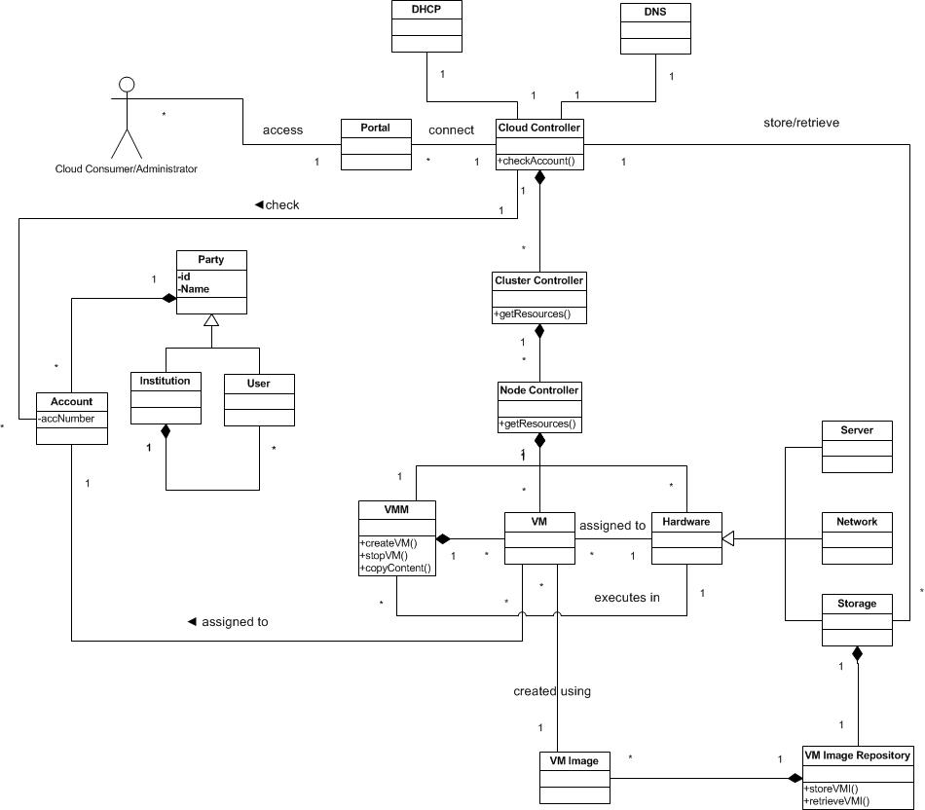
Class Diagram for Infrastructure-as-a-Service architecture

Slide 108
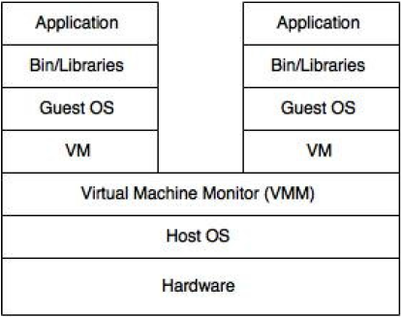
Software Container
Intent: A Software Container provides an execution environment for applications sharing a host OS, binaries, and libraries with other containers with strong isolation between them.
Containers are lightweight, portable, extensible, reliable, and secure.
Docker is a popular example of software containers.
Figure 1. “Two containers sharing one OS” vs “A Virtual machine”

Slide 109
Class Diagram for Software Container

Slide 110
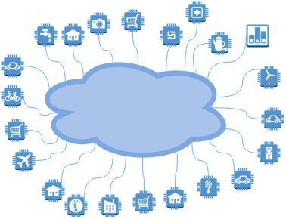
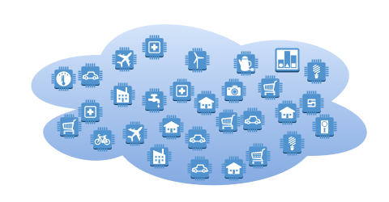
Internet of Things - Cloud

Slide 111
Internet of Things (IoT)
Tagged objects that communicate through the Internet
Users can query their status and even control them
Physical objects can be part of applications
Examples: smart homes, wireless patient care, transportation systems,…
Large amounts of real-time information
Preprocessing usually needed

Slide 112
Problem Domain
Cloud Ecosystems
Internet of Things
Security and Privacy
Security Issues in Fog Computing
Fog Computing

Slide 113
Internet of Things and Fog Computing
IoT applications require low latency, mobility support, location awareness and support for geo-distribution.
Popularity of IoT has made the limitations of clouds more apparent, We need new solutions.
Fog computing offers one of such solutions.
It complements rather than replaces the cloud.
Cisco fog computing solutions, Amazon Web Services (AWS) Amazon IoT cloud service, IBM IoT solutions for analytics.
Numerous papers discuss these IoT applications in connection to fog computing. Ours is the first pattern for fog computing.
Containers are also providing more lightweight, portable virtualization solutions that will offer support for IoT applications.
Notes:
Cloud computing has established itself as a promising computing paradigm. However, the recent p

Slide 114
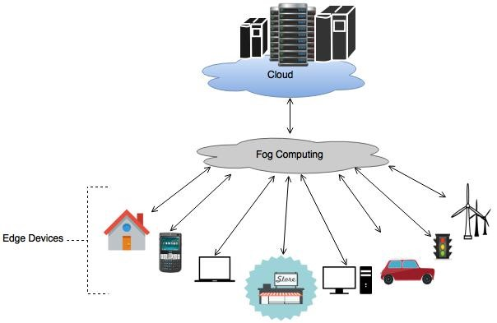
Fog Computing
Intent Fog Computing is a virtualized platform that stands between cloud computing systems and Internet devices, providing to these computation, storage, and networking services and allowing a cloud to control and communicate with these devices.
Fog can offer low latency, location awareness, efficient use of bandwidth and storage services.
Cisco provides fog computing platforms
Figure 3: Idea of Fog Computing

Slide 115
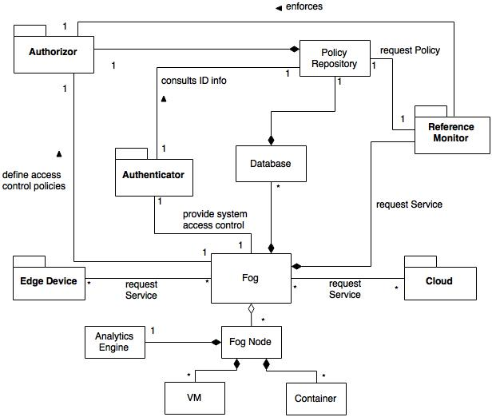
Class diagram of the Fog Computing pattern

Slide 116
Value of Cloud ecosystems
Can control heterogeneity
Can provide a holistic and unified security view
Analyzing security aspects of an ecosystem, use it to answer several security questions
Starting with security in fog controlling variety of devices
Lack of unified view can make integration of systems, each with its own security policies, very challenging
Compliance with standards and regulations
Support for software development
Agile software development framework, DevOps which is enabled by cloud
Notes:
Containers facilitate application distribution, especially for DevOps teams.
It calls for increased communication, collaboration and smooth integration between developers and operations teams. It enables continuous development and frequent releases of software to the end user, which can lead to earlier problem detection and solution delivery.
DevOps is driven by the wide availability of virtualized and cloud infrastructure.

Slide 117
Compliance
Compliance is the application of rules designed to enforce standards based on established laws, regulations, specifications, and best practices
The complexity and the number of standards are increasing with the advancement of technologies and consumer needs.
Compliance varies from country to country. In most cases, they share almost identical rules and regulations customized to their local needs.

Slide 118
Compliance II
Compliance may require the use of multiple IT attributes such as confidentiality, integrity, availability, reliability, and accountability
Compliance comes with a high cost of implementation and maintenance.
Failing to comply could result in penalty fees, lawsuits, and bad business reputation
There are a number of standards such as PCI DSS, HIPAA, GLBA, SOX, European Union Data Privacy and many others

Slide 119
Standards and regulations
HIPAA (Healthcare Insurance Portability and Accountability Act) is a standard for individuals’ protected health information(PHI). It requires covered entities(i.e. health care providers) to protect privacy and security of PHI.
PCI-DSS (Payment Card Industry Data Security Standard) is an information security standard to improve the security of financial transactions related to debit, credit, prepayments, e-purse, ATM, and POS cards.

Slide 120
Standards and regulations II
GLBA (Gramm-Leach-Bliley Act) is a standard that requires financial institutions that offer consumers financial products or services to develop, implement, and maintain a compressive information security program that protects the privacy and integrity of customer records.
SOX (The Sarbanes-Oxley Act) is a standard to protect shareholders and the general public from accounting errors and fraudulent practices in the enterprise. It defines which records needs to be stored and for how long. It doesn’t define how business should store records.

Slide 121
Standards and regulations III
COBIT (Control Objectives for Information and related Technology) is designed to provide management and business process owners with an information technology (IT) governance model that helps in delivering value from IT and managing the risks associated with IT
ISO/IEC 27000 family of standards helps organizations to keep information assets secure.
ISO/IEC 27001 –Information security management systems requirements
ISO/IEC 27002 – Code of practice for information security controls
ISO/IEC 27003 –Information security management system implementation guidance
ISO/IEC 27004 - Security techniques -- Information security management

Slide 122
Standards and regulations IV
NIST-53(National Institute of Standards and Technology - 53) is a standard on security and privacy Controls for Federal Information Systems and Organizations. NIST-53 is very similar to ISO/IEC 27002 but specific to government offices and agencies
FISMA (Federal Information Security and Management Act) is a standard to maintain security requirements and controls in all federal agencies

Slide 123
Example: Medical information
Medical information is very sensitive and must be protected.
In addition to the medical personnel, there are various actors involved in handling this information.
The organization and access control of the private medical information of each individual is complex and fragmented.
To provide guidelines for the protection of these records many countries, including the US, are enacting laws that regulate the use of electronic patient records.
The British Medical Association in 1996 put strong controls on UK patient records. In the US, the Health Insurance Portability and Accountability Act (HIPAA) does similarly.

Slide 124
HIPAA
Title II of HIPAA, known as the Administrative Simplification (AS) provisions, requires the establishment of national standards for electronic health care transactions and national identifiers for providers, health insurance plans, and employers.
The AS provisions also address the security and privacy of health data. The standards intend to improve the efficiency and effectiveness of the nation's health care system by encouraging the widespread use of electronic data interchange
The HHS has promulgated five rules regarding AS: the Privacy Rule, the Transactions and Code Sets Rule, the Security Rule, the Unique Identifiers Rule, and the Enforcement Rule.

Slide 125
Regulations overlap
HIPAA
SOX
GLBA

Slide 126
Reliability
A failure is said to occur in a system when the system’s environment observes an output from the system that does not conform to its specification. An error is the part of the system, e.g. one of its constituent (sub)systems, which is liable to lead to a failure. A fault is the adjudged cause of an error and may itself be the result of a failure. Hence, a fault causes an error that produces a failure, which subsequently may result to a fault, and so on.
An error class captures the cause for an error, the error can then manifest itself into a fault which is dealt with in the fault class. If the fault is not contained then it can manifest itself into a failure which is defined in the failure class. The pattern class handles failures when they occur. The pattern class defines the policies which are used to handle failures in the failure class.

Slide 127
A Metamodel for Reliability Concepts

Slide 128
Reliability
It is the ability for a system to follow its specifications
It is the probability that a system is working at time t2 knowing that it was working at time t1
Reliability is fundamental for safe-critical systems, where the lives of people could be endangered
Fault tolerance is being operational when some parts of the system are not functioning properly

Slide 129
Hardware and software reliability
Hardware faults are random and due to aging or physical disturbances
In the software reliability engineering community some believe that statistical models used in hardware reliability are useful as a measure of software reliability: the longer you run software, the higher the probability you will eventually use it in an untested manner and find a latent defect that results in a failure. Others believe that software faults are not random and statistical models are not appropriate; they use fault trees and similar tools to study software reliability
Hardware faults can be handled though redundancy, software faults require diversity (or very careful design)

Slide 130
Reliability mechanisms

Slide 131
Dependability
Ability to deliver service that can justifiably be trusted
Ability of a system to avoid failures that are more frequent or more severe, and outage durations that are longer than is acceptable to the user(s)
It usually includes reliability, availability, and safety, although some authors also include security
Survivability: the quantified ability of a system, subsystem, equipment, process, or procedure to continue to function during and after a natural or man-made disturbance.

Slide 132
Availability
Availability is the proportion of time a system is in a functioning condition.
It measures the up time of a system, the system is there when I need it
If there are short periods when the system is not working, availability can still be good
Availability is much more important than reliability for clouds, for airplanes it is the reverse

Slide 133
Safety
Safety is a property of a system that reflects the system’s ability to operate, normally or abnormally, without danger of causing human injury or death and without damage to the system’s environment.
It is important to consider software safety as most devices whose failure is critical now incorporate software-based control systems.
Safety requirements are often exclusive requirements i.e. they exclude undesirable situations rather than specify required system services. These generate functional safety requirements.
Safety is usually expressed using assertions: “The doors of an elevator cannot open when it is moving”

Slide 134
More terms
Monitoring: observe and check the progress or quality of (something) over a period of time; keep under systematic review. The objective is to ensure that a system is operating within an assured level of service by providing information about the operations and about the state of each component
Resilience is the ability to provide and maintain an acceptable level of service in the face of faults and challenges to normal operation. Threats and challenges for services can range from simple misconfiguration, to large scale natural disasters, or to targeted attacks

