Slide 1
Solutions to Final Exam COP5339
Object-Oriented Design
Spring 2017

Slide 2
Final Exam Question 1
Consider the model of the port using patterns of Assignment 2 (attached).
Write a Java or C++ program to transform Containers and Ships class interfaces into a relational database that has tables (relations): CARGO_UNIT, W_LOCATION, and VESSEL. Use an appropriate pattern in your code.
When a container arrives to the warehouse we must create a container object including all its relevant information (size, weight,…). We assign a location to this container. We then write this record to the database together with its corresponding location.

Slide 3
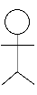
Port
The Port
*
Warehouse
*
Crane
Model
1
F5 = Singleton
*
*
*
1
Operator
Functional Role
F2 = Dist. MVC (+Broker)
Qualified For
1
Broker
1
F1 = Role Pattern
*
1
load / unload
Container Assigner
Crane Operator
*
*
Stored At
1
Location
*
*
*
Crane View/Cont.
F8 = Malfunction Repository
1
Blackboard
1
Operator
(Actor)
*
1
Ship Stay
*
Container
*
Simple Location
Composite Location
*
*
F4= Composite
1
1
Regular Decorator
Container Decorator
Ship
1
1
Adapter
F7= Mediator
1
F6= Decorator
1
Tugboat
1
1
Fragile
Container Decorator
Database
F3= Adapter

Slide 4
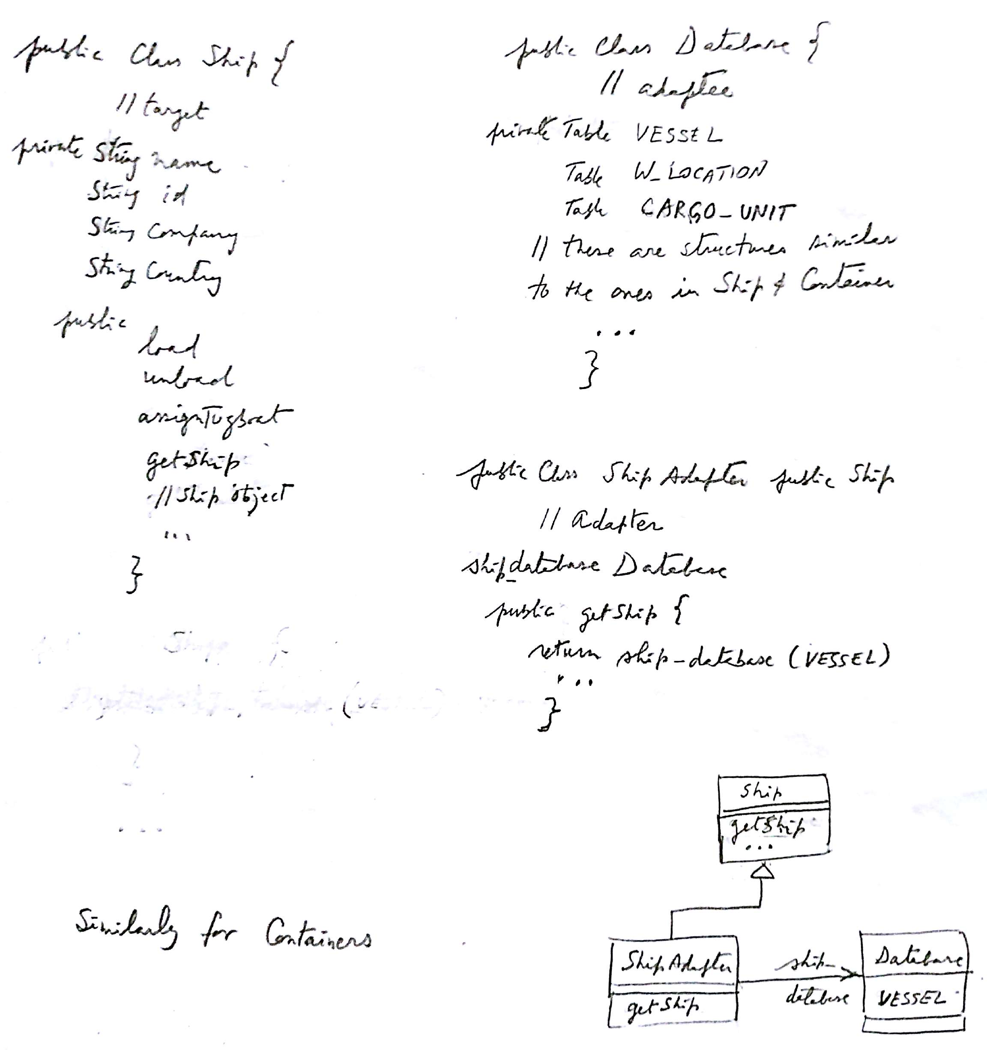

Slide 5
Question 2
Extend the UML class diagram of Q1 by:
1. Adding sensors to the warehouse locations and ships to detect when the crane has arrived.
2. Allowing different tugboats to be assigned to ships on arrival and departure.
3. Classifying cranes into Normal and Delicate Handling. The classes already in the model must not be changed, you can only add classes.

Slide 6
