Slide 1
COT 5612 Cloud Computing 2016 Ch 1: Introduction
Prof. Eduardo B. Fernandez
fernande@fau.edu
http://faculty.eng.fau.edu/fernande/

Slide 2
Course description
Cloud computing is concerned with the use and architecture of this new style of computation. We study the services provided by clouds, their internal structure, and their possibilities and limitations. We use UML as a language to describe architectures and patterns to help the design of software applications using clouds

Slide 3
Instructor
Dr. Eduardo B. Fernandez (Eduardo Fernandez Buglioni), Professor of CSE
Office hours: MW 1:00-3:45 (or by appointment)
fernande@fau.edu
http://faculty.eng.fau.edu/fernande

Slide 4
About me
Professor of Computer Science at Florida Atlantic University, Boca Raton, FL., USA, since 1983
At IBM for 8 years (L.A. Scientific Center).
Wrote the first book on database security (Addison-Wesley, 1981).
Author of many research papers
Consultant to IBM, Siemens, Lucent,…
Ing. Civil Elect. USM, MS EE Purdue U, PhD CS UCLA
Invited by Conicyt to USM, Feb. to Dec. 2013
Currently collaborates with Japanese, Chilean, Australian, and Spanish groups

Slide 5


Slide 7
Grading and textbook
45 % assignments (3)
55% final take-home exam.
Assignments and exam will include theoretical questions, research questions, and hands-on access to real clouds, Amazon and Microsoft.
Textbook: slides and papers

Slide 8
Goals
Understanding of the issues in using existing cloud services and in designing cloud applications. Analysis of cloud components and governance, security, reliability, and identity aspects. Study of the value of the services provided by clouds.
Prereqs: Background on software engineering and computer systems. Basic knowledge of UML

Slide 9
Course objectives
Describe the possibilities and limitations of cloud computing from the point of view of users, application designers, and architects
Analyze examples of real cloud architectures with respect to their structure and function.
Estimate the security and reliability levels of systems running different types of applications and in different environments. Define requirements and defenses to provide appropriate security and reliability levels.
Analyze and apply UML and patterns to describe and design cloud systems.

Slide 10
Objectives II
Be able to understand what components and tools are used to deal with clouds
Be able to log into real clouds, open accounts, and select services from them.
Given a set of application requirements, students should be able to select the most convenient cloud product from a set of commercial offerings, and write appropriate service contracts
Be able to understand the future perspectives of this technology

Slide 11
Outline
Motivation and objectives, Objectives of cloud computing. Advantages and problems. Applications appropriate for clouds. Typical services.
Service levels. Infrastructure as a Service, Middleware (Platform) as a Service Software as a Service. Advantages and problems of each type of service.
Architectures and SLAs. Reference architectures. SOA and its relationship to cloud computing. A model of SLA.
Infrastructure as a Service. Virtualization approaches. Desktop and server virtualization. Example: Amazon EC2
Middleware as a Service. Platform approaches. Agnostic middleware. Example: Microsoft Azure.

Slide 12
Outline II
Software as a Service. Example: Google Apps.
Service-oriented architectures. Web services and their standards
Security. Attacks and their defenses. Misuse patterns.
Reliability. Providing reliability, availability, and fault tolerance in cloud systems
Identity management. Importance and examples
Wireless clouds. Effect on security and functionality
Governance. Policies and management.
The Internet of Things
Clouds and cyberphysical systems
Cloud ecosystems

Slide 13
Chapter 1: Introduction
Motivation
Definitions
Advantages and disadvantages
Types of services
Types of deployment
Market and jobs

Slide 14
What is Cloud Computing?
Wikipedia: Cloud computing is the delivery of computing as a service rather than a product, whereby shared resources, software, and information are provided to computers and other devices as a metered service over a network (typically the Internet).
NIST (National Institute of Standards and Technology): Cloud computing is a model for enabling convenient, on-demand network access to a shared pool of configurable computing resources (e.g., networks, servers, storage, applications, and services) that can be rapidly provisioned and released with minimal management effort or service provider interaction

Slide 15
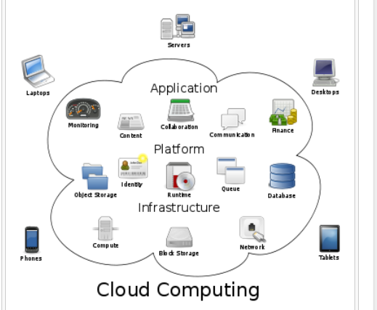

Slide 16
Cloud services
A cloud service has three distinct characteristics that differentiate it from traditional hosting. It is sold on demand, typically by the minute or the hour; it is elastic -- a user can have as much or as little of a service as they want at any given time; and the service is fully managed by the provider (the consumer needs nothing but a personal computer and Internet access)
Significant innovations in virtualization and distributed computing, as well as improved access to high-speed Internet and a weak economy, have accelerated interest in cloud computing.

Slide 17
User view
The illusion of infinite computing resources available on demand. Cloud providers allow users to increase/decrease resources depending on their needs.
Accessibility to resources from anywhere (Internet)
The reduction of an up-front commitment by users. Minimize up-front costs associated with on-premise hardware and software license.
The ability to pay only for use of computing resources as needed. Clouds offer pay-as-you-go services to the public where users only pay for the services consumed.

Slide 18
Combination of two old ideas
Utility computing—an infrastructure provides a set of resources to be shared by applications which use them as needed and pay only for what they use. This approach lets applications have access to a variety of almost unlimited resources (at the cost of giving up parts of the control about where and how data is processed).
Virtual machines—this is a concept used for supporting the execution of operating systems sharing the same hardware. The virtual machine seen by a given customer is created from one or more servers in the cloud and has practically unlimited power and storage capacity.

Slide 19
Architectural levels

Slide 20
Architectural layers
User interfaces
User Applications:
SaaS
financial manufacturing
student registration
DBMS
SQL
..
NoSQL
..
OS utilities Media Player Browser
PaaS
OS kernel
processes memory
device control file system
distribution middleware services
Networking
IaaS
Hardware: Processors Storage I/O devices

Slide 21
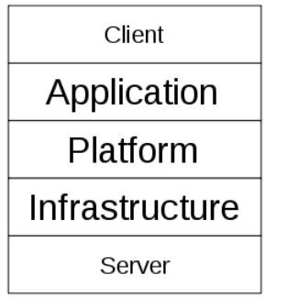
Cloud stack

Slide 22
Core services
Software as a Service (SaaS), An infrastructure that runs customer services and provides those services for the customer itself or for its own customers
Platform as a Service (PaaS), A platform where a customer can run his applications in a configured execution infrastructure.
Infrastructure as a Service (IaaS). A hardware service where customer applications can be executed.

Slide 23
Other types of services
Security as a Service—authentication, authorization,…
Identity as a Service—standardization of identities
Database as a Service (DaaS)—modeling, transactions,…
Cells as a Service—cells contain VMs, storage, and subnets, described in an XML document and are units of isolation
Application as a Service—access to user-specified applications across clouds
Business Processes aaS
Crime aaS

Slide 24
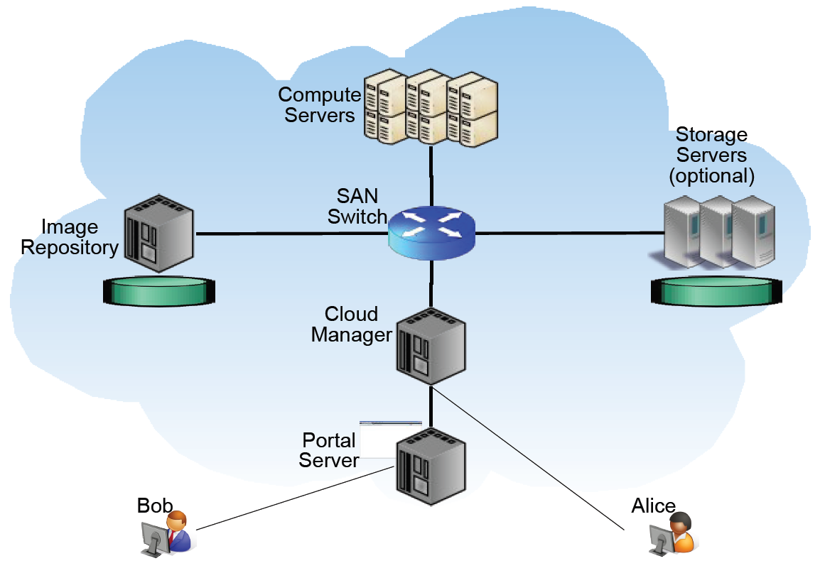

Slide 25
Cloud Deployment
Public – public clouds are run by third party providers. They provide services to any client who pays for their services. These services can be accessed across the Internet or a private network. Public clouds are preferable for non-critical applications that are related to few core processes of the organization.
Private – private clouds are built for the exclusive use of an institution, providing strong control over data, security, and quality of service. Private clouds can be built and managed by the organization or by a cloud provider. Their use is significantly more expensive than public clouds.
Hybrid – combines the two previous approaches. Hybrid clouds are environments in which an organization manages some resources in-house and uses external clouds for other services.
Community – community clouds might be established where different organizations that share similar requirements want to share the infrastructure. Community clouds can be deployed using any of the three models mentioned before.

Slide 26
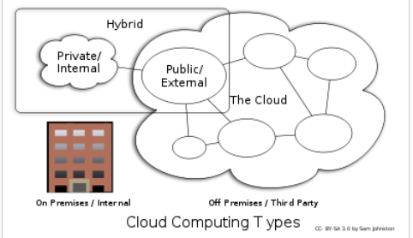

Slide 27
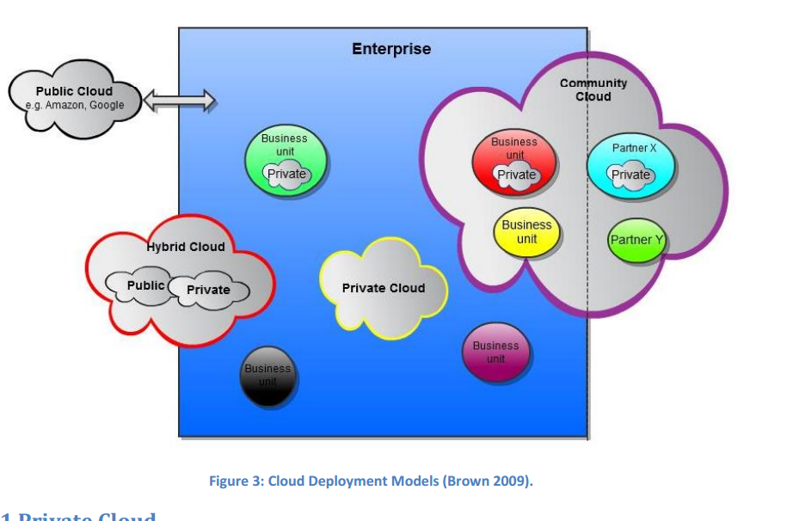

Slide 28
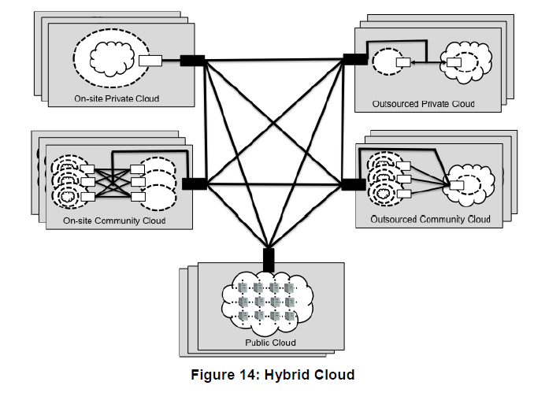
NIST view of types of clouds

Slide 29
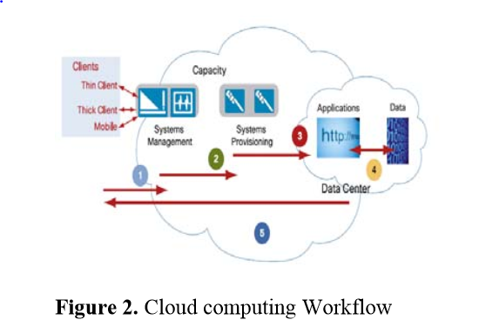

Slide 30
Relationships of clouds to existing disciplines
Software architecture—software units and their connections become very important
Object-oriented design and UML—important for designers and to understand architectures
Security and reliability— critical issues
Operating systems—mostly transparent to application users but very important for cloud system designers
Networking—a critical aspect
No direct effect on standard coding, except speed (lower or higher) and restrictions on languages and libraries
Parallel processing for high performance tasks

Slide 31
Initial concerns or fears
Confusion: The interesting thing about Cloud Computing is that we’ve redefined Cloud Computing to include everything that we already do. . . . I don’t understand what we would do differently in the light of Cloud Computing other than change the wording of some of our ads
Larry Ellison, quoted in the Wall Street Journal, September 26, 2008
Fear of Lack of control: Richard Stallman, known for his advocacy of “free software”, thinks Cloud Computing is a trap for users—if applications and data are managed “in the cloud”, users might become dependent on proprietary systems whose costs will escalate or whose terms of service might be changed unilaterally and adversely
Availability: a crash interrupts your business
Security: many people fear that clouds will be insecure

Slide 32
Applications?
The cloud is appropriate for many applications but not for all
Several groups have studied this topic
Degree of security and availability needed can be very important
Clouds provide standard (shared) services and may not useful for very specialized uses

Slide 33
Werner Vogels, CTO of Amazon http://en.wikipedia.org/wiki/Werner_Vogels
http://www.youtube.com/watch?v=PW1lhU8n5So
Debunking six myths about the cloud
http://www.bmc.com/solutions/cloud-computing/viewpoint/debunking-six-myths-about-the-cloud.pdf

Slide 34
Myth 1: Cost is the biggest benefit when adopting the cloud.
Many companies first consider the cloud because of the cost savings. They realize the benefits they can gain by getting the capital expenses of hardware and software off their books, and by avoiding the "heavy lifting“ of negotiating with vendors and procuring, configuring, and managing hardware and software.
Those cost savings are real. But many customers, who come to the cloud to save money, find real benefits in business agility. This means everything from quickly launching a test environment for a new application to creating a new e-mail and messaging server to accommodate new users as a result of an acquisition.

Slide 35
Myth 1 (Cont.)
This agility means you don't have to wait for a server to get through the procurement process before you deploy a new service. It results in faster time to market with instantly available IT resources. It allows managers to focus on the business they would like to build, instead of on their technology infrastructure. In the long run, you may find that
agility often provides even more business benefit than the immediate cost

Slide 36
Justifications of using clouds
http://www.forbes.com/sites/joemckendrick/2012/09/10/18-solid-justifications-for-cloud-computing-and-10-situations-where-it-doesnt-work/
http://www.boozallen.com/media/file/Economics-of-Cloud-Computing-fact-sheet.pdf
http://cloudcomputing.sys-con.com/node/1793982

Slide 37
From the Forbes reference: where the cloud is appropriate
Chokepoints: Just as air traffic controllers can regulate arriving and departing flights to keep airports running smoothly, “the cloud can accomplish the same thing – throttling, policing, shaping, limiting, and managing data traffic.”
Context: Core activities — such as product design — should remain within the enterprise , but “context” activities can be easily moved to the cloud, Weinman says. Examples of context activities include generic business functions that offer no competitive business advantage, such as expense reporting, funnel management and billing.
Celerity: Celerity, or speed, is an advantage offered by cloud, since applications can be stood up in a matter of days, or sometimes hours. Software as a Service (SaaS) and PaaS reduce development time, while Infrastructure as a Service (IaaS) avoids the need to “un-crate equipment, turn it up, and test it.”

Slide 38
The cloud is not appropriate
Custom environments: Customized environments — which often are a source of business advantage — are impossible to replicate in more plain-vanilla cloud environments. Of course, if they do not offer business advantages, it may be worthwhile to consider a cloud move.
Classic legacy: The cost of migration is high, and “the effort to migrate [legacy] code to newer scale-out architectures and modern programming paradigms just may not be worth it.”
Close coupling of applications: Legacy applications tend to be tightly bound to existing on-premises infrastructure, such as storage or networks — and thus may be difficult and expensive to break off.
Covert: Don’t go to the cloud if you have trade secrets or proprietary information you don’t want anyone to see. “The legal status of your data held at the cloud provider is still uncertain”

Slide 39
Netflix Fixes a Disruption to Its Video Streaming NYTimes, 12/26/12
A disruption at one of Amazon’s Web service centers hit users of Netflix’s streaming video service on Christmas Eve and was not fully resolved until Christmas Day
The disruption affected Netflix subscribers across the United States, Canada and Latin America and blacked out various devices — including video game consoles and DVD players
The issue was the result of a failure at an Amazon Web Services cloud computing center in Virginia and started at about 3:30 p.m. Eastern time on Monday and was fully restored Tuesday morning
A disruption at Amazon Web Services knocked out sites like Flipboard and Foursquare in October, and a storm in June similarly affected services like Netflix, Instagram and Pinterest.

Slide 40
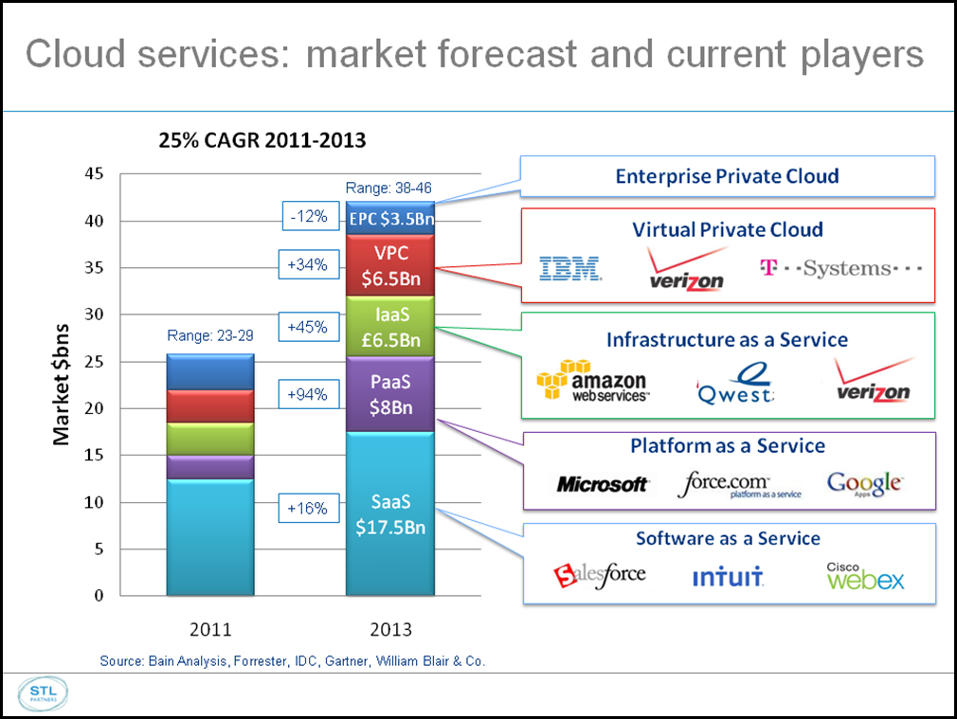

Slide 41
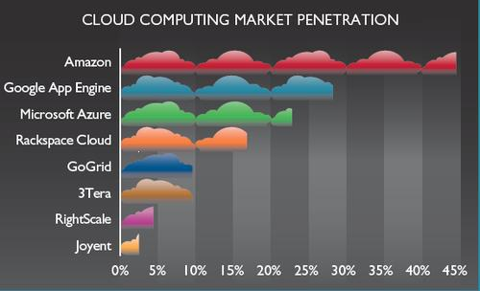

Slide 42
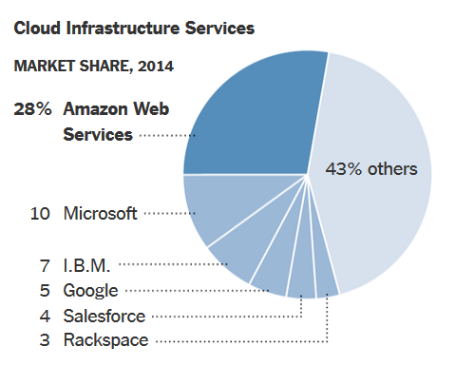
New York Times, 04/24/15

Slide 43
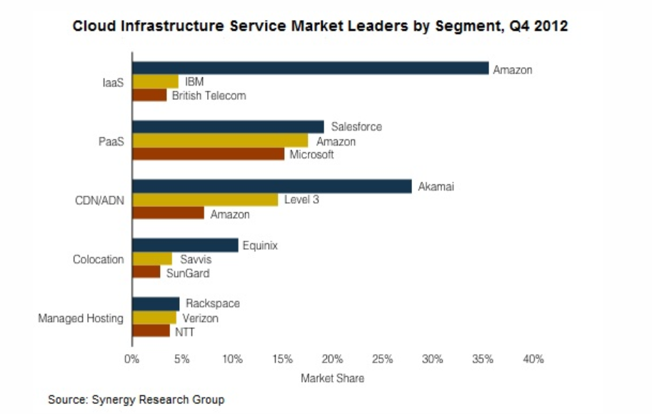

Slide 44
Content delivery (distribution)network or content network (CDN)
A globally distributed network of proxy servers deployed in multiple data centers
The goal of a CDN is to serve content to end-users with high availability and high performance
CDNs serve a large fraction of the Internet content today, including web objects (text, graphics and scripts), downloadable objects (media files, software, documents), applications (e-commerce, portals), live streaming media, on-demand streaming media, and social networks.

Slide 45
Colocation
With colocation, organizations own, use and maintain their own equipment
However, they rent space in a colocation facility, sharing the cost of power, cooling, communications and data center floor space with other companies
Colocation is a good option for organizations that want to maintain complete control over their equipment
Companies that must adhere to specific data protection or compliance requirements (i.e., HIPAA and PCI) opt for a colocation environment.

Slide 46
Managed hosting
Managed hosting differs from other dedicated hosting in that the service provider administers the hardware, operating systems and system software
The client usually has administrative access but as a rule rarely uses it, instead interacting with the leased system through a Web-based interface
Typically, the hosting provider is responsible for setting up and configuring hardware, installing and configuring software, technical support, patch management, system maintenance, monitoring and updates.

Slide 47
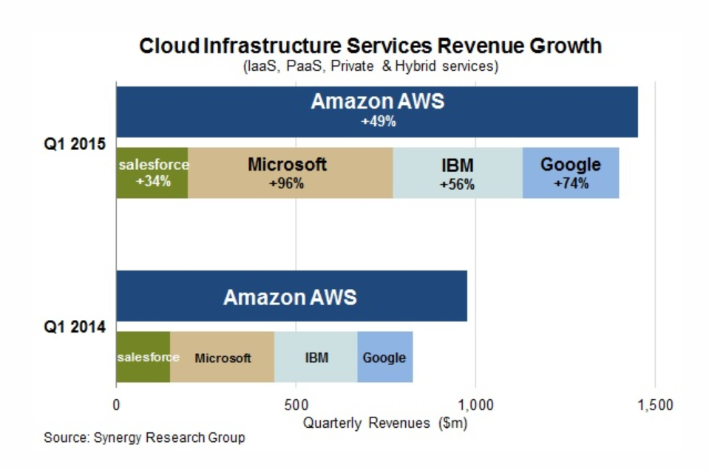

Slide 48
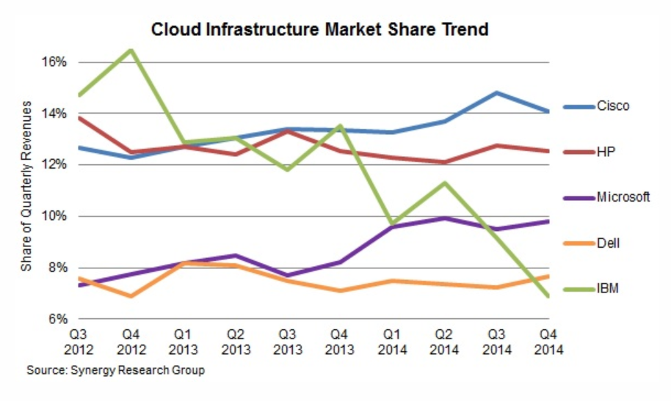

Slide 49
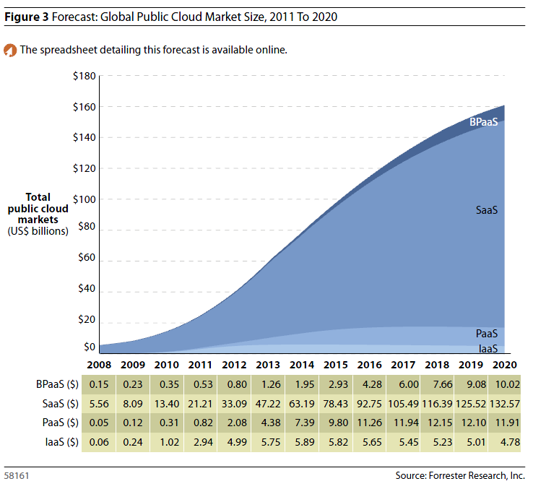

Slide 50
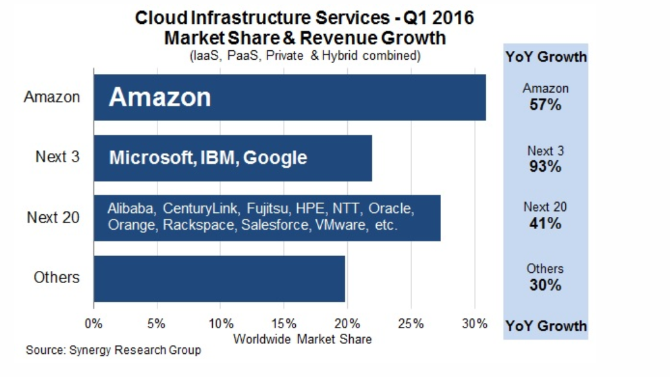

Slide 51
Cloud Jobs: 7 Million In 3 Years, IDC Says http://www.informationweek.com/windows/microsoft-news/cloud-jobs-7-million-in-3-years-idc-says/240145194?cid=nl_IW_cloud_2013-01-03_html&elq=be29adeb2376437a8ec8ce9c57b5fc26
Cloud computing, and related areas like virtualization and data management, will create 7 million jobs over the next three years, according to a new study published by Microsoft and IDC.
The study also claimed that currently there are 1.7 million open cloud jobs worldwide that organizations are having a tough time filling.
The study's authors contend that cloud computing will drive demand for individuals with a hard-to-find mix of business and IT skills, given that many of the new jobs will involve architecture, design, advisory, and transitional services as opposed to just hands-on tech functions.

Slide 52
Demand for Linux skills
Demand for people with Linux skills is increasing, a trend that appears to follow a shift in server sales.
Cloud infrastructure, including Amazon Web Service, is largely Linux based, and cloud services' overall growth is increasing Linux server deployments. As many as 30% of all servers shipped this year will be cloud services providers, according to research firm IDC.

Slide 53
Applications
Medical health record sharing – provides storage of personal health-care information online such as Microsoft Health Vault [Mic] and Google Health [Goo].
Web-based email – it is accessed through a web browser, and it uses the cloud for processing and data storage. Users can access their webmail from anywhere. For example, Yahoo and Gmail provide web-based email service.
Social Networks – provides a plataform to facilitate communication and sharing between users to post profile, create collaboration groups, and share contents. For example Facebook users can build scalable Cloud based applications hosted by Amazon Web Services [Ama].
Data Analytics—Analysis of sales, data mining, statistical analysis of customer preferences.
End-user applications – these applications are delivered on a PC such as word processing, databases, spreadsheets, media editing, presentations, collaboration, and many others. For instance, Google Docs [Wika] offers web-based applications that allow users to create and edit documents online.

Slide 54
Possible uses
Gaming, extended to personalized medication, product development,…
Repair information for field technicians
Comparison shopping and making sure you find a product
Suggest activities, movies,…
Cheap computational power for planning, stock market selection,..

Slide 55
Analyzing "big data" will now be the big challenge NYTimes 12/28/11
The idea of big data goes something like this: In a world of ever-increasing digital connectivity, ever larger mountains of data are produced by our mobile phones, computers, digital cameras, RFID readers, smart meters and GPS devices. The huge quantity of data becomes unwieldy and difficult for companies and governments to manage and understand.
Splunk, is a San Francisco-based start-up whose software indexes vast quantities of machine-generated data into searchable links. Companies search those links, as one searches Google, to analyze customer behavior in real time.

Slide 56
Future uses (from a paper)
The dawn of the 21st century has seen a growing interest in vehicular networking and its myriad potential applications. The initial view of practitioners and researchers was that radio-equipped vehicles could keep the drivers informed about potential safety risks and increase their awareness of road conditions.
The view then expanded to include access to the Internet and associated services.
This position paper proposes and promotes a novel and more comprehensive vision namely, that advances in vehicular networks, embedded devices and cloud computing will enable the formation of autonomous clouds of vehicular computing, communication, sensing, power and physical resources.
Hence, we coin the term, autonomous vehicular clouds (AVCs).
A key feature distinguishing AVCs from conventional cloud computing is that mobile AVC resources can be pooled dynamically to serve authorized users and to enable autonomy in real-time service sharing and management on terrestrial, aerial, or aquatic pathways or theaters of operations.
In addition to general-purpose AVCs, we also envision the emergence of specialized AVCs such as mobile analytics laboratories. Furthermore, we envision that the integration of AVCs with ubiquitous smart infrastructures including intelligent transportation systems, smart cities and smart electric power grids will have an enormous societal impact enabling ubiquitous utility cyber-physical services at the right place, right time and with right-sized resources.

Slide 57
Requirements
Scalability: This is its strongest point of clouds. The provider can have many servers and the users can lease them according to their needs.
Application development and deployment support. The provider can have a variety of tools and application assistance that would be hard to duplicate in a small company.
Availability. The cloud provider can have replicated servers such that the cloud environment is always available to the application.
Fine access control. Only specific users of the cloud should be able to access its data and only in specific ways. This applies to the employees of the application company and to the employees of the service provider. In sensitive applications, code or data access through the service provider may need to be restricted to suitably obfuscated/encrypted code/data bases.
Regulatory compliance. The application owner must comply with the appropriate regulations, depending on the type of application, e.g., medical-related applications must comply with HIPAA. Service providers must follow regulations about the protection they provide to the hosted data. Regulations may also limit the special flexibility of distributing tasks within a cloud (cf. the item Data location below).

Slide 58
Requirements II
Recovery. It is the responsibility of the service provider to completely recover the data in a timely manner in case of a crash or attack.
Data persistence. If the provider goes out of business or is acquired by another company, we should guarantee the persistence and security of the data until somebody takes over.
Survivability. There should be no catastrophic failures, where the customer’s data or programs just disappear
Isolation. A cloud application is sharing resources with other applications. The application should be protected from interference with other applications.
Data location. Different organizations and countries have different data protection and privacy rules and laws. The service provider should enforce regulations that are applicable to the owner of the application.

Slide 59
Requirements III
Interoperability. Clouds which follow standards are more flexible and allow more freedom to its customers. This is particularly important in applications which may partially run in more than one cloud.
Portability. This is usually a weak point. Once you move to some cloud, it is hard to migrate to a different cloud. From a cloud provider point of view, limiting portability or being able to control how applications are moved to different platforms, may actually be a design goal.
Convenient software management. No worries about software licenses, installation, or updates.
Dynamic adaptation. Changes in services do not require work for the customer..

Slide 60
Products and companies
I will mention specific products and companies but this is not an endorsement or recommendation
Products are shown to see what is available and to illustrate features
In fact, some products or companies may not be around anymore and many new ones are appearing

Slide 61
Why UML and patterns?
We need to describe cloud architectures and configurations
Block diagrams are imprecise
Formal descriptions are an overkill, design is not a mathematical discipline
UML is a good compromise; it is intuitive (graphical) and semi-formal
It is also an standard and many developers use it
The most convenient way to describe and design architectures is by the use of patterns

Slide 62
Patterns
A pattern is a solution to a recurrent problem in a specific context
Idea comes from architecture of buildings (C. Alexander)
Applied initially to software and then extended to other domains
Appeared in 1994 and are slowly being accepted by industry

Slide 63
Value of patterns
A pattern addresses a recurring design problem that appears in some design step and provides a solution for it. Encapsulate experience and knowledge of designers (best practices)
Patterns can be used to document design experience and specific design decisions.
Patterns are concerned with sets of classes, above the abstractions presented by classes or objects, so they provide a larger unit of reuse.
Patterns provide a communication vocabulary for designers.
Good to describe systems and to handle complexity

Slide 64
Pattern conferences
Pattern Languages of Programs (PLoP) U of Illinois, USA
EuroPLoP –Siemens, Munich (Irsee)
AsianPLoP—Tokyo, Japan; Taipei, Taiwan
Latin American PLoP— Brasil/Argentina
GuruPLoP—India
VikingPLoP—Scandinavia or North Europe

Slide 65
Types of patterns
Design patterns—the most common. Describe how to improve code
Architectural patterns—best practices for architectures
Analysis patterns –describe semantic conceptual models
Security patterns—solutions to security problems
Misuse patterns—how an attack is performed
Reliability, safety, and availability patterns
Organizational patterns—how to teach a course, how to organize a company,…

Slide 66
Refs. I
M. Armbrust et al, “Above the Clouds: A Berkeley View of Cloud Computing”, Technical Report No. UCB/EECS-2009-28, http://www.eecs.berkeley.edu/Pubs/TechRpts/2009/EECS-2009-28.html
Mahesh H. Dodani, “Cloud Architecture”, Journal of Object Technology, Volume 8, no. 7 (November 2009), pp. 35-44, doi:10.5381/jot.2009.8.7.c3.
NIST http://www.nist.gov/itl/cloud/
Wikipedia, “Cloud computing”, http://en.wikipedia.org/wiki/Cloud_computing
Q. Zhang, L. Cheng, R. Boutaba, “Cloud computing: state-of-the-art and research challenges”, J. Internet Serv. Appl. , vol. 1, 2010, 7-18.

Slide 67
Refs. II (Patterns)
F. Buschmann, R. Meunier, H. Rohnert, P. Sommerlad, M. Stal. Pattern-Oriented Software Architecture: A System of Patterns, Volume 1, Wiley, 1996.
E.B.Fernandez, Security patterns in practice: Building secure architectures using software patterns, Wiley Series on Software Design Patterns, 2013.
E. Gamma, R. Helm, R. Johnson, J. Vlissides. Design Patterns: Elements of Reusable Object-Oriented Software, Addison-Wesley, Boston, Mass., 1994.
C. Larman. Applying UML and Patterns: An Introduction to Object-Oriented Analysis and Design and Iterative Development. 3nd edition. Prentice-Hall, 2005.
M. Schumacher, E. B.Fernandez, D. Hybertson, F. Buschmann, and P. Sommerlad, Security Patterns: Integrating security and systems engineering, Wiley Series on Software Design Patterns, 2006.

