Slide 1
Cloud Computing 2016 Ch2: Service levels
Prof. Eduardo B. Fernandez
fernande@fau.edu
http://faculty.eng.fau.edu/fernande/

Slide 2
Chapter 2. Service levels
Software as a Service SaaS
Platform as a Service PaaS
Infrastructure as a Service IaaS

Slide 3
Service Model Architectures

Slide 4
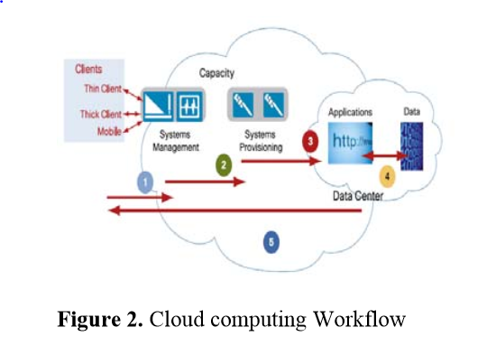

Slide 5
Software as a Service (SaaS)
An infrastructure that runs customer services and provides those services for the customer itself or for its own customers
The user rents software from the cloud provider instead of buying it. The software is hosted in the data center managed by the provider, and it is available over the network, typically the Internet.
Examples of SaaS: CRM, ERP, Word Processor, Spreadsheet, database applications, etc.

Slide 6
Advantages
Access via the web: end users access the application via the Internet using a web browser instead of the traditional PC-based client.
Vendor support: the application is hosted and operated by the cloud provider.
Subscription Pricing: users only pay only for what they use.
Low Customization: the applications are highly standardized across customers, often hosted in a “multi-tenant” architecture model. This could be a disadvantage too.
Managed Upgrades: functionality enhancements such as upgrades and installations are completely in the hands of the vendor.

Slide 7
Liabilities
Loss of control: SaaS applications are hosted on machines that are owned by the provider.
Providers are able to inspect or modify users’ data and computation. A potential security exposure
Dependability: users only have access to the applications while the provider’s servers are functioning.
Application security risks: due to multi-tenancy and the Internet
Slower Speed: usually SaaS applications run at slower speeds than client/server applications. Not always though.
Variable features: in many cases, SaaS applications do not have all the features as the standard applications. Users need to make sure that the hosted application delivers the features needed.

Slide 8
Example: Taleo
Taleo Corporation was a publicly traded database vendor based in Dublin, California
Taleo's product offerings primarily focus on talent acquisition (recruitment), performance management, learning and development, and compensation management. These capabilities combine to provide what Taleo calls "Talent Intelligence" - an enhanced level of insight into candidates and employees.
Taleo sells its Human resource management system (HRMS / HRIS) products entirely via a SaaS model, in which all software and information resides in data centers operated and secured by Taleo.
On February 9, 2012, Oracle Corporation acquired Taleo Corporation for $1.9 billion.
Oracle Corporation continues to use the Taleo software name for its talent-management software suite. As of December 2013, Taleo software had over 20 million users.

Slide 9
TALEO http://www.oracle.com/us/products/applications/taleo/overview/index.html?utm_source=WeeklyEmail&utm_medium=email&utm_campaign=February28
The Oracle Taleo Cloud Service enables enterprises and midsize businesses to recruit top performers with the right cloud talent skills, aligning them to key goals and performance while developing and compensating them appropriately.
The industry's broadest cloud-based talent management platform, Oracle Taleo Cloud Service collects relevant information throughout the employee's entire lifecycle, empowering HR, managers, and employees to leverage their cloud talent to drive improved performance and business success.
Oracle TBE Recruiting Cloud Service is the leading recruiting software and e-Recruitment solution for small and medium-sized organizations. Thousands of companies use Oracle TBE Recruiting Cloud Service to help build the solid foundation they need to become employers of choice.

Slide 10
PaaS
Platform as a Service offers a development environment for developers where they can develop and run their applications.
The development environment provides a complete software lifecycle management, from planning to design to building applications to testing, deployment, and maintenance

Slide 11
Advantages of PaaS
Geographically distributed development teams can work together on software development projects.
Pay-as-you-go – users only pay for the resources they use for a specific time.
Cost reduction -- Initial and ongoing costs can be reduced by the use of infrastructure services from a cloud provider. Overall expenses can be also minimized by unification of programming development efforts.
Maintenance – cloud providers manage upgrades, patches, and other maintenance processes.
Quicker development – developers can focus on development without worrying about the infrastructure.

Slide 12
Liabilities
PaaS involves a risk of “lock-in” if they require proprietary service interfaces, operating systems, or development languages.
Some PaaS providers may not be able to support the need of some users whose requirements rapidly evolve or are very specialized.
Applications may be constrained by the capabilities that the cloud provider chooses to deliver
Security risks may increase (weak OSs,…)

Slide 13
Examples of PaaS
Google Apps Engine offers APIs for storage, platform, and database. It supports applications written in different programming languages such as Java and Python
Force.com Force.com is a PaaS that allows developers to create multinenant (single instance of software runs on a server and serves multiple tenants) add-on applications that integrate into the main Salesforce.com application.
Microsoft Azure (to be seen)
IBM Bluemix (to be seen)

Slide 14
IaaS
The IaaS layer virtualizes computing power, storage and network connectivity, and offers them as services to customers.
Computing power is delivered to users in the form of virtual machines. A virtual machine looks to its user as a hardware processor where you can install any of the software packages provided by the Cloud Provider or your own software.

Slide 15
VM stack (system view)

Slide 16
A virtual machine as seen by a user

Slide 17
Containers
A Software Container provides an execution environment for applications sharing a host operating system, binaries, and libraries with other containers.
Containers can be lightweight, portable, extensible, reliable, and secure.
A Container controls a set of Applications sharing a Host OS that provides a set of Resources. An Interceptor mediates the services provided to the application by the container. Applications hosted in containers can be accessed remotely through Proxies, where the Container acts as a broker. The Container provides a set of Services to the applications.

Slide 18
Container stack

Slide 19
IaaS Advantages
Utility computing – users only pay for what they use. This allows users to pay as they gow.
Maintenance – the need for every user to maintain his own infrastructure is eliminated. IaaS providers own the infrastructure and are responsible for housing, running, monitoring, and maintaining it. Thus, users can focus on their businesses.
Saves money – users just pay for what they use and not for having in-house equipment.
Dynamic Scaling -- You can scale as much as you need. You can get computer power as you need it from the cloud. If your traffic gets back down, you can release your services back to the cloud.

Slide 20
Disadvantages
Lock-in: some applications deployed in one cloud provider cannot be migrated conveniently to a different cloud. For example, applications developed on Amazon’s EC2 cannot be easily migrated due to its particular storage framework [Gol].
Security risks: attacks through the virtual machines
Availability: all functions in the cloud –single point of failure

Slide 21
GoGrid
https://www.datapipe.com//
GoGrid is a cloud infrastructure service, hosting Linux and Windows virtual machines managed by a multi-server control panel and a RESTful API.
It is a managed cloud for AWS
On January 20, 2015, Datapipe acquired GoGrid.
Robust Cloud Infrastructure
Cloud Servers starting at just $0.04 per hour
▶ Windows and Linux servers
▶ Pay hourly, monthly, or annually
▶ 24x7x365 Support included for free
Generous SLAs
One of the most generous SLAs in the industry
▶ 100% Uptime Service Level Agreement (SLA)
▶ Comprehensive coverage
▶ Guaranteed network performance

Slide 22
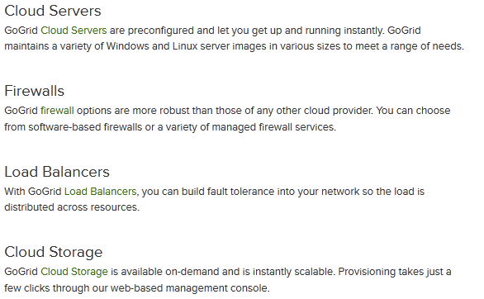
Components

Slide 23
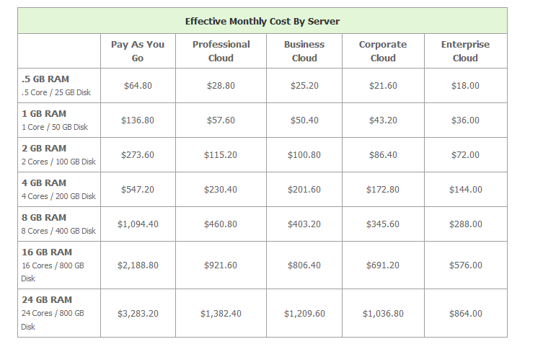
GoGrid pricing 01/2012

Slide 24
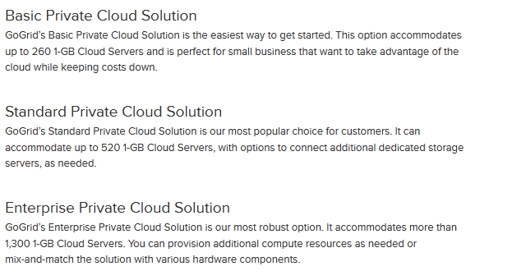
GoGrid private clouds

Slide 25
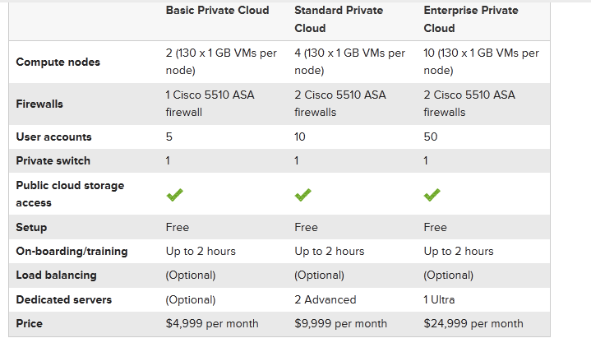
GoGrid Private cloud pricing

Slide 26
Orange Business Services
Orange Business Services discovered that with a hosted private cloud- built to the requirements of their solution - they could reduce the overall total cost of ownership, reduce time to market and innovate new solutions for customers. Uses GoGrid infrastructure.
Orange provides a wide range of technology solutions to global multi-national corporations (MNC) including telephony, mobility, CRM, and network management.
The Service Management group is one part of Orange and is responsible for monitoring these solutions globally. Orange has 30,000 employees in 166 countries and territories across the world.
Orange Service Management solution is delivered via their Customized Infrastructure Care (CIC) solution. The solution remotely monitors every component of a customers' communication infrastructure, both hardware and software, utilizing a management web portal so both Orange and the customer can see what is happening at any point in time and take corrective actions as required.

Slide 27
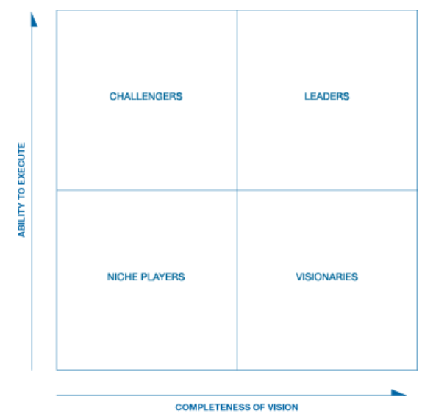
Gartner’s Magic Quadrant http://www.gartner.com/technology/research/methodologies/research_mq.jsp

Slide 28
Gartner’s Magic quadrant for cloud-enabled managed hosts
The cloud-enabled managed hosting (CEMH) market deals in standardized, productized hosting offerings that combine a cloud-enabled system infrastructure (CESI) platform — comprising compute, network and storage hardware owned and operated by a service provider — with cloud management platform software to facilitate self-service and rapid provisioning with managed services
The infrastructure platform may be located in a service provider's data center, or optionally at the customer's data center, but, either way, it requires standardized deployment across all customers and uses a single code base that has been pre-engineered and/or predeployed by the provider prior to customer sign-up.
At minimum, a service provider must supply server OS management services, including guest OS instances when virtualization is used. The provider may optionally supply other managed and professional services relating to the infrastructure's deployment and operation.

Slide 29
CEMH-II
Customers must be able to access a self-service interface, which may be different from the platform interfaces used internally by the provider.
A service provider can potentially intervene in the self-service workflow to manually approve, deny or alter a customer's requests, as long as the provisioning requested is fulfilled in a fully automated manner thereafter.
Managed services (such as OS backups, patching and monitoring) must be available to customers on commitments of less than one year.

Slide 30
Use cases
This Magic Quadrant focuses on the following common use cases, independent of the type or types of infrastructure used for the associated workloads:
E-business hosting for digital marketing sites, e-commerce websites, SaaS, social websites, and similar modern online properties and applications. These workloads are often complex and are associated with a high rate of change in systems and application infrastructure.
Web-based business application hosting for corporate intranets and Web-based applications delivered to users primarily within enterprises. The applications may be commercial software or developed in-house; workloads are often relatively static and do not have a high rate of change.
Enterprise application hosting. Managed hosting for the infrastructure used to support large commercial software applications, such as those of Oracle, SAP and other enterprise software vendors. These workloads are often complex and require specialized knowledge to operate optimally, but do not have a high rate of change.

Slide 31
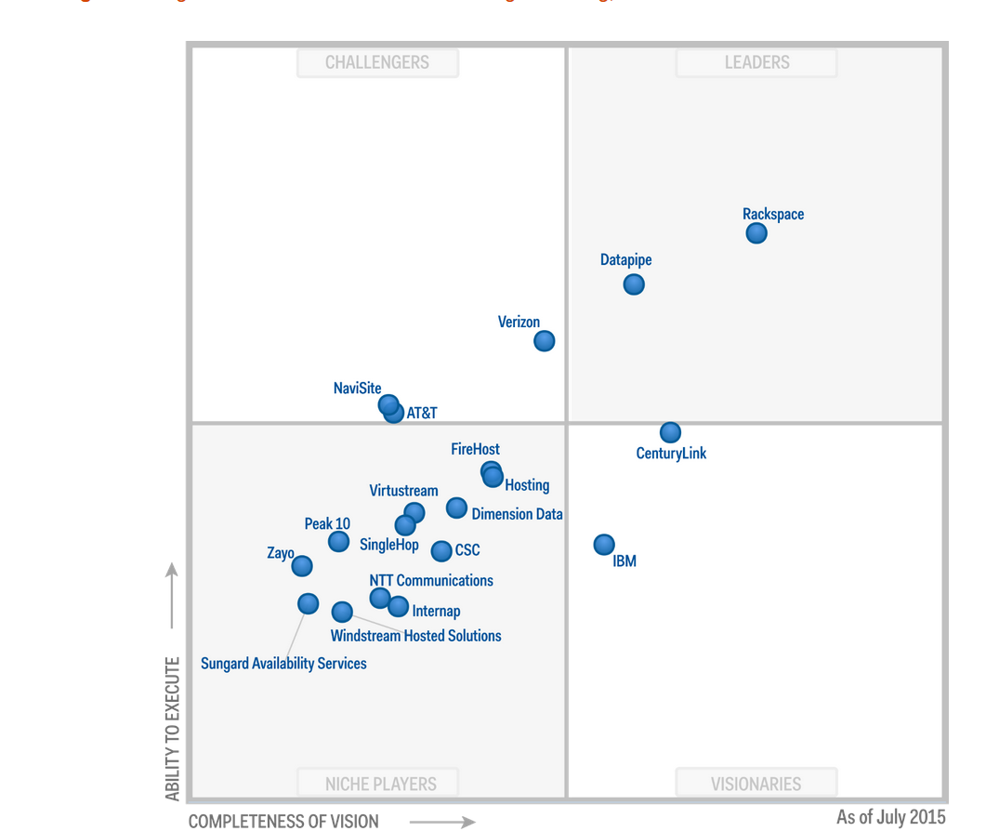

Slide 32
Amazon’s EC2
Amazon Elastic Compute Cloud (EC2) is a central part of Amazon.com's cloud computing platform, Amazon Web Services (AWS). EC2 allows users to rent virtual computers on which to run their own applications
EC2 allows scalable deployment of applications by providing a web service through which a user can boot an Amazon Machine Image to create a virtual machine, which Amazon calls an "instance", containing any software desired.
A user can create, launch, and terminate server instances as needed, paying by the hour for active servers, hence the term "elastic“
AWS also provides containers
EC2 provides users with control over the geographical location of instances which allows for latency optimization and high levels of redundancy. For example, to minimize downtime, a user can set up server instances in multiple zones which are insulated from each other for most causes of failure
EC2 uses Xen virtualization. Each virtual machine functions as a virtual private server. Amazon.com sizes instances based on "Elastic Compute Units".

Slide 33
EC2 Locations
Multiple Locations – Amazon EC2 provides the ability to place instances in multiple locations. Amazon EC2 locations are composed of Regions and Availability Zones. Availability Zones are distinct locations that are engineered to be insulated from failures in other Availability Zones and provide inexpensive, low latency network connectivity to other Availability Zones in the same Region. By launching instances in separate Availability Zones, you can protect your applications from failure of a single location
Regions consist of one or more Availability Zones, are geographically dispersed, and will be in separate geographic areas or countries. A Service Level Agreement (SLA) commitment is 99.95% availability for each Amazon EC2 Region. Amazon EC2 is currently available in four regions: US East (Northern Virginia), US West (Northern California), EU (Ireland), and Asia Pacific (Singapore).

Slide 34
Addresses
Elastic IP Addresses – Elastic IP addresses are static IP addresses designed for dynamic cloud computing. An Elastic IP address is associated with your account not a particular instance, and you control that address until you choose to explicitly release it
Unlike traditional static IP addresses, however, Elastic IP addresses allow you to mask instance or Availability Zone failures by programmatically remapping your public IP addresses to any instance in your account
Rather than waiting on a data technician to reconfigure or replace your host, or waiting for DNS to propagate to all of your customers, Amazon EC2 enables you to engineer around problems with your instance or software by quickly remapping your Elastic IP address to a replacement instance. In addition, you can optionally configure the reverse DNS record of any of your Elastic IP addresses by filling out a form.

Slide 35
EC2 Utilities
Amazon CloudWatch – Amazon CloudWatch is a web service that provides monitoring for AWS cloud resources. It provides you with visibility into resource utilization, operational performance, and overall demand patterns—including metrics such as CPU utilization, disk reads and writes, and network traffic. You can get statistics, view graphs, and set alarms for your metric data. You select the instances that you’d like to monitor; CloudWatch will begin aggregating and storing monitoring data that can be accessed using web service APIs or Command Line Tools.
Auto Scaling – Auto Scaling allows you to automatically scale your Amazon EC2 capacity up or down according to conditions you define. With Auto Scaling, you can ensure that the number of instances you’re using scales up seamlessly during demand spikes to maintain performance, and scales down automatically during demand lulls to minimize costs. Auto Scaling is particularly well suited for applications that experience hourly, daily, or weekly variability in usage. Auto Scaling is enabled by Amazon CloudWatch and available at no additional charge beyond Amazon CloudWatch fees.

Slide 36
ECR
Amazon EC2 Container Registry (ECR) is a fully-managed Docker container registry that makes it easy for developers to store, manage, and deploy Docker container images.
Amazon ECR is integrated with Amazon EC2 Container Service (ECS), simplifying your development to production workflow.
Amazon ECR eliminates the need to operate your own container repositories or worry about scaling the underlying infrastructure.
Amazon ECR hosts your images in a highly available and scalable architecture, allowing you to reliably deploy containers for your applications.
Integration with AWS Identity and Access Management (IAM) provides resource-level control of each repository.
With Amazon ECR, there are no upfront fees or commitments. You pay only for the amount of data you store in your repositories and data transferred to the Internet.

Slide 37
Eucalyptus
Eucalyptus is an acronym for “Elastic Utility Computing Architecture for Linking Your Programs To Useful Systems”.
Eucalyptus is free and open-source computer software for building Amazon Web Services (AWS)-compatible private and hybrid cloud environments marketed by the company Eucalyptus Systems. Eucalyptus enables pooling compute, storage, and network resources that can be dynamically scaled up or down as application workloads change. Eucalyptus Systems announced a formal agreement with AWS in March 2012 to maintain compatibility. In September 2014, Eucalyptus was acquired by Hewlett-Packard.

Slide 38
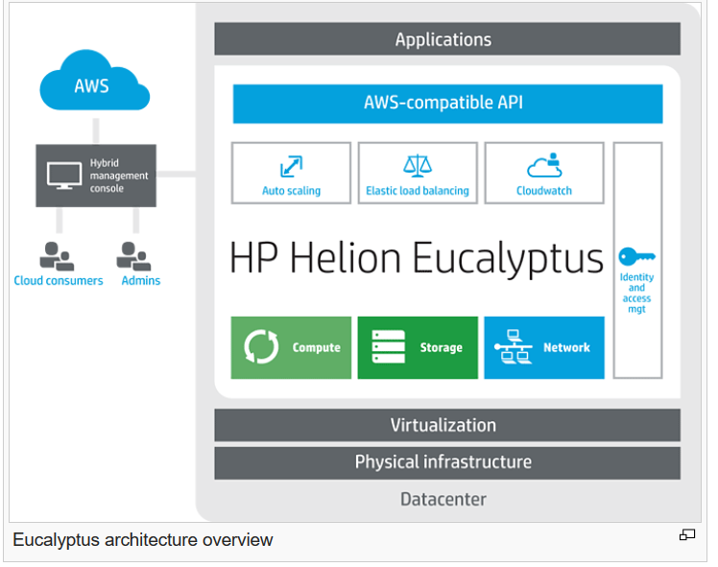

Slide 39
Eucalyptus II
They have an enterprise edition and an open-source edition. Currently, it exports a user-facing interface that is compatible with the Amazon EC2 and S3 services but the platform is modularized so that it can support a set of different interfaces simultaneously
The development of Eucalyptus software is sponsored by Eucalyptus Systems, a venture-backed start-up, based on a UC Santa Barbara design
Eucalyptus works with most currently available Linux distributions including Ubuntu, Red Hat Enterprise Linux (RHEL), CentOS, SUSE Linux Enterprise Server (SLES), OpenSUSE, Debian and Fedora. Similarly Eucalyptus can use a variety of virtualization technologies including VMware, Xen and KVM hypervisors to implement the cloud abstractions it supports.

Slide 40
Eucalyptus features
Eucalyptus implements IaaS style private and hybrid clouds
The platform provides a single interface that lets users access computing infrastructure resources (machines, network, and storage) available in private clouds—implemented by Eucalyptus inside an organizations's existing data center—and resources available externally in public cloud services
The software is designed with a modular and extensible web-services-based architecture that enables Eucalyptus to export a variety of APIs towards users via client tools
Currently, Eucalyptus implements the industry-standard AWS API API, which allows the interoperability of Eucalyptus with existing AWS services and tools.
Eucalyptus provides its own set of command line tools called Euca2ools, which can be used internally to interact with Eucalyptus private cloud installations or externally to interact with public cloud offerings, including Amazon EC2.

Slide 41
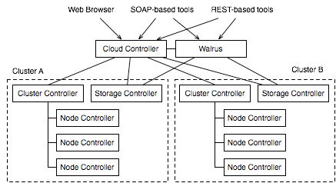
Eucalyptus architecture

Slide 42
Components
The Eucalyptus cloud computing platform has five high-level components: Cloud Controller (CLC), Cluster Controller (CC), Walrus, Storage Controller (SC) and Node Controller (NC)
Each high-level system component has its own Web interface and is implemented as a stand-alone Web service
This has two major advantages: First, each Web service exposes a well defined language-agnostic API in the form of a WSDL document containing both the operations that the service can perform and the input/output data structures
Second, Eucalyptus leverages existing Web-service features such as security policies (WSS) for secure communication between components and relies on industry-standard web-services software packages.

Slide 43
Component functions
Cloud Controller (CLC) - The CLC is responsible for exposing and managing the underlying virtualized resources (machines (servers), network, and storage) via user-facing APIs. Currently, the CLC exports a well-defined industry standard API (Amazon EC2) and via a Web-based user interface.
Walrus - Walrus implements scalable “put-get bucket storage.” The current implementation of Walrus is interface compatible with Amazon’s S3 (a get/put interface for buckets and objects), providing a mechanism for persistent storage and access control of virtual machine images and user data.
Cluster Controller (CC) - The CC controls the execution of virtual machines (VMs) running on the nodes and manages the virtual networking between VMs and between VMs and external users.
Storage Controller (SC) - The SC provides block-level network storage that can be dynamically attached by VMs. The current implementation of the SC supports the Amazon Elastic Block Storage (EBS) semantics.
Node Controller (NC) - The NC (through the functionality of a hypervisor) controls VM activities, including the execution, inspection, and termination of VM instances.

