Slide 1
Cloud Computing Fall 2016
Ch. 3 Architectures
Prof. Eduardo B. Fernandez
ed@cse.fau.edu
http://faculty.eng.fau.edu/fernande/

Slide 2
3. Architecture topicss
Service Oriented Architectures SOA
Grid computing
Reference Architectures
Service Level Agreements (SLAs)
Standards

Slide 3
What is software architecture?
Software architecture is concerned with design at a high level of abstraction, trying to optimize global properties as opposed to improving code aspects.
The architecture of a software system defines the system in terms of components (units, elements) and of interactions between these units
The software architecture of a system comprises its software elements (components, units), the externally visible properties of those elements, and the relationships among them.
"Externally visible” properties are those assumptions other elements can make of an element, such as its provided services, performance characteristics, fault tolerance, security, and other global system properties.

Slide 4
Architecture II
Architecture includes: system topology and organization, decomposition into components, assignment of functionality to components, component interactions, system properties (nonfunctional requirements, e.g. performance, security), correspondence between requirements and units.
Three types of architectural elements are normally considered: processing elements, data elements, and connection elements.

Slide 5
Non-functional requirements (NFRs)
Analysis of high-quality architectures shows that they followed methodological and organizational principles, achieved some design goals, and exposed particular structural properties.
Quality is mostly measured with factors such as reliability or performance. These aspects are usually called non-functional requirements (NFRs)
An architecture must balance functional and non-functional requirements.
The selection of NFRs depends on the type of application

Slide 6
Reference Architectures
A reference architecture (RA) or domain-specific architecture is a standardized, generic architecture, valid for a particular domain.
It is reusable, extendable, and configurable, that is, it is a kind of pattern for whole architectures and it can be instantiated into a specific software architecture by adding implementation-oriented aspects
From RAs we can derive concrete architectures with different degrees of specificity, e.g. a cloud computing using Oracle products

Slide 7
Situation before clouds
Server
S
Memory
M
Services
Software
product
Users

Slide 8
Cloud SP
Server
…
Server
Internet
Users
M
…
M
Services
…
Software

Slide 9
Requirements for RAs
We need a precise representation with details of unit interconnections
Useful to actually build new systems or use the architecture to build applications
UML models are a good way for this purpose
We can find patterns to make specific units or functions reusable and to produce more specialized architectures
We have produced a cloud RA and a cloud SRA (Security RA)
The next slides show the NIST Cloud RA:
“Cloud Computing Reference Architecture.” 2011. http://www.nist.gov/customcf/get_pdf.cfm?pub_id=909505

Slide 10
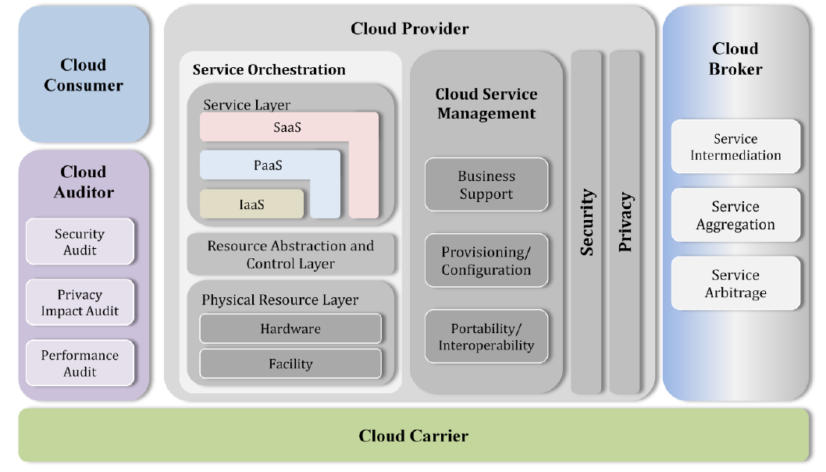

Slide 11
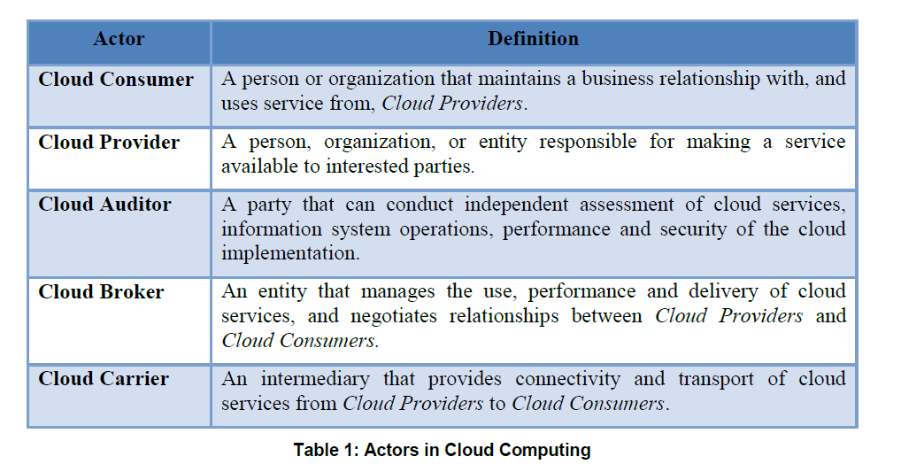

Slide 12
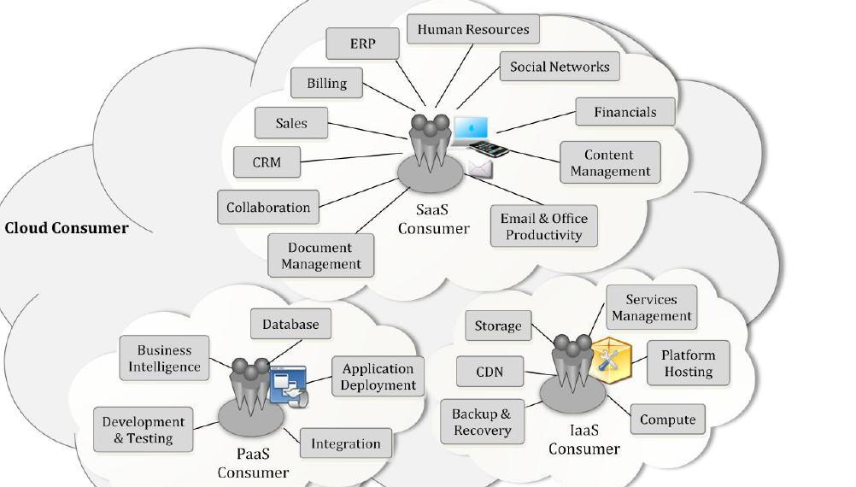
Services available to actors

Slide 13
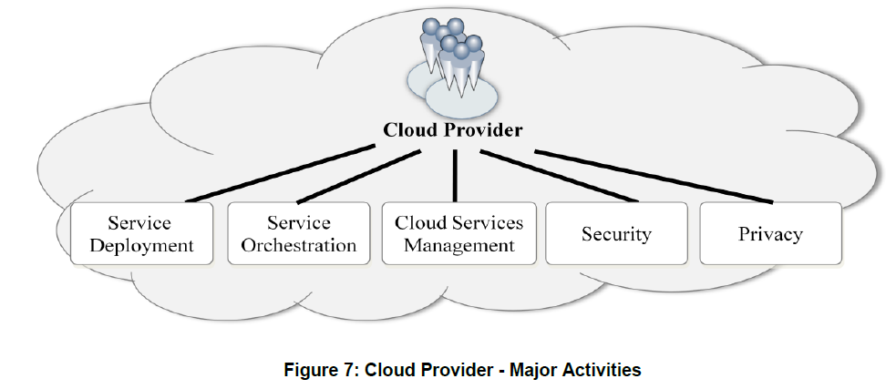

Slide 14
Cloud Auditor
A cloud auditor is a party that can perform an independent examination of cloud service controls with the intent to express an opinion thereon. Audits are performed to verify conformance to standards through review of objective evidence. A cloud auditor can evaluate the services provided by a cloud provider in terms of security controls, privacy impact, performance, etc.

Slide 15
Cloud Broker
Multiple cloud providers offer disparate services that it may be too complex for consumers to integrate them.
A cloud broker is an entity that mediates between cloud consumers and providers, so instead of contacting a cloud provider directly, a cloud consumer contacts a cloud broker
A cloud broker can improve some functionalities or combine different services from different cloud providers.

Slide 16
CMB
According to the National Institute of Standards, a Cloud-Management Broker (CMB) “provides a cloud-user a unified and enhanced management interface to multiple cloud-providers.”
The essential features of a CMB as a unified interface, federated cloud-subscriber credentials for multiple cloud-providers, and federated access to multiple cloud-provider programming interfaces.

Slide 17
Cloud Broker functions
Service Intermediation: A cloud broker enhances a given service by improving some specific capability and providing value-added services to cloud consumers. The improvement can be managing access to cloud services, identity management, performance reporting, enhanced security, etc.
Service Aggregation: A cloud broker combines and integrates multiple services into one or more new services. The broker provides data integration and ensures the secure data movement between the cloud consumer and multiple cloud providers.
Service Arbitrage: Service arbitrage is similar to service aggregation except that the services being aggregated are not fixed. Service arbitrage means a broker has the flexibility to choose services from multiple agencies. The cloud broker, for example, can use a credit-scoring service to measure and select an agency with the best score.

Slide 18
Cloud carrier
Acts as an intermediary that provides connectivity and transport of cloud services between cloud consumers and cloud providers.
Cloud carriers provide access to consumers through network, telecommunication and other access devices.
A cloud provider will set up SLAs with a cloud carrier to provide services consistent with the level of SLAs offered to cloud consumers, and may require the cloud carrier to provide dedicated and secure connections between cloud consumers and cloud providers.

Slide 19
Layers
The application layer includes software applications targeted at end users or programs. The applications are used by SaaS consumers, or installed/managed/ maintained by PaaS consumers, IaaS consumers, and SaaS providers.
The middleware layer provides software building blocks (e.g., libraries, database, and Java virtual machine) for developing application software in the cloud. The middleware is used by PaaS consumers, installed/managed/maintained by IaaS consumers or PaaS providers, and hidden from SaaS consumers.

Slide 20
OSs in IaaS
The OS layer includes operating system and drivers, and is hidden from SaaS and PaaS consumers.
IaaS allows one or multiple guest OS’s to run virtualized on a single physical host.
Generally, consumers have broad freedom to choose which OS to be hosted among all the OS’s that could be supported by the cloud provider.
The IaaS consumers should assume full responsibility for the guest OS’s, while the IaaS provider controls the host OS.

Slide 21
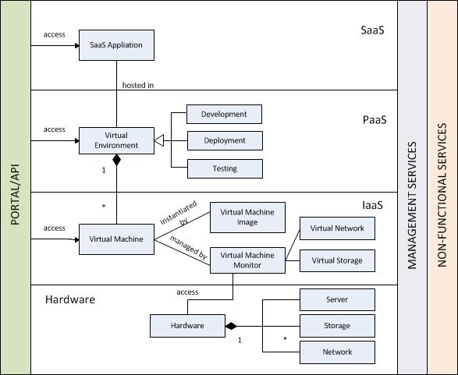
A UML cloud RA

Slide 22
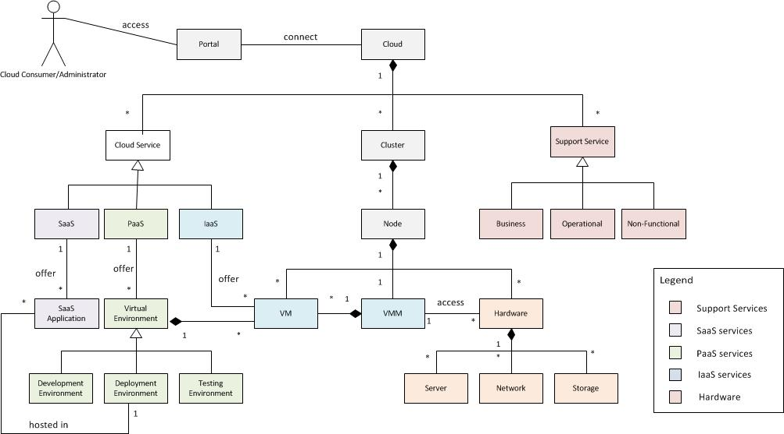
CC Environment

Slide 23
Environment description
The Portal is the way to access cloud services. A Cloud is composed of cloud services, infrastructure (cluster), and support services. Cloud physical resources can be located in different zones or Clusters. A Cluster is a collection of Nodes that are located within a close physical proximity. A Node is made up of a set of Hardware units (Servers, Storage and Network), Virtual Machines (VMs), and a Virtual Machine Monitor (VMM). A VMM creates and manages virtual machines and makes direct access to the hardware on behalf of them. The fundamental cloud service levels are Software-as-a-Service (SaaS), Platform-as-a-Service (PaaS), and Infrastructure-as-a-Service (IaaS).
The SaaS provides on-demand Applications while the PaaS offers Virtual Environments such as Development, Deployment and Testing Environments, which include programming languages, databases, libraries, and other tools. IaaS provides virtualized resources such as servers and storage that can be assigned to Virtual Machines. Support services are needed to provision the creation, implementation and management of cloud services which we call collectively a Cloud Management Point. Business Support Services provide centralized management of cloud resources, including metering, billing, reporting, and account administration. Operational Support Services are responsible for monitoring, provisioning, and other management functions such as configuration, upgrades, and installations of the system. Non-Functional Services include security, availability, reliability, interoperability, and possibly other quality factors.

Slide 24
Use cases
Some people call the applications of some product or method a use case, as we saw in Gartner’s example of last chapter.
In object-oriented design a use case is a complete interaction of a user with the system
A UC is composed of several activities or actions, which we consider atomic
UML defines a syntax for use case diagrams but not for use case descriptions

Slide 25
Cloud Use Cases (NIST) http://www.nist.gov/itl/cloud/use-cases.cfm
Cloud Management Use Cases 3.1 Open An Account 3.2 Close An Account 3.3 Terminate An Account 3.4 Copy Data Objects Into a Cloud 3.5 Copy Data Objects Out of a Cloud 3.6 Erase Data Objects In a Cloud 3.7 VM Control: Allocate VM Instance 3.8 VM Control: Manage Virtual Machine Instance State 3.9 Query Cloud-Provider Capabilities and Capacities
Cloud Interoperability Use Cases 4.1 Copy Data Objects between Cloud-Providers 4.2 Dynamic Operation Dispatch to laaS Clouds 4.3 Cloud Burst From Data Center to Cloud 4.4 Migrate a Queuing-Based Application 4.5 Migrate (fully-stopped) VMs from one cloud-provider to another

Slide 26
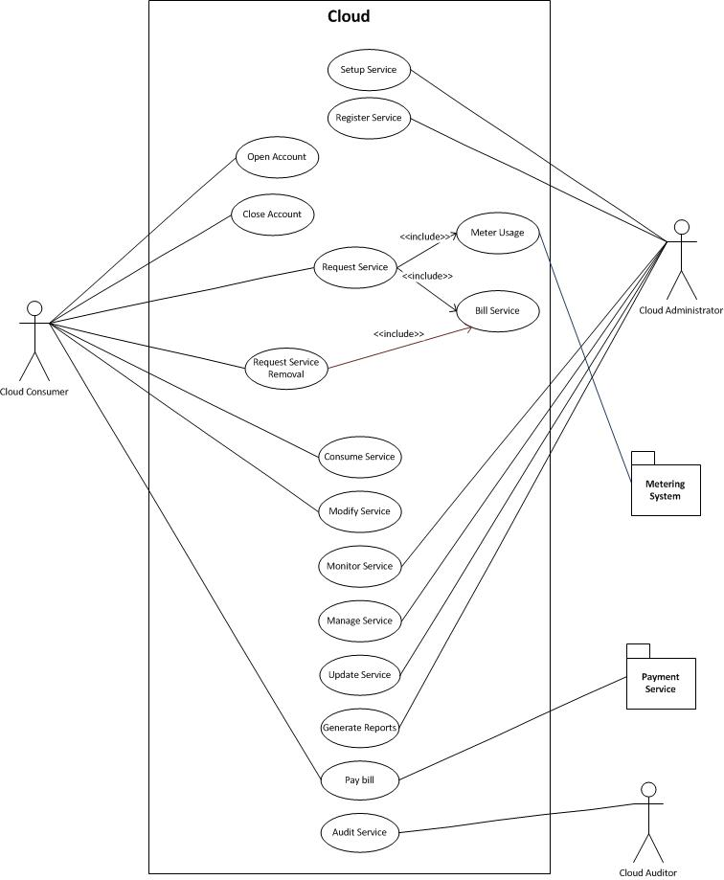

Slide 27
3.1 Open An Account
Actors: unidentified-user, cloud-subscriber, payment-broker, cloud-provider.
Goals: Cloud-provider opens a new account for an unidentified-user who then becomes a cloud-subscriber.
Assumptions: A cloud-provider's account creation web page describes the service offered and the payment mechanisms. An unidentified-user can access the cloud-provider's account creation web page.
Success Scenario: (open, IaaS, PaaS, SaaS): An unidentified-user accesses a cloud-provider's account creation web page. The unidentified-user provides: (1) a unique name for the new account; (2) information about the unidentified-user's financial; and (3) when the unidentified-user wants the account opened. The cloud-provider verifies the unidentified-user's financial information; if the information is deemed valid by cloud-provider, the unidentified-user becomes a cloud-subscriber and the cloud-provider returns authentication information that the cloud-subscriber can subsequently use to access the service.
Failure Conditions: (1) the unidentified-user does not provide a suitable name; (2) the financial information is not valid; (3) cloud-provider fails to notify the cloud-subscriber the account is open.
Failure Handling: For (1) and (2), new account is not created; For (3) See Use Case 3.2 below on failure handling related to notifications from cloud-provider to cloud-subscriber.

Slide 28
4.1 Copy Data Objects between Cloud-Providers
Actors: cloud-subscriber, cloud-provider-1, cloud-provider-2, transport-agent
Goals: Copy data objects from a cloud-provider-1's system to a cloud-provider-2's system on the initiative of a cloud-subscriber.
Assumptions: Cloud-subscriber has established an account with cloud-provider-1 and cloud-provider-2.
Success Scenario (copy, IaaS): A cloud-subscriber mutually authenticates to cloud-provider-1 (where the data object initially resides) using cloud-provider-1's mutual authentication mechanisms, and starts a command shell (or equivalent) on cloud-provider-1. From cloud-provider-1, thecloud-subscriber may access other systems on the Internet. The cloud-subscriber determines the object identifiers of the data objects that the cloud-subscriber wishes to copy from cloud-provider-1 to cloud-provider-2. From the command shell on cloud-provider-1 the cloud-subscriber authenticates to cloud-provider-2 using cloud-provider-2's authentication mechanisms (note: this approach passes authentication through cloud-provider-1). The cloud-subscriber locates a container (e.g., a directory) on cloud-provider-2 where the copied object will reside. The cloud-subscriber may have to create a container. For each data object that the cloud-subscriber wishes to copy, thecloud-subscriber: 1) downloads the contents of the object to the virtual machine the cloud-subscriber is using in cloud-provider-1 2) uploads the data as a new object in cloud-provider-2's object store, and 3) deletes the copy of the data just created in the virtual machine in cloud-provider-1. The copy of the data just created in virtual machine in cloud-provider-1 is deleted as described in Use Case 3.6 (Erase Data Objects in Clouds).
Failure Conditions: (1) The cloud-subscriber is unable to authenticate to cloud provider-1; (2) the cloud-subscriber has insufficient privileges for the requested actions.
Failure Handling: The cloud-providers notify the subscriber of the failure and provide a description of the failure (e.g. expired certificate, insufficient privileges, etc.).
Credit: TBD
Note: Success Scenario 3 or New Use Case – Version Control - : - idea of several versions of same data object copied across multiple clouds and version control – distributed CVS

Slide 29
Service-Oriented Architecture (SOA)
SOA is an architectural style in which a system is composed from a set of loosely coupled services that interact with each other by sending messages
A service is a logical representation of a business activity that has a specified outcome
A service may come from an existing product running in the cloud or be built specifically by an SP
To be used a service publishes its description, which defines its interface and expresses constraints and policies that must be respected in order to interact with it.
Applications are built by coordinating and assembling services (usually workflow style)
A key principle about services is that they should be easily reusable and discoverable, even in an inter-organizational context

Slide 30
Related architectures
SOA Service-Oriented architectures
Grid computing--can be implemented as a SOA
Web services or XML web services—a variety of SOA
Cloud computing—another variety of SOA
The services in clouds can be implemented as XML web services or REST services

Slide 31
SOA properties
SOA has been adopted as a main direction by IBM and Microsoft among others
It is a high-level architectural approach that attempts to glue and unify disjoint pieces of software
SOA can be implemented using ad hoc architectures, CORBA, Jini, web services, clouds, or other distributed architectures
A mail service is a basic type of SOA (with only one service)
SOA can be seen as the generalization of client-server architectures.

Slide 32
Service Interfaces
What is important is the use of explicit interfaces defining some services without showing the implementation of these services
They apply the standard concepts of information hiding and encapsulation from object-oriented design
A schema describes the service and its physical binding. A service resides in an abstract hosting environment called a container
Clients and servers can use any technology and don’t need to know the technology of the services they use
A container may have several interfaces (Extension Interface Pattern). The separation of interfaces and implementation can be described by a Bridge pattern (to be seen later)

Slide 34
SOA communication
Communication can be performed by:
Asynchronous messages. Send a document
to a service and receive an answer later.
Synchronous messages, using a Broker
Sender and receiver must agree on document structure and meaning
A message includes a header (describing routing and security information) and an envelope (carrying the message contents)
A contract defines the meaning of header and envelope for the entities that exchange messages.

Slide 35
Use of services
Remote Procedure Call (RPC) style—A message invokes a service with some parameters and the response is sent back over the same connection. This is a synchronous approach.
Document style—A complete document (or parts of it) is manipulated. This is a coarser-grained asynchronous approach.
In general, the document style is more efficient, more extensible, and more scalable. However, the RPC approach is more prevalent today because it is similar to earlier, more familiar approaches.
The fact that data is exchanged for business purposes and between different entities means that, in addition to the usual requirements of security, accountability is an important factor.

Slide 36
Web services
Web services (WS) are a popular approach to implementing SOA. Also called XML services
Web services define an abstract framework, called the Web services platform which is comprised of several parts
Many of these parts address a particular aspect of the common SOA and are defined by standards organizations and implemented on proprietary technology platforms
The Organization for the Advancement of Structured Information Standards (OASIS) and the World Wide Web Consortium (W3C) are examples for standards organizations that work on the specification and standardization of abstract concepts within the Web services platform.
Used mostly for B2B interactions

Slide 38
Service Level Agreement
Use of services in Service-oriented architectures (SOAs) require the use of of Service-Level Agreements (SLAs)
A SLA is a contract that specifies clearly the rights and obligations of providers and customers and determines the benefits and responsibilities of each party
The only means the provider can gain trust of clients is through the SLA
Due to the dynamic nature of the cloud, continuous monitoring on Quality of Service (QoS) attributes is necessary to enforce SLAs [Pat09]

Slide 39
More on SLAs
Requirements for SLAs include: monitorable, understandable, precise, timeliness, reliability of service.
Precise modeling of cloud architectures lead to precise SLAs and in turn to more convenient certification. Clouds can be ranked according to their degree of security and their ability to match the requirements of specific types of applications.
A reference architecture is also useful to define what aspects of a SLA should be monitored.
IBM proposed a framework for specifying and monitoring SLA for web services named Web Service Level Agreement (WSLA). Although WSLA [Lud03] was designed for web services, it can be applicable to Cloud Computing as well.
We can build a pattern for WSLA as a project

Slide 40
WSLA
Parties: It is composed of two parties: supporting parties and signatory parties. Signatory parties are the service provider and the consumer. Supporting parties are the third parties that act in behalf of the service provider or the consumer.
Service Definitions: describe the services to be delivered in terms of operations and service’s metrics.
Obligations: define the service level that is guaranteed with respect to the metrics defined in service definitions.

Slide 42
Amazon EC2 Service Level Agreement
AWS will use commercially reasonable efforts to make Amazon EC2 available with an Annual Uptime Percentage (defined below) of at least 99.95% during the Service Year. If the Annual Uptime Percentage for a customer drops below 99.95% for the Service Year, that customer is eligible to receive a Service Credit equal to 10% of their bill (excluding one-time payments made for Reserved Instances) for the Eligible Credit Period.
Only one level of availability
No mention of security or other quality aspects
Amazon Web Services (AWS) delivers a highly scalable cloud computing platform with high availability and reliability, and the flexibility to enable customers to build a wide range of applications. In order to provide end-to-end security and end-to-end privacy, AWS builds services in accordance with security best practices, provides appropriate security features in those services, and documents how to use those features. In addition, AWS customers must use those features and best practices to architect an appropriately secure application environment.

Slide 43
Dynamic aspects of SLAs

Slide 44
Standards
Standards Creation is Time Consuming
• Critical features (interoperability, portability)
require high quality, mature standards.
• But standards development is a consensus oriented process: often years to complete.
• Even longer for international standards
The mission of the National Institute of Standards and Technology (NIST) is to promote U.S. innovation and industrial competitiveness by advancing measurement science, standards, and technology in ways that enhance economic security.

Slide 45
NIST role
Shorter Term Standards Effort
• Until standards mature:
• What is needed is a process to test important cloud system
requirements --- NIST is providing that.
SAJACC
Standards Acceleration Jumpstarting Adoption of Cloud Computing

Slide 46
NIST report
NIST Special Publication 500-291,
Version 2, (Supersedes Version 1.0, July 2011)
NIST Cloud Computing Standards Roadmap
NIST Cloud Computing Standards Roadmap Working Group
July 2013
Interoperability, performance, portability, and security

Slide 47
More standards
Standards for SLAs
http://dmtf.org/sites/default/files/standards/documents/DSP-IS0103_1.0.0.pdf

Slide 48
State of standards
Many people view the lack of CC standards as a potential roadblock to adoption, stemming from SP lock-in fears and the inability to move virtual machines and data from cloud to cloud.
Today, there is a single cloud standard -- the Open Virtualization Format (OVF), pioneered by VMware for facilitating the mobility of virtual machines -- but it alone does not solve the cloud interoperability issue.

Slide 49
OVF
Various proprietary and open APIs have been proposed to provide interoperability among VMs and IaaSs. The first and only cloud-oriented standard that has been ratified is the OVF, which was approved in September 2010 after three years of processing by the DMTF.
OVF’s open packaging and distribution format for VMs gives customers and vendors some platform independence. It helps facilitate mobility, but it does not provide all of the independence needed for cloud interoperability.
OVF lets vendors or enterprises package VMs together with applications and operating systems and calls to any other applications and hardware as needed. This meta data includes information about VM images, such as the number of CPUs and memory required and network configuration information.

Slide 50
API standards
What users want is a cloud application programming interface (API) like the network API, TCP/IP, one that’s implemented in all cloud products and services and promotes transparent interoperability. This would increase the confidence of prospective cloud adopters, as they’d be able to leave their providers whenever they want. It would also eliminate the belief that it’s easy to get into the cloud but difficult to get out.
However, Forrester analyst James Staten (and david Linthicum) says he believes that a common cloud API is way off in the future. He sees the push for standards as too far ahead of where the market is: “There is no compelling reason to comply; not enough enterprise users have established cloud computing initiatives.” AWS API is a de facto standard.

Slide 51
More
Red Hat submitted the Deltacloud API to DMTF as a standard for cloud interoperability in August 2010. It is a set of open APIs that can be used to move cloud-based workloads among different private clouds and public cloud providers. Red Hat has contributed Deltacloud to the Apache Software Foundation as an incubator project. Deltacloud attempts to abstract the details of cloud provider cloud implementations so that an application or developer writing an application only has to call a single API to get a response regardless of the back-end cloud.
The Rackspace Cloud API has been open sourced and is included in OpenStack.
The Amazon EC2 API is viewed by many as the de facto public cloud API standard. Vendors such as Eucalyptus Systems and OpenNebula implement much of the Amazon EC2 API. It has not been submitted to DMTF or any other open standards group.

Slide 52
Deltacloud API provides:
an opportunity to manage cloud instances
a way to protect apps from cloud API changes and incompatibilities
three frontends: 'classic' Deltacloud, DMTF CIMI, and EC2 (Amazon)
support for all major cloud service providers
makes it easy for cloud providers to add their cloud
lets you use your RHEV-M (Red Hat enterprise Virtualization Manager)and vSphere (VMWare) installations as a cloud (to be seen)

Slide 53
Standards organizations
NIST : already mentioned
The Distributed Management Task Force (DMTF) develops cloud interoperability and security standards. The DTMF created the Open Cloud Standards Incubator (OCSI) in 2009 to address the need for open management standards for cloud computing. An OCSI-produced white paper, Interoperable Clouds White Paper, helps users with questions about integrating computer, network and storage services from one or more cloud service providers into business and IT processes.
The Open Cloud Consortium (OCC) is a member-driven organization that develops reference implementations, benchmarks and standards for cloud computing.

Slide 54
More standards organizations
The Open Grid Forum (OGF) is an open community committed to driving the rapid evolution and adoption of applied distributed computing. OGF accomplishes its work through open forums that build the community, explore trends, share best practices and consolidate these best practices into standards. OGF has launched the Open Cloud Computing Interface Working Group to deliver an open community, consensus-driven API, targeting cloud infrastructures.
The Storage Networking Industry Association (SNIA) has adopted the role of industry catalyst for the development of storage specifications and technologies, global standards, and storage education.
The Cloud Security Alliance (CSA) publishes guidelines for secure cloud computing,
The Cloud Computing Interoperability Forum (CCIF) is a vendor-neutral, open community of technology advocates and consumers dedicated to driving the rapid adoption of global cloud computing services.
The Cloud Standards Customer Council is an end user advocacy group dedicated to accelerating cloud's successful adoption, and drilling down into the standards, security and interoperability issues http://cloud-standards.org/wiki/index.php?title=Main_Page

Slide 55
OCC http://opencloudconsortium.org/
The Open Cloud Consortium announced the release of Tukey. Developed as open source middleware, Tukey is named after John Tukey, an American mathematician best known for development of the FFT algorithm and box plot.
Tukey was developed because nothing existed with all the features we needed for a portal to the Open Science Data Cloud. There are offerings like Elasticfox and Horizon which lacked features such as federated authentication using Shibboleth and OpenID, SSH keypair generation for gateway machines, and support for both Eucalyptus and OpenStack clouds.
Tukey is written in Python using the Django framework and Horizon, the OpenStack dashboard. The Tukey Portal project provides a web front end for tools used and developed for managing OSDC resources and the Tukey Middleware project provides a translation layer between cloud resource, primarily Eucalyptus, and the OpenStack API.
Note that this is site is oriented to scientific computing (physics, maths, astronomy,…), an important application of clouds

Slide 56
OpenStack
OpenStack is a free and open-source software platform for cloud computing, mostly deployed as IaaS. It consists of interrelated components that control hardware pools of processing, storage, and networking resources throughout a data center.
Users either manage it through a web-based dashboard, through command-line tools, or through a RESTful API.
OpenStack.org released it under the terms of the Apache License.
OpenStack began in 2010 as a joint project of Rackspace Hosting and NASA.
As of 2016, it is managed by the OpenStack Foundation, a non-profit corporate entity established in September 2012 to promote OpenStack software and its community. More than 500 companies have joined the project

Slide 57
Questions to ask providers
Because interoperability standards between cloud platforms are not yet in place, what should a prospective cloud adopter do? For starters, do not wait for interoperability standards to be ratified. In an environment of tremendous change where the potential benefits could be large, a better decision is to study up and make a choice.
Try to determine which vendors have the best opportunities to turn their cloud APIs into de facto standards for private and public clouds. Be sure to ask a number of questions like these and then compare the answers with your needs for both the short and the long term:
Does the vendor have cloud APIs that appeal to customers and service providers, along with widespread acceptance in the cloud marketplace?
Has the vendor submitted one or more of its cloud APIs for ratification to DMTF or one of the other standards organizations?
Does the vendor have significant numbers of partners to promote and use its cloud APIs?
Does the vendor’s cloud API promote interoperability between private and public clouds? What about between the vendor’s cloud and another vendor's cloud?
Can the vendor provide a way to transfer your data out of its service?

Slide 58
Django
An open source web application framework, written in Python, which follows the model–view–controller architectural pattern.
It was originally developed to manage several news-oriented sites for The World Company^{[5]} of Lawrence, Kansas, and was released publicly under a BSD license in July 2005; the framework was named after guitarist Django Reinhardt. In June 2008 it was announced that a newly formed Django Software Foundation will maintain Django in the future.
Django's primary goal is to ease the creation of complex, database-driven websites. Django emphasizes reusability and "pluggability" of components, rapid development, and the principle of don't repeat yourself. Python is used throughout, even for settings, files, and data models. Django also provides an optional administrative create, read, update and delete interface that is generated dynamically through introspection and configured via admin models.
Some well known sites that use Django include Pinterest,^{[8]} Instagram,^{[9]} Mozilla,^{[10]} The Washington Times,^{[11]} and the Public Broadcasting Service.^{[12]}
We will see the MVC pattern now

Slide 59
MVC pattern-- intent
The model contains the core functionality and data. Views display information to the user. Controllers handle user input. Views and controllers together comprise the user interface. A change-propagation mechanism ensures consistency between the user interface and the model.”

Slide 60
Problem
User interfaces are especially prone to change requests. When you extend the functionality of an application, you must modify menus to access these new functions.
A customer may call for a specific user interface adaptation, or a system may need to be ported to another platform with a different ‘look and feel’ standard.
Even upgrading to a new release of your windowing system can imply code changes.
The user interface platform of long-lived systems thus represents a moving target.

Slide 61
Forces
The same information is presented differently in different windows, for example, in a bar or pie chart.
The display and behavior of the application must reflect data manipulations immediately.
Changes to the user interface should be easy, and even possible at run-time.
Supporting different ‘look and feel’ standards or porting the user interface should not affect code in the core of the application.

Slide 62
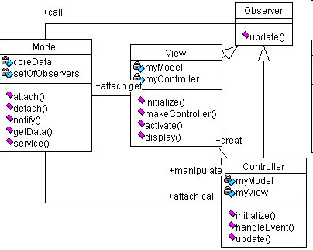
MVC class diagram

Slide 63
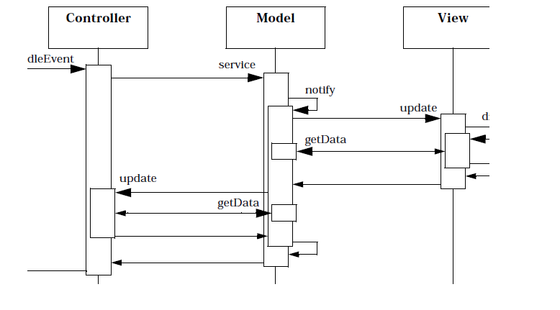
Propagating an event

Slide 64
MVC in the web
The model is the information in an application or the database
The controller is an instance of ASP or JSP that assembles information from the application or database
The views are the browser interfaces that are used to access data

Slide 65
Grid computing
Both cloud and grid computing are examples of distributed computing architectures.
Grid computing is a distributed computing environment composed of resources from different administrative domains
The primary goal of grid computing is to perform large computational tasks.

Slide 66
Grid Computing
Distributed parallel processing across a network
Key concept: “the ability to negotiate resource-sharing arrangements”
Characteristics of grid computing
Coordinates independent resources
Uses open standards and interfaces
Quality of service
Allows for heterogeneity of computers
Distribution across large geographical boundaries
Loose coupling of computers

Slide 67
Comparison to clouds
Economical aspects – both are used to economize computing by maximizing use of existing resources.
Business Model – in clouds, a customer pays on a consumption basis. The business model for Grids is project-oriented, in which users have certain number of service units (i.e. CPU hours) they can spend [Fos09].
Architecture – Grids focus on integrating existing resources with their hardware, operating systems, local resources management, and security infrastructure [Fos09].

Slide 68
Comparison II
Computation Model – most grids use a batch-scheduled computation model where users request resources for some time from a local resource manager. Grids require batch job scheduling or sophisticated policies for allocating jobs, while clouds do not. In clouds, resources can be shared by several users at the same time.
Virtualization – Grids does not rely on virtualization as much as clouds do, but that might be more due to policy and having each individual organization maintain full control of their resources [Fos09].
Monitoring – in grids, users can access resources at different grid sites through their identity delegation, and the resources are not highly abstracted and virtualized as in clouds. In clouds, users can access resources through defined APIs, and they do not have the liberty to deploy monitoring infrastructure.

Slide 69
Comparison III
Tasks – grids are well suited for organizations that handle large amounts of data requested by few users. The objective of the grid is to complete a specified task that requires intensive computational resources. Grid computing has been used mainly by scientific and governmental institutions. On the other hand, clouds are well suited for environments with large number of users that request small amount of data. Cloud computing is designed for general applications.
Allocation of resources [Zha10] – In grid computing, a small number of users can use most of all the resources. While the resources are in use, other users have to wait until they become available. On the contrary, clouds support larger number of users who use a small fraction of the physical resources. Thus, the allocation of resources in cloud environments is on-demand.
Services provided – grid computing offers computational power services while cloud computing offers this and other services.

Slide 70
Summary of Chapter 3
Given the complexity of cloud systems we need an abstract model, a reference architecture—NIST and vendors use models that describe components and functions, we need more precise models, that can also show associations between components
Clouds are a type of SOA and experience and theory of SOA applies to them—grid computing and XML web services are predecessors
Service Level Agreements are very important to define rights and obligations of users and providers—need to be specified precisely

Slide 71
Refs. For Ch. 3
[Avg03] P. Avgeriou, “Describing, instantiating and evaluating a reference architecture: A case study”, Enterprise Architecture Journal, June 2003
[Has13] Keiko Hashizume, Eduardo B. Fernandez, and Maria M. Larrondo-Petrie, A Reference Architecture for Cloud Computing, to be published
[Mic09] Microsoft Power and Utilities, Smart Energy Reference Architecture, Oct. 2009, http://www.Microsoft.com/Utilities
[Tay10] R.N. Taylor, N. Medvidovic, and E.M. Dushofy, “Software architecture: Foundations, theory, and practice”, Wiley 2010.
[The10] W. Theilman et al., “A Reference Architecture for multi-level SLA management”, Journal of Internet Eng., vol. 4, No 1, Dec. 2010, 290-298.
[Wor10] S.Worrall, and T.Gross, “SOA and cloud computing: A match made in heaven”, http://www.ebizq.net/topics/soa_management/features/12327.html
[Zha10] S. Zhang, X. Chen, X. Huo, and S. Zhang, “The Comparison between Cloud Computing and Grid Computing”, 2010 International Conference on Computer Application and System Modeling, ICCASM 2010

