Slide 1
Cloud Computing 2016
Ch4- Virtualization
Prof. Eduardo B. Fernandez
ed@cse.fau.edu
http://faculty.eng.fau.edu/fernande/

Slide 2
Chapter 4 Virtualization
Operating systems and Virtual memory
Virtual Address Space
Types of virtualization
Virtual machine operating system
VM Environment
Virtual machine monitor (hypervisor)
I/O, network, memory, and desktop virtualization

Slide 3
Operating systems
Operating systems act as an intermediary between the user of a computer and its hardware.
The purpose of an operating system is to provide an environment in which users can execute programs in a convenient and efficient manner without being concerned with lower level details
Operating systems control and coordinate the available resources in order to present to the user an abstract machine with a uniform set of high-level features, independent of the hardware platform.
Computer system functionality can be divided between the kernel, and user-oriented utilities or services.

Slide 4
Operating systems functions
Controls system resources by controlling hardware
Process and processor management
Memory management –for executing programs
Data management-- persistent data
I/O devices -- disks, communications ,…
Login, including user authentication
9/12/2016
4

Slide 5
Processes
A process is a program in execution
A process is defined by its Process Control Block (PCB), a data structure containing its id, and references to its context.
The context is the system data needed for its execution
A process should receive a separate address space for its execution.
A thread is a lightweight process (faster context switching than a process) and shares its address space with other threads. Typically, a thread includes a program counter, a register set, and a stack.
User processes and threads can be created with special packages, e.g., Posix in Unix, or through the language, as in Java or Ada.

Slide 6
Process management
A process state (context) includes its Program counter, code, local variables, data, execution stack, pointers to memory areas, links to I/O devices,…
A process is created when a user or another process requests it
A process terminates when it completes execution or is killed by the kernel
When a process is suspended, its state must be saved to be brought back when it resumes execution (context switch)
The scheduler assigns processor(s) to processes

Slide 7
Virtual Address Space (VAS)
The VAS contains all the logical memory space used by a specific process to perform its work
Each process needs a VAS to execute (and a Process Control Block)
The VAS includes its code, space for variables, pointers to I/O devices, temporary data, its stack (execution record) (context plus application data)
Processes (threads) may share VASs in order to cooperate

Slide 8
Virtual memory
In early operating systems the entire logical (virtual) address space (VAS) of the process was required to be in memory before the process could run.
Most code/data isn't needed at any instant, we can bring it in only when needed.
We can then get a higher level of multiprogramming
The program size isn't constrained (thus the term 'virtual memory').
Virtual memory allows very large logical address spaces.

Slide 9
Virtual memory II
Virtual memory allows the total size of the memory used by processes to exceed the size of physical memory
The virtual address in an instruction is translated by the Address Translation Unit (called Memory Management Unit (MMU) in many processors) to obtain a physical address that is used to access physical memory
To execute a process, the kernel creates a per-process virtual address space
We need to accommodate a multiprogramming system for a variety of users and applications.

Slide 11
Page faults
A process is allocated a given number of pages for its execution
If the process needs a page not currently allocated to it, it must request this page from the OS
The OS brings a new page and loads it in the process physical memory
The pages allocated to a process may use a static (a fixed number) or dynamic (working set) allocation strategy

Slide 12
Page fault sequence
A process invokes some data in memory in its current instruction
The data address is translated by the page table. If it is not in memory it traps to the operating system
The page is found in the disk
The page is brought to the memory of the process
The page table now points to the address in physical memory
The instruction is restarted so it can use the new page

Slide 14
Kernel and utilities
The kernel includes the fundamental services of the OS: process creation and deletion, memory allocation, I/O handling, controlling the state of the processes, scheduling of processes, security functions,…
Extensions or utilities run on top of the kernel and include file systems, browsers, user interfaces, media players, database systems,…
User applications run on top of the utility layer

Slide 15
9/12/2016
15

Slide 16
Modes of operation
At least two modes of operation are needed to have any security. Most hardware architectures use a supervisor and a user or problem mode. These modes define a coarse pair of domains. In the user mode some instructions, called privileged instructions, cannot be executed directly. Some of these instructions manipulate the state of the processes and should not be accessible to users.
Supervisor mode is reserved for the kernel and in this mode all the instructions can be executed.
The state of a process is kept in a Program Status Word or Process Vector, which is part of the Process Control Block.
When a user process needs to perform a system action, it issues a system call to the supervisor (typically by trying to execute a privileged instruction that traps to the operating system), which performs the action on its behalf and may check the parameters.

Slide 17
Protection Rings
Some hardware architectures define a set of protection rings (typically 4 to 32) with hierarchical levels of trust
Rings are a generalization of the concept of mode of operation and define finer domains of execution.
Crossing of rings is done through gates that check the rights of the crossing process
A process calling a segment in a higher ring must go through a gate.

Slide 18
Intel Instruction execution
The use of machine instructions can be made more precise with rings; for example, the Intel X86 series divides instructions into four levels:
Privileged instructions that can only be executed at level 0 (the most privileged level).
Instructions that can execute up to level 1.
Instructions modified according to level.
Instructions that can be executed at any level.

Slide 20
Intel X86 rules for rings
Calls are allowed only in a more privileged direction, with possible restriction of a minimum calling level.
Data at level p can be accessed only by a program executing at a more privileged level (<= p).
[Fer08] E.B.Fernandez and D. LaRed M., "Patterns for the secure and reliable execution of processes". Procs. of the 15th Int.Conference on Pattern Languages of Programs (PLoP 2008), colocated with OOPSLA, Nashville, TN, Oct. 2008.

Slide 21
A process calling a higher level process

Slide 22
Pattern: The Virtual Machine Operating System Architecture
Provides a set of replicas of the hardware architecture (Virtual Machines), that can be used to execute (maybe different) operating systems with a strong isolation between them
Context: Mutually suspicious sets of applications that need to execute in the same hardware. Each set requires isolation from the other sets

Slide 23
Forces
Each operating system needs to have access to a complete set of hardware features to support its execution.
Each OS has its own set of machine dependent features, e.g., interrupt handlers. In other words, each operating system uses the hardware in different ways.
When an OS crashes or it is penetrated by a hacker, the effects of this situation should not propagate to other OSs in the same hardware.
There should be no way for a malicious user in a VM to get access to the data or functions of another VM.

Slide 24
VM execution

Slide 25
VM operating system

Slide 26
UC: Execute a system call

Slide 27
Known uses
IBM VM/370 [Cre81]. This was the first VMOS, it provided VMs for an IBM370 mainframe.
VMware [Nie00]. This is a current system that provides VMs for Intel x86 hardware.
Solaris10 [Sun04] calls the VMs “containers” and one or more applications execute in each container.
Connectix [Con] produces virtual PCs to run Windows and other operating systems.
Xen is a VMM for the Intel x86 developed as a project at the University of Cambridge, UK [Bar00]. Used by VMWare and others

Slide 28
Advantages
The VMM intercepts and checks all system calls. The VMM is in effect a Reference Monitor and provides total mediation on the use of the hardware. This can provide a strong and secure isolation between virtual machines.
Each environment (VM) does not know about the other VM(s), this helps prevent cross-VM attacks
There is a well-defined interface between the VMM and the virtual machines.
The VMM is small and simple and can be checked for security and correctness.

Slide 29
Liabilities
All the VMs are treated equally. If one needs different categories of VMs it is necessary to build specialized versions
Extra overhead in use of privileged instructions.
It is rather complex to let VMs communicate with each other (if this is needed).
Security attacks are possible (to be seen) because of implementation additions (see VM Environment)

Slide 30
Virtual Machine Environment (VME)
Intent
Provide units of execution (virtual machines), which have access to virtualized hardware (processor, memory, and networks). A VME creates and manages virtual machines according to user requests.
Context
Many companies and individuals need access to inexpensive processing power. Many companies develop software intended to run in multiple hardware platforms, where their software needs to be developed and tested.
Problem
How do we provide inexpensive computing power to many users? Real processors can be purchased and used to host applications; however, this is expensive and most of the resources they provide will most likely go under-utilized.

Slide 31
A VM Environment

Slide 32
Known uses
IBM VM/370 [Cre81]. This was the first VMOS, it provided VMs for an IBM370 mainframe.
VMware [Nie00]. This is a commercial company that provides VMs for Intel x86 hardware.
QEMU (Quick Emulator) is an open-source VMM which runs on x86 systems [Qem16]. It can be run as a pure emulator or native VM.
Xen is a VMM for the Intel x86 developed as a project at the University of Cambridge, UK [Bar00].
VirtualBox is a free and open-source VMM from Oracle for x86 hardware. [Vir16].
Some smart phone operating systems use a few specialized virtual machines to separate the user’s private system from her work environment. These include the L4 Microvisor [Hei10] and RIM’s Black Berry 10 OS [Bla16].

Slide 33
Solution
Solution
Create execution instances (processes) where application developers can think they are interacting with the real hardware, i.e., a virtualized processor with all the features of a hardware processor, this is a Virtual Machine (VM). In this case, the software or even the hardware can be chosen so as to support the application and optimize or improve a non-functional requirement. A variety of software, e.g., databases, CAD/CAM, analytics packages, can be obtained from the Service Provider (SP) and loaded in the VM using a menu-like approach (Binaries/libraries).
Structure
Figure 2 shows the class diagram of the VM Environment. Each VM runs under the control of a Virtual Machine Monitor (VMM) (a.k.a Hypervisor), which provides a replica of all the features of some Hardware architecture. This means we can run any type of Guest Operating System and Binaries/Libraries in each VM. The diagram show a Host OS but this is not used in some implementations

Slide 34
Hypervisor (VMM)
Type 1 (or native, bare metal) hypervisors run directly on the host's hardware to control the hardware and to monitor guest operating systems. A guest operating system thus runs on another level above the hypervisor.
Type 2 (or hosted) hypervisors run within a conventional OS environment. With the hypervisor layer as a distinct second software level, guest operating systems run at the third level above the hardware.

Slide 35
Hypervisors Type 1 and 2

Slide 36
VMMs
A VMM provides a uniform view of underlying hardware, making machines from different vendors with different I/O subsystems look the same, which means that virtual machines can run on any available computer.
Administrators can view hardware simply as a pool of resources that can run arbitrary services on demand.
Load balancing among a collection of machines thus becomes trivial, and there is a robust model for dealing with hardware failures or for scaling systems
When a computer fails and must go offline or when a new machine comes online, the VMM layer can simply remap virtual machines accordingly.
Virtual machines are also easy to replicate, which lets administrators bring new services online

Slide 37
VMM advantages II
Encapsulation also means that administrators can suspend virtual machines and resume them at arbitrary times or checkpoint them and roll them back to a previous execution state.
With this general-purpose undo capability, systems can easily recover from crashes or configuration errors.
Because the VMM also offers complete encapsulation of a virtual machine’s software state, the VMM layer can map and remap virtual machines to available hardware resources at will and even migrate virtual machines across processors.

Slide 38
Open Virtualization Format (OVF)
Various proprietary and open APIs have been proposed to provide interoperability among VMs and IaaSs. The first and only cloud-oriented standard that has been ratified is the OVF, which was approved in September 2010 after three years of processing by the DMTF.
The standard describes an "open, secure, portable, efficient and extensible format for the packaging and distribution of software to be run in VMs". The OVF standard is not tied to any particular hypervisor or processor architecture. The unit of packaging and distribution is a so-called OVF Package which may contain one or more virtual systems each of which can be deployed to a virtual machine.
OVF’s open packaging and distribution format for VMs gives customers and vendors some platform independence. It helps facilitate mobility, but it does not provide all of the independence needed for cloud interoperability.
OVF lets vendors or enterprises package VMs together with applications and operating systems and calls to any other applications and hardware as needed. This meta data includes information about VM images, such as the number of CPUs and memory required and network configuration information.

Slide 39
Virtualizable architectures
A CPU architecture is virtualizable if it supports direct execution—executing the virtual machine on the real machine, while letting the VMM retain control of the CPU.
Implementing basic direct execution requires running the virtual machine’s privileged (operating-system kernel) and unprivileged code in the CPU’s unprivileged mode, while the VMM runs in privileged mode.
Thus, when the virtual machine attempts to perform a privileged operation, the CPU traps into the VMM, which emulates the privileged operation on the virtual machine state that the VMM manages.
Consequently, the key to providing virtualizable architecture is to provide trap semantics that let a VMM safely, transparently, and directly use the CPU to execute the VM.

Slide 40
Types of VMs (another naming problem)
A system VM provides a complete, persistent system environment that can support many operating systems and their applications
A process VM is a virtual platform that executes a single process; it is created and terminated with the process
Clouds use system VMs, Java and C# use process VMs

Slide 41
System and process VMs

Slide 42
Standard environment
HLL program
Intermediate code
Compiler
Object code
VM interpreter /compiler
distribution
Memory image

Slide 43
High-Level VM environment
HLL program
Portable code
distribution
VM loader
VM image
VM interpreter /compiler
Host instructions

Slide 44
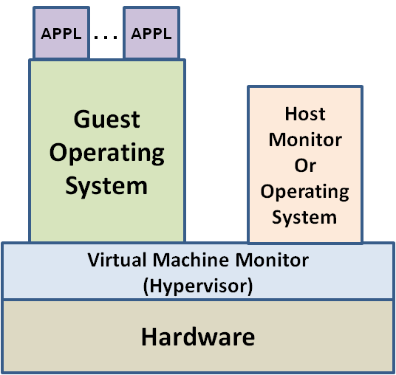
History of Virtual Machine Technology
IBM 7044 -- First Virtual Machine (VM) capable system
Announced in 1961 Designed to run both Multiple OS instances
IBM 360 Model 67 – First True VM Hardware Platform
Announced in 1966
Classical privileged instruction trap & emulate
Utilized VMM Technology – CP/67
Important paper published by G. Popek & R. Goldberg in 1974
“Formal Requirements for Virtualizable Third Generation Architectures”
Fidelity – Software on the VMM executes identically to its execution on hardware, barring timing effects.
Performance – An overwhelming majority of guest instructions are executed by the hardware
with out the intervention of the VMM
Security – The VMM manages all hardware resources
Technology began to disappear in the mid 1970’s
Inexpensive minicomputers and microcomputers
Primarily used for operating system testing
Re-emerged in the late 1990’s
Emulation for legacy systems
Better Server Hardware Utilization
Re-Tasked in the 2000’s -- Principal technology for Cloud Computing

Slide 45
Overview of VM Technology
VM technology grouped into 6 categories
Hardware Virtualization (Emulation)
Full or Native Virtualization
Paravirtualization
Operating System Virtualization
Library Level Virtualization
Virtual Container
Principal Components
Hardware
Virtual Machine Monitor (Hypervisor)
Guest Operating System
Host Monitor or Operating System
Applications
VM works on the principle that VMM manages all system resources
I/O
Memory
Privileged Instructions
VMM handles all system resource requests by taking
control and managing request. Guest operating systems
and applications usually have no knowledge of the VMM.

Slide 46
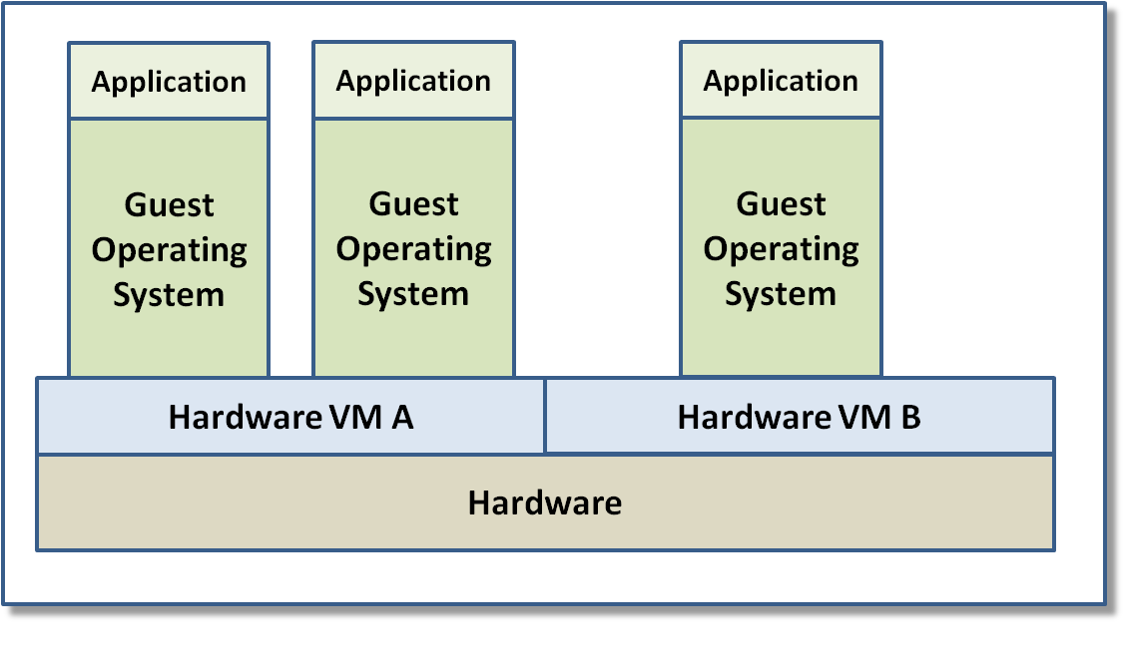
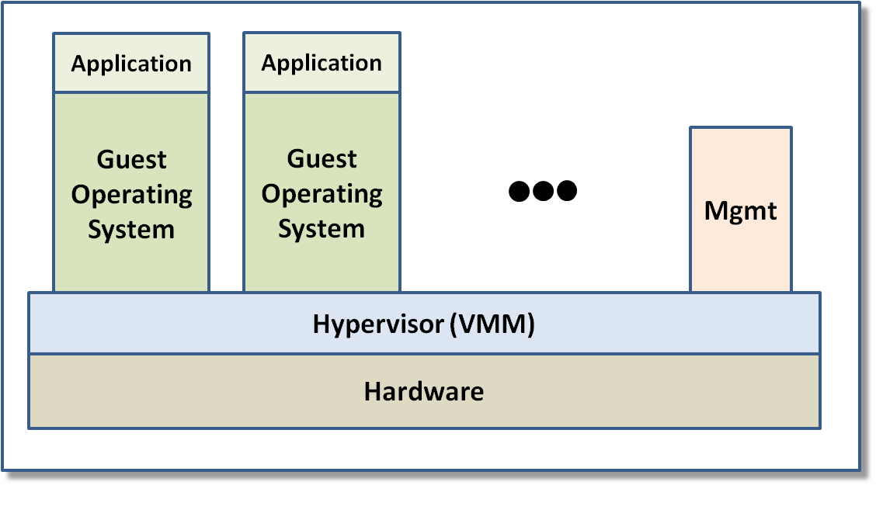
Overview of VM Technology
Hardware Virtualization (Emulation)
HVM emulates guest hardware platform
HVM manages all system resources
New hardware platforms
Multi-hardware platform utilization
Legacy hardware, operating system, and
application platforms
Inefficient instruction ratio – 100 to 1000 : 1
For legacy systems this may be ok
Full Virtualization
Hardware Virtualization – Trap & Emulate
Software Virtualization – Binary Translation(BT)
VMM manages all system resource requests
Guest OS have no knowledge of VM environment
Sometimes VMM has I/O driver suite
Faster but a lot of new I/O code development
Sometimes Host OS manages I/O driver suite
Slower but little new I/O code development
Some Combine both for best performance/code
tradeoff
Hardware Virtualization
Full Virtualization

Slide 47
Full virtualization
Translates kernel code to replace nonvirtualizable instructions with sequences of instructions that have the intended effect on the virtual hardware.
User level code is directly executed on the processor
Each virtual machine monitor provides each V M with all the services of the physical system, including a virtual BIOS, virtual devices and virtualized memory management.
The guest OS is fully abstracted (completely decoupled) from the underlying hardware by the virtualization layer. The guest OS is not aware it is being virtualized and requires no modification.
Full virtualization offers the best isolation and security for virtual machines, and simplifies migration and portability as the same guest OS instance can run virtualized or on native hardware.
Some VMware’s virtualization products, Parallels, and Microsoft Virtual Server are examples of full virtualization.

Slide 48
Full virtualization idea

Slide 49
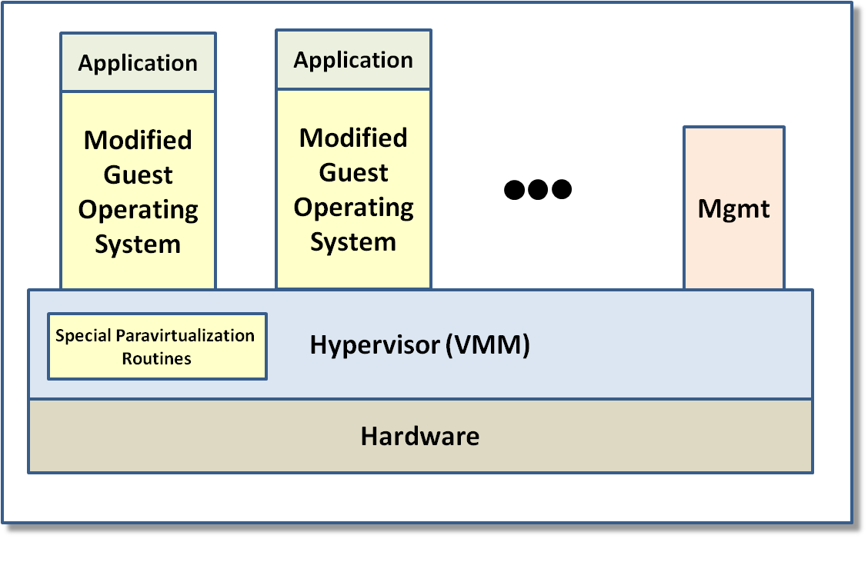
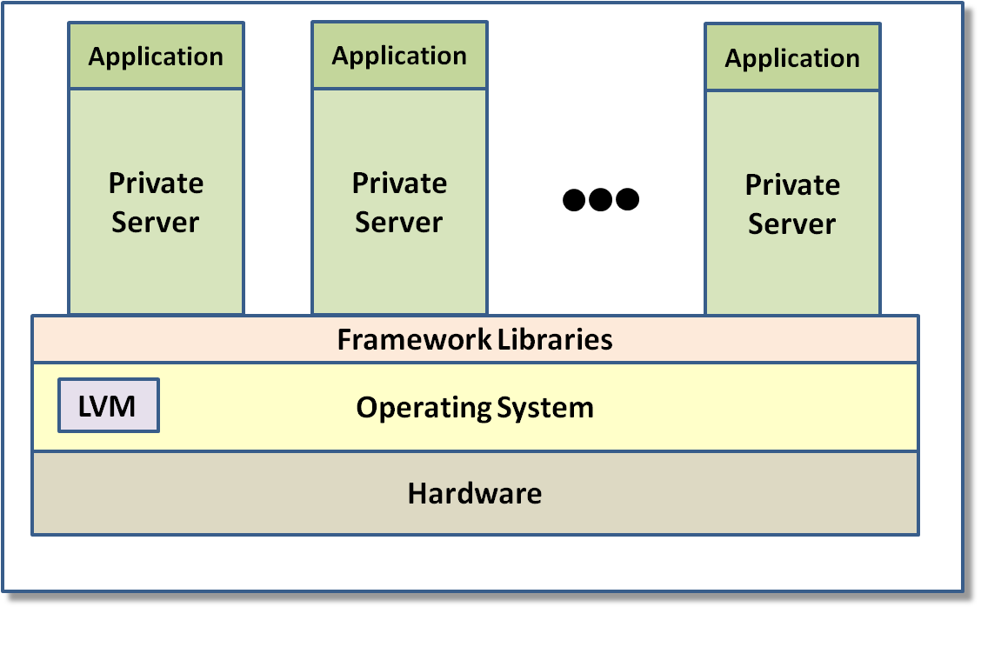
Overview of VM Technology
Paravirtualization
Guest operating system modified
I/O
Memory
Privileged
Better performance
Eliminates hardware issues
Requires unique operating system release
Not all operating systems are open
Operating System Virtualization
Recent VM technology
Utilizes framework containers
Server Programming Model
Container manages isolation
Framework libraries manages resources
Language Virtual Machine manages security
Very popular with server development
community – IIS, Tomcat, Geronimo
Allows very quick scale up of servers
Paravirtualization
Operating System Virtualization

Slide 50
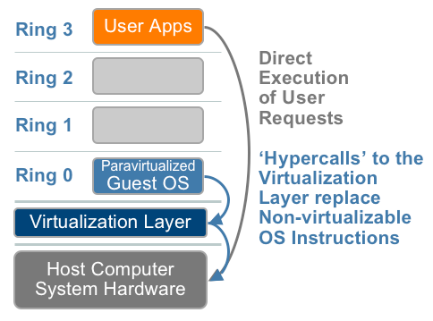
Paravirtualization

Slide 51
Paravirtualization
It involves modifying the OS kernel to replace nonvirtualizable instructions with hypercalls that communicate directly with the hypervisor.
The hypervisor also provides hypercall interfaces for other critical kernel operations such as memory management, interrupt handling and time keeping.
The value of paravirtualization is in lower virtualization overhead, but the performance advantage of paravirtualization over full virtualization can vary greatly depending on the workload.
As paravirtualization cannot support unmodified operating systems (e.g. Windows 2000/XP), its compatibility and portability is poor.
Paravirtualization can also introduce significant support and maintainability issues in production environments as it requires deep OS kernel modifications. But the VMM is simpler than in full virtualization.
The open source Xen project is an example of paravirtualization that virtualizes the processor and memory using a modified Linux kernel and virtualizes the I/O using custom guest OS device drivers. VMWare uses this approach in some products.

Slide 52
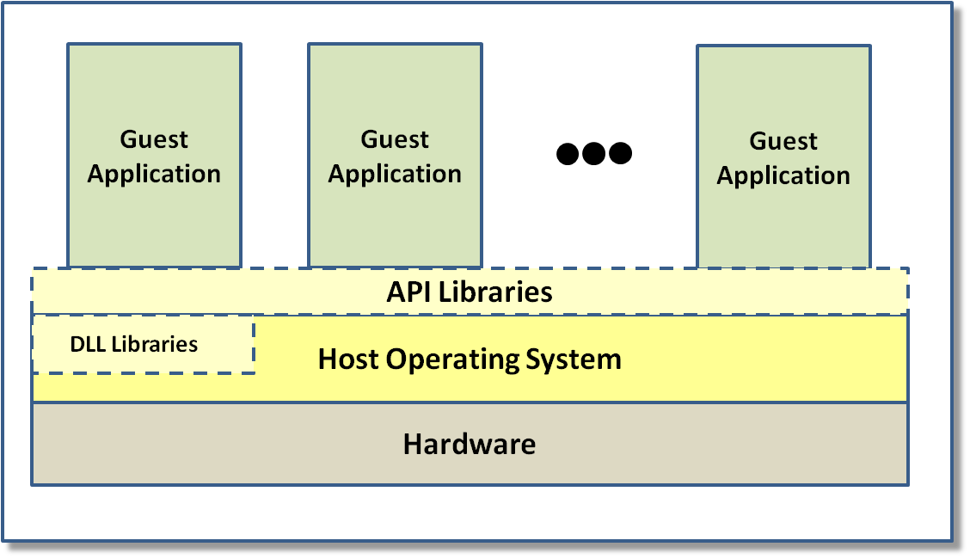
Overview of VM Technology
Library Virtualization
Guest applications are virtualized
Applications acquire system resources
through API calls
Virtualization is done through API’s
Guest API calls are converted to Host
API calls
I/O & Interrupts are handled by special
DLL Libraries
Typically enables applications to run on many platforms
Often you see this with Windows applications running on Linux
Apple Macintosh OS good example – Runs Windows apps on MacOS
Library Virtualization

Slide 53
Hardware assist
Hardware vendors have developed features to simplify virtualization techniques. First generation enhancements include Intel Virtualization Technology (VT-x) and AMD’s AMD-V which both target privileged instructions with a new CPU execution mode feature that allows the VMM to run in a new root mode below ring 0.
Privileged and sensitive calls are set to automatically trap to the hypervisor, removing the need for either binary translation or paravirtualization.
The guest state is stored in Virtual Machine Control Structures (VT-x) or Virtual Machine Control Blocks (AMD-V).
Processors with Intel VT and AMD-V became available in 2006
Used by Microsoft, Parallels, VMware Workstation (for 64-bit guests only), XenCenter, Xen 3.x (including derivatives like Virtual Iron), Linux KVM and Microsoft Hyper-V.

Slide 54
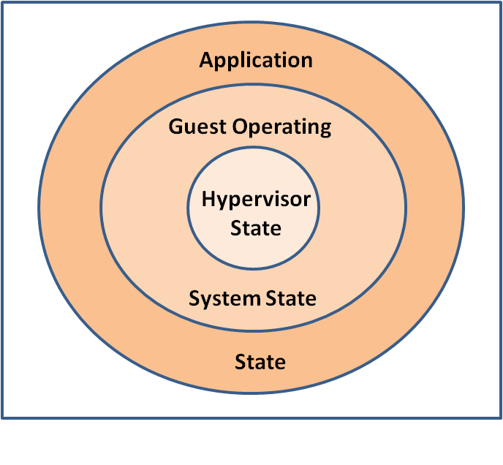
Intel Virtual Technology (VT)
Developed new privilege state -- VMX Root/VMX Non-Root
Previous x86 hardware implementations 0>1>2>3
Almost all operating systems run on 0/3
Best option would be 0/1/3 operation for VM
OS design forced 0/3/3 operation – Many problems
Added additional privilege state
VMX Root 0>VMX-non Root 0>1>2>3
Operating system maintained privilege ring design
VMX Root allowed VMX Root 0/VMX Non-Root 0/4 Operation
Eliminated Ring Aliasing and Ring Compression Problems
All privilege instructions trap at ring 3
Some trap at VMX Non-Root 0
None trap at VMX Root 0
Fixed Privileged Instruction and Hidden State Issues
Better management of Interrupt Masking in VMX Non-Root 0
Added VT-c – High performance I/O Virtual DMA mapping for NIC’s
Added VT-d – Similar to VT-c but a more generalized I/O model for other devices
Virtual Machine Privilege Rings

Slide 55
Hardware assist

Slide 56
Memory virtualization
To run multiple virtual machines on a single system, another level of memory virtualization is required: One has to virtualize the Memory Management Unit (MMU) to support the guest OS
The guest OS continues to control the mapping of virtual addresses to the guest memory physical addresses, but the guest OS cannot have direct access to the actual machine memory. The VMM is responsible for mapping guest physical memory to the actual machine memory, and it uses shadow page tables to accelerate the mappings
The VMM uses TLB hardware (a cache) to map the virtual memory directly to the machine memory to avoid the two levels of translation on every access.
When the guest OS changes the virtual memory to physical memory mapping, the VMM updates the shadow page tables to enable a direct lookup.
MMU virtualization creates some overhead for all virtualization approaches, but this is the area where second generation hardware assisted virtualization offers efficiency gains.

Slide 57
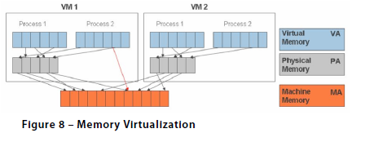

Slide 58
Page faults in Virtualized Memory
Page faults are generated when an application tries to use memory that is part of its working set, but can't find it. Page faults can be either hard or soft: Hard page faults occur when the page is found in the page file on the hard disk. Soft page faults happen when the page is found somewhere else in memory.
Hard page faults involve disk I/O and impact performance. Soft page faults also impact performance, but may not result in heavy performance loss in a physical environment.
VMware software does not cause the guest operating system running in the virtual machine to see additional page faults, but VMware software must virtualize the page faults that originate from within the virtual machine.
Both soft and hard page faults in a virtual machine cause a context switch into the virtualization layer and some additional processing to virtualize memory management data structures. As on native hardware, hard page faults in a virtual machine also require disk I/O to the page file. For best performance, avoid page faults whenever possible.

Slide 59
I/O virtualization
Involves managing the routing of I/O requests between virtual devices and the shared physical hardware.
The hypervisor virtualizes the physical hardware and presents each virtual machine with a standardized set of virtual devices as seen in Figure 9 (next slide).
These virtual devices effectively emulate well-known hardware and translate the virtual machine requests to the system hardware.
This standardization on consistent device drivers also helps with virtual machine standardization and portability across platforms as all virtual machines are configured to run on the same virtual hardware regardless of the actual physical hardware in the system.

Slide 60
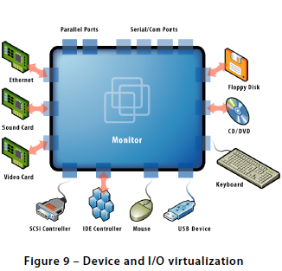

Slide 61
Virtual desktops
AKA VDI (Virtual Desktop Interface)
A virtual desktop is an individual user's interface in a virtualized environment. The virtualized desktop is stored on a remote server rather than locally.
When users work from their local machine, all of the programs, applications, processes, and data used are kept on the server and run centrally. This allows users to execute operating systems and applications from a thin client or mobile device, which exceed the user hardware's ability to run
Some virtualization platforms allow the user to simultaneously run multiple virtual machines on local hardware, such as a laptop, using hypervisor technology. Virtual machine images are created and maintained on a central server, and changes to the desktop VMs are propagated to all user machines through the network, thus combining both the advantages of portability afforded by local hypervisor execution and of central image management.
Examples: Citrix Xen Desktop, Citrix Synergy, VMWare View, Parallels

Slide 62
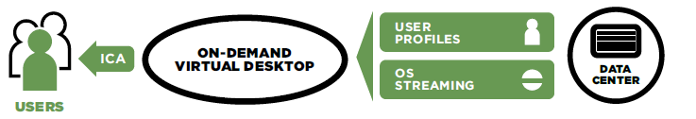

Slide 63
Benefits of server-side Vdesktops
Use a server hypervisor to encapsulate, deliver, and maintain personalized desktops in a centralized processor
Better resource utilization
Centralized management of user desktops means simpler administration
Potentially better security if server is well protected
Users have access to their desktops anywhere
A “bare-metal” (BM) desktop hypervisor runs independently of the client OS, and can provide better security and performance
A BM hypervisor allows users to have two desktop images on a PC or mobile device, one for work and another for personal use

Slide 64
Disadvantages
If there are many virtual desktops, the server must be big, with lots of memory
Hypervisor and connection broker are needed and can be expensive
Require high-speed Internet connection
Cannot work offline
Can be a single point of failure
Some complex applications, e.g. multimedia, are hard to run

Slide 65
Client-side/remote hypervisor desktop
Includes OS, applications, and data in a VM that runs locally (but only as much as needed) using images from a server
Easier to scale than server side
No single-point of failure
Software is simpler than server side
More flexible to interact with clouds or other applications
More responsive than server side
Can work online or offline
May be less secure (not inherently), but compromises only one client
Technology is less mature
Examples: XenApps, Windows Remote Desktop Services

Slide 66
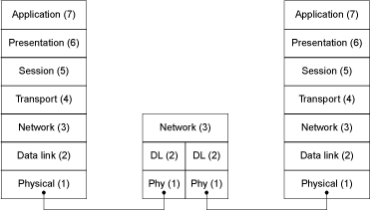
Network ISO Layers

Slide 67
Internet layers
Layer 7 (HTTP),
Layer 4 (TCP, Transmission Control Protocol),
Layer 3 (IP, Internet Protocol),
Layer 1.
At the higher levels, the sub-protocols used are TCP (a connection-oriented protocol), and UDP (User Datagram Protocol)
9/12/2016
67

Slide 68
Layers 1 and 2
Layer 1 is the physical layer that links one node of a network to the next. Even at this low level, decisions have an impact on security: it is significantly harder to tap an optical fiber connection than a copper cable, which, in turn, is significantly harder to tap than data communications based on broadcast radio. Similar remarks can be made about the introduction of fake messages into the network. This means that these vulnerabilities have to be addressed at higher levels in the protocol stack.
Layer 2 is the data link layer, to carry data from one node, via the physical connection, to the next. To illustrate security concerns again, note that the fact that Ethernet broadcasts all messages to all connected nodes, makes it easy for a connected node to sniff (listen) to communications between other nodes. Also note that most data link layer protocols contain CRCs (cyclic redundancy codes) to ensure that data has not been modified in transit. This obviously contributes to integrity.

Slide 69
Layers 3 and 4
Layer 3 is the network layer — responsible for routing messages from the source node, through all intermediate routers, to the destination node. There is no notion of end-to-end communication yet — each router forwards the message to the next router or the destination node. Consider encryption again: If messages are encrypted on the network layer, they will have to be decrypted at each router; since there is no notion of end-to-end communication, it is not possible to share keys between endpoints yet. Encryption is not the only concern: If a router is compromised, it becomes possible to divert communications to nodes that mas­querade as the destination node or simply to cause the network to fail. This could affect confidentiality, integrity and availability. The Internet Protocol is currently the most widely used network protocol,
Layer 4 is the transport layer. This layer uses the underlying network infras­tructure to provide an end-to-end network path that can be used by the application-oriented protocols on the upper three layers. The transport layer often deals with congestion and other integrity and availability issues.
The Transmission Control Protocol (TCP) is the transport layer used in the TCP/IP protocol suite.

Slide 70
Network terms
Ports—numbered parts of the OS, used for communications
Addresses are used to identify the destination host for any request or response. Since such addresses are typically hard to use for human beings, addresses can be associated with logical names (URLs)
The Domain Name System (DNS) is used for this association. To translate the logical name www.xx.co.za to its corresponding address, a client sends a request to a DNS server. This server may have to send a request to other DNS servers until it has determined the corresponding address — which it can then supply to the client.

Slide 71
Network virtualization [Luo10]
Network bridging supports the network connectivity of multiple network interface cards (NICs) via a common link.
A network bridge connects two or more Ethernet segments together in a protocol-independent way. With bridges, packets can be forwarded based on the Ethernet address instead of IP addresses
Such layer-two forwarding enables transparent packet forwarding for all upper-layer protocols independently. For example, the current Linux bridge code implements a subset of the IEEE 802.1d standard and supports both filtering and traffic shaping.

Slide 72
Ethernet
Ethernet is a family of networking technologies commonly used in local area networks (LANs) and metropolitan area networks (MANs).
It was commercially introduced in 1980 and first standardized in 1983 as IEEE 802.3, and has since been refined to support higher bit rates and longer link distances.
The original 10BASE5 Ethernet uses coaxial cable as a shared medium, while the newer Ethernet variants use twisted pair and fiber optic links in conjunction with hubs or switches.
Over the course of its history, Ethernet data transfer rates have been increased from the original 2.94 Mbit/s to the latest 100 Gbits/sec.
The Ethernet standards comprise several wiring and signaling variants of the OSI physical layer in use with Ethernet.
Systems communicating over Ethernet divide a stream of data into shorter pieces called frames. Each frame contains source and destination addresses, and error-checking data so that damaged frames can be detected and discarded
As per the OSI model, Ethernet provides services up to and including the data link layer.

Slide 73
Media Access Control (MAC)
In the IEEE 802 reference model, the media access control (MAC) layer is the lower sublayer of the data link layer (layer 2) of the seven-layer OSI model
The MAC sublayer provides addressing and channel access control mechanisms that make it possible for several terminals or network nodes to communicate within a multiple access network that incorporates a shared medium, e.g. an Ethernet network. The hardware that implements the MAC is referred to as a media access controller.
The MAC sublayer acts as an interface between the logical link control (LLC) sublayer and the network's physical layer. The MAC layer emulates a full-duplex logical communication channel in a multi-point network. This channel may provide unicast, multicast or broadcast communication service.

Slide 74
Network switch
A network switch (also called switching hub, bridging hub, officially MAC bridge) is a network device that connects vices together on a computer network, by using packet switching to receive, process and forward data to the destination device
A network switch forwards data only to one or multiple devices that need to receive it, rather than broadcasting the same data out of each of its ports.
A network switch is a multiport network bridge that uses hardware addresses to process and forward data at the data link layer (layer 2) of the OSI model.
Switches can also process data at the network layer (layer 3) by additionally incorporating routing functionality that most commonly uses IP addresses to perform packet forwarding; such switches are commonly known as layer-3 switches or multilayer switches

Slide 75
Network interface controller (NIC)
Also known as a network interface card, network adapter, LAN adapter or physical network interface
Connects a computer to a computer network
Modern network interface controllers offer advanced features such as interrupt and DMA interfaces to the host processors, support for multiple receive and transmit queues, partitioning into multiple logical interfaces, and on-controller network traffic processing
The NIC is both a physical layer and data link layer device, as it provides physical access to a networking medium and, for IEEE 802 and similar networks, provides a low-level addressing system through the use of MAC addresses that are uniquely assigned to network interfaces.

Slide 76
DNS
The Domain Name System (DNS) is a hierarchical distributed naming system for resources connected to the Internet.
It associates addresses (system names) with domain names (user names) assigned to the resources.
It is a hierarchical distributed naming system for any resource connected to the Internet.
Because of its importance, it has become a potential target for terrorists, and several attacks have already happened, e.g., the Syrian Electronic Army, a pro-Assad group, altered the DNS records used by the New York Times, Twitter, and the Huffington Post

Slide 77
DHCP
The Dynamic Host Configuration Protocol (DHCP) is a standardized networking protocol used on Internet Protocol (IP) networks for dynamically distributing network configuration parameters, such as IP addresses for interfaces and services.
With DHCP, computers request IP addresses and networking parameters automatically from a DHCP server, reducing the need for a network administrator or a user to configure these settings manually. The protocol operates based on the client-server model. DHCP is very common in all modern networks
Most residential network routers receive a globally unique IP address within the provider network. Within a local network, DHCP assigns a local IP address to devices connected to the local network.

Slide 78
Bridging
A VM can have multiple virtual NICs (VNICs) that communicate with outside networks.
Guest OSs use the VNICs through device drivers
The common way to communicate is to use a bridge. This is done by instantiating the same number of VNICs on the host machine and binding each one to the VNICs inside the VM
This one-to-one mapping from VM-VNICs to host machine (HN)-VNICs implies that the host CPU must differentiate between and forward all Ethernet packets to the VNICs inside the VMs.
This bridging operation introduces increasingly significant overhead when the number of VMs or VNICs increases.

Slide 79
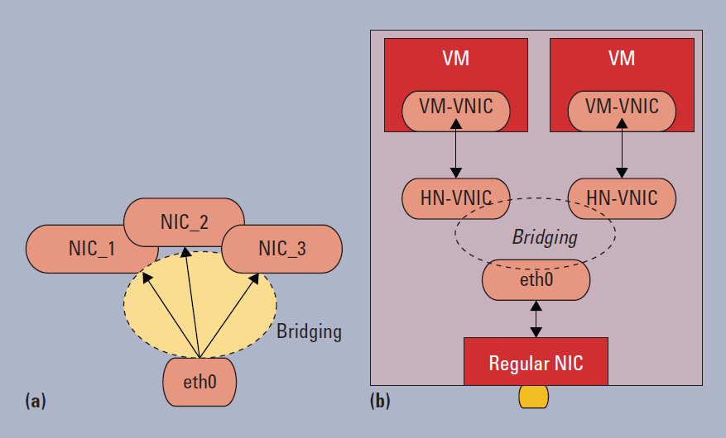

Slide 80
NIC Bonding
Also known as link aggregation
It groups multiple physical network links and provides the network bandwidth as an aggregate logic to the VMs
NIC bonding can break link bandwidth ceilings with little cost and improve the network connection’s reliability.
It also eases the virtual link management for VMs

Slide 81
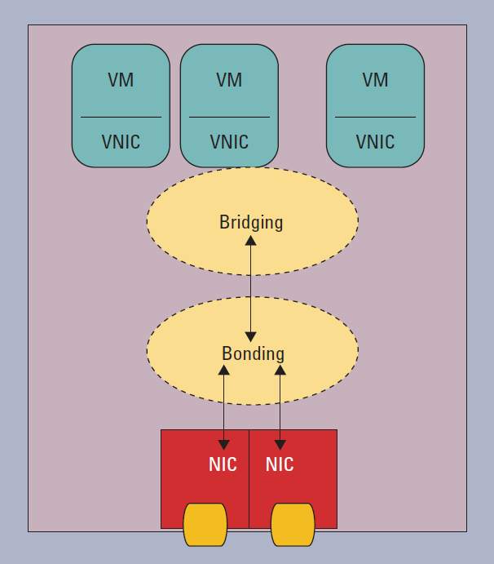

Slide 82
VMDq
Virtual Machine Device Queues (VMDq), proposed by Intel
Offloads the host CPU from sorting and multiplexing the packets to and from VMs.
At the chipset level (Intel 82598, for example), VMDq handles parallel queues of packets, routing them to the appropriate VMs and offloading the VMM.
This approach improves performance
FW= packet forwarding
NetFlow=traffic statistics collection
QoS=quality of service enforcement

Slide 83
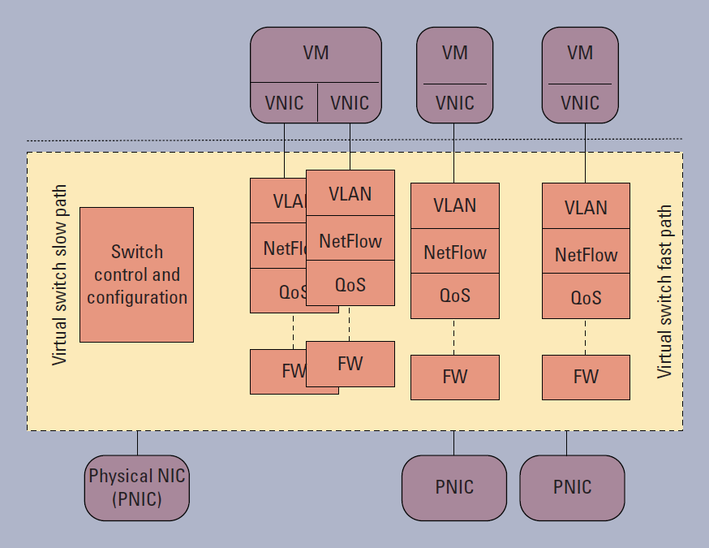

Slide 84
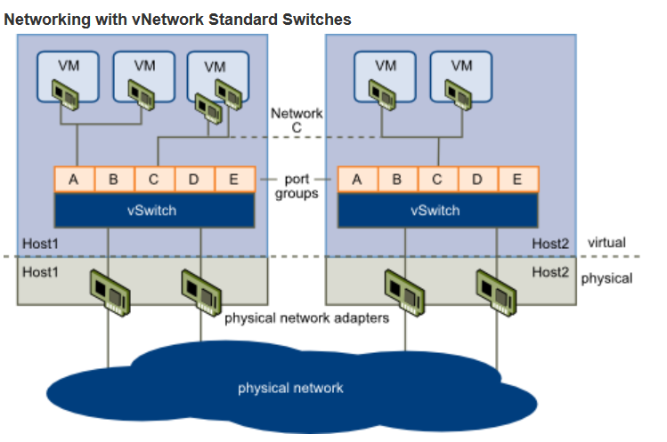
Vmware approach

Slide 85
Network Functions Virtualization (NFV)
Intent
It is an architecture for the construction of network services using software building blocks. The building blocks, Virtual Network Functions (VNFs), are typically created from cloud services using virtual machines or containers.
Problem
There is a variety of network devices that are required in order to set up communication networks. As indicated above, until recently, these devices were physical devices, but this approach implies a high up-front cost and is not scalable. When the needs of the users of the networks change we need to buy more or different devices. The new set up also takes time and we cannot be very responsive to the needs of our customers. If the devices have weak security protection it is difficult to harden them. How can we provide more flexible, responsive, and secure services to our customers?

Slide 86
Solution
Service providers (SPs) can use SaaS services to provide network functions where we simulate the specific functions of a hardware device using software running in one or more virtual machines or containers in the cloud
We can build network services using the PaaS and IaaS services and deploy them as SaaS services. These network services can then be used for the needs of the applications being accessed by the Consumers.
The Network Services are provided by a telco company, which in turn rents virtual hardware from the cloud provider (or owns the cloud).

Slide 87
Network implementation changes

Slide 88
Idea of NFV

Slide 89
NFV pattern

Slide 90
Software Defined Networking (SDN)
It is an emerging architecture for networks that separates the control from the data in switches and routers. Under SDN, the control plane is implemented in software in servers separate from the network equipment and the data plane is implemented in commodity network equipment.
OpenFlow is a leading SDN architecture.
In routing, the control plane is the part of the router architecture that is concerned with drawing the network map, or the information in a (possibly augmented) routing table that defines what to do with incoming packets.
Control plane functions, such as participating in routing protocols, run in the architectural control element. In most cases, the routing table contains a list of destination addresses and the outgoing interface(s) associated with them.
Control plane logic also can define certain packets to be discarded, as well as preferential treatment of certain packets for which a high quality of service is defined by such mechanisms as differentiated services.

Slide 91
References
[Fer15] E. Fernandez and Brahim Hamid, “A pattern for Network Functions Virtualization”, 21st European Conf. on Pattern Languages of Programs (EuroPLoP 2015)
[Hut10] G. Hutch, “Getting the most out of Virtualization”, The Architecture Journal, http://msdn.microsoft.com/en-us/architecture/ff803574.aspx
[Luo10] Y. Luo, “Network I/O virtualization for cloud computing”, IEEE IT Pro, Sept./Oct. 2010, 36-41
[Nur09] D. Nurmi, et al., “The Eucalyptus Open-source Cloud-computing system”, 9th IEEE/ACM Int. Symposium on Cluster Computing and the grid, 2009, 124-131.
[Pop74] G. J.Popek and R.P. Goldberg, “Formal requirements for virtualizable third generation architectures”, Comm. of the ACM, vol. 17, No 7, 1974. http://en.wikipedia.org/wiki/Popek_and_Goldberg_virtualization_requirements

Slide 92
References II
[Nut03] G. Nutt, Operating systems (3rd Ed.), Addison-Wesley, 2003.
[OVF] https://en.wikipedia.org/wiki/Open_Virtualization_Format
[Qem16] QEMU. 2016. https://en.wikibooks.org/wiki/QEMU. Accessed: 08/10/2016.
[Ros05] M. Rosenblum and T. Garfinkel, “Virtual machine monitors: Current technology and future trends”, Computer, IEEE May 2005, 39-47.
[Vmw] Vmware, “Understanding full virtualization, paravirtualization, and hardware assist”, https://www.vmware.com/content/dam/digitalmarketing/vmware/en/pdf/techpaper/VMware_paravirtualization.pdf

Slide 93
Solutions
Types of questions of Past assignments/exams

Slide 94
Q1
The Analytics department of a large corporation needs to perform complex computations to predict prices, earnings, and similar. They have a large server but now this is not enough for the new calculations they need to make. They are considering three possibilities:
Buy more servers, more memory and I/O, and run their own computational facility.
Rent computational power in a public cloud.
Build their own private cloud.
Evaluate these proposals by showing a table comparing them. Add short justifications to each item in the table.
Based on your table, recommend for them the best solution. Justify it.

Slide 95
Solution
 | Own Comp. Facility | Public Cloud | Private Cloud
Cost | Initial high cost, it will outdate in a few years, servers, storage and networking needs dedicated to one activity. Requires IT personnel to run data center. Expensive to procure and configure. | Cheaper, pay as you go, so pay and use only what you need. No IT personnel required. On the other hand, no capital gain or tax advantages because having servers and network equipment can pay off in the long run as assets and tax advantages. | Initial high cost but because it is reconfigurable and not dedicated to one activity it is never idle so it is cheaper on a per server basis. Gives researchers access to IT services relatively inexpensively in minutes. Less dedicated servers. Extra personnel.
Availability | Planned and scheduled down time. Additional facilities , i.e. more investment. | Because public cloud service providers don’t want to advertise planned down time, unexpected major outages may occur, other than that, overall hardware and network availability that meets or exceeds that of the average corporate data center. On the negative side, some cloud service providers caution users that their instance (or server) can disappear at any time and that they should plan accordingly. | High availability, more control of their outages, planned and scheduled down times if any. Since it is real time reconfigurable, loads on non functioning servers can be easily switched to functioning servers, thus increasing availability
Performance | High Performance since it is dedicated to the users and their computational tasks only. Depends on local connection. | Very little control over the architecture, performance, or how resources are shared between user and hundreds of other users in the same cloud. Slow, data transfer rate depends on the ISP which is usually 10 mbps. | High Performance but because there is extra monitoring inside the cloud to be able to reconfigure itself real time, it may be slower than the dedicated computational facility. Private clouds are deployed inside firewall so transfer rate can be as fast as 100 mbps or faster if using a gigabit Ethernet connection.

Slide 96
Maintainability | Full Maintenance. Owners need to provide all the necessary tools and resources to the operations and maintenance staff. Tools need to be installed on each computer. | No Maintenance. Tools and resources do not have to be installed on each user's computer. Cloud services provider in charge of support, changes reach the clients instantly. Having a virtualized public cloud means never having to deal with a physical server, it can be maintain from a configuration screen. | Full Maintenance, if hosted onsite. Owners need to provide adequate power, cooling and general maintenance. Possibly more complex than in the first case.
Scalability | Need to plan ahead carefully | Highly scalable, instantly accessible solution for users needing extra computer power or storage. | Can scale more than old facility but limited by existing servers
Resources | Dedicated and specialized IT personnel needed to run the institute’s IT department. | No dedicated or specialized IT personnel needed. Owned by an organization selling cloud services. | It may be managed by the institute or a third party and may exist on premise or off premise.
Accessibility | Only local access | Can be accessed from anywhere | Can be accessed from anywhere
Reliability | Good if we spend on redundancy | Depends on provider | Same as first option. Hardware vendors have several solutions

Slide 97
Security | Highly secure. Security measures are implemented and monitored by the corporation. On the other hand, if not much money or resources invested in security, it could be totally the opposite, not very secure at all. | Lower security. Concerns can persist about loss of control over certain sensitive data, and the lack of security for stored servers. Sometimes, no logs provided. On the other hand, security is often as good as or better than under traditional systems, in part because providers are able to devote resources to solving security issues that many customers cannot afford. More insiders have access to data. | Private cloud only as secure as IT staff make it. Private cloud management software may include high security measures. Internet access reduces security.
Administration | Our own IT team controls everything | Provider control | Own IT team
Recovery | Need a backup site | Handled by provider (we have to pay for it) | Need a backup site but it is easier to do

Slide 98
Recommendation
Critical factors: information is sensitive so high security is needed; calculations may be very long so reliability is needed. Accessibility may be important.
Calculations are predictable so flexibility is not so important. Number of users is known, no unpredictable growth. We already have servers so there is only an incremental cost.
Best solution is a private cloud.

Slide 99
Q1 A poor solution, considers only one factor: The best solution for the corporation is using Public Cloud because it provides the most cost efficient solution, no initial cost and shortest implementation times. Other options have significant initial and annual costs and long implementation times.
Usage efficiency | LOW Since servers are configured for running specific task, it’s very hard to use them for other tasks, so when computation is not needed servers are not in use, which means low utilization of hardware. | HIGH When computation is completed and not needed for period of time, servers can be used for other purposes, which provides high utilization of hardware. | HIGH When computation is completed servers can be stopped, which provides high utilization and low price.

Slide 100
A similar problem
A group of medicine/biology scientists are discussing their need for more computational power. They need to run large computational tasks to perform experiments about genomics, image processing, data mining, and similar. They are considering three proposals:
Buy a large multiprocessor with lots of memory and I/O, and run their own computational facility.
Rent computational power in a public cloud.
Build their own private cloud.
This is for a new institute, so they don’t have now any facilities. Evaluate these proposals by showing a table comparing them. Add short justifications to each item in the table.
Based on your table, recommend for them the best solution. Justify it.

Slide 102
7 | Scalability | Limited. Any extra additions required are limited to the existing hardware and software and limits of budget. | Scalability is provided upon your request, but it’s subject to fees. | You can control your degree of scalability based on your needs. If your resources are enough, that’s fine, but if not, you can contact other vendors to do so.
8 | Integration Of Apps | Applications as deployed are fixed. Chances of adding or removing apps are minimum and limited. | Choosing applications that fit your need is limited to the vendor’s available and compatible applications. | Choosing applications is balanced between your own applications and the vendor’s menu of apps.
9 | Flexibility | Hardware and software limitations give you less-flexible system. Any necessary changes will consume time and efforts. | A higher degree of flexibility is expected. But adapting new features of your system is limited to the provider capabilities. | A higher degree of flexibility is expected. Adapting new features of your system is possible by managing your resources carefully.
10 | Sensitive info | Sensitive data are protected. No worry of privacy and misuse violations should be addressed. | Unless compiling with HIPAA, Clouds are not ideal for critical or sensitive information | Unless compiling with HIPAA, Clouds are not ideal for critical or sensitive information
11 | Way of Operating | Less considerable. Even your actors have full local operating mode, Adding more computational units will add more unnecessary complexity to this project, and might switch this project to a Grid Computing project that goes beyond your control. | The system is functioning on a remote operational mode. You have less chances of adaptability to move your system from a vendor to another. | It’s different than Choice A. a good separation of executing tasks locally or remotely is enough to give the system an operable mode. Switching between vendors is possible.

Slide 103
Other types of questions for future assignments
Write a SLA for a specific type of application
Make a UML class diagram to refine some part of the RA or SRA. For example, in our SRA we refined the control of VM images
Consider the advantages and disadvantages of using a cloud for some activity, e.g. Manufacturing, airplane navigation and control

