Slide 1
Cloud Computing 2016 Chapter 10: Reliability, availability, and fault tolerance Identity Management
Dr. E.B. Fernandez

Slide 2
Reliability
A failure is said to occur in a system when the system’s environment observes an output from the system that does not conform to its specification. An error is the part of the system, e.g. one of its constituent (sub)systems, which is liable to lead to a failure. A fault is the adjudged cause of an error and may itself be the result of a failure. Hence, a fault causes an error that produces a failure, which subsequently may result to a fault, and so on.
An error class captures the cause for an error, the error can then manifest itself into a fault which is dealt with in the fault class. If the fault is not contained then it can manifest itself into a failure which is defined in the failure class. The pattern class handles failures when they occur. The pattern class defines the policies which are used to handle failures in the failure class.

Slide 3
A Metamodel for Reliability Concepts

Slide 4
Reliability
It is the ability for a system to follow its specifications
It is the probability that a system is working at time t2 knowing that it was working at time t1
Reliability is fundamental for safe-critical systems, where the lives of people could be endangered
Fault tolerance is being operational when some parts of the system are not functioning properly

Slide 5
Hardware and software reliability
Hardware faults are random and due to aging or physical disturbances
In the software reliability engineering community some believe that statistical models used in hardware reliability are useful as a measure of software reliability: the longer you run software, the higher the probability you will eventually use it in an untested manner and find a latent defect that results in a failure. Others believe that software faults are not random and statistical models are not appropriate; they use fault trees and similar tools to study software reliability
Hardware faults can be handled though redundancy, software faults require diversity (or very careful design)

Slide 6
Reliability mechanisms

Slide 7
Trip to Toulouse, France
Out Nov. 29 to Dec. 4
Attend habilitation defense of Prof. Brahim Hamid, U. of Toulouse.
“Habilitation” is the European way to promote assistant professors to associate professors. It entails writing a thesis summarizing their work of the last five years and defending it before a jury. I am part of his jury.
Prof. Hamid has visited us in 2015 and 2016. I wrote two papers with him and am now writing another one. I helped him with his thesis too.
I’ll leave class notes and the exam to make up for the missed class.
We still have classes on Monday Dec. 5.

Slide 8
Final exam (due Monday, Dec. 12 by midnight)
Q1. Clouds have been proposed (maybe used?) as a way to control drones. Discuss the advantages and disadvantages of this idea. Consider both military and commercial use of drones.
Q2. What would be the advantages/disadvantages of controlling the traffic lights of a city using fog computing.
Q3. Describe a Security SLA using a UML model extending the one we saw for an SLA in Chapter 3. How would you express the degree of security required by the consumer? How would the SLA be enforced? Complement the UML model with explanations to describe the meaning of your classes. Consider the use of patterns.
No verbose descriptions, itemize your ideas, add diagrams whenever relevant, indicate your sources of information separately for each question.

Slide 9
Dependability
Ability to deliver service that can justifiably be trusted
Ability of a system to avoid failures that are more frequent or more severe, and outage durations that are longer than is acceptable to the user(s)
It usually includes reliability, availability, and safety, although some authors also include security
Survivability: the quantified ability of a system, subsystem, equipment, process, or procedure to continue to function during and after a natural or man-made disturbance.

Slide 10
Dependability achievement (policies)
Fault avoidance
The system is developed in such a way that human error is avoided and thus system faults are minimised.
The development process is organised so that faults in the system are detected and repaired before delivery to the customer.
Fault detection
Verification and validation techniques are used to discover and remove faults in a system before it is deployed.
Fault tolerance
The system is designed so that faults in the delivered software do not result in system failure.

Slide 11
Diversity and redundancy
Redundancy
Keep more than 1 version of a critical component available so that if one fails then a backup is available.
Diversity
Provide the same functionality in different ways so that they will not fail in the same way.
However, adding diverse redundancy adds complexity and this can increase the chances of error.
Some researchers advocate simplicity and extensive Validation & Verification as a more effective route to software dependability.
However, all flight control systems I know used diverse redundancy (Airbus 320 to 380, Boeing 777 and 787, Space Shuttle)
The A340-600 has a purely electrical (not electronic) back-up rudder control system, and beginning with the A380 airliner, all flight-control systems have back-up systems that are purely electrical.

Slide 12
Example: Fly-by-Wire, Airbus 320/330/340 [Bri93]
Computer controls all actuators
No control rods or cables in the plane
5 central flight control computers
Different systems used: Thomson CSF => 68010 SFENA => 80186
Software for both hardware systems written by different software houses
All error checking & debugging performed separately
Computer allows pilot to fly aircraft up to certain limits – beyond them the computer takes over
With the Boeing 777 model airliners, the two pilots can completely override the computerized flight-control system to permit the aircraft to be flown beyond its usual flight-control envelope during emergencies.

Slide 13
Airbus reliability architecture
The Airbus FCS has 5 separate computers, any one of which can run the control software.
Extensive use has been made of diversity
Primary systems use a different processor from the secondary systems.
Primary and secondary systems use chipsets from different manufacturers.
Software in secondary systems is less complex than in primary system – provides only critical functionality.
Software in each channel is developed in different programming languages by different teams.
Different programming languages used in primary and secondary systems.

Slide 14
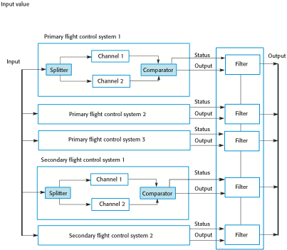
Airbus flight control system architecture

Slide 15
Availability
Availability is the proportion of time a system is in a functioning condition.
It measures the up time of a system, the system is there when I need it
If there are short periods when the system is not working, availability can still be good
Availability is much more important than reliability for clouds, for airplanes it is the reverse

Slide 16
Safety
Safety is a property of a system that reflects the system’s ability to operate, normally or abnormally, without danger of causing human injury or death and without damage to the system’s environment.
It is important to consider software safety as most devices whose failure is critical now incorporate software-based control systems.
Safety requirements are often exclusive requirements i.e. they exclude undesirable situations rather than specify required system services. These generate functional safety requirements.
Safety is usually expressed using assertions: “The doors of an elevator cannot open when it is moving”

Slide 17
More terms
Monitoring: observe and check the progress or quality of (something) over a period of time; keep under systematic review. The objective is to ensure that a system is operating within an assured level of service by providing information about the operations and about the state of each component
Resilience is the ability to provide and maintain an acceptable level of service in the face of faults and challenges to normal operation. Threats and challenges for services can range from simple misconfiguration, to large scale natural disasters, or to targeted attacks

Slide 18
Acknowledgement pattern [Buc09]
Intent: Detects errors in a system by acknowledging the reception of an input within a specified time interval.
Solution: Acknowledge receipt of an input within a specified time interval without increasing the time overhead significantly. Once the monitoring system provides input to the monitored system, it sets a local timer to a predefined timeout. While the timer is counting down from the set timeout, the monitoring system waits to receive an acknowledgment about the reception of the input by the monitored system. If the acknowledgment arrives before the timeout has expired, the monitored system is considered to function correctly; otherwise the monitoring system assumes that an error has occurred on the monitored system.

Slide 19
Solution
The Sender in conjunction with the Timer constitutes the Monitoring system. The Sender is responsible for contacting the monitored system. The Timer is responsible for counting down the timeout period every time an input is provided to the monitored system. When the timeout period expires for N consecutive times without receiving an acknowledgement from the monitored system, the timer detects an error on the Monitored system and notifies the sender. The Receiver in conjunction with the Acknowledger entity constitutes the Monitored system. The Acknowledger is responsible for sending an acknowledgement to the timer every time the monitored system receives an input.

Slide 20
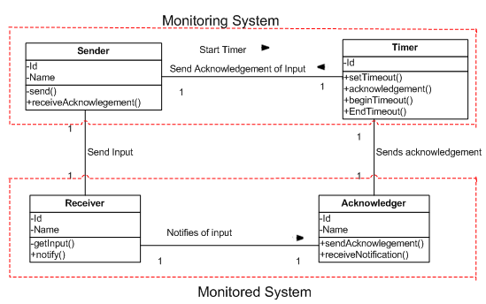
Acknowledgement pattern

Slide 21
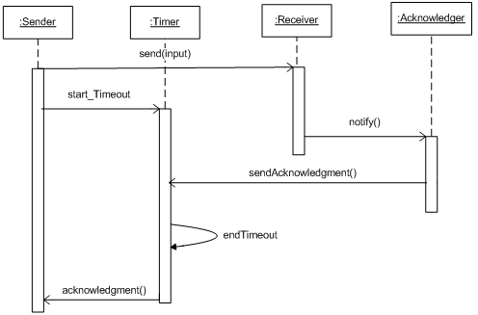
Get acknowledgment use case

Slide 22
Active Replication [Buc09]
Intent : Active replication masks hardware errors that can lead to a failure in a system. It uses a set of replicated processors that take in the same input and conduct independent and concurrent processing of that input. The outputs from all replicas are compared to ascertain the correct output. One processor error can be masked using three processors.
Example : Consider an aircraft which has to perform critical operations such as changing the path or direction of the airplane, based on a defined input. If the output given by the processor is incorrect this could result in a system failure possibly leading to a plane crash.
Context : Applications or critical systems that are deterministic and which can experience errors while processing inputs. These errors may lead to system failures.

Slide 23
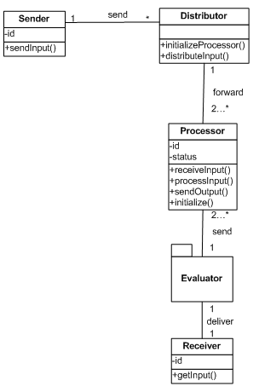
Active Replication

Slide 24
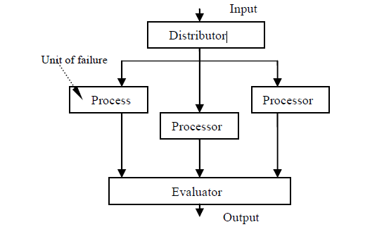
Triple Modular Redundancy

Slide 25
Known uses and Related patterns
Known Uses
The Boeing 777 airplane manufactured by Boeing Commercial Airplanes uses this approach [Boe90].
The HP Integrity NS16200 Server, manufactured by Hewlett Packard, is a server that provides scalable operational data stores for real time processing with high transaction volumes [HP08].
The Lunar Landing Research Vehicle (LLRV) was created by Bell Aerosystems and was used in the Apollo 13 project for landing on the moon¡¦s surface [Bel64].
Related patterns
The Active replication pattern is an extension of the Fail-Stop Processor pattern. The Fail-Stop Processor pattern is used for masking errors that lead to Byzantine failure.
The Object Group pattern is an object behavioral pattern for group communication and fault tolerance in distributed systems. This pattern can be used to dynamically manage and synchronize the processors.

Slide 26
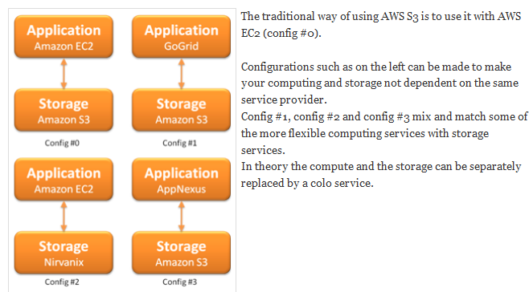
Mukul Kumar’s ideas http://mukulblog.blogspot.com/2008/07/cloud-availability.html

Slide 27
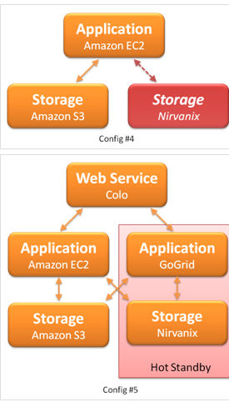
Mukul Kumar’s ideas http://mukulblog.blogspot.com/2008/07/cloud-availability.html

Slide 28
Nirvanix
Nirvanix was an American-based provider of cloud storage services headquartered in San Diego, California, United States. The company offered public, hybrid and private cloud storage services with usage-based pricing. Nirvanix shut down in October 2013.

Slide 29
RobustBPEL Approach
This study looked at a language-based approach to address reliability in the business layer.
RobustBPEL is a part of the transparent shaping programming model
A composite web service defined as a BPEL process is instrumented automatically to monitor its partner web services at runtime.
Events such as faults and timeouts are monitored from within the adapted process.
This adapted process is augmented with a proxy that dynamically replaces failed services.
They assert that this will improve fault tolerance and performance of BPEL processes by transparently adapting their behavior.
Transparency is achieved by using a dynamic proxy.
No change is made to the BPEL engine.

Slide 30
Key Features of VMware Fault Tolerance
• Runs on standard x86 based servers, vendor neutral.
• Supports standard unmodified guest operating systems and applications.
• Protects dozens of guest operating systems already supported by ESX, including 32- and 64-bit Windows, Linux, Solaris, and many other legacy guests.
• x86 hypervisor-based solution; integration with virtual machine technology, operating system neutral.
• Support for all emerging applications frameworks that have not yet evolved their own clustering solutions.
• Support for existing virtual machines.
• Single image management: virtual machine is installed and managed in the usual way as a single image; no need for additional operating system and software licenses

Slide 31
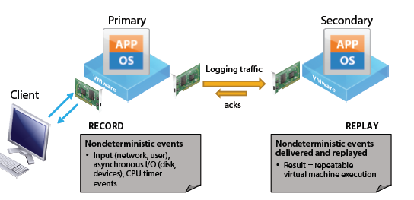
vLockstep architecture

Slide 32
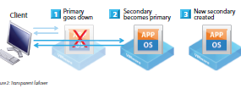
Vmware failover

Slide 33
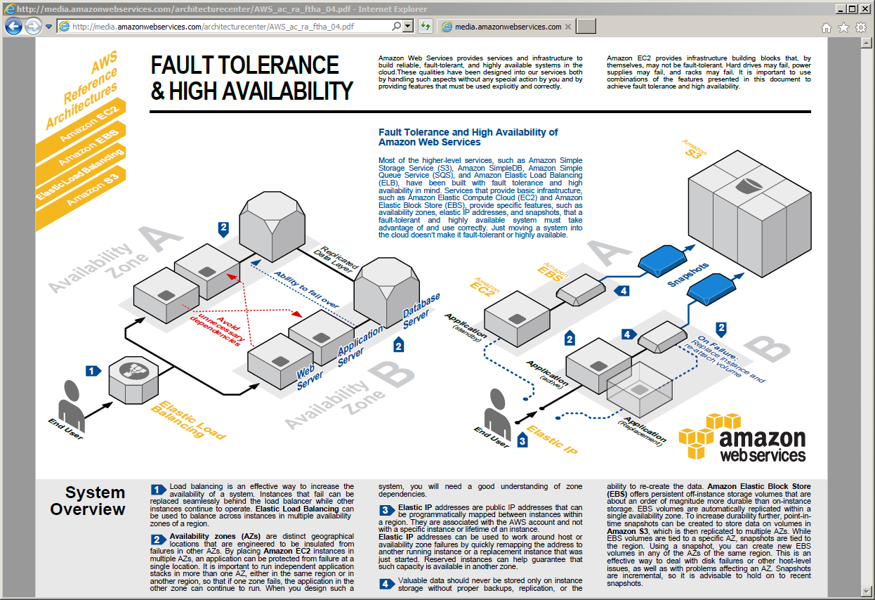

Slide 34
Reliability in Huawei Fusion Cloud
Active and standby processors
Heartbeat detection (Acknowledgement pattern)
Software watchdogs for processes
VM fault isolation
Data store redundancy
Redundant network paths
Detached plane network communication

Slide 35
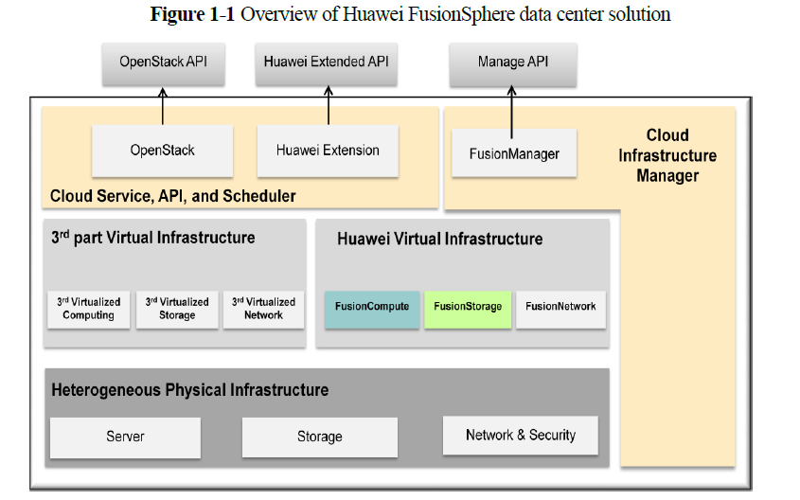

Slide 36
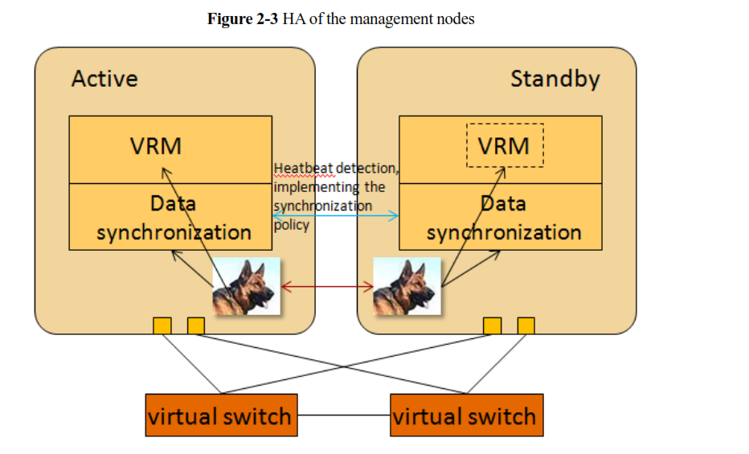

Slide 37
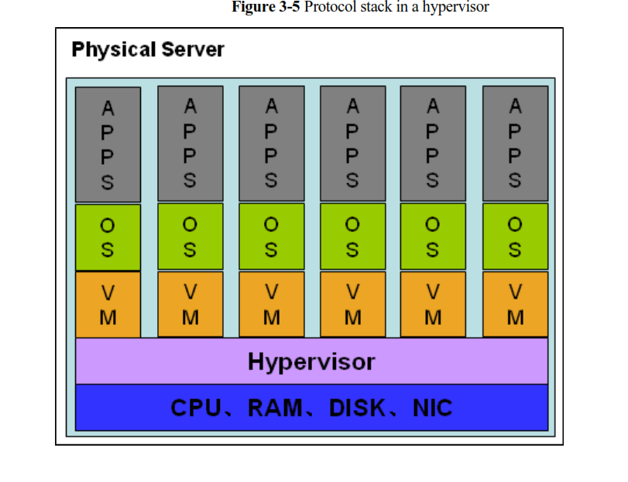

Slide 38
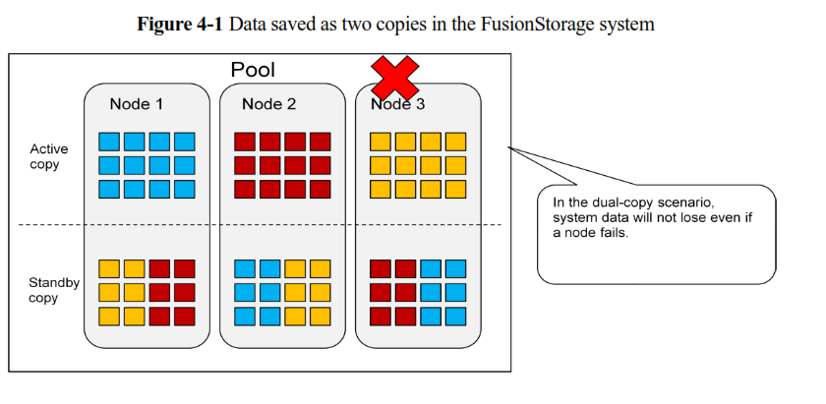

Slide 39
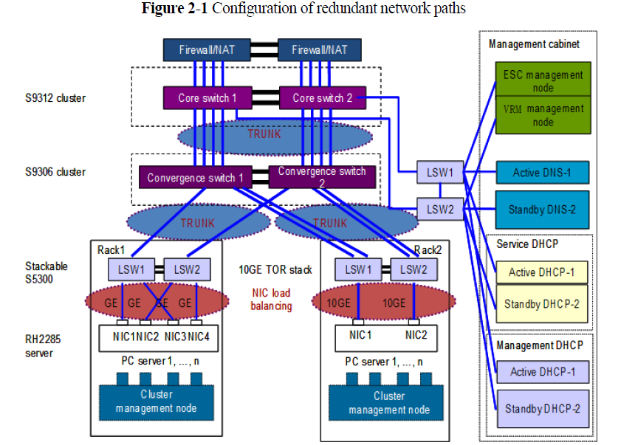

Slide 40
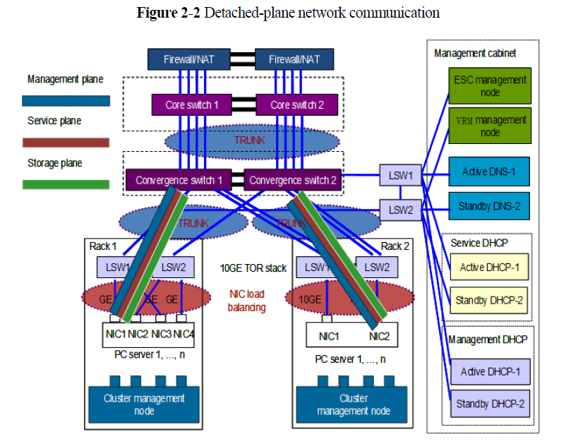

Slide 41
Amazon S3 Availability Event: July 20, 2008 http://status.aws.amazon.com/s3-20080720.html
At 8:40am PDT, error rates in all Amazon S3 datacenters began to quickly climb and our alarms went off. By 8:50am PDT, error rates were significantly elevated and very few requests were completing successfully. By 8:55am PDT, we had multiple engineers engaged and investigating the issue.
Our alarms pointed at problems processing customer requests in multiple places within the system and across multiple the system and across multiple data centers. While we began investigating several possible causes, we tried to restore system health by taking several actions to reduce system load. We reduced system load in several stages, but it had no impact on restoring system health.
We've now determined that message corruption was the cause of the server-to-server communication problems. More specifically, we found that there were a handful of messages on Sunday morning that had a single bit corrupted such that the message was still intelligible, but the system state information was incorrect.
We use MD5 checksums throughout the system, for example, to prevent, detect, and recover from corruption that can occur during receipt, storage, and retrieval of customers' objects. However, we didn't have the same protection in place to detect whether this particular internal state information had been corrupted. As a result, when the corruption occurred, we didn't detect it and it spread throughout the system causing the symptoms described above. We hadn't encountered server-to-server communication issues of this scale before and it took some time during the event to diagnose and recover from it.

Slide 42
Summary of the Amazon EC2 and Amazon RDS Service Disruption in the US East Region 04/2011 http://aws.amazon.com/message/65648/
The issues affecting EC2 customers last week primarily involved a subset of the Amazon Elastic Block Store (“EBS”) volumes in a single Availability Zone within the US East Region that became unable to service read and write operations. In this document, we will refer to these as “stuck” volumes. This caused instances trying to use these affected volumes to also get “stuck” when they attempted to read or write to them. In order to restore these volumes and stabilize the EBS cluster in that Availability Zone, we disabled all control APIs (e.g. Create Volume, Attach Volume, Detach Volume, and Create Snapshot) for EBS in the affected Availability Zone for much of the duration of the event.
For two periods during the first day of the issue, the degraded EBS cluster affected the EBS APIs and caused high error rates and latencies for EBS calls to these APIs across the entire US East Region. As with any complicated operational issue, this one was caused by several root causes interacting with one another and therefore gives us many opportunities to protect the service against any similar event reoccurring.

Slide 43
Amazon’s crash
As technical problems interrupted computer services provided by Amazon for a second day, industry analysts said the troubles would prompt many companies to reconsider relying on remote computers beyond their control.
“It will force a conversation in the industry.” That discussion will most likely center on what data and computer operations to send off to the cloud and what to keep inside the corporate walls.
Another issue will be a re-examination of the contracts that cover cloud services — how much to pay for backup and recovery services, including paying extra for data centers in different locations. That is because the companies that were apparently hit hardest by the Amazon interruption were start-ups that, analysts said, are focused on moving fast in pursuit of growth, and less apt to pay for extensive backup and recovery services.

Slide 44
Amazon crash II
Amazon has thousands of corporate customers, from Pfizer and Netflix to legions of start-ups, whose businesses often live on Amazon Web Services. Those reporting service troubles included Foursquare, a location-based social networking site; Quora, a question-and-answer service; Reddit, a news-sharing site; and BigDoor, which makes games
Amazon has data centers around the world, but the current problems have come from its big center in Northern Virginia, near Dulles airport. Amazon’s Web page on the status of its cloud services said on Friday that matters were improving but were still not resolvedools for Web publishers.
Netflix said it had sailed through the last couple of days unscathed. “That’s because Netflix has taken full advantage of Amazon Web Services’ redundant cloud architecture”.
BigDoor, a 20-employee start-up in Seattle, was knocked down by Amazon’s travails. It had backup and recovery services with Amazon, said Keith Smith, the chief executive, but only at Amazon’s data center in Virginia.

Slide 45
Microsoft outage Aug. 2010
On Monday Microsoft experienced a two-hour long outage of its hosted software services in North America due to a network issue, reports IDG. The downtime, which took place between 8:30 am and 10:45 am US Eastern Time, affected the Business Productivity Online Suite (BPOS) as well as number of other hosted services including Exchange Online, SharePoint Online, Office Live Meeting, Exchange Hosted Services, and Office Communications Online. Access to Microsoft’s Administration Center, Sign-In application and other online services was also impacted by the outage.
Microsoft issued a statement to warn the potentially affected customers that they “may experience timeouts with multiple services” and claim that “During the duration of the issue, customers were updated regularly via our normal communication channels”. However, the problems provoked a strong reaction and were widely discussed in the official Microsoft Online Services discussion forums. Some of the users pointed to other recent outages and performance issues, as well as about sluggish communication about them from Microsoft.

Slide 46
Summary of Windows Azure Service Disruption on Feb 29th, 2012 http://blogs.msdn.com/b/windowsazure/archive/2012/03/09/summary-of-windows-azure-service-disruption-on-feb-29th-2012.aspx
This partial service outage impacted Windows Azure Compute and dependent services: Access Control Service (ACS), Windows Azure Service Bus, SQL Azure Portal, and Data Sync Services. It did not impact Windows Azure Storage or SQL Azure.
While the trigger for this incident was a specific software bug, Windows Azure consists of many components and there were other interactions with normal operations that complicated this disruption.
There were two phases to this incident. The first phase was focused on the detection, response and fix of the initial software bug. The second phase was focused on the handful of clusters that were impacted due to unanticipated interactions with our normal servicing operations that were underway. Understanding the technical details of the issue requires some background on the functioning of some of the low-level Windows Azure components.

Slide 47
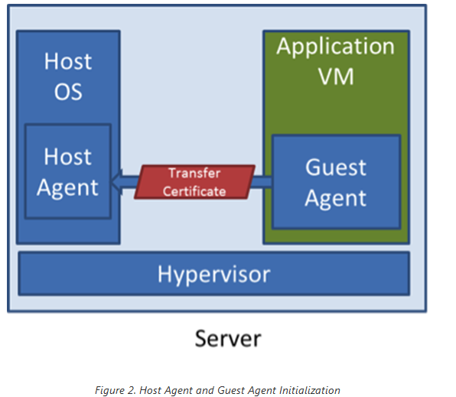

Slide 48
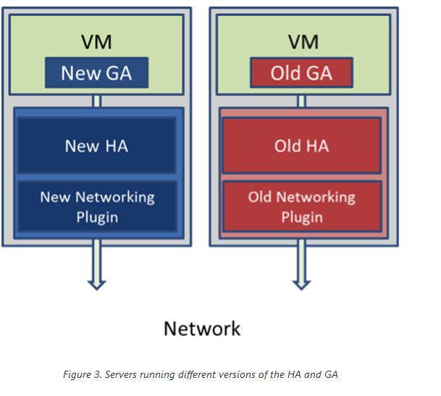

Slide 49
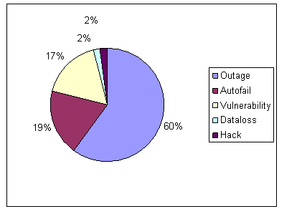
Cloud computing incidents: 128, 40, 37, 4, 4

Slide 50
Mission-critical clouds
Used by the military, government, and other applications
May combine different types of clouds: public, private, community.
Need for security, availability, reliability, safety, and timeliness
Must include monitoring and policy assessment: need-to-know, separation of duty
Governance and manageability
See Campbell et al., J. Internet Serv. Appl. Nov. 2011

Slide 51
References
[Bri93] D. Briere, and P. Traverse, “Airbus A320/A330/A340 Electrical flight Controls: A Family of Fault-Tolerant systems”, Procs. FTCS-23, pp.616-623, 1993
Jeff Barr, Attila Narin, and Jinesh Varia, “Building Fault-Tolerant Applications on AWS”, October 2011 http://media.amazonwebservices.com/AWS_Building_Fault_Tolerant_Applications.pdf
[Buc09] I.A.Buckley and E.B.Fernandez, "Three patterns for fault tolerance" , Procs. of the OOPSLA MiniPLoP, October 26, 2009.
Roy H. Campbell, Mirko Montanari, Reza Farivar: A middleware for assured clouds. J. Internet Services and Applications 3(1): 87-94 (2012)
http://cloudpatterns.org/design_patterns/redundant_storage
R. Jawhar and V. Piuri, “Fault tolerance and resilience in cloud computing environments”, in Computer and Info. Security Handbook, 2nd Ed., Morgan Kaufmann, 2013

Slide 52
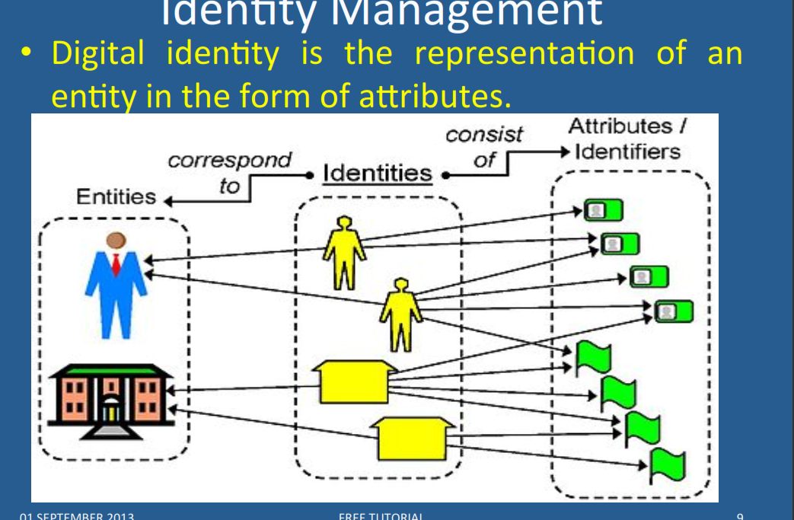

Slide 53
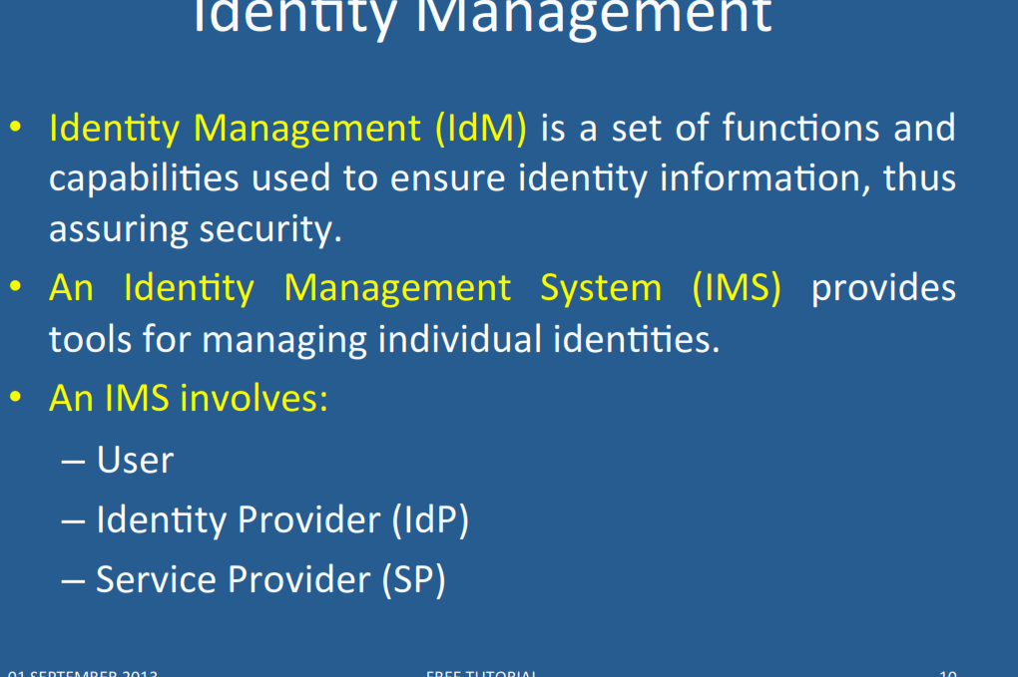

Slide 54
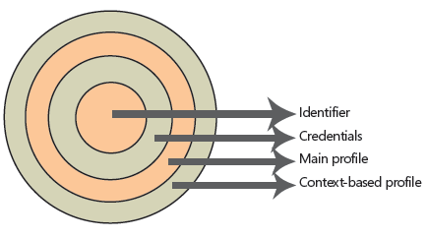
Digital identities

Slide 55
Identities
The innermost layer is the unique identifier of this digital identity. There should be no identical unique identifiers in the same security domain. Users must have unique identifiers to be easily recognizable by any system to which they have access.
To have access to this identifier, the user must present to the security system a set of credentials that will be checked against the computing secrets stored in the identity database. This is the nearest we can get in terms of proof of possession. A user is entitled to access her own unique identifier if and only if she presents the correct set of credentials to unlock this magic number.
After the user unlocks the unique identifier, a set of common attributes (called the main profile) is accessible to a system that may require a little more knowledge than the unique identifi er itself. This can be, for example, the user name, department, Social Security number, company name, and so on. These attributes do not vary from system to system; they are the same wherever the user logs on. They are a fixed set of values that are tied to the user during the lifetime of the logon session.

Slide 56
Identities II
But not all systems need to share information. There are sets of information that are only meaningful in the context of a system or related systems. For example, frequent flier miles are meaningful only under the context of an airline carrier, losing most of its meaning if moved from one carrier to another. But they share the same semantic context when used by the mileage program associates (restaurants, hotels, credit cards, and so on). These sets of attributes are stored in the context-based profile.
One digital identity can have only one unique identifier, a limited set of credentials (username/password pair, digital certificate/pin number pair, biometrical data), a unique set of main profile attributes, and an unlimited set of context-based profile attributes.

Slide 57
Identity management patterns

Slide 58
Circle of Trust
The Circle of Trust pattern allows the formation of trust relationships among service providers in order for their subjects to access an integrated and more secure environment.
Context: Service providers that provide services to consumers (subjects) over large systems such as the Internet.

Slide 59
Circle of trust class diagram

Slide 60
Identity Provider
The Identity Provider pattern allows the centralization of the administration of subjects’ identity information for a security domain.
Context: One or several resources, such as web services, CORBA services, applications, etc, that are accessed by a determined set of subjects. The subjects and resources are typically from the same organization.
Problem: Each application, or service may implement its own code for managing subjects’ identity information, leading to an overload in implementation and maintenance costs and that may lead to inconsistencies across the organization’s units.

Slide 61
Identity Provider class diagram

Slide 62
Identity Federation
The Identity Federation pattern allows the formation of a dynamically created identity within an identity federation consisting of several service providers. Therefore, identity and security information about a subject can be transmitted in a transparent way for the user among service providers from different security domains.
Problem: There may be no relationship among some of the security domains accessed by a Subject. Thus subjects may have multiple unrelated identities within each security domain. Consequently, they may experience multiple cumbersome registrations, authentications and other identity-related tasks prior to accessing the services they need.

Slide 63
Identity Federation

Slide 64
Identity Federation

Slide 65
References for Identity
N. Delessy, E.B.Fernandez, and M.M. Larrondo-Petrie, "A pattern language for identity management", Procs. of the 2nd IEEE Int. Multiconference on Computing in the Global Information Technology (ICCGI 2007), March 4-9, Guadeloupe, French Caribbean.
http://www.computer.org/portal/web/csdl/doi/10.1109/ICCGI.2007.5
E.B.Fernandez, “Security patterns in practice: Building secure architectures using software patterns”, Wiley Series on Software Design Patterns, 2013. Chapter4: Identity Management
J. Rodriguez and J. Klug, “Federated identity patterns in a service-oriented world”, Microsoft Architecture Journal, 16, 6-11.
SOA Patterns, “Federated identity”, http://soapatterns.org/federated_identity.php

Slide 66
