Slide 1
Cloud Computing 2016 Chapter 11: The mobile cloud Chapter 12: IoT and CPSs The future
Dr. E.B. Fernandez

Slide 2
Use of the cloud for mobile applications
Authoritative sourcing of data. The cloud serves as the custodian of the definitive versions of all shared data. Many local copies (such as cache copies or replicas) of a data item can be created for performance or reliability reasons, but the cloud is always the definitive source.
Synchronizing multi-user collaboration. Through a variety of workflow-related software, the asynchronous actions of a group of mobile users can be sequenced correctly.
Overcoming resource limitations. As mobile computing pushes to capabilities such as free-form speech recognition, natural language translation, face and object recognition, dynamic activity interpretation from video, and body language interpretation, it becomes necessary to amplify the compute power of resource-challenged mobile devices. Extending battery life, speeding up execution, and solving larger problems can all be obtained by offloading resource-intensive computation to the cloud.

Slide 3
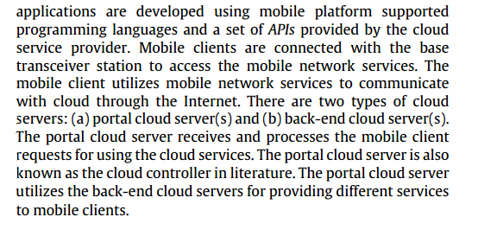

Slide 4
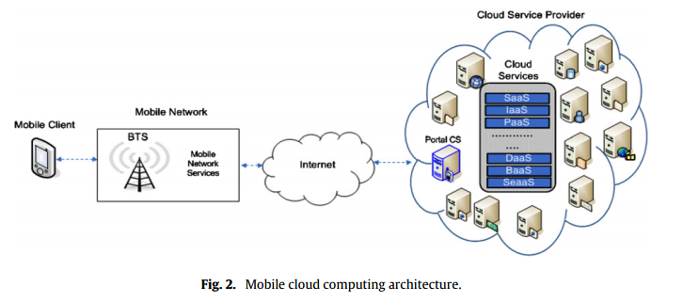

Slide 5
P.A. Cox, Mobile cloud computing http://www.ibm.com/developerworks/cloud/library/cl-mobilecloudcomputing/
A notable issue with the mobile cloud is the resource poverty of mobile devices. Compared to desktop computers, they have less screen size, less memory, less computational power, and battery capacity limits. Because of the resource poverty, the mobile cloud is most often viewed as an SaaS cloud, meaning that computation and data handling are usually performed in the cloud. Smart phones often access the cloud through web browsers or thin clients.
Latency and bandwidth affect the mobile cloud, as well. Wi-Fi improves latency but may decrease bandwidth when many mobile devices are present. Bandwidth for 3G cellular may further be limited by cell tower bandwidth in some areas. Similarly, connectivity may be intermittent. As cellular providers build out their networks, the situation will improve, but dead spots won't completely disappear.
Security issues increase with mobile devices. After all, it's easier to lose a mobile device. What if that device contains sensitive data just downloaded from the cloud? Hopefully, years of experience in the computer industry and cloud computing mean that mobile is not far behind in resolving these issues.

Slide 6
Possible applications
Image processing: running an optical character recognition (OCR) program on a
collection of mobile devices. In a real life scenario, this would be useful in a case of a
foreign traveler who takes an image of a street sign, performs OCR to extract the words,
and translates words into a language she knows.
Natural language processing: Translation is a viable candidate since different sentences
and paragraphs can be translated independently.
Crowd computing: Video recordings from multiple mobile devices can be spliced to
construct a single video that covers the entire event from different angles and
perspectives
Sensor data applications: Since most mobile phones are equipped with sensors today,
readings from sensors such as GPS, accelerometer, light sensor, microphone, thermometer, clock,
and compass can be timestamped and linked with other phone readings.

Slide 7
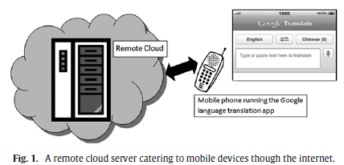

Slide 8
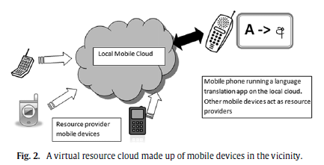

Slide 9
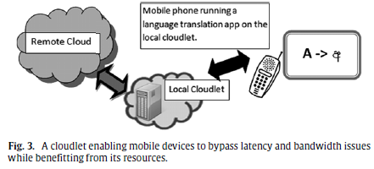

Slide 10
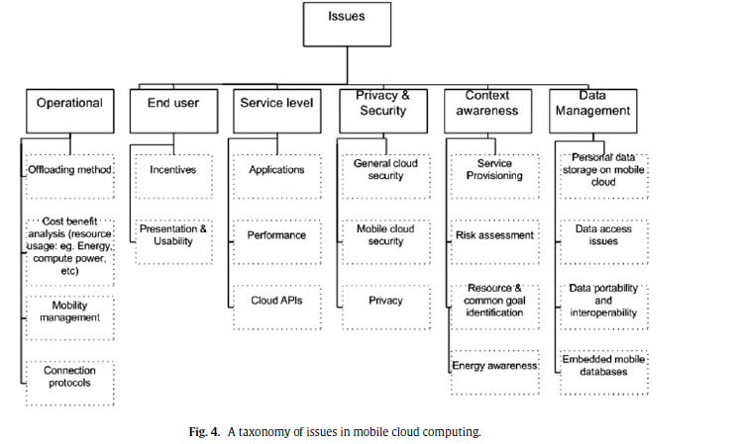

Slide 11
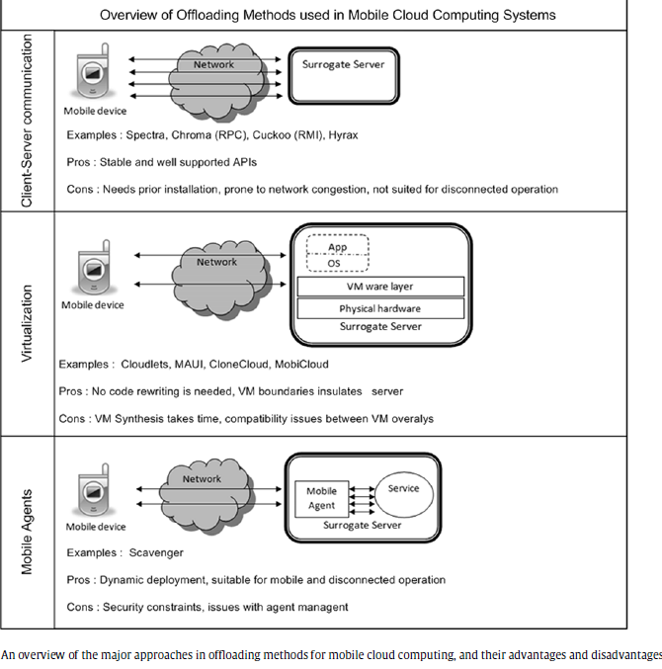

Slide 12
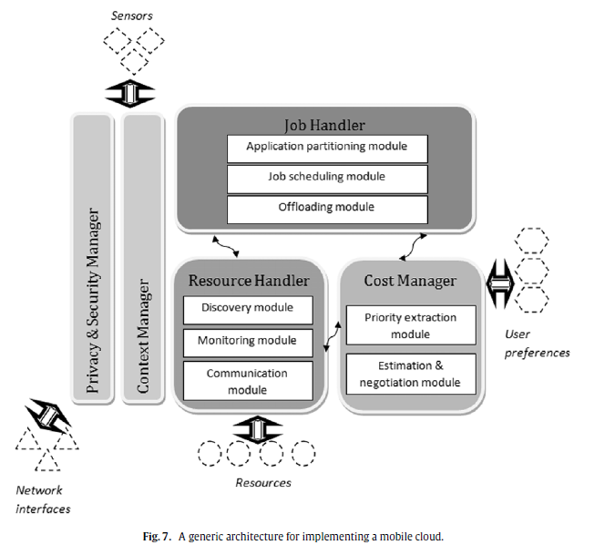

Slide 13
Cloudlets in a hostile environment [Sat13]
The prime example of a hostile environment is a theater of military operations.
Another example is a geographical region where
recovery is underway after a natural disaster or
terrorist attack.
A third example is a developing
country with a weak networking infrastructure.
A cloudlet can be viewed as a surrogate or proxy
of the real cloud, located as the middle tier of a
three-tier hierarchy: mobile device, cloudlet, and
cloud. Cloudlets are transparent to the users

Slide 14
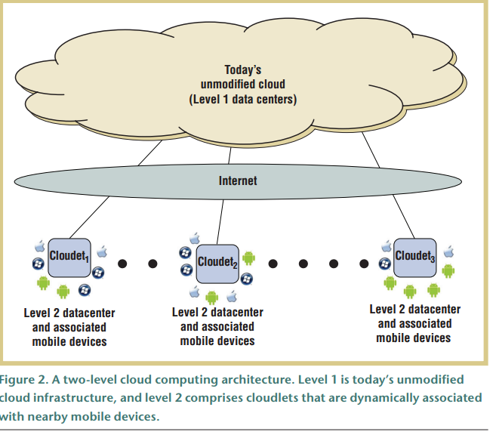

Slide 15
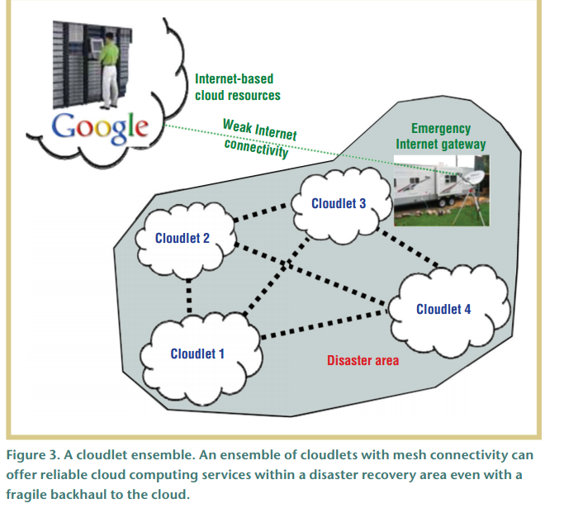

Slide 16
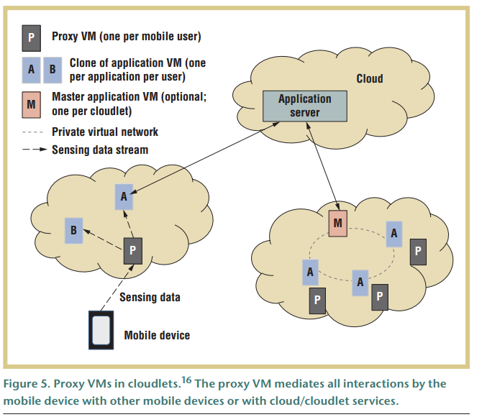

Slide 17
Cloud phones
Applications are run on a remote server and then sent to the user. Because of the advanced improvement in mobile browsers thanks to Apple and Google over the past couple of years, nearly every mobile should have a suitable browser. This means developers will have a much wider market and they can bypass the restrictions created by mobile operating systems.
Mobile cloud computing gives new company chances for mobile network providers. Several operators such as Vodafone, Orange and Verizon have started to offer cloud computing services for companies.
Alibaba Group launched cloud computing-based operating system Aliyun on 29th july 2011. The Aliyun operating system features cloud services such as email, Internet search and support for web-based applications. Users are not required to download or install applications onto their mobile devices.

Slide 18
Aliyun OS (July 29, 2011) http://www.pcmag.com/article2/0,2817,2389450,00.asp
Alibaba's operating system makes use of "cloud-based" services, including e-mail, Internet search, weather updates and GPS and mapping applications, the company said. The OS will apparently require users to be constantly connected to take advantage of its Web-based apps, instead of designing applications that can run natively on the phone's hardware. But, the company added, there will be some interoperability with the Android OS. (Yun= cloud in Chinese)
Alibaba claims it is the largest e-commerce company in China, with first-quarter (2011) revenue of 1.53 billion yuan ($237.7 million).
Alibaba said that each user would be given a free 100 Gbytes of storage to back up data to AliCloud's remote data center, which could be replicated to the PC and mobile devices.
Third-party developers can opt to either develop cloud apps over their own servers or choose to use AliCloud's infrastructure and open platform services at a low cost and quickly develop their businesses, Alibaba said. "The cloud OS is the result of three years of development and uses AliCloud's self-developed distributed file system and virtual machine; the cloud OS is also fully compatible with Android-based applications,"

Slide 19
Aliyun OS
Alibaba has updated its Aliyun mobile OS to version 2.0, bringing a bunch of new features and refinements to take it into the new year. The update will eventually be given to users of its first phone, the K-Touch W700 which debuted with the OS in 2012, and will come out-of-the-box on the newest W800 model.
Aliyun revolves around the idea of bringing cloud functionality to mobile devices. According to the company, Aliyun will feature cloud-based e-mail, Web search, weather updates, and GPS navigation tools. In addition, the Aliyun services will synchronize and store call data, text messages, and photos in the cloud for access across other devices, including personal computers. Alibaba says it will offer customers 100 GB of storage at launch. The Aliyun would allow users to access applications from the Web, rather than download apps to their devices
Alibaba’s foray into mobile faces stiff competition from Baidu (NASDAQ:BIDU), which now has an Android-based OS that recently launched with Dell (NASDAQ:DELL), a bigger name hardware partner than the Aliyun phone has.

Slide 20
Samsung
Note 7 Cloud-- allows users to send content up to the cloud and sync that across multiple devices.
Samsung Cloud handles backing up of a device the same was Apple's iCloud backup works -- all apps are backed up, without requiring any work on the developer's part.
Here's what gets backed up according to the main settings page:
Contacts (Samsung account only)
Calendar (Samsung account only)
Samsung Notes
Internet (Samsung's browser)
Keyboard data
Gallery

Slide 21
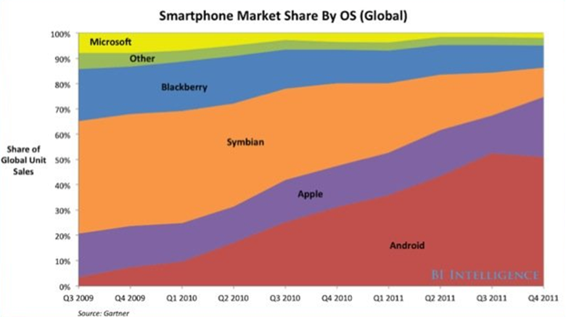

Slide 22
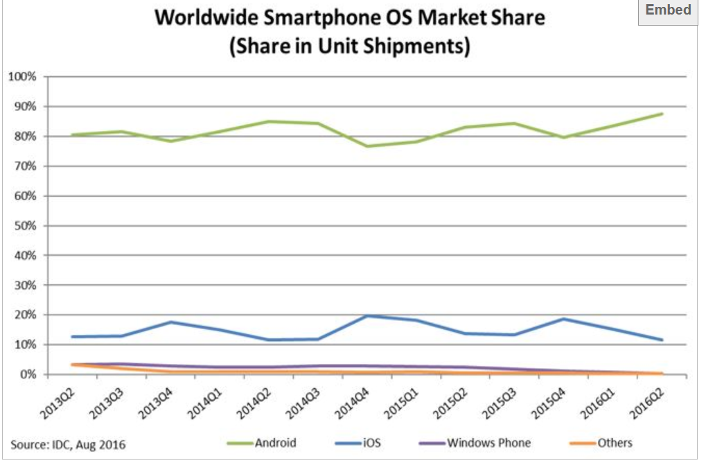

Slide 23
Chapter 11. CPS, IoT
The Internet of Things (IoT)
Cyber-physical systems (CPSs)
New standards OpenStack
Multiclouds (Cloud Federations)
Ecosystems
Open source frameworks
Migration
Forensics
Examples: Cisco, Huawei,…

Slide 24
IOT
Internet of Things—refers to communication through the Internet between non-phone, ordinary objects providing information about their surroundings and activities.
Another term for the Internet of Things is Web 4.0 and sometimes, the Symbiotic Web.
The migration of online functionality to real-world objects, as in the example of being able to run a Google search of your home to find the TV remote control.
Many new applications but also many new security problems

Slide 25
IoT
The Internet of Things (IoT) is the interconnection of uniquely identifiable embedded computing devices within the existing Internet infrastructure. Typically, IoT is expected to offer advanced connectivity of devices, systems, and services that goes beyond machine-to-machine communications (M2M) and covers a variety of protocols, domains, and applications.^{[1]} The interconnection of these embedded devices (including smart objects), is expected to usher in automation in nearly all fields, while also enabling advanced applications like a Smart Grid.
Things, in the IoT, can refer to a wide variety of devices such as heart monitoring implants, biochiptransponders on farm animals, automobiles with built-in sensors, or field operation devices that assist fire-fighters in search and rescue.^{[3]} Current market examples include smart thermostat systems and washer/dryers that utilize wifi for remote monitoring.
As the Internet of Things spreads widely, cyber attacks are likely to become an increasingly physical (rather than simply virtual) threat. In a January 2014 article in Forbes, cybersecurity columnist Joseph Steinberg listed many Internet-connected appliances that can already "spy on people in their own homes" including televisions, kitchen appliances, cameras, and thermostats. Computer-controlled devices in automobiles such as brakes, engine, locks, hood and truck releases, horn, heat, and dashboard have been shown to be vulnerable to attackers who have access to the onboard network. (These devices are currently not connected to external computer networks, and so are not vulnerable to Internet attacks.)

Slide 26
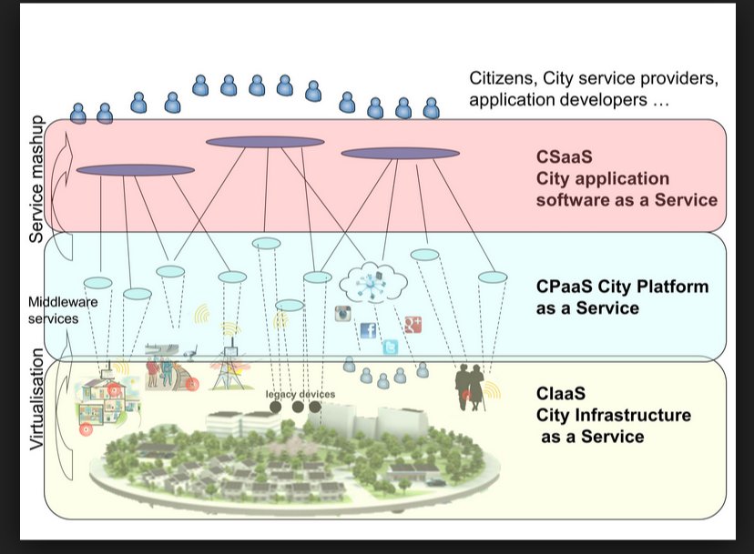

Slide 27
BBC News 10/01/14
British computer chip designer ARM is creating an operating system to power new kinds of internet-connected devices (IoT).
The company is designing the mbed OS software to require as little battery power and memory as possible, and will not charge for its use. It will have a size of a few hundreds KBytes
More than three million developers will be involved in internet-of-things activities by 2019 - about double the number today - according to a recent forecast by ABI Research.
ARM says that at the moment a lot of companies are creating what it terms "internet of silos", because the various teams involved are each creating and using different code to power their products.
ARM said its launch partners for mbed OS included IBM, Telefonica and chipmakers Marvell, NXP and Freescale.
09/16: they had some problems but some products are starting to appear

Slide 28
BlackBerry IOT http://us.blackberry.com/internet-of-things.html
In IoT, the struggling mobile vendor has found an emerging area of technology where it may have the right combination of strengths. The company announced Project Ion, a future cloud-based service it said would make it easier for enterprises to develop IoT software.
DESIGN PRINCIPLES
SECURITY
Authentication, authorization, and data security are provided through patented BlackBerry cryptography and key management technologies. These techniques are architected for a wide range of devices, including those operating under resource constraints and those that require high performance.
The BlackBerry IoT Platform is hosted in the secure, global BlackBerry infrastructure.
SCALABILITY
The IoT landscape includes a massive number of devices – far greater, more diverse and more richly interconnected than the mobile and PC waves preceding it. To support this, the BlackBerry IoT Platform is engineered with modern technologies to support massive scalability, instantaneous data indexing, and redundant long-term storage. The IoT Platform is designed to avoid bottlenecks and to be scalable at every layer of the architecture.

Slide 29
Cyber-physical systems
A CPS processes and reacts to data from external stimuli from the physical world and makes decisions that may impact the physical world
Include flight avionics, smart grids, medical devices, building control,…
Reliability, safety, and security are very important; they are also usually real-time systems
Mobile devices have sensors and can participate in CPSs
Clouds are starting to be used in CPSs

Slide 30
Cyber-physical systems
Physical systems controlled through information
Control from local or remote networks, including the Internet
Wireless networks made them much more important
UML can be used to represent software but also physical things
Things can be represented by classes which indicate physical features and include commands to interact with the thing
Example: Sensor Node pattern
Example: Ships and containers

Slide 31
Sensor node

Slide 32
Types of information in class diagrams
Database-like: A shipping company owns several ships
Temporal information: The containers in a ship change along time
Physical information: The containers and ships are physical entities that can be controlled through operations on the information, e.g. addContainer would actually move a container into a ship

Slide 33
Ships and containers

Slide 34
City transportation systems
Tags in vehicles, tags in fixed positions, tag readers,…
Can track location of vehicles, perform real-time traffic analysis, determine optimal routes,…
Use hybrid networks, combining Wi-Fi, GSM, GPS, IP, …
Used in bus systems, taxis,…

Slide 35
Usability
Security dashboards to monitor and manage the security or resources environment
Support for security policy customization, optimization of run-time configurations, security monitoring and management

Slide 36
Forensics, the SAP cycle
Securing of collected evidence data
Analysis to decipher what happened
Presentation: the other phase are documented and explained
In public clouds we do not know exactly where the data is stored
To analyze the data the consumer does not have trustworthy access logs, VM images, router logs, …
For SaaS we may have high-level logs if supported by the SP
In IaaS we have control on our VMs and we can install forensic tools but finally it depends on the SP

Slide 37
Interclouds
An Inter-Cloud is a system in which heterogeneous service providers join their services in order to provide an extensive catalog of services to their Consumers and enlarge their resource pool. Inter-Cloud can be classified into two modes, federated and non-federated, the first one is also called federated Inter-Cloud and the second Multi-Cloud. In federated Inter-Cloud, Service Providers (SP) can share their capabilities in order to supply a large amount of services/resources to their clients .
The Cloud Broker’s aim is to decentralize the satisfaction of requests using the Cloud Exchange component; for that reason, their main use cases are related to the forwarding of request across the Service Provider and the Cloud Exchange. It is reasonable also to think in the Cloud Broker as a cache.

Slide 38
Cloud Federation pattern model
A Service Provider is part of a Cloud Federation and processes requests from Consumers through a Portal. The Service Provider can be assembled in different ways such as an aggregation of clouds, a set of peers, implied, etc. The Service Provider performs requests to a Cloud Broker. The Cloud Broker redirects the request to the Cloud Exchange component. The Cloud Exchange consults its Catalog (a.k.a. Information Repository) looking for the best match for the request. The Catalog lists several kinds of Services. The Cloud Exchange is aware of the condition of the entire system through status information coming from Cloud Brokers. The Catalog is updated considering the information sent by the Cloud Brokers.

Slide 39
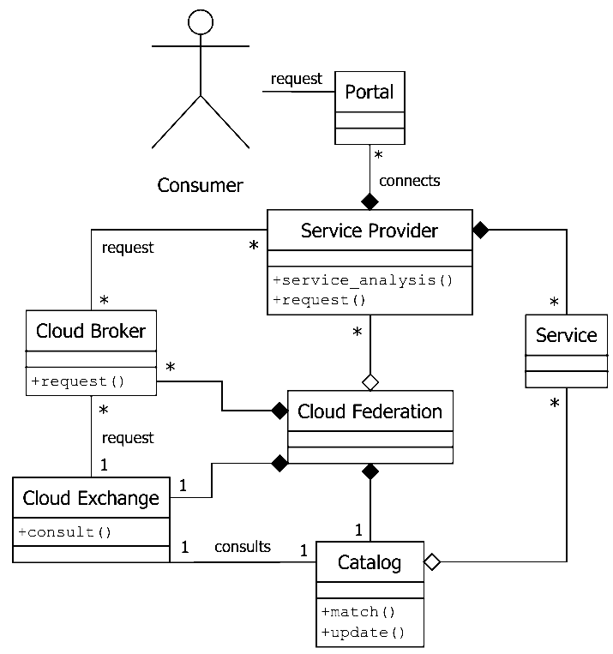
Class diagram of a Cloud Federation

Slide 40
Cloud Computing
Security
Software
Architecture
Cloud
Security
Patterns

Slide 41
Future of clouds (Dec. 2016)
Amazon’s cloud business had its most profitable quarter in 1Q of 2016
Intel has shifted the emphasis of their chips from PCs to ships for cloud servers
Strong emphasis on AI requires large computational loads which are coming from clouds
Cisco and other network porovidesr are shifting towards software to provide virtualized networks
Dell is entering the cloud business by going into cloud management products (they bought Gale Technologies)
Oracle is buying cloud companies to support their DBMS products

Slide 42
References
A.A. Cardenas, S. Amin, Z.-S. Lin, Y.-L.Huang, C.H.Huang, and S. Sastry, “Attacks against process control systems: Risk assessment, detection, and response”, Procs. of ASSIACS’11, March 22-24, 2011, Hong Kong, China, 355-366.
Oscar Encina, E.B. Fernandez, and Raúl Monge, “Towards Secure Inter-Cloud Architectures”. Proceedings of Nordic Pattern Conference on Pattern Languages of Programs, Sagadi Manor, Estonia, April 2014.
A.N.Khan, M.L.Mat Kiah, S.U.Khan, and S.A.Madani, “Towards secure mobile computing: A survey”, Future Generation Comp. Systs., 29 (2013), 1278-1299, doi:10.1016/j.future.2012.08.003
Anupama Sahu, E.B. Fernandez, Mihaela Cardei, and M. VanHilst, "A pattern for a sensor node", Procs. 17th Conf. on Pattern Languages of Programs, PLoP 2010. http://www.hillside.net/plop/2010/index.php?nav=program
M. Satyanarayanan, Grace Lewis, Edwin Morris, Soumya Simanta, and Jeff Boleng, Kiryong Ha, “The role of cloudlets in hostile environments”, IEEE Pervasive Computing, Oct-Dec 2013
“How smart, connected products are transforming competition”,
http://hbr.org/insights.iot

