Slide 1
Cloud Computing 2016 Chapter 8: Security
Dr. E.B.Fernandez

Slide 2
Security concepts
Why worry about security?
Countermeasures
Security architectures
Cloud security products
Are clouds secure?

Slide 3
Value of information
We rely on information for our credit, health, professional work, business, education,…
Data is valuable for individuals and institutions
This value attracts criminals, terrorists, and vandals
Illegal access (reading, modification, or destruction) to information can produce serious problems

Slide 4
Do we have a problem?
Almost every week we have a major security incident.
Companies: Target, Sony (twice), Home Depot, Goodwill, JP Morgan, Chick-fil-A, Neiman Marcus, Michaels,…
Government: IRS, DOE, OPM,…
Physical systems: German steel mill
Medical systems and devices: several, e.g. Anthem
Point of sale: Target, Michaels, Home Depot, …

Slide 5
Costs of a data breach
An attack on Google cost that company about $500,000 in 2005.
In a recent study, the average cost of a data breach for a company was $3.75 M in 2014, and the average cost for each stolen or lost record was $154.
Done by Ponemon Institute, sponsored by IBM

Slide 6
The security problem
Unauthorized data disclosure (confidentiality or secrecy).
Unauthorized data modification (integrity). May result in inconsistencies or erroneous data. Data destruction may bring all kinds of losses.
Denial of service—Users or other systems may prevent the legitimate users from using their system. Denial of service is an attack on the availability of the system.
Lack of accountability—Users should be responsible for their actions and should not be able to deny what they have done (non-repudiation).

Slide 7
The meaning of security
Security implies providing these objectives in the presence of attacks
Security requires technical, managerial, and physical countermeasures (defenses)
We only consider technical aspects here
A related aspect is privacy, a legal and ethics concern

Slide 8
Countermeasures (defenses)
Identification and Authentication (I&A)—Identification is a user or system action where the user provides an identity. Authentication implies some proof that a user or system is the one he/it claims to be. The result of authentication may be a set of credentials, which later can be used to prove identity and may describe some attributes of the authenticated entity (See Chapter 4).
Authorization and Access control (A & A)—Authorization defines permitted access to resources depending on the accessor (user, executing process), the resource being accessed, and the intended use of the resource. Access control requires some mechanism to enforce authorization (See Chapter 2).
Logging and Auditing (L&A)—Implies keeping a log of actions that may be relevant for security. These functions can be used to collect evidence for prosecution (forensics) and to improve the system by analyzing why the attack succeeded.
Hiding of information—It is usually performed by the use of cryptography but steganography is another option.The idea is to hide the information in order to protect it. ( Chapter 3).
Intrusion detection—Intrusion Detection Systems (IDS) alert the system when an intruder is trying to attack the system (Chapter 7).

Slide 9
Basic secure architecture
Authentication must happen first
Authorization rules define what is allowed or not allowed (who can see what and how)
Lower architectural levels enforce authentication and authorization
Cryptography protects messages in transit and stored data, and provides non-repudiation and authentication
Logging for later auditing

Slide 10
Need for a holistic view
Need for a holistic view, not disjoint pieces. Disjoint mechanisms cannot prevent threat that are combinations of legal actions
Security should be based on institution policies
Methods based on local protection, e.g., cryptography , are very important to enforce the high-level restrictions but are not adequate in isolation.
Code-based security is incomplete, security is a systems problem
Notes:
Without institution policies security is hopeless. In that case security will become a series of patches and isolated measures with enormous holes in between.
This is the case of many places now.

Slide 11
Related aspects
Assurance is a measure of the trust we put on a system as being able to provide the required degree of security
Risk analysis is the study of possible attacks and their impact in terms of money and time. We need it to perform some risk analysis in order to decide on the investment on systems and personnel to provide security. In particular, we need to enumerate the threats to the system to know how much effort and money we should invest to make the system secure
Governance refers to the responsibilities of the institution directors to define policies and regulations to handle their information. Typically directors focus on increasing the value of their assets but don’t pay much attention to their security.

Slide 12
Related topics
Reliability and fault tolerance—Controlling the effect of accidental errors (see Chapter 10)
Dependability—confidence that the system will follow its specifications
Survivability—ability to provide service in the presence of disruptions
Privacy—an individual right, not a technical issue, but enforced by technical means

Slide 13
Attacks and defenses
The generic attacks are realized in two basic ways: by direct attacks from a person trying to exploit a vulnerability or flaw in the system, or using malware, software that contains code that exploits one or more of these flaws
Security defenses may operate in one or more of three modes and we need to combine them:
Prevent or mitigate an attack. Prevention means completely stopping the attack while mitigation implies partial defense or reducing its effects
If we cannot stop or mitigate the attack, at least we should be able to know that an attack is happening, i.e., we should detect the attack. Detection is also useful to stop an attack because it can alert other mechanisms to take action
After the attack has happened we need to have ways to recover from its effects and analyze it so we can improve the system

Slide 14
A good response to an attack
In 2008, T. Rowe Price "Retirement Plan Services" alerted and informed 35,000 clients that their names and Social Security numbers were compromised in files on computers that were stolen from one of their service providers. However, to deal with the crisis, the company offered those affected a free one-year subscription to an online credit monitoring service and up to $25,000 of identity theft insurance, as well as tips on protection from identity theft. -

Slide 15
Security environments or contexts
Early systems were isolated and single user --few security problems
Mainframes brought many users but we knew them (registered)—complexity and attacks increased
Distributed systems increased the problem by scattering the users

Slide 16
Environments II
The Internet opened up our systems to unknown users—exponential growth in attacks
Wireless devices increase the problem because of their number and ubiquity
The widespread use of sensors will make security even worse
The cloud brings new problems

Slide 18
Threats
We need to understand the threats to the system to decide how to defend it
Excess of security mechanisms results in loss of performance, extra complexity, and higher costs
The objective is to provide an appropriate defense according to the value of our assets

Slide 19
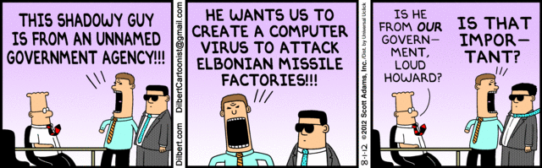

Slide 20
Types of Threats
Direct attacks to the operating system
Direct attacks to the database system
Directs attacks to the application
Denial of service
Almost no attacks to the messages in the network
Malware: Trojan horses, viruses, worms
Repudiation

Slide 21
Definitions
A vulnerability is a situation or state that may be exploited by an attack: code flaws, configuration errors, incorrect rules,…
A threat is a potential attack
An attack is an attempt to misuse the system
A defense (safeguard, countermeasure) is a way to block or reduce an attack
A misuse is a violation of a security property (confidentiality, integrity, availability)

Slide 22
Types of misuse
The outcome of a misuse can be loss of confidentiality or integrity, theft of services, or denial of service.
An attack has a perpetrator, who has a motivation or goal.
The attack has a method of operation to accomplish a mission with respect to a target (modus operandi).
The damage of a mission can be loss of assets, money, lives

Slide 23
Attackers
Insiders -- A good number of attacks to a system come from insiders
Hackers -- Usually try to show off their ability by penetrating systems
Spies -- Industrial or government espionage
Organized crime—a large number of attacks
Terrorists—attacks to infrastructure systems

Slide 24
Attack stages
Preparation—Information gathering, scanning, planting malicious code, masquerading (spoofing)
Activation—perpetrator-controlled, timed, victim activated
Mission—active (affects integrity and availability), and passive misuse (eavesdropping, inference), denial of service

Slide 25
Attack stages
<<actor>>
:Attacker
target1:
:Data
target2:
prepare Attack
activate Attack
read
modify/destroy
propagate

Slide 26
Distributed Denial of Service (DDoS)
The Attacker penetrates a system as an operations base
From there, other systems are penetrated and special programs are inserted, these systems become slaves or zombies or bots
The attacker commands the slaves to send streams of messages to the victim clogging its web site

Slide 27
Distributed Denial of Service attack

Slide 28
Why possible?
Poor security in many sites (OS flaws, weak passwords…)
Poor configuration control
Features of TCP/IP protocol: 3-way handshake to assign connection numbers, handling of very long or very short packages (SYN-flooding)
Echo mode in UDP

Slide 29
Big DDoS Attack http://www.nytimes.com/2016/10/22/business/internet-problems-attack.html?action=click&contentCollection=Movies&module=Trending&version=Full&region=Marginalia&pgtype=article
Major websites were inaccessible to people across wide swaths of the United States on Friday after a company that manages crucial parts of the internet’s infrastructure said it was under attack.
Users reported sporadic problems reaching several websites, including Twitter, Netflix, Spotify, Airbnb, Reddit, Etsy, SoundCloud and The New York Times.
The company, Dyn, whose servers monitor and reroute internet traffic, said it began experiencing a distributed denial-of-service attack just after 7 a.m. Reports that many sites were inaccessible started on the East Coast, but spread westward in three waves as the day wore on and into the evening.
The attack appears to have relied on hundreds of thousands of internet-connected devices like cameras, baby monitors and home routers that have been infected — without their owners’ knowledge — with software that allows hackers to command them to flood a target with overwhelming traffic.

Slide 30
More http://www.bbc.com/news/technology-37738823
Security firm Flashpoint said it had confirmed that the attack used botnets infected with the "Mirai" malware.
Many of the devices involved come from Chinese manufacturers, with easy-to-guess usernames and passwords (often “admin” or “12345” or even, yes, “password”) that cannot be changed by the user - a vulnerability which the malware exploits.
Mirai scours the Web for IoT (Internet of Things) devices and then enlists the devices in attacks that hurl junk traffic at an online target until it can no longer accommodate legitimate visitors or users.
The owner of the device would generally have no way of knowing that it had been compromised to use in an attack.

Slide 31
New way to attack and new targets
DDoS attacks are typically aimed at a single website. Friday's attack on Dyn, which acts as a directory service for huge numbers of firms, affected several of the world's most popular websites at once.
The use of internet-connected home devices to send the attacking messages is also a relatively new phenomenon, but may become more common.
The Mirai software used in these attacks was released publicly in September - which means anyone with the skill could build their own attacking botnet.
Jeff Jarmoc, head of security for global business service Salesforce, pointed out that internet infrastructure is supposed to be more robust:
"In a relatively short time we've taken a system built to resist destruction by
nuclear weapons and made it vulnerable to toasters,"

Slide 32
http://www.nytimes.com/2016/10/23/us/politics/a-new-era-of-internet-attacks-powered-by-everyday-devices.html?hp&action=click&pgtype=Homepage&clickSource=story-heading&module=first-column-region&region=top-news&WT.nav=top-news&_r=0
Such assaults are the reason so many companies are pushing at least parts of their infrastructure to cloud computing networks, to decentralize their systems and make them harder to attack.

Slide 33
Malicious code
Trojan Horses—A Trojan Horse is an apparently useful program that has harmful hidden functions
Viruses – A virus is a program that attaches itself to another program, propagates, and usually causes some data destruction.
Worms—A worm is a program that propagates itself without infecting the host.

Slide 34
More varieties
Spyware—collect passwords, credit card numbers, or general info. (adware)
Spam—wholesale sending of messages, can be used to propagate viruses
Phishing messages—enticing users to disclose information

Slide 35
More varieties
Some malware are combinations of the basic types and can combine worms with spam or spyware, these are called blended threats
A zero-day attack is an attack that takes advantage of a vulnerability just discovered (maybe only by the hacker) and for which there is no patch or detection method yet.
Rootkit: Any software that takes control of an operating system, allowing illegal administrative functions. They alter parts of the operating system kernel and hide their presence.
A bot or zombie is a computer that can be controlled by another through the introduction of a Trojan Horse or another type of malware.

Slide 36
Data breach at Anthem 2/6/15
Anthem is one of the largest US health insurers
The hackers gained access to up to 80 million records that included Social Security Numbers, birthdays, addresses, email and employment information and income data for customers and employees, including its own chief executive.
The hackers are thought to have infiltrated Anthem’s networks by using a sophisticated malicious software program that gave them access to the login credential of an Anthem employee.
They did not encrypt their database

Slide 37
Anthem II
The combination of stolen attributes is enough for some of Anthem’s customers to become victims of identity theft or email phishing schemes in which criminals try to trick unsuspecting people into providing their credit card information.
Stolen medical information could also be used to make false insurance claims.

Slide 38
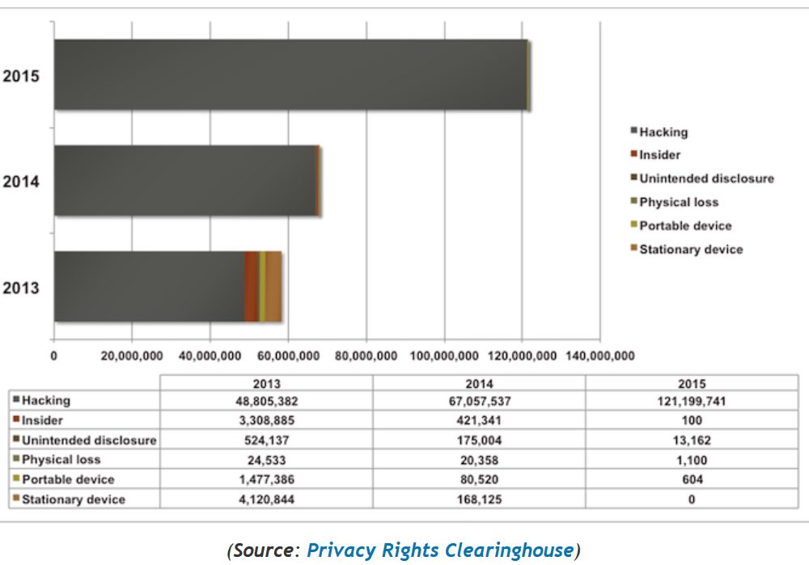
Data breaches

Slide 39
Detection
During an attack, the malware may do some actions to hide its presence. A stealth virus/worm hides its presence by using encryption or wrapping itself in another file, possibly compressed. Some attacks try to destroy evidence by erasing logs and other tracks of intrusions. A polymorphic virus/worm modifies itself when propagating
Metamorphic malware uses code obfuscation approaches such as code transposition, module rearrangement, and extra code, to produce variants of a core/base malware that are thus harder to detect. The variants have the same functionality as the core but different signatures, which makes them harder to identify by a signature-based detector
Some malicious code comes encrypted (harder to understand), some just propagate, some destroy or leak information, some have delayed missions, some insert backdoors (for later attacks)
Detecting any malicious code is an undecidable problem (there is no general algorithm), but specific versions can be detected (antivirus products and IDS rely on them)

Slide 40
Threat/Misuse patterns
Describe threats and misuses from the point of view of the attacker.
They use sequence diagrams (and more) to describe how an attacker performs a misuse, they describe attack scenarios
The pattern tries to show how the attacker works (modus operandi) so we can apply defenses to stop it
The objects in the sequence diagram represent architectural units of the target system
A misuse pattern indicates what security mechanisms are needed as countermeasures and where to collect evidence of the attack.
We wrote some misuse patterns for clouds

Slide 41
Architectural layers
User interfaces
User Applications:
SaaS
financial manufacturing
student registration
DBMS
SQL
..
NoSQL
..
OS utilities Media Player Browser
PaaS
OS kernel
processes memory
device control file system
distribution middleware services
Networking
IaaS
Hardware: Processors Storage I/O devices

Slide 43
Policies
Institution policies
Security policies
Example

Slide 44
Need for policies
The policies of an institution define its way of accomplishing its objectives
Security policies define a way to protect its information applying principles
Without policies we don’t know what we should protect
Policies can be realized by tactics applied to the system architecture

Slide 45
Some security policies
Open/closed systems--In a closed system everything is forbidden unless explicitly allowed
Need-to-know (Least privilege)-- Give enough rights to perform duties
Information belongs to the institution versus private ownership
Authorization-- access types, small units of access

Slide 46
Security policies II
Obligation—What has to be done before accessing data
Separation of duty—Separate critical functions into parts to be done by different people or systems
Content-dependent access control—Access decision are based on the values of the data
Authenticate all transactions—needed for accountability and access control

Slide 47
Use of policies
Secure systems must be closed but sometimes open access to information is more important, e.g., libraries, data warehouses, …
The least privilege principle must be applied with an appropriate granularity, many attacks happen because of too many rights

Slide 48
Example of university policies
An instructor can look at all the information about the course he is teaching.
An instructor can change the grades of the students in the course he is teaching
A student may look at her grades in a course she is taking
The department head can add/delete course offerings
The registrar can add/delete students from course offerings
Faculty members can look at information about themselves

Slide 49
From policies to models
Models make precise the policy requirements
Models can be formal (based on mathematics) or semi-formal
UML is a semiformal model
It can be made more formal by using OCL (Object-Constraint Language)
We will see models for Authentication, Authorization, and Logging

Slide 50
Authentication
Before they can perform any activities in the system both users and systems must identify themselves and be authenticated.
Identification and Authentication (I&A) use some kind of protocol to establish identity.
I&A is the basis for authorization and for logging, it provides accountability.
Once verified, the system may provide a proof of authentication and a handle (reference) to the user’s account. For example, IBM’s z/OS provides an accessor environment element (ACEE), which follows the authenticated process during its execution
Approaches for authentication can be of four types:
Something the user knows. Passwords are the most common example of this type.
Something the user has. Typically a smart card.
Something the user is. A body feature of the user, e.g. her fingerprints, is used to authenticate the user.
Where the user is. The location of the user is enough to grant him access.

Slide 51
More secure authentication
Smart cards, where a card with some processing power is used to establish the connection. Smart cards use a PIN provided by the user and other information such as date, time, or name of the user to send an encrypted message to the system (typically some Authentication Server). Only if the system can decipher the message the user is connected.
The card must be tamper-resistant to prevent a person who steals the card from finding the PIN in the card. Given that these cards have a significant amount of memory there have been proposals about including in them financial, health, and employment information about their owners, although this may bring additional privacy problems [She02]. Passports are another example.
Biometrics. This is the use of some unique personal characteristic, e.g., fingerprints, retina scan, face contour, face recognition, signature dynamics [Jai00]. This can be a more secure approach but it is more expensive and slower than the other two [Mil94].
Fingerprint recognition security has been put in doubt, people leave their fingerprints in many places and gummy fingers appear to fool most systems [Mat02].
After September 11 this approach has become considerably more popular. This popularity has also been helped by the lower cost of some of these approaches.

Slide 52
Authentication hierarchy

Slide 53
Class diagram of Authenticator

Slide 54
Authenticating a user

Slide 55
Authorization and Logging
After a user is recognized as a legitimate user she is admitted to the system.
For the user to access specific resources (memory, files, I/O devices) or data items she needs authorization rights.
For every access (read or writes) to data a Logging system records the data item accessed, the time, the type of access, and the user who performed the access.
The log can be audited later to check the proper use of the data.

Slide 56
Classification of authorization models
Multilevel --users and data are assigned security levels
Access matrix -- subject has specific type of access to data objects
Mandatory --access rules defined only by administrators
Discretionary -- users own data and can grant access to other users

Slide 57
Access matrix authorization rules
Basic rule ( s, o, t ) , where s is a subject (active entity), t is an access type, and o is an object
Extended rule ( s, o , t , p,f) , where p is a predicate (access condition or guard) and f is a copy flag
This, and the other models, can be described by OO patterns

Slide 58
Authorization pattern

Slide 59
Authorization mapping

Slide 60
Reference Monitor
Each request for resources must be intercepted and evaluated for authorized access
Abstract concept, implemented as memory access manager, file permission checks, CORBA adapters, etc.

Slide 61
Reference Monitor idea

Slide 62
Enforcing access control

Slide 63
Role-Based Access Control
Users are assigned roles according to their functions and given the needed rights (access types for specific objects)
When users are assigned by administrators, this is a mandatory model
Can implement least privilege and separation of duty policies
Reduces number of rules

Slide 64
Basic RBAC pattern

Slide 66
Multilevel model
In this model users and data are assigned classifications or clearances
Classifications include levels (top secret, secret,…), and compartments (engDept, marketingDept,…)
For confidentiality, access of users to data is based on rules defined by the Bell-LaPadula model, while for integrity, the rules are defined by Biba’s model
10/24/2016
66

Slide 67
Summary of models
Most commercial systems use RBAC: Oracle, DB2, Apache, Windows, Solaris,…
Access matrix is useful for specialized applications with not many users
Multilevel models are only used in very-high security systems and to structure software

Slide 68
Security Logger and Auditor
Intent
How can we keep track of user’s actions in order to determine who did what and when?
Log all security-sensitive actions performed by users and provide controlled access to records for Audit purposes.
Variants
Most systems have a System Logger, used to undo/rollback actions after a system crash. That type of Logger has different requirements but sometimes is merged with the Security Logger [SAP01]. System logs are of interest to system and database administrators, while security logs are used by security administrators, auditors, and system designers.
Another variant could include the automatic rising of alarms by periodic examination of the Log, searching records that match a number of rules that characterize known violations. For example, Intrusion Detection Systems use this variant.
We can also add logging for reliability, to detect accidental errors.

Slide 69
Class diagram of Logger/Auditor

Slide 70
Security in DBMSs
In most cases, a DBMS is implemented on top of an operating system and relies on its security features
Low level security issues such as: protection of memory buffers, or separation between various threads of control are delegated to the OS, and the DBMS is not concerned with them
In addition, most DBMSs rely on the OS for user authentication, although some products (e.g. Oracle) provide their own authentication methods.

Slide 71
Views
A view enables users (or groups of users) to access only a portion of the database, thus providing both convenience and security
A view also enables conversion of logical data types into language-dependent data types depending on the host language in which the view is embedded
In all SQL based systems, a view can be defined using the standard SQL syntax.
Since all SQL syntax is available to the definer of a view, a view may be very complex.
It's important to note though that a view is only a "window" on the database, and does not exist as a physical table. Thus the view has to be retrieved with every access, and therefore is always up-to-date.

Slide 72
Privileges (rights)
Select - the right to read all columns of the object, including columns added later by an SQL Alter Table command.
Insert - the right to insert new values (tuples) into all columns of the object. If the object is a View, restrictions apply on what can be inserted, but this is dependent on the view definition and not on the authorization.
Update - the right to update all columns of the object with options similar to those of Insert.
Delete - the right to delete rows from an Object. In addition, there are two new privileges:
Usage - the right to use the current definition in other definitions.
Reference - the right to use the object in specifying Integrity constraints of other objects. Again, a specific column may be specified.

Slide 73
Web databases
When users and administrators interact directly with the database the standard mechanisms of SQL like Views and Grant/Revoke are applied.
The situation in the Web is different. Now users are connected to a Web server which itself interacts with the database
In this architecture all the communication to the database is done by the web server which interacts with the users. In contrast with the standard database architecture where there are a small number of known users which are authenticated to the DBMS at session initiation time, and where it is easy to associate transactions to the user performing them, in the Web/Database case we have the following situation:
Users are casual and unknown
The number of users is not limited
Users do not connect directly to the DB

Slide 74
Connection security
Often the technique of Connection Pooling is used. In this case, different web users can run their SQL statements on the same DB connection and one user can run her SQL statements on different connections. This technique contributes to application efficiency since the time to open and close the connection is saved per each request, but it has serious implications on the database’s access control mechanism.
Now the DBMS cannot identify the real application user who accesses it, and usually the only user accessing the database is the 'user' of the web application server which has "super-user" privileges. This means that at the database level, no user-based access control and no RBAC can be applied, and the principle of least privilege is violated.
This situation would be OK if Web applications would have been written by (honest) security experts, but this is often not the case and as a result the Web application and the database itself are very vulnerable.

Slide 75
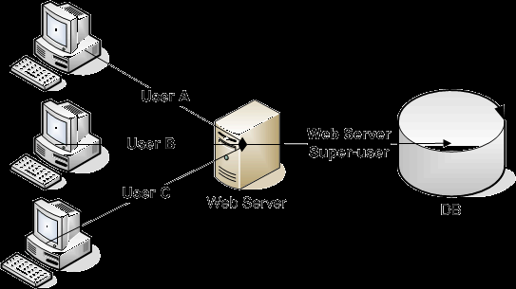
Web database architeture

Slide 76
SQL injection attack
This attack happens when a web application displays a web page to the user asking him to fill various parameters.
These parameters are transferred to the Web server by an HTTP Get or Post command
The Web server in turn fetches these parameters and insert them into an SQL template in the application, and then sends the resultant dynamic SQL to the DBMS.

Slide 77
Some SQL-based incidents
From November 2004 to January 2005, a hacker by the name of “Hung” used a form of SQL Injection to hack into the databases of Information Security, a well-known magazine, in order to obtain member and commercial information.
In August 2009 Albert Gonzalez and his associates hacked into databases of a credit card processor and retrieved over 170 million credit card and ATM account numbers. He was caught and is now serving a 20-year prison term.
In July 2012 a hacker group was reported to have stolen 450,000 login credentials from Yahoo!. The logins were stored in plaintext. The group breached Yahoo's security by using a “union-based SQL injection technique“
In October 2015, an SQL injection attack was used to steal the personal details of 156,959 customers from British telecommunications company Talk Talk’s servers, exploiting a vulnerability in a legacy web portal.

Slide 78
Top DBMS threats (From Imperva)
Excessive or unused privileges—not applying need-to-know principle
Privilege abuse—Insider misusing his rights
Input injection—includes SQL injection and adds NoSQL injection
Malware—blended threats, spearphishing
Weak audit trail (log)—coarse or non-existent
Backup storage media exposure—often not protected
Exploitation of misconfigured databases—default accounts and configuration parameters
Unmanaged sensitive data—non-used databases may contain sensitive information
Denial of Service—flooding the network with DBMS queries
Limited security expertise and education

Slide 79
DB encryption
Databases can be attacked from the application, the OS and directly.
One of the advanced measures being incorporated by enterprises to address this challenge of data exposure, especially in the banking, government, and healthcare industries, is database encryption.
While database-level encryption does not protect data from all kinds of attacks, it offers some level of data protection by ensuring that only authorized users can see the data, and it protects database backups in case of loss, theft, or other compromise of backup media.

Slide 80
From T. White, “Hadoop—The definitive guide”
HFDS (Hadoop File Data System) file permissions provide authorization (based on Linux)
Relies on Kerberos for user authentication (passwords)
Authentication produces a Ticket Granting Ticket (TG)
The TGT can be presented to the server for authorization of services
HDFS blocks are not encrypted in storage

Slide 81
Hadoop authentication
<<actor>>
:Client
:Kerberos
Authentication
Server
:Kerberos
TGServer
:Server
get(TGT)
getService(TGT,ST)
getService(ST)

Slide 82
Transmission of information
To send information to other sites we set up a communication channel
The messages in transit can be attacked and must be protected
The usual way to protect messages is through cryptography
Cryptography is also useful to protect databases and for authentication

Slide 83
Cryptography
Cryptography is the study of message concealment
Cryptanalysis is the study of how to discover the encrypted message.
Cryptology includes both
Cryptanalysis is difficult and requires good mathematical knowledge, so you don’t see many hackers trying to break codes. The equivalent to hackers are now scientists employed by a government or organized crime.

Slide 84
Cryptography value
Authentication—Can authenticate the identity of users, transactions, and systems.
Protection of messages—Can protect the secrecy of a message and prevent illegal modification. Cannot protect against destruction of the message.
Protection of software and data—Can protect the confidentiality of them although not avoid their destruction. For example, passwords can be encrypted.

Slide 85
Cryptography value II
Digital signatures—Can authenticate the origin of a message.
Nonrepudiation—A user that signed or otherwise authenticated a document using cryptography cannot deny having sent it.

Slide 86
Mechanism
Encryption is encoding a message to hide its meaning.
Plaintext is converted into cyphertext. Formally, C=E(M) and M=D(C) .
The cryptosystem must produce M=D(E(M)) to be useful

Slide 87
Symmetric cryptosystem

Slide 88
Notation
M – Message - Plaintext or clear text.
C – Ciphertext - encrypted message.
K – Key.
E – The encryption function (or procedure) C = Ek(M)
D – The decryption function M = Dk(C)
For any key K, and for any message M: M = Dk(Ek(M))
We also use the notation: C = E(K,M); M = D(K,C)

Slide 89
Classification
Number of keys used: symmetric (one key) and asymmetric (encryption and decryption keys, these are the public-key systems). Neither approach is the best for all cases.
Type of encrypting operations: Symmetric systems use substitution and transposition stages. Substitutions just replace a bit or character for another. Transpositions rearrange bits or characters in the data. Product ciphers are combinations of substitutions and transpositions. Public key systems are based on invertible mathematical functions.

Slide 90
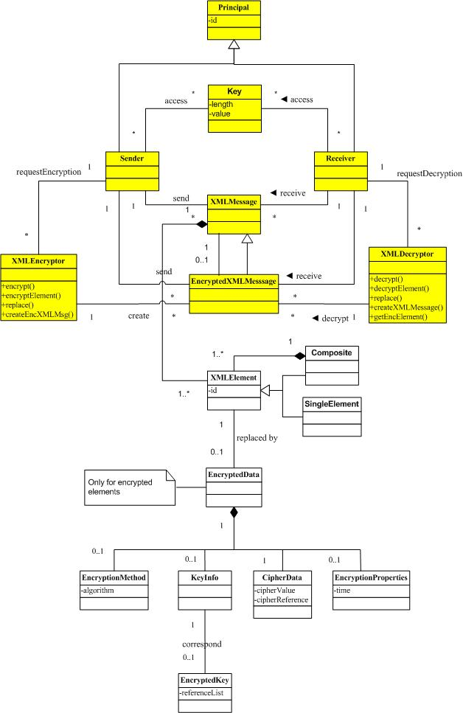

Slide 91
Security of a cipher
A theoretical measure which measures this difficulty without regards to the computational resources needed.
A complexity measure which measures this difficulty in terms of the computational resources needed. The common complexity measures of Polynomial and NP-hard complexity are generally used in this context

Slide 92
Evaluating ciphers
Any algorithm can be eventually broken by trying all possible keys, a secure algorithm just requires such a large number of tries that it is computationally unfeasible to find the key in a reasonable time.
If the algorithm has shortcuts, it is not necessary to try all the possible keys. For example, if the statistical frequency of letters is kept in the ciphertext, the work to find the key is considerably smaller. Other approaches involve common words, differential and linear cryptanalysis.

Slide 93
Evaluation
A practical secure encryption algorithm should have the following properties:
No method of recovering the key is known other than trying all possible keys.
Trying all the possible keys is not feasible with a limited cost and limited time.
That is not enough however, a secure algorithm must be implemented properly and used properly or other attacks may bypass the cryptographic defenses; for example, through the operating system, through timing attacks, by power consumption estimates, and other ways [Sch01].

Slide 94
Public Key systems
The main problem with symmetric encryption is that to be secure, it requires periodic change of the common encryption key
A secure channel is required for key exchange, which makes the scheme inconvenient
The main feature that distinguishes public-key from symmetric-key schemes is the separation of encryption and decryption capabilities.
The public key algorithms use two keys, one of which is public and the other secret. The approach is based on the infeasibility of determining the decryption key given the algorithm and the public key
Instead of permutations and substitutions these algorithms use properties of mathematical functions. In particular, they use the theory of NP functions, those for which there is no known polynomial time solution algorithm. The most famous public key cipher is the RSA cipher developed by Rivest, Shamir, and Adelman, which is used in most current systems. This cipher takes advantage of the difficulty of factoring a large number into primes.

Slide 95
Public key systems
10/24/2016
95

Slide 96
Digital signature requirements
a) Authenticity - the signature must be authentic, i.e. belongs only to the signing user
b) Unforgeable - no other user can sign on behalf of the valid user, or forge his signature
c) Nonrepudiation - the signing user, once he has signed, cannot deny his signature. That is, it is impossible to claim that a certain message was “made up” by someone else and has the sender’s authentic signature.

Slide 97
Digital signatures
PK algorithms have the property that the roles of the keys can be reversed; that is, D(E(M)) = E(D(M)) = M. This is the basis for digital signatures.
The sender does: SIG = D private key(M)
Now using E which is known, everybody can recover M. However, only the sender could have signed it, since only he knows the private key, that is, the signature verification scheme is:
M =? E public key (SIG)

Slide 98
Certificates
To make sure that public keys are valid, and to prevent the "man in the Middle" attacks, one uses the notion of Certificates. Certificates use the following principles:
The public keys are normally registered with a certification authority (CA). This authority distributes certificates, which are public keys with the signature of the CA.
There are authentication and attribute certificates. Attribute certificates assert that certain properties are true of the owner of some authentication certificate. Attribute certificates are also used in SSL and other protocols.

Slide 99
Certificate contents
Version – which version of the standard
Serial number – unique, used for Revocation
Algorithm Id – which algorithm is used for the signature
Issuer – the CA issuing the certificate
Period of validity
The subject – attributes describing the subject (name, position, etc.)
Public key – of the subject
Signature – of the above by the private key of the CA

Slide 100
Secure channels
10/24/2016
100

Slide 101
IPsec
IPsec defines security protocols for the IP layer and can be used with TCP or UDP. It provides for confidentiality, authentication, and key management. It can also be used to build VPNs (see later).
Its advantages include being transparent to applications and to users because it is below the transport layer.
Two protocols provide security: an authentication protocol using the message header (AH) and an encryption/authentication protocol, the Encapsulation Security Payload (ESP).

Slide 102
SSL/TLS
SSL (Secure Sockets Layer) was developed by Netscape to provide message con­fidentiality and integrity. SSL has now been replaced by TLS (Transport Layer Security) which is standardized by the IETF.
Both SSL and TLS are transport layer protocols: They encrypt the traffic between two communicating applications. SSL/TLS is positioned just above TCP. In many cases it is used to encrypt communication between a Web browser and a Web server. However, its application is not restricted to the Web — in principle it is possible to use it between any two parts of a communicating application. It is, for example, also often used between an email client and an email server when the client retrieves mail from the server using POP3 (Post Office Protocol 3).
SSL/TLS is a two-layer protocol. The SSL/TLS Record Protocol is responsible for encryption between the two endpoints of the communications channel. The SSL/TLS Handshake Protocol is the second layer. It authenticates the parties who will be communicating, and negotiates an encryption algorithm and keys to use during communication.

Slide 103
TLS (SSL) protocol pattern

Slide 104
Virtual Private Networks (VPNs)
VPNs make use of public network resources to access the internal nodes of an enterprise. The transmission is protected through a cryptographic tunnel that provides message confidentiality and integrity.
There may be authentication at each endpoint

Slide 105
Intrusion Detection Systems (IDSs)
Statistical anomaly detection --based on profiles of normal user and system behavior. Events that deviate from this behavior are considered suspicious. The profiles are built from past audit logs.
Rules-based detection -- based on sequences of events (attack signatures), that correspond to known types of attack.
10/24/2016
105

Slide 107
Use of IDSs
Only alert of attacks, cannot stop them
Cannot detect some types of attacks
Based on “normal” behavior (hard to define, many false positives) or “complete” catalog of attacks (needs constant update)
10/24/2016
107

Slide 108
Firewalls
Firewalls control access from networks to internal systems (boundary protection)
Network layer firewall --analyzes packets
Application layer firewall -- uses application proxies
Stateful firewall-- keeps the state of connections
10/24/2016
108

Slide 109
Network layer firewall
10/24/2016
109

Slide 110
Application (Proxy) layer firewall
Uses security proxies to represent services
Uses a variety of the Proxy pattern
Prevents direct access
Analyzes application commands
Keeps logs for later auditing
Poor scalability
Complex if no proxies are available
10/24/2016
110

Slide 111
Application layer firewall
10/24/2016
111

Slide 113
Overall evaluation of firewalls
A basic component of any system connected to networks
Transparent to users
Relatively inexpensive
Good control of access to ports or services but no understanding of messages
No protection against internal users
Must be complemented with other controls
10/24/2016
113

Slide 114
Secure development cycles
We must use a secure development cycle to build applications
Microsoft introduced their SDL a few years ago with good results. The apply it to all their products. Based on code checking to detect vulnerabilities.
Adobe, Cisco, and others have their own secure methodologies
Several research projects use model-driven security, e.g. UMLSec, Secure UML, Secure Tropos, Eduardo Fernandez-Medina,…
We are building a secure development methodology based on patterns
We have a catalog of about 70 patterns, given as a tutorial in conferences and short courses in universities
Book in preparation, contract with J. Wiley & Sons
Extension to reliable systems

Slide 115
Secure systems development methodology
Apply security principles throughout the whole software lifecycle
Use of object-oriented design and RBAC
Use cases define rights for roles
Patterns build a secure conceptual model
Multilayer architecture extends the model to the lower architectural levels

Slide 116
Secure lifecycle

Slide 117
Use patterns at all levels
Patterns for models define the highest level
At each lower level we refine the model patterns to consider the specific aspects of each level
Patterns for file systems, web documents, cryptography, distributed objects, J2EE components
Code may need verification but the design controls most of their bad actions

Slide 118
Analysis of Cloud systems security issues
We did first a categorization of security issues for Cloud Computing considering its service models SaaS, PaaS and IaaS.
We identified the main vulnerabilities and the most important threats.
We also showed some countermeasures related to these threats.
We related compliance to security
We now develop a Security Reference Architecture

Slide 119
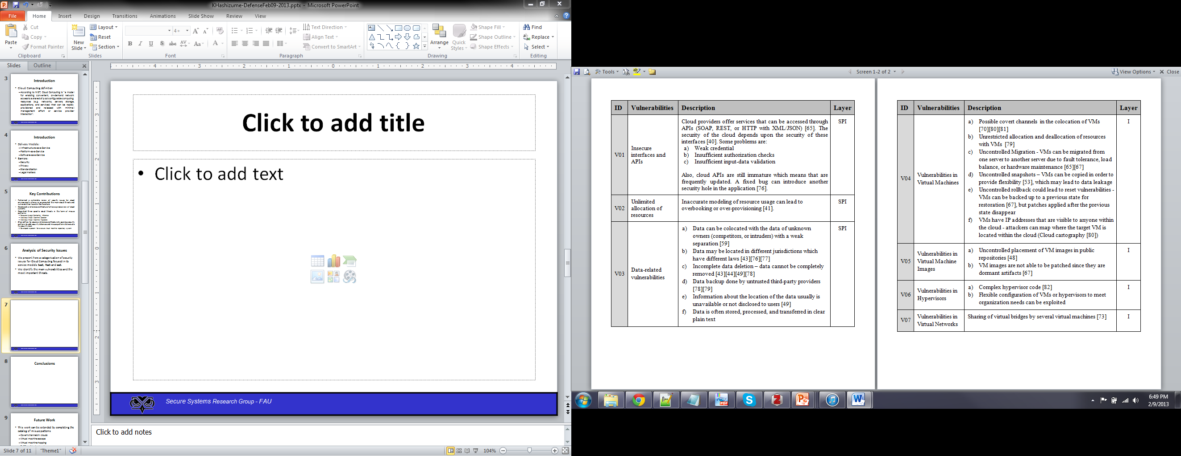
Vulnerabilities in Cloud Computing

Slide 120
Vulnerabilities in Cloud Computing

Slide 121
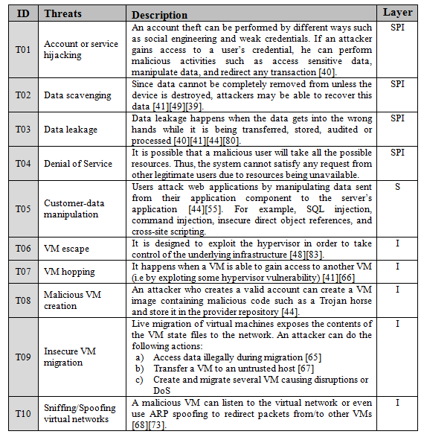
Threats in Cloud Computing

Slide 122
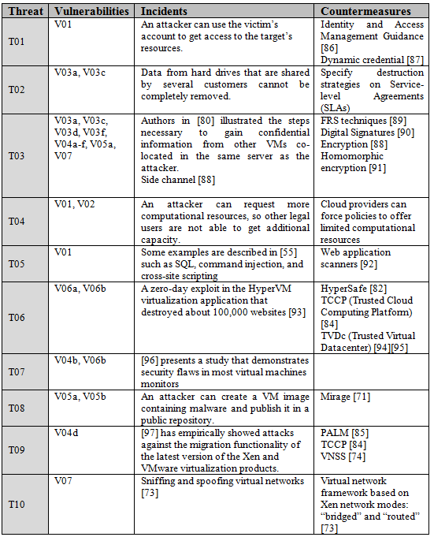
Relationships between Threats, Vulnerabilities, and Countermeasures

Slide 123
Analysis of Security Issues
Attacks to storage, virtualization, and networks are the biggest security concerns in Cloud Computing.
The relationships and dependencies between cloud components may also be a source of security risks.
We need a way to describe in detail how these threats happen so we can avoid them (misuse patterns).
We first built patterns for each layer

Slide 124
Infrastructure-as-a-Service Pattern
Intent: Describe the infrastructure to allow the sharing of distributed virtualized computational resources such as servers, storage, and network.
Context: Distributed systems where we want to improve the utilization of resources and provide convenient access to all users.

Slide 125
Infrastructure-as-a-Service Pattern
Problem:
No resources to invest in infrastructure, middleware, or applications
Not able to handle higher demands, or they cannot afford to maintain and store unused resources.
How can they get access to computational resources?

Slide 126
Infrastructure-as-a-Service Pattern
Forces
Transparency: Users should be able to use the provider’s services without understanding its infrastructure.
Flexibility: Different infrastructure configurations and amounts of resources can be demanded by users.
Elasticity
Pay-per-use
On-demand-service
Manageability
Accessibility
Testability
Shared resources
Isolation

Slide 127
Infrastructure-as-a-Service Pattern
Solution
A structure that is composed of many servers, storage, and a network, which can be shared by multiple users and accessible through the Internet.
These resources are provided to the users as a form of service called Infrastructure-as-a-Service (IaaS).

Slide 128
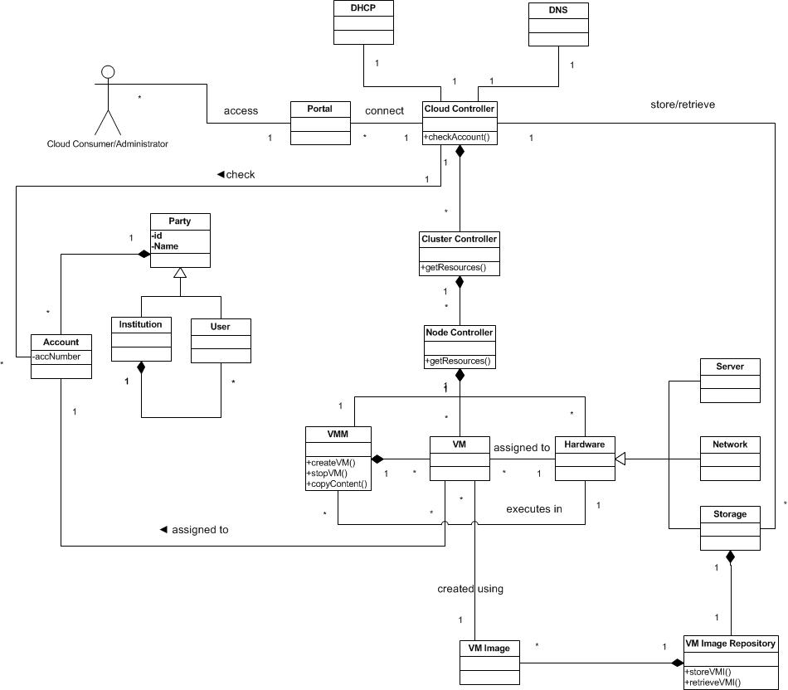
Class Diagram for Infrastructure-as-a-Service architecture

Slide 129
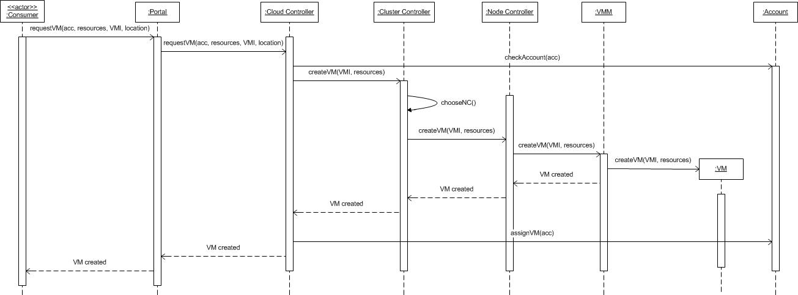
Infrastructure-as-a-Service Pattern
Sequence Diagram for Use Case Create a Virtual Machine

Slide 130
Misuse pattern: Malicious VM Creation
Intent
An attacker may create a VM image that contains malicious code.
The attacker may read also confidential data from images.
Context
Some IaaS providers offer a VM image repository where users can retrieve images in order to initialize their VM.

Slide 131
Malicious VM Creation
Problem
To perform some types of misuse it is necessary to be able to create and publish VM images.
The attack can be performed by taking advantage of the following vulnerabilities:
Any valid user can create and register a VM image.
Common place to share VM images.
VM images contain prepackaged software components for an application.
VM images contain installed and fully configured applications.

Slide 132
Malicious VM Creation
Solution
Any valid user of the cloud is able to use an image to instantiate his VM.
This VM image can contain malicious code.
The attacker can have control of the VM and perform malicious activities.
Infected VM may appear briefly, infect other virtual machines, and disappear before they can be detected

Slide 133
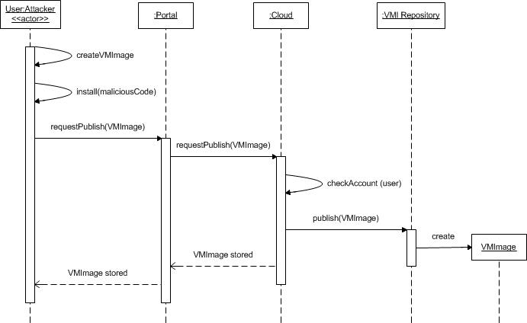
Malicious VM Creation
Sequence Diagram for the Use Case Publish a Malicious VM Image

Slide 134
Use of misuse patterns
Misuse patterns can be used to evaluate the security of a reference architecture.
We need to develop a good catalog for misuse patterns.
The catalog is based on the threat analysis of clouds
We started with three misuse patterns for clouds

Slide 135
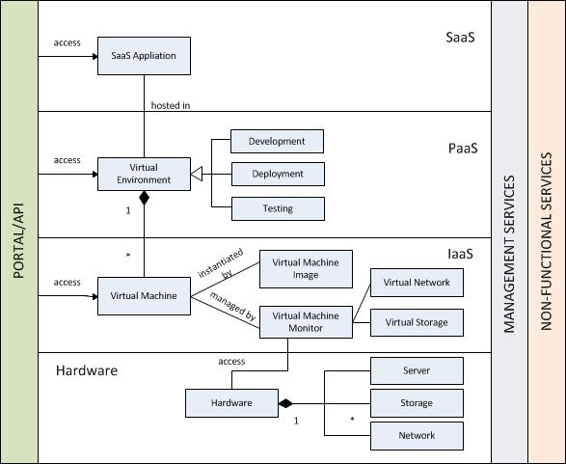
Cloud Architecture Overview
Cloud Architecture Overview

Slide 136
Securing an RA
We start from a list of use cases which describe the typical cloud uses and their associated roles. Lists of cloud use cases are shown in [Bad12], [nis11], and [Has13c].
We analyze each use case looking for vulnerabilities and threats as in [Bra08]. This implies checking each activity in the activity diagram of the use cases to see how it can be attacked. This approach results in a systematic enumeration of threats.
We use the list of threats from [Has13a] to confirm these threats and to find possible further vulnerabilities and threats.
These threats are expressed in the form of misuse patterns. We developed some misuse patterns for Cloud Computing in [Has13b], we show more later.
We apply policies to handle the threats and we identify security patterns to realize the policies. There are also regulatory policies which are realized as security patterns.

Slide 137
Vulnerabilities
Security
Analysis
Threats
Cloud
Countermeasures
stopped by
Misuse patterns
Security patterns
Reference Architecture
threats
IaaS
defenses
PaaS
SaaS
defenses
Security best practices

Slide 138
Metamodel for concepts

Slide 139
Enumerating threats
We can enumerate threats systematically by considering each activity in each use case and analyzing its possible threats
The approach is systematic and considers all the activities where attacks can occur. For illustration we use a running example of a Virtual Machine Image (VMI) Repository, which stores VM images for use by service consumers and which is part of the administrative functions of the cloud
We apply to each action in this repository the STRIDE attacks , e.g. Read a VMI (confidentiality attack), Tamper a VMI (integrity attack).

Slide 140
Enumerating threats

Slide 141
Misuse Activities Analysis

Slide 142
Threats vs. Defenses
ID | Threats | Defense
T11 | The cloud consumer is malicious and inserts malicious code into the VMI | Authenticator - Authorizer
T21 | An external attacker listens to the network to obtain information about the VMI | Secure Channel
T22 | VMI may be modified while in transit | Secure Channel
T23 | Disavows sending a VMI | Security Logger/Auditor
T31 | The IaaS administrator is malicious and collects information within the VMI | Authenticator - Authorizer
T32 | The IaaS disavows receiving a VMI | Security Logger/Auditor
T33 | Insert malicious code in the image | Authenticator - Authorizer
T41 | The IaaS administrator stores a malicious VMI | Authorizer – Authorizer Filter

Slide 143
Cloud security patterns
Secure migration process – provides protection for live and offline migration.
Secure hypervisor – reinforces the security of the hypervisor to avoid some attacks.
Secure virtual network – secures the communication among virtual machines.
Virtualized Trusted Platform – provides a framework to determine whether the environment is secure before launching a virtual machine.
Secure DNS, where Access Control Lists (ACLs) are used to protect the DNS (PLoP2014)
Security Group Firewall. A Security Group Firewall divides the firewall in customer groups that have similar filtering requirements [Fer14b]
Cloud-based Web Application Firewall (CWAF). Controls access to web applications communicating through HTTP according to authorization rules with the objective of stopping XSS, SQL injection, and similar attacks.
Secure DHCP

Slide 144
More misuse patterns for clouds
Covert channels in clouds – covert channels allow inter-VM communication bypassing the security rules of the hypervisor.
Virtual machine escape – describes how to exploit the hypervisor in order to take control of the underlying platform.
Virtual machine hopping – describes how a virtual machine can access other virtual machines, for example by exploiting the hypervisor.
Sniffing virtual networks – describes how a virtual machine can listen to the virtual network traffic in order to get confidential information.
Spoofing virtual networks – describes how a malicious virtual machine can intercept information in the virtual network with the purpose of altering its routing function.

Slide 145
Secure Reference Architecture
The identified threats can be neutralized by applying appropriate security patterns.
We showed how each threat can be controlled by a corresponding security pattern. Once security patterns are identified, we apply them into the reference architecture in order to stop or mitigate the threats
Security mechanisms are added to the basic RA, including Authenticator, Authorizer, Security Logger/Auditor and others that mitigate specific threats

Slide 147
Secure IaaS

Slide 148
Validation of the SRA
RAs are not directly implementable; they are abstract models and cannot be evaluated with respect to security or performance through experimentation or testing.
An RA is similar to a pattern and it has similar value, it is a paradigm to guide implementation of new systems or evaluation of existing systems.
Their evaluation must be based on how well they represent the relevant concepts of the systems they describe, how well they handle abstract threats, how complete they are, how precise they are, how they can be applied to the design or evaluation of systems, and how useful they are for other relevant functions.
Their final validation comes from practitioners using them to build concrete architectures.
We identified a variety of uses for a cloud SRA

Slide 149
Uses of a SRA
Security Service Level Agreement (SSLA). An RA can provide a framework for defining the requirement of the provider with respect to the requirements of the consumer; the SRA can define the security mechanisms that the SP has or could have and the customer can then select them for the corresponding SSLA. In particular, a SSLA can include several levels and the SRA makes clear where the services belong. SSLAs require monitoring to assure that the SP fulfilled its contact.
Reference for monitoring functions. Monitoring requires mechanisms to obtain information about the system status. A SRA provides guidelines about the places where security events should be collected in order to fulfill SLAs requirements and for system administration.

Slide 150
More uses of SRAs
A holistic security view. Several authors emphasize the need to develop secure systems in a holistic way. Systems built piecemeal omit important interactions that may result in vulnerabilities. A SRA provides such a holistic view by indicating the places where security mechanisms can be attached and their effect in the functional parts of the architecture. As such a SRA can be useful for developing secure cloud development methodologies. We can expand Figure 9 by indicating all the points where threats are neutralized with corresponding security Patterns. Holistic views are very important to combine quality factors such as safety or reliability with security.
A way to unify cloud terminology. Different vendors have different ways to describe their security services and products. A SRA can be used as a framework to unify terms and descriptions. This is useful for selecting cloud providers. Some ontologies for this purpose exist, but they don’t relate the terms to a RA, much less to a SRA.

Slide 151
SRAs in practice
NIST
IBM
Oracle
Fujitsu
Amazon
VmWare
Cisco
Trend Micro
Intel

Slide 152
Cloud security products

Slide 153
Cloud-based Web Application Firewall
Also member of the web application firewall (WAF) and Web applications security family of technologies. This technology is unique due to the fact that it is platform agnostic and does not require any hardware or software changes on the host. All providers but one require a DNS change, wherein all web traffic is routed through the WAF where it is inspected and threats are thwarted. Cloud-based WAFs are typically centrally orchestrated, which means that threat detection information is shared among all the tenants of the service. This collaboration results in improved detection rates and lower false positives. Like other cloud-based solutions, this technology is elastic, scalable and is typically offered as a pay-as-you grow service. This approach is ideal for cloud-based web applications and small or medium sized websites that require web application security but are not willing or able to make software or hardware changes to their systems.
XyberShield is the only cloud-based WAF which does not require a DNS change^{[13]}, instead relying upon a local 4k script and constant communication to its global service platform of 55 points of presence.
In 2010, Imperva spun out Incapsula to provide a cloud-based WAF to small to medium sized businesses.
Since 2011, United Security Providers provides the Secure Entry Server as an Amazon EC2 Cloud-based Web Application Firewall
Akamai Technologies offers a cloud-based WAF that incorporates advanced features such as rate control and custom rules enabling it to address both layer 7 and DDoS attacks.
Since 2012, Penta Security Systems, Inc. offers a cloud-based WAF, named WAPPLES V-Series^{[14]}, to the public with the strategic partnership with ISPs including KT, Korea.

Slide 154
CipherCloud http://www.ciphercloud.com/products/
The CipherCloud Open Platform eliminates cloud security issues by delivering a single platform to secure sensitive customer information across all of your cloud applications, while preserving usability, functionality and performance. Available as a service or virtual appliance, CipherCloud delivers a comprehensive set of protection controls including encryption, tokenization, activity monitoring, data loss prevention (DLP) and malware detection that can overcome your cloud security concerns.

Slide 155
Lenovo cloud security
Lenovo has a secure and manageable way of accessing Web applications by adding a cloud-connecting client to its desktop and laptop computers.
Cloud Ready Clients, are ThinkPad laptops and ThinkCentre desktops equipped with client software powered by webNetwork, an application delivery method developed by Lenovo partner Stoneware. The cloud-ready PCs have to be powered by Intel's second-generation Core or Core vPro processors.
Intel is involved because Lenovo uses its application programming interfaces that expose security, management, and power management features in the hardware. These features are used by Lenovo's client software, which it calls Secure Cloud Access.

Slide 156
Lenovo II
For example, customers could tie a fingerprint reader on a PC to a cloud application for authentication. SCA also can be used to automatically detect the hosting device's processor performance, free memory, graphics and available bandwidth, and then fit the application delivery within those parameters.
Available security methods includes SSL or VPN access, integration with Active Directory, eDirectory or LDAP directories, and the ability to incorporate additional layers of authentication when such security measures do not already exist on the device. SCA tries to prevent virus contamination by providing access to corporate applications and print and file resources, while walling off its intranet.
The cloud-ready software allows single sign-on to applications, whether Windows, Web, internal or hosted, and services. This is meant to reduce the number of password resets by IT management. Lenovo also offers a built-in fingerprint reader with its PCs to complement or replace application-unique passwords.
SCA has a starting price of about $80 per user, and is available only in North America.

Slide 157
Porticor® Virtual Private Data™
Porticor Virtual Private Data (VPD™) combines state of the art data encryption with patented homomorphic¹ split-key management to offer the most secure, cost-effective solution for safeguarding data in the cloud. Easy to install and use, Porticor VPD provides a complete solution for the entire data layer, and solves the biggest challenge of cloud data encryption – safe storage of the keys. Porticor VPD is an official Amazon Solution Provider.
In Infrastructure as a Service (IaaS) and Platform as a Service (PaaS) clouds, protecting data at rest is your responsibility. To meet privacy obligations to your customers and employees, and to comply with regulatory standards such as PCI DSS, HIPAA and SOX, businesses must securely encrypt cloud-based data, while keeping operational overhead to a minimum.
Encryption of most data storage types – including virtual disks, databases, files, distributed storage and more – using strong encryption algorithms such as AES-256.

Slide 158
Terremark
Verizon acquired the hosting firm Terremark for $1.4 billion.
The deal builds on a relationship the two companies began in September 2010, under which Verizon sold cloud services to small and medium-sized businesses out of Terremark’s data centers.
Terremark was early to market with cloud services in 2008 and joined the VMware vCloud initiative in 2009.
That year VMware took a 5% stake in Terremark, approximately $20 million of stock, to ensure that the company built out its cloud infrastructure on VMware technology. Verizon is also a member of the vCloud initiative and runs its cloud on VMware.

Slide 159
Verizon/Terremark
Verizon plans to operate the new unit as a wholly owned subsidiary, with the Terremark name retained and the company's management team continuing to run operations.
Headquartered in Miami, Terremark operates 13 data centers in the U.S., Europe and Latin America.
The company's Enterprise Cloud service provides some of the world’s largest companies and U.S. government agencies with on-demand computing resources
Like all cloud providers, it's had it's share of outages, but Terremark made a name for itself in the secure cloud services market, a big deal when selling to traditional enterprise IT organizations.

Slide 160





Windstream Cloud Connect
June 28, 2016: Windstream’s Cloud Connect enables companies to connect to cloud providers and cloud-based applications with a dedicated, highly-secure, reliable solution that bypasses the public internet
Custom Connectivity Options – Options include switched Ethernet, MPLS, VPN or point-to-point, and supports both virtual and dedicated connectivity models
Support for Widely-Used Platforms – Launching now for AWS and MS Azure ExpressRoute, with more platform support to come

Slide 161
Intel® Expressway Cloud Access 360 http://info.intel.com/rs/intel/images/Intel-Cloud-Access-360_Data-Sheet.pdf
It is a solution suite designed to control the entire lifecycle of access security for enterprises and their partners connecting to the cloud applications
Control: The identity lifecycle with account de-provisioning and automatic identity data syncronization to maintain data quality. Enforce context-aware authorization, deliver integrated strong authentication, and empower users with seamless SSO from multiple devices–all tied to authoritative IdM systems.
Visibility: Monitor user, administrator and API access activity…receive alerts against SLAs…all from a central administrative console.

Slide 162
ECA 360
• Compliance: Protect access to sensitive information with strong authentication soft/hard OTP, maintain audit records of identity lifecycle events, and correlate cloud user activity with on-premise logs for end-to-end compliance. Detect and de-provision orphan accounts to meet industry regulations.
• Protect Client to Cloud: Deploy mission critical apps in the cloud and enforce sophisticated client aware security policies to ensure requests are received from an attested client device or application.

Slide 163
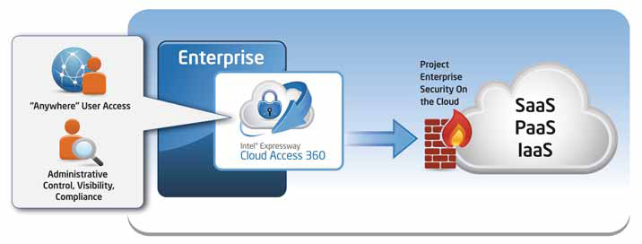
360 Access for the Cloud

Slide 164
Solutions to Control the Cloud Access lifecycle
Intel® ECA 360 is an integrated suite of Intel & Nordic Edge (an Intel company) identity technologies that can be deployed to secure enterprise user access to SaaS/PaaS/IaaS providers.
SSO-Intel® ECA 360 has a web based administrative console that makes it easy to view, author, and control access policy by cloud provider. Packaged with the solution are first mile “session look-up” connectors to common IdM & enterprise platforms such as Microsoft* SharePoint and “last mile” session creation & account provisioning connectors to popular SaaS and PaaS platforms. Federated authentication and authorization protocols are based on SAML, XACML, and emerging Oauth & Open ID identity standards that can connect internet based identity providers (e.g. Facebook) with corporate identities and authorization policy.
Mobile strong authentication
Two-factor authentication for mobile or remote clients

Slide 165
Protecting Cloud Services
Cloud security is not just about safe user access…its also about ensuring on premise or cloud hosted apps can securely expose and initiate system to system web service interactions for internal developers, or any application that needs to access data on the user’s behalf. Based on mature, ten year old technology, Intel has provided the leading XML Security. The appliance is deployed as a proxy at
the network edge to address common XML, and SOA problem areas such as acceleration, SOAP & REST security, service mediation, runtime governance, API security, and STS security token mapping for enterprise to cloud services.
For administrators, 360 access and CONTROL is achieved from a single administrative console where complex role-based access, time, network, and location based authorization policies are authored and enforced by provider.
COMPLIANCE is delivered with account deprovisioning reports and aggregated audit
logging correlated with log management platforms.
VISIBILITY means monitoring user activity and developer API access across cloud applications and provider platforms.

Slide 166
Cloud Standards and ECA
At an industry level, Intel & some solution providers have formed the Intel® Cloud Builders program to define and prototype reference cloud architectures.
Intel Expressway has a reference architecture for the “Cloud Access” usage model.
Intel is also a member of the Cloud Security Alliance which promotes the use of best practices for providing security assurance within cloud computing.

Slide 167
GFI Cloud http://www.gficloud.com/land/vbo-landing-page/?adv=13871&loc=1&dm_i=13BM,19OQE,6UIEAC,4ASW2,1
GFI Cloud™ gives IT admins control with patch management, web protection, antivirus, workstation and server monitoring, asset tracking, and remote control in one simple, web-based platform.
You can manage your entire network through GFI Cloud from your web browser. Anytime, anywhere, you can check the status of your network and take corrective actions when necessary. Simply monitor, add and update the services you want for each of your computers, without complex licensing or processes.

Slide 168
VmWare security
VMware vCloud Suite is an integrated solution for building and managing a complete cloud infrastructure that meets IT’s most critical needs. vCloud Suite fulfills the promise of the software-defined datacenter by pooling industry-standard hardware and running each layer of the datacenter as software-defined services. It creates pools of servers, storage and networking with dynamically configurable security, availability and management services which can meet the needs of any and all applications. Built-in self-service portal and catalog, policy-based infrastructure and application provisioning and automated operations management help to complete the picture. As delivered by VMware vCloud Suite, the software-defined datacenter provides all the cloud infrastructure characteristics essential for success: Standardized—Homogeneous infrastructure delivered across pools of standard x86 hardware, to eliminate unnecessary complexity. Holistic—A unified platform optimized for the entire datacenter fabric, to support any and all workloads. Adaptive—Self-programmable infrastructure that dynamically configures and reconfigures the environment according to changing application demands. Automated—A management framework with built-in intelligence to eliminate complex and brittle scripting, for cloud-scale operations with less manual effort and significant cost savings. Resilient—A software-based architecture that compensates for failing hardware, delivering unprecedented resiliency at minimum cost. http://www.vmware.com/products/datacenter-virtualization/vcloud-suite/overview.html

Slide 169
IBM Cloud security services (10/14)
The Dynamic Cloud Security portfolio concentrates on aiding enterprises in three of areas of security: authenticating access in the cloud, protecting applications and data in the cloud, and improving visibility into the effectiveness of security controls watching over cloud resources.
More than 200 engineers helped build the portfolio over the past year. The services extend IBM's collection of security software programs, such as QRadar security event management software and the Guardian data protection software, so they can be used to guard cloud resources as well.
The portfolio includes a central portal that offers a summary of the state of security across all of an organization's assets. Most security breaches can take weeks or even months to discover, IBM has estimated. The longer a breach goes undiscovered, the more damage an attacker can do. So a security portal can help identify problems as soon as they arise.

Slide 170
IBM security services II
The IBM services can scan the applications being used in the cloud for potential vulnerabilities, and can alert developers or system administrators of any potential security weaknesses. They can identify sensitive data in the cloud, and then monitor that data for any unauthorized usage. Pricing is based on different services used, overall usage and other factors.
IBM itself already collects more than 20 billion daily security events in the course of its duties managing security for clients. This intelligence allows IBM to identify threats early on.
IBM has identified security as a growth market for the company. It has acquired 12 security companies in the past decade, and has invested more than $2 billion into security research, garnering more than 3,000 patents in this area.
In the field of cloud security, IBM will be competing against a wide variety of companies such as Symantec, Barracuda, Qualys, SafeNet, TrendMicro and WatchGuard

Slide 171
IBM and the cloud
IBM has announced two tiers of cloud service, under the umbrella name of the IBM SmartCloud.
One, the Enterprise service, is an infrastructure-as-a-service offering similar to those from Amazon Web Services. Customers can deploy Windows or Linux applications in IBM data centers and IBM says it will guarantee 99.5 percent uptime annually.
The other, Enterprise Plus, offers higher levels of security and a 99.9 percent uptime guarantee, plus the option to run virtual machines on dedicated hardware, rather than servers shared with other customers, and the option to use AIX as well Windows and Linux. It also has more flexible management, security, and availability options. IBM will manage just the hardware and hypervisors, for example, or almost any combination of the OS, middleware, application, or entire business process.

Slide 172
IBM plans II
IBM is also offering the products behind the services as a hardware and software package that companies can deploy in their own data centers. It includes numerous Tivoli and Systems Director products, including Tivoli Service Automation Manager and Tivoli Provisioning Manager for Images.
The biggest challenge for enterprises will be management, according to IBM, in particular the proliferation of virtual machines and software images. It hopes to distinguish itself from other cloud providers by the level of security and management it says it can offer.
"We see the proliferation of images happening at a rate that makes the proliferation of Intel machines look like it was happening in slow motion," said Robert LeBlanc, IBM senior vice president for middleware.

Slide 173
Analysis of IBM plans
The Smart Business Cloud - Enterprise is a big step up from IBM's previous pure IaaS offering, the Smart Business Development and Test Cloud. Users can provision stock VMs running Red Hat Enterprise Linux, SUSE Linux Enterprise Server and Microsoft Windows Server, or they can choose from an arsenal of preconfigured software appliances that IBM, in part, manages and that users consume. These include Industry Application Platform, IBM DB2, Informix, Lotus Domino Enterprise Server, Rational Asset Manager, Tivoli Monitoring, WebSphere Application Server, Cognos Business Intelligence and many others.
In what may tell the back story of IBM's own cloud computing development path, all of the images and applications being offered from SBC - Enterprise presently run in Amazon’s EC2 environment. Not all of the announced IBM cloud applications run in the IBM compute environment.
Apparently sensitive to its enterprise audience, IBM has taken some pains to offer higher-end features, including access and identity management control, security and application monitoring tools, and VPN and VLAN capabilities, as well as VM isolation. IBM technical support will also be available.
IBM has been a consistent supporter of open source software for the enterprise market and the inclusion of Red Hat Enterprise Linux (RHEL) and SUSE Linux are indications that IBM feels those products have the chops for big customers running Linux. Being based on Linux (Blue Insight) also makes it easy for IBM to port its technology into an Amazon-type network.

Slide 174
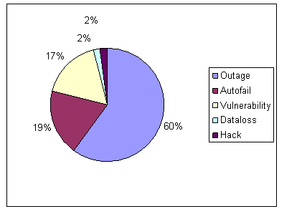
Cloud computing incidents: 128, 40, 37, 4, 4

Slide 175
Cloud security incidents
https://www.voltage.com/technology/cloutage-a-database-of-cloud-computing-security-incidents/
https://www.cnet.com/news/nasa-falls-short-on-its-cloud-computing-security/
http://www.computerworld.com/article/2526154/security0/twitter-breach-revives-security-issues-with-cloud-computing.html

Slide 176
Cloud-based service steals Wi-Fi passwords
For $34, a new cloud-based hacking service can crack a WPA (Wi-Fi Protected Access) network password in just 20 minutes, its creator says.
The WPA Cracker service bills itself as a useful tool for security auditors and penetration testers who want to know if they could break into certain types of WPA networks. It works because of a known vulnerability in Pre-shared Key (PSK) networks, which are used by some home and small-business users.
WPA Cracker customers get access to a 400-node computing cluster that employs a custom dictionary, designed specifically for guessing WPA passwords. If they find the $34 price tag too steep, they can use half the cluster and pay $17, for what could be a 40-minute job. Marlinspike declined to say who operates his compute cluster.
The attack will work if the network's password is in Marlinspike's 135 million-phrase dictionary, but if it's a strong, randomly generated password it probably won't be cracked.

Slide 177
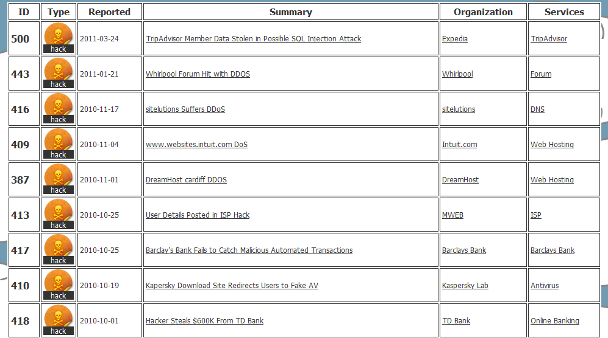
Cloutage.org

Slide 178
Security perspective
Identification and Authentication (I&A)—Passwords, biometrics, cryptography
Authorization and Access control (A & A)—Authorization systems in application, databases, operating systems
Logging and Auditing—In database system and/or operating system
Hiding of information—It is usually performed by the use of cryptography but steganography is another option. Protects messages in transit
Intrusion detection—Intrusion Detection Systems (IDS) combined with firewalls
Antimalware: virus detectors
DDoS controlled by replication, IDS, and firewalls

Slide 179
Can we measure security?
There is no absolute or quantitative measure of security, we can just find qualitative measures.
If we can make a systematic enumeration of threats and we can show that all are stopped or mitigated, we consider a system secure. That is our measure of security.

Slide 180
Evaluating degree of security
Verify that all misuse cases have been controlled by some security pattern
If we enumerate all the threats we just need to verify that the architecture includes a security pattern that can neutralize all the threats
If T={t₁,…t_{i}…}is the set of threats, and SP= {sp₁…sp_{j}…} is the set of security patterns, we have: ∀ t_{i} ∈ T ⇒ ∃ sp_{j} ∈ SP, ∋ sp_{j} controls t_{i}
When the SRA is instantiated to define a specific type of cloud, each misuse pattern can be realized following the specific architecture components, which means that we may need further security patterns to stop them
If MP=[ap₁,…ap_{i},…}, where ap_{i} is an attack pattern used by the MP, if ∃ sp_{j} ∋ sp_{j} stops ap_{i}, the misuse case cannot occur.
An attack (threat) pattern describes a specific step leading to a misuse [Uzu14]; e.g., using a stolen credential to have access to a DBMS where we can perform a misuse by using SQL injection.

Slide 181
Are clouds secure?
Consider a typical business application, e.g. a financial application: high security requirements, remote access, highly available
If it is in our control, we can put authentication, authorization, logging, firewalls, IDS, cryptography, where needed
If in a cloud from some provider, we need to specify the same defenses through the SLA
If provider satisfies these requirements, we need to consider extra threats: Internet access to the cloud itself, multitenancy, insecure images, migration attacks, insider attacks from provider employees,…
Best security in the cloud will always be less than best security under our control
In practice, it is harder to tell because we might not have enough expertise, not enough money for security, …

Slide 182
In summary
For a company that manages well its security, has appropriate expertise, and has installed enough security mechanisms, the cloud may be a decrease in security due to the extra threats, lack of control, and dependency on a provider that may not be as careful.
For a company that does not have enough expertise and not enough money to buy security products, training, etc. , the cloud may be a clear improvement.
The choice is affected by the application requirements, the value of the assets to be put in the cloud, compliance, and quality factors.

Slide 183
Security SLA
Specifies the security obligations of the SP associated with a service
No SP offers them now
SRA can be used as a guideline to specify what the customer wants

Slide 184
Need for Transparency
The split responsibility makes it hard to draw broad generalizations about cloud providers’ ability to meet audit requirements. A major issue is a perceived lack of visibility into cloud providers’ operations and security. “At the moment, cloud providers seem to want customers to treat them like a black box,” says Craig Balding of Cloud Security, who also works on the security team at a Fortune 500 financial company.
Patterns could be a way to provide this transparency: the provider provides in the SLA a list of the security patterns that they use to support security and compliance.
This approach gives a guarantee to the user and keeps some of the secrecy of the provider. The pattern provides an abstraction of security mechanisms not details of implementation. The customer only cares about this conceptual security.

Slide 185
Publications
Keiko Hashizume, David G. Rosado, Eduardo Fernández-Medina, Eduardo B. Fernandez, “An Analysis of Security issues for Cloud Computing”, Journal of Internet Services and Applications 2013, 4:5 (27 February 2013)
K. Hashizume, E. B. Fernandez, and M. M. Larrondo-Petrie, “Cloud Service Model Patterns,” in 19th Conference on Pattern Languages of Programs, 2012.
K. Hashizume, E. B. Fernandez, and M. M. Larrondo-Petrie, “A pattern for Software-as-a-Service in Clouds,” in Workshop on Redefining and Integrating Security Engineering (RISE’12), Washington, DC, USA, 2012.
K. Hashizume, E. B. Fernandez, and M. M. Larrondo-Petrie, “Cloud Infrastructure Pattern,” in First International Symposium on Software Architecture and Patterns, in conjunction with the 10th Latin American and Caribbean Conference for Engineering and Technology, Panama, 2012.
K. Hashizume, N. Yoshioka, and E. B. Fernandez, “Three Misuse Patterns for Cloud Computing,” in Security Engineering for Cloud Computing: Approaches and Tools, D. G. Rosado, D. Mellado, E. Fernandez-Medina, and M. Piattini, Eds. IGI Global, 2013, pp. 36–53.
K. Hashizume, N. Yoshioka, and E.B.Fernandez, "Misuse Patterns for Cloud Computing", Procs. of Asian PLoP 2011.
Keiko Hashizume, Eduardo B. Fernandez, and Nobukazu Yoshioka, "Misuse patterns for cloud computing: Malicious virtual machine creation"", Procs. of the Twenty-Third International Conference on Software Engineering and Knowledge Engineering (SEKE 2011), Miami Beach, USA, July 7-9, 2011
E.B.Fernandez and M. VanHilst, ''The Secure Domain Name System pattern'', 21st Conf. on Pattern Languages of Programs (PLoP 2014)

Slide 186
References II
E.B. Fernandez, Raul Monge, and Keiko Hashizume, "Two patterns for cloud computing: Secure Virtual Machine Image Repository and Cloud Policy Management Point"20th Conf. on Pattern Languages of Programs (PLoP 2013)
E. B. Fernandez, Nobukazu Yoshioka, and Hironori Washizaki, “Patterns for cloud firewalls”, Procs. of AsianPLoP (Pattern Languages of Programs) 2014, Tokyo, Japan, March 2014.
Oscar Encina, E.B. Fernandez, and Raúl Monge, “A misuse pattern for Denial-of-Service in federated Inter-Clouds”, Procs. of AsianPLoP (Pattern Languages of Programs) 2014, Tokyo, Japan, March 2014.
D.A,B.Fernandes, et al., “Security issues in cloud environment”, Int. J. of Information Security, 2014.
E.B. Fernandez, Raul Monge, and Keiko Hashizume, “Building a security reference architecture for cloud systems”, in revision for Requirements Engineering.
Guidelines on Security and Privacy in Public Cloud Computing, Wayne Jansen and Timothy Grance, NIST, January 2011 http://csrc.nist.gov/publications/drafts/800-144/Draft-SP-800-144_cloud-computing.pdf
A. Juels and A. Oprea, "New approaches to security and availability for cloud data", Comm. of the ACM, vol. 56, No 2, February 2013, 64-73.

