Slide 1
Cloud Computing 2016 Chapter 9: Compliance and Governance
Dr. E.B. Fernandez

Slide 2
Trip to Buenos Aires, Argentina (Nov 10-20)
I gave a tutorial on security patterns at the Universidad Nacional de La Plata (6 hrs. in two days)
I gave a talk at the patterns school of the Latin American Pattern Languages Conference (http://hillside.net/sugarloaf/2016/patterns-school/
I had two papers at this conference:
E.B.Fernandez and HernanAstudillo, “Experimental Evaluation of Secure Software Methodologies using Patterns”, 11th Latin American Pattern Languages of Programs Conference, Buenos Aires, Argentina, November 14-18, 2016
A.Alkazimi and E.B.Fernandez, “A Misuse Pattern for Transport Layer Security (TLS): Triple Handshake Authentication Attack'‘.
I was session moderator for the analysis of four patterns.
I met with Prof. Hernan Astudillo (Chile) to discuss current work and plan future work.

Slide 3
Compliance
Compliance is the application of rules designed to enforce standards based on established laws, regulations, specifications, and best practices
The complexity and the number of standards are increasing with the advancement of technologies and consumer needs.
Compliance varies from country to country. In most cases, they share almost identical rules and regulations customized to their local needs.

Slide 4
Compliance II
Compliance may require the use of multiple IT attributes such as confidentiality, integrity, availability, reliability, and accountability
Compliance comes with a high cost of implementation and maintenance.
Failing to comply could result in penalty fees, lawsuits, and bad business reputation
There are a number of standards such as PCI DSS, HIPAA, GLBA, SOX, European Union Data Privacy and many others

Slide 5
Standards and regulations
HIPAA (Healthcare Insurance Portability and Accountability Act) is a standard for individuals’ protected health information(PHI). It requires covered entities(i.e. health care providers) to protect privacy and security of PHI.
PCI-DSS (Payment Card Industry Data Security Standard) is an information security standard to improve the security of financial transactions related to debit, credit, prepayments, e-purse, ATM, and POS cards.

Slide 6
Standards and regulations II
GLBA (Gramm-Leach-Bliley Act) is a standard that requires financial institutions that offer consumers financial products or services to develop, implement, and maintain a compressive information security program that protects the privacy and integrity of customer records.
SOX (The Sarbanes-Oxley Act) is a standard to protect shareholders and the general public from accounting errors and fraudulent practices in the enterprise. It defines which records needs to be stored and for how long. It doesn’t define how business should store records.

Slide 7
Standards and regulations III
COBIT (Control Objectives for Information and related Technology) is designed to provide management and business process owners with an information technology (IT) governance model that helps in delivering value from IT and managing the risks associated with IT
ISO/IEC 27000 family of standards helps organizations to keep information assets secure.
ISO/IEC 27001 –Information security management systems requirements
ISO/IEC 27002 – Code of practice for information security controls
ISO/IEC 27003 –Information security management system implementation guidance
ISO/IEC 27004 - Security techniques -- Information security management

Slide 8
Standards and regulations IV
NIST-53(National Institute of Standards and Technology - 53) is a standard on security and privacy Controls for Federal Information Systems and Organizations. NIST-53 is very similar to ISO/IEC 27002 but specific to government offices and agencies
FISMA (Federal Information Security and Management Act) is a standard to maintain security requirements and controls in all federal agencies

Slide 9
Example: Medical information
Medical information is very sensitive and must be protected.
In addition to the medical personnel, there are various actors involved in handling this information.
The organization and access control of the private medical information of each individual is complex and fragmented.
To provide guidelines for the protection of these records many countries, including the US, are enacting laws that regulate the use of electronic patient records.
The British Medical Association in 1996 put strong controls on UK patient records. In the US, the Health Insurance Portability and Accountability Act (HIPAA) does similarly.

Slide 10
HIPAA
Title II of HIPAA, known as the Administrative Simplification (AS) provisions, requires the establishment of national standards for electronic health care transactions and national identifiers for providers, health insurance plans, and employers.
The AS provisions also address the security and privacy of health data. The standards intend to improve the efficiency and effectiveness of the nation's health care system by encouraging the widespread use of electronic data interchange
The HHS has promulgated five rules regarding AS: the Privacy Rule, the Transactions and Code Sets Rule, the Security Rule, the Unique Identifiers Rule, and the Enforcement Rule.

Slide 11
HIPAA Rules
The Privacy Rule regulates the use and disclosure of certain information held by covered entities (healthcare providers, health care clearinghouses, employer sponsored health plans, and health insurers) and their business associates (lawyers, accountants, IT consultants). It establishes regulations for the use and disclosure of Protected Health Information (PHI).
The Transactions and Code Sets Rule defines specific transaction types.
For example, the EDI Health Care Claim Transaction set (837) is used to submit health care claim billing information, encounter information, or both, except for retail pharmacy claims. It can be sent from providers of health care services to payers, either directly or via intermediary billers and claims clearinghouses.

Slide 12
Class diagram for HIPAA’s Privacy rule

Slide 13
The Security Rule
The Security Rule complements the Privacy Rule.
While the Privacy Rule pertains to all Protected Health Information (PHI) including paper and electronic, the Security Rule deals specifically with Electronic Protected Health Information (EPHI)
It lays out three types of security safeguards required for compliance: administrative, physical, and technical.

Slide 14
Class diagram for HIPAA’s Security Rule

Slide 15
GLB
The Gramm–Leach–Bliley Act (GLB), also known as the Financial Services Modernization Act of 1999, (Pub.L. 106-102, 113 Stat. 1338, enacted November 12, 1999) is an act of the 106th United States Congress (1999–2001). It was signed into law by President Bill Clinton and it repealed part of the Glass–Steagall Act of 1933, opening up the market among banking securities and insurance companies.
The Gramm–Leach–Bliley Act allowed commercial banks, investment banks, securities firms, and insurance companies to consolidate.
GLB compliance is mandatory; whether a financial institution discloses nonpublic information or not, there must be a policy in place to protect the information from foreseeable threats in security and data integrity.

Slide 16
GLB compliance
In terms of compliance, the key rules under the Act include The Financial Privacy Rule which governs the collection and disclosure of customers’ personal financial information by financial institutions. It also applies to companies, regardless of whether they are financial institutions, who receive such information.
The Safeguards Rule requires all financial institutions to design, implement and maintain safeguards to protect customer information. The Safeguards Rule applies not only to financial institutions that collect information from their own customers, but also to financial institutions – such as credit reporting agencies, appraisers, and mortgage brokers – that receive customer information from other financial institutions.

Slide 17
PCI and SaaS
The PCI Council formed a body of security standards known as the PCI Data Security Standards, PCI DSS, and these standards consist of 12 significant requirements including multiple sub-requirements which contain numerous directives against which businesses may measure their own payment card security policies, procedures and guidelines.
By complying with qualified assessments of these standards, businesses can become accepted by the PCI Standards Council as compliant with the 12 requirements, and thus receive a compliance certification and a listing on the PCI Standards Council website.
SaaS affects compliance with numerous regulations, but perhaps the best benchmark is PCI DSS, which has explicit provisions for "service providers," . Requirement 12.8 of PCI requires service providers to be compliant and contractually acknowledge their responsibility for protecting the client's
cardholder data.

Slide 18
Privacy regulations
Privacy is the right of individuals or groups to keep their personal information away from public knowledge or their ability to control personal information flow
In the electronic or the real world, people seek privacy, so they can perform their actions without others monitoring them
Individuals should be able to live without being disturbed and users interacting with the web, navigate without being identified. People providing information to medical institutions or storing their personal records in commercial companies should know what to expect about the privacy of their information.
This right is recognized by all civilized societies and is considered a fundamental human right.
The first national privacy protection law was the Swedish Data act of 1973. This was followed by the US Privacy Act of 1974. The intent of this act was to protect individuals against invasion of privacy by the Federal Government. This law is complemented by the Computer Security Act of 1987, which defines requirements for federal agencies about the security of their information.

Slide 19
Privacy preferences
User control over personal information
P3P (Platform for Privacy Preferences), developed by the W3C
A standardized set of multiple-choice questions about privacy policies

Slide 20
Modeling regulations and policies
Regulations define sets of policies
Policies can be described using UML class models
Some policies are rules about security
Some policies are rules that define constraints in the handling of some type of information

Slide 21
Some policies for medical information
Patients can see their records, consent to their use, must be informed of their use
A doctor or other medical employee is responsible for use of record (custodian)
Records of patients with genetic or infectious diseases must be related
One or more medical records per patient

Slide 23
OCL (Object Constraint Language)
Similar to Z and SQL, 1st order predicate calculus
Adds precision to UML constraints
Part of UML standard
Implementation oriented
Important for safety-critical applications

Slide 25
Analogies
Regulations may have similar objectives and we can use analogy to create a new pattern from an existing pattern
For example, HIPAA and SOX protect records and we can deduce a pattern for SOX from the HIPAA pattern
Regulations also have overlapping policies, we can find patterns from them

Slide 26
Analogy: Sarbanes Oxley

Slide 27
Regulations overlap
HIPAA
SOX
GLBA

Slide 28
Cloud compliance issues
Every regulation requires organizations to adequately protect their physical and informational assets. To do this, there is an implied or assumed ability to control and prove:
What information is stored on the system?
Where is the information stored?
Who can access the system?
What they can access?
How is the data protected?
What data backup they use?
How you may reserve the right to audit the security and compliance framework that they build around your data.
Do they have an incident response plan which should cover any type of legal requests to get access to data stored on the cloud
All this should be in the SLA

Slide 29
Answers
All of these questions imply some level of ownership of the assets in question, and that is where cloud compliance issues become apparent. In a public cloud environment, you are able to answer the first of those questions with certainty; the other, however, end up posing a compliance problem.
In the cloud, there is no expectation on the provider's side to be able to show you where your information resides. This is not to say that the provider cannot do it, but that the market has not driven them to the point of providing this service. Also, to be fair, requiring that type of location awareness is in conflict with the purpose of cloud computing.
So what can you do? Ensure that the provider you use is able and willing to work with you to provide, and prove, any data location restrictions you may have.
There are special products, e.g. Caballero’s, to prove location of data

Slide 30
Compliance in the traditional private network
Companies have full control to enforce compliance
Confidentiality, integrity , availability and accountability are managed by company IT department
Limited security and compliance experts in the market . As a result, it is a challenge to enforce 100% compliance
Full understanding and implementation of compliance rules is a challenge because of the complexity and lack of precision
High maintenance cost
Huge penalty fee and bad reputation if companies fail to comply
Advances in technologies such as cloud and mobile platforms as well as BYOD policies make it more complex

Slide 31
Compliance in the cloud
As per Gartner, security and compliance are the primary concerns in the cloud
Compliance in the cloud is a shared responsibility among customers, service providers, and brokers
The Cloud Security Alliance (CSA) and National Institute of Standards and Technology (NIST)are leading the overall standardization effort in the cloud
Cloud service providers are using independent third party certifying bodies and auditors to assert their compliance in the cloud, e.g., FedRAMP, Third Party Assessment Organization (3PAO),Truste, CSA, and others

Slide 32
Compliance in clouds II
Third party auditors and certifying bodies are not using common certifying and auditing process but they are using their own proprietary solutions and standards.
Companies and government agencies are also using compliance tools such as WatchGuard, Trust Wave and FedRAMP process to certify their compliance
Customers don’t have an easy way to compare each cloud service providers with a common checklist because of the number of available standards and proprietary solutions

Slide 33
A better approach
Precise understanding of rules using reference architecture, patterns and modeling tools
Use patterns and well known security APIs instead of reinventing the wheel
Take advantage of analogies and overlaps to reuse knowledge
Enforce the standard in all stages of the software development lifecycle

Slide 34
Governance
Governance means establishing and enforcing how a group agrees to work together in co-ordination. Specifically, governance is the establishment of:
Chains of responsibility to assign duties and rights to people
Measurement to gauge effectiveness
Policies to guide the organization to meet its goals
Control mechanisms to ensure compliance
Communication to keep all required parties informed
Governance determines what decisions are to be made, who should be making the decisions and what policies should be considered before making any decisions

Slide 35
Specific objectives in clouds
Governance guides the development of reusable services and establishes how the services should be designed and developed and how those services should change over time. It establishes agreements between the providers of services and the consumers of those services, telling the consumers what they can expect and the providers what they're obligated to provide.
Governance is a set of practices that is applicable throughout the various stages of a service-oriented architecture such as service definition, service deployment lifecycle, service versioning, service migration, service registries, service message model, service monitoring, service ownership, service testing and service security.
Governance is typically enacted by a center of excellence (COE) which is a board of knowledgeable practitioners who establish and supervise policies to help ensure an enterprise's success. The COE establishes policies for identification and development of services, establishment of SLAs, management of registries, and other efforts that provide effective governance.
Governance policies can be enforced through a combination of an enterprise service bus (ESB) and a service registry. A service can be exposed so that only certain ESBs can invoke it. Then the ESB/registry combination can control the consumers' access, monitor usage, measure SLA compliance, and so on. This way, the services focus on providing the business functionality and the ESB/registry focuses on aspects of governance.

Slide 36
Cloud governance concerns
How do I enforce existing security policies and procedures when my data is in the cloud?
If my cloud provider is sued, can the suing party get access to my data?
How do I get access to full reporting that I need for my IT governance and compliance responsibilities?
How do I know what other data is in my cloud?
How do I know if my cloud is secure?
How do I automate access rights management in the cloud?

Slide 37
Cloud management
Management defines ways to apply specific aspects of governance to the control of cloud resources
The following paper discusses some of its aspects

Slide 38
Manageability: [Cook et al. 2011]
Ability to monitor and control the operation and evolution of long-lived distributed applications and services, avoiding manual intervention
Need to reconfigure services dynamically
Collective processes of deployment, configuration, optimization, and administration during the lifecycle of services
Includes Resource management: scheduling and resource assignment, performance and availability, VMs, workload
Automation: deployment, provisioning, monitoring, configuration, changes, and problems

Slide 39


Slide 40
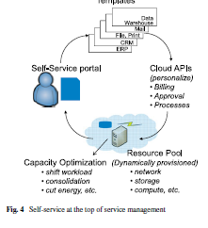

Slide 41
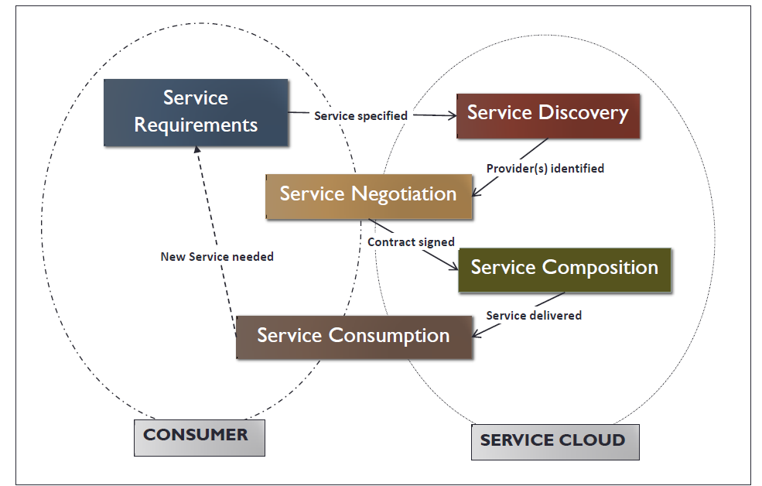
Services lifecycle [Joshi2014]

Slide 42
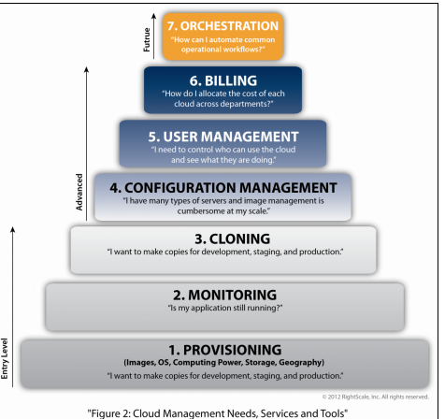
Darryl Eaton, March 28, 2012 http://cloudcomputing.sys-con.com/node/2207848

Slide 43
Steps
You provision basic or pre-configured images to meet your specifications and the needs of your users and customers, with memory, computing power, storage, OS and geographic proximity.
Once you've installed applications in your cloud, you'll want to monitor them. Are they running properly? Have any of them gone down? Can you get alerts if something goes wrong?
After you've tweaked your images, you'll want to clone them, say, for development/staging/production, for multiple developers or to meet increasing demand and traffic. You can also try products for cloud auto-scaling (originally invented by RightScale).
It's easy to take snapshots of images; sometimes too easy. You forget why you created them, what's inside them and whether anybody is still using them. You need configuration management to deal with image sprawl. Once you have that under control, you also need configuration management to create repeatable applications and services (for your own mini Platforms-as-a-Service).

Slide 44
Policy Management
Policy Management Manage lifecycle policies for services
Define and manage service validation and conformance policies for service design and registration
Manage run-time policies for services
Define and manage security, routing, reliability, mediation, and other Operational Governance policies
Define policies for services across all popular types of service containers including, Java and .NET app servers, ESBs, mainframe, and packaged applications
NOTE: Without deep integration with an SOA Operational Governance solution, these policies will be informational only, and will not be enforced
Audit run-time policy enforcement through compliance auditing and reporting
Use metrics and reports from the run-time system to validate that running services comply with defined run-time policies
Capture performance and usage metrics according to policies
Statistically and algorithmically capture comprehensive message data
Track and manage security and other policy exceptions
Compare and reconcile collected metrics with policies for audit purposes

Slide 45
Need for automated support for negotiation and enforcement of SLAs—[Lit12]
How to assure that SLAs are enforced?
We need automated support for negotiation, monitoring, and enforcement of SLAs
Represent SLAs as executable policies that can be evaluated by both parties
Provider has local policies (LP) and a Policy Manager (PM) to enforce them
The gateway is a Policy Enforcement Point

Slide 46
Enforcement
In a) the PM of the provider checks if the client service access complies with the policies
In b) both client and provider can check
In c) an independent third party checks for compliance
D) shows the possibility of the client and provider negotiating policies

Slide 47
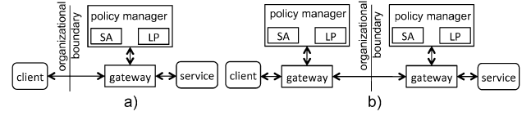

Slide 48
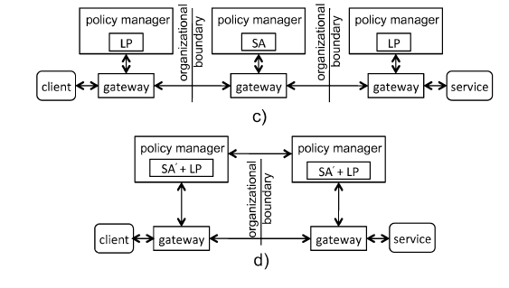

Slide 49
Management patterns
Secure Virtual Machine Image Repository: Avoid the poisoning of VM images during creation and the leaking sensitive information accidentally left in the VMI by enforcing access control to the repository.
Cloud Policy Management Point: Provide an administrative dashboard for security functions, including authentication, authorization, cryptography, logging, and control of VM images.

Slide 50
Cloud management patterns

Slide 51
Forces
Expressiveness. We should be able to represent any policies or constraints to decide access.
Security. Access and identity information should only be manipulated by authorized people.
Usability. The information about access should be presented to the security administrator in a clear and systematic way.
Scalability. The number of users and the number of roles should be able to be increased conveniently.
Extensibility. We should be able to add new management functions in a convenient way.
Flexibility. It should be easy to change policies about security.

Slide 52
Use cases for PMP

Slide 53
PMP pattern

Slide 54
Repository pattern http://msdn.microsoft.com/en-us/library/ff649690.aspx
In many applications, the business logic accesses data from data stores such as databases, SharePoint lists, or Web services. Directly accessing the data can result in the following:
Duplicated code
A higher potential for programming errors
Weak typing of the business data
Difficulty in centralizing data-related policies such as caching
An inability to easily test the business logic in isolation from external dependencies

Slide 55
Repository II
Use the Repository pattern to achieve one or more of the following objectives:
You want to maximize the amount of code that can be tested with automation and to isolate the data layer to support unit testing.
You access the data source from many locations and want to apply centrally managed, consistent access rules and logic.
You want to implement and centralize a caching strategy for the data source.
You want to improve the code's maintainability and readability by separating business logic from data or service access logic.
You want to use business entities that are strongly typed so that you can identify problems at compile time instead of at run time.
You want to associate a behavior with the related data. For example, you want to calculate fields or enforce complex relationships or business rules between the data elements within an entity.
You want to apply a domain model to simplify complex business logic.

Slide 56
Repository Solution
Use a repository to separate the logic that retrieves the data and maps it to the entity model from the business logic that acts on the model. The business logic should be agnostic to the type of data that comprises the data source layer. For example, the data source layer can be a database, a SharePoint list, or a Web service.
The repository mediates between the data source layer and the business layers of the application. It queries the data source for the data, maps the data from the data source to a business entity, and persists changes in the business entity to the data source. A repository separates the business logic from the interactions with the underlying data source or Web service. The separation between the data and business tiers has three benefits:
It centralizes the data logic or Web service access logic.
It provides a substitution point for the unit tests.
It provides a flexible architecture that can be adapted as the overall design of the application evolves.

Slide 57
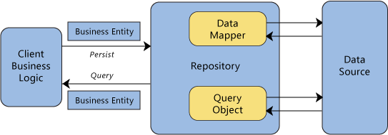
Repository interactions

Slide 58
Microsoft management tool May 2015
Microsoft launched a tool that initially is best for managing its public and private clouds but that the company says will soon enable enterprises to control hybrid clouds based on Amazon Web Services and VMware clouds, too.
The Operations Management Suite helps simplify management of your datacenter assets wherever they live,” wrote Jeremy Winter, a product manager at Microsoft, in a blog post. “That means any instance in any cloud, including your data center, Azure, AWS, Windows Server, Linux, VMware, and OpenStack.”
Microsoft, which revealed OMS at its inaugural Ignite Conference in Chicago, is attempting to fill a void in the market for management tools that work across clouds.
What OMS does include are features for analytics (such as monitoring logs to show how cloud resources are being used), automation (for creating and running automated tasks), availability (to manage automatic backup and recovery) and security (to define role-based access controls for cloud resources).

Slide 59
SOA Software Policy Manager http://www.soa.com/products/policy_manager/
Policy Manager™ is a comprehensive SOA Policy Governance Automation solution offering governance process and collaboration capabilities to instill consistency and accountability and encourage desired behavior.
It can be deployed stand-alone providing SOA Governance Automation capabilities with built-in lifecycle policy enforcement and operational policy management. It integrates seamlessly with SOA Software’s Repository Manager™ for comprehensive metadata management, and can also be deployed with SOA Software’s Service Manager™, or any other standards-based SOA Operational Governance Automation solution, to deliver comprehensive Integrated SOA Governance Automation infrastructure.
Policy Manager provides an enterprise-class UDDIv3 registry with a role-based JSR-168 compliant Web-based portal interface to ensure that different users have easy access to the features and capabilities they need and use the most.
Provides comprehensive SOA Governance tools for all the different roles in the organization including; service developer, consumer developer, architect, business stakeholder, IT operations, security operations, and more. It uses a role-based security model for authorization of policy-driven SOA Governance process control such as service publishing and provisioning, and to protect sensitive information.
Policy Manager defines, monitors, and manages Active Contracts™ between consumers and providers. These contracts are created through a negotiation process, supported by ad-hoc collaboration between vested constituents and can be enforced by a standards-based SOA run-time security and management solution like Service Manager. They define the specific policy sets that will be used and enforced, the SLAs and alerts the service commits to, and the access profile and capacity granted to the consumer.

Slide 60
Policy Manager II
Policy Manager delivers powerful publish and discovery approvals features for service publishing and provisioning combined with search, browse, and collaboration features to:
Ensure that published services are appropriate and comply with enterprise design guidelines
Provide a publishing process with built-in tests to verify compliance with policies
Reduce development cost and time by providing a service for publishing and discovery of services and all related assets
Developers browse or search a central registry for categorized services
Retrieve basic service assets from the registry/repository
Flexible tagging, categorization, and taxonomy models
Facilitate communication between vested parties through contextual collaboration
Ad-hoc and unstructured interactions between vested constituents around organization, policy, service, and contract

Slide 61
Policy Manager: SOA Software Contract Management
Policy Manager uses Active Contracts to:
Manage relationships between service consumers and providers
Provide a process allowing the negotiation of policies, SLAs,and capabilities between consumer and provider
Enforce a contract that tracks this relationship
Provide notifications on changes
Deliver consumer-led service and policy definition
Consumers can request a service (WSDL) with constraints and capabilities (policy) they would like to use, and allow organizations to fulfill this by negotiating and implementing the agreed policies and services
Manage the supply and demand equation for services with a contract-based provisioning process for:
Capacity planning
Version management
Service deprecation
Mapping relationships between services for impact and exception analysis and reporting

Slide 62
SOA Software Repository Manager
It enables enterprises to understand what services and other software assets exist, where they're located and how each fits into a company's business and technical landscape. By providing a context for understanding and assessing existing software assets, Repository Manager serves to automate the path to SOA.
Repository Manager™ is a development governance platform that automates machine and role-based signoffs across the software development lifecycle. Development governance occurs as a service moves through the various phases of the software development lifecycle.
Without development governance, SOA initiatives will fail to deliver agility to the enterprise - the core value of SOA. Enterprises must be able to track all of the components of SOA, changing them as needed while maintaining a clear understanding of underlying interdependencies. This holistic perspective can only be achieved through effective development governance.
Repository Manager's strong integration with application development environments, federation with all major service registries and extensive integration with Policy Manager™ enables customers to rapidly develop, govern and deploy services and their supporting assets within the SOA service lifecycle.

Slide 63
Microsoft System Center 2012: Taking Systems Management to the Cloud http://technet.microsoft.com/en-us/magazine/hh273449.aspx
Users expect constant access to corporate services from wherever they are on whichever device they’re using. To support a rich user experience across an expanding range of mobile devices, you need to adopt new processes, new physical infrastructure and virtualization technology. You must also ensure those changes meet corporate control and compliance requirements. You have to manage and secure these enabling technologies without driving up operational costs or increasing administrative complexity.
System Center Configuration Manager (SCCM) 2012 (now R2) can address these challenges in myriad ways. SCCM 2012 enables the device freedom that users have come to expect, while ensuring that you can still exert an appropriate level of control. SCCM 2012 introduces multivendor platform support, with native support for all devices that leverage Exchange ActiveSync technology. This includes Windows Phone-, Apple iOS-, Symbian- and Android-based devices. You can manage multiple mobile device platforms, complete with asset tracking and policy enforcement. You can even manage mobile devices that connect to public cloud-hosted e-mail infrastructure, like Office 365.
System Center Virtual Machine Manager (VMM) 2012 focuses on delivering private cloud solutions. It moves beyond provisioning and managing individual servers. It helps you manage “Fabric” resources as well—not just servers, but shared resources like storage and networks.

Slide 64
HP VM manager tasks
Create, configure, and control virtual machines and their resources, such as virtual switches (vswitches), virtual network devices, and virtual storage devices
Monitor VM Host and virtual machine operation
Modify virtual machine configurations
Migrate virtual machines from host to host
Collect and view utilization data for VM Host, virtual machines, and their resources
Respond to status reports, error messages, and problems concerning virtual machines

Slide 65
RightScale Cloud Management http://www.rightscale.com/products/
The bridge between your applications and your cloud infrastructure.
The MultiCloud Platform provides a universal remote to conveniently access your public, private, and hybrid cloud resource pools from one Dashboard and API.
The Configuration Framework provides intelligent cloud blueprints to configure and operate your servers in a dynamic and completely customizable fashion.
The MultiCloud Marketplace™ provides a one-stop shop of cloud-ready components.
The Automation Engine gives you the power to provision, monitor, scale, and manage entire server deployments efficiently and reliably.
Governance Controls allow you to keep watch over access, security, auditing, reporting, and budgeting through a “single pane of glass” view.

Slide 66
Multiple clouds
RightScale Cloud Management enables you to manage of all of your clouds — public, private, and hybrid — and all of your resources — compute, storage, and networking. Cloud-specific differences are abstracted so you can focus on running your applications. All of your resources are in one place and are organized for ease with logical groups of servers called deployments. Provision, configure, and automate individual servers or entire deployments in minutes. All of your resources are accessible on your terms from our RightScale Dashboard or via the RightScale API.
See and manipulate all of your cloud servers in one place. Configure your networking resources such as IP addresses, content delivery networks, firewalls, and virtual private networks. Manage block storage volumes and object stores to enable web serving, content delivery, persistent data storage, and backups.

Slide 67
RightScale manager
Access the powerful features of RightScale with a web-based Dashboard and API. RightScale acts as your “universal remote” for the cloud, enabling unified access and transparency across all of our supported clouds. Integrate the power of RightScale in your own third-party applications using our comprehensive API. Our API offers a range of powerful features:
Cloud resources: Provision, configure, edit, and decommission.
Monitoring: Track and graph custom metrics in the dashboard or export to your own systems.
Auditing: Track and export audit logs.
Provisioning: Manage accounts, users, and permissions.

Slide 68
Uptime Software
Headquarters: Toronto, Canada
What it offers: UptimeCloud, cloud cost and capacity management SaaS.
How it works: Once an IT organization signs up for the service through the UptimeCloud portal, Uptime begins monitoring its cloud infrastructure. Initially available for cloud infrastructure from Amazon Web Services (AWS), UptimeCloud talks to the AWS open API, capturing pricing information in real time and feeding it into its rating and pricing engine, says Uptime CTO Alex Bewley. Uptime also applies historical data collection, trending and prediction functions.
Why it's worth watching: For many IT organizations, the cloud decision can be fraught with paralyzing uncertainties regarding the monthly infrastructure bill. Uptime aims to eliminate the mystery by providing visibility into how much cloud computing costs in real time, across applications, services, line of business, user location and instance. Uptime's ability to correlate the performance of a cloud workload with how much it's costing an organization is pretty innovative, says 451 Group's Callaghan. "This whole concept of ERP for IT is really going to take off."

Slide 69
References
K. Beckers, I. Coté, S. Fassbender, M. Heisel, and S. Hofbauer, “A pattern-based method for establishing a cloud-specific information security management system”, Requirements Eng. vol. 18, 2013, 343-395.
Cook, Milojicic, and Talwar, “Manageability”, J. Internet Serv. Appl. Dec 2011
E. B. Fernandez, R. Monge, and K. Hashizume, “Two patterns for cloud computing: Secure Virtual Machine Image Repository and Cloud Policy Management Point”, 20th Conf. on Pattern Languages of Programs (PLoP 2013).
Karuna Pande Joshi et al., "Automating Cloud Services Lifecycle through Semantic technologies", IEEE Transactions on Service Computing, January 2014
Dereje Yimam and Eduardo B. Fernandez, A Survey of compliance issues in cloud computing, Journal of Internet Services and Applications, 2016, 7:5 DOI: 10.1186/s13174-016-0046-8 URL: http://www.jisajournal.com/content/7/1/5

Slide 70
Refs. II
Mark Little · Santosh Shrivastava · Stuart Wheater, “Another look at the middleware for dependable distributed computing”, J. Internet Serv Appl (2012) 3:95–105, DOI 10.1007/s13174-011-0055-6

