Slide 1

Executive Sales Report
A comprehensive analysis of sales performance and strategic recommendations.

Slide 2
Part 1: Sales Performance Review
Key metrics and dashboard analysis

Slide 3

OBJECTIVE
Analyze the trend and growth and sales over year, quater and month
To find the product which product increase the sales of the overall time period
To derive key insights and inferences
And discuss strategic business proposal

Slide 4
DATASET INTRODUCTION

Slide 5
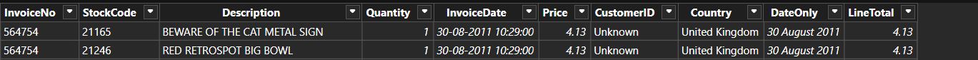
DATASET INTRODUCTION
This Online Retail II data set contains all the transactions occurring for a UK-based and registered, non-store online retail between 01/12/2009 and 09/12/2011.The company mainly sells unique all-occasion gift-ware. Many customers of the company are wholesalers.
InvoiceNo: A 6-digit integral number uniquely assigned to each transaction.
StockCode: A 5-digit integral number uniquely assigned to each distinct product.
Description: Product name.
Quantity: The quantities of each product per transaction.
InvoiceDate: The day and time when a transaction was generated.
UnitPrice: Product price per unit.
CustomerID: A 5-digit integral number uniquely assigned to each customer.
Country: The name of the country where a customer resides.

Slide 6
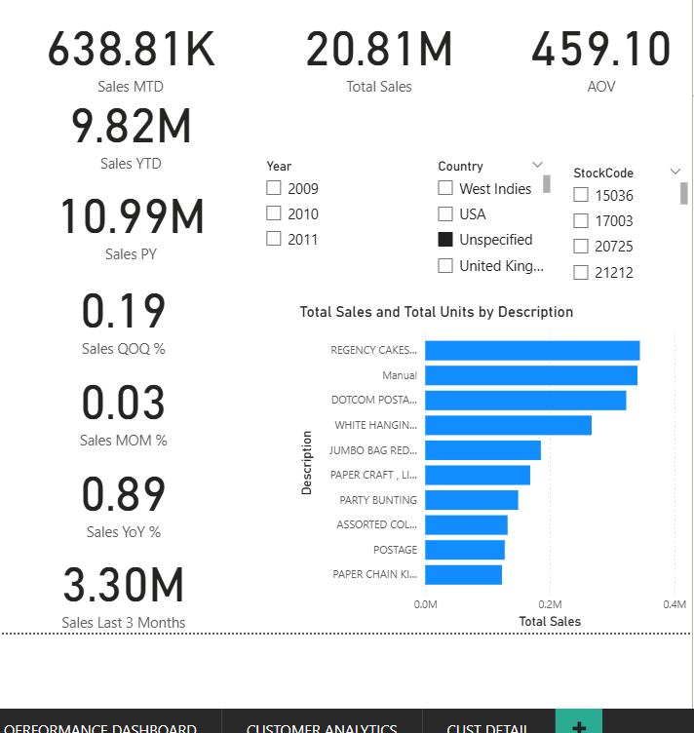
Executive Summary Dashboard
This summary provides a high-level view. For 2011, we see a Sales YTD of 9.82M against a Previous Year of 10.17M. We're also tracking:
Total Sales (All Time) : 20.81M
Average Order Value (AOV): 459.10
Sales Last 3 Months: 3.30M

Slide 7
Key Performance Indicators (Overall)
Focus on What Matters
20.81M
The entire dataset shows 20.81 Million in total sales. Our Average Order Value (AOV) is high at 459.10, with 11 Million total units sold. While the overall project shows 0.89% YoY growth
Total Sales

Slide 8

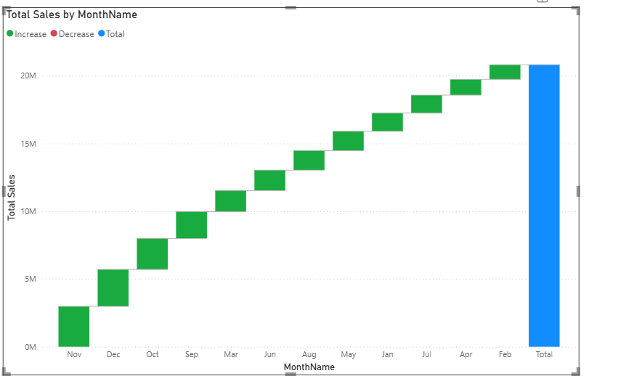
Quarterly Sales Trends
The quarterly chart reveals a critical seasonal trend:
Sales consistently and dramatically peak in Q4 of each year.
For example, 2010 Q4 sales (light blue) were approx. 3.5M.
The 2011 trend shows a powerful ramp-up, with Q4 sales on track to 3.30M, significantly outpacing the previous year's peak.

Slide 9
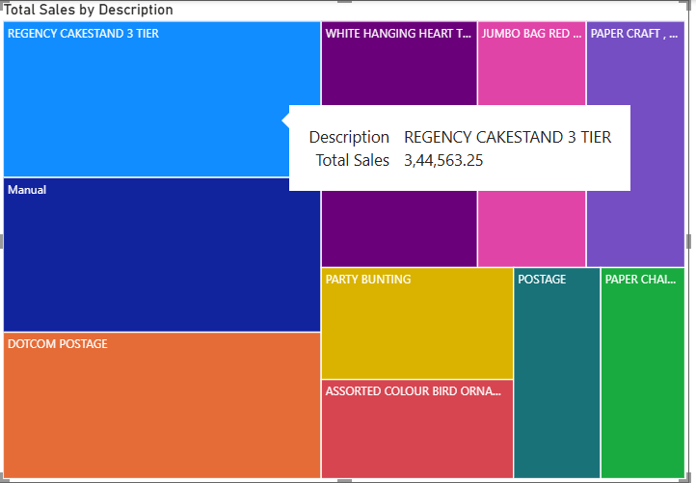
Product Performance Dashboard
The product dashboard breaks down our 20.8M in sales:
The treemap and bar chart both identify "REGENCY CAKESTAND 3 TIER" as the top product.
"Manual" and "DOTCOM POSTAGE" are also top-tier revenue drivers.
The table reveals a key insight: some products drive revenue (e.g., "Manual" with 429.13 AOV), while others drive *volume* (e.g., "WHITE HANGING HEART" with 100k+ units).
•

Slide 10
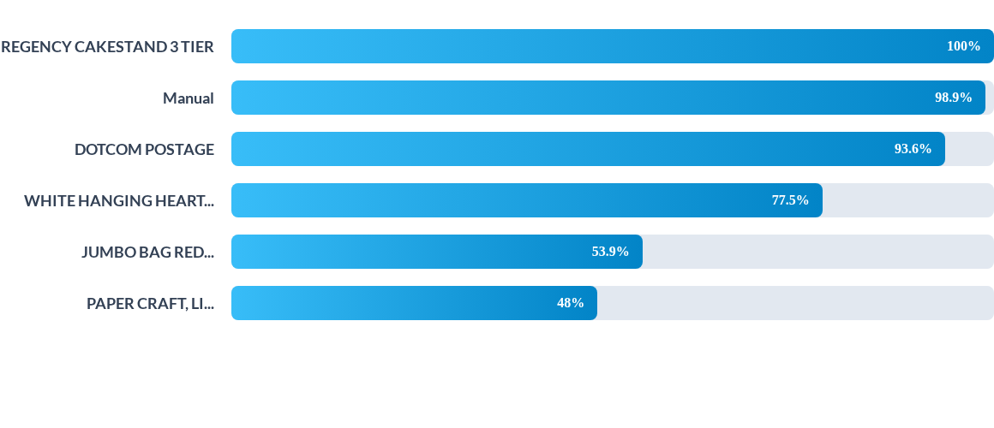
Top Products by Sales (Relative)
"REGENCY CAKESTAND" leads with ~3.44M in sales. It's followed closely by "Manual" (~3.40M) and "DOTCOM POSTAGE" (~3.22M). These three products are our core revenue drivers.

Slide 11
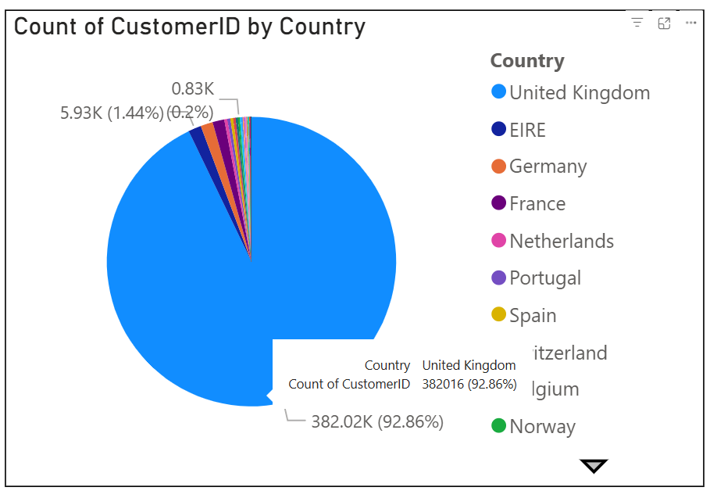
Customer Analytics
The customer analytics report shows that 90.06% of all customers (964.68k) are based in the United Kingdom.

Slide 12
Top Products - Detailed View
Description | StockCode | Sales YoY % | AOV | Total Sales | Total Units
REGENCY CAKESTAND 3 TIER | 22423 | 0.74 | 87.65 | 3,44,563.25 | 27232
Manual | M | 0.29 | 429.13 | 3,40,731.33 | 10062
DOTCOM POSTAGE | DOT | 1.29 | 226.90 | 3,22,657.48 | 2941
WHITE HANGING HEART T-LIGHT HOLDER | 85123A | 0.55 | 48.81 | 2,67,102.06 | 100301
JUMBO BAG RED RETROSPOT | 85099B | 0.95 | 46.17 | 1,85,566.47 | 97375

Slide 13
Key Insights & Inferences
Critical Q4 Performance: Sales consistently peak in Q4. In 2010, Q4 accounted for approx. 3.5M in sales. The 2011 Q4 is poised to exceed 4.0M.
High-Value Drivers: "Manual" (3.4M sales ) and "DOTCOM POSTAGE" (3.2M sales) have extremely high AOVs (429.13 and 226.90 respectively).
Geographic Concentration: The customer analytics report shows that 90.06% of all customers (964.68k) are based in the United Kingdom.

Slide 14






Strategic Business Proposal
Maximize Q4 Campaigns
Segment Product Strategy
Explore Market Expansion
Aggressively scale marketing and ad spend in Q3 to capitalize on the 4M+ Q4 sales potential. Secure inventory for the ~100k unit high-volume movers.
Market "REGENCY CAKESTAND" (3.4M+ sales) as a core product. Investigate the high-AOV (429.13) "Manual" transactions to replicate their success.
Given that 90%+ of our customers are in the UK, we are heavily exposed to a single market. Propose a formal analysis to expand into E.U. markets (e.g., Germany, France).

Slide 15
Part 2: Report Preparation
Data preparation and methodology

Slide 16
DATA PREPARATION & CLEANUP
Handling Missing Values: Reviewed key columns (like CustomerID, Description) for nulls. Null CustomerIDs were grouped into an 'Unknown' category for analysis.
Measures Table: A blank, disconnected table was created to store all DAX measures, keeping the data model clean and organized.
Filtering Irrelevant Data: Excluded cancelled orders or transactions with zero/negative quantities that could skew sales analysis.
Standardizing 'Manual' Entries: Investigated 'Manual' stock codes, which represent 3.4M in high-value sales, to ensure they were categorized correctly.

Slide 17
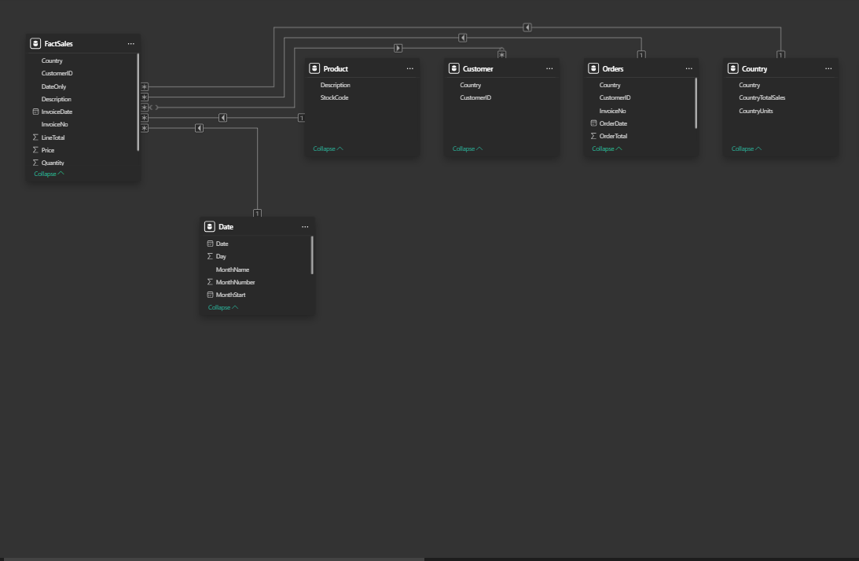
MODEL VIEW

Slide 18

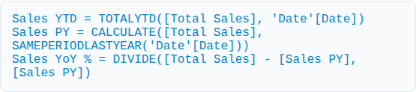
CORE DAX MEASURES
Core Aggregations
Time Intelligence
Simple, robust measures were created to form the report's foundation.
DAX was used to compare performance across time periods.

Slide 19
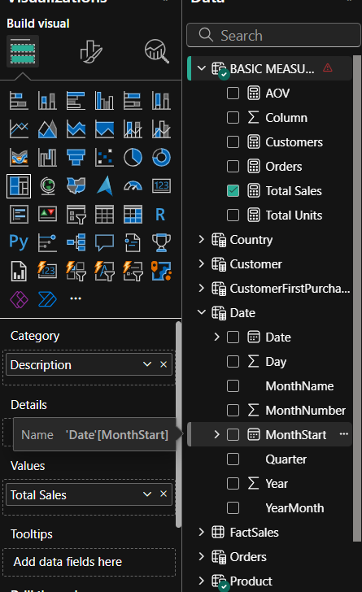
DATA MODEL: BASIC TABLES
A robust data model is essential for accurate analysis. Key tables were created:
Date Table: A dedicated 'Date' table was created. This is a best practice in Power BI and is required for all time-intelligence functions (YTD, PY, etc.).
Measures Table: A blank, disconnected table was created to store all DAX measures, keeping the data model clean and organized.

Slide 20
Thank You!!

