Slide 1



EquiSense Force Platform
Low-cost four-load-cell Centre-of-Pressure platform for balance assessment after minor lower-limb amputation
Vishwakarma Application ID: [enter ID] Track: [enter track]
Team: Dhiyadharshini V. · Kaviashree Rangasamy · Kameshwaran V. · Lakshmi Praba M.
Supervisor: Mrs. C. Radhika, AP/BME · Department of Biomedical Engineering, Tamil Nadu

Slide 2

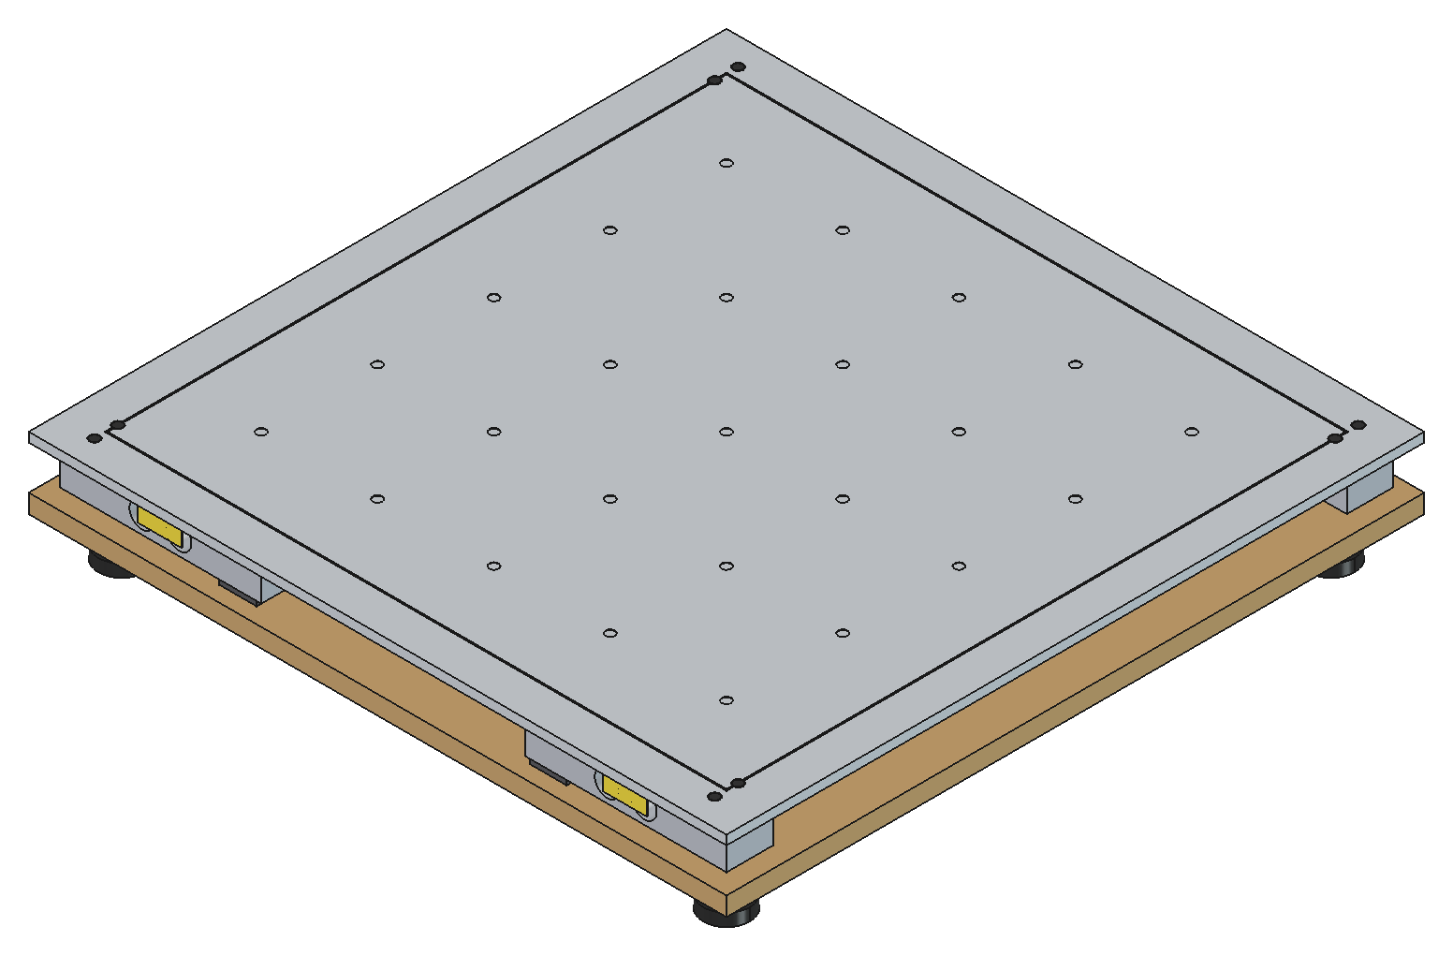
Project Overview & Problem Statement
PROJECT OVERVIEW
Core Innovation (one line)
A battery-isolated, 80 Hz four-load-cell platform that measures centre-of-pressure sway to millimetre accuracy and reports MVELO and PEA95 against each patient's own baseline, for ₹13,624.
Problem Statement
After a toe, ray or transmetatarsal amputation, the shortened forefoot and diabetic neuropathy make standing balance unstable. District rehabilitation centres can only score balance with ordinal tests (Berg, TUG), because lab force plates cost ₹8 lakh or more. Sway deterioration goes unmeasured until a fall.
Figure: EquiSense Rev 2.0 platform, FreeCAD assembly (450 × 450 mm)
Field | Details
Project title | EquiSense: Low-Cost Four-Load-Cell Force Platform for CoP Assessment
Team ID / Track | [enter Team ID] / [enter Track]
Team | Dhiyadharshini V., Kaviashree Rangasamy, Kameshwaran V., Lakshmi Praba M.
Supervisor | Mrs. C. Radhika, AP/BME, Department of Biomedical Engineering
Target Beneficiary Segment
Primary: adults after minor lower-limb amputation from diabetes or PAD.
Users: physiotherapists at district and taluk rehabilitation centres in India.
Secondary: teaching labs and researchers who need affordable posturography.
Status: Rev 2.0 design frozen with CAD, FEA and schematic complete; fabrication and bench validation (V1–V9) run Nov 2026 to Feb 2027.

Slide 3
User Journey: Before vs After
USER JOURNEY
Before State: Current Pain-Point Mapping
After State: Future Solution Mapping
1
Patient with a toe or transmetatarsal amputation comes for a rehab review
1
30-s eyes-open quiet-stance baseline on EquiSense, stored for each patient
2
Physiotherapist scores the Berg Balance Scale / TUG by eye: ordinal and observer-dependent
2
4 channels at 80 Hz → CoP, MVELO, RDIST, PEA95 and ASYM_AP computed on the ESP32
3
No objective sway number, so slow deterioration between visits goes unseen
3
Score = MVELO(trial) ÷ MVELO(baseline): Stable < 1.5 · Moderate 1.5–2.5 · High ≥ 2.5
4
Gait-lab force plates exist only in tertiary centres; action often follows a fall
4
Trend shown on the Wi-Fi dashboard and exported as CSV for the physiotherapist
₹8 L+
10 Hz
Ordinal
₹13,624
≤ 5 mm
30 s
LAB PLATE ONLY
STOCK HX711 RATE
BBS / TUG SCORES
TOTAL BUILD COST
CoP RMS ERROR TARGET
PER TRIAL
Quantified inefficiency: no affordable mm-level measure; a 10 Hz build under-samples sway velocity and makes patients look falsely stable.
Quantified efficiency: about 98% cheaper than a lab plate, portable and battery-run, with mm-level CoP read against each patient's own baseline.
Note: After-state figures are Rev 2.0 engineering targets, checked by the V1–V9 bench battery. Clinical benefit will be measured in the IEC-cleared observational study.

Slide 4
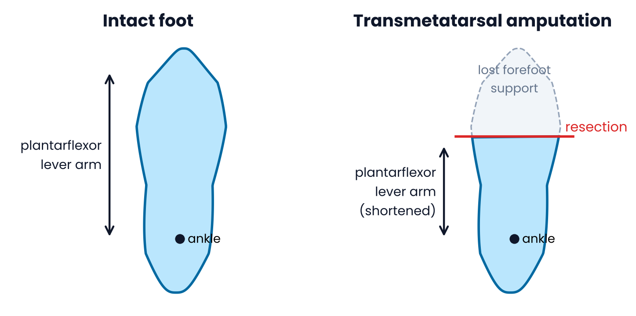
Problem Context: Evidence & Beneficiary
PROBLEM CONTEXT
56.1%
70.9%
₹8,00,000+
0–56 pts
LIMB-LOSS COHORT WHO FELL IN FOLLOW-UP
INDIAN DIABETIC AMPUTATIONS: MINOR
COST OF A RESEARCH FORCE PLATE
BERG SCALE: ORDINAL, NO mm SWAY DATA
Target Beneficiary & Problem Statement
Target User: People after minor lower-limb amputation (toe, ray, transmetatarsal) caused by diabetes or PAD, and the physiotherapists in district-level rehabilitation centres in India who treat them.
Problem Statement: Losing the forefoot shortens the actuator (ankle lever arm), and diabetic neuropathy dulls the sensor (plantar feedback). Sway corrections become larger and faster, so fall risk goes up.
Operational Gap: Clinics score balance with ordinal tests (Berg Balance Scale, Timed Up and Go). Objective centre-of-pressure posturography needs a lab force plate costing ₹8 lakh or more.
Public Search Disclosure: Kistler/AMTI plates are lab-bound; the Wii Balance Board is discontinued and was never built as an instrument; stock HX711 builds sample at 10 Hz, under-sampling sway.
Measurement Need: Objective, repeatable sway metrics (MVELO, PEA95) read against each patient's own baseline, at a cost a district clinic can afford.
Figure: Forefoot loss shortens the plantarflexor lever arm and anterior base of support (schematic)
Project Overview: Team ID: [enter] | Track: [enter] | Core Innovation: battery-isolated 4-load-cell CoP platform (80 Hz, MVELO + PEA95) for ₹13,624.

Slide 5
System Architecture & Specs
SYSTEM ARCHITECTURE
System Block Diagram
Engineering Target Specifications & Hardware
MECHANICAL STRUCTURE
Parameter | Target spec | Selected hardware / protocol
Sampling rate | 80 Hz per channel (trial blocked < 60 Hz) | HX711, RATE pin 15 tied to DVDD
Force capacity | 4 × 200 kg = 800 kg; SF > 5.3 at 150 kg | Phaeton 611E, 2.0 mV/V, IP65
ADC range | ±16.8 mV FS (1.95× headroom) | HX711 Channel A, gain 128
CoP accuracy | ≤ 5 mm RMS, ≤ 10 mm max | 400 × 400 mm sensor rectangle
CoP noise | < 1.0 mm RMS (70 kg static) | Butterworth LPF, fc 10 Hz
Inter-ADC skew | ≤ 12.5 ms (≤ 0.13 mm at 10 mm/s) | Shared PD_SCK on GPIO 27
Power | Battery-isolated, no mains | 2×18650 Shield V8 → AMS1117
Controller | Dual-core 240 MHz, Wi-Fi | ESP32-WROOM-32 (NodeMCU-32S)
450×450×6 mm Al 6061-T6 top plate → 3 mm steel Z-mount spacers → 12 mm plywood base + 4 levelling feet
SENSING (×4 corners at ±200 mm)
Phaeton 611E parallel-beam load cells, 200 kg, 2.0 mV/V, full Wheatstone bridge
ANALOGUE FRONT-END (×4)
POWER
HX711 24-bit ΣΔ, Ch A gain 128, RATE→DVDD = 80 SPS; shared PD_SCK
2×18650 Shield V8 → 5 V
AMS1117 → 3.3 V
S8550 → AVDD 4.30 V
(no mains path)
CONTROLLER: ESP32-WROOM-32
Core 1: acquisition + Butterworth + CoP + guards
Core 0: Wi-Fi dashboard, CLI, NVS baseline
OUTPUTS / FIRMWARE LOGIC
JSON status at 10 Hz · serial CSV dump · status LED · baseline-ratio risk score · haptic (disabled)
Figure: EquiSense Rev 2.0 subsystem map (mechanical → sensing → AFE → MCU → outputs)
Architecture Rationale: one shared PD_SCK clock with four dedicated DOUT lines starts all conversions together; battery power removes 50 Hz mains pickup; gain 128 keeps 1.95× headroom over 200 kg.

Slide 6
Signal Chain, CoP Maths & Firmware
SYSTEM ARCHITECTURE
Platform Coordinates & Centre-of-Pressure
Dual-Core Firmware & Signal Processing
Corners (mm)
FL (−200, +200)
FR (+200, +200)
BL (−200, −200)
BR (+200, −200)
Plate envelope
450 × 450 × 6 mm
Front = anterior (+Y)
CORE 1 · priority 3 · real-time
FL
FR
Wait for all 4 DOUT lines low → 25 PD_SCK pulses inside taskENTER_CRITICAL (a pulse > 60 µs would power the HX711 down)
+Y
FILTER
+X
2nd-order Butterworth, DF-II transposed, fs 80 Hz, fc 10 Hz, ~12 ms delay; b = [0.0976, 0.1953, 0.0976], a = [1, −0.9428, 0.3333]; state seeded from F[0]
(0,0)
METRICS (Prieto 1996)
TOTEX path length, MVELO = TOTEX/T (primary), RDIST, PEA95 prediction ellipse, ASYM_LR / ASYM_AP
BL
BR
400 mm sensor rectangle · valid CoP |X|, |Y| ≤ 195 mm
CORE 0 · housekeeping
JSON status at 10 Hz, serial CLI (rate, trial 30, dump), Wi-Fi dashboard, baseline kept in NVS; spinlock-guarded buffers
X_CoP = 200 · [(F_FR + F_BR) − (F_FL + F_BL)] / ΣF
Y_CoP = 200 · [(F_FL + F_FR) − (F_BL + F_BR)] / ΣF
Guards: clamp F_i < 0 → 0 · compute only if ΣF ≥ 20 kg · reject samples outside ±195 mm
PEA95 = 2π · F₀.₀₅(2, N−2) · (N+1)(N−1)/[N(N−2)] · √det(S)
OFFLINE (official numbers)
4th-order zero-phase filtfilt, fc 10 Hz, in analyze_cop.py; 25-point affine grid fit in analyze_grid.py
Why a prediction ellipse: confidence ellipses shrink as 1/N, so longer recordings make a patient look more stable; the PEA95 is asymptotically independent of N (Schubert & Kirchner, 2014).

Slide 7
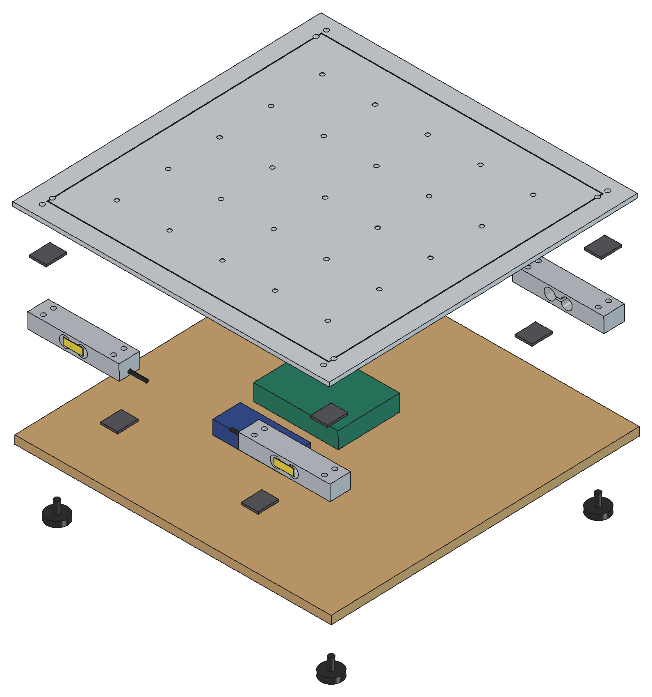
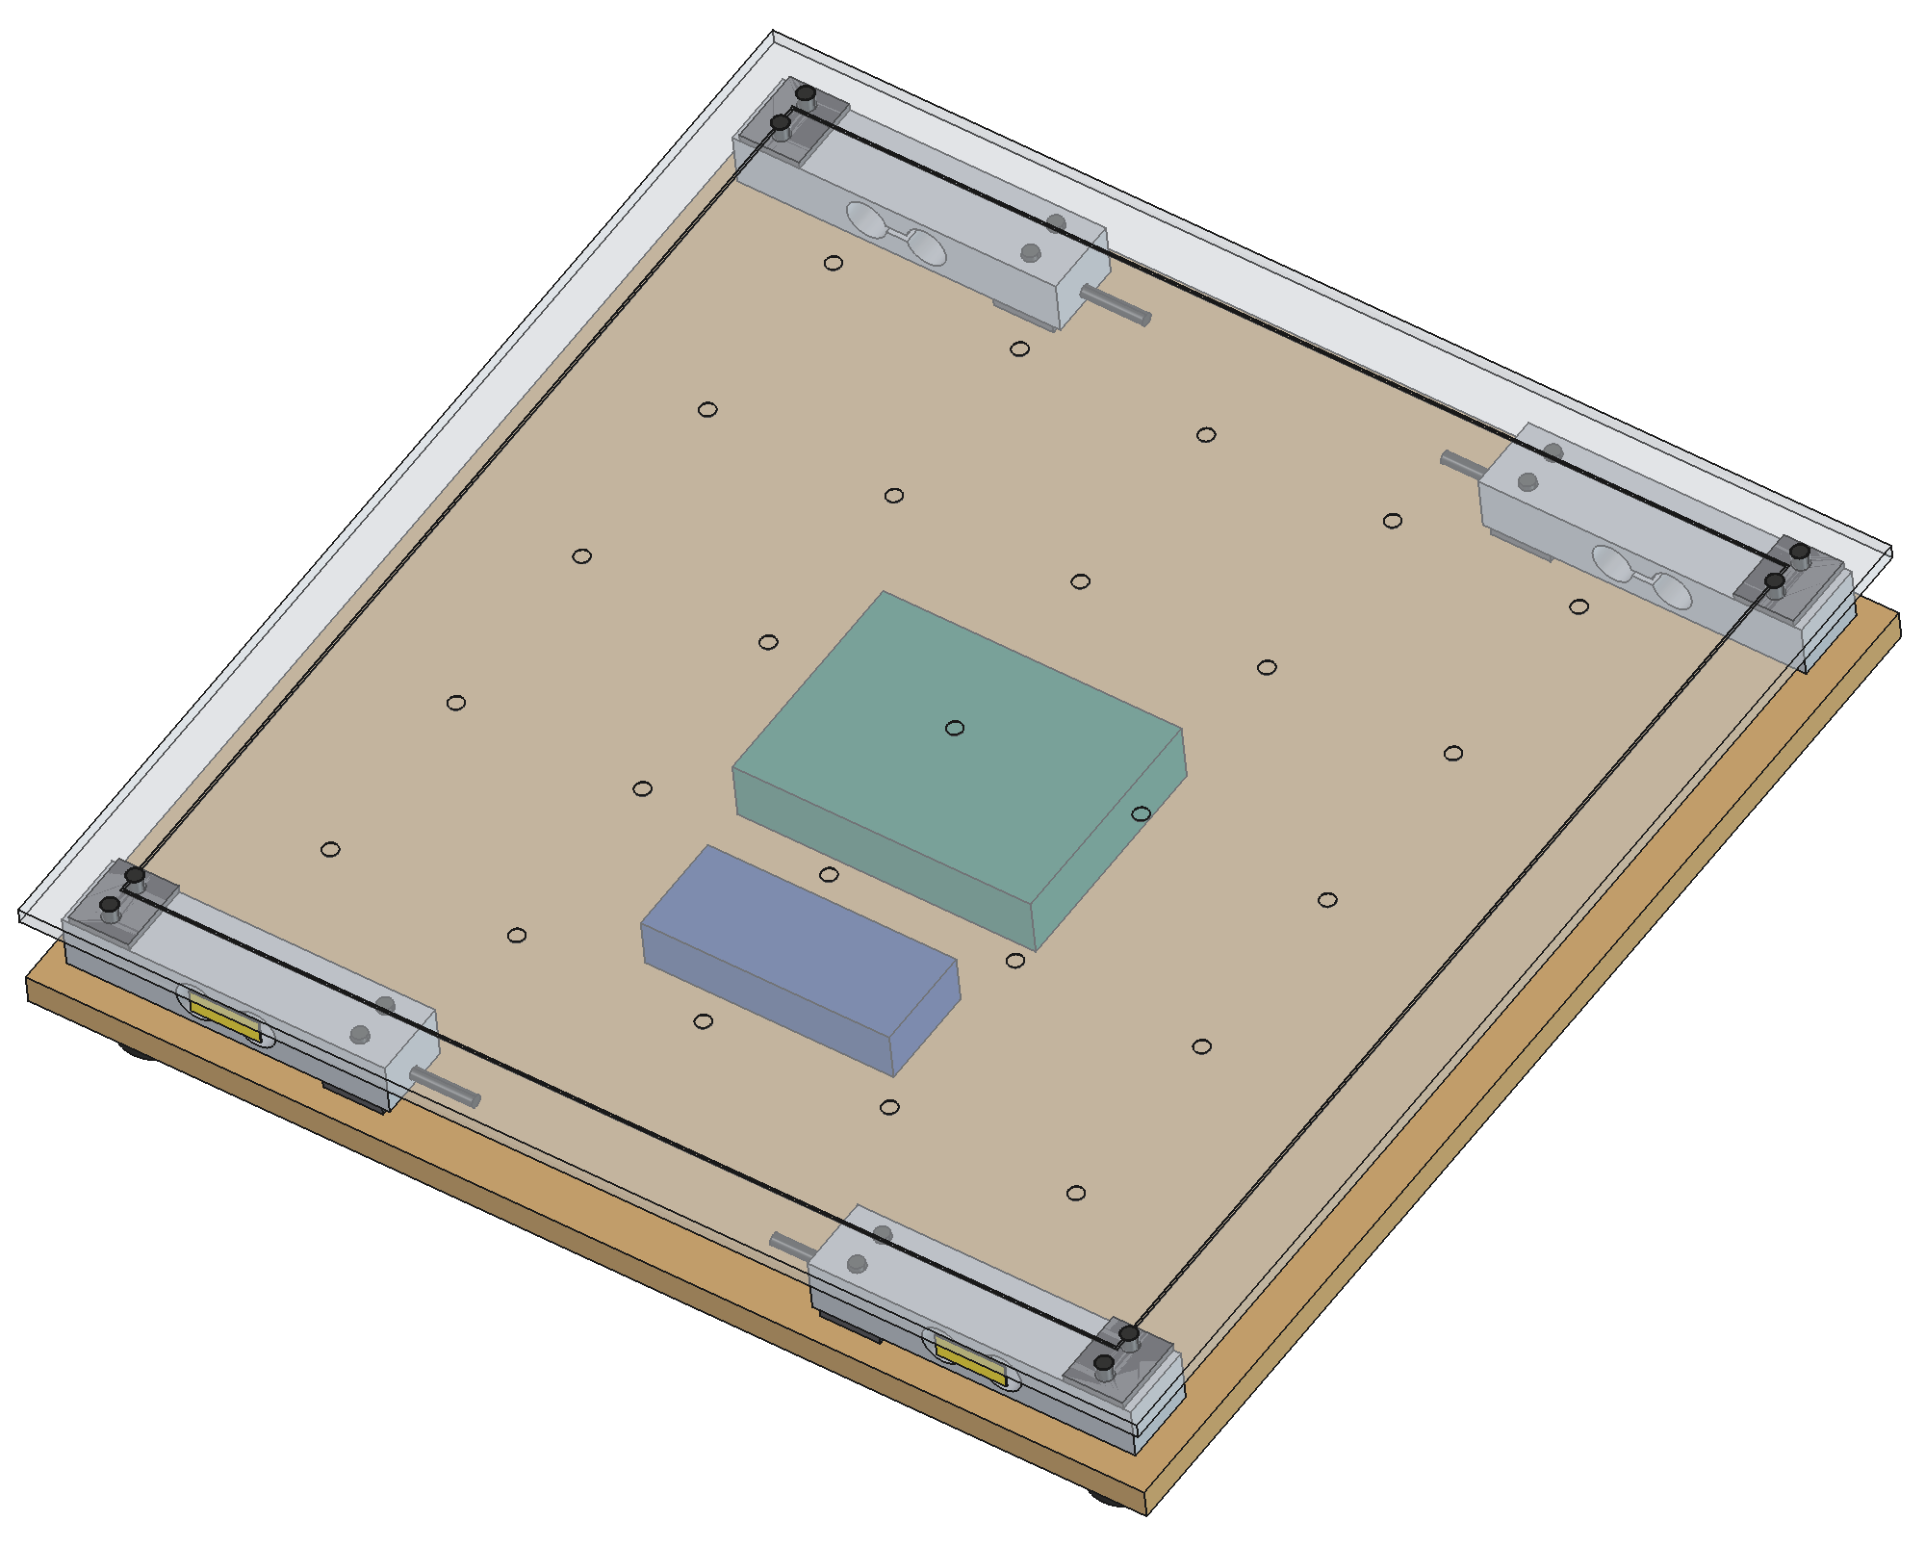
CAD Design & Mechanical Specs
CAD DESIGN
Material Selection & Mechanics
Top plate: 6 mm Al 6061-T6 tooling plate (yield 276 MPa): flat, stiff and light; 25-point grid and 400 mm scribe engraved for V6/V7.
Load path: 4× Phaeton 611E bars; loaded end under each corner at (±200, ±200) mm, fixed end inboard.
Z-mount: 3 mm ground-steel spacers above and below, so each beam deflects freely; M6 8.8 bolts at 8 N·m.
Base: 12 mm marine plywood on four M8 rubber levelling feet; electronics and battery sit in the 28 mm cavity.
Levelling: shims hold support heights within 0.2 mm (four supports are statically indeterminate).
Capacity: 800 kg gross; safety factor > 5.3 for a 150 kg participant. Step height 71 mm.
Portability: the top plate weighs about 3.3 kg (6 mm Al), keeping the platform portable between clinics.
Assembled, 25-point test grid on top
Figure: FreeCAD exploded assembly
X-ray view: Z-mounted cells at corners
Native files (hardware/cad in the repo): EquiSense_ForcePlatform.FCStd + .step (FreeCAD 1.1): 44 solids: 2 plates, 4 load cells, 8 spacers, 16 M6 bolts, 4 feet, enclosure, battery pack, plus gauge seals and cable stubs.

Slide 8
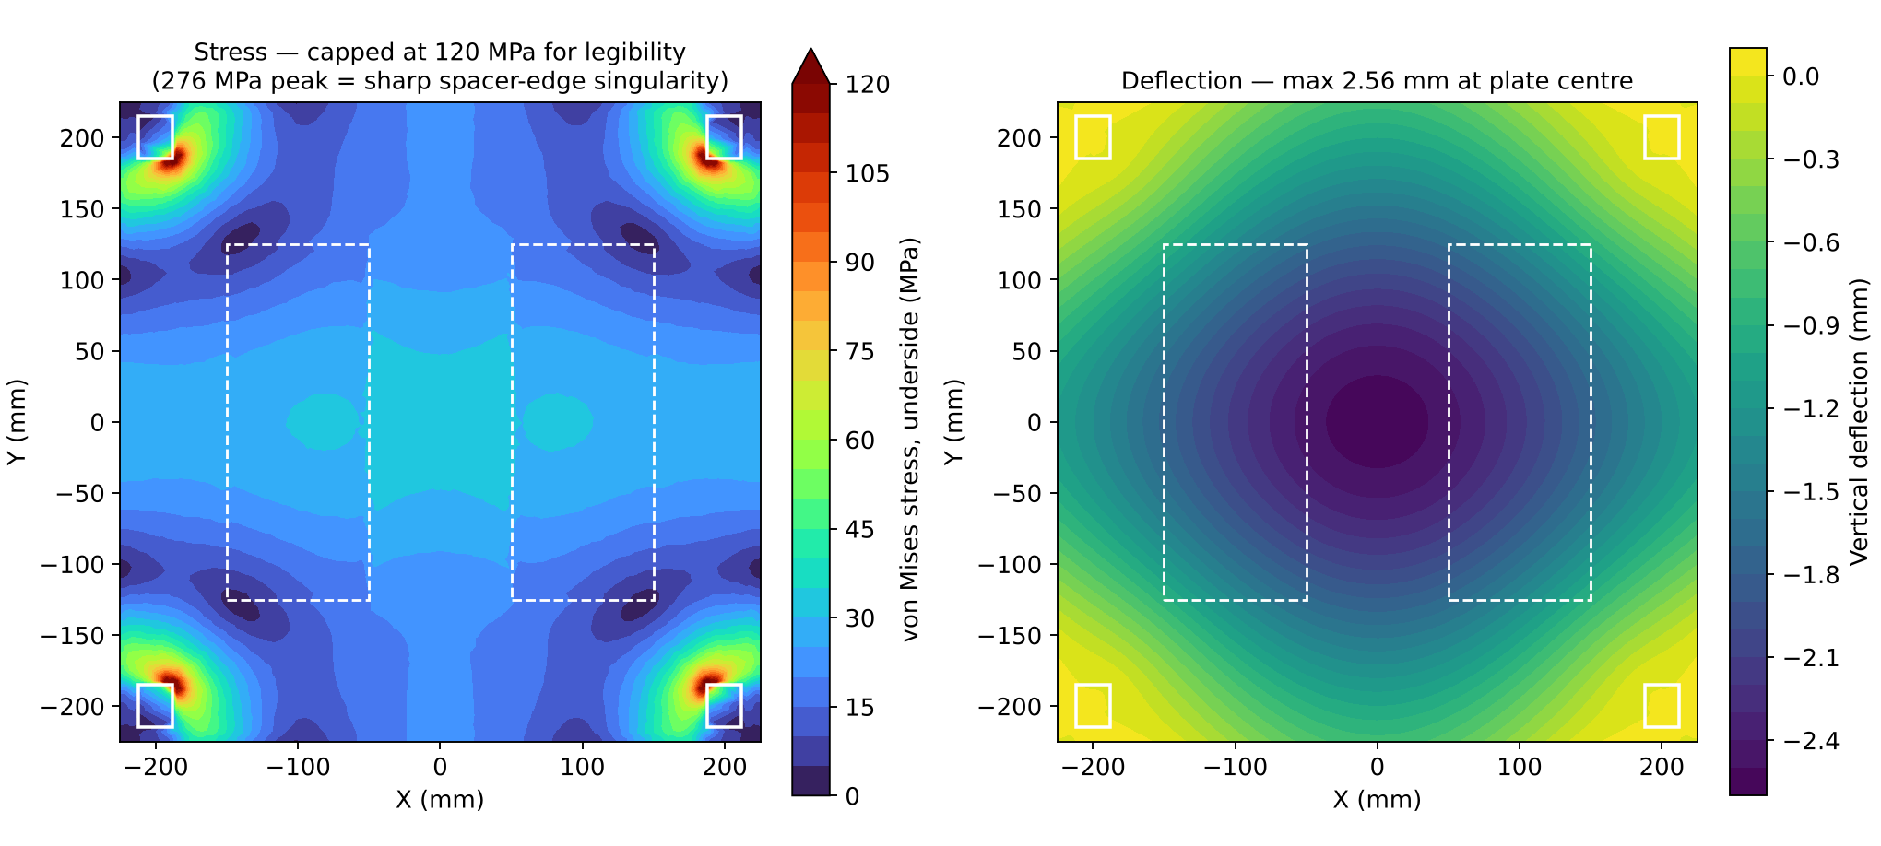
FEA: Top-Plate Stress & Deflection
CAD DESIGN
FEA Stress Report
Model: Al 6061-T6 plate (E 68.9 GPa, ν 0.33) fixed on four 24 × 30 mm spacer faces at (±200, ±200) mm.
Load case: 2 × 150 kg = 2,943 N for step-on impact, spread over two 100 × 250 mm foot pads at a 200 mm stance.
Mesh: Gmsh 2nd-order tetrahedra, 56,502 nodes and 28,287 elements, 1–8 mm.
Stress: Field stress stays ≤ 56 MPa (FoS 4.9). The 276 MPa peak is a sharp-corner singularity at the spacer edge, not a bulk failure.
Deflection: 2.56 mm at centre leaves only ~1.4 mm over the 24 mm electronics enclosure.
CoP effect: Bending does not change the force balance; CoP stays a statics result as long as nothing touches the plate.
Comparison: the 10 mm option was re-run with identical mesh settings (56,335 nodes) for a like-for-like check.
Figure: CalculiX linear-static result, 6 mm plate, 2,943 N on two foot pads (supports white, feet dashed)
Result (2 × 150 kg load) | 6 mm plate (baseline) | 10 mm plate (option)
Max deflection | 2.56 mm | 0.61 mm
Field stress > 40 mm from supports | 56 MPa → FoS 4.9 | 21 MPa → FoS 13
Peak at spacer edge (singular) | 276 MPa | 120 MPa
Design Iteration: radius the spacer edges and cap the enclosure at 20 mm (≥ 5 mm clearance). A 10 mm plate cuts sag by 76% and is the upgrade path if V6 grid residuals exceed 3 mm.

Slide 9
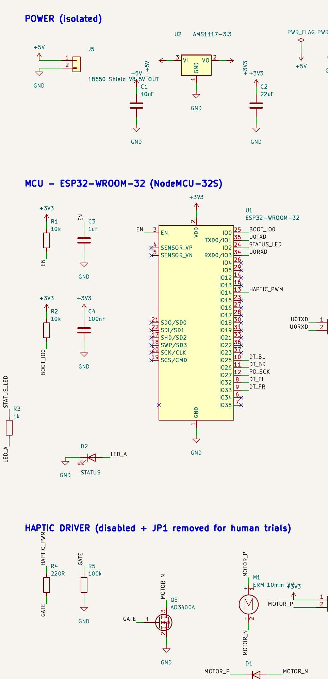
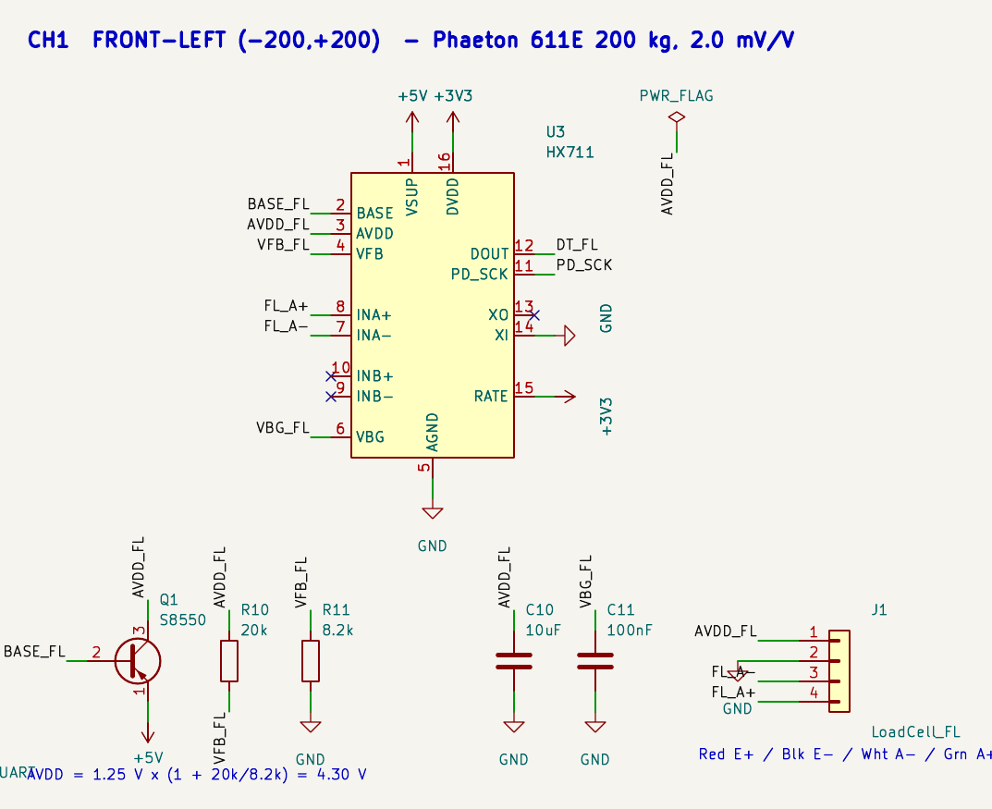
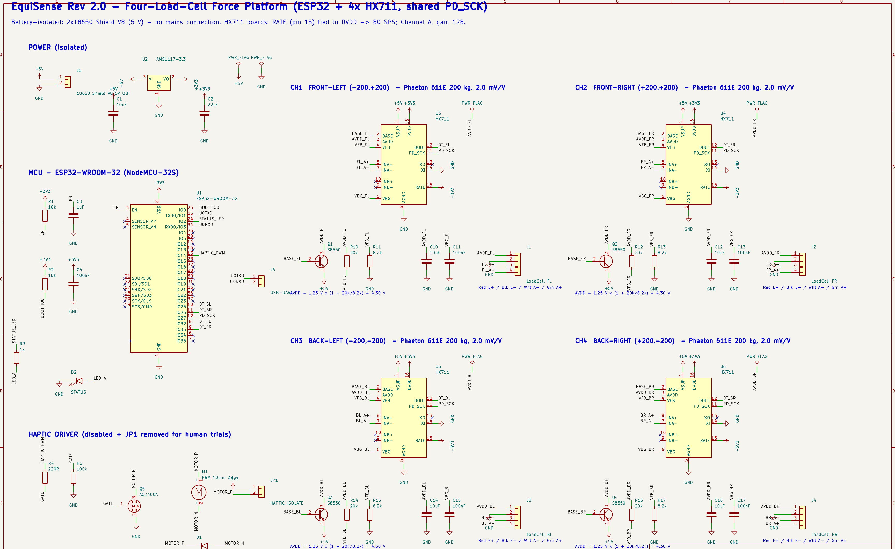
Electronics Schematic (KiCad 10)
ELECTRONICS
ESP32 Pin Map & Power
Signal | GPIO | Notes
PD_SCK (shared) | 27 | Clock to all 4 HX711
DT_FL | 32 | Front-left data
DT_FR | 33 | Front-right data
DT_BL | 25 | Back-left data
DT_BR | 26 | Back-right data
HAPTIC_PWM | 14 | AO3400A + 1N4007
STATUS LED | 2 | Self-test / errors
AVDD: 1.25 V × (1 + 20k/8.2k) = 4.30 V per channel via S8550; bridge E+ = AVDD.
Bridge: Red E+, Black E−, White A−, Green A+; Channel B unused (NC).
Avoided pins: GPIO 6–11 (flash), 12 (strap), 34–39 (input-only).
Haptic: JP1 removed and firmware off for human trials.
HX711 channel 1 of 4 (FL)
Power, ESP32 and haptic driver
Full A3 sheet: EquiSense_schematic.pdf
ERC: KiCad 10 ERC returns 0 errors and 0 warnings (46 symbols, 43 named nets). RATE (pin 15) is tied to DVDD (pin 16); the Rev 2.0 note's "pin 6" is VBG, not a 3.3 V rail.

Slide 10
Itemised Bill of Materials
ELECTRONICS & BOM
Component | Part / specification | Qty | Unit (₹) | Total (₹) | Sourcing
Load cell | Phaeton 611E, 200 kg, 2.0 mV/V, IP65 | 4 | 650 | 2,600 | Domestic · industrial weighing supplier
24-bit ADC | HX711 breakout (green PCB), RATE mod | 4 | 120 | 480 | Domestic · electronics retail
Microcontroller | ESP32 NodeMCU-32S V1 | 1 | 450 | 450 | Domestic · electronics retail
Top plate | 6 mm Al 6061-T6, 450 × 450 mm | 1 | 1,800 | 1,800 | Local waterjet / machine shop
Base plate | 12 mm marine plywood | 1 | 900 | 900 | Local timber supplier
Z-mount spacers & shims | 3 mm mild steel, laser-cut, ground flat | 8 | 90 | 720 | Local laser-cutting shop
Fasteners | M6 grade 8.8 bolts, Nyloc nuts, washers | 16 | 12 | 192 | Local fastener depot
Levelling feet | M8 adjustable, rubber pad | 4 | 60 | 240 | Local hardware
Power | 18650 Battery Shield V8 (2 cells) | 1 | 700 | 700 | Domestic · electronics retail
Haptic actuator | 10 mm ERM motor + MOSFET driver | 1 | 165 | 165 | Domestic · electronics retail
Enclosure & cabling | Enclosure, cable glands, 4-core loom | 1 | 600 | 600 | Local electrical
Calibration service | Certified masses 5/10/20 kg (secondary std.) | 1 | 3,000 | 3,000 | Accredited calibration lab
Subtotal |  |  |  | 11,847
Contingency (15%) | Mechanical rework / spare parts |  |  | 1,777
Total build cost | ≈ US$166 at ₹82/US$ |  |  | ₹13,624 | All items available in India
Procurement Status: no imported parts; the critical path is machining the plate and spacers. Vendor lead times will be confirmed at PO (Nov 2026).

Slide 11
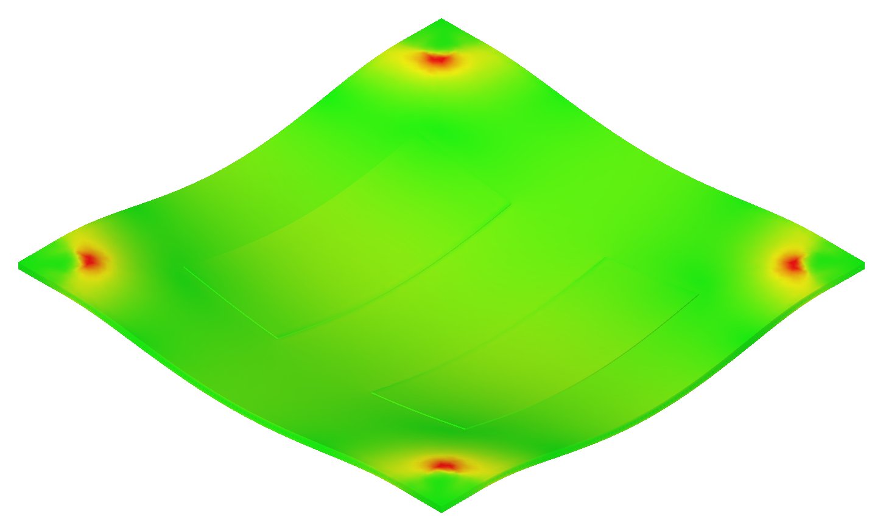
Your Maker Journey: Evidence of Work
MAKER JOURNEY
Authenticity Verification
Work-in-Progress Software Evidence
Raw Repository Linkage
https://github.com/amalnathkp13-boop/EquiSense-ForcePlatform
[ Team photo: modelling / soldering / assembling, ID badges visible ]
Native file | Folder
EquiSense_ForcePlatform.FCStd | hardware/cad
EquiSense_ForcePlatform.step | hardware/cad
TopPlate_FEA_6mm / 10mm.FCStd | hardware/cad
EquiSense.kicad_sch / .net | hardware/kicad
EquiSense_ERC.rpt | hardware/kicad
BOM.csv | hardware
PROJECT_HANDOVER.md | docs
FreeCAD FEM result view (6 mm plate)
CAD: FreeCAD 1.1 parametric assembly, 44 solids; STEP export.
FEA: Gmsh 2nd-order tetra mesh, 56,502 nodes / 28,287 elements; CalculiX solved (6 mm and 10 mm).
EDA: KiCad 10 schematic, 46 symbols, 43 named nets.
ERC log: 0 errors, 0 warnings (EquiSense_ERC.rpt).
[ Joint lab review photo with faculty guide ]
Commit history carries the file timestamps for the Stage 2 audit. No embedded videos; any demo video will be shared as an external link.
High-resolution lab photos of the team at work, to be added before submission.
Institutional Sign-Off: work supervised by Mrs. C. Radhika, AP/BME, Department of Biomedical Engineering.

Slide 12
Maker Journey: Stage 1 → Stage 2 Iterations
MAKER JOURNEY
Stage 1 → Stage 2 Engineering Iterations
Rev 1 → Rev 2 audit: 10 specification errors fixed: gain 32 → 128, 10 → 80 Hz, "perfect sync" replaced by a declared 12.5 ms skew, Z-mount cross-talk claim withdrawn, shimming made mandatory, PEA95 adopted, hard-coded cut-offs replaced by a baseline-referenced score, haptic disabled.
CAD milestone: FreeCAD 1.1 assembly (44 solids) with STEP export; CalculiX FEA of the top plate (56,502 nodes) run 14 Oct 2026.
EDA milestone: KiCad 10 schematic, 46 symbols, ERC clean; netlist, BOM and PDF exported.
Datasheet catch: the RATE jumper goes to DVDD (pin 16), not VBG (pin 6), giving a valid logic-high for 80 SPS.
Repository: github.com/amalnathkp13-boop/EquiSense-ForcePlatform with hardware/cad (.FCStd, .step, FEA), hardware/kicad (.kicad_sch, ERC, netlist, BOM, PDF), docs/ and analysis/.
Original design assets: KiCad HX711 channel (left) and FreeCAD assembly (right)
Iteration evidence: FEA sag result drove the 20 mm enclosure cap
Institutional Sign-Off: work supervised by Mrs. C. Radhika, AP/BME, Department of Biomedical Engineering.

Slide 13
Safety & Hazard Mitigation
SAFETY
Physical Fail-Safes & Mechanical Safety
Standards Compliance & Regulatory Position
✓
Battery-only supply
Standard / guideline | How it is addressed
ICMR National Ethical Guidelines 2017 | Observational protocol; IEC clearance before any human data; bilingual (Tamil/English) consent
CDSCO Medical Device Rules 2017 | Haptic feedback disabled so the study stays non-interventional
IEC 60601-1 (electrical safety) | Not claimed; investigational instrument, battery-only low-voltage supply
IEC 62133-2 (Li-ion cells) | Use certified 18650 cells in the battery shield
IEC 60529 IP65 | Sealed load cells (Phaeton 611E)
2 × 18650 cells, ≤ 5 V everywhere; no conductive path from mains to the participant.
✓
Haptic isolation
JP1 jumper removed and actuator disabled in firmware for all human trials.
✓
Structural margin
4 × 200 kg cells = 800 kg gross; safety factor > 5.3 at the 150 kg participant limit.
✓
Low step height
71 mm platform height; spotter and support rail beside the plate during trials.
✓
Anti-slip & sealing
Rubber levelling feet; IP65 load cells; enclosure with cable glands.
Clinical gating: the logistic-regression classifier ships disabled (returns UNCALIBRATED) until it is trained on ≥ 40 trials from ≥ 8 subjects with subject-disjoint cross-validation.

Slide 14
Roadmap: 4-Month Fabrication Plan
ROADMAP
Month 1 · Nov 2026
Month 2 · Dec 2026
Month 3 · Jan 2027
Month 4 · Feb 2027
Procure & machine
Assemble & bring up
Metrology
Integrate & document
Order cells, HX711s, ESP32, battery shield
Waterjet top plate; laser-cut spacers and shims
RATE mod on 4 boards; V1 rate test ≥ 60 Hz
Z-mount assembly, shimming, 8 N·m torque
Dual-core firmware + Wi-Fi dashboard
V2 noise, V3 linearity, V4 mass, V5 drift
V6 25-point grid, affine fit (≤ 5 mm RMS)
V7 repeatability, V8 CoP noise, V9 cross-talk
Plate/enclosure fix if residual > 3 mm
Run selftest + offline filtfilt pipeline
Submit observational protocol to IEC
Freeze Rev 2.1 drawings, BOM and demo kit
DELIVERABLE
DELIVERABLE
DELIVERABLE
DELIVERABLE
Machined plate + 4 modified HX711 boards
Assembled platform streaming 80 Hz CoP
Signed V1–V9 bench test report
IEC dossier + Stage 3 demo kit
Stage 3 Commitment
A bench-validated EquiSense platform that passes V1–V9, ready for a live jury demo: standing CoP trace, MVELO and PEA95 on the Wi-Fi dashboard, and the 25-point grid accuracy run on certified masses. Human data only after IEC clearance.
Fabrication timeline: machining (M1) → assembly and firmware (M2) → metrology V6–V9 (M3) → integration, IEC submission and Stage 3 kit (M4).

Slide 15
Safety by Design & Roadmap
SAFETY & ROADMAP
Design FMEA (Failure Mode and Effects Analysis)
Failure mode | Potential hazard | Embedded fail-safe / mitigation
HX711 left at 10 Hz (RATE mod missing) | MVELO under-read, so the patient looks falsely stable | Boot self-test measures rate; trials blocked below 60 Hz
PD_SCK pulse > 60 µs (RTOS preemption) | HX711 powers down; corrupted sample | 25 pulses clocked inside taskENTER_CRITICAL
Corner unloading / stepping off | CoP extrapolated beyond the sensors | Clamp F < 0; CoP only when ΣF ≥ 20 kg; reject |X|, |Y| > 195 mm
Uneven support heights (> 0.2 mm) | Hidden CoP bias that calibration cannot see | Shims + 8 N·m torque; V6 grid residual > 3 mm flags a mechanical fault
Warm-up / thermal drift | Mass and CoP drift during a trial | 60-min warm-up; V5 limit < 0.5% drift over 30 min
Participant loses balance on the plate | Fall injury | 71 mm step height; spotter and support rail; mass ≤ 150 kg (SF > 5.3)
Fabrication Phase (Months 1–2)
Integration & Validation (Months 3–4)
Nov 2026: order parts; waterjet the top plate; laser-cut spacers and shims; RATE mod on 4 HX711 boards; V1 rate test.
Dec 2026: Z-mount assembly, shimming and 8 N·m torque; dual-core firmware and Wi-Fi dashboard; V2–V5 bench tests.
Jan 2027: V6 25-point grid with affine fit, V7 repeatability, V8 CoP noise, V9 cross-talk.
Feb 2027: offline filtfilt pipeline, IEC protocol submission, Stage 3 jury demo kit.
Stage 3 Target: a bench-validated platform passing V1–V9, demonstrated live with a standing CoP trace, MVELO and PEA95 on the Wi-Fi dashboard.

Slide 16
Technical Challenges & Risks
CHALLENGES
!
Static Indeterminacy
!
ADC Timing & Sync
!
Plate Compliance
!
Cross-Talk & Drift
Observed risk
Observed risk
Observed risk
Observed risk
Four supports on one rigid plate are statically indeterminate. A height mismatch over 0.2 mm loads one diagonal more, biasing CoP in a way per-cell calibration cannot see.
The four HX711s run on free-running RC oscillators (worst-case skew 12.5 ms), and a PD_SCK pulse over 60 µs puts the chip into power-down mid-read.
FEA: the 6 mm plate sags 2.56 mm under a 2× step-on load, leaving ~1.4 mm over the enclosure. The spacer-edge corner reaches 276 MPa (singular).
Bar cells respond to off-axis moments (the Z-mount reduces but cannot remove this), and HX711 + bridge output drifts until the system warms up.
Design Trade-offs Met During Simulation & Review
Trade-off | Option A | Option B | Decision
Plate stiffness vs weight | 6 mm Al: 3.3 kg, 2.56 mm sag | 10 mm Al: 5.5 kg, 0.61 mm sag | 6 mm + 20 mm enclosure cap; 10 mm if V6 fails
ADC headroom vs noise | Gain 32: 1.1% of range used at 70 kg | Gain 128: 1.95× headroom at 200 kg | Gain 128 (Channel A)
Biofeedback vs study class | Haptic on: interventional (licensing) | Haptic off: observational | Off and JP1 removed for trials
Engineering bottleneck: force linearity (R² > 0.999) does not prove position accuracy; that depends on gain matching, true geometry and planarity, so it needs the V6 grid test.

Slide 17
Potential Solutions & Risk Mitigation
RISK MITIGATION
✓
Static Indeterminacy
✓
ADC Timing & Sync
✓
Plate Compliance
✓
Cross-Talk & Drift
Mitigation
Mitigation
Mitigation
Mitigation
Mandatory shims with 8 N·m torque; V6 25-point affine fit separates spacing errors (fixable in firmware) from binding (residual > 3 mm).
Shared PD_SCK starts conversions together; clocking happens in a critical section; declared skew ≤ 0.13 mm at 10 mm/s.
Radius the spacer edges, cap the enclosure at 20 mm and recheck sag on the bench at 150 kg.
V9 single-corner loading maps the coupling into a 4 × 4 correction matrix; 60-min warm-up with V5 drift < 0.5%.
Verified by
Verified by
Verified by
Verified by
V6 grid ≤ 5 mm RMS; V7 σ ≤ 2 mm
V1 ≥ 60 Hz; V8 CoP noise < 1 mm
Bench sag at 150 kg; V6 residual ≤ 3 mm
V9 coupling map; V5 drift < 0.5%
BACKUP SOLUTION
BACKUP SOLUTION
BACKUP SOLUTION
BACKUP SOLUTION
3-point kinematic seating or re-machined spacers.
ADS131M04, a 4-channel simultaneous-sampling 24-bit ADC.
10 mm plate (0.61 mm sag, 120 MPa peak) or bonded stiffening ribs.
log temperature with each trial and re-zero between trials.
Verification: every mitigation maps to a V1–V9 acceptance test, so a fix counts only when the corresponding bench criterion passes.

Slide 18
Technical Challenges: Observations & Standards
CHALLENGES
Bottleneck: 10 Hz Stock HX711
Bottleneck: Plate Sag & Clearance
Standards & Enclosure Specs
Observed Risk: the green HX711 boards ground RATE (pin 15) with a PCB trace, locking them at 10 SPS. At 10 Hz the sway path is under-sampled and MVELO reads low, so a patient looks falsely stable.
Mitigation: cut the trace, tie RATE to DVDD (pin 16, not VBG pin 6), and block trials in firmware if the measured rate is below 60 Hz.
Observed Risk: CalculiX shows 2.56 mm centre sag on the 6 mm plate under a 2× step-on load, leaving ~1.4 mm above a 24 mm enclosure, plus a 276 MPa singular peak at the sharp spacer edge.
Mitigation: cap the enclosure at 20 mm (≥ 5 mm clearance), radius the spacer edges, and keep the 10 mm plate as the upgrade path.
IEC 60529 IP65: sealed Phaeton 611E load cells; enclosure entries through cable glands.
IEC 62133-2: certified Li-ion cells only in the 18650 shield.
ICMR 2017 / CDSCO MDR 2017: observational study design with haptic disabled.
What the RATE Modification Changes (HX711 datasheet values)
Setting | Output rate | Sample interval | Samples per channel in a 30 s trial | Suitable for sway velocity (MVELO)?
Stock board (RATE = GND) | 10 SPS | 100 ms | 300 | No: under-samples the sway path
Modified (RATE = DVDD) | 80 SPS | 12.5 ms | 2,400 | Yes: firmware filters at fc 10 Hz
Simulation Verification: in identical CalculiX runs the 10 mm plate cut centre deflection by 76% (2.56 → 0.61 mm) and the spacer-edge peak by 57% (276 → 120 MPa).

Slide 19
References & Sources
REFERENCES
Prieto TE, Myklebust JB, Hoffmann RG, Lovett EG, Myklebust BM. Measures of postural steadiness: differences between healthy young and elderly adults. IEEE Trans Biomed Eng. 1996;43(9):956–966. doi:10.1109/10.532130
Schubert P, Kirchner M. Ellipse area calculations and their applicability in posturography. Gait & Posture. 2014;39(1):518–522. doi:10.1016/j.gaitpost.2013.09.001
Winter DA. A.B.C. (Anatomy, Biomechanics and Control) of Balance during Standing and Walking. Waterloo Biomechanics; 1995.
Wong CK, Chihuri ST, Li G. Risk of fall-related injury in people with lower limb amputations: a prospective cohort study. J Rehabil Med. 2016;48:80–85. doi:10.2340/16501977-2042 (56.1% fell during follow-up)
Viswanathan V, Kumpatla S. Pattern and causes of amputation in diabetic patients: a multicentric study from India. J Assoc Physicians India. 2011;59:148–151. PMID 21751622 (70.9% of 1,295 amputations were minor)
Avia Semiconductor. HX711 24-bit ADC for weigh scales, datasheet (pin functions, RATE 10/80 SPS, AVDD regulator).
Espressif Systems. ESP32-WROOM-32 datasheet (strapping pins, flash-connected GPIO 6–11).
FreeCAD 1.1 with FEM workbench (Gmsh mesher, CalculiX solver); KiCad EDA 10.0. Open-source engineering software used for CAD, FEA and schematic capture.
ICMR. National Ethical Guidelines for Biomedical and Health Research Involving Human Participants. 2017. · CDSCO. Medical Device Rules, 2017.

Slide 20
Image Sources
IMAGE SOURCES
Forefoot base-of-support schematic (slide 4)
Source: Drawn for this project in Python/matplotlib · docs/figures/foot_bos.png
Assembled platform render (slides 2, 7, 12)
Source: FreeCAD 1.1 · hardware/cad/renders/cad_iso.png
Exploded assembly render (slide 7)
Source: FreeCAD 1.1 · hardware/cad/renders/cad_exploded.png
Top-plate stress and deflection maps (slide 8)
Source: CalculiX via FreeCAD FEM, plotted with analysis/plot_fea.py
Electronics schematic views (slides 9, 12)
Source: KiCad 10 · hardware/kicad/export/EquiSense_schematic.pdf
FEM result view (slide 11)
Source: FreeCAD 1.1 FEM workbench · hardware/cad/renders/fea_vonmises.png
All images are original: every figure was produced for this project; native files are at https://github.com/amalnathkp13-boop/EquiSense-ForcePlatform. No third-party images are used.

