Slide 1



Application ID: [Enter ID]
VergeLink — camera-free eye + jaw-clench control of fan and light for people with quadriplegia
Team ID: [Team ID] | Track: [Track] | Dept. of Biomedical Engineering, VCET Erode (Batch 23BM7A)
Faculty guide: Mrs. C. Radhika · Industry mentor: K. P. Amalnath, Mediowel Healthineers

Slide 2







Problem Context (1/2): Who Is Affected
VERGELINK · STAGE 2
~20,000 / yr
1.5 million
54.4 lakh
~12.9 h / day
NEW SPINAL CORD INJURIES, INDIA
INDIANS LIVING WITH SCI
MOVEMENT DISABILITY (CENSUS 2011)
UNPAID CARE, SCI USERS (US STUDY)
Project Overview
Target Beneficiary Segment
Title: VergeLink — camera-free eye + jaw-clench control of fan and light.
Team / Track: [Team ID] | [Track]
Core innovation: bilateral EOG vergence + ToF depth + a deliberate jaw clench (EMG) give two-factor, camera-free appliance control from ₹13,093 of parts.
Primary users: adults with high cervical spinal cord injury, ALS/MND or similar conditions who keep reliable eye movement and jaw control.
Secondary users: family caregivers at home, and attendants on rehabilitation wards who handle every environmental request by hand.
Setting: Indian homes and wards with ordinary ceiling fans, regulators and wall switches — no smart-home wiring assumed.
Who is out of scope (for now): users without dependable jaw control, and wheelchair driving — that needs separate safety engineering.
Problem Statement
People with quadriplegia who can still move their eyes and jaw cannot switch their own fan or light. Every change waits on a caregiver, and the hands-free options available depend on a camera, on clear speech, or cost well beyond most Indian households.
Data sources: International Health Policies (SCI incidence and prevalence), Census of India 2011 (movement disability), SCIRE Project / Robinson-Whelan & Rintala 2003 (care hours, US data) — see References.

Slide 3
Problem Context (2/2): Why Today's Options Fall Short
VERGELINK · STAGE 2
Existing hands-free approaches vs the needs of a person with quadriplegia
Approach | What it needs from the user | Where it breaks down at home | Cost signal
Calling a caregiver | Voice, and a caregiver within earshot | Every change waits on someone else, day and night | Caregiver time
Camera eye-tracker | Stable head, screen-facing camera, steady lighting | Lighting changes, privacy concerns, needs a screen in view | Imported devices
Voice assistant | Clear, consistent speech | Fails with weak, slurred or absent speech | Low
Sip-and-puff / switch | Breath control or residual movement | Mouth-held tube, caregiver set-up, hygiene | Moderate
EOG communicator (Netravaad) | Eye gestures | Built for communication, not for direct appliance control | ₹1.65 lakh
VergeLink (this project) | Eye movement + jaw clench | Prototype stage — performance to be measured in Stage 3 | ₹13,093 parts
The gap
Public search disclosure
No low-cost, camera-free option lets the user switch a specific appliance with intent they control — without speech and without a caregiver.
VergeIO (2025) showed bilateral EOG can tell 4 depth gestures apart on glasses (97%). It is an input study, not home-appliance control for paralysed users.
Positioning: VergeLink combines published bilateral-EOG vergence sensing with ToF depth evidence and a jaw-clench confirmation, aimed at one job: independent fan and light control.

Slide 4
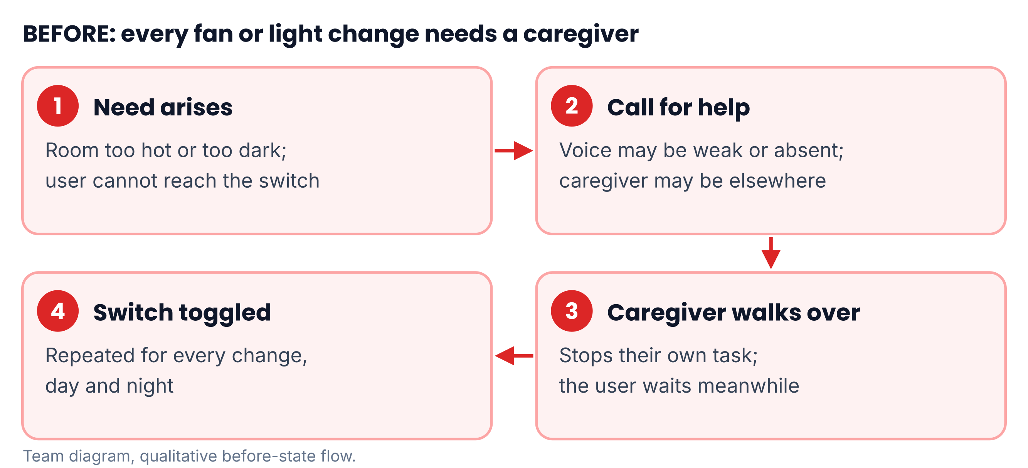
User Journey (1/2): Before State
VERGELINK · STAGE 2
Quantified Inefficiency
100%
OF FAN / LIGHT CHANGES NEED ANOTHER PERSON
~12.9 h / day
UNPAID CARE RECEIVED BY SCI USERS (US STUDY)
₹1.65 lakh
PRICE OF AN INDIAN EOG COMMUNICATOR
Figure: Current pain-point flow for one fan or light change.
Time loss: user waits for every change; caregiver's own task is interrupted each time.
Safety: a user left too hot or in the dark cannot fix it alone.
Wait time per change: not yet measured — the baseline log above will give it.
Baseline we will record before Stage 3
3-day log with a partner family: each fan/light request, time asked, time done, who helped.
Same log format reused in Stage 3 trials, so before and after are measured the same way.
Honesty note: the 100% figure follows from the user being unable to reach a switch; the care-hours figure is US data; local wait times will come from our own baseline log.

Slide 5
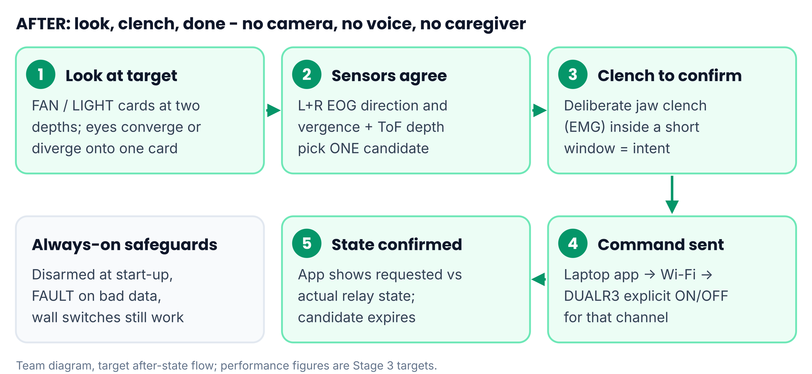
User Journey (2/2): After State & Efficiency
VERGELINK · STAGE 2
Quantified Efficiency (targets)
Metric | Before | VergeLink target
Who switches | Caregiver | User alone
Time per change | Caregiver response | ≤ 3 s look → relay
Hands-free cost | ₹1.65 L (Netravaad) | ₹13,093 BOM (−92%)
Camera / mic | Needed | Neither
False activations | n/a | ≤ 1 per 30 min
Selection accuracy | n/a | ≥ 90% (2 × 2 targets)
Caregiver trips | Every change | Zero for fan/light
Figure: Target after-state flow — look, clench, relay switches.
How these targets will be measured (Stage 3)
Timed trials: app logs time from target shown to relay state confirmed, per attempt.
False activations: 30-minute armed sessions of rest, talking, chewing and blinking.
Accuracy: 2 targets × 2 depths, scripted order, team volunteers under approval.
Scope: only the cost row is a fact today. Every other VergeLink figure is a design target to be measured after parts arrive.
Beneficiary impact: routine fan and light changes become self-directed, so the caregiver's time goes to care that genuinely needs a person.

Slide 6
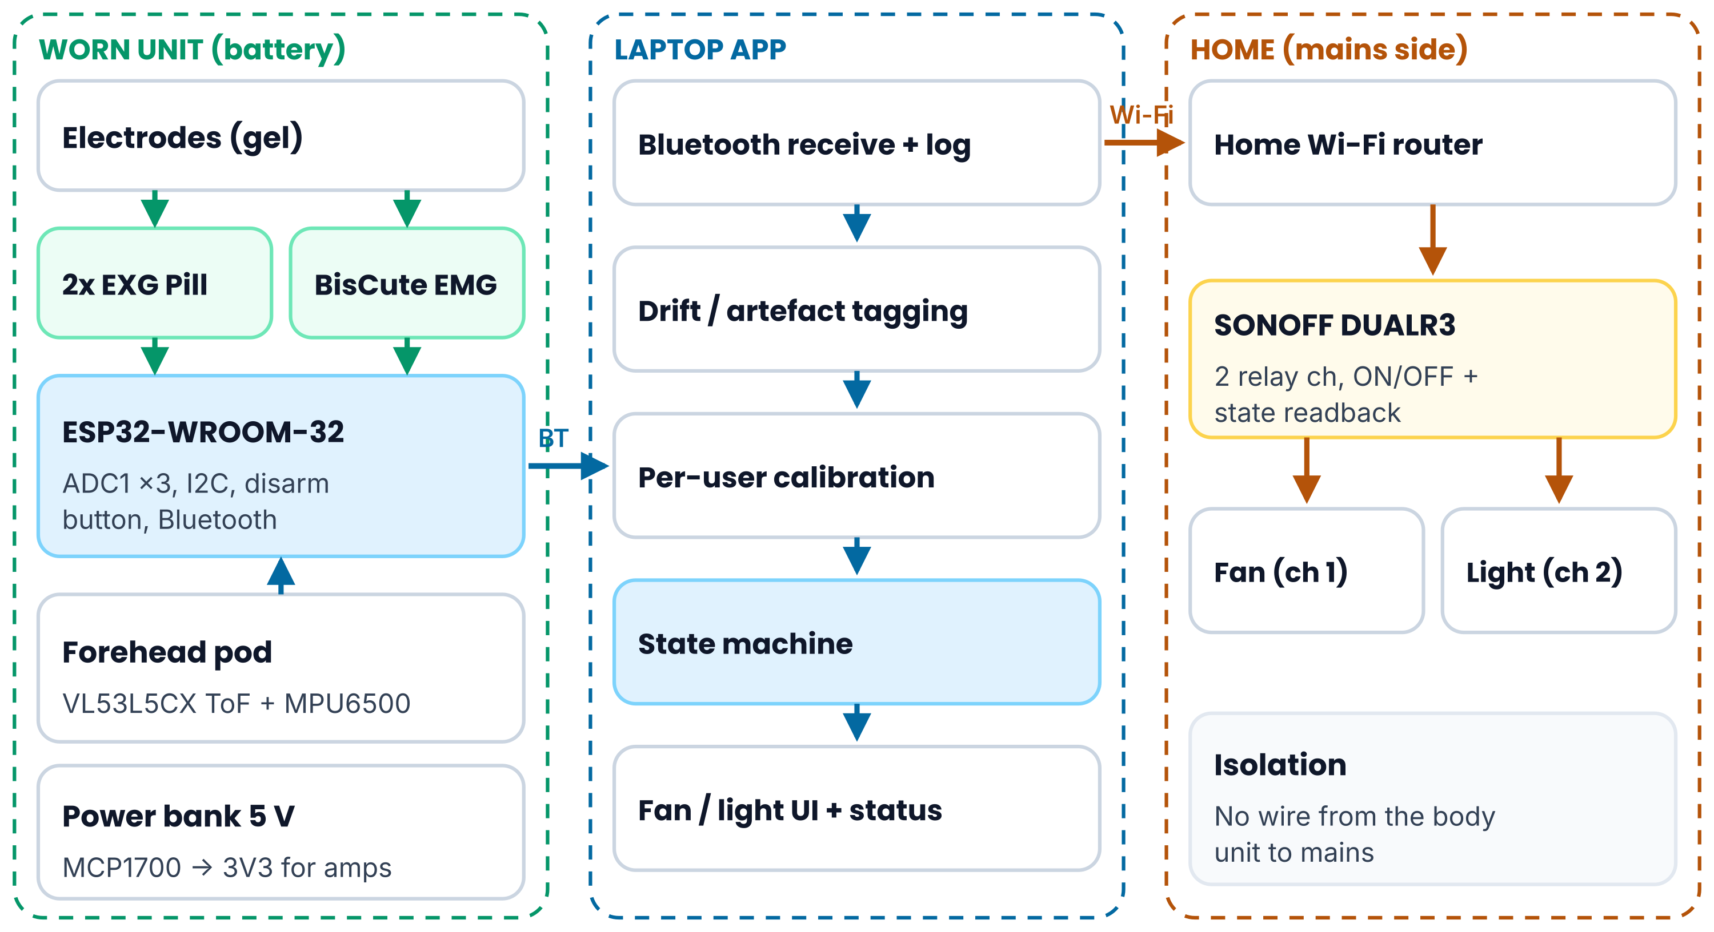
System Architecture (1/2): Block Diagram
VERGELINK · STAGE 2
Subsystems & Firmware / Logic Flow
Mechanical: PETG body-worn enclosure + forehead sensor pod on an elastic headband.
Power: 10,000 mAh bank → ESP32 VIN; separate MCP1700 3V3 rail for the bio-amps.
Electronics: 2× EXG Pill, BisCute, ESP32 ADC1, VL53L5CX + MPU6500 on I2C.
Firmware: timed sampling of 3 analog channels + I2C sensors; every frame time-stamped and health-flagged.
Laptop logic: DISARMED → ARMED → CANDIDATE (gaze + depth agree) → CONFIRMED (clench in window) → explicit ON/OFF.
Figure: Subsystems — worn sensing unit, laptop application, and mains-side relay.
Signal path: electrodes → bio-amps → RC filter → ESP32 ADC1 → Bluetooth → laptop decoder → Wi-Fi → DUALR3 relay → fan / light.
Architecture rationale: analog inputs use ADC1 only because ESP32 ADC2 cannot be used while the radio runs; the body-worn unit has no wired path to mains.

Slide 7
System Architecture (2/2): Specs & Hardware Selection
VERGELINK · STAGE 2
Engineering Target Specifications
Hardware Selection & Protocols
Parameter | Target spec | Status
Eye signals | 2 ch bilateral horizontal EOG | Parts ordered
Intent confirm | 1 ch jaw EMG (72–720 Hz band) | Parts ordered
Depth evidence | 8×8 zones, up to 4 m | Parts ordered
Sampling | ≥ 500 Hz per analog channel | Target
Laptop link latency | < 50 ms per frame | Target
Look → relay time | ≤ 3 s | Target
Session length | ≥ 8 h on battery | Target
Appliance channels | 2, explicit ON / OFF | Parts ordered
Block | Selected | Why
EOG front-end | 2× BioAmp EXG Pill | Single-supply, matches published bilateral set-up
EMG front-end | BisCute | Built-in EMG band-pass; low cost
Controller | ESP32-WROOM-32 | 3 ADC1 inputs + Bluetooth + Wi-Fi
Depth | VL53L5CX (I2C) | 8×8 zones, Class 1 emitter
Head motion | MPU6500 (I2C) | Motion rejection only
Laptop link | Bluetooth serial | No extra radio hardware
Relay | SONOFF DUALR3 | 2 channels in one retrofit box
Superseded choices: ADS1293 AFE (₹6,995, cancelled), nRF52840 MCU and two MINIR4 relays from Stage 1 were replaced to stay within the ₹16,000 cap.

Slide 8
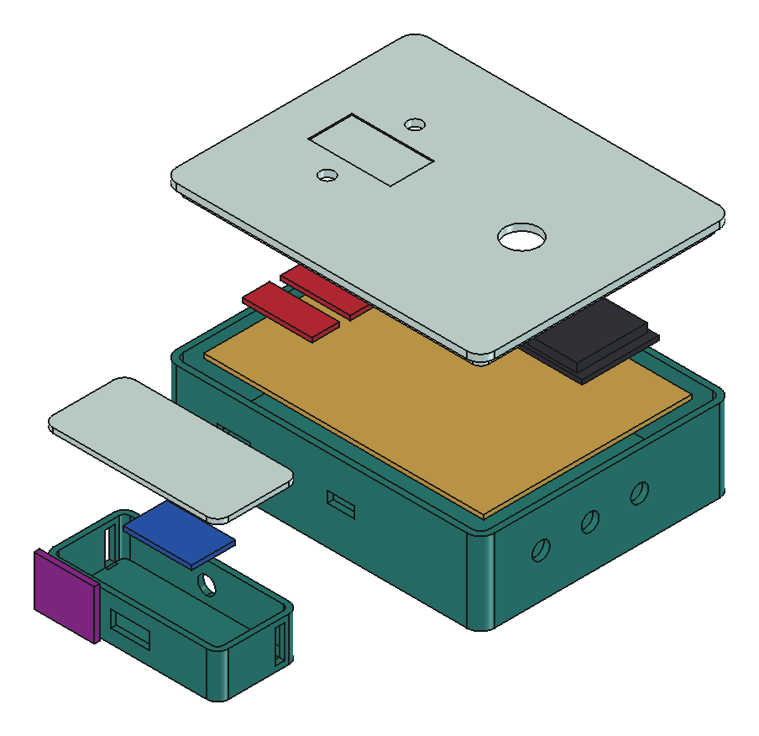
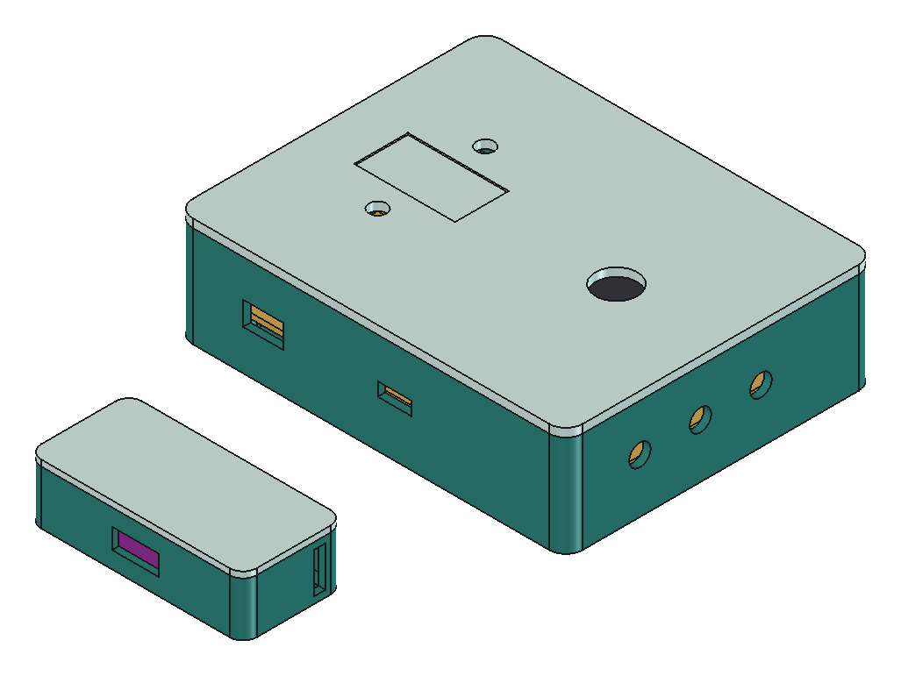
CAD Design & Mechanical Specs (1/2)
VERGELINK · STAGE 2
Mechanical Specifications
Item | Specification
Enclosure (outer) | 116 × 92 × 30 mm, 2.2 mm walls, 5 mm radii
Board mounting | 4 × M2.5 standoffs, 3×4 in perfboard pattern
Wall ports | 3 electrode leads, pod cable, USB power, ESP32 USB
Lid | Disarm button hole, 2 status LEDs, label pocket
Forehead pod | 64 × 30 × 16 mm; 14 × 10 mm ToF window
Headband slots | 26 × 3.5 mm, elastic band
Strap loops | 2 rear loops for 25 mm webbing
Material | PETG, FDM (college printer)
Figure: FreeCAD 1.1 exploded assembly of enclosure, lid, perfboard, modules and sensor pod.
12 parts
Parametric FreeCAD model; STEP exported for printing.
Design iteration: CAD review caught the strap-loop gap modelled on the wrong side (loop was solid against the case) — corrected before FEA.

Slide 9
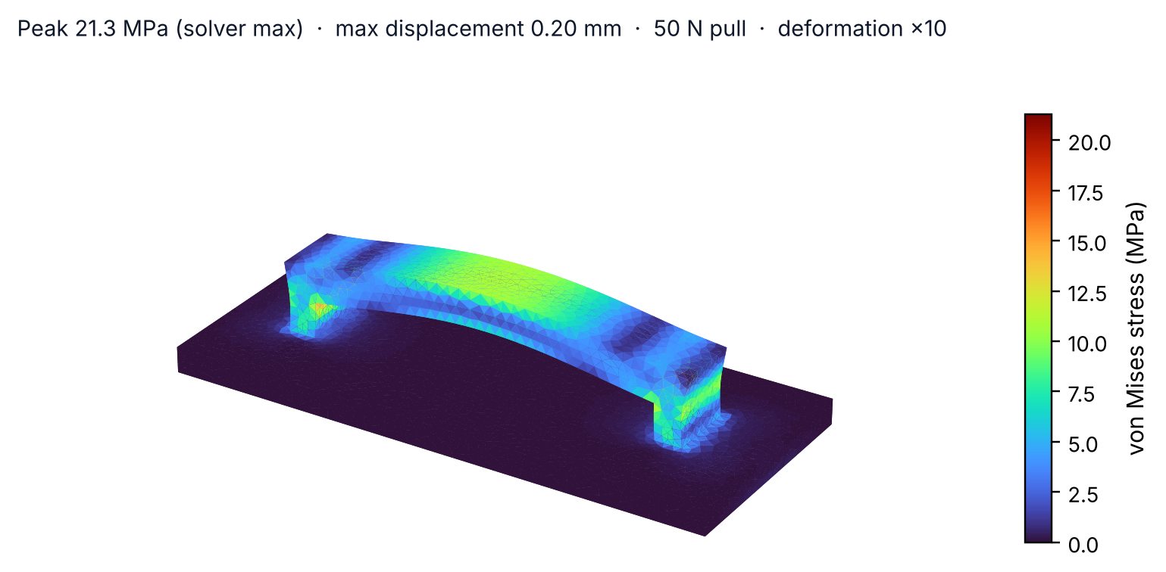
CAD Design & Mechanical Specs (2/2): FEA
VERGELINK · STAGE 2
FEA Load Case & Results
Geometry: 30×6×6 mm loop, 2 mm posts, 3 mm bridge, on a 2.2 mm wall patch.
Load / support: wall face fixed; 50 N pull on the bridge, away from the case.
Mesh: 44,420-node 2nd-order tetrahedra; E = 2.1 GPa, ν = 0.38.
Result: peak 21.3 MPa at the sharp bridge/post corner; max displacement 0.20 mm; FoS ≈ 2.1–2.3 vs ~45–50 MPa PETG yield.
Material Selection
Material | For this device | Decision
PETG | Tough, prints well, tolerates warm rooms | Selected
PLA | Softens at modest temperatures, brittle | Rejected
ABS | Warps on an open-frame printer | Rejected
Figure: CalculiX von Mises stress on the strap loop, 50 N pull, deformation ×10.
Why this part: the strap loop carries the whole box if the strap snags on a wheelchair or bed rail.
Next action: add a 1 mm fillet at the stress corner and print with layers along the load path, since FDM inter-layer strength is below bulk.

Slide 10
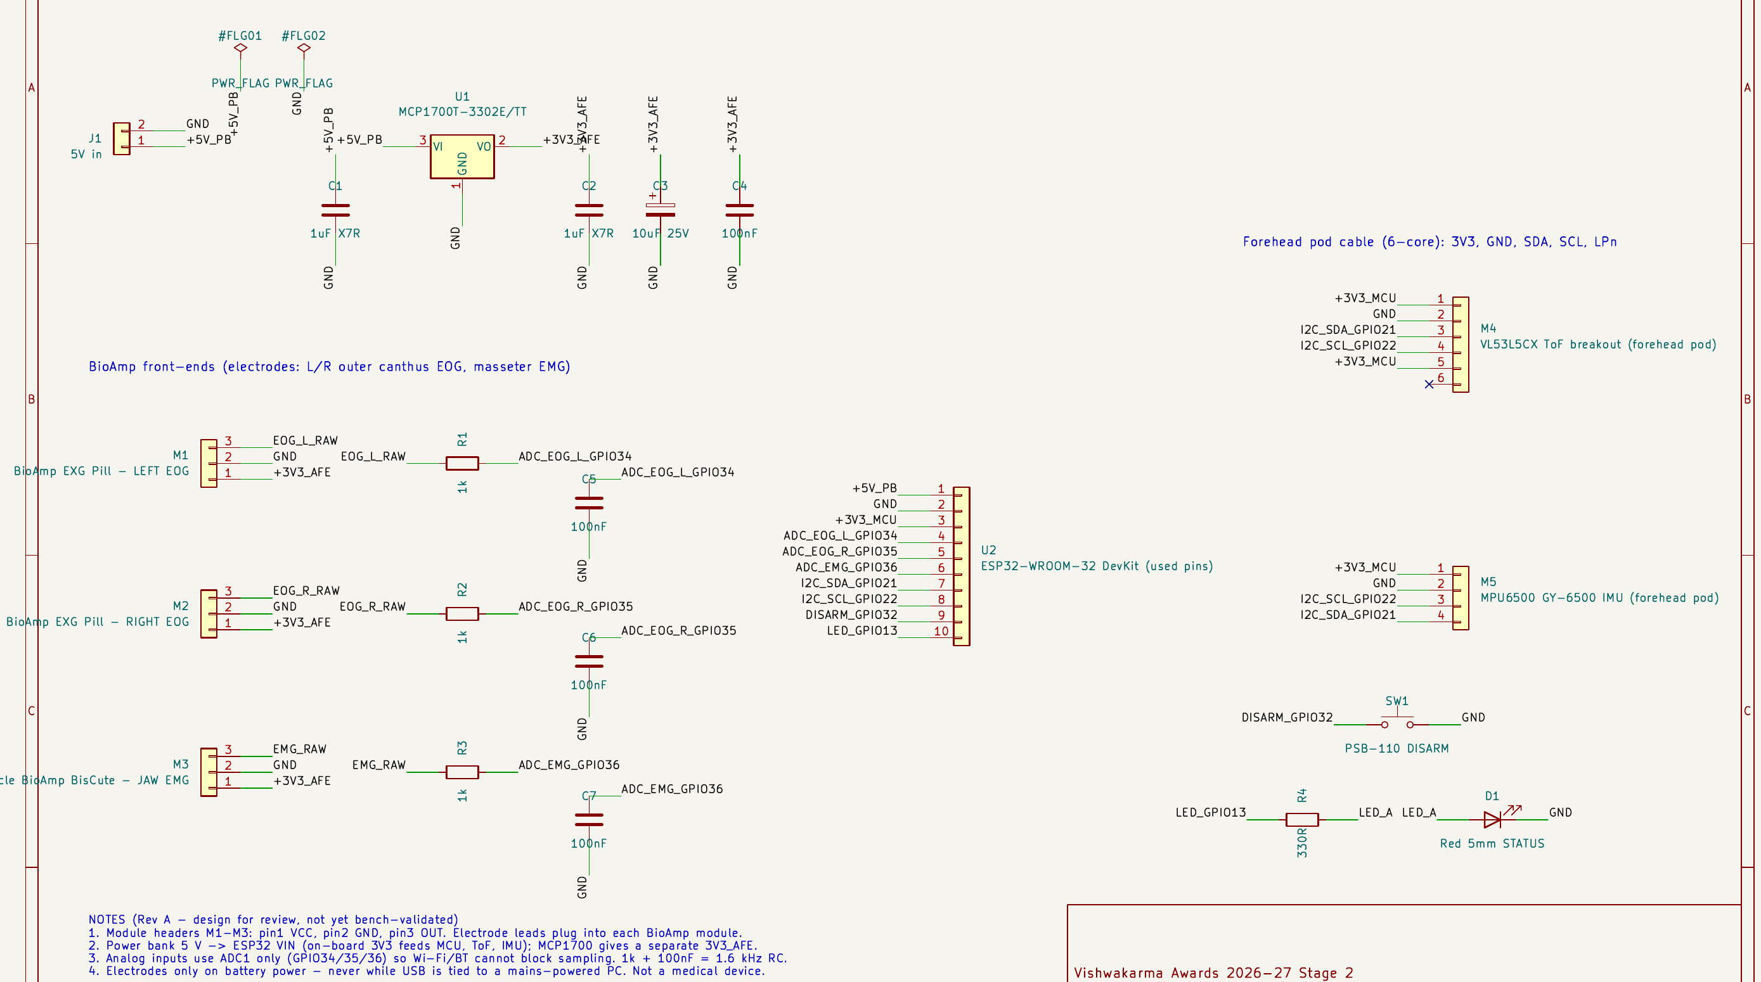
Electronics Schematics & BOM (1/2): Schematic
VERGELINK · STAGE 2
ESP32 Pin Map
Pin | Signal
GPIO34 (ADC1_CH6) | Left EOG
GPIO35 (ADC1_CH7) | Right EOG
GPIO36 (ADC1_CH0) | Jaw EMG
GPIO21 | I2C SDA
GPIO22 | I2C SCL
GPIO32 | Disarm button
GPIO13 | Status LED (330 Ω)
VIN | 5 V from power bank
3V3 out | ToF + IMU supply
Figure: KiCad 10 schematic, Rev A — ERC 0 errors / 0 warnings (kicad/VergeLink_Mainboard.kicad_sch).
Power distribution: power bank 5 V → ESP32 VIN; MCP1700 LDO (1 µF in/out, 10 µF + 100 nF bulk) feeds only the three bio-amps; 1 kΩ + 100 nF RC (1.6 kHz) on each ADC input.

Slide 11
Electronics Schematics & BOM (2/2): Itemized BOM
VERGELINK · STAGE 2
Itemized Prototype Bill of Materials (as ordered, incl. GST & shipping)
Component | Part / specification | Qty | Vendor (India) | Order status (6 Oct 2026) | Cost ₹
EOG front-end | Upside Down Labs BioAmp EXG Pill kit | 2 | Upside Down Labs | Paid, order received | 5,198.00
EMG front-end | BisCute kit + 100 cm cable + 2 electrode packs | 1 | Upside Down Labs | Paid, order received | 1,346.00
Wi-Fi relay | SONOFF DUALR3, 2 channel | 1 | SONOFF India | Paid | 1,665.06
Power bank | Portronics Aero 10, 10,000 mAh | 1 | Portronics | COD, confirmed | 1,303.00
Depth sensor | SmartElex VL53L5CX ToF breakout | 1 | RoboTechMinds | Paid | 1,096.80
MCU | ESP32-WROOM-32 38-pin DevKit | 1 | Robu | Completed | 421.00
IMU | GY-6500 MPU6500 | 1 | FlyRobo | COD, confirmed | 345.00
LDO | MCP1700T-3302E/TT, SOT-23 | 2 | Robu | Paid, processing | 145.00
Passives & build | Resistor kit, caps, LEDs, perfboard, headers, wire, button, OLED, cables | lot | Robu / IHC / ElectronComponents | Paid / completed | 1,573.41
Total |  |  |  | Cap ₹16,000 → headroom ₹2,906.73 | 13,093.27
Procurement: every part is from Indian sellers — no imports. Delivery inventory and module-revision checks are in progress, so no lead time is claimed as met yet.

Slide 12
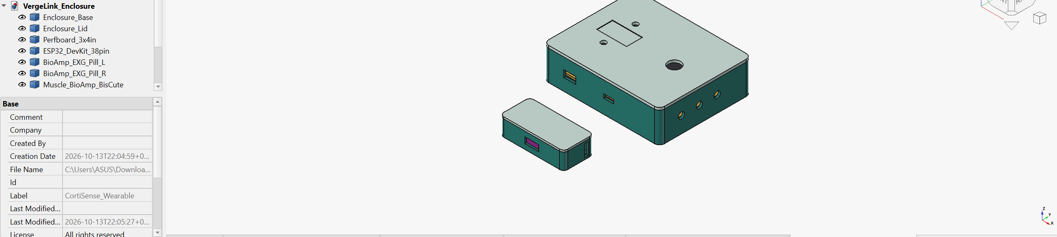
Your Maker Journey (1/2): Stage 1 → Stage 2
VERGELINK · STAGE 2
Stage 1 to Stage 2 Engineering Iterations
Front-end pivot: Stage 1 planned ADS1293 + AD8232 + nRF52840. The ₹6,995 ADS1293 order was cancelled; two EXG Pills + BisCute + ESP32 keep the build inside ₹16,000.
Scope made honest: vertical EOG channel, magnetometer heading, wheelchair DAC and dry electrodes are out of this build; Stage 1 simulation figures are not reported as results.
Actuation: two MINIR4 relays replaced by one SONOFF DUALR3.
CAD milestone: 12-part FreeCAD assembly, STEP export and CalculiX FEA completed 14 Oct 2026.
EDA milestone: KiCad 10 schematic, 21 components, 15 named nets; ERC 0 errors / 0 warnings on 14 Oct 2026.
Figure: FreeCAD 1.1 session — VergeLink_Enclosure feature tree and model.
[Add photo]
Team members soldering the perfboard / assembling the enclosure, wearing institutional ID badges.
Institutional sign-off: Faculty guide Mrs. C. Radhika, Dept. of Biomedical Engineering, VCET Erode (Batch 23BM7A) — [add review date / signature].

Slide 13
Your Maker Journey (2/2): Evidence & Repository
VERGELINK · STAGE 2
Raw Repository Linkage
[Add photo]
Parts laid out on delivery, with order labels visible.
[Add photo]
Joint review with the faculty guide.
github.com/amalnathkp13-boop/vergelink
presentation/ deck (.pptx) + PDF
cad/ .FCStd, .step, FEA model + results
kicad/ .kicad_sch, netlist, BOM, ERC report
figures/ every figure used in this deck
README.md status, FEA summary, safety notes
Work-in-Progress Software Evidence
Authenticity Verification Plan
CAD: parametric FreeCAD tree with unsuppressed features (slide 12 screenshot).
EDA: KiCad ERC report — 0 errors, 0 warnings (kicad/erc_report.rpt).
FEA: 44,420-node mesh and CalculiX result stored in the .FCStd file.
Team members commit their own build logs, photos and firmware to the repository as each milestone lands.
All photos taken with institutional ID badges in frame; no embedded videos — links only.
Timestamps: native files carry their creation dates; each new commit adds a dated record of Stage 2 progress for audit.

Slide 14
Safety & Hazard Mitigation
VERGELINK · STAGE 2
FMEA Matrix — failure modes and embedded protections
Failure mode | Potential hazard | Embedded fail-safe / mitigation response
Electrodes worn while USB goes to a mains PC | Leakage current through skin electrodes | Battery-only operation whenever electrodes are attached; program over USB only with electrodes removed; no wired path to the relay.
Chewing / talking produces jaw EMG | Fan or light switches unintentionally | EMG accepted only inside a candidate window after gaze + depth agree; refractory period; physical disarm button (GPIO32).
EOG drift, electrode peel, sensor dropout | Wrong target selected | Clipping / stale / missing-sensor flags force FAULT; per-session calibration; candidates expire automatically.
Bluetooth or Wi-Fi link drops | Command lost or repeated | Restart in DISARMED; explicit ON / OFF (never toggle); app shows requested vs actual relay state.
Supply sag / LDO overload | Noisy or clipped bio-signals | Bio-amps on a separate MCP1700 rail; ESP32 and radio on the DevKit regulator; rail currents measured at bring-up.
Mains wiring of the DUALR3 | Shock or fire | Licensed electrician installs in existing switchboard; wall switch and fan regulator stay in service.
Physical Fail-safes
Standards Compliance (considered, not certified)
Disarm button: momentary PSB-110 on GPIO32 drops the system to DISARMED at once.
Enclosures: PETG case and pod cover all boards; no exposed conductors near the skin.
Isolation: body-worn unit and mains relay share no wire — only Wi-Fi.
ISO 14971: risk-management file started from this FMEA.
IEC 60601-1: leakage-current principles for body-worn electrodes.
IEC 60825-1: VL53L5CX emitter is Class 1 (per ST).
Human testing: electrode trials on team members first; volunteer sessions only after institutional ethics approval. No medical-device claim is made.

Slide 15
Roadmap: 4-Month Fabrication Plan
VERGELINK · STAGE 2
M1
M2
M3
M4
Oct 2026 · Fabrication
Nov 2026 · Fabrication
Dec 2026 · Integration
Jan 2027 · Field demo
Delivery inventory and module revision checks
Perfboard soldering per Rev A schematic
ADC bring-up with a signal generator — no body contact yet
PETG print of enclosure + pod on the college printer
Firmware: timed acquisition + health flags
Laptop app v0; electrode trials on team members
Calibration routine and two-factor state machine
ToF depth gating, IMU motion rejection
DUALR3 fitted by an electrician and integrated
Timed trials: accuracy, false triggers, latency
Stage 2 → 3 report with measured data
Demo rehearsal with the faculty guide
Stage 3 Target
Commitment: a working prototype that switches a real fan and light from look + clench, ready for functional testing in Stage 3.
Evidence we will bring: logged accuracy, false-activation and latency numbers from scripted sessions, plus the commits and photos for each milestone.
Dependencies: parts delivery (ordered by 6 Oct 2026), college 3D-printer slot, electrician visit for the DUALR3, and ethics approval before volunteer testing.

Slide 16
Technical Challenges & Risks
VERGELINK · STAGE 2
Bottleneck: EOG drift vs vergence
Bottleneck: ESP32 ADC quality
Bottleneck: false jaw-clench triggers
Constraint: The near/far vergence change is small next to slow electrode drift. A strong high-pass filter would remove the drift — and the vergence signal with it.
If unmanaged: Wrong depth chosen; selections that wander over a session.
Constraint: The ESP32 ADC is non-linear near its range limits and noisy, and ADC2 is unavailable while Wi-Fi or Bluetooth runs.
If unmanaged: Distorted EOG / EMG traces; poor repeatability between units.
Constraint: Chewing, talking and swallowing all produce masseter EMG that can look like a deliberate clench.
If unmanaged: Unwanted fan or light switching during meals or conversation.
Other risks tracked
ToF on dark / glossy targets: measured surface distance may not match where the eyes converge.
No magnetometer: MPU6500 yaw drifts, so it cannot give a stable room heading.
Relay control path: the DUALR3's local (LAN) vs cloud control options must be confirmed before the app is written.
Why this matters: each of these could make the demo work on the bench but fail with a real user — so each has a planned test on the next slide.

Slide 17
Potential Solutions & Risk Mitigation
VERGELINK · STAGE 2
Risk | Primary mitigation | Backup / fallback | How we will verify
EOG drift vs vergence | Keep low-frequency path; per-trial baseline removal; discrete near/far targets (as in VergeIO) | Require ToF depth agreement before any candidate | 10-min fixed-gaze recordings at both depths
ESP32 ADC quality | ADC1 only, linear input band, 1.6 kHz RC, oversampling, Espressif calibration API | External I2C ADC from the ₹2.9k headroom | Signal-generator sine sweep before body contact
False clench triggers | Clench must be held inside a candidate window; per-user threshold; refractory period | Raise threshold / add dwell; physical disarm | Scripted chew / talk / rest sessions, false triggers counted
ToF on dark / glossy targets | Matte, high-contrast target cards | Use ToF only as a gate, not as gaze depth | Distance tests on matte, dark and glossy cards
IMU yaw drift | Use IMU only to reject head motion | Fixed-head demo posture | Logged yaw during 10-min sessions
Relay control path | Confirm DUALR3 local-LAN control first | Vendor app / Home Assistant bridge | Explicit ON/OFF + state readback test
Verification plan: every risk above has a bench test; results — including failures — will be reported with the Stage 3 submission.

Slide 18
Summary & Stage 3 Readiness
VERGELINK · STAGE 2
₹13,093
0 / 0
FoS ≈ 2.1–2.3
4 months
PARTS ORDERED (CAP ₹16,000)
KiCad ERC ERRORS / WARNINGS
STRAP LOOP, 50 N FEA
TO A STAGE 3 DEMO
Done (Stage 2)
Next (Oct – Dec 2026)
Stage 3 will show
Revised architecture inside budget
All parts ordered from Indian sellers
12-part CAD + STEP
Strap-loop FEA
Schematic with clean ERC
Public repository with native files
Delivery inventory and bring-up
Enclosure print and assembly
Firmware + laptop app
Calibration and two-factor logic
Relay installation by an electrician
A real fan and light switched by look + clench
Measured accuracy, false triggers and latency
Baseline vs after comparison from the same log format
Every failure reported, not hidden
Ask: progression to Stage 3 to complete fabrication and measured user testing under faculty supervision.

Slide 19
References & Sources
VERGELINK · STAGE 2
[1] Zhang X. et al., “VergeIO: Depth-Aware Eye Interaction on Glasses,” arXiv:2507.02187 (2025) — arxiv.org/abs/2507.02187
[2] Upside Down Labs, BioAmp EXG Pill documentation — docs.upsidedownlabs.tech/hardware/bioamp/bioamp-exg-pill
[3] Upside Down Labs, Muscle BioAmp BisCute documentation — docs.upsidedownlabs.tech/hardware/bioamp/muscle-bioamp-biscute
[4] STMicroelectronics, VL53L5CX Time-of-Flight 8×8 multizone sensor — st.com/en/imaging-and-photonics-solutions/vl53l5cx.html
[5] Espressif, ESP-IDF ADC (oneshot) driver and calibration documentation, ESP32 — docs.espressif.com
[6] Microchip, MCP1700 low-quiescent-current LDO datasheet (DS20001826)
[7] SONOFF DUALR3 two-gang smart switch — sonoff.in
[8] International Health Policies, “Spinal cord injuries in India: towards a comprehensive preventive and rehabilitative response”
[9] Office of the Registrar General & Census Commissioner, India — Census 2011 disability data (via punarbhava.in)
[10] SCIRE Project, Non-intervention attendant care studies (Robinson-Whelan & Rintala 2003) — scireproject.com
[11] Amrita Vishwa Vidyapeetham, news release on Netravaad eye-gesture communication device — amrita.edu
Data sources: statistics on slides 2–4 and the Netravaad price come from [8]–[11]; component specifications from [2]–[7].

Slide 20
Image Sources
VERGELINK · STAGE 2
Slide | Figure | Source / tool
4 | Before-state user flow | Project diagram (drawn for this submission)
5 | After-state user flow | Project diagram (drawn for this submission)
6 | System block diagram | Project diagram (drawn for this submission)
8 | Exploded and assembled enclosure views | FreeCAD 1.1 — cad/VergeLink_Enclosure.FCStd
9 | Strap-loop von Mises stress plot | FreeCAD FEM + CalculiX — cad/VergeLink_StrapLoop_FEA.FCStd
10 | Mainboard schematic | KiCad 10 — kicad/VergeLink_Mainboard.kicad_sch
12 | FreeCAD session screenshot | Screen capture of the project model
Third-party images: none. All files are in the project repository: github.com/amalnathkp13-boop/vergelink

