Slide 1
Predicting Land Prices in the Colombo District
A fair asking price per perch from a plot's area, size and land type
4,494 real listings
160 areas
Live web app
Amal Ranawaka · IT5514 Applied Machine Learning · Final assignment
Notes:
[0:25] This project predicts land prices in the Colombo district. Land is the biggest purchase most Sri Lankan families make, but there is no public, plot-level price guide - people judge prices from a few online ads, and similar plots are advertised at very different prices. So I built a model that estimates a fair asking price per perch from a plot's area, size and land type, and put it in a live web app.

Slide 2
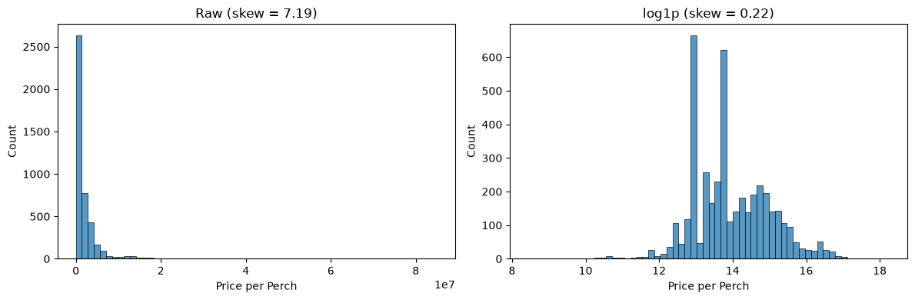
Data and preparation: 4,494 listings to 4,275
1
Target: price per perch
Comparable across plot sizes; advertised total price dropped (leakage)
2
Fixed a unit error
3 listings priced per acre were never converted (divided by 160)
3
Removed 198 duplicates
Price per perch: skew 7.19 before, 0.22 after the log transform
Before splitting, so no listing is in both train and test
4
Log transform, then outliers
Source: Land prices of Colombo district (Kaggle), online ads posted Jul-Sep 2021, with 27 distance/count features per listing (Fort, schools, hospitals, banks, rail, expressway).
Removed 21 true outliers instead of 297 genuine expensive plots
Notes:
[0:40] The data is 4,494 real land advertisements from the Colombo district, posted in 2021. I chose price per perch as the target, because it makes plots of different sizes comparable, and I dropped the advertised total price because it would leak the answer. Three listings were priced per acre and never converted, so I fixed them, and I removed duplicates. And because prices are extremely skewed, removing outliers directly would have thrown away 297 genuine expensive plots in central Colombo - so I log-transformed the price first, which left only 21 real outliers. That gave 4,275 clean listings.

Slide 3
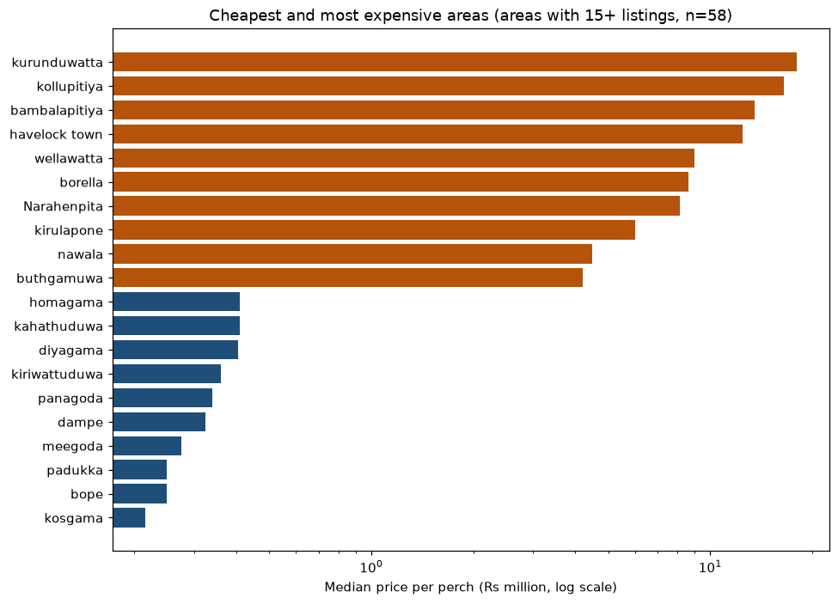
What the data says: location sets the price
84×
price gap between the cheapest and most expensive areas
ρ = −0.81
distance from Colombo Fort vs price (strongest link)
22 of 45
location-feature pairs strongly correlated (|ρ| > 0.7)
Notes:
[0:30] The exploratory analysis showed one thing very clearly: location sets the price. The median price per perch differs 84 times between the cheapest area, Kosgama, and the most expensive, Kurunduwatta in central Colombo. Distance from Colombo Fort has a correlation of minus 0.81 with price. And the location features are strongly correlated with each other - they mostly describe one thing: how central and built-up an area is.

Slide 4
Model accuracy: CatBoost (new) and the final stack
Model | CV RMSE (log) ↓ | Test R² ↑ | Median error ↓
Stacking (RF + XGB + Cat) | 0.4265 | 0.866 | 11.8%
LightGBM (tuned) | 0.4274 | 0.862 | 13.5%
XGBoost (tuned) | 0.4282 | 0.862 | 12.2%
Random Forest (tuned) | 0.4289 | 0.861 | 11.5%
CatBoost (tuned) ★ new | 0.4311 | 0.866 | 12.3%
Random Forest (default) | 0.4450 | 0.834 | 10.3%
XGBoost (default) | 0.4490 | 0.830 | 11.0%
Ridge (baseline) | 0.4509 | 0.836 | 16.5%
★ New algorithm: CatBoost
Not taught in lectures
Handles the 160 area categories natively, without target leakage
R² 0.866 (tied best); best on unseen areas
Final model: stacking
Lowest cross-validated error (0.4265); chosen on CV, not the test set
Combines RF + XGBoost + CatBoost
Ranked by cross-validated error (training data only). Tuning lifted R² from about 0.83 (defaults) to 0.86. Band classifier: 90.5% accuracy.
Notes:
[0:55] This table compares every model I trained. Random Forest and XGBoost were taught in the module, so together with a Ridge baseline they are my comparison models. My new algorithm is CatBoost, which was not covered in the lectures. I chose it because the area column has 160 categories, many of them rare, and CatBoost encodes categories without leaking the target. It reached an R-squared of 0.866, tied for best, and it generalised best to areas it had never seen. Tuning with five-fold cross-validation clearly helped: about 0.83 with default settings, 0.86 tuned. The final model is a stacking ensemble of Random Forest, XGBoost and CatBoost, chosen because it had the lowest cross-validated error. It reaches a median error of about 12 percent.

Slide 5
Key finding: location explains almost everything
81%
of price variation is between areas
All 27 location features have one value per area: they were calculated from the area name, not the plot.
On areas never seen in training, tree models clearly beat the linear model.
So the app only offers areas the model knows.
Notes:
[0:40] The most important finding came from the data itself. All 27 location features have exactly one value per area - they were calculated from the area name, not from each plot. So 81 percent of price variation is between areas. When I tested the models on areas they had never seen, accuracy dropped - but that is where the tree models clearly beat the linear model: R-squared 0.70 against 0.54. Because of this, the app only offers areas the model knows.

Slide 6
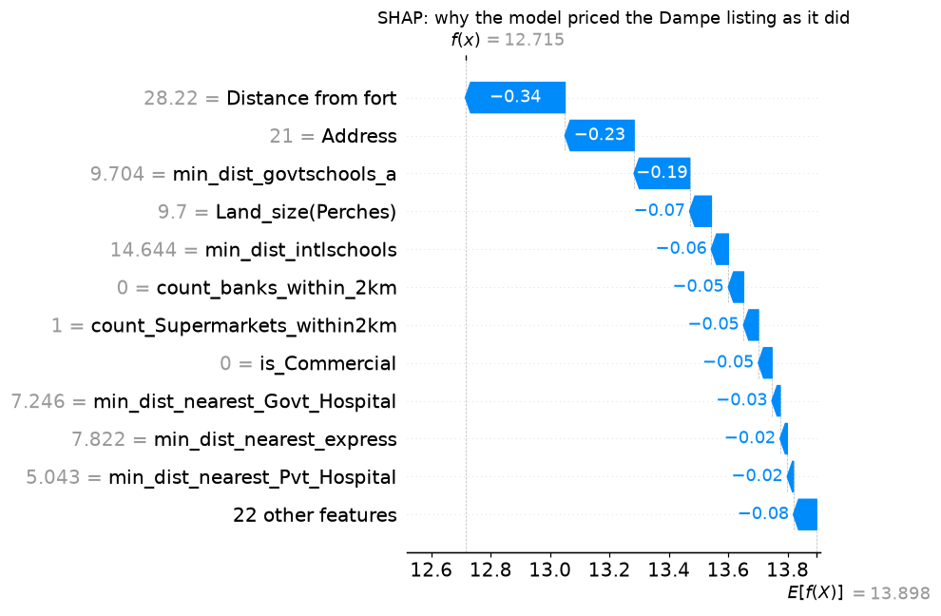
Explainability: SHAP and LIME agree
Held-out Dampe plot: 28 km from Fort, a low-priced area and far from a grade-A school pull the price down. LIME agrees on the same top 3 drivers.
Notes:
[0:40] To explain the model I used SHAP and LIME on the final ensemble. SHAP shows that location drives 87 percent of the model's decisions, land type 9 and land size 4. For a single held-out plot in Dampe, the waterfall shows why it was priced low: it is 28 kilometres from Fort, Dampe is a low-priced area, and the nearest grade-A school is far away. LIME, which works in a completely different way, agreed on the same top three drivers, and CatBoost's own exact SHAP values show the same 87 percent location share.

Slide 7
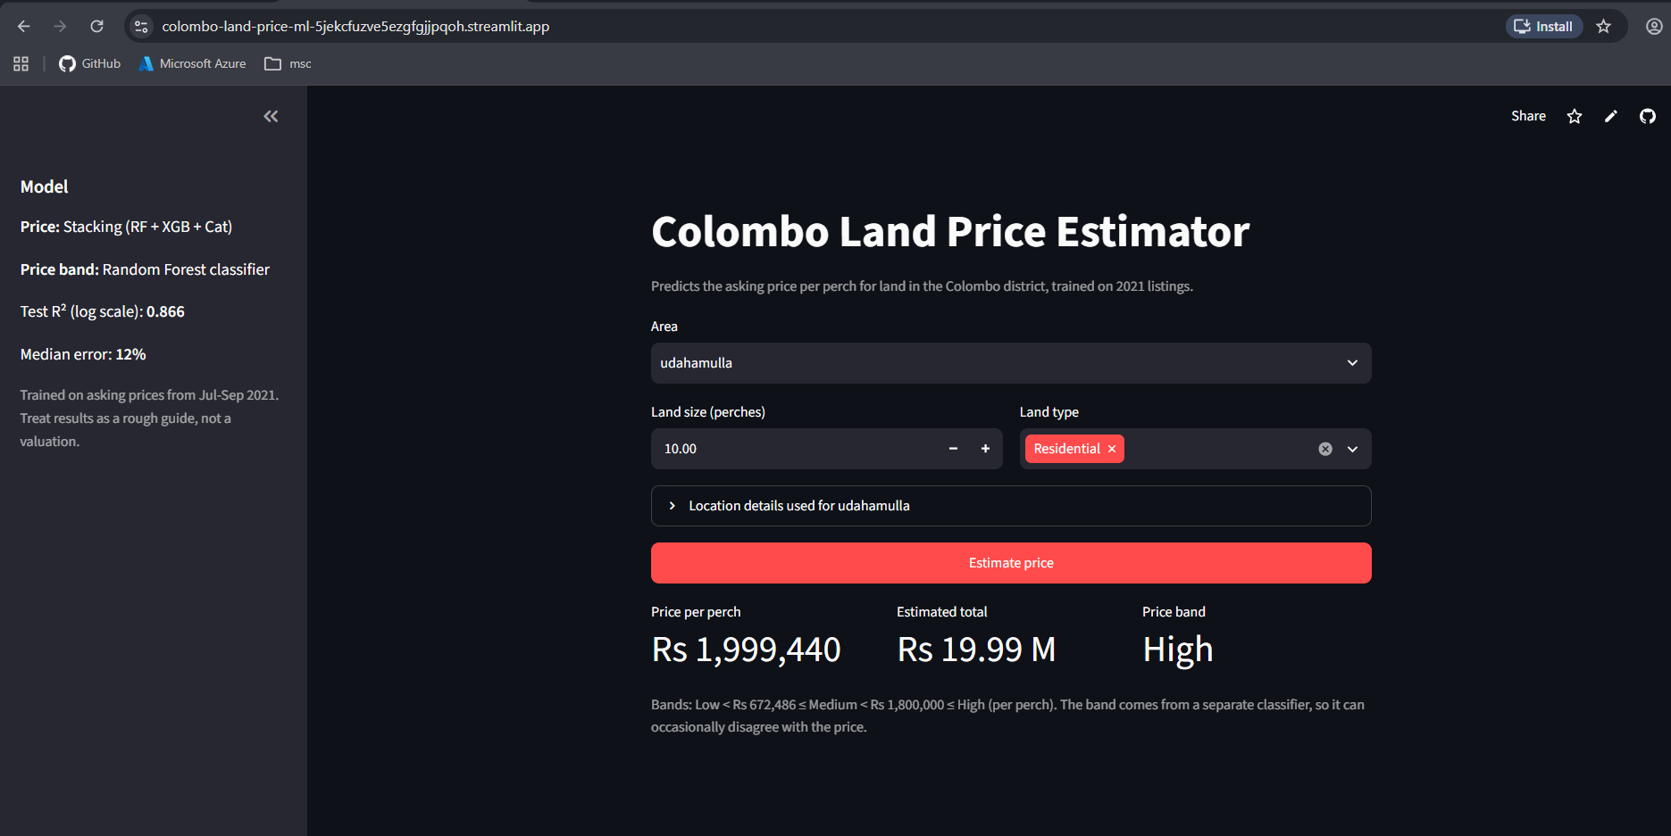

Live demo: the deployed app
Try it:
scan the QR code or open the link below
colombo-land-price-ml-…streamlit.app
Battaramulla: ≈ Rs 2.58M per perch · High
Kaduwela: ≈ Rs 460k per perch · Low
Every price is explained: "Why this price?" (SHAP)
Backup screenshot if the internet is unavailable
MLOps
Private GitHub repo
CI: 15 tests passing
Retraining + quality gate
Auto-deploy on push
Notes:
[0:45] Here is the deployed application. [Switch to the browser.] I choose an area and a size. Battaramulla, about 11 kilometres from Fort, comes out at about 2.6 million rupees per perch, in the high band; Kaduwela, further out, at about 460,000, in the low band. Under each price, the app explains it: for Battaramulla, its location roughly doubles the price compared with a typical plot. Behind it is a GitHub repository with 15 automated tests, a retraining pipeline with a quality gate, and automatic redeployment. [Switch back to the slides.]

Slide 8
Conclusion
What we learned
Limitations
Next step
The data, not the algorithm, limits accuracy: all tuned models perform almost the same.
Asking prices, not sale prices; 2021 data; location recorded per area, not per plot.
Per-plot location data and recent prices would improve the model more than any tuning.
Thank you · Questions?
Notes:
[0:15] To conclude: all tuned models perform almost the same, so the data - not the algorithm - limits the accuracy. The main limitations are asking prices rather than sale prices, 2021 data, and location recorded per area. Per-plot location data would improve the model most. Thank you - I am happy to take questions.

Slide 9
Appendix: full model comparison (test set, 855 listings)
Model | CV RMSE (log) | Test RMSE (log) | Test R² (log) | MAE (Rs/perch) | Median error
Stacking (RF + XGB + Cat) | 0.4265 | 0.3677 | 0.866 | 554,620 | 11.8%
LightGBM (tuned) | 0.4274 | 0.3726 | 0.862 | 567,464 | 13.5%
XGBoost (tuned) | 0.4282 | 0.3729 | 0.862 | 561,203 | 12.2%
Random Forest (tuned) | 0.4289 | 0.3742 | 0.861 | 552,220 | 11.5%
CatBoost (tuned) | 0.4311 | 0.3677 | 0.866 | 565,099 | 12.3%
Random Forest (default) | 0.4450 | 0.4092 | 0.834 | 537,807 | 10.3%
XGBoost (default) | 0.4490 | 0.4138 | 0.830 | 594,944 | 11.0%
Ridge (baseline) | 0.4509 | 0.4063 | 0.836 | 594,270 | 16.5%
Notes:
Appendix - only for questions. Final model selected on cross-validated RMSE (lowest: stacking, 0.4265), not on the test set.

Slide 10
Appendix: tuned hyperparameters
Model | Selected values | Why
Random Forest | 271 trees, max_depth 20, min_samples_leaf 3, max_features 0.3 | Limit memorising noisy asking prices; fewer features per split because of multicollinearity
XGBoost | 1,066 trees, learning_rate 0.013, max_depth 5, subsample 0.79, colsample 0.78, reg_lambda 4.0 | Small steps, shallow trees, sampling and regularisation
LightGBM | 820 trees, learning_rate 0.013, num_leaves 15, min_child_samples 11 | Very small trees chosen
CatBoost | 800 iterations, depth 8, learning_rate 0.03, l2_leaf_reg 5 | Native handling of the 160-area category
All tuned with RandomizedSearchCV and 5-fold cross-validation; tuning lowered CV RMSE from about 0.445 to 0.429.
Notes:
Appendix - only for questions. Every model chose strong regularisation, consistent with little signal within an area beyond size and type.

