Slide 1
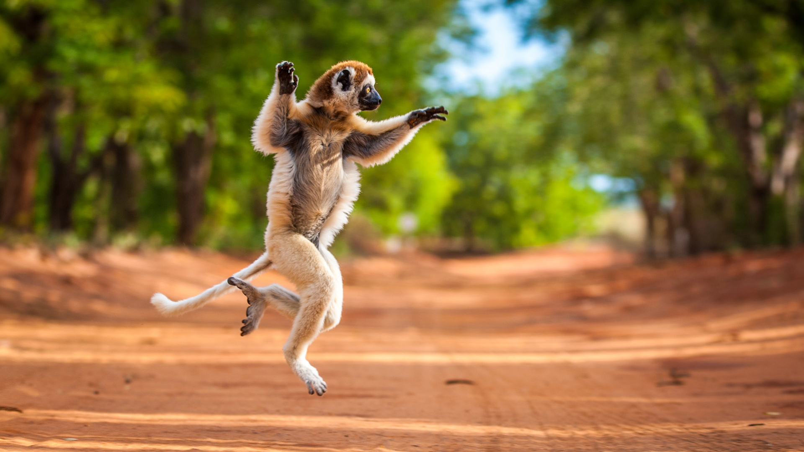
Dry Deciduous Forests
The composition of the wildlife of Madagascar reflects the fact that the island has been isolated for about 88 million years.

Slide 2
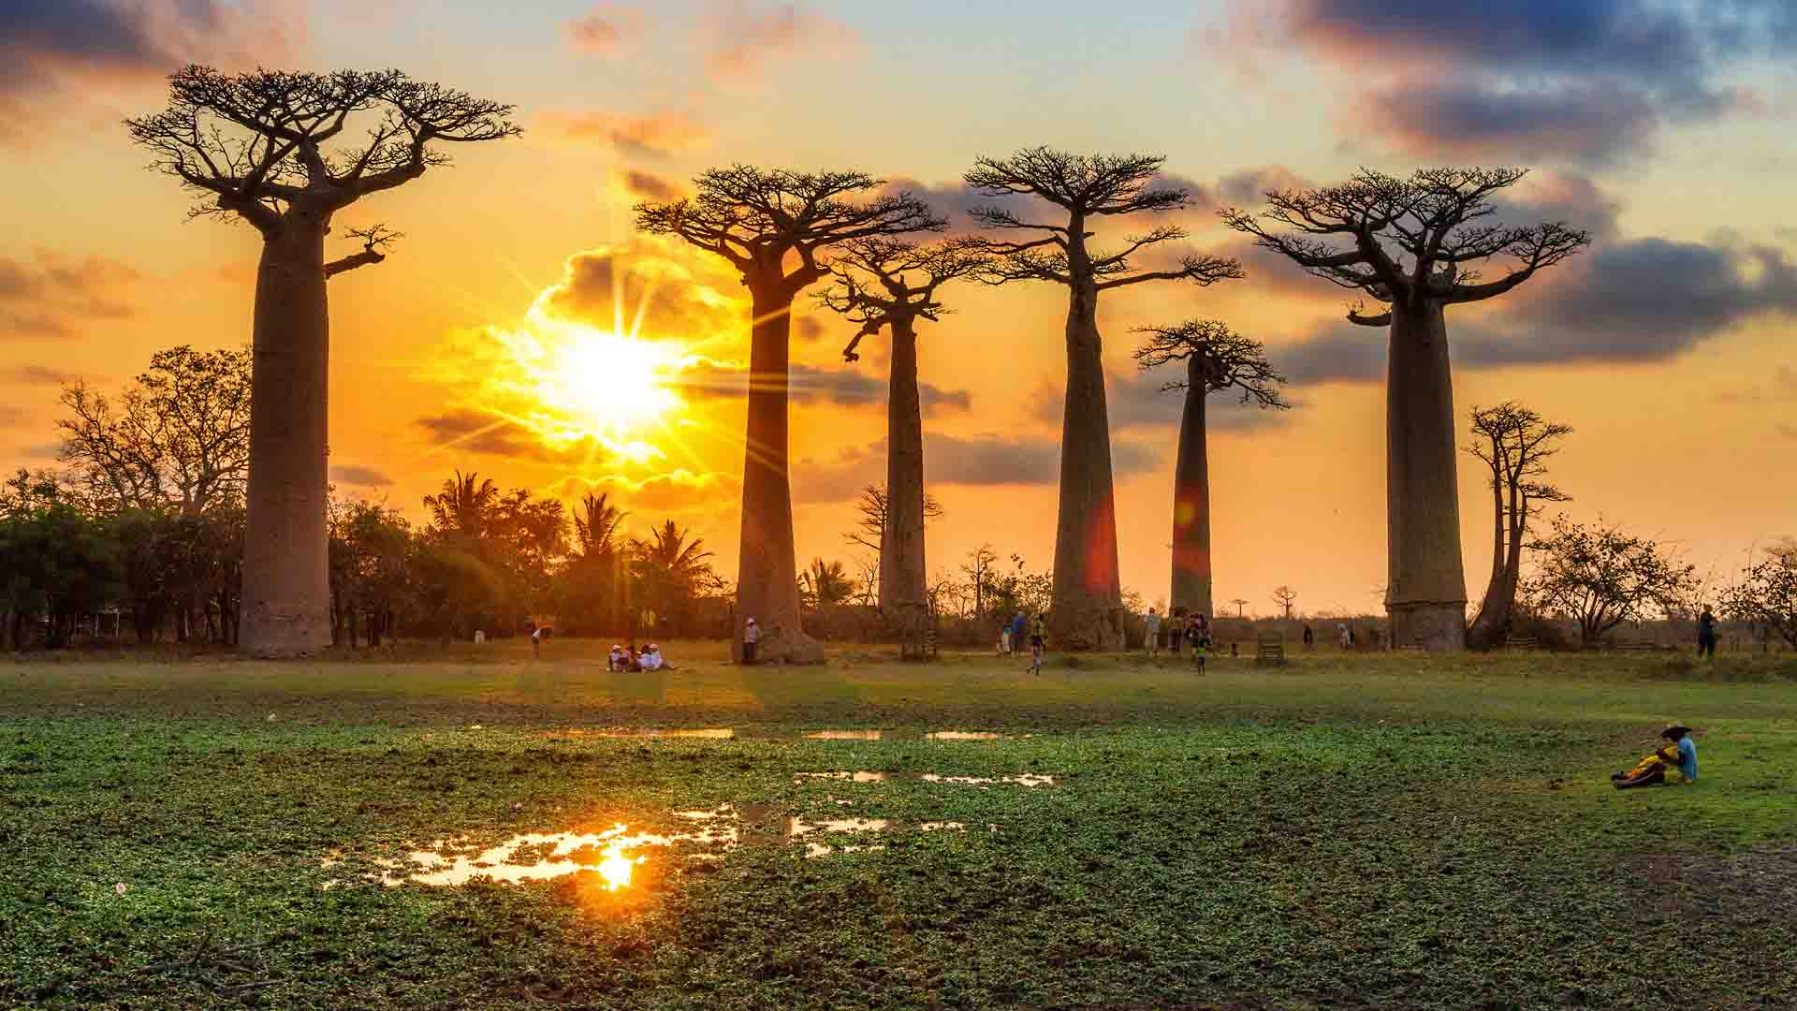
Kirindy National Park
The Avenue or Alley of the Baobabs is a prominent group of baobab trees lining the dirt road between Morondava and Belon'i Tsiribihina in the Menabe region in western Madagascar.

Slide 3
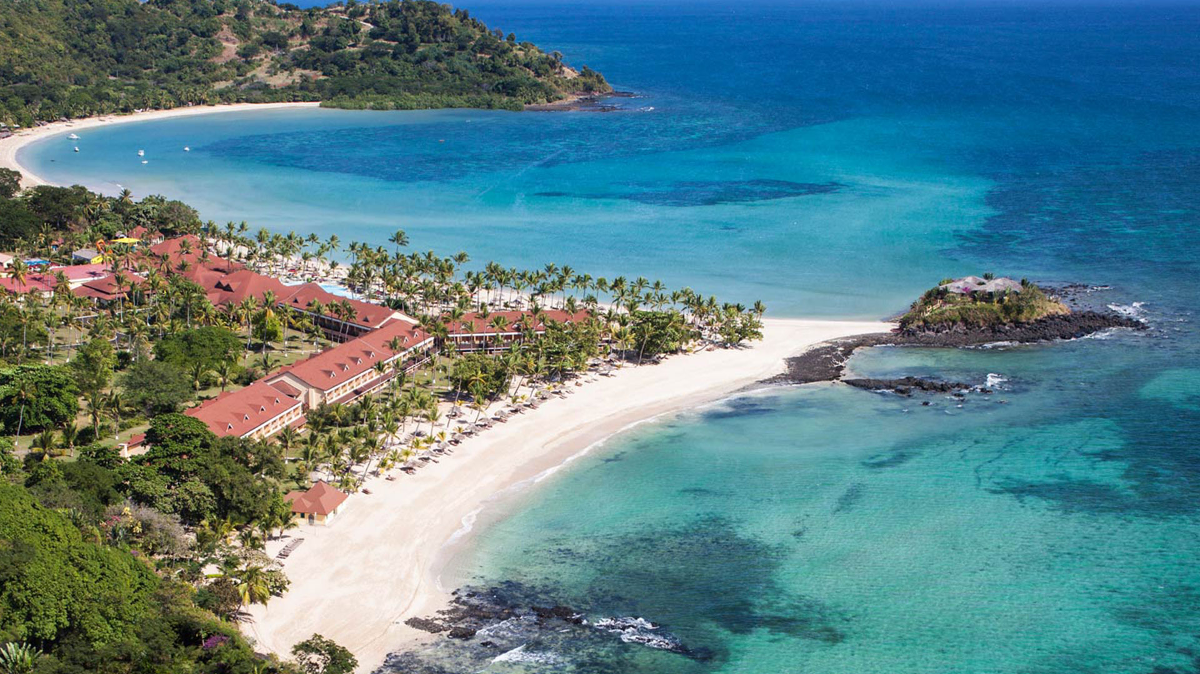
Andilana Beach Resort
Andilana Beach Resort, nestled in the beautiful island of Nosy Be, is a luxury hotel in Madagascar, a dreamy destination ideal for demanding travellers.

Slide 4
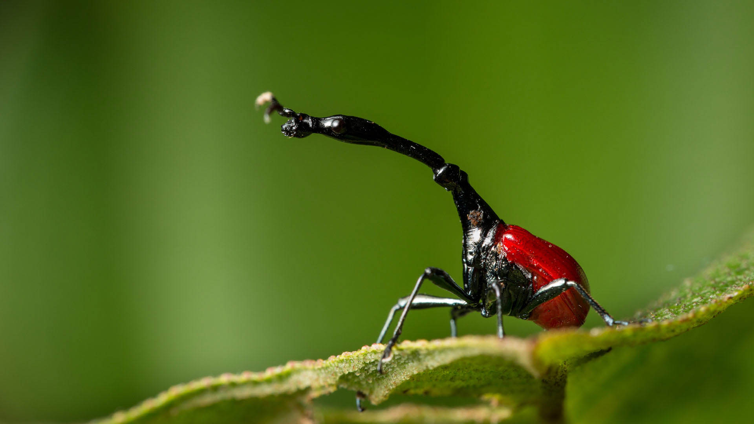
Giraffe Weevil
The giraffe weevil is a weevil endemic to Madagascar. It derives its name from an extended neck much like that of the common giraffe.

