Slide 1
STUDENT CLUBS PORTAL
BY,
NIDHIN V ALEX 18UBCA7475
AMAL ROY 18UBCA7460

Slide 2
TOPIC :
STORING THE DETAILS AND INFORMATION OF MEMBERS IN VARIOUS CLUBS IN A COLLEGE, USING THE CLOUD TECHNOLOGY.

Slide 3
INTRODUCTION
This project is developed for storing the details and information of members in various clubs in a college.
This project is developed using the php and cloud technology.
It will overcome the problems of institutions to store the details of the club members.

Slide 4
INTRODUCTION
Cloud computing is widely used in various fields because of its various applications.
Cloud computing provides the best solution to setup the infrastructure for the project with reduced costs.
It uses the internet and remote servers to maintain data and applications.

Slide 5
EXISTING SYSTEM
IN GENERAL , IF ANY CLUB IS PLANING FOR STORING THEIR CLUB MEMBERS NAMES AND INFORMATION .THEY ARE STORE IT IN A BOOK.
ALSO THE CLUBS ARE CONDUCTING THEIR EVENTS IN OFFLINE MODE.
DATA IS NOT SECURE IN THE EXISTING SYSTEM. IT CAN LOSE ANYTIME.
TIME COSUMING.

Slide 6
PROPOSED SYSTEM
IN THE PROPOSED SYSTEM THE DRAWBACKS OF THE EXISTING SYSTEMS ARE OVERCOME.
STUDENT CLUBS PORTAL IS THE CLUBS WEBSITE WHICH GIVES ALL THE REQUIRED FACILITIES .
BY USING THIS PROJECT WE CAN EASILY MANAGE A CLUB AND THE STUDENTS CAN EASILY JOIN IN IT.
IT REDUCES THE ISSUE OF TIME CONSUMING AND DATA LOSE.

Slide 7
NEED FOR THIS APPLICATION
Today, the previous year activities and club members details in various clubs in a college is not available.
To access the information from anywhere.
Never loses the data .

Slide 8
USE CASE DIAGRAMS
LOGIN
EDIT DETAILS
ADMIN
VIEW MODULES
ADD NEW EVENTS
ACCESS DATABASE

Slide 9
USE CASE DIAGRAMS
VIEW DETAILS
STUDENT
JOIN CLUB
CREATE PROFILE
JOIN IN AN EVENT

Slide 10
MODULES
ADMIN :
Admin or administrator is the super user of our system.
Admin log in to the system by using a separate login page.
Admin can check all the data in the server.
Admin can also make changes in the user data.

Slide 11
MODULES
USER(STUDENT)
User can register in the clubs
User can join in the events and view the winner.
Also user can view the previous year activities of the club and gallery.

Slide 12
MODULES
THE SYSTEM MODULES OF THIS PROJECT ARE :
Login
Event creation
Winner announcement
Edit profile
Edit login details
Contact with club representatives.

Slide 13
OBJECTIVE
The main objective of the project is to record the details of clubs in the virtual space rather than the manual method.
So that the data can be stored for a longer time period .
Only the administrator will have the full software access.

Slide 14
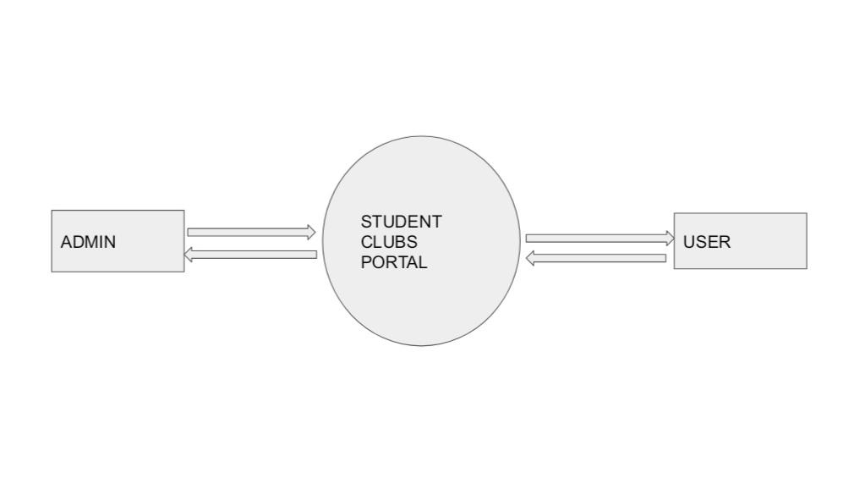
DATA FLOW DIAGRAM (ZERO LEVEL DFD)

Slide 15
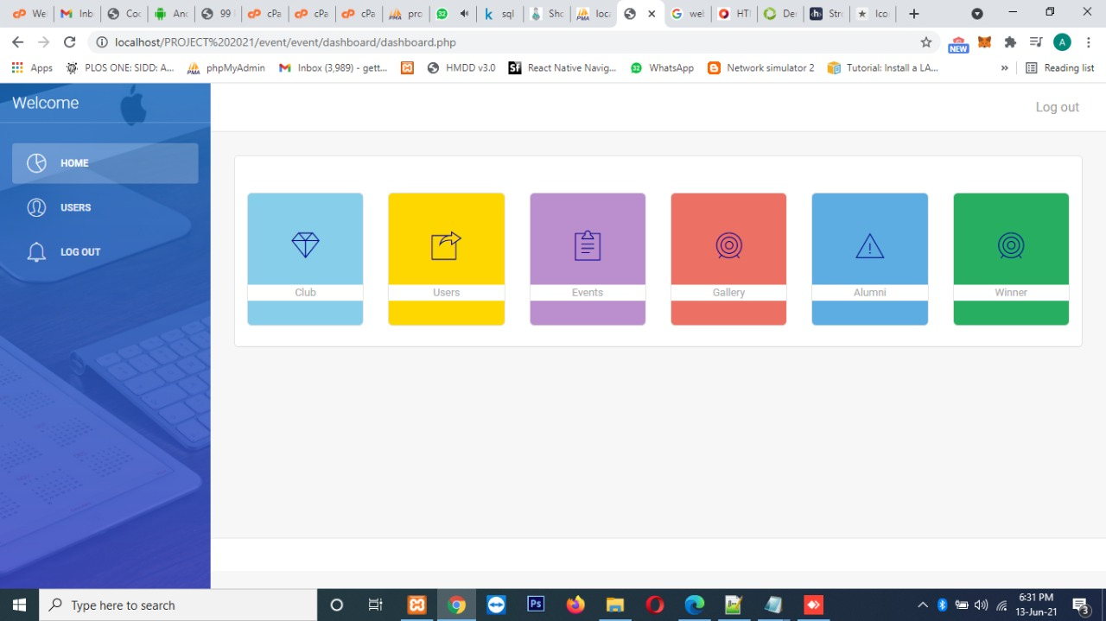
GRAPHICAL USER INTERFACE(GUI)
MKKKKKK
IN THIS USER INTERFACE WE CAN SELECT THE FEATURES LIKE CLUB ,USERS,EVENTS,GALLERY,ALUMNI ,WINNER.(for admin and student)

Slide 16
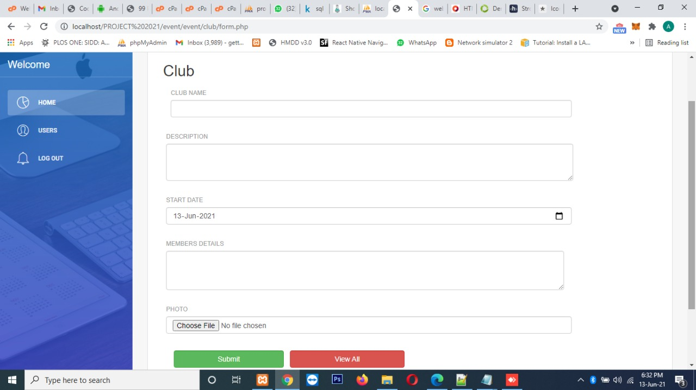
GRAPHICAL USER INTERFACE(GUI)- ADD A CLUB

Slide 17
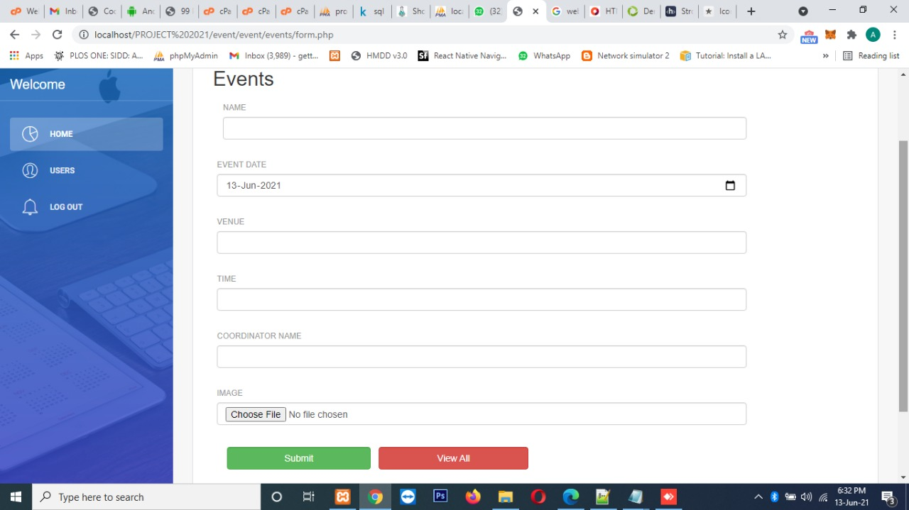
GRAPHICAL USER INTERFACE(GUI)-CREATE AN EVENT

Slide 18
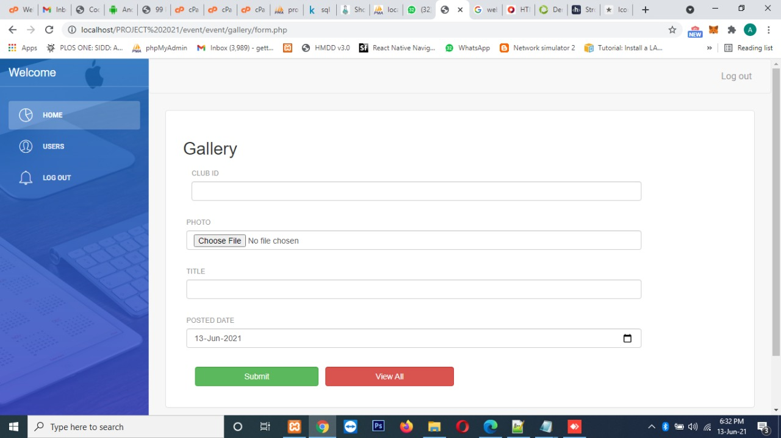
GRAPHICAL USER INTERFACE(GUI) -UPLOAD IMAGES IN THE GALLERY

Slide 19
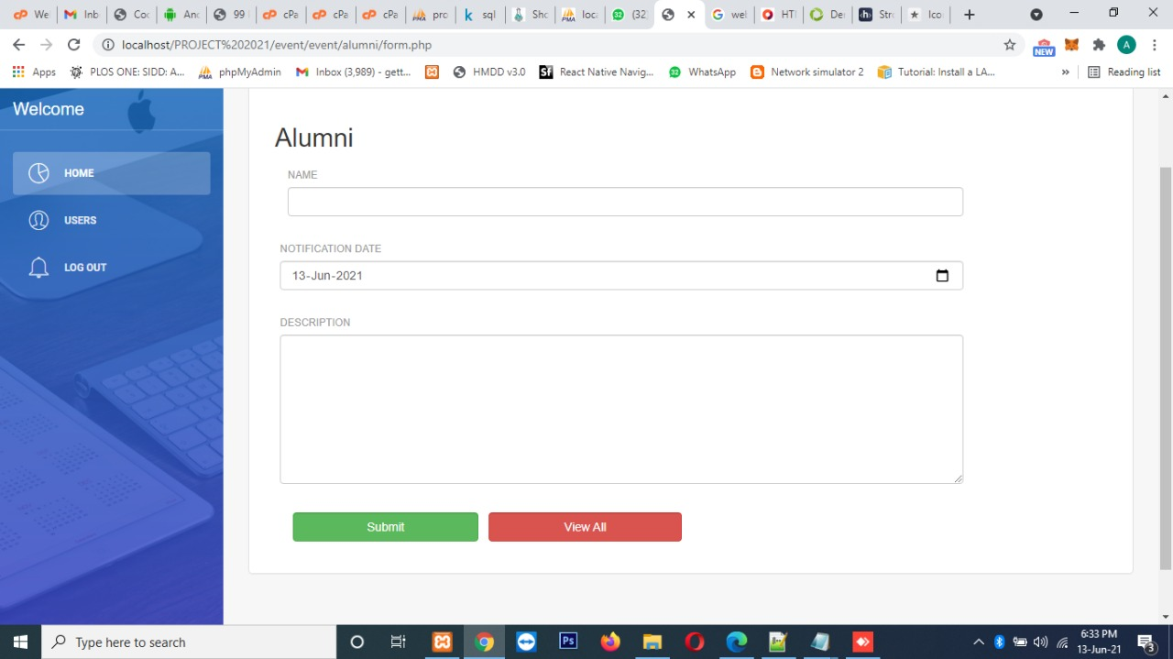
GRAPHICAL USER INTERFACE(GUI)-ADD ALUMNI DETAILS

Slide 20
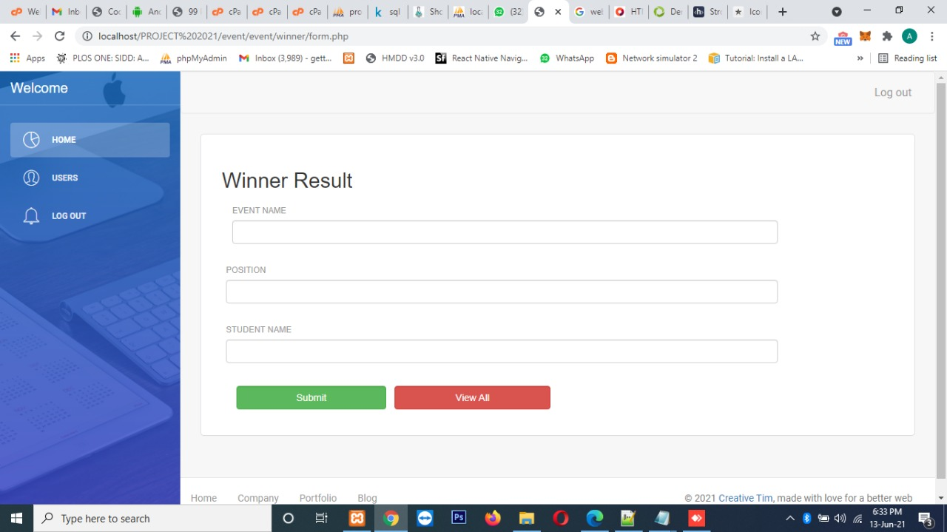
GRAPHICAL USER INTERFACE(GUI)-ANNOUNCE WINNER

Slide 21
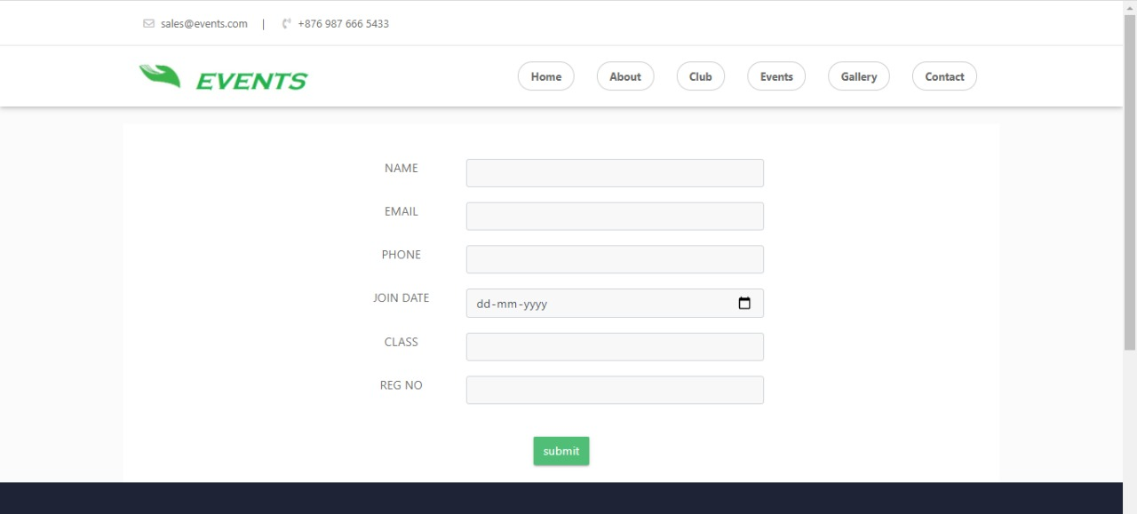
GRAPHICAL USER INTERFACE(GUI)-STUDENT JOIN IN A CLUB

Slide 22
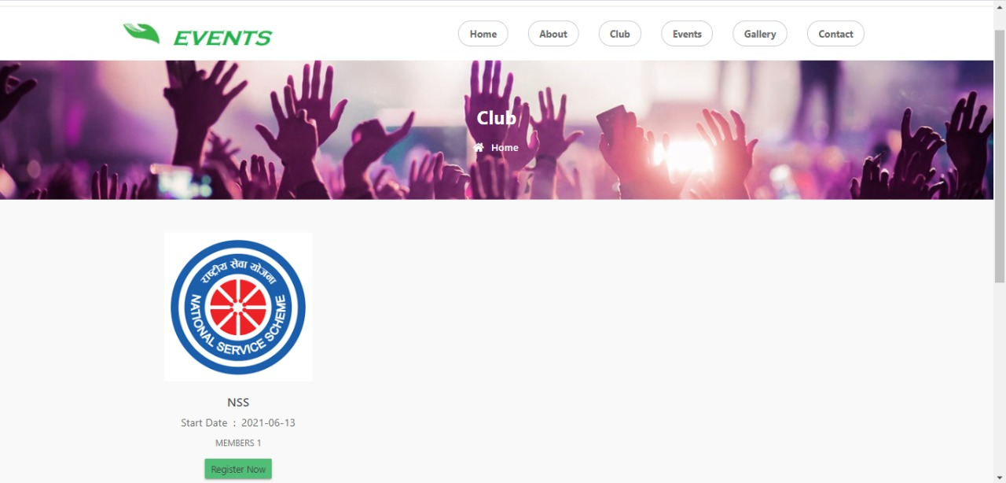
GRAPHICAL USER INTERFACE(GUI)-JOIN IN AN EVEVT

Slide 23
FUTURE SCOPE
This project can be used in the clubs in outside the college.
The data can be easily access in the future.
Add new features that is needed in the future.

Slide 24
REFERENCES
Learning PHP, MySQL, JavaScript, CSS & HTML5: A Step-by-Step Guide to Creating Dynamic Websites.
https://www.tutorialspoint.com/php/index.htm
https://www.w3schools.com/php/DEFAULT.asp
https://www.coursera.org/learn/cloud-computing-basics

Slide 25
THANK YOU

