Slide 1

Dynamics, Mechanisms, and Surrogate Modelling,
of
Noise from a Leading Edge Slat
Laboratoire de Mécanique des Fluides et d'Acoustique - UMR 5509
PhD Defense:
Amal Roy Murali*
Supervisors:
Marc C Jacob
Vincent Clair
Michel Roger
Jury:
Florian Guiho
Anita Schulz
Benjamin Cotté
Florent Margnat
Emmanuel Lévêque
6th June 2025

Slide 2
Outline
ECL Thesis – Started on December 15th 2021
Themes:
Aero-acoustic Surrogate Modelling
Coupling Aeroacoustic simulations with Bayesian Active Learning
Slat noise investigation using LBM - ProLB
Parametric simulations, Cove vortex behaviour
Structure of the talk
Introduction
ProLB: LBM-LES for slat aeroacoustics
Noise computation and validation
Some new interesting features of cove flow dynamics
Conclusions on the noise mechanism

Slide 3

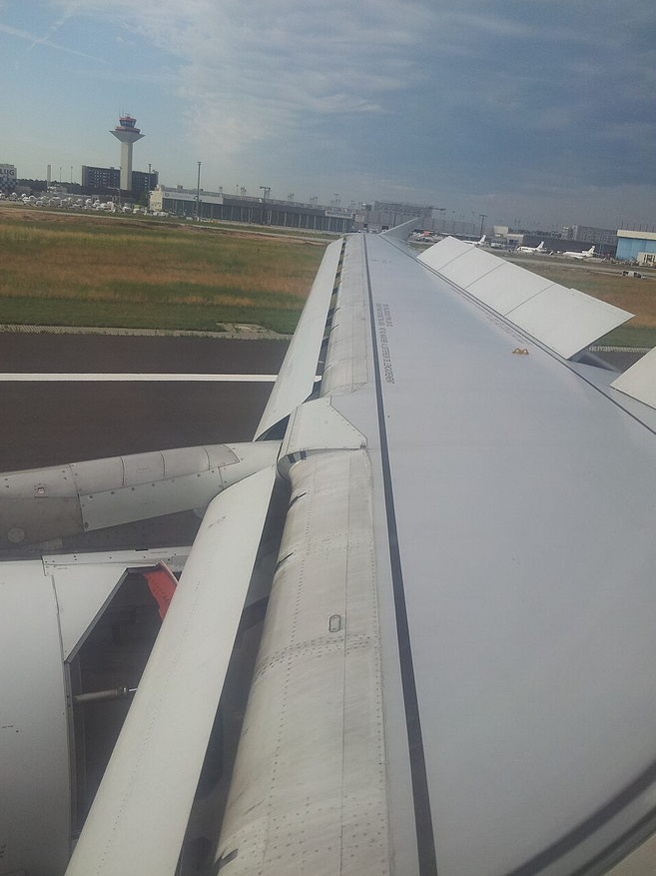
Introduction
A319 with LE slat deployed before landing
Slat device in an Airbus A319
S/N: 1

Slide 4
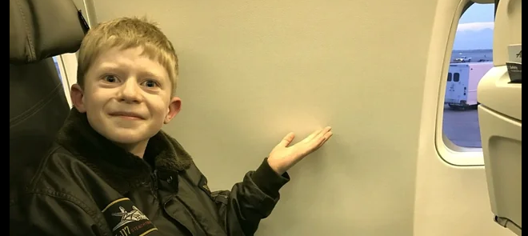
Introduction
A319 with LE slat deployed before landing
Slat device in an Airbus A319
S/N: 1

Slide 5
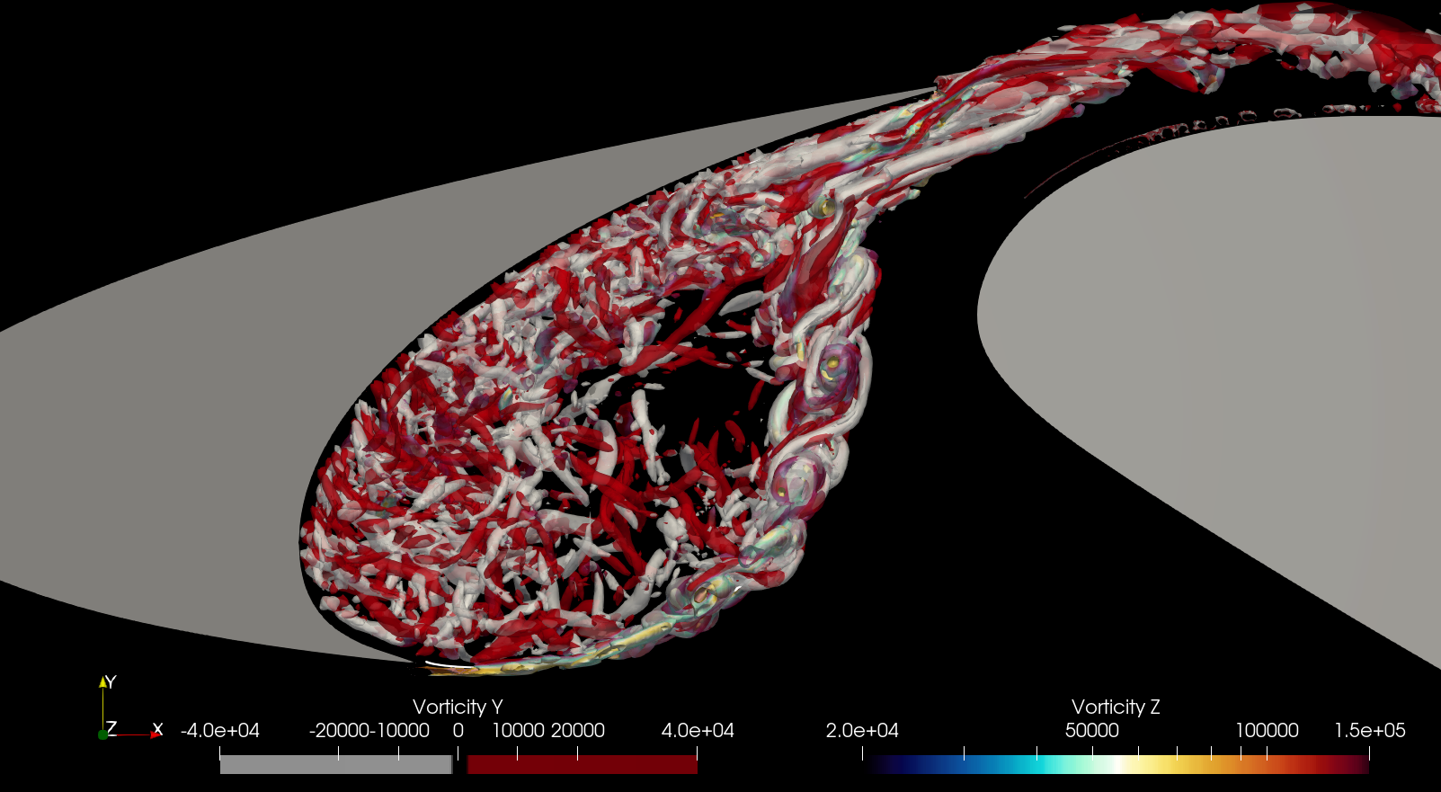
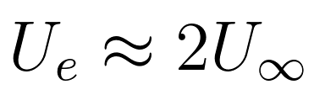
Introduction
Main flow features:
Turbulence ejection
High speed ejection
Spanwise + Streamwise vorticity
Quasiperiodic
1
Above: Vortices in a slat cove visualised using ProLB simulation
S/N: 3

Slide 6
Introduction
Main flow features:
Turbulence ejection
Recirculation
Closed loop vortex
St_{Cs} = 0.15
St_{peaks} = 0.8 – 4.0
1
2
Above: Vortices in a slat cove visualised using ProLB simulation
S/N: 3

Slide 7
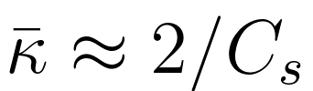
Introduction
Main flow features:
Turbulence ejection
Recirculation
Curved, Accelerated, Free Shear Layer
Curvature (Mean)
1
Cs
2
K
3
Above: Vortices in a slat cove visualised using ProLB simulation
S/N: 3

Slide 8
Introduction
Main flow features:
Turbulence ejection
Recirculation
Curved accelerated Free
Shear Layer
Spanwise to streamwise vorticity transfer
1
4
2
3
Two novel hypotheses
a) Due to curvature
b) Due to acceleration
(Prof. M C Medeiros, Brazil)
S/N: 3

Slide 9
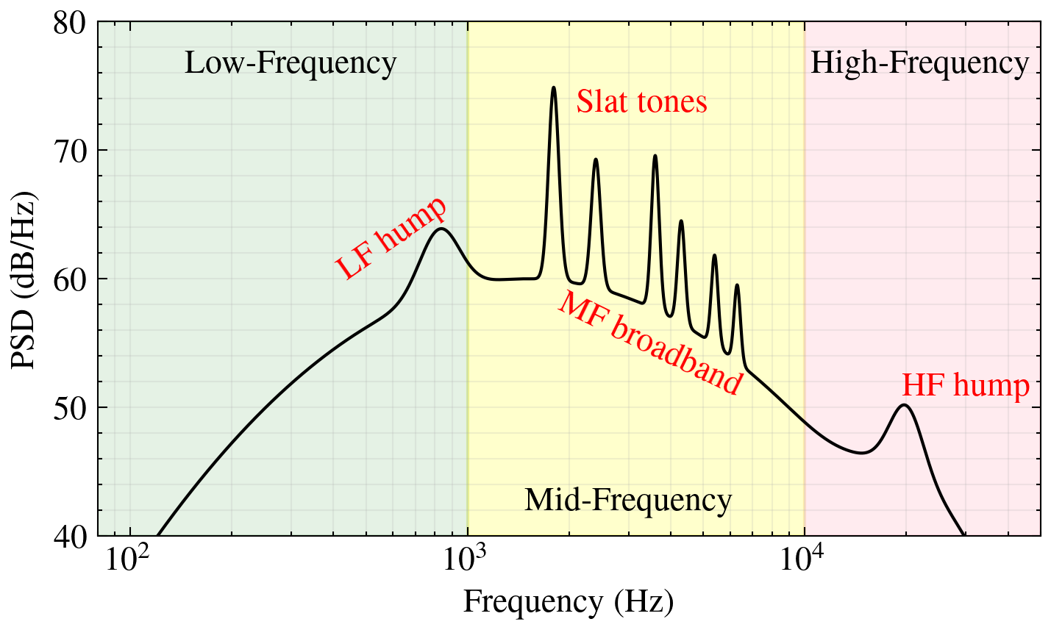
Introduction
Main flow features:
Turbulence ejection
Recirculation
Curved accelerated Free
Shear Layer
Spanwise to streamwise vorticity transfer
1
4
2
3
1
Noise Sources:
Broadband – Turbulence ejection
Tonal – Rossiter modes – Aeroacoustic Resonance
S/N: 3

Slide 10
Introduction
Main flow features:
Turbulence ejection
Recirculation
Curved accelerated Free
Shear Layer
Spanwise to streamwise vorticity transfer
1
4
2
3
Resonance
Noise Sources:
Broadband – Turbulence ejection
Tonal – Rossiter modes – Aeroacoustic Resonance
1
S/N: 3

Slide 11
Introduction
Main flow features:
Turbulence ejection
Recirculation
Curved accelerated Free
Shear Layer
Spanwise to streamwise vorticity transfer
Noise Sources:
Tonal – Rossiter modes
Broadband
1
4
2
3
Above: Vortices in a slat cove visualised using ProLB simulation
S/N: 3

Slide 12
Theme 1
Aero-Acoustic Surrogate Modelling
ProLB (LBM)
Ffowcs Williams-Hawkings
Gaussian Process Regression
}
CAA
- ML

Slide 13

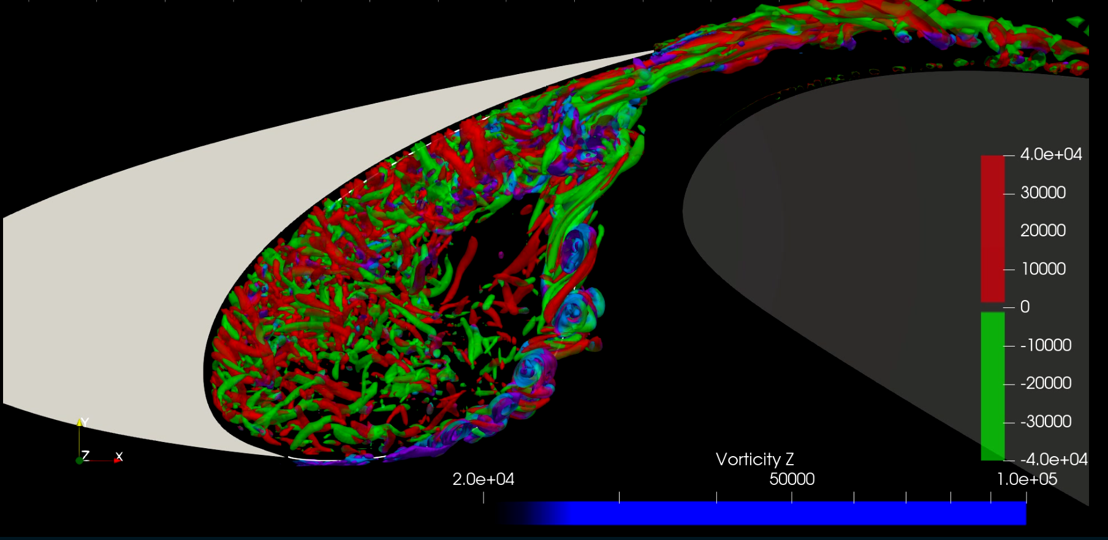

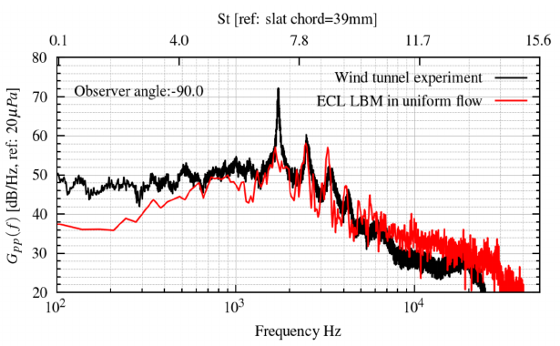

LBM - CAA Framework
1
ProLB enables unsteady 3D LBM-LES (SISM)
Low dissipation for CAA
Immersed Boundary Method enables rapid parameterisation
Data Recording
FWH
TurbAc’An
2
FWH approach for noise computation using TurbAc’An
Far-field noise validated
against experiment
S/N: 4

Slide 14
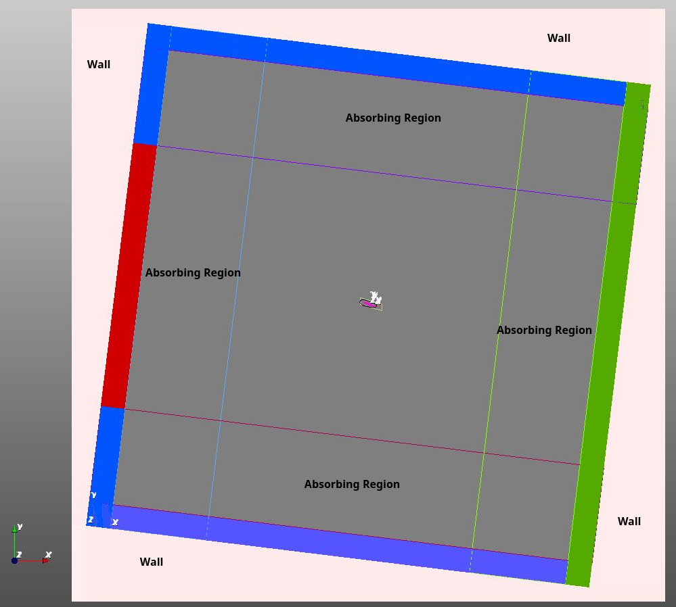
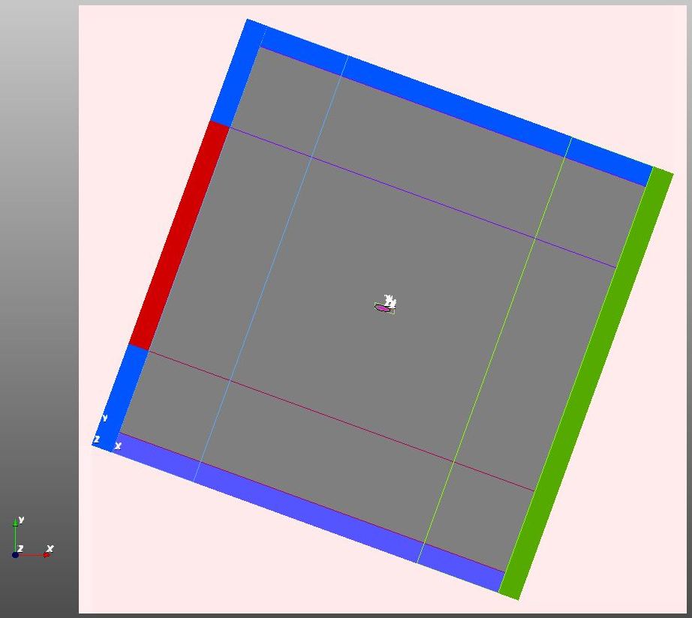
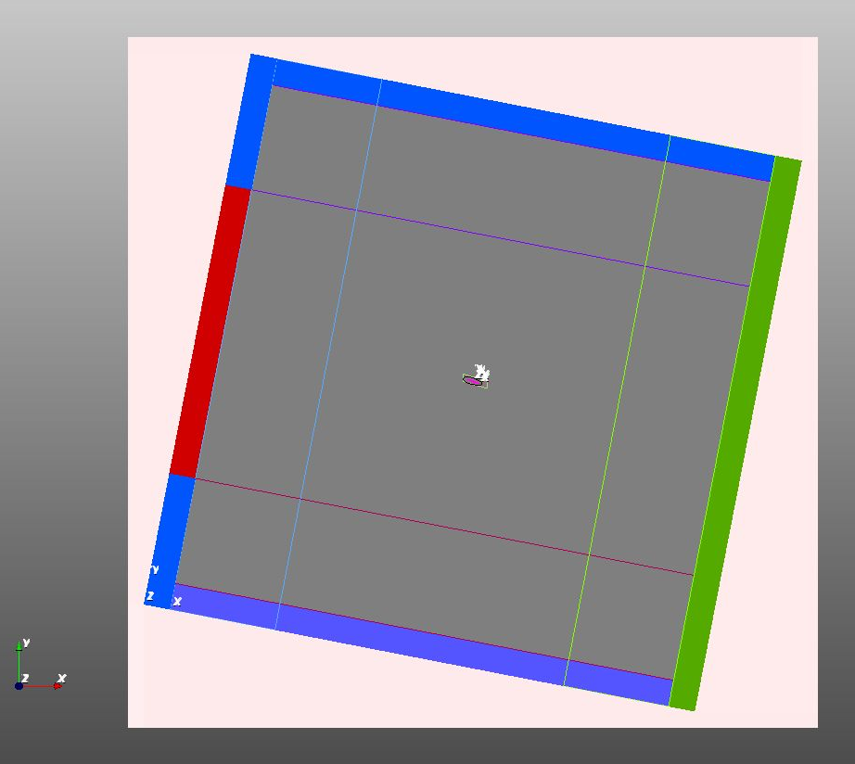
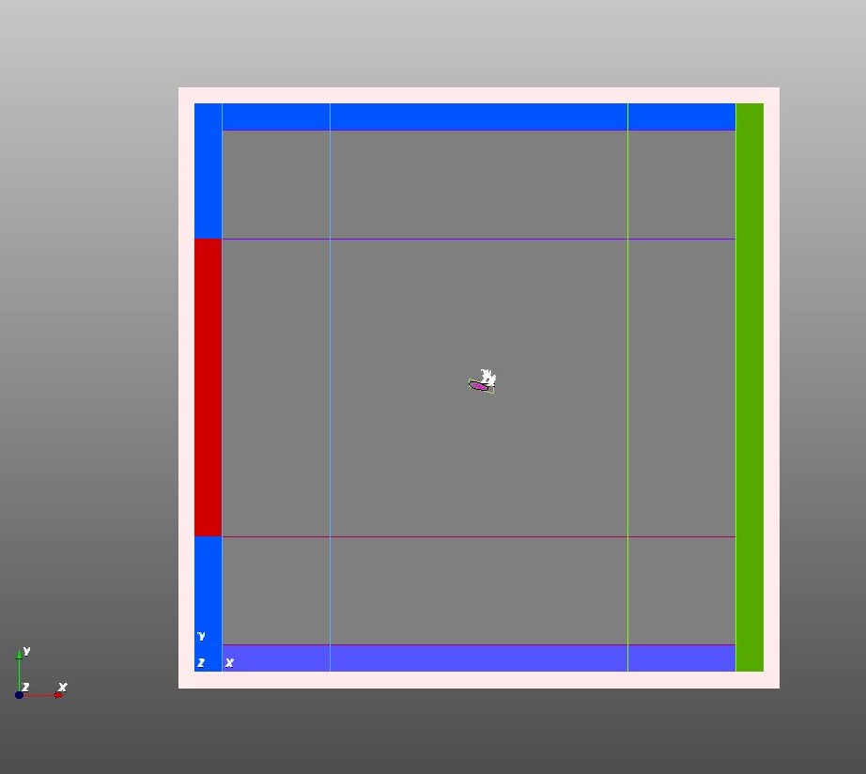
ProLB LBM – In Detail
Pressure = 1atm
No Mesh
No Mesh
Spanwise periodic
30C x 30C domain
BCs with non-reflecting conditions
HLD mesh static
(domain rotated to vary AOA) – compatibility between simulation/postprocessing
Immersed boundary method enable hands free meshing
Absorbing region
Pressure = 1atm
Inlet U=50m/s
Pressure = 1atm
No Mesh
No Mesh
Rotating domain with static HLD
S/N: 5

Slide 15

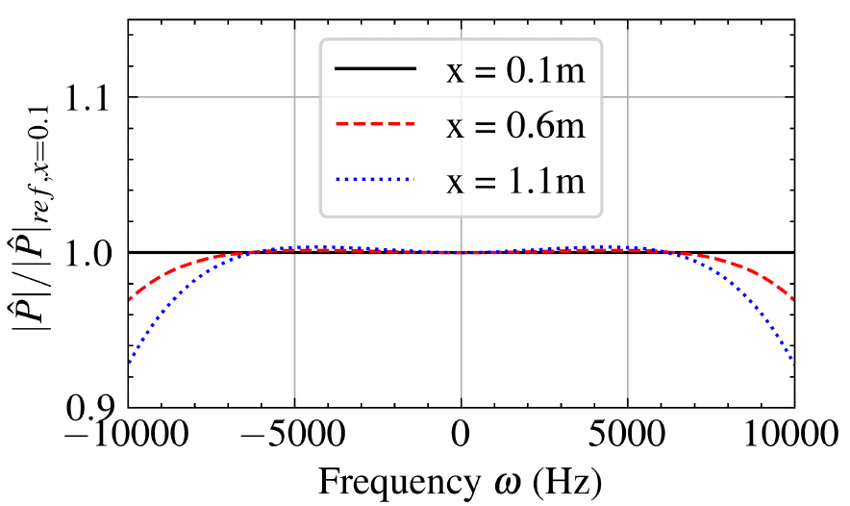
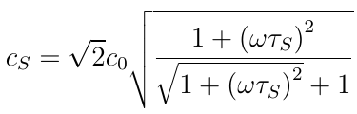
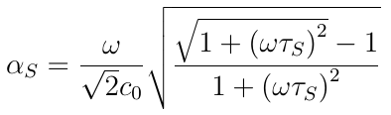



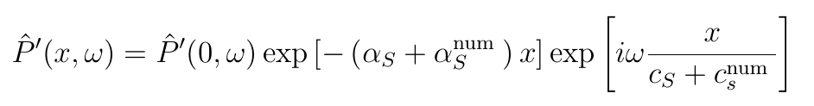
Focus : LBM-Details
Mesh criteria for acoustics
Classical test used to obtain mesh critera for acoustics (Bres et al. 2018)
Linearised adiabatic NS system
Wave form
NL Dispersion relation
Assuming complex wavenumber and real frequency
Fourier transforms at varying locations allow dispersion and dissipation testing
FWH propagation region
S/N: 6

Slide 16
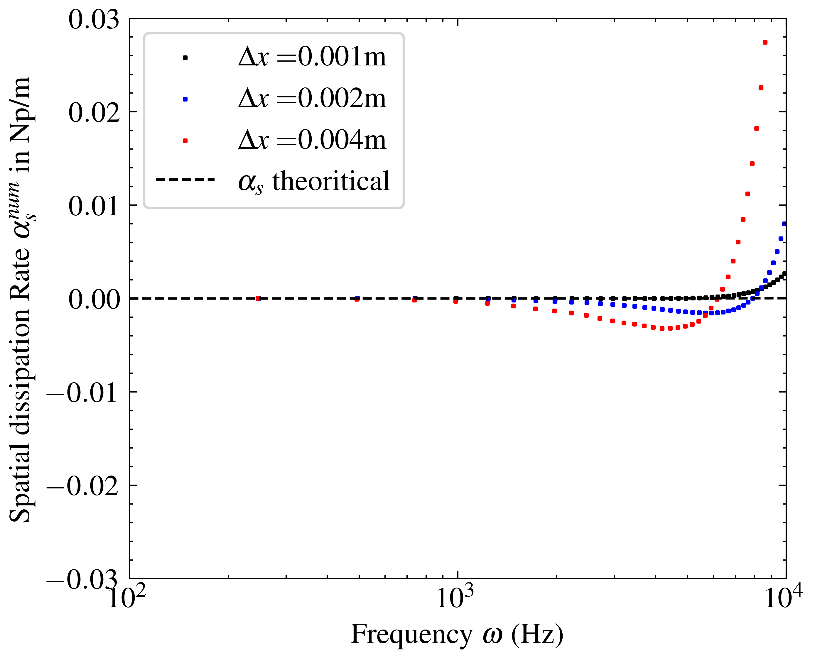
Focus : LBM-Details
Empirical data used to finalise requirements for CAA
17PPW at 10kHz provides <0.1dB/m of loss of a linear acoustic pulse
Linear acoustic wave dissipation rate in ProLB
– Murali et al. 2022
S/N: 7

Slide 17
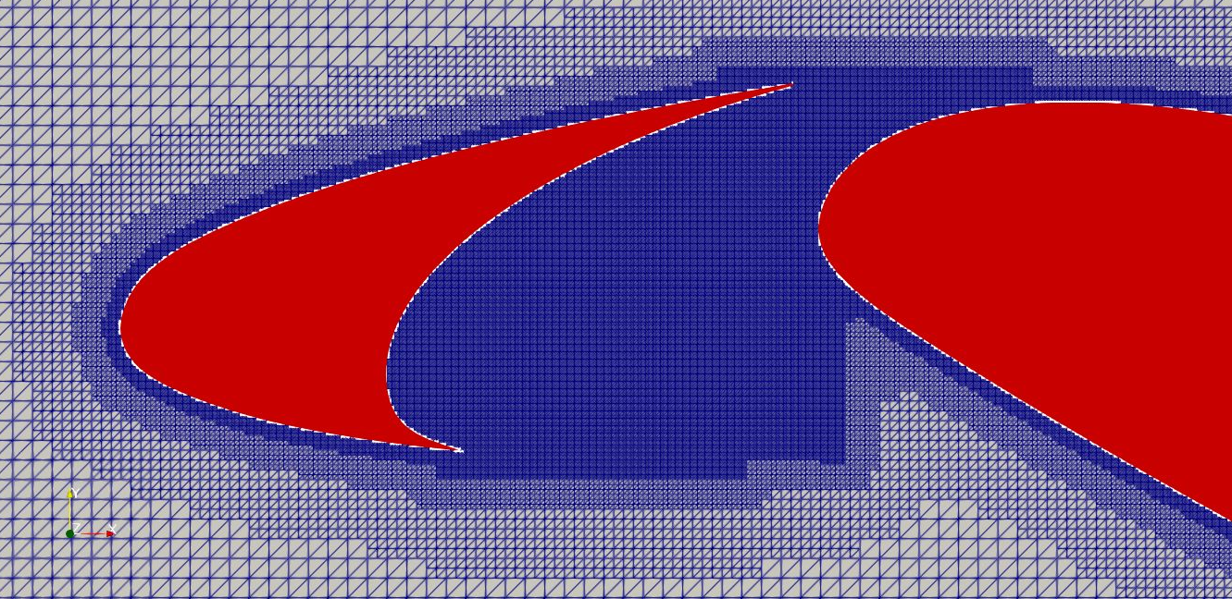
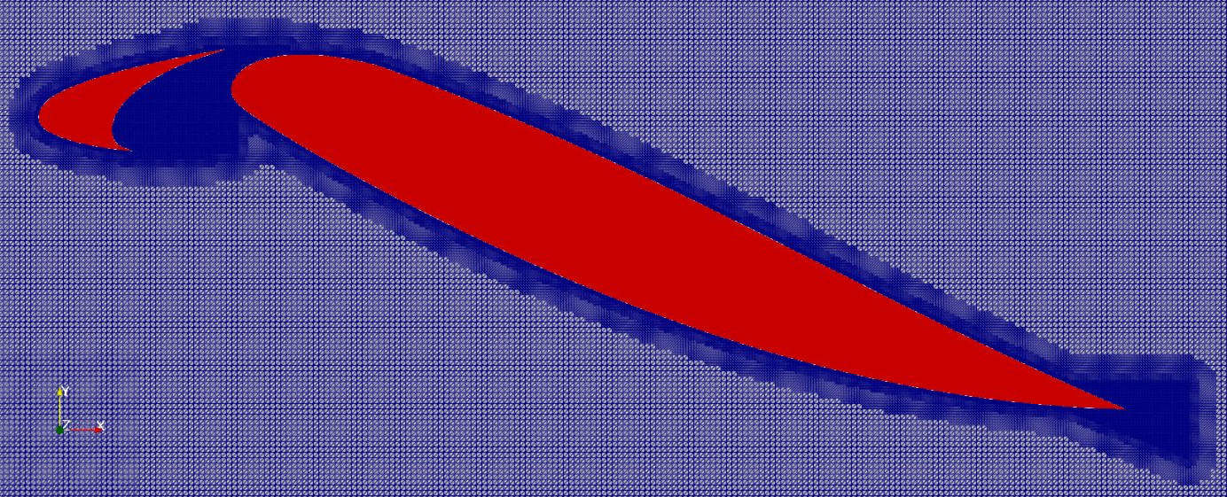
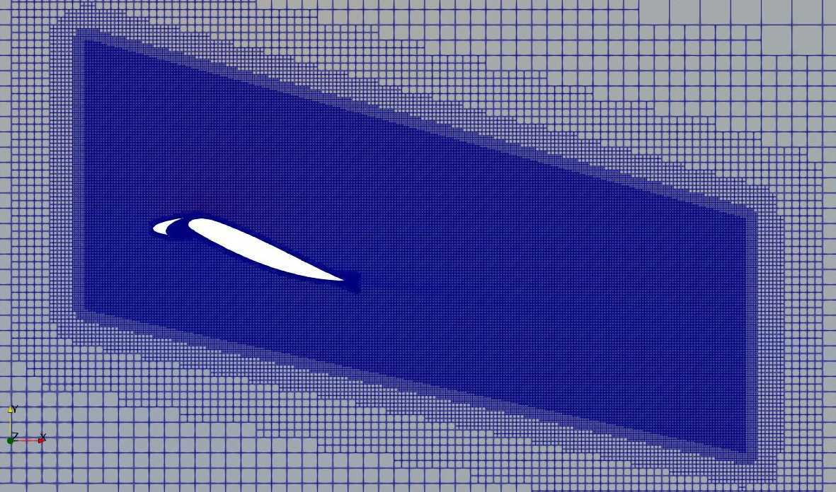
Focus : LBM-Details
Empirical data used to finalise requirements for CAA
17PPW at 10kHz provides <0.1dB/m of loss of a linear acoustic pulse
Wall y+ of 35 at 0.2mm at Ref. Lvl. 1
Cove region
Around the HLD
Linear acoustic wave dissipation rate in ProLB
– Murali et al. 2022
FWH propagation region
S/N: 7

Slide 18
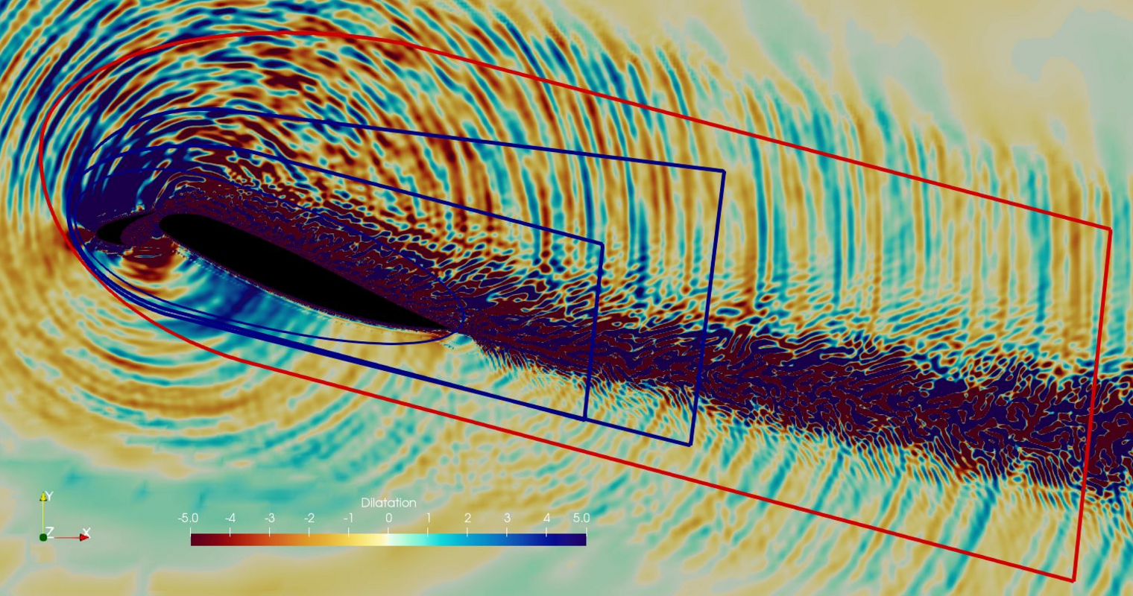
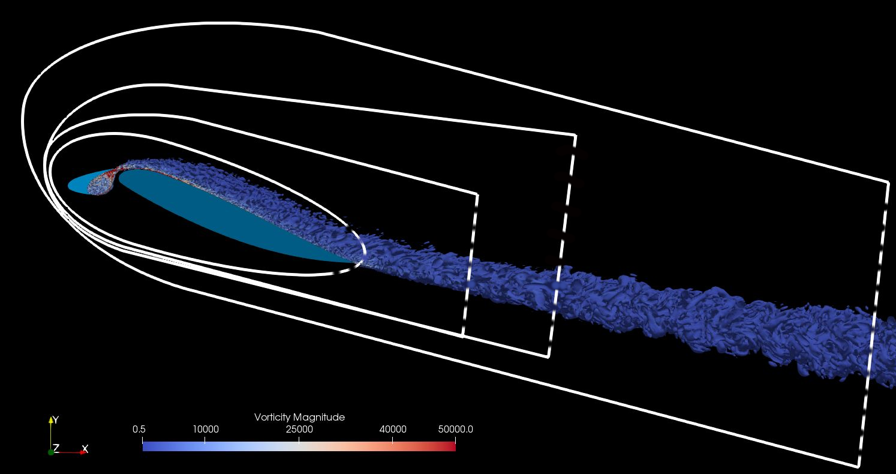
FWH Surface placement
Dilatation field and FWH surfaces
Q-crit vortices and FWH surfaces
FWH surface needs to be placed outside region of turbulence
4 surface tested and farthest surface was chosen for parametric simulation
Requires good resolution (17PPW) until the FWH surface
Computed farfield spectra against experiment ~ Murali et al. 2022
S/N: 8

Slide 19
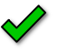
FWH Surface placement
Dilatation field and FWH surfaces
Q-crit vortices and FWH surfaces
FWH surface needs to be placed outside region of turbulence
4 surface tested and farthest surface was chosen for parametric simulation
Requires good resolution (17PPW) until the FWH surface
Computed farfield spectra against experiment ~ Murali et al. 2022
S/N: 9

Slide 20
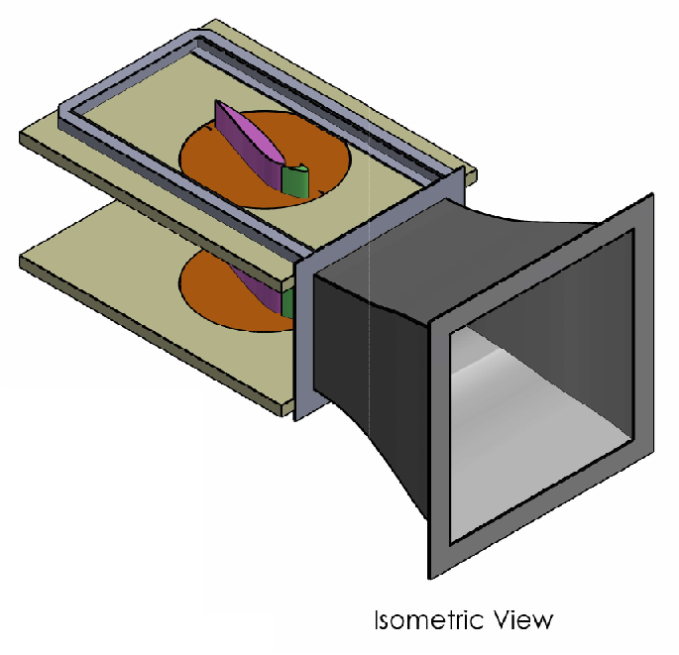
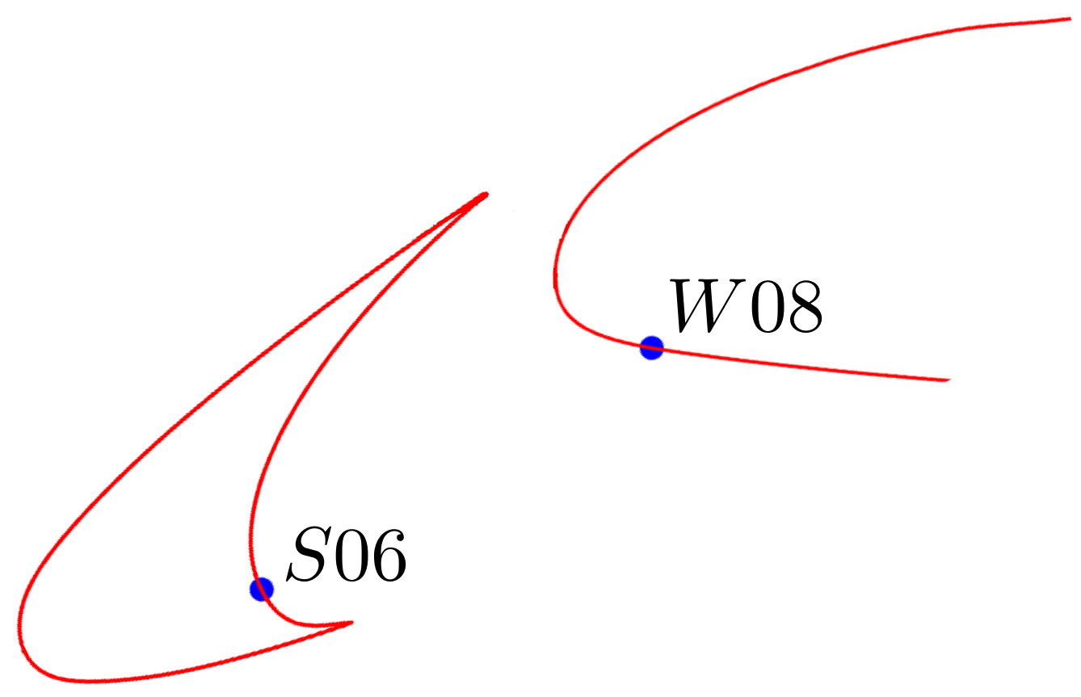
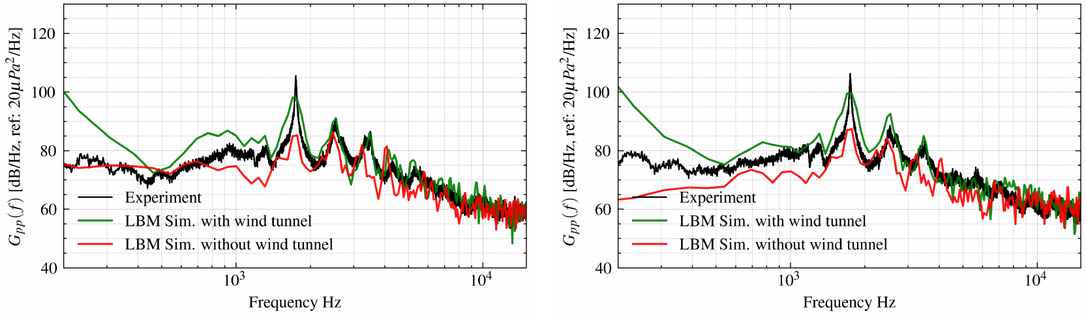
Presence of Wind Tunnel
Wind tunnel has lateral sidewalls
Spectra differences are due to flow physics and numerical issue!
S/N: 10

Slide 21
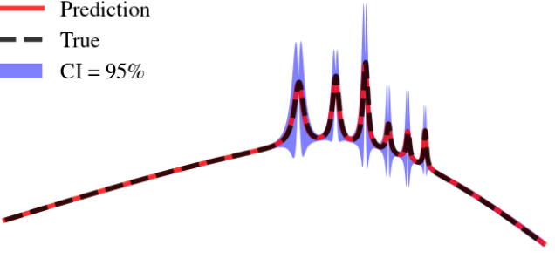
Bayesian Active Learning
for
Noise spectra

Slide 22
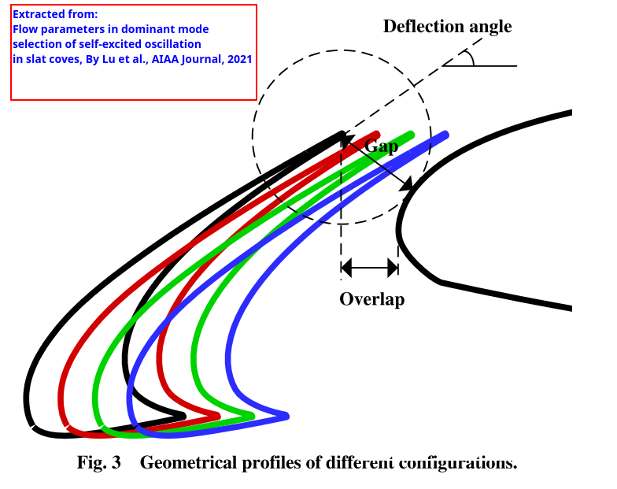
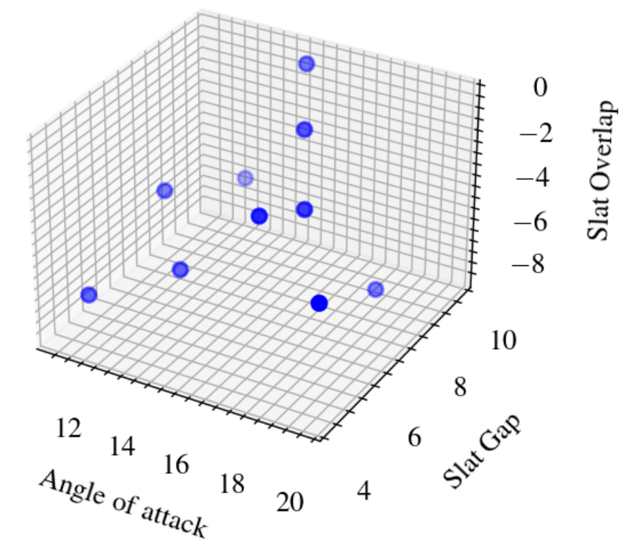
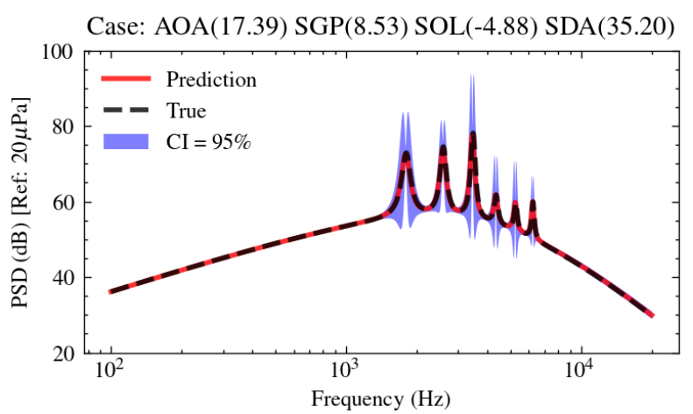


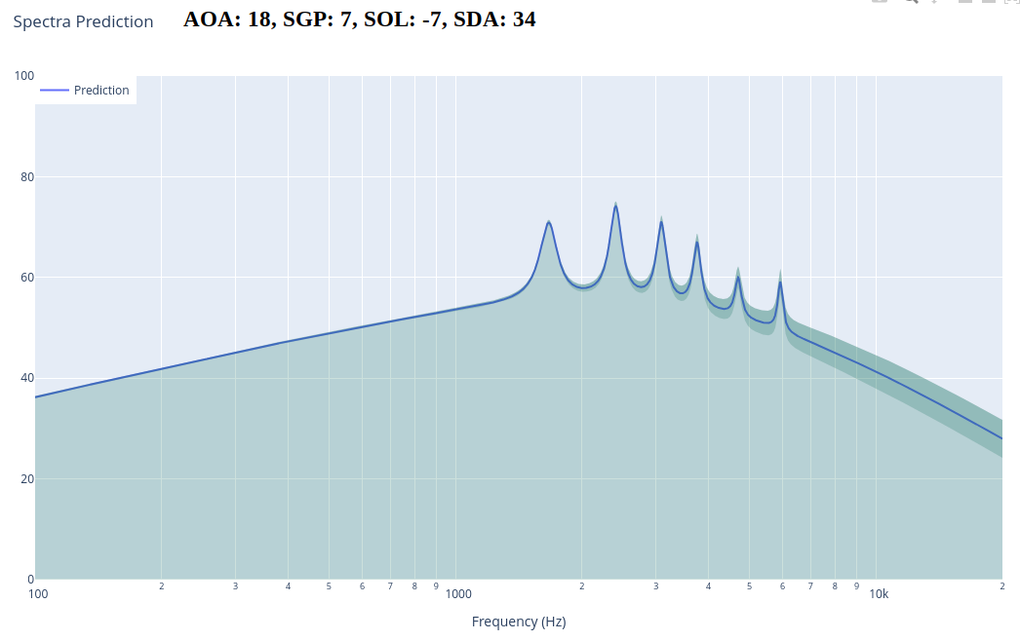
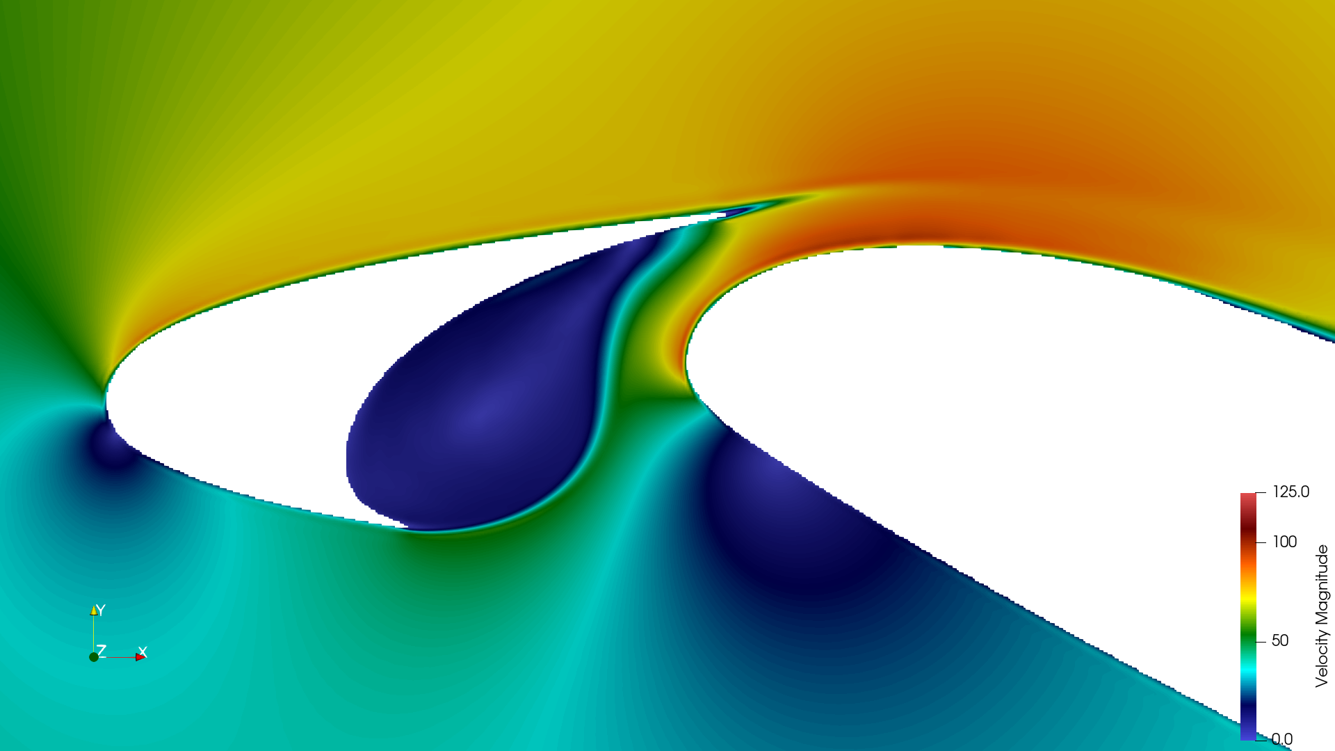
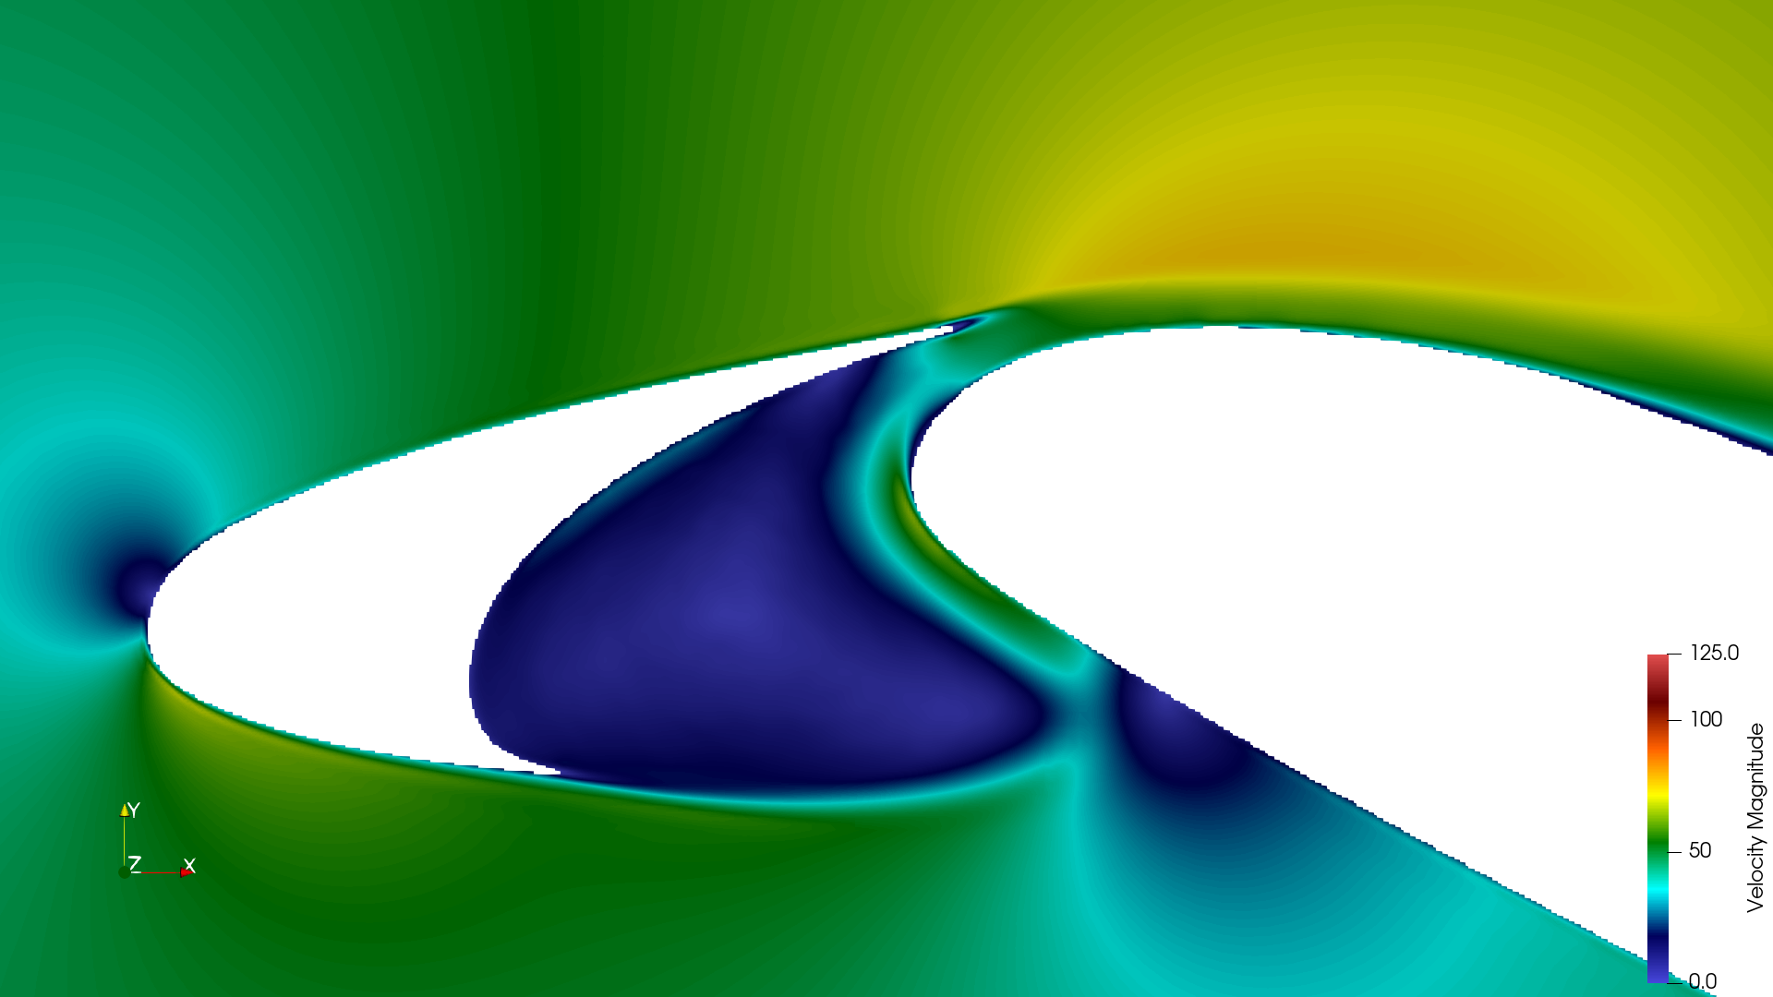
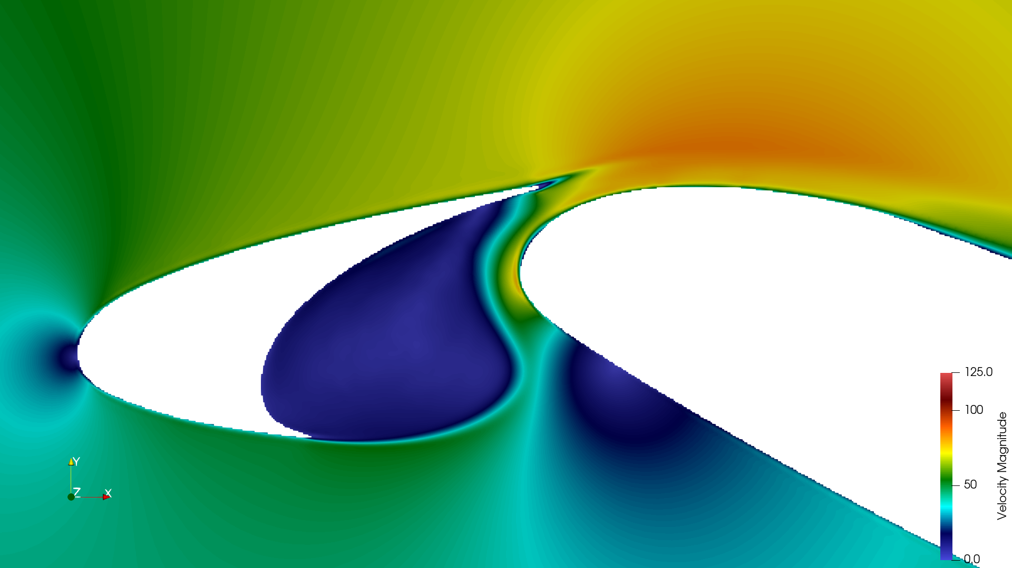
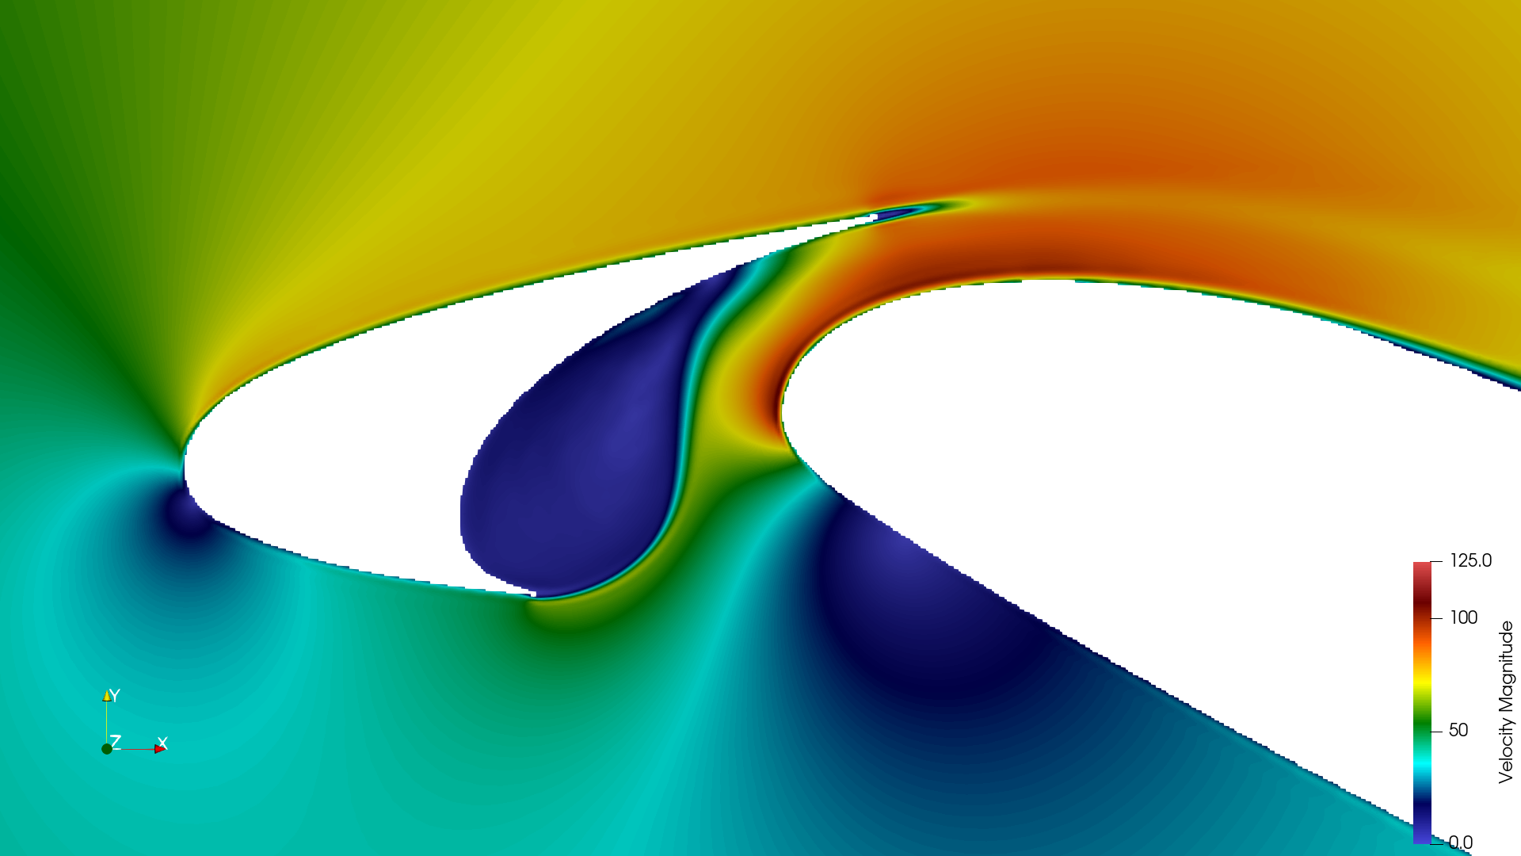
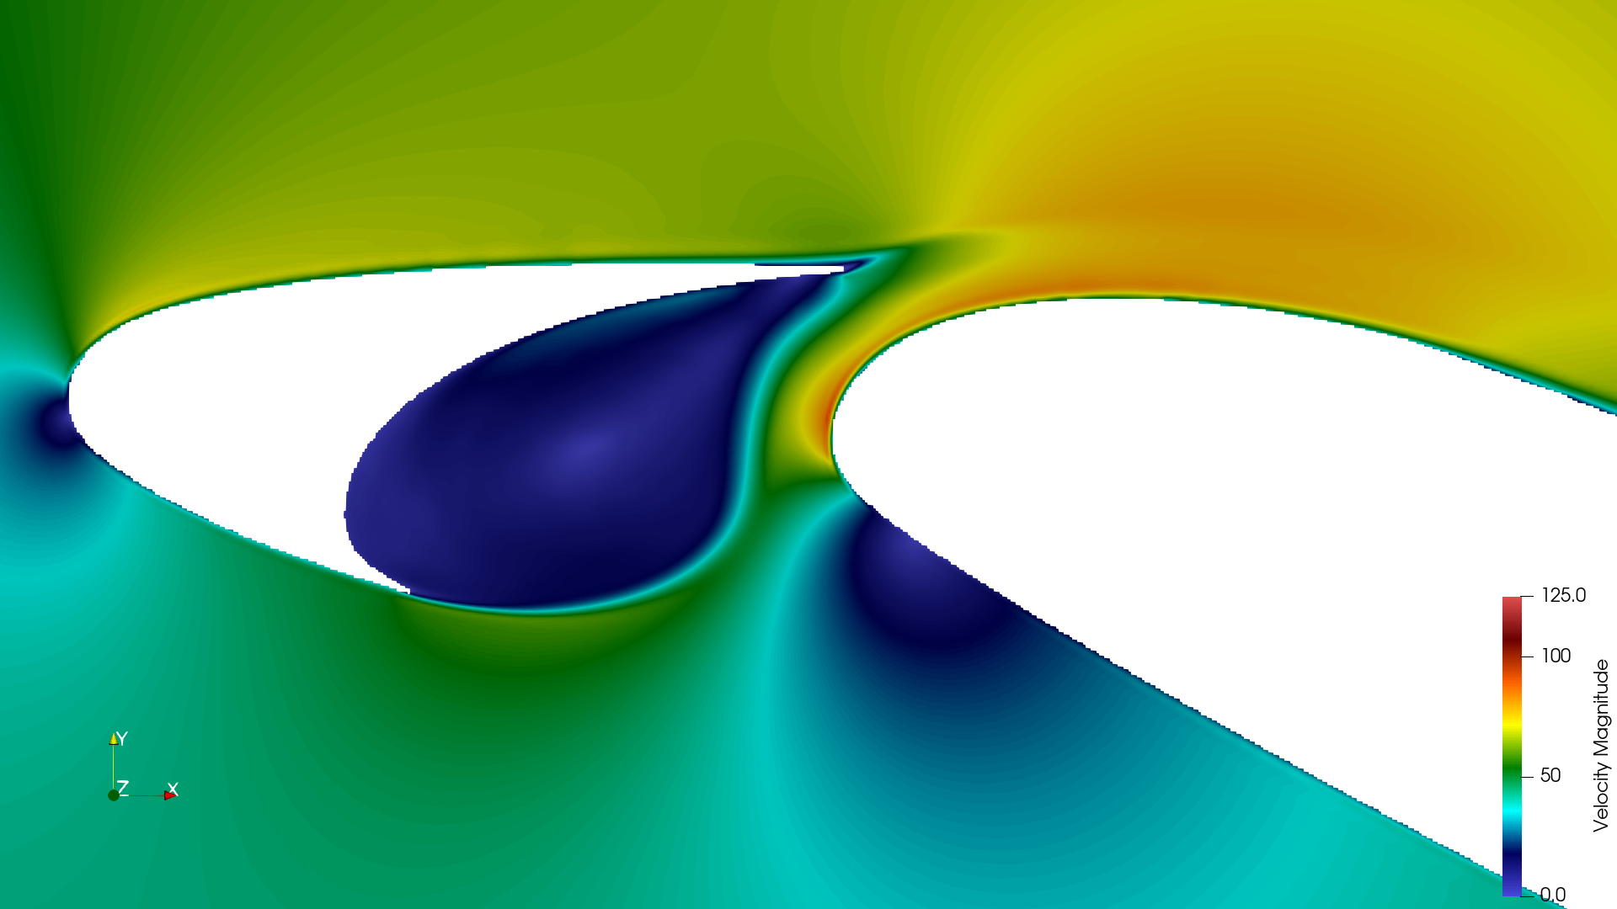
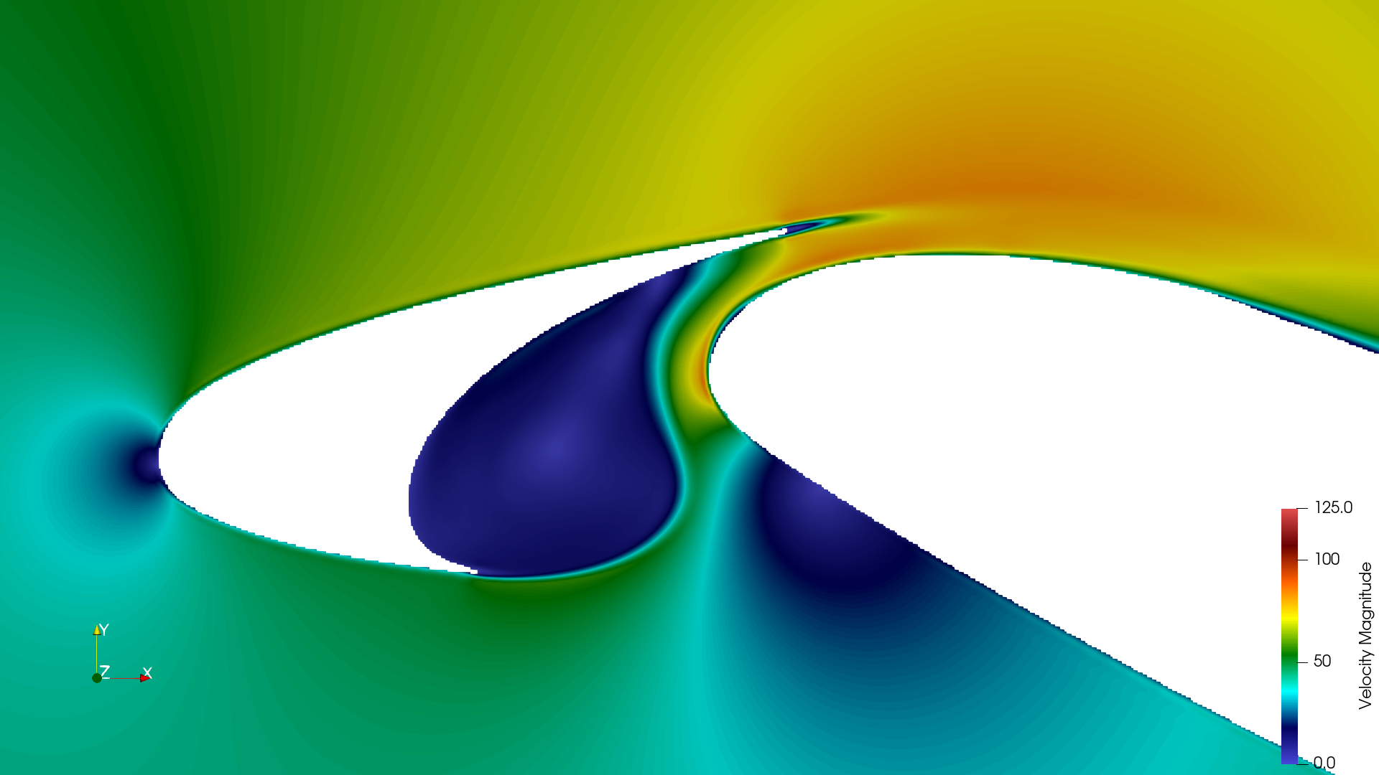
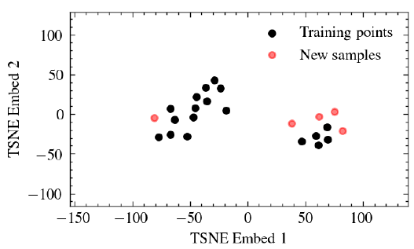
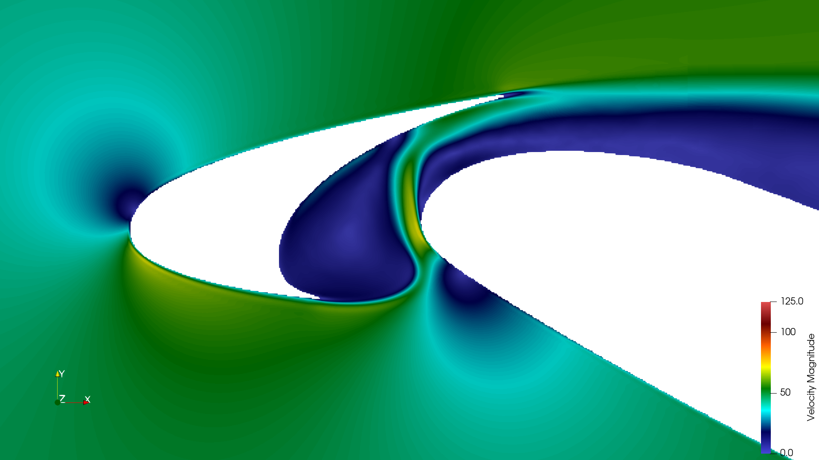
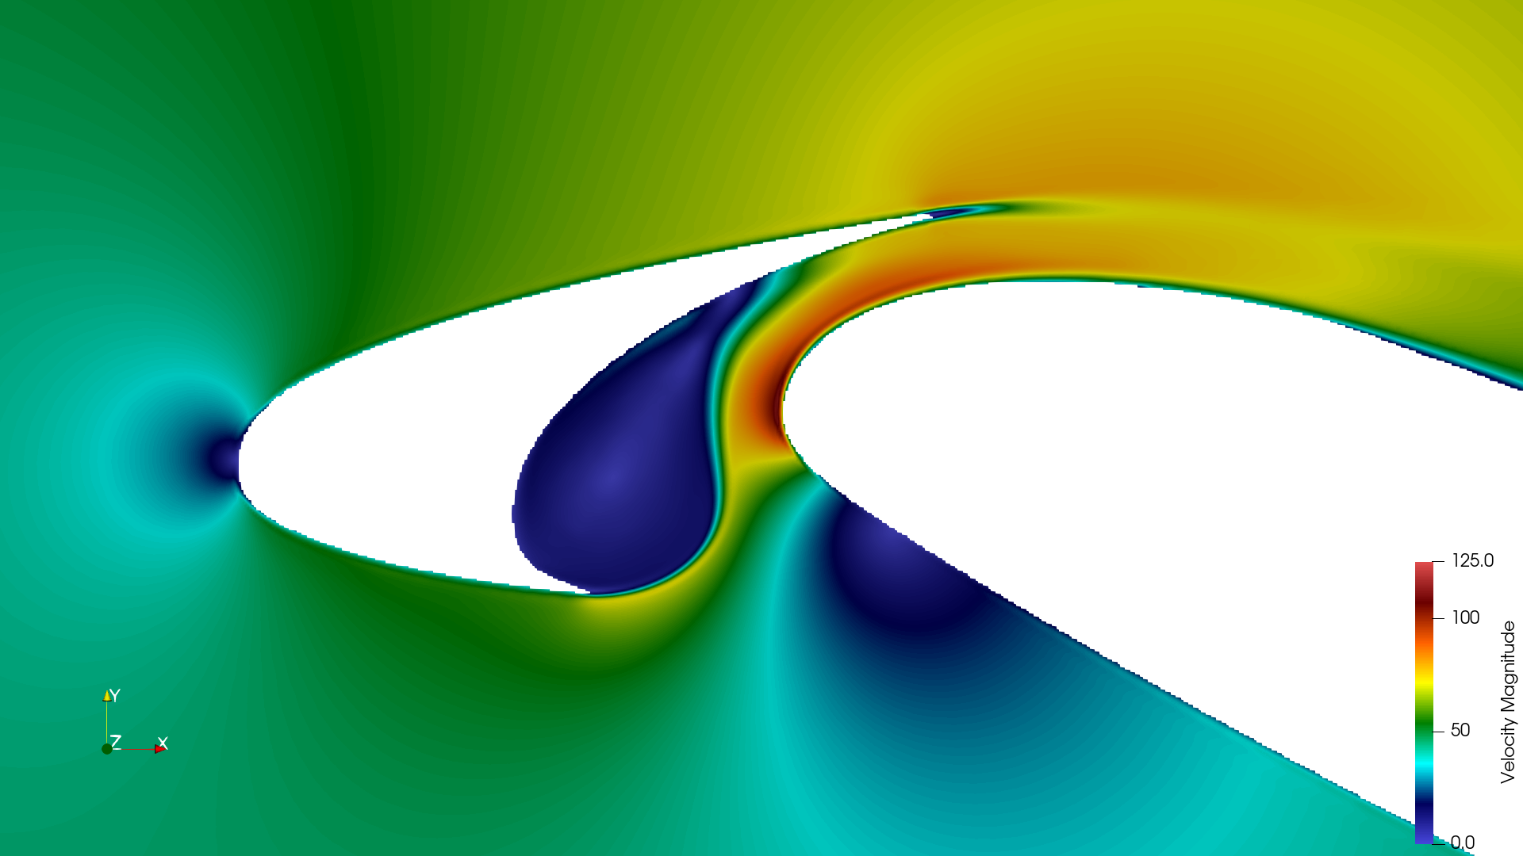
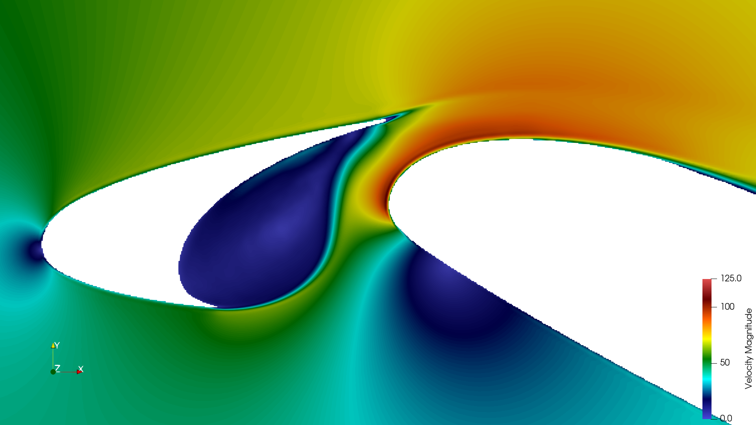
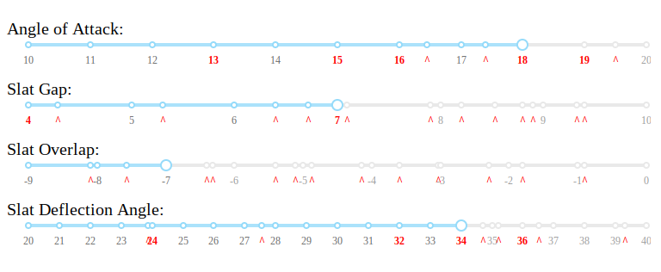
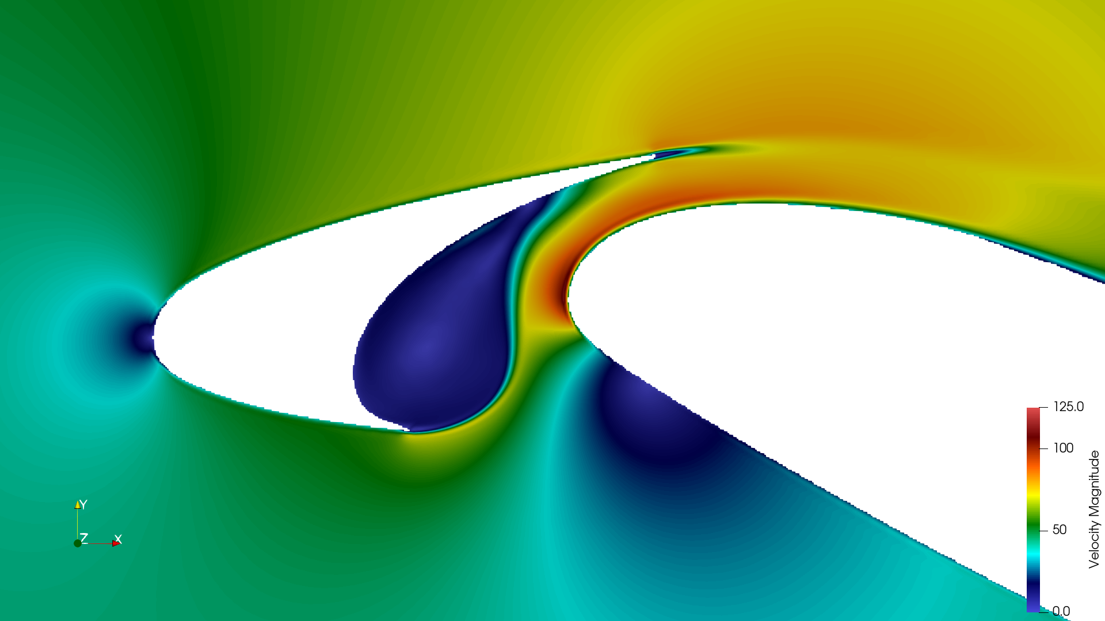
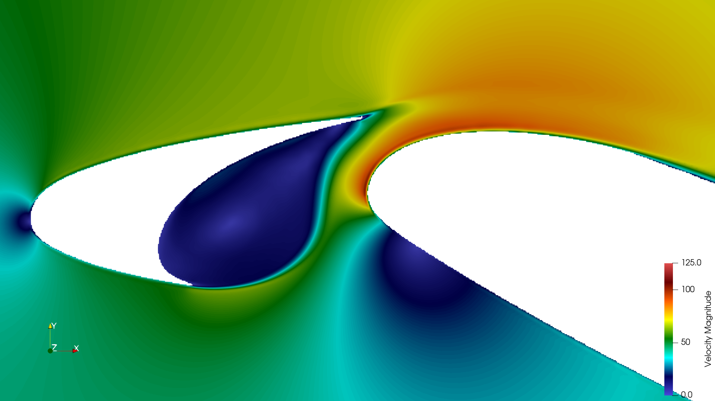
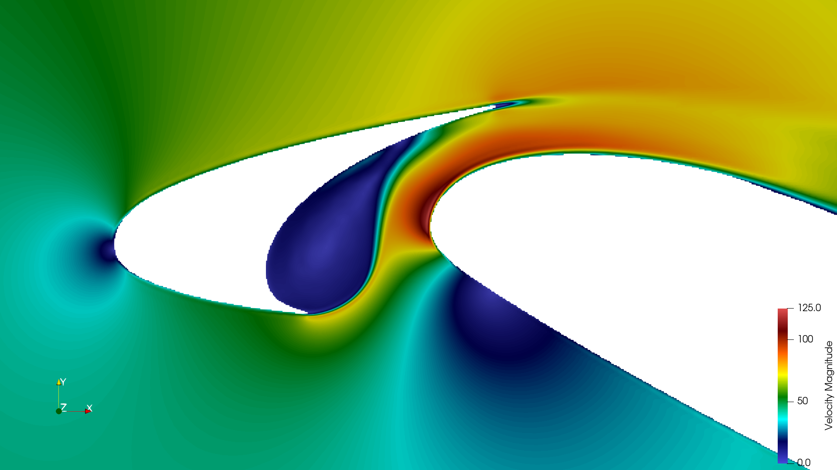
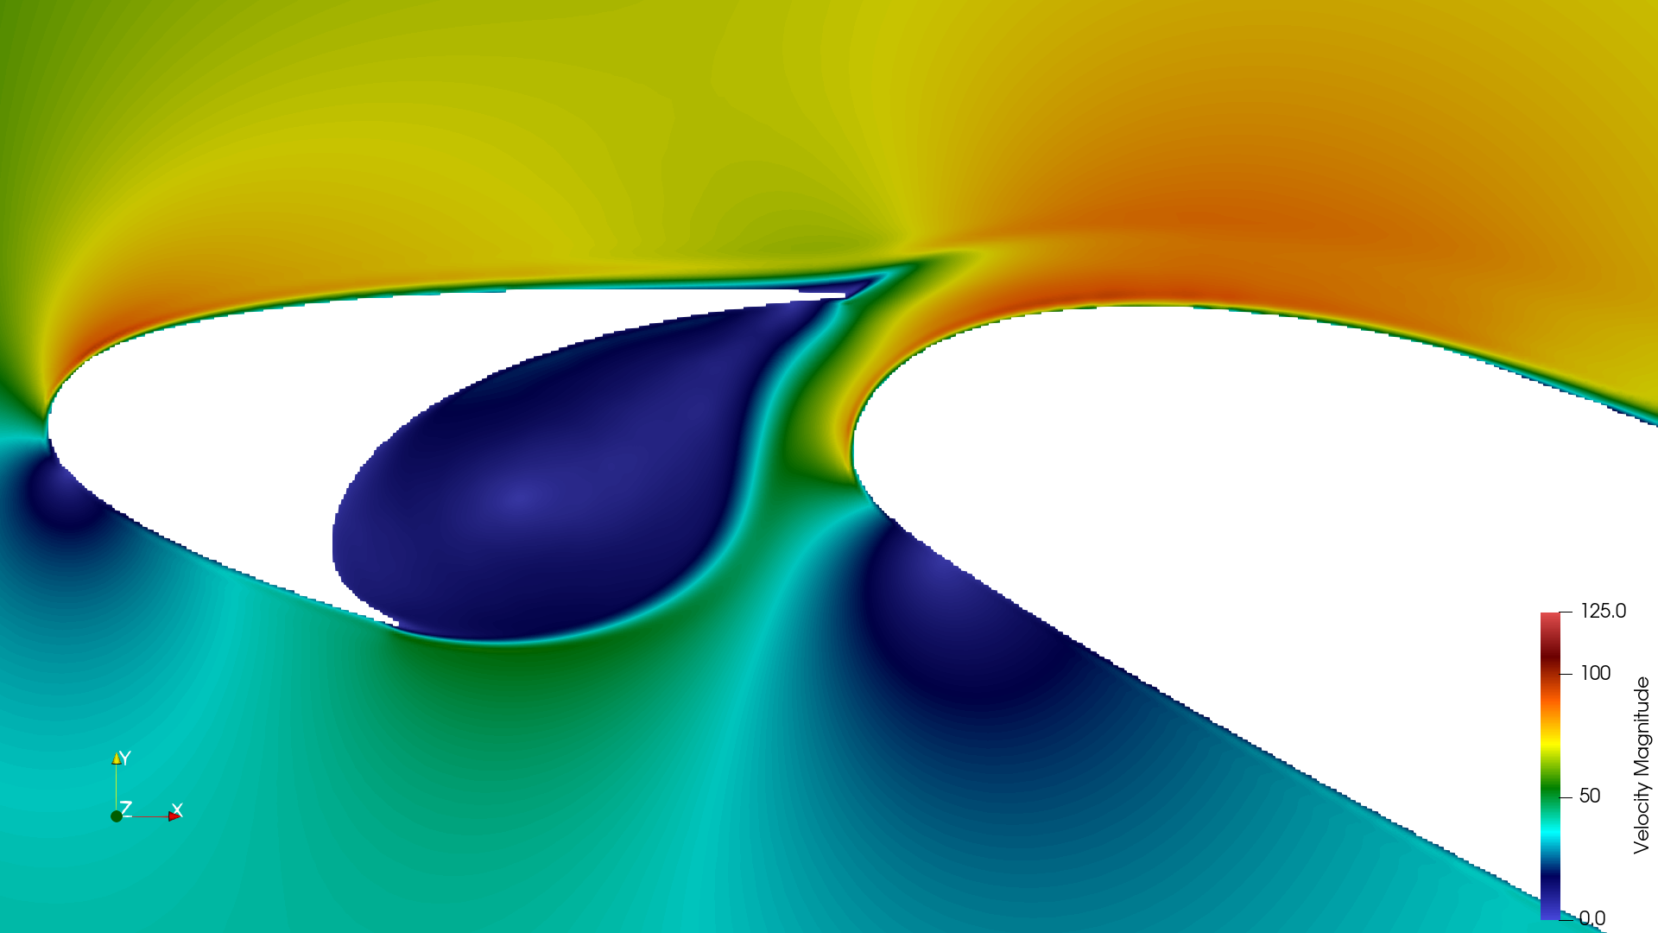
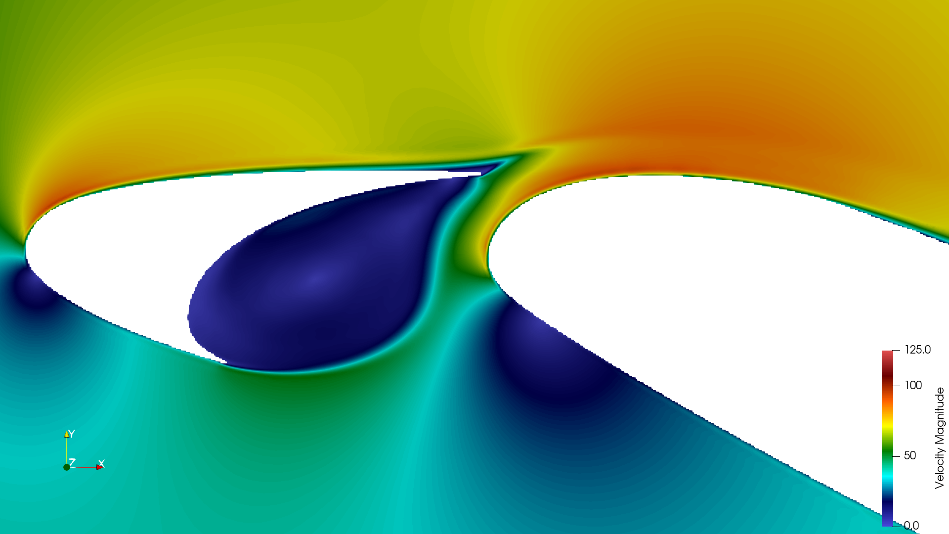
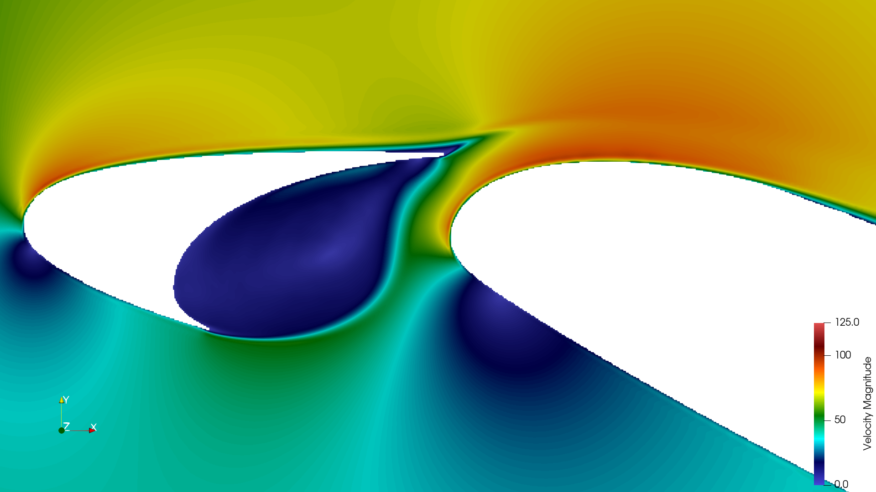
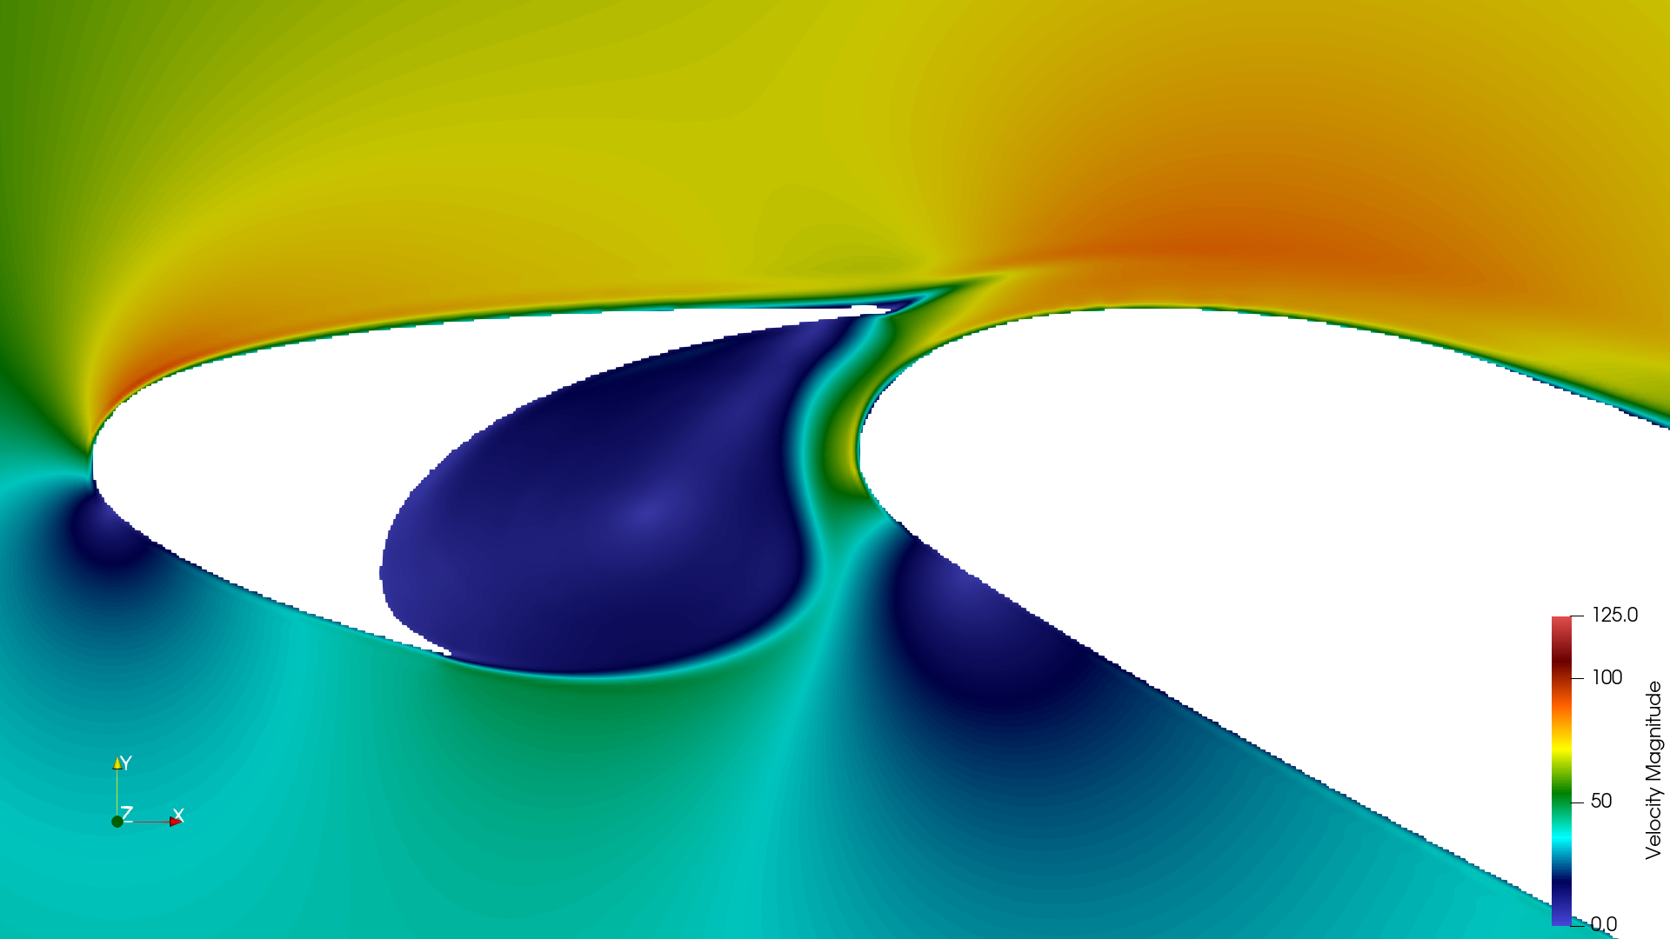
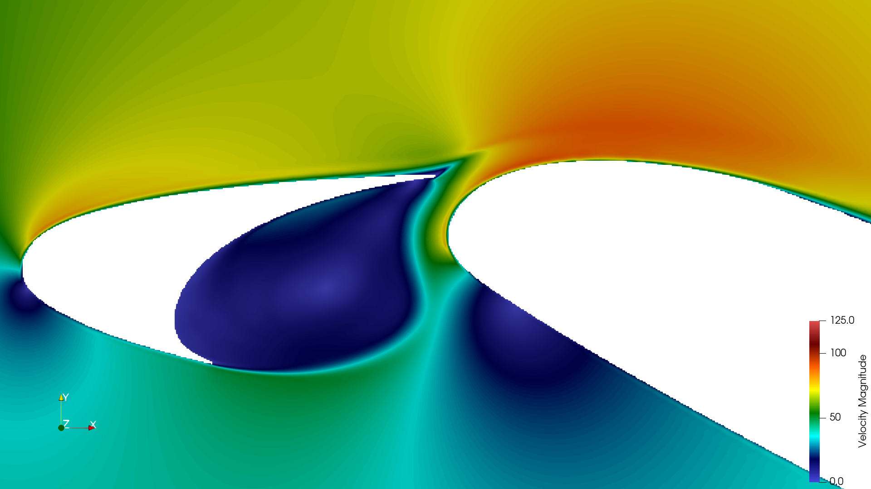




Bayesian Active Learning
Initial sample
Surrogate model for noise spectra and uncertainities
Geometry parameters 4D
TurbAc’An
Stochastic sampling
(UCB)
Domain monitoring dashboard
Dataset – Flow & Noise Spectra
Stochastic Sampling around noisy
configuration

Slide 23
Bayesian Active Learning
Initial sample
Surrogate model for noise spectra and uncertainities
Geometry parameters 4D
TurbAc’An
Stochastic sampling
(UCB)
Active Learning Loop
Domain monitoring dashboard
Dataset – Flow & Noise Spectra
Stochastic Sampling around noisy
configuration

Slide 24



Bayesian Active Learning
Feature Extraction
Extract BB shape using Guo’s shape function
Extract tonal peaks as Lorentians
Total parameters per spectra: 17 variables
Procedure
Fit Guo’s shape function by least squares
(limit domain to 1000 to 7000Hz)
Locate peaks by deviation from Shape function
Assume : peaks frequencies are unrelated
(peak interaction and modulation not accounted in Souza’s model)
Fit peak amplitudes using least squares
S/N: 12

Slide 25



Bayesian Active Learning
Bayesian Regression enables
4-D slat positional coordinates
to
17-D representation of spectra
Figure: Maximum coefficient of variation
Good fit for 17 variables in dataset
S/N: 13

Slide 26




Varying slat position
Slat position varied to investigate the spectra
Key observations
Shear layer shape and exit velocity are the major features
Noise most sensitive to slat gap
Standard slat position
– is nearly the most noisy
– most effective configuration for lift perfomance (suction peak)
S/N: 14

Slide 27
Theme 2
Slat Cove Dynamics

Slide 28




Spanwise Velocity Cells
Case 11
Case 5
Case 22, most noisy
Strong three dimensionality noticed in the spanwise mean velocity field
Not directly linked to the generation of tones but can modulate them
Case 29
S/N: 15

Slide 29
Strong three-dimensionality
Spanwise velocity disribution inside the slat cove showing well arranged cell formation
S/N: 16

Slide 30



Strong three dimensionality
Slat cove dynamics develop spanwise modulation of the mean pressure and velocity
A1
B1
Leads to generation of converging and diverging planes
Question: Is it an artifact of spanwise periodic condition ???
A1
B1
S/N: 17

Slide 31




Simulation including the Wind Tunnel
(With Florian Guiho, Airbus )
Wind tunnel simulation geometry with no requirement for spanwise periodic condition
They are NOT artifacts of spanwise BC
Walls affect 80% of the spanwise domain
Cell formation
S/N: 18

Slide 32




Hot wire probes
Probe 24
Probe 0
S/N: 19

Slide 33


Hot wire probes
Probe 14 – Just outside the shear layer
S/N: 20

Slide 34







Spanwise variation of spectra
Probe 24
Inside SL
Probe 20
Slightly inside SL
Probe 17
On the SL
Probe 14
S/N: 8
Slightly outside SL
S/N: 21

Slide 35
Spanwise variation of spectra
Probe 24
Inside SL
Probe 20
Slightly inside SL
Probe 17
On the SL
Probe 14
S/N: 8
Slightly outside SL
S/N: 22

Slide 36
Visualisation
Shear layer bursting at 0.214s, 0.219s, ...
S/N: 23

Slide 37
Visualisation
Shear layer bursting at 0.214s, 0.219s, ...
S/N: 24

Slide 38


Visualisation
Shear layer bursting at 0.214s, 0.219s, ...
Spanwise coherence is broken periodically by “Bursting” of the shear layer
Spanwise coherence periodically broken leads amplitude modulation of Rossiter modes
S/N: 25

Slide 39


Spanwise modulation in Cavity flows are still being explored
Spanwise velocity modulation for flow over a backward facing step
– Barkley 2002
Spanwise velocity modes in a rectangular cavity
– Bres et. al. 2008
Spanwise modulations are suspected to be an effect of the curvature effect although not definitively
Bres et al. showed that spanwise cells have a pulsation at frequency one order of magnitude lower than Rossiter modes
They also modulate Rossiter tones
S/N: 29

Slide 40



Cove Recirculation Frequency
The recirculation time for first streamline loop corresponds tp approx 200 Hz
Consistent across all cases
3D streamline
S/N: 30

Slide 41




Cove Recirculation Frequency
Case 22 – Most noisy case

Slide 42




Cove Recirculation Frequency
Recirculation frequency well defined even when there are no cells

Slide 43
Focus : Unsteady field and the spanrollers
Vorticity Conversion

Slide 44


Vorticity transfer from spanwise to streamwise
S/N: 30

Slide 45




Streamline Curvature
Shear layer distortion leads to quiet configurations and even suppression of tones
– Bradshaw 1969
S/N: 31

Slide 46



Tonal noise level based on Ri_{c}
Curvature Richardson number history can quantitatively suggest the presence of tones
Early curvature inflection leads to destruction of spanwise eddies, hence reduction of tonal noise strength
S/N: 32

Slide 47
Conclusions
A new spanwise mode formation previously undocumented is shown to exist via parametric dataset and is reasoned as driven by the curvature of the shear layer.
A mechanism through which the spanwise modes affect the acoustics is clearly identified
Spanwise to streamwise vorticity conversion is shown to affect the strength of the tones – also an effect of the shear layer curvature
History of curvature richardson number can suggest the strength of Rossiter tones
Future activity
Document the above said arguments and submit thesis
Test if the Strouhal number estimate for low frequency oscillation is generalisable
S/N: 33

Slide 48
Thank you for Listening!

Slide 49

Appendix 1

Slide 50

Absorbing Layer settings
Pressure = 1atm
No Mesh
Spanwise periodic
30C x 30C domain
BCs with non-reflecting conditions
HLD mesh static
(domain rotated to vary AOA) – compatibility between simulation/postprocessing
Immersed boundary method enable hands free meshing
No Mesh
Absorbing region
Pressure = 1atm
Inlet U=50m/s
Pressure = 1atm
No Mesh
No Mesh
S/N: 5

Slide 51


Absorbing Layer
LBM formulation
Analysis of the absorbing layers for the weakly-compressible lattice Boltzmann methods
~ Xu and Sagaut, 2013

Slide 52

Absorbing Layer
LBM formulation
ProLB: A Lattice Boltzmann Solver of Large-Eddy Simulation for Atmospheric Boundary Layer Flows
~ Feng et al., 2021

Slide 53


Jawahar et.al. Experiment at Bristol
Jawahar et. al. used a larger spanwise extend leading to stronger three dimensionality of cove oscillations discovering the low frequency hump and its stochastic nature
Our theory is that this is due to a larger spanwise length (span to chord ratio) leading to a full development of the curvature related pulsation
(Jawahar Re=0.7M, VALIANT Re=1M)
Jawahar et al. – C = 0.35m, S = 0.5m = 1.4C
VALIANT experiment – C = 0.30m, S = 1.0C
Stochastic nature can arise from the intermittent bursting of the shear layer like in open cavity flows
– Bres et al. (2018)
S/N: 26

Slide 54

Jawahar et.al. Experiment at Bristol
Far-field spectra
Wall pressure spectra
S/N: 27

Slide 55
Jawahar et.al. Experiment at Bristol
First Rossiter Tone
Second
Third
Far-field spectra
Wall pressure spectra
ΔSt = 0.12 = 70Hz (Cs=0.15x0.35m, U=30m/s)
At inlet velocity of 30m/s, 30P30N HLD has an amplitude modulation at 70Hz
Question: Our Δst = 0.156. Can we see the same in our spectra? No, we need longer signal
S/N: 28

