Slide 1

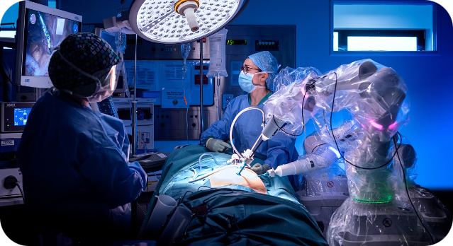
Hackathon: Healthcare Technology
This presentation outlines a proposed solution for improving surgical workflows using robotic automation. The team, consisting of Christin Benny, Amal Tom Ajith, Shravan S Kammath aims to address the limitations of manual surgical procedures.

Slide 2

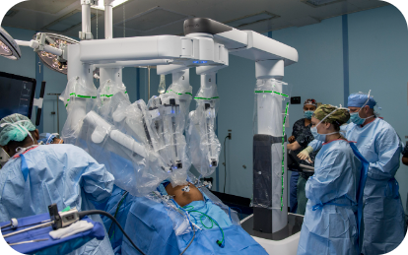

Problem Statement
1
Manual Surgical Workflows
2
Study of Perioperative Outcomes
3
Possible Risks of Surgery
Manual surgical procedures often involve significant challenges, including human error, variability in surgeon skill levels, and physical limitations during intricate operations.
Possible risks of surgery include postoperative pain, pneumonia, blood clots, a reaction to anesthesia, surgical site infection, nerve damage, and surgical accidents.
A study of perioperative outcomes for abdominoperineal resections for colorectal cancer at one institution found that, compared to patients who underwent laparoscopic surgery, patients who underwent robotic surgery had a significantly reduced complication rate (13.2% vs 23.7%, respectively).

Slide 3

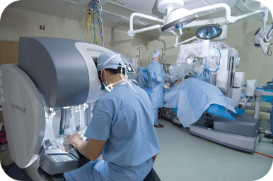
Proposed Solution: Robotic Surgery Automation
Accuracy
Remote Surgery
3D Imaging
Leveraging advanced robotic systems like the Da Vinci Surgical System, we aim to automate surgical workflows. This automation includes precise control of surgical instruments, enhanced visualization through 3D imaging, and AI-assisted decision-making to ensure accuracy and consistency in complex surgical procedures.
Surgeons who use the robotic system find that it can increase precision, flexibility and control during the operation. The robotic system also allows them to better see the site, compared with traditional surgical methods.
Using robotic surgery, surgeons can perform delicate and complex procedures that may be difficult or impossible with other methods.

Slide 4
Practical Implications
Patient Outcomes
Accessibility and Training
Surgical Efficiency
Patients typically experience faster recovery times due to smaller incisions and less trauma during surgery. Enhanced precision reduces the likelihood of surgical errors, leading to fewer post-operative complications and infections. Smaller incisions result in less visible scarring, improving cosmetic outcomes for patients.
Surgeons can operate remotely, allowing patients in underserved or remote areas access to high-quality surgical care from specialists. Surgeons can use robotic systems to enhance their skills through simulation and practice, leading to overall improvements in surgical expertise and confidence. Multiple surgeons can collaborate on complex procedures, combining their expertise to achieve the best possible outcomes for patients.
Robots can perform repetitive tasks with consistent accuracy, reducing variability in surgical outcomes due to human fatigue or error. Faster recovery times and fewer complications mean patients can be discharged sooner, reducing hospital costs and freeing up resources for other patients.

Slide 5
Implementation
Research and Development
1
Study existing robotic surgery systems like the Da Vinci Surgical System to understand their design, functionalities, and limitations. Identify the necessary hardware (robotic arms, surgical instruments, imaging systems) and software (AI algorithms, control systems) components.
2
Design and Prototyping
Develop a comprehensive design plan detailing the mechanical, electrical, and software architecture of the robotic system. Create a prototype of the robotic surgical system, focusing on the key functionalities such as precision control, 3D visualization, and AI assistance.
Software Development
3
Develop algorithms for precise control of the robotic arms and surgical instruments. Implement AI for real-time decision-making, error detection, and enhanced visualization. Design an intuitive user interface for surgeons to control the robotic system and monitor the surgery.
4
Testing and Validation
Conduct extensive simulations to test the system’s performance and accuracy in various surgical scenarios. Collaborate with medical professionals to perform clinical trials, ensuring the system meets safety and efficacy standards.
Training and Documentation
5
Develop a training program for surgeons to become proficient in using the robotic system. Create comprehensive documentation and user manuals for operating and maintaining the system.

Slide 6

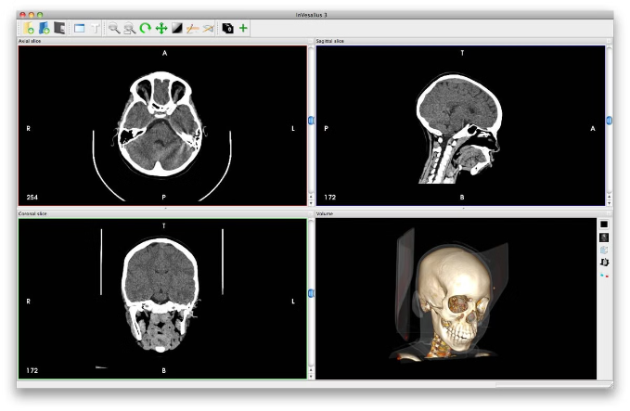
3D/Spatial Imaging
//Libraries
import cv2
import tensorflow as tf
import numpy as np
//Assume that we have a saved model
model = tf.keras.models.load_model('path/to/your/model.h5')
//Image preproccessing
def preprocess_image(image_path):
# Load image
image = cv2.imread(image_path)
# Convert to RGB (if your model expects RGB images)
image = cv2.cvtColor(image, cv2.COLOR_BGR2RGB)
# Normalize image
image = image / 255.0
# Expand dimensions to match model input shape
image = np.expand_dims(image, axis=0)
return image
//Make predictions on preprocessed image
def predict(image_path):
image = preprocess_image(image_path)
# Perform prediction
predictions = model.predict(image)
# Interpret predictions
# For classification, you might use np.argmax to get the class with highest probability
predicted_class = np.argmax(predictions, axis=1)
//The main Function
def main(image_path):
predicted_class = predict(image_path)
print(f'Predicted class: {predicted_class}')
if __name__ == '__main__':
# Replace 'path/to/image.jpg' with the path to your image
main('path/to/image.jpg')

Slide 7

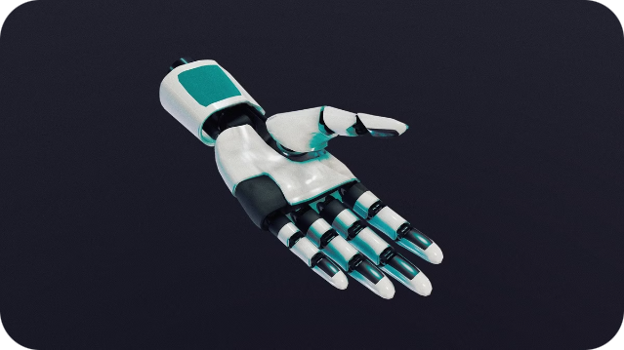

Conclusion
The proposed solution aims to revolutionize surgical workflows by leveraging robotic automation, 3D imaging, and AI. This approach holds the potential to improve patient outcomes, enhance surgical efficiency, and expand access to high-quality care.

Slide 8


Thank You
The team is grateful for the opportunity to present this innovative solution. We believe that robotic surgery automation has the potential to significantly impact the future of healthcare.

