Slide 1
PDFCombiner
PDF File Reconstruction App
Amal TP
EN-4AD

Slide 2
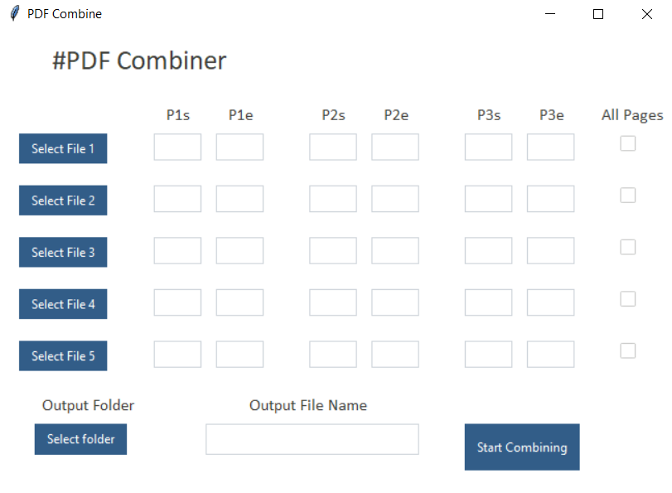
Procedure to Use
Open the Application PDFCombiner.exe

Slide 3
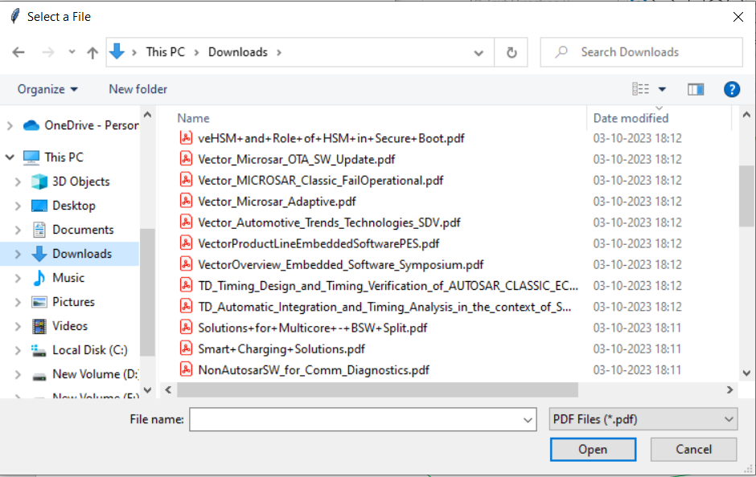
Procedure to Use
Select the PDF files
(Min 1 to be selected)

Slide 4
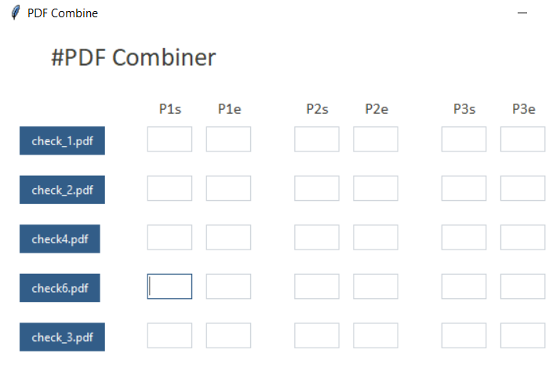
Procedure to Use
Ensure button name changed to file name
Select the PDF files
(Min 1 to be selected)

Slide 5
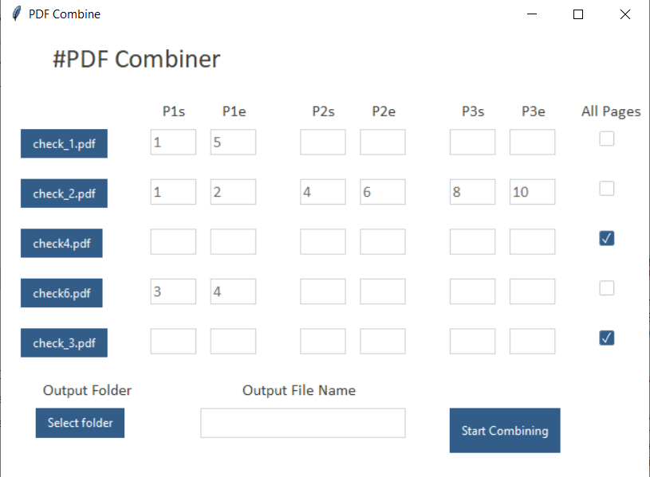
Procedure to Use
Provide page index/check the all-page checkbox
(maximum 3 combination))
*Empty cells will not consider for searching

Slide 6
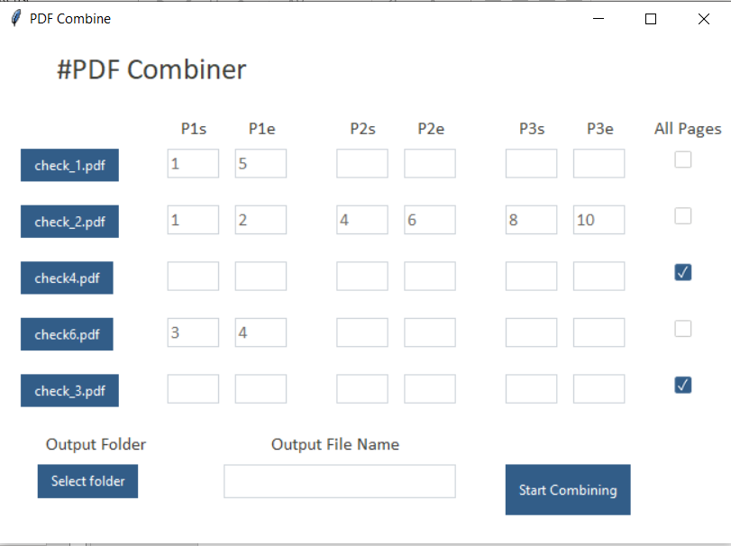
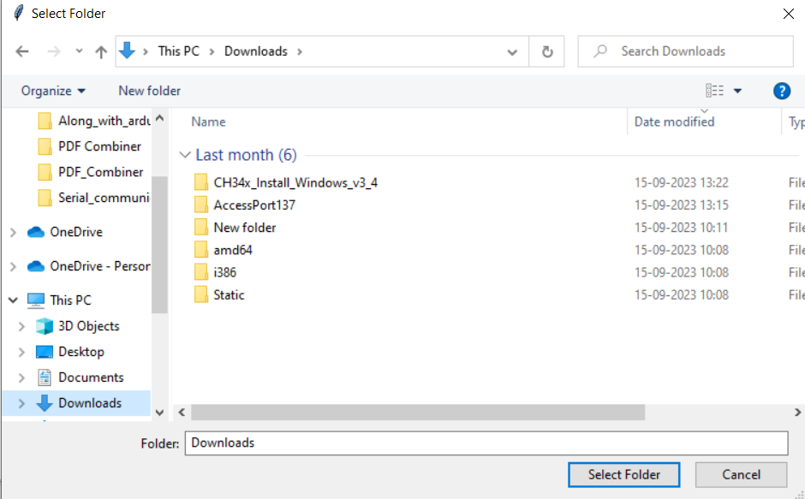
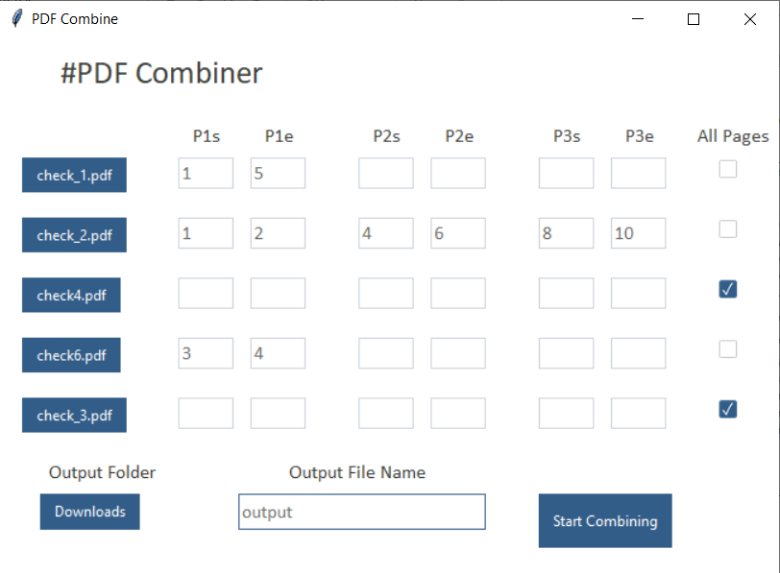
Procedure to Use
Ensure button name changed to folder name
Select output folder & provide file name

Slide 7
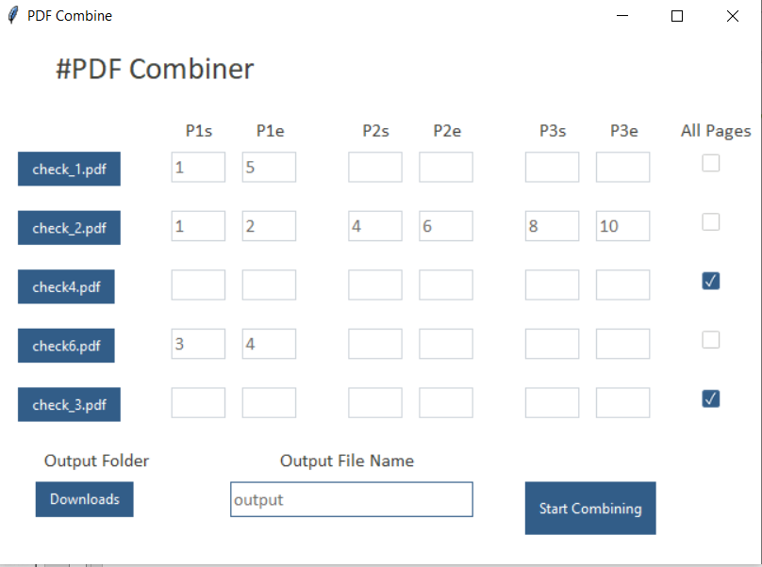
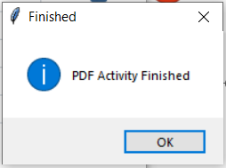
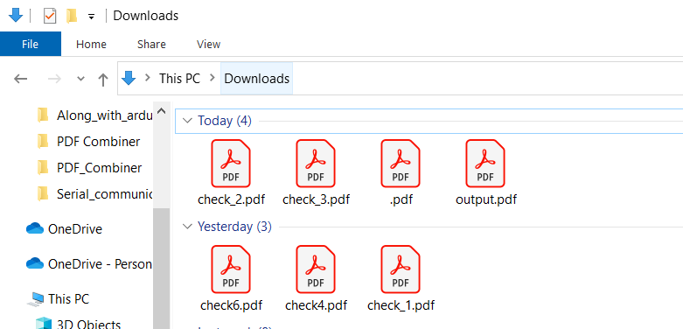
Procedure to Use
Click Start Combining and resultant pdf will be saved in given location with given name.
*This is the draft of the final application so may have bugs. Please highlight if you find any.

Slide 8
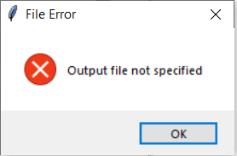
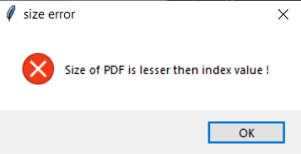
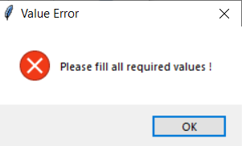
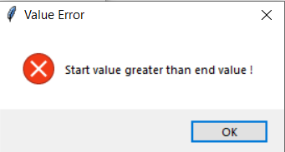
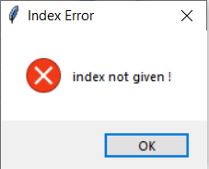
Error Messages & Reason
Output file details are not provided
Index values are greater than size of input PDF file
Some index value combinations are missing
Starting index greater than ending index
Not even single combination is provided for selected file

Slide 9
Capabilities & Use Cases
Capabilities
For combining multiple PDFs.
For cutting pages from PDF.
Cut blocks of pages from multiple PDFs & make single PDF.
Use Cases
Can be used to combine PDF for E-doc KM documents
For combining ADAS specific parts of Owners manual of multiple vehicles etc.

