Slide 1
OpenGL

Slide 2
What is OpenGL?
OpenGL is a library for doing computer graphics.
Create interactive applications which render high-quality color images composed of 3D geometric objects and images

Slide 3
OpenGL has two types of things that it can render:
Geometric primitives and image primitives.
Geometric primitives are points, lines and polygons.
Image primitives are bitmaps and graphics images

Slide 4
OpenGL is window and operating system independent.
GLUT, written by Mark Kilgard, is a public domain window system independent toolkit for making simple OpenGL applications.
GLUT (pronounced like the glut in gluttony) is the OpenGL Utility Toolkit, a window system independent toolkit for writing OpenGL programs.

Slide 5
GLUT provides a portable API so you can write a single OpenGL program that works across all PC and workstation OS platforms.
GLUT is designed for constructing small to medium sized OpenGL programs.
GLUT is simple, easy, and small.

Slide 6
Lab work 1
1) Install code blocks and opengl package to your system
TIME : 1 HOUR

Slide 7
First Single OpenGL Program:
/* simple.c */
/* This program draws a white rectangle on a black background.*/
#include <GL/glut.h> /* glut.h includes gl.h and glu.h*/
void main(int argc, char** argv)
{
/* Initialize mode and open a window in upper left corner of
/* screen */
/* Window title is name of program (arg[0]) */
glutInit(&argc,argv);
glutInitDisplayMode(GLUT_SINGLE | GLUT_RGB);

Slide 8
glutInitWindowSize(500, 500); // Set window Size
glutInitWindowPosition(0, 0); //Set Window Position
glutCreateWindow("simple"); //Create Window and Set title
glutDisplayFunc(display); //Call the Displaying function
init(); //Initialize Drawing Colors
glutMainLoop(); //Keep displaying until program is closed.
}

Slide 9
void display()
{
/* clear window */
glClear(GL_COLOR_BUFFER_BIT);
/* draw unit square polygon */
glBegin(GL_POLYGON);
glVertex2f(-0.5, -0.5);
glVertex2f(-0.5, 0.5);
glVertex2f(0.5, 0.5);
glVertex2f(0.5, -0.5);
glEnd();
/* flush GL buffers */
glFlush();
}

Slide 10
void init() // initialize colors
{
/* set clear color to black */
glClearColor(0.0, 0.0, 0.0, 0.0);
/* set fill color to white */
glColor3f(1.0, 1.0, 1.0);
}

Slide 11
1) OPEN \\10.10.10.10\mca\OPEN GL
2) Install code blocks in to windows system USING codeblocks-16.01mingw-setup
3) Add OpenGL package to windows system
Copy glut32.dll to C:\Windows\System32
Copy glut32.lib to C:\Program Files (x86)\CodeBlocks\MinGW\lib
Copy glut.h to C:\Program Files (x86)\CodeBlocks\MinGW\include\GL.
4) start Code::Blocks and make a new project.
Open up Code::Blocks. Start a new Project by going to File, NewProject.
Select to make a new GLUT project and press Go to continue.
LINK : http://www.sci.brooklyn.cuny.edu/~goetz/codeblocks/glut/
C:\Program Files\CodeBlocks\MinGW\lib\libglu32.a
C:\Program Files\CodeBlocks\MinGW\lib\libglut32.a
C:\Program Files\CodeBlocks\MinGW\lib\libopengl32.a

Slide 12
Sample Program
#include <GL/glut.h>
#include <GL/gl.h>
void main(int argc, char** argv)
{
int mode = GLUT_RGB|GLUT_DOUBLE;
glutInitDisplayMode( mode );
glutInitWindowSize( 500,500 );
glutCreateWindow( “Simple” );
init();
glutDisplayFunc( display );
glutKeyboardFunc( key );
glutMainLoop();
}

Slide 13
Sample Program
#include <GL/glut.h>
#include <GL/gl.h>
void main(int argc, char** argv)
{
int mode = GLUT_RGB|GLUT_DOUBLE;
glutInitDisplayMode( mode );
glutInitWindowSize( 500,500 );
glutCreateWindow( “Simple” );
init();
glutDisplayFunc( display );
glutKeyboardFunc( key );
glutMainLoop();
}
Specify the display
Mode – RGB or color
Index, single or double
Buffer

Slide 14
Sample Program
#include <GL/glut.h>
#include <GL/gl.h>
void main(int argc, char** argv)
{
int mode = GLUT_RGB|GLUT_DOUBLE;
glutInitDisplayMode( mode );
glutInitWindowSize( 500,500 );
glutCreateWindow( “Simple” );
init();
glutDisplayFunc( display );
glutKeyboardFunc( key );
glutMainLoop();
}
Create a window
Named “simple”
with resolution
500 x 500

Slide 15
Sample Program
#include <GL/glut.h>
#include <GL/gl.h>
void main(int argc, char** argv)
{
int mode = GLUT_RGB|GLUT_DOUBLE;
glutInitDisplayMode( mode );
glutInitWindowSize( 500,500 );
glutCreateWindow( “Simple” );
init();
glutDisplayFunc( display );
glutKeyboardFunc( key );
glutMainLoop();
}
Your OpenGL initialization
code (Optional)

Slide 16
Sample Program
#include <GL/glut.h>
#include <GL/gl.h>
void main(int argc, char** argv)
{
int mode = GLUT_RGB|GLUT_DOUBLE;
glutInitDisplayMode( mode );
glutInitWindowSize( 500,500 );
glutCreateWindow( “Simple” );
init();
glutDisplayFunc( display );
glutKeyboardFunc(key);
glutMainLoop();
}
Register your call back
functions

Slide 17
glutMainLoop()
#include <GL/glut.h>
#include <GL/gl.h>
int main(int argc, char** argv)
{
int mode = GLUT_RGB|GLUT_DOUBLE;
glutInitDisplayMode(mode);
glutInitWindowSize(500,500);
glutCreateWindow(“Simple”);
init();
glutDisplayFunc(display);
glutKeyboardFunc(key);
glutMainLoop();
}
The program goes into an infinite
loop waiting for events

Slide 18
OpenGL Geometric Primitives
The geometry is specified by vertices.
There are ten primitive types:

Slide 19
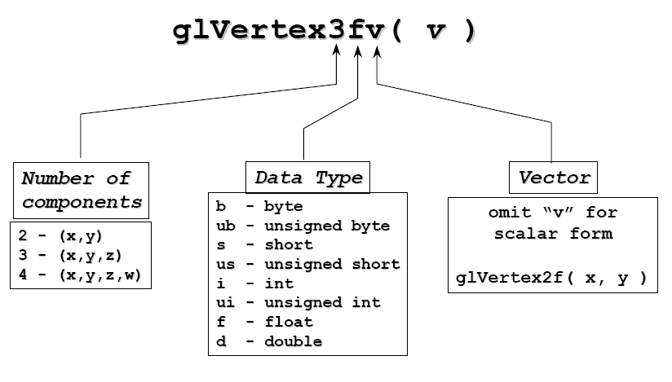
OpenGL Command Format
glVertex3fv

Slide 20
Vertices and Primitives
Primitives are specified using
glBegin( primType );
…
glEnd();
primType determines how vertices are combined
GLfloat red, green, blue;
Glfloat coords[nVerts][3];
/*Initialize coords and colors somewhere in program*/
glBegin( primType );
for ( i = 0; i < nVerts; ++i ) {
glColor3f( red, green, blue );
glVertex3fv( coords[i] );
}
glEnd();

Slide 21
Vertices and Primitives
Points, GL_POINTS
Individual points
Point size can be altered
glPointSize (float size)
glBegin(GL_POINTS);
glColor3fv( color );
glVertex2f( P0.x, P0.y );
glVertex2f( P1.x, P1.y );
glVertex2f( P2.x, P2.y );
glVertex2f( P3.x, P3.y );
glVertex2f( P4.x, P4.y );
glVertex2f( P5.x, P5.y );
glVertex2f( P6.x, P6.y );
glVertex2f( P7.x, P7.y );
glEnd();

Slide 22
// this code will draw a point located at [100, 100, -25]
glBegin(GL_POINTS);
glVertex3f(100.0f, 100.0f, -25.0f);
glEnd( );

Slide 23
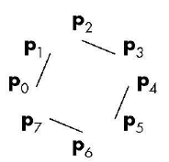
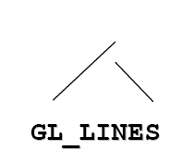
Vertices and Primitives
Lines, GL_LINES
Pairs of vertices interpreted as individual line segments
Can specify line width using:
glLineWidth (float width)
glBegin(GL_LINES);
glColor3fv( color );
glVertex2f( P0.x, P0.y );
glVertex2f( P1.x, P1.y );
glVertex2f( P2.x, P2.y );
glVertex2f( P3.x, P3.y );
glVertex2f( P4.x, P4.y );
glVertex2f( P5.x, P5.y );
glVertex2f( P6.x, P6.y );
glVertex2f( P7.x, P7.y );
glEnd();

Slide 24
// next code will draw a line at starting and ending coordinates specified by glVertex3f
glBegin(GL_LINES);
glVertex3f(100.0f, 100.0f, 0.0f); // origin of the line
glVertex3f(200.0f, 140.0f, 5.0f); // ending point of the line
glEnd( );

Slide 25
// this code will draw two lines "at a time" to save
// the time it takes to call glBegin and glEnd.
glBegin(GL_LINES);
glVertex3f(100.0f, 100.0f, 0.0f); // origin of the FIRST line
glVertex3f(200.0f, 140.0f, 5.0f); // ending point of the FIRST line
glVertex3f(120.0f, 170.0f, 10.0f); // origin of theSECOND line
glVertex3f(240.0f, 120.0f, 5.0f); // ending point of the SECOND line
glEnd( );

Slide 26
Vertices and Primitives
Line Strip, GL_LINE_STRIP
series of connected line segments

Slide 27
Vertices and Primitives
Line Loop, GL_LINE_LOOP
Line strip with a segment added between last and first vertices

Slide 28

Vertices and Primitives
Polygon , GL_POLYGON
boundary of a simple, convex polygon

Slide 29
Vertices and Primitives
Triangles , GL_TRIANGLES
triples of vertices interpreted as triangles

Slide 30
// the following code draws a triangle
glBegin(GL_TRIANGLES);
glVertex3f(100.0f, 100.0f, 0.0f);
glVertex3f(150.0f, 100.0f, 0.0f);
glVertex3f(125.0f, 50.0f, 0.0f);
glEnd( );

Slide 31
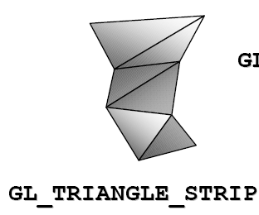
Vertices and Primitives
Triangle Strip , GL_TRIANGLE_STRIP
linked strip of triangles
v0
v1
v2
v3
v4
v5
v7
v6

Slide 32
Vertices and Primitives
Triangle Fan , GL_TRIANGLE_FAN
linked fan of triangles
v1
v2
v3
v4
v0
v5

Slide 33
Vertices and Primitives
Quads , GL_QUADS
quadruples of vertices interpreted as four-sided polygons

Slide 34
void display(void)
{
/* clear all pixels */
glClear (GL_COLOR_BUFFER_BIT);
/* draws a colorful triangle */
glBegin(GL_TRIANGLES);
glColor3f(1.0f, 0.0f, 0.0f); // red
glVertex3f(5.0f, 5.0f, 0.0f);
glColor3f(0.0f, 1.0f, 0.0f); // green
glVertex3f(25.0f, 5.0f, 0.0f);
glColor3f(0.0f, 0.0f, 1.0f); // blue
glVertex3f(25.0f, 25.0f, 0.0f);
glEnd();
glFlush ();
}

