Slide 1

CMR COLLEGE OF ENGINEERING & TECHNOLOGY
(Autonomous)
Kandlakoya, Medchal Road, Hyderabad
MAC Address Finder
Batch: 03
Course: Computer Networks Laboratory

Slide 2
ABSTRACT
MAC Address Finder
C-based Computer Networks project to find MAC addresses.
Identifies network adapters available on a computer.
MAC address is a unique hardware address of a network interface.
Works at the Data Link Layer of networking.
Supports interfaces such as Wi-Fi, Ethernet, and Bluetooth.
Uses the Windows IP Helper API to retrieve adapter information.
Automatically detects adapters and displays their MAC addresses.
Provides a simple command-line interface.
Demonstrates MAC addressing and network interface identification using C.
MAC Address Finder CN-Lab

Slide 3
INTRODUCTION
For an Introduction slide, you don't need all the details. Keep it concise and PPT-friendly:
Introduction – MAC Address Finder
Introduction
MAC Address Finder is a C-based Computer Networks project for identifying MAC addresses of network adapters.
The system automatically detects available network adapters on a Windows computer.
It retrieves and displays the adapter name and corresponding MAC address in a clear format.
The project uses the Windows IP Helper API to obtain network interface information.
It provides a simple command-line interface for displaying the results.
The project is limited to local computer network adapters and does not scan other devices on the network.
It demonstrates the practical concept of MAC addressing and network interface identification using C.
MAC Address Finder CN-Lab

Slide 4
Scope & Limitations
In Scope
Out of Scope
The scope of this project is limited to finding MAC addresses of network adapters on the local computer.
The system:
Detects available network adapters.
Retrieves their MAC addresses.
Displays the adapter name and corresponding MAC address.
Works as a command-line C application on Windows.
The program is designed for Windows systems using the Windows IP Helper API.
It finds MAC addresses of adapters on the local computer only.
It does not find the MAC addresses of other devices on the network.
It does not perform packet capture or network traffic monitoring.
It uses a command-line interface rather than a graphical interface.
The information displayed depends on the network adapters detected by the operating system.
MAC Address Finder CN-Lab

Slide 5
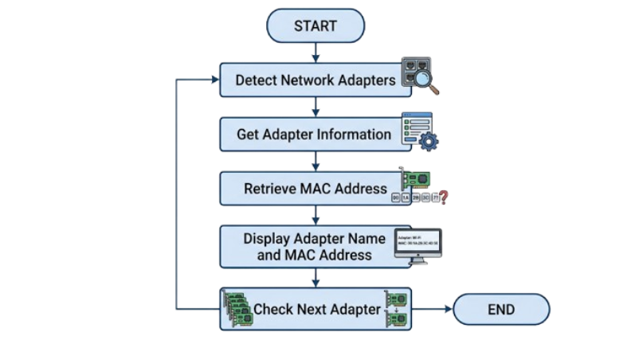
PROPOSED SYSTEM
The proposed system is a C-based MAC Address Finder that automatically retrieves the MAC addresses of network adapters available on the local computer.
The program uses the Windows IP Helper API, particularly the GetAdaptersInfo() function, to obtain network adapter information.
The basic working process is:
MAC Address Finder CN-Lab

Slide 6
KEY FEATURES
Simple: The program has a straightforward command-line interface.
Automatic: Network adapters are detected automatically.
No manual entry: The user does not need to enter a MAC address.
Multiple adapters: The program can display MAC addresses for multiple network adapters.
Educational: It demonstrates practical concepts related to network interfaces and MAC addressing.
MAC Address Finder CN-Lab

Slide 7
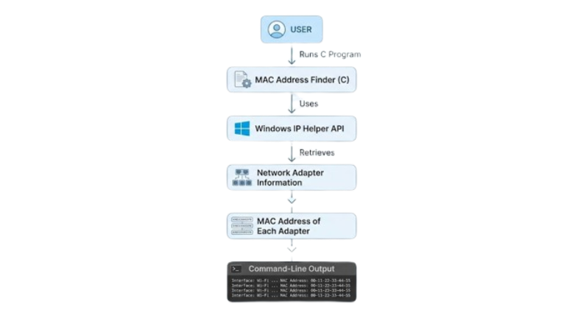
FLOWCHART
MAC Address Finder CN-Lab

Slide 8
IMPLEMENTATION
C Program: Controls the complete execution of the application.
Windows IP Helper API: Provides functions for accessing network configuration and adapter information.
Network Adapter Information: Provided by the OS. The program processes this information to obtain the MAC address.
Command-Line Interface: The retrieved information is displayed to the user through the command prompt.
Step 1: Include Required Libraries
Step 2: Link the IP Helper Library
Step 3: Obtain Adapter Information
Step 4: Process Each Adapter
Step 5: Extract the MAC Address
Step 6: Display the Result
MAC Address Finder CN-Lab

Slide 9
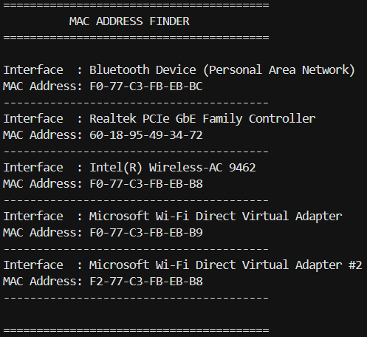
RESULTS AND DISCUSSIONS
MAC Address Finder CN-Lab

Slide 10
Conclusion & Future Enhancements
Developed a successful C-based MAC Address Finder for Windows systems.
Uses the Windows IP Helper API to obtain network adapter information.
Displays MAC addresses in a clear and readable format.
Detecting devices connected to the local network.
Displaying additional network adapter information.
Adding a graphical user interface.
Providing options to save the retrieved information to a file.
MAC Address Finder CN-Lab

Slide 11
THANK YOU

