Slide 1

CMR COLLEGE OF ENGINEERING & TECHNOLOGY
(Autonomous)
Kandlakoya, Medchal Road, Hyderabad
MAC Address Finder
Batch: 03
Course: Computer Networks Laboratory

Slide 2
ABSTRACT
Project is designed to identify and display network interface details on a computer.
Built using Python, Flask, and the psutil library.
Retrieves and displays MAC addresses, IPv4 addresses, interface status, and interface types.
Features a simple, user-friendly web-based interface as a convenient alternative to manual system commands.
Demonstrates practical network concepts, including MAC and IPv4 addressing, network interfaces, and Data Link Layer principles.
MAC Address Finder CN-Lab

Slide 3
INTRODUCTION
Network Interfaces: Computers feature multiple interface types (Wi-Fi, Ethernet, Bluetooth, and loopback), each with a unique MAC address used for Data Link Layer communication.
The Problem: Finding network interface information manually often requires navigating operating-system-specific commands.
The Solution: A web-based application that automatically detects available interfaces and centralizes their network details.
Technology Stack: Powered by Python's psutil library for gathering network data and Flask to connect the backend logic with the web interface.
MAC Address Finder CN-Lab

Slide 4
Scope & Limitations
In Scope
Out of Scope
Detecting network interfaces available on the local computer.
Finding MAC addresses associated with the interfaces.
Displaying interface status.
Providing a web-based interface for viewing the information.
Allowing the user to refresh/scan the information when required.
It displays information about the network interfaces of the local computer only.
It does not scan or identify devices connected to the entire network.
It does not capture or analyze network packets.
It does not provide detailed network traffic monitoring.
MAC Address Finder CN-Lab

Slide 5
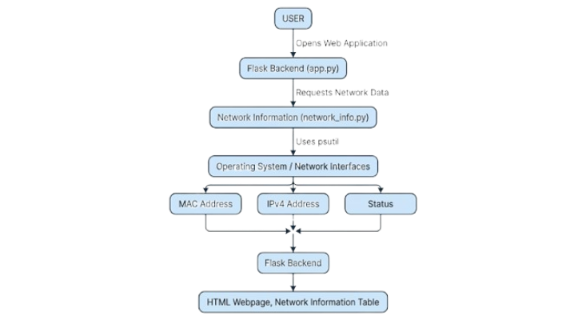
PROPOSED SYSTEM
The proposed system is a web-based MAC Address Finder and Network Interface Analyzer. The system uses the psutil library to retrieve information about the network interfaces available on the computer. The collected information is processed by the Flask backend and then displayed on a webpage.
MAC Address Finder CN-Lab

Slide 6
KEY FEATURES
Detects available network interfaces.
Retrieves their MAC addresses.
Displays their IPv4 addresses.
Shows whether an interface is active or inactive.
Presents the information in an easy-to-understand web interface.
MAC Address Finder CN-Lab

Slide 7
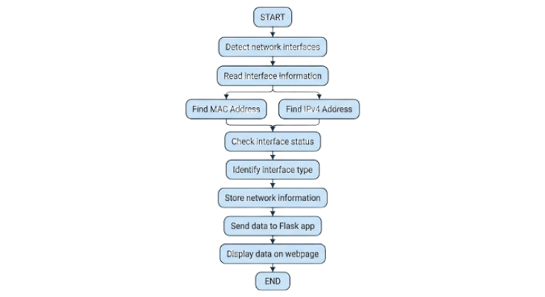
FLOWCHART
MAC Address Finder CN-Lab

Slide 8
IMPLEMENTATION
Python: Main programming language
Flask: Web application framework
psutil: Retrieves network-interface information
HTML: Creates the webpage structure
CSS: Styles the webpage
The psutil library supplies network-interface data to the Python program, which iterates through each interface to extract the relevant details.
The Flask application passes the gathered data to a template, rendering it on the webpage in a structured table.
Clicking the Scan Network Interfaces button re-requests the webpage, prompting the application to fetch and display updated network information.
MAC Address Finder CN-Lab

Slide 9
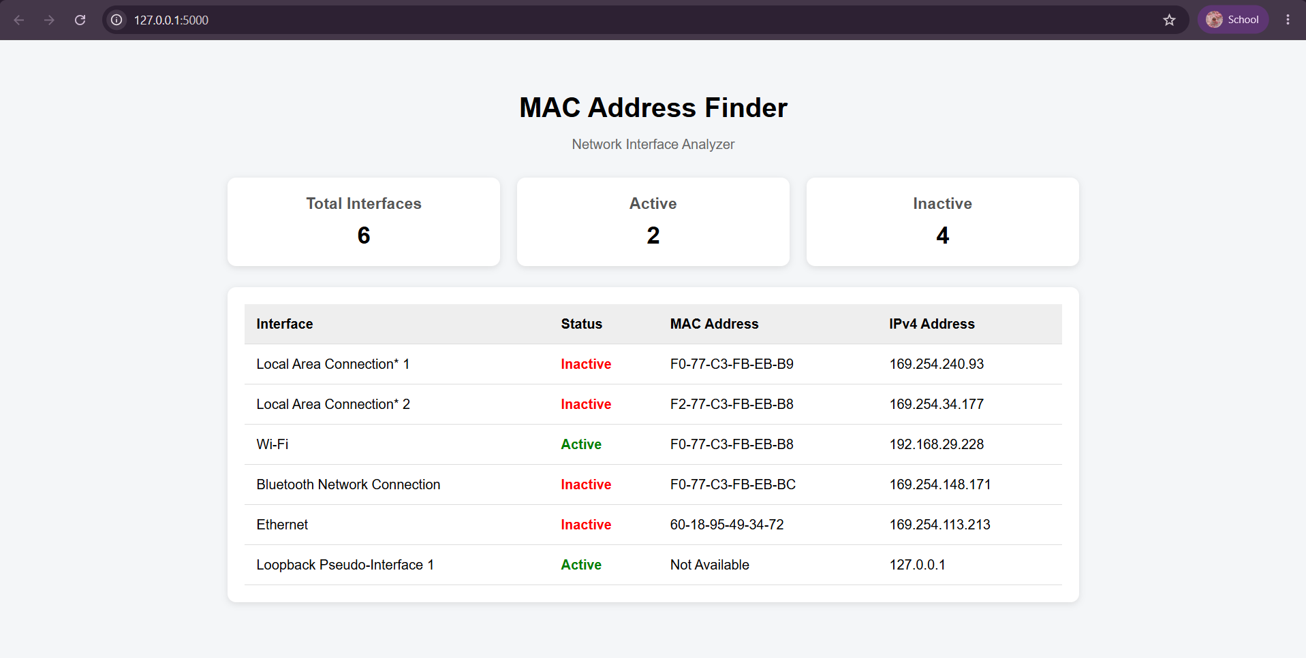
RESULTS AND DISCUSSIONS
MAC Address Finder CN-Lab

Slide 10
Conclusion & Future Enhancements
The MAC Address Finder retrieves and displays real-time network interface MAC addresses on a computer via a user-friendly web interface powered by Python, psutil, and Flask.
Detecting devices connected to the local network.
MAC address vendor identification.
Detailed IPv4 and IPv6 information.
Network speed and interface statistics.
Network traffic monitoring.
Exporting the detected information to a file.
MAC Address Finder CN-Lab

Slide 11
THANK YOU

