Slide 1
Big Mountain Ski Resort Ticket Price Modeling
Abdullah Al Mamun

Slide 2
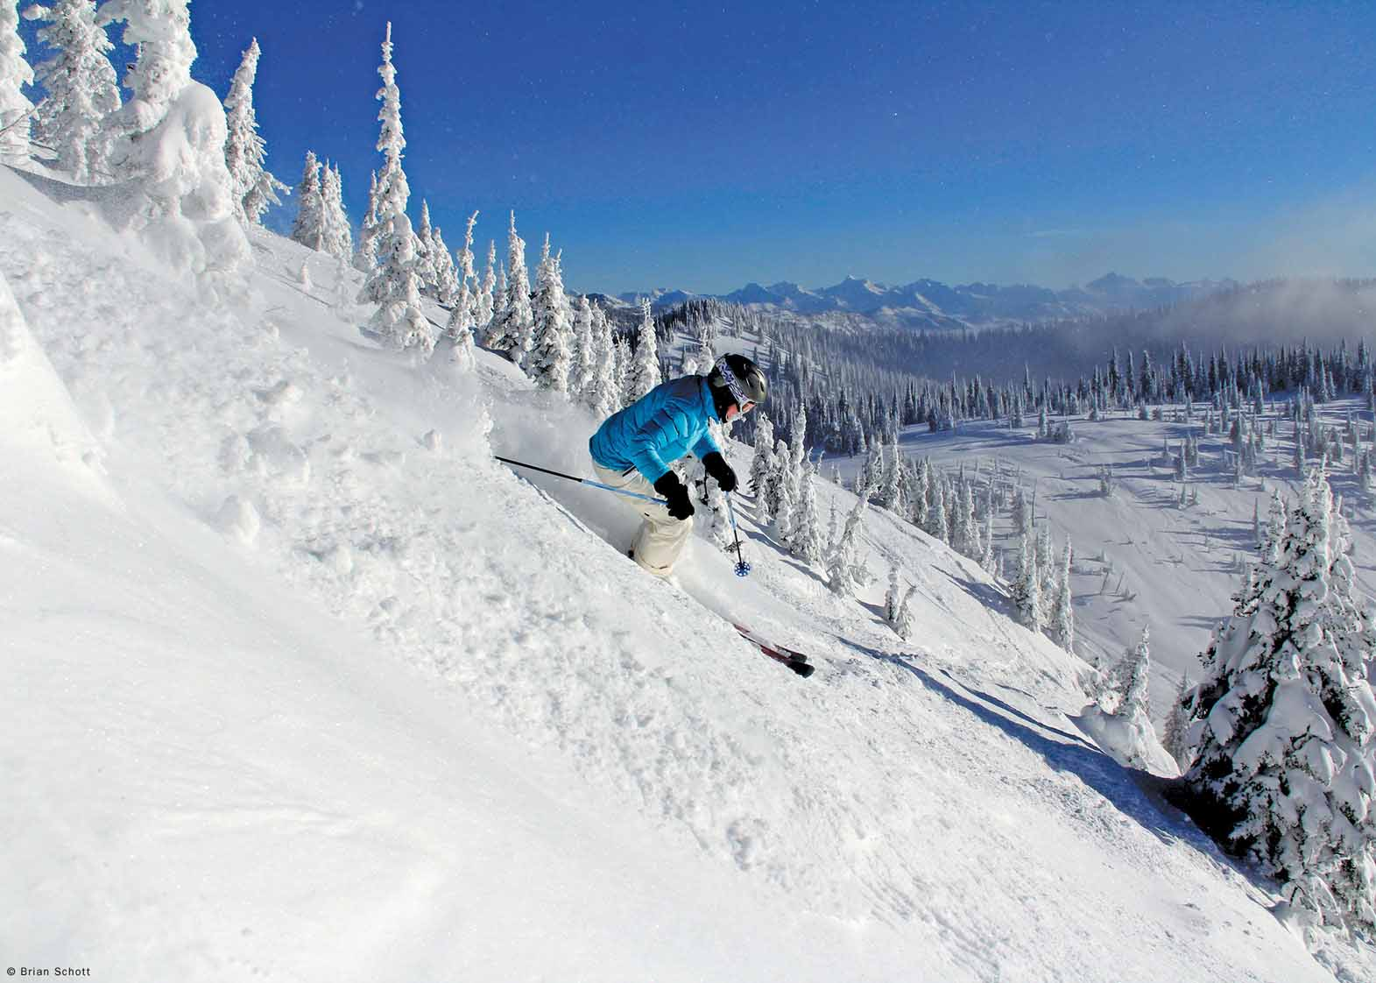
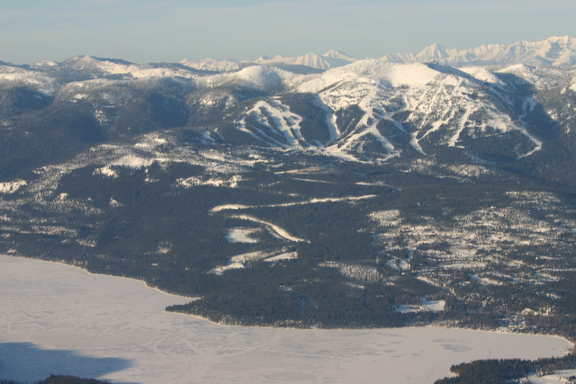
The Problem
Big Mountain ski resort located at Montana has 11 lifts, 2 T-bars, 1 magic carpet that can support 350,000 skiers per year. It has recently acquired a new chair lift, increasing their operating costs by 1.5 million dollars for the season, What strategies Big Mountain resort can implement for recouping the increased operational cost of $1.54 millions for installing new chair list this season, while keeping the profit margins at 9.2% and give an insight on annual revenue for the season over the next year.

Slide 3
Key Findings
Price vs facilities model predicts that the market support for adult weekend ticket price of $96 (+/- $10) without impacting ticket sales while the current ticket price is $81.
Extra $1.99/ticket value if boost vertical drop by 150ft.
Price boost yields +$3.5M revenue which will easily support the extra $1.54M costs
Closing 10 least-used runs reduces modeled ticket price by $1.81
This ticket price drop reduces revenue by $3.2M

Slide 4
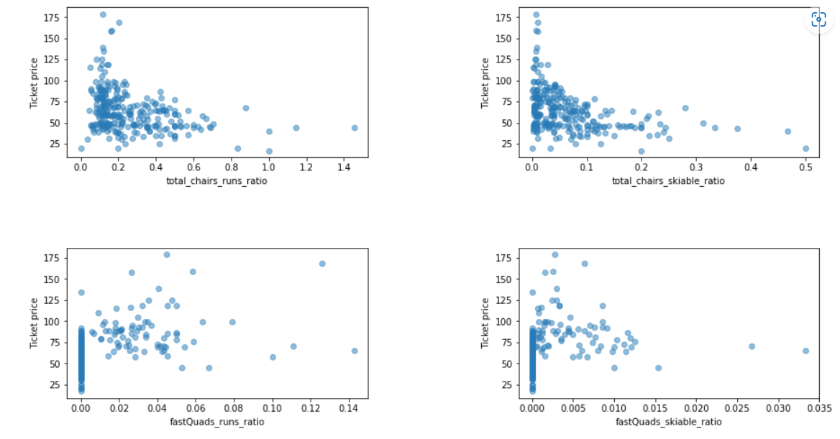
Exploratory Data Analysis
For Big Mountain Resort initial analysis shows that there is not enough information for not to compare to resorts across the country.
Across the entire country, consumers seem to support higher ticket prices at resorts that have guaranteed snow via numerous snow making equipment, more night skiing, more and faster runs and more chairlifts.

Slide 5
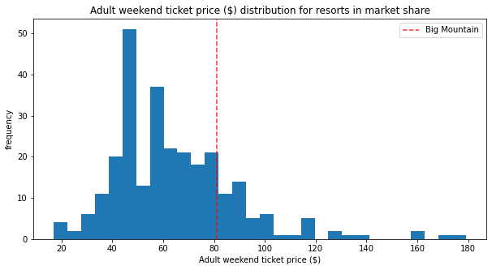
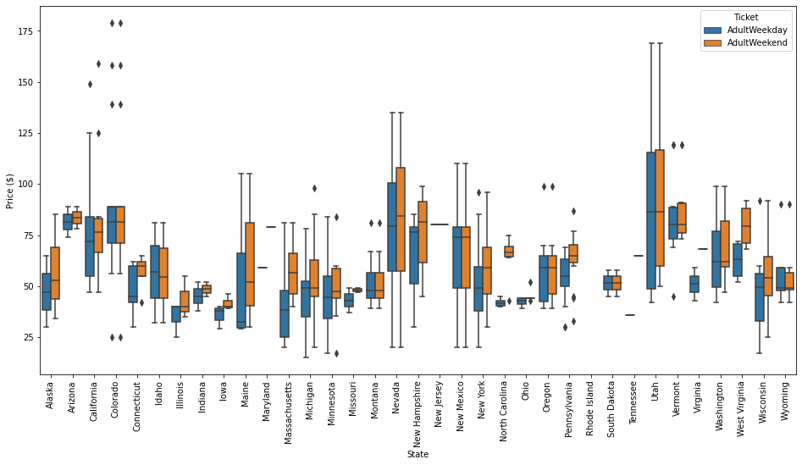
Current Ticket Price vs the Market

Slide 6
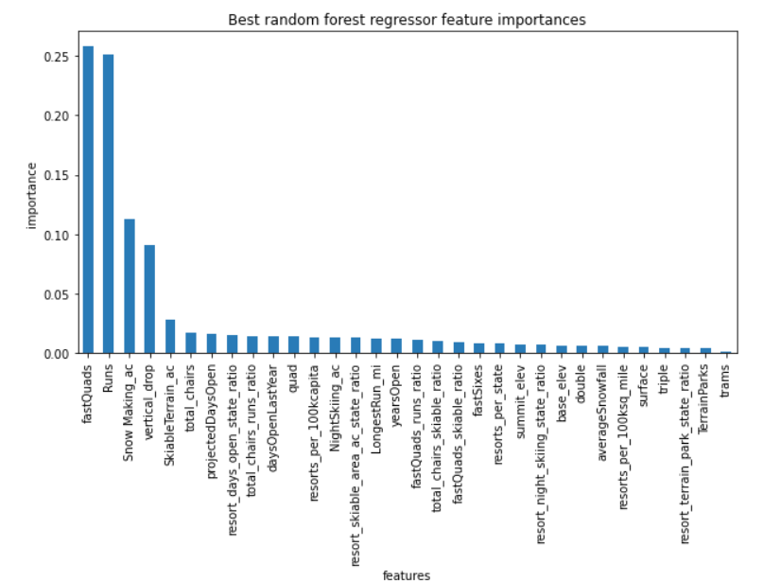
Processing and Training
Among all the tested models, the best predictive power was shown by random forest regression model.
The model was used to predict ticket prices across the country, and it found that the most important factors to price were vertical drop, fast runs, number of runs, and total area covered by snowmakers.

Slide 7
Recommended Strategies
Since Big Mountain is undercharging for tickets relative to competitors across the country, they could easily increase the ticket prices from 81 dollars to nearly 96 dollars. This increase would bring the resort more inline with similar resorts across the country.
Big Mountain ski resort can increase their ticket prices by $2 each this year as a result of the new ski lift. This will raise revenues by nearly 3.5 million dollars enough to cover the cost of the new lift.
Big Mountain resort also could lower costs by closing their least used skiing run without having an impact on the value of their ticket prices.

