Slide 1
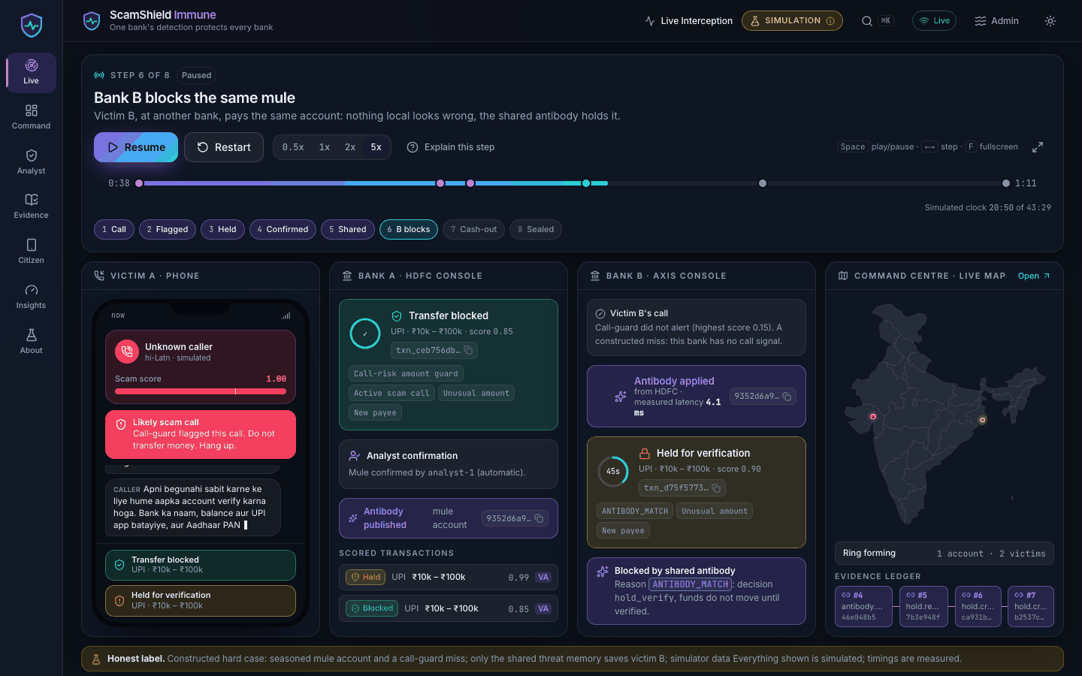
DIGITAL PUBLIC SAFETY PLATFORM
ScamShield Immune
One bank's detection protects every bank
Reflex, shared memory and a fraud-network brain, with evidence a third party can verify.
SIMULATED DATA
Benchmark seed 42, hero run seed 1
ScamShield Immune 1 / 14
Notes:
Opening: one sentence. Digital-arrest scams move money in minutes and every bank sees only its own customers; this platform makes one bank's detection protect all of them, before the money moves.
Say up front: everything in this talk is simulator data and real service code. The hero case is constructed.
Sources: README.md (concept and quickstart), docs/architecture.md, docs/demo-script.md. Screenshot: docs/screenshots/player-live-1440x900-dark.png.

Slide 2
THE PROBLEM
Reactive investigation loses to scams that move in minutes
1.14 million
Why it fails
complaints, India, 2023
Money leaves before any report.
Banks see only their own customers.
Mules are reused on the next victim.
Rs 1,776 crore
digital-arrest scams, first nine months of 2024
Source: challenge statement
Simulation data
ScamShield Immune 2 / 14
Notes:
Talk track: the scale is the challenge statement's: 1.14 million cybercrime complaints in India in 2023, and digital-arrest scams above Rs 1,776 crore in the first nine months of 2024. Investigation after a complaint starts when the money is already gone; and a mule account that has already hurt a customer of bank A is invisible to bank B.
Sources: both figures are quoted from the challenge statement as supplied with the brief; they are NOT in the repository's files, so they carry no repo citation. The framing sentence is from docs/superpowers/specs/2026-10-07-scam-immune-system-design.md section 1 (Intent).

Slide 3
THE INSIGHT
An immune system for payments
Bank A
Bank B
detects and holds
blocks the same mule
Antibody hub
keyed hashes only
Bank C
blocks it too
Detect once, protect everywhere. Hold and verify before the money moves.
Simulation data
ScamShield Immune 3 / 14
Notes:
Talk track: biology metaphor kept literal. One detection becomes an antibody, a keyed hash of the mule account, applied at every bank. The hub never holds the key and never sees names or account numbers. Holds are verify steps, not blocks; they never auto-release or auto-block at the deadline.
Sources: README.md (How it works), docs/architecture.md sections 3 and 4, services/antibody_hub/README.md (threat model and key handling), services/txn_guard/README.md (hold-and-verify).

Slide 4
WHAT WE BUILT
Three layers, a citizen shield and evidence you can verify
SIGNALS (SIMULATED)
REFLEX
MEMORY
BRAIN
PEOPLE
Calls and messages
call-guard
txn-guard
antibody-hub
graph-twin
Citizen shield
Analyst console
UPI / IMPS / NEFT
Hold and verify in minutes
Shared keyed-hash memory
Rings and takedown what-if
Command centre
EVIDENCE LEDGER
Hash chain, signed checkpoints, signed package, offline verify.py
Simulation data
ScamShield Immune 4 / 14
Notes:
Talk track: reflex is per-transaction hold-and-verify; memory shares antibodies as keyed hashes; brain finds rings and simulates a takedown. The citizen shield scores a message in plain language in four languages. Everything the services decide is appended to a ledger that never sits on the hot path.
Sources: README.md (architecture diagram and services table), docs/architecture.md sections 1 to 5, services/*/README.md. Counterfeit-currency detection was dropped by decision (spec section 1).

Slide 5
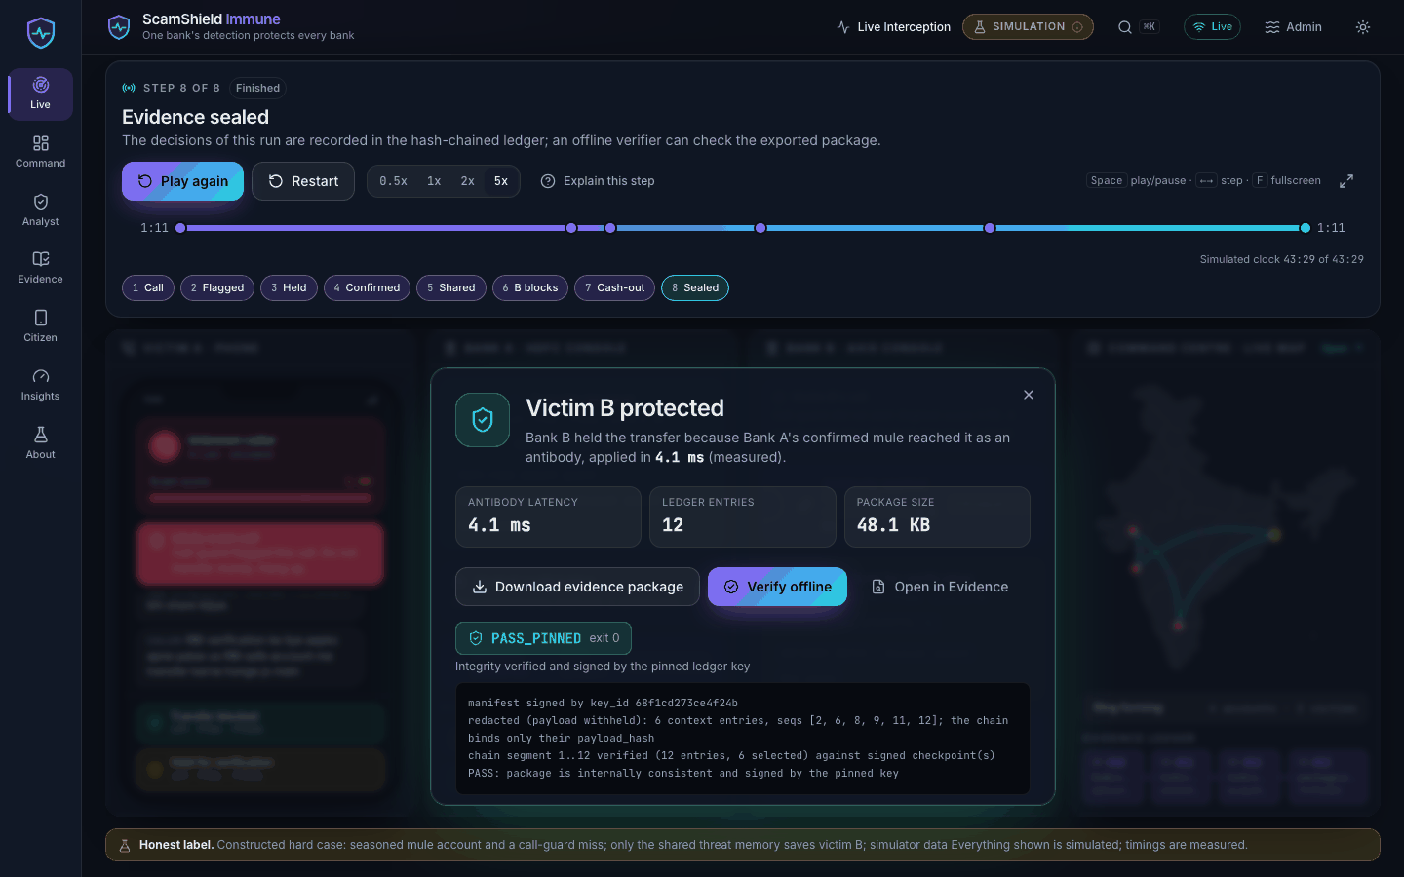
THE HERO RUN
One constructed case, eight steps, 71 seconds at 1x
Bank B blocks the same mule
Victim B protected, evidence sealed
1
2
3
4
5
6
7
8
Call begins
Call flagged
Transfer held
Analyst confirms
Antibody shared
Bank B blocks
Cash-out
Evidence sealed
Simulation data
ScamShield Immune 5 / 14
Notes:
Talk track (matches docs/demo-script.md, seed 1, cinematic pacing): victim A gets a scam call; call-guard flags it; her transfer to a new payee is held; an analyst confirms the mule; the antibody is shared; victim B at another bank pays the same mule 90 s later with an unflagged call and is held on ANTIBODY_MATCH; the ring cashes out on the map; evidence is sealed. Step offsets at 1x: held +24.7 s, confirmed and shared +27.2 s, bank B blocks +36.7 s, cash-out +51.2 s, sealed +71.1 s.
Be explicit that this is a constructed hard case (seasoned mule, off-script call).
Sources: docs/demo-script.md (Timings table), README.md (The story in eight steps), docs/screenshots/player-live-1440x900-dark.png and player-finale-1440x900-dark.png.

Slide 6
UNDER THE HOOD
Real services and models, a simulated world
Piece | Real | Simulated
Call scoring | clf-v1 classifier | scripts, speakers
Txn scoring | gbm-v1 model | accounts, transfers
Threat memory | hub store, outbox | two banks
Evidence | Ed25519 chain, verifier | simulated clock
Analyst | resolve API | 60 s oracle
make demo runs the real services in one process.
Simulation data
ScamShield Immune 6 / 14
Notes:
Talk track: the detection code is real and runs in-process; the world it sees is synthetic. No real telecom or bank integration exists. The demo is one process over an in-memory bus; the multi-container compose stack exists but was NOT run (no Docker daemon).
Sources: web-console/src/lib/about/architecture.ts (REAL_VS_SIMULATED, shown on the console's /about page), README.md (Two packagings, What was and was not exercised), docs/architecture.md.

Slide 7
RESULTS
Honest results: no false holds, with a weak NEFT rail
100.0%
82.6%
0.000%
+6h 29m
Precision, hold
Recall, scam txns
Benign held (FPR)
Mean lead time
95% CI 99.3 to 100.0
95% CI 79.6 to 85.3
upper CI 0.018%
5 of 5 before 10th victim
Benign false-positive rate by rail (%)
Ablations: recall (%), axis from 50
NEFT: no scam data
Simulation data
ScamShield Immune 7 / 14
Notes:
Talk track: seed 42 simulator run, 21,736 benign and 680 scam transactions. Precision 100% [99.3, 100.0] because zero benign transactions were held (upper bound of the false-positive rate 0.018%); recall 82.6% [79.6, 85.3]. Precision depends on prevalence: the run is 3.03%, real prevalence is far lower (prevalence table in the report). Per rail: held benign is 0.000% everywhere, but flagged-benign (step-up or hold) is UPI 0.016%, IMPS 0.37%, NEFT 0.83%. NEFT is the worst rail and the simulator has no NEFT scams, so its figure is benign traffic only and its thresholds are hand-scaled. Ablation: removing antibodies drops victim-transfer recall from 100% to 94.5%; no call signal 98.1%; degraded call signal 99.2%. Lead time: 5 of 5 campaigns detected before the 10th victim, mean +6h29m13s at the first hold; few campaigns, wide uncertainty.
All chart values are read from services/demo_server/demo_server/data/benchmark_summary.json at build time (headline, per_rail, ablations); lead time and prevalence from docs/benchmark_report.md. Simulator data, same generators as training, disjoint seeds.
Note: the ablation axis starts at 50 so the differences are visible; say so out loud.

Slide 8
HARD-CASE HONESTY
Hard on purpose: antibodies must land early
Victim B's first transfer, 40 hero seeds
Recall (%) vs analyst confirmation delay
Seasoned mule, off-script call: the model alone allowed 39 of 40; with the antibody all 40 were held.
At a 24 h confirmation delay the benefit is gone (94.5%).
Simulation data
ScamShield Immune 8 / 14
Notes:
Talk track: we built the hero to be the hardest case, not the typical one: a seasoned mule (68 to 398 days old, so no young-account signal) and an off-script call that call-guard misses. Across 40 hero seeds the model alone allowed victim B's first transfer 39 times and stepped it up once; with the antibody all 40 were held. The 40 seeds vary mule age, amounts and timing, not the script. Right chart: the confirmation delay is a free parameter. Victims in the simulator are minutes to hours apart, so delays up to 1 h cost nothing; at 6 h recall is 99.2%; at 24 h it is back to 94.5% and no antibody matches. This is the honest bound on 'detect once, protect everywhere': an antibody has to land before the next victim pays.
Also say: antibody poisoning, false confirmations and merchant antibodies are not simulated; benign antibody matches = 0 holds by construction.
Sources: benchmark_summary.json keys hero (model_only, with_antibody, seeds) and sensitivity; docs/benchmark_report.md (Antibody stage, Limitations); docs/judging-map.md.

Slide 9
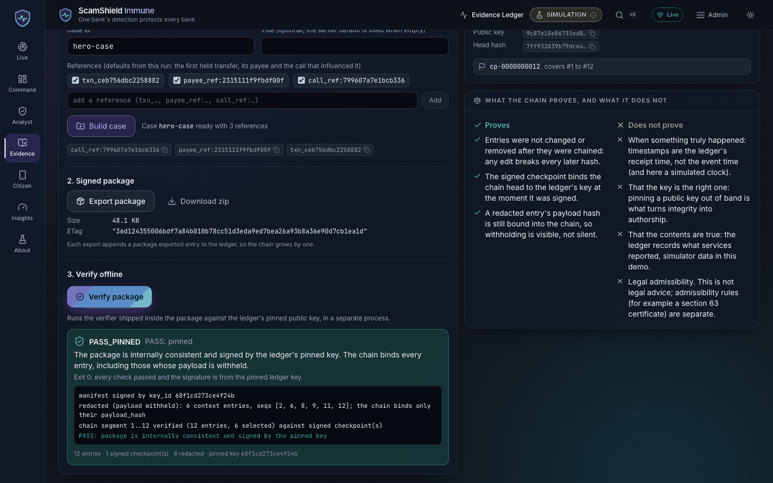
AUDITABILITY
Evidence a third party can check without trusting us
PROVES
Entries unaltered, in order, signed under a pinned key.
DOES NOT PROVE
That events were true, or legally admissible.
VERIFY OFFLINE
python -I -S verify.py --trusted-pubkey KEY
Payloads hold ids, reason codes and amount buckets only; PII-shaped entries are quarantined.
Simulation data
ScamShield Immune 9 / 14
Notes:
Talk track: every decision is appended to a hash-chained ledger with signed checkpoints; a case package ships its own verify.py, run isolated (python -I -S) and pinned to the ledger public key. The screenshot shows PASS_PINNED. Integrity is not truthfulness: it proves what the services recorded, in what order, unaltered. We make no admissibility claim; the Section 63 certificate is a template for counsel. A DB superuser can still edit rows; that is made detectable, not prevented. No external timestamping.
Sources: docs/audit-trail.md, services/evidence_ledger/README.md, docs/architecture.md sections 5 and 8, docs/screenshots/evidence-verified-1440x900-dark.png, `make verify-package` (PASS, README 'What was exercised').

Slide 10
PRIVACY AND SAFETY ENGINEERING
Tokens and hashes only, and audit never blocks an alert
Tokens, not identities
PII guard
Never on the hot path
Fail safe
Keyed hashes only.
No amounts or free text.
Alerts publish before audit.
Rules fallback; no auto-release.
INDEPENDENT ADVERSARIAL REVIEW
Independent adversarial review of each service; about 15,000 ledger mutations, none passed.
Simulation data
ScamShield Immune 10 / 14
Notes:
Talk track: privacy is structural, not a policy: the platform sees pseudonymous tokens and keyed hashes, the hub never holds the federation key, and the ledger refuses PII-shaped payloads. Audit is never awaited on the fraud path (outbox, circuit breaker, sweeper). Fail-safe: missing or tampered model artifacts fall back to rules; antibody bootstrap fails open (weaker protection, never a blocked payment); holds are flagged overdue, never auto-resolved.
Review claim: README 'Development workflow' states one task at a time with an independent adversarial review after each and fix rounds until findings were closed. The about-15,000-mutation ledger attack campaign figure is from docs/judging-map.md (Technical excellence); the review ledger itself is a git-ignored working file under .superpowers/, so we give no per-service finding counts here. Test counts, if asked: about 1,490 Python tests plus 172 console unit tests, make test-all 13 of 13 (README).
Sources: docs/architecture.md sections 4, 6 and 8; docs/audit-trail.md; docs/judging-map.md; README.md.

Slide 11
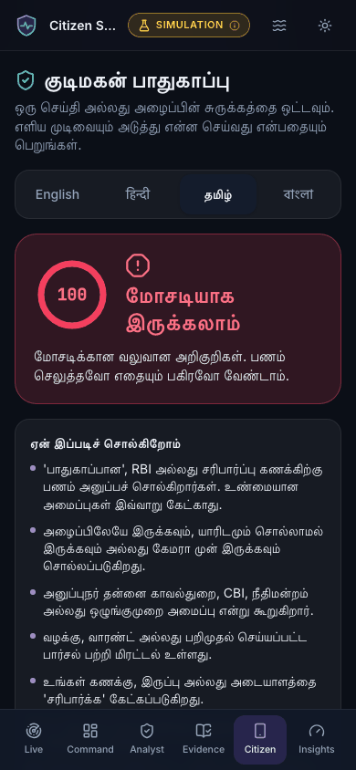
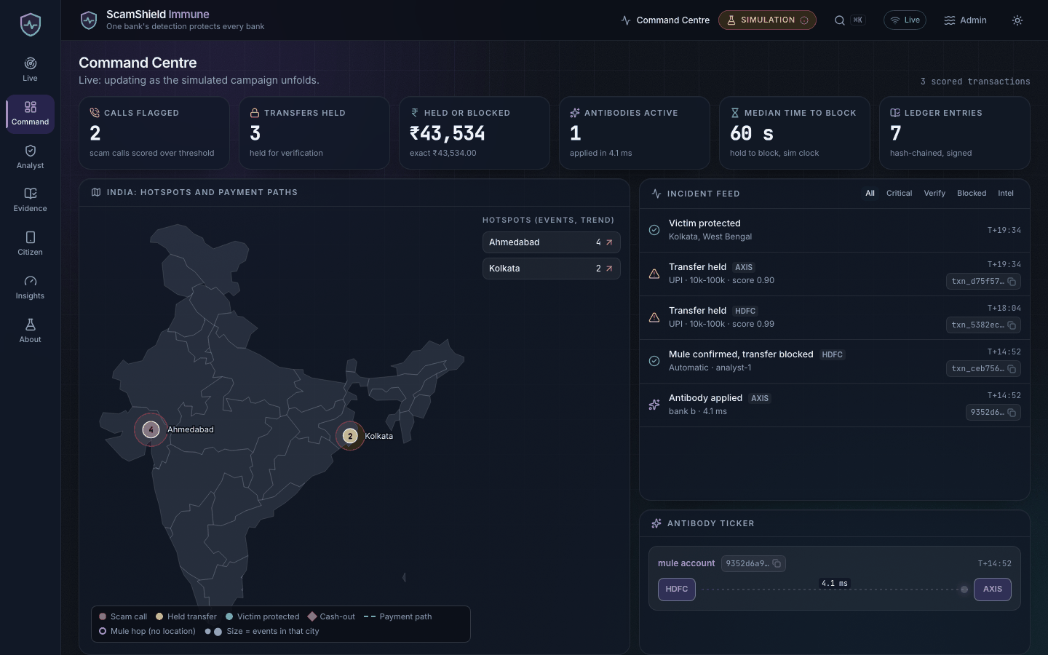
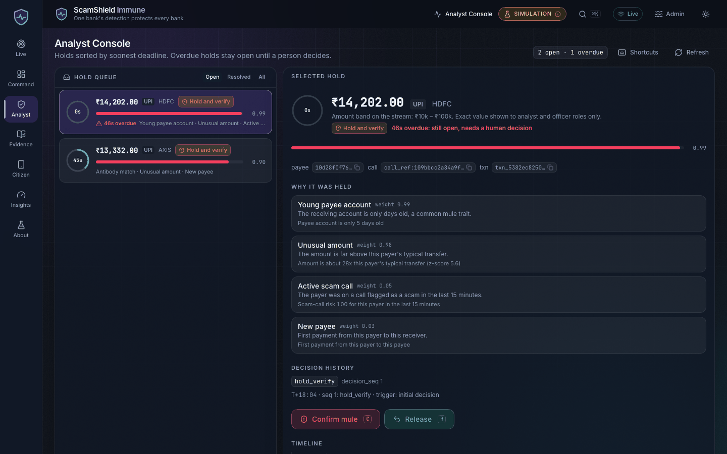
THREE AUDIENCES
Command centre, analyst console and citizen shield
Command centre: map, ring, takedown
Analyst: deadline-sorted hold queue
Citizen verdict, Tamil
English, Hindi, Tamil, Bengali
axe-core: 0 serious or critical
Keyboard shortcuts, palette
Risk is never shown by colour alone; one verdict per screen for citizens.
Simulation data
ScamShield Immune 11 / 14
Notes:
Talk track: seven pages, three audiences. The officer sees the map, ring graph and a takedown what-if; the analyst works a deadline-sorted hold queue with countdown rings and a guarded resolve; the citizen pastes a message and gets one plain-language verdict in English, Hindi, Tamil or Bengali, nothing stored. 'Safe' only means no clear scam cues found.
Accessibility: WCAG AA tokens; axe-core (wcag2a/aa, 2.1 a/aa) on all 7 pages in dark and light reported 0 serious or critical violations (web-console F2 report, a git-ignored working file). Automated rules only; the Playwright e2e and axe checks were not re-run in the final delivery pass (README 'What was and was not exercised'). Citizen reason lists stay in English in this build.
Sources: README.md (UX), docs/judging-map.md (UX table), web-console/README.md, .superpowers/sdd/2026-10-07-scam-immune-system/web-console-f2-report.md; screenshots command-1440x900-dark, analyst-1440x900-dark, citizen-verdict-ta-390x844-dark (top 844 px).

Slide 12
SCALABILITY AND OPERATIONS
Designed to scale by partition key; not load-tested here
Topic | Partition key
txn.events | payer_token
call.events, call.risk | victim_token
txn.decisions | txn_id
antibody.published | key_hash
7 ms
3
p50 per transaction
compose profiles
p99 about 14 ms
core, stack, observability
Audit outbox; stateless scorers.
Latency is in-process. The Docker stack was validated, not run.
Simulation data
ScamShield Immune 12 / 14
Notes:
Talk track: ordering is by payer: txn.events is keyed by payer_token and call.events/call.risk by victim_token so a call's risk meets that payer's transactions in order; antibody.published is keyed by key_hash so a revoke cannot overtake its create. Scorers are stateless apart from Redis and scale by consumer-group partitions; hub and ledger scale as replicas over one Postgres; graph-twin is a single replica (no sharding). Latency: consumer-path p50 about 7 ms and p99 about 14 ms per transaction with fakeredis stores (txn-guard README); the benchmark JSON's own latency_ms block reads p50 5.3 ms, p99 15.3 ms over 2,242 decisions. Target p99 under 300 ms. Not load-tested against real Kafka, Redis or Postgres.
Sources: docs/architecture.md section 7 (Deployment notes) and section 2; contracts/scam_contracts/topics.py (via architecture.md); services/txn_guard/README.md; infra/docker-compose.yml (profiles); README.md (What was and was not exercised).

Slide 13
LIMITS AND NEXT STEPS
What we do not know yet, and what comes next
LIMITS
NEXT STEPS
Simulator data only
No NEFT scam data
Modelled analyst
Stack not run
1 Real data integration
2 NEFT scam data
3 Graph-twin on live traffic
4 Legal review of evidence
5 One-bank pilot
Simulation data
ScamShield Immune 13 / 14
Notes:
Talk track: be direct about what the numbers are: a regression and ablation harness on simulator data, not real-world performance. NEFT has no scam transactions so its recall is undefined and its false-positive figure is benign traffic only. The analyst is an assumed oracle with a 60 s delay; poisoning is not simulated. The docker stack was validated with compose config only. Next steps are the pilot path: real data integration (call metadata, bank transaction feeds), NEFT scam data, graph-twin on live traffic (it is a single replica today), counsel review of the evidence package and the Section 63 certificate template, then one bank.
Sources: README.md (Honest limitations), docs/benchmark_report.md (Limitations), docs/judging-map.md caveat columns, docs/architecture.md.

Slide 14
TRY IT
Run it in one command
make demo
Open http://localhost:8080, choose Officer, press Play.
Repository: <repo URL placeholder>
Thank you
SIMULATED DATA
ScamShield Immune 14 / 14
Notes:
Close: one detection, every bank protected, every action auditable. Everything is simulated and says so. make demo builds the console and serves it at http://localhost:8080 (README quickstart). A recorded hero run with captions is in docs/demo/ (no narration; the script is docs/demo-script.md). Repository URL is a placeholder to fill in before sharing.
Sources: README.md (60-second quickstart), docs/demo-script.md, docs/demo/README.md.

