Slide 1
POST OFFICE DATABASE
Group:15 | Post office Database
Submitted By
Group 15
KAUSHIK GHOSH (13000116101)
AMAN KUMAR MISHRA(13000116137)
PULKIT(13000116081)
YASSAR ALI(13000116022)

Slide 2
Contents :
Group:15 | Post office Database
Problem Definition
Requirement Analysis
Technical Requirements
ER Diagram
Relational Schema
Assumptions
Normalisation
Queries
Conclusion
References

Slide 3
Problem Definition
Group:15 | Post office Database
To design a database Management System which offers the following services:
Customer service to the public and handles their mail needs.
Post offices offer mail-related services such as acceptance of letters and parcels; provision of post office boxes; and sale of postage stamps, packaging, and stationery.

Slide 4
Requirement Analysis
Group:15 | Post office Database
Employees | Post office needs to store all the details of employees which are working for the post office, for which it needs the entity type EMPLOYEE. EMPLOYEE is a generalized entity because there are different types of employees(e.g Postman,Clerk,Ground Staff,Manager).
Post Office | A post office is a public department that provides a customer service to the public and handles their mail needs.Post offices offer mail-related services such as acceptance of letters and parcels; provision of post office boxes; and sale of postage stamps, packaging, and stationery

Slide 5
Services | Post office provides different kinds of services to the customers .Services for saving scheme and even mail services. SERVICES is a generalised entity because there are different types of SERVICES (e.g Courier, Speed Post etc ).
Courier | Courier service is provided by any Post Office for the customers to transfer important informations and packages from one place to another. In our design Courier is a sub part of Services.
Speed Post | The speed post transmission follows a hub and spoke model. All the pincode in India are mapped to one of the hubs. The post office will send the shipment to its parent hub. Speed Post service is provided by post office and in our project it is a subpart of Services.

Slide 6
Customer | A customer is an individual or business that purchases another company's goods or services. So in case of Post Office Database Management System we keep the records of all the customers who come to the post office for either receiving or sending telegrams or for any other works.

Slide 7
Technical Requirements
Group:15 | Post office Database
Design of ER Diagram and Relational Schema : Dia Diagram Editor Version 0.97.2
Creation of the Database(Creation of Tables , Insertion into the Database and Data Handling ): Oracle 10g
The entire documentation for the same has been done on Google Office Suite.

Slide 8
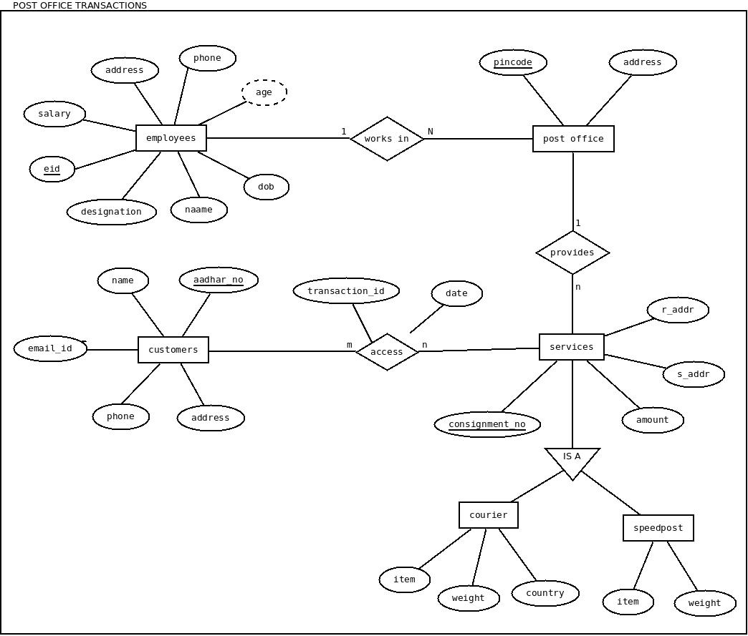
ER Diagram
Group:15 | Post office Database

Slide 9
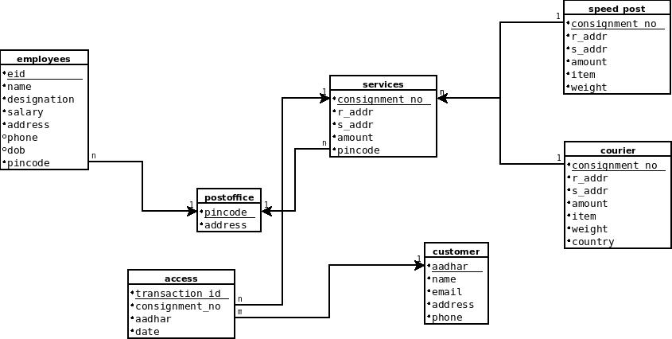
Relational Schema
Group:15 | Post office Database

Slide 10
Assumptions
Group:15 | Post office Database
The following are the assumptions associated with this design.
-> Employees to postoffice is a 1 to many relationship.
-> postoffice to services is 1 to many relationship.
-> postoffice to services is 1 to many relationship.
-> services are of two types:- a)courier b)speedpost.
-> customers to services is many to many relationship.
-> The relation access is modeled as aggregation namely postoffice transactions.

Slide 11
Normalisation
1.Employees
Employees(eid,pincode,name,designation,address,phone,dob,salary)
eid,pincode,phonenumber -> name,designation,salary,address,phone,dob,pincode
eid,dob -> name,designation,salary,address
Final set of decomposed BCNF relations:
EMPLOYEES0(DOB, EID, NAME, SALARY, ADDRESS, DESIGNATION) having FD(s): DOB,EID → NAME; DOB,EID → SALARY; DOB,EID → ADDRESS; DOB,EID → DESIGNATION.
EMPLOYEES1(DOB, EID, PHONE, PINCODE) having FD(s): EID,PHONE,PINCODE → DOB.

Slide 12
Normalisation (cont.)
2.Services
services(consignment_no,r_addr,s_addr,amount,item,weight)
consignment_no -> r_addr,s_addr,amount,pincode
pincode -> consignment_no,r_addr,s_addr,pincode
Final set of decomposed BCNF relations (removing duplicate and subset relations):
SERVICES_0(RADDR, SADDR, AMOUNT, PINCODE, CONSIGNMENTNO) having FD(s): CONSIGNMENTNO → RADDR; CONSIGNMENTNO → SADDR; CONSIGNMENTNO → AMOUNT; CONSIGNMENTNO → PINCODE; PINCODE → RADDR; PINCODE → SADDR; PINCODE → PINCODE; PINCODE → CONSIGNMENTNO.
SERVICES_1(ITEM, WEIGHT, CONSIGNMENTNO) having FD(s): (none).
SERVICES_3(ITEM, WEIGHT, PINCODE) having FD(s): PINCODE → PINCODE.

Slide 13
Normalisation (cont)
3. Access
access(transactionid,consignmentid,aadhar,date)
transactionid,consignmentno -> aadhar,date
transactionid -> consignmentno
Input relation is already in BCNF. No decomposition necessary.

Slide 14
Normalisation (cont)
4. Customer
customer(aadhar,name,email,address,phone)
aadhar-> name,email,address,phone
Input relation is already in BCNF. No decomposition necessary.

Slide 15
Normalisation (cont)
5. Speedpost
speedpost(consignmentno,raddr,saddr,amount,item,weight)
consignmentno -> raddr,saddr,amount,item,weight
Input relation is already in BCNF. No decomposition necessary.

Slide 16
Normalisation (cont)
4. Customer
customer(aadhar,name,email,address,phone)
aadhar-> name,email,address,phone
Input relation is already in BCNF. No decomposition necessary.

Slide 17
Normalisation(Cont.)
6. Courier
consignmentno(raddr,saddr,amount,item,weight,country)
consignmentno -> raddr,saddr,amount,item,weight,country
Input relation is already in BCNF. No decomposition necessary.

Slide 18
Table Creation
create table employee(eid number(3) primary key not null, name varchar2(10) not null, designation varchar2(10) not null, salary number(6) not null, address varchar2(12) not null, phone number(10),dob date, pincode number(6) references postoffice(pincode) on delete cascade not null);
Name Null? Type
----------------------------------------- -------- ----------------------------
EID NOT NULL NUMBER(3)
NAME NOT NULL VARCHAR2(10)
DESIGNATION NOT NULL VARCHAR2(10)
SALARY NOT NULL NUMBER(6)
ADDRESS NOT NULL VARCHAR2(12)
PHONE NUMBER(10)
DOB DATE
PINCODE NOT NULL NUMBER(6)

Slide 19
Table Creation (continued)
create table customers(aadhar number(5) primary key not null, name varchar2(10) not null, email varchar2(15) not null, phone number(10), address varchar2(10) not null);
Name Null? Type
----------------------------------------- -------- ----------------------------
AADHAR NOT NULL NUMBER(5)
NAME NOT NULL VARCHAR2(10)
EMAIL NOT NULL VARCHAR2(15)
PHONE NUMBER(10)
ADDRESS NOT NULL VARCHAR2(10)

Slide 20
Table Creation (continued)
create table postoffice(pincode number(6) primary key not null, address varchar2(12) not null);
Name Null? Type
----------------------------------------- -------- ----------------------------
PINCODE NOT NULL NUMBER(6)
ADDRESS NOT NULL VARCHAR2(12)

Slide 21
Table creation (continued)
create table services(consignment_no number(3) primary key not null, aadhar number(5) references customers(aadhar) on delete cascade not null, pincode number(6) references postoffice(pincode) on delete cascade not null, r_addr varchar2(10) not null, s_addr varchar2(10) not null, amount number(6) not null);
Name Null? Type
----------------------------------------- -------- ----------------------------
CONSIGNMENT_NO NOT NULL NUMBER(3)
PINCODE NOT NULL NUMBER(6)
R_ADDR NOT NULL VARCHAR2(10)
S_ADDR NOT NULL VARCHAR2(10)
AMOUNT NOT NULL NUMBER(6)

Slide 22
Table Creation (continued)
create table accesst(transaction_id number(3) primary key not null, aadhar number(5) references customers(aadhar) on delete cascade not null, consignment_no number(3) references services(consignment_no) on delete cascade not null, dateT date not null);
Name Null? Type
----------------------------------------- -------- ----------------------------
TRANSACTION_ID NOT NULL NUMBER(3)
AADHAR NOT NULL NUMBER(5)
CONSIGNMENT_NO NOT NULL NUMBER(3)
DATET NOT NULL DATE

Slide 23
Table Creation (continued)
create table speedpost(consignment_no number(3) references services(consignment_no) on delete cascade not null,r_addr varchar2(10) not null, s_addr varchar2(10) not null, amount number(6) not null, item varchar2(10) not null, weight number(3) not null);
Name Null? Type
----------------------------------------- -------- ----------------------------
CONSIGNMENT_NO NOT NULL NUMBER(3)
R_ADDR NOT NULL VARCHAR2(10)
S_ADDR NOT NULL VARCHAR2(10)
AMOUNT NOT NULL NUMBER(6)
ITEM NOT NULL VARCHAR2(10)
WEIGHT NOT NULL NUMBER(3)

Slide 24
Table Creation (continued)
create table courier(consignment_no number(3) references services(consignment_no) on delete cascade not null, r_addr varchar2(10) not null, s_addr varchar2(10) not null, amount number(6) not null, item varchar2(10) not null, weight number(3) not null, country varchar2(12) not null);
Name Null? Type
----------------------------------------- -------- ----------------------------
CONSIGNMENT_NO NOT NULL NUMBER(3)
R_ADDR NOT NULL VARCHAR2(10)
S_ADDR NOT NULL VARCHAR2(10)
AMOUNT NOT NULL NUMBER(6)
ITEM NOT NULL VARCHAR2(10)
WEIGHT NOT NULL NUMBER(3)
COUNTRY NOT NULL VARCHAR2(12)

Slide 25
Queries
Group:15 | Post office Database
1.How many transactions were done by ‘Ram’ in 2019?
Ans:-
select count(*) "No. of transactions" from (select name,aadhar,transaction_id,datet from (select transaction_id,aadhar,name,datet from customers natural join accesst) where name='Ram' and datet like '%19');
No. of transactions
-------------------
2

Slide 26
Queries (continued)
2. What is the total salary given to post man by the post office ?
Ans:-
select sum(salary) from employee where designation='Post man';
SUM(SALARY)
-----------
87000

Slide 27
Queries (continued)
3. What is the total money spent by ‘Ram’ ?
Ans:-
select sum(amount) from (select aadhar,name,r_addr,s_addr,amount from customers natural join services) where name='Ram';
SUM(AMOUNT)
-----------
1046

Slide 28
Queries (continued)
4. What is the total revenue of post office with pincode 700156 and 700159 ?
Ans:-
select sum(amount) "Total Revenue" from services where pincode in(700156,700159);
Total Revenue
-------------
1200

Slide 29
Queries (continued)
5.What is the the amount paid on different transactions and on which date ?
Ans:-
select transaction_id, datet,amount from services natural join accesst;
TRANSACTION_ID DATET AMOUNT
-------------- --------- ----------
140 12-SEP-19 544
143 12-MAR-19 300
141 30-DEC-19 250
144 12-FEB-19 502
142 01-JAN-19 350
145 12-FEB-19 250

Slide 30
Queries (continued)
6. List the number of services provided by each post office.
Ans:-
select * from postoffice natural join (select pincode,count(*) "No of services provided" from services group by pincode);
PINCODE ADDRESS No of services provided
---------- ------------ -----------------------
715564 Bhopal 2
700156 Kolkata 3
700159 Mumbai 1
700165 Delhi 2

Slide 31
Conclusion
Group:15 | Post office Database
The project post office database is used to digitialize each post office. It’s aim is to reduce the paperwork as much as it can. It will record every transaction in computerized way so that there is no case of loss in files of transactions. It will save time and will be user friendly. We have done BCNF decomposition which ensures the schema is normalised and will not take extra space whilst executing the queries in the real world.

Slide 32
References
Group:15 | Post office Database
https://www.indiapost.gov.in/MBE/Pages/Content/More-Info.aspx
Database System Concepts by Sudarshan, Korth
https://docs.oracle.com/en/
https://www.oracle.com/technetwork/indexes/documentation/index-100966.html
https://www.w3schools.com/sql/

