Slide 1
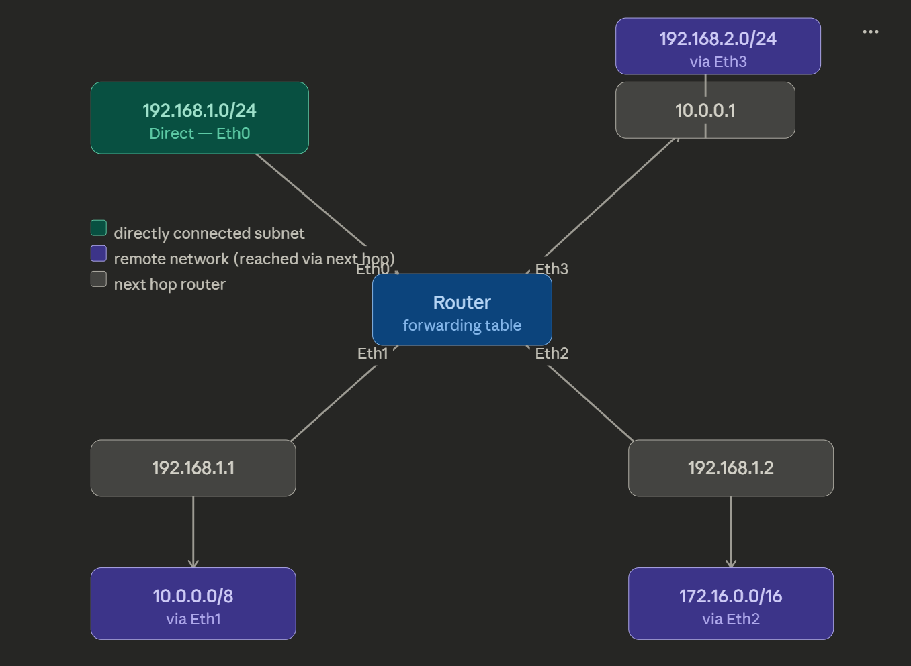
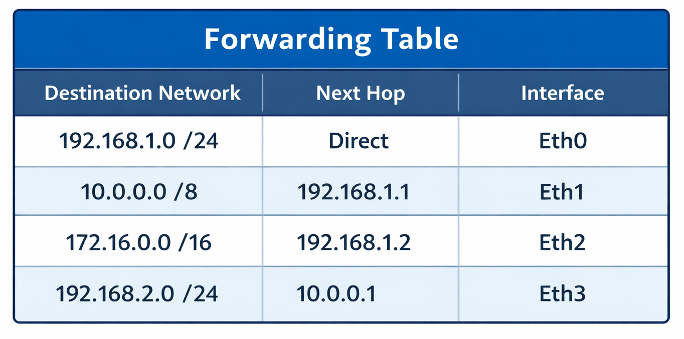
FORWARDING TABLE
A forwarding table is a data structure used by network devices like routers and switches to quickly forward packets or frames.
It stores a mapping between the destination address (IP or MAC) and the appropriate outgoing interface or next hop, allowing efficient data transmission without delay.
The forwarding table contains only the essential information needed for forwarding, such as destination network and outgoing interface.
It does not include metrics or multiple route options, which makes it smaller, optimized, and quicker to search.

Slide 2
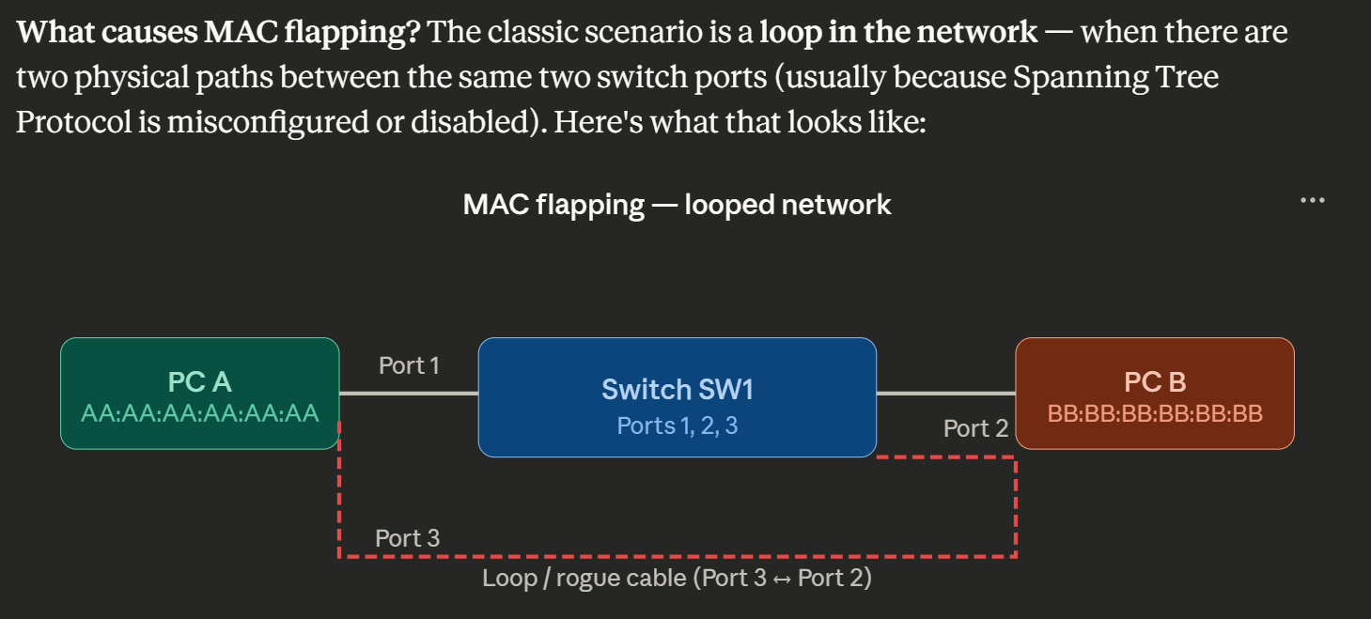
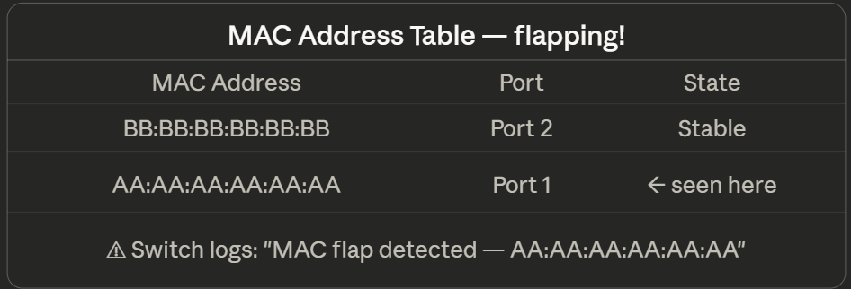
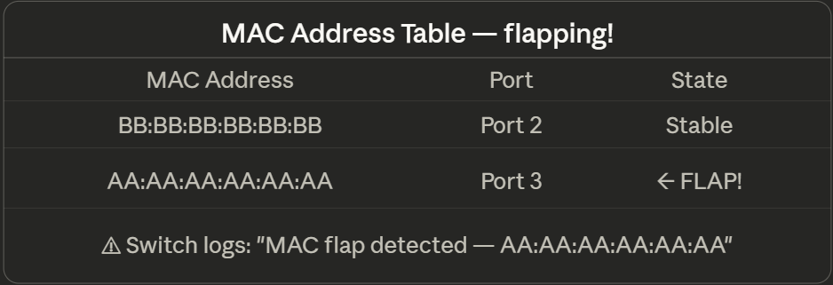
FLAPPING
PC A sends a frame to the switch. The switch inspects the source MAC address (AA:AA:AA:AA:AA:AA) and notes it arrived on Port 1. It writes this into the MAC table.
PC B sends its first frame. The switch learns BB:BB:BB:BB:BB:BB on Port 2.
Now frames from PC A loop back through the switch on Port 3. The switch sees AA:AA:AA:AA:AA:AA arrive on Port 3 and immediately overwrites its table entry.
The looped frame re-enters again from Port 1 a millisecond later — and then from Port 3 again. This repeats thousands of times per second. The MAC table thrashes back and forth. The switch can't learn where PC A really is.

