Slide 1
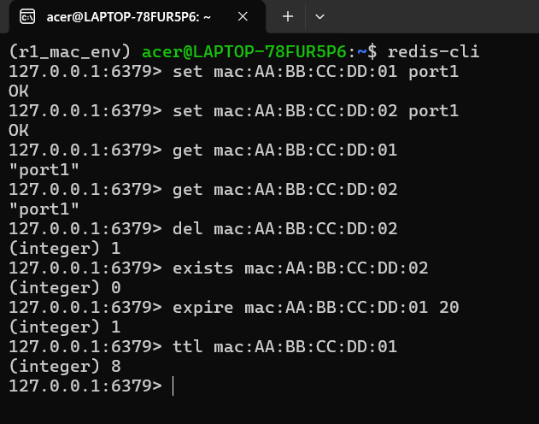
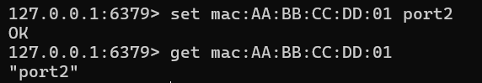
String

Slide 2
String
Command | Function | Working Example | Project Use Case
SET | Stores a key-value pair | set mac:AA:BB:CC:DD:01 port1 | Used to learn and map a host to a port.
GET | Retrieves the value of a key | get mac:AA:BB:CC:DD:01 | Allows the agent to look up a host's location.
EXPIRE | Sets a timeout on a key | expire mac:AA:BB:CC:DD:01 20 | Simulates MAC aging by timing out old entries.
TTL | Checks remaining time to live | ttl mac:AA:BB:CC:DD:01 | Monitors when a MAC entry is about to expire.
DEL | Removes a key | del mac:AA:BB:CC:DD:02 | Manually removes a host from the forwarding table.
EXISTS | Checks if a key exists | exists mac:AA:BB:CC:DD:02 | Verifies if a MAC address is currently "learned."

Slide 3

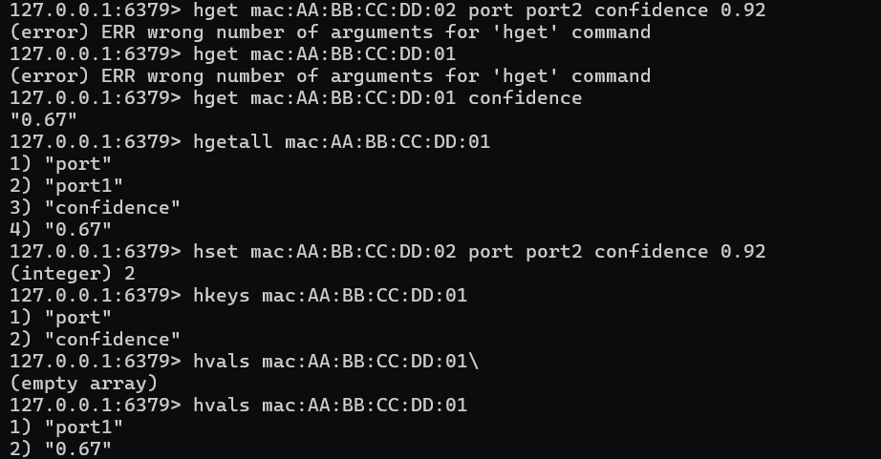
Hash

Slide 4
Hash
Command | Function | Working Example | Project Use Case
HSET | Sets multiple fields in a hash | hset mac:AA:BB:CC:DD:01 port port1 confidence 0.67 | Stores the agent's location prediction and confidence.
HGET | Gets the value of a specific field | hget mac:AA:BB:CC:DD:01 confidence | Retrieves only the confidence level for a specific MAC.
HGETALL | Retrieves all fields and values | hgetall mac:AA:BB:CC:DD:01 | Provides the full "State" profile of a network host.
HKEYS | Lists all field names in a hash | hkeys mac:AA:BB:CC:DD:01 | Identifies which attributes are tracked for a MAC.
HVALS | Lists all values in a hash | hvals mac:AA:BB:CC:DD:01 | Extracts raw data (port and score) for processing.

Slide 5
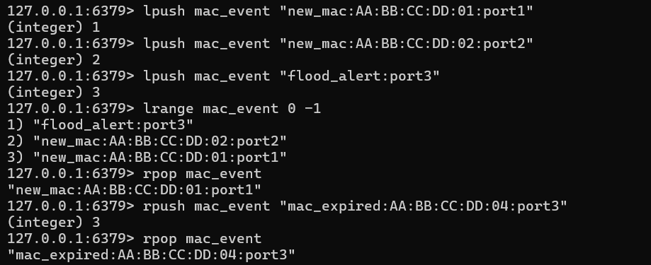
List
1 2 3
flood_alert
port3
new_mac02
new_mac01
1 2 3
flood_alert
port3
new_mac02
mac_expiredport3
1 2 3
flood_alert
port3
new_mac02

Slide 6
List
Command | Function | Working Example | Project Use Case
LPUSH | Adds an event to the head (Left) | lpush mac_event "flood_alert:port3" | Logs the most recent network event.
RPUSH | Adds an event to the tail (Right) | rpush mac_event "mac_expired..." | Appends background logs or cleanup events.
LRANGE | Retrieves a range of events | lrange mac_event 0 -1 | Provides a timeline of events for pattern analysis.
RPOP | Removes the oldest element | rpop mac_event | Processes and clears the oldest log entry.
LINDEX | Gets an event at a specific index | lindex mac_event 1 | Inspects a specific point in the network history.

Slide 7
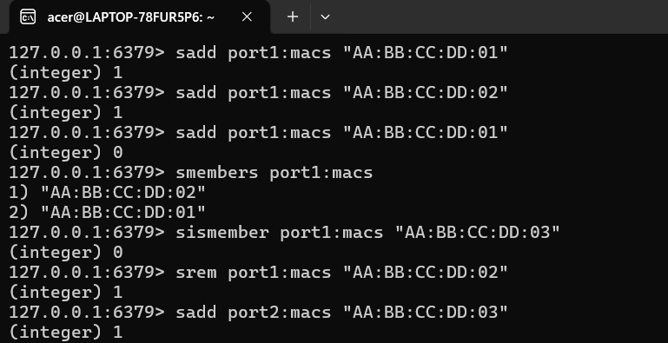
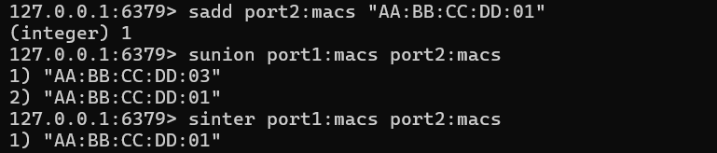
Set

Slide 8
Set
Command | Function | Working Example | Project Use Case
SADD | Adds a unique MAC to a port set | sadd port1:macs "AA:BB:CC:DD:01" | Tracks all unique devices connected to a port.
SMEMBERS | Lists all MACs on a port | smembers port1:macs | Audits the current population of a specific port.
SREM | Removes a MAC from the set | srem port1:macs "AA:BB:CC:DD:02" | Updates the set when a host disconnects.
SUNION | Combines MACs from multiple ports | sunion port1:macs port2:macs | Checks the total device count across the switch.
SINTER | Finds MACs present on both ports | sinter port1:macs port2:macs | Detects Network Loops or duplicate MAC issues.

Slide 9

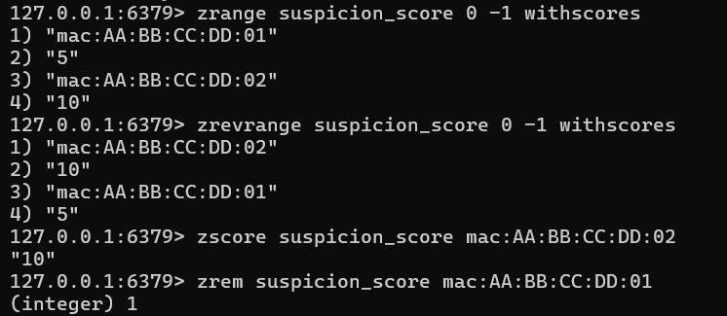

Sorted Sets

Slide 10
Sorted Sets
Command | Function | Working Example | Project Use Case
ZADD | Adds a MAC with a numeric score | zadd suspicion_score 10 mac:AA...:02 | Ranks hosts by their likelihood of causing a flood.
ZRANGE | Lists MACs by lowest score | zrange suspicion_score 0 -1 | Identifies the most "trusted" devices in the network.
ZREVRANGE | Lists MACs by highest score | zrevrange suspicion_score 0 -1 | Highlights the most suspicious hosts for the agent.
ZSCORE | Gets the score of a specific MAC | zscore suspicion_score mac:AA...:02 | Checks the exact threat level of a specific host.

Slide 11
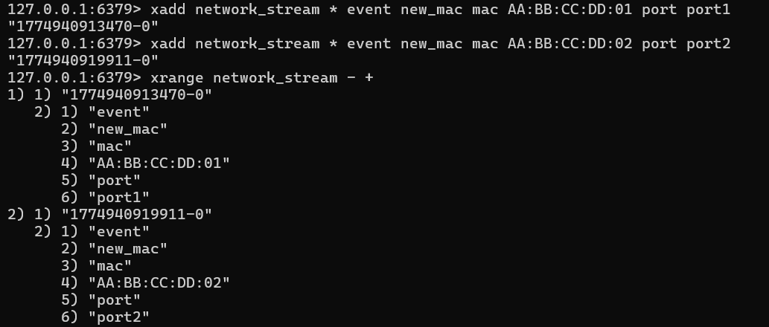
Stream

Slide 12
Stream
Command | Function | Working Example | Project Use Case
XADD | Appends a new event with a timestamp | xadd network_stream * event new_mac... | Creates a real-time, immutable audit trail.
XRANGE | Queries events between two IDs | xrange network_stream - + | Analyzes traffic spikes within a specific timeframe.

