Slide 1
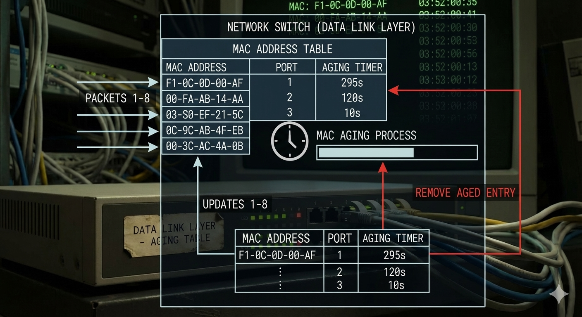
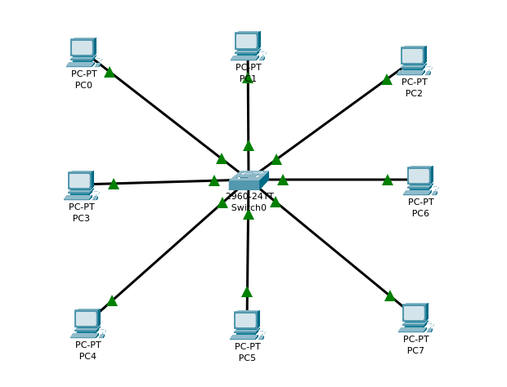
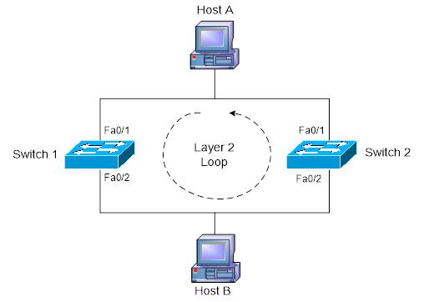
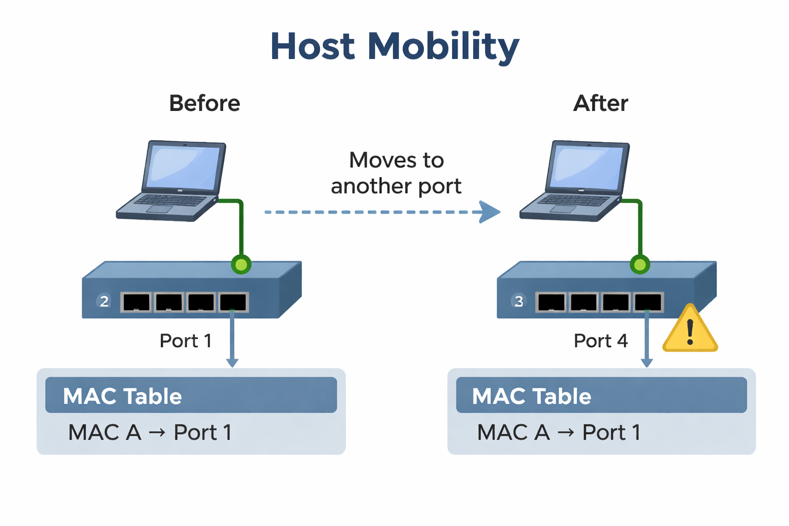
Challenges associated with the Layer 2 (L2) network
MAC Aging
Flooding
Occurs when the switch does not know the destination MAC address
Frame is sent to all ports (except source)
Causes unnecessary traffic and congestion
Common due to unknown devices or MAC aging
Switch removes MAC entries after a timeout
Helps free memory but may cause frequent relearning
Leads to unknown unicast flooding
Improper aging time → performance issues
MAC Flapping
Same MAC appears on multiple ports repeatedly
Happens rapidly and continuously
Caused by loops or misconfiguration
Abnormal behavior
Leads to network instability & packet loss
Host Mobility
Device moves from one port to another
MAC address updates after movement
Happens occasionally
Normal network behavior
Causes temporary delay or minor flooding

