Slide 1
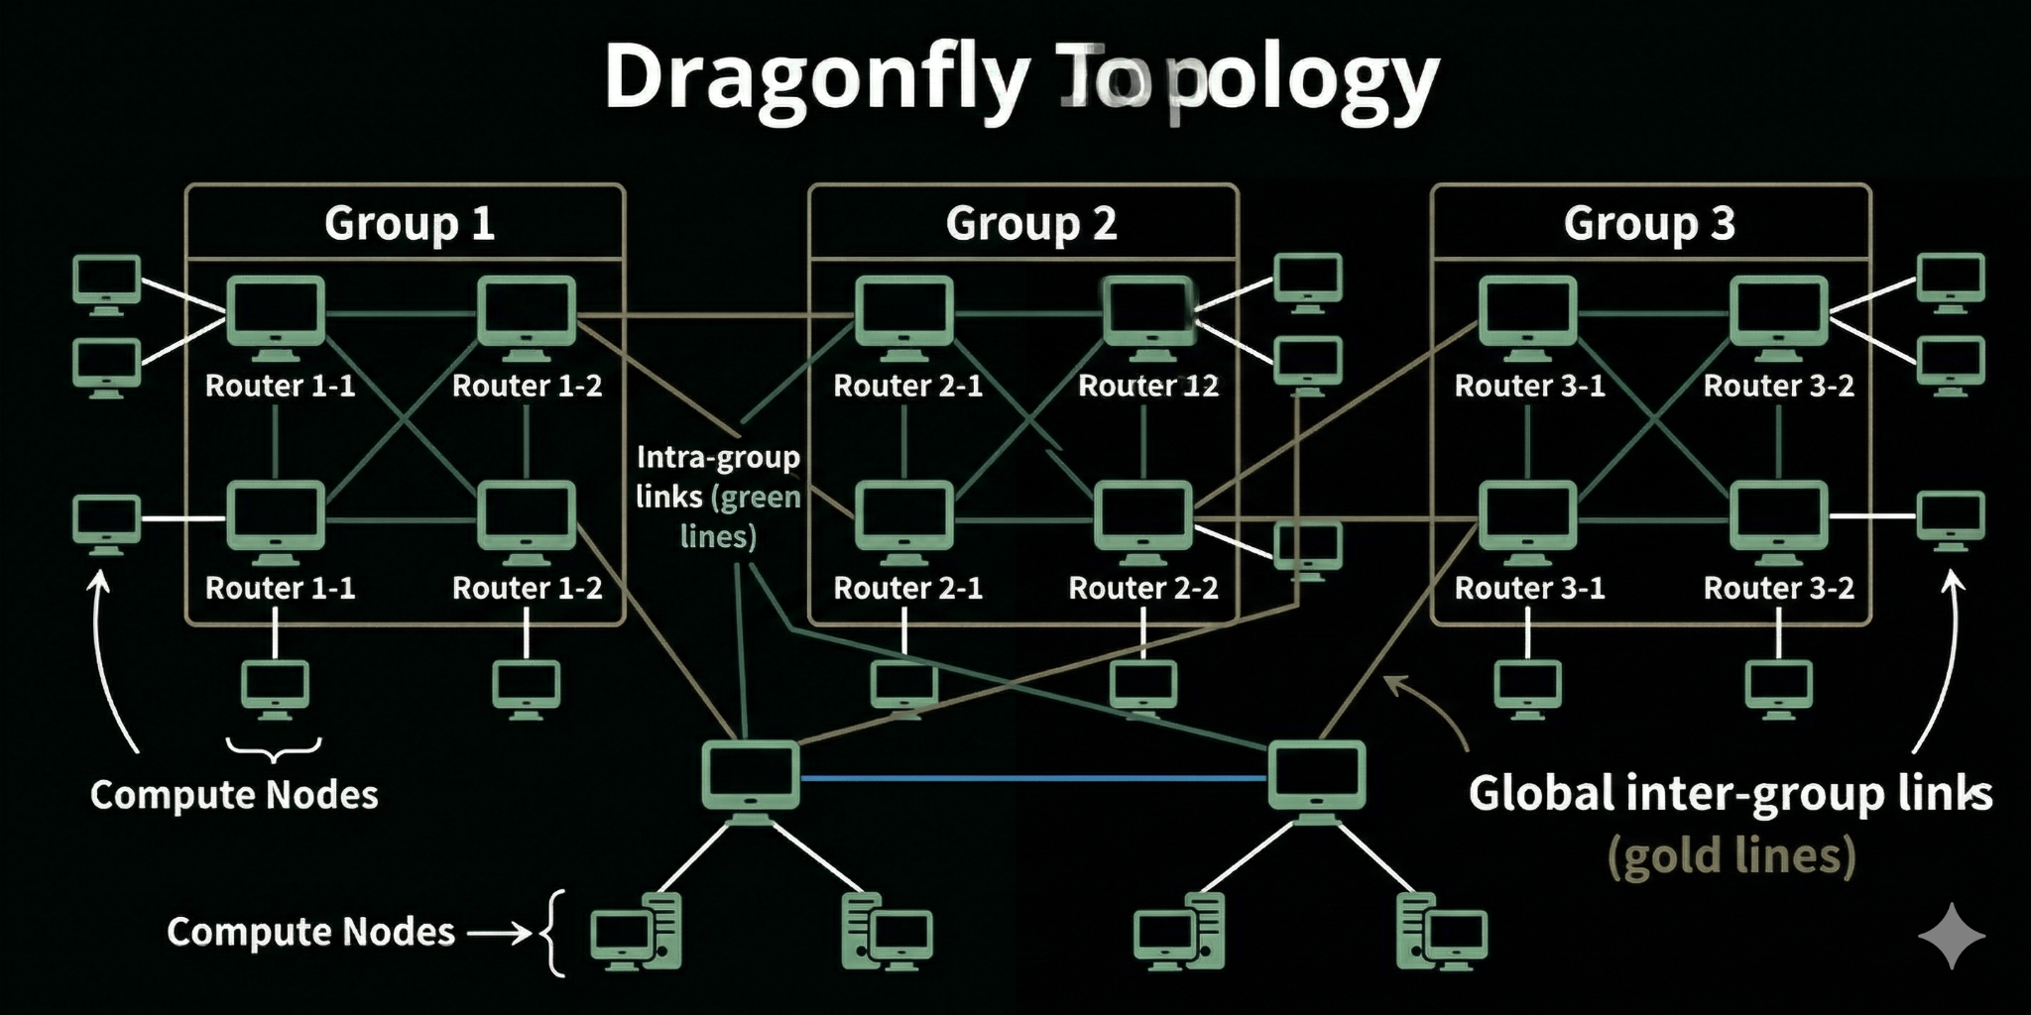

Network Topologies: Types & Use Cases
- Lavanya Goyal
Bus
Star
Ring
Structure: Single backbone cable
Structure: Central hub/switch
Structure: Circular loop
+ Low cost, simple
+ Easy management, fault isolation
+ No collision, predictable
– Collisions, low scalability
– Hub failure = network down
– Single break affects network
Use: Legacy, small setups
Use: Home Wi-Fi, office LANs
Use: Telecom, fiber rings
Tree
Mesh
Hybrid
Structure: Hierarchical (Star + Bus)
Structure: Multiple redundant paths
Structure: Combination of topologies
+ Scalable, structured
+ High reliability, no single failure
+ Flexible, optimized performance
– Backbone dependency
– Expensive, complex
– Complex, costly
Use: Corporates, campuses
Use: Internet backbone, data centers
Use: Cloud, enterprise networks
Dragonfly (Advanced)
Structure: Group-based network
+ Low latency, scalable
– Complex design
Use: HPC, AI clusters, Supercomputers
Dragonfly topology with AI-based MAC provisioning enables scalable, low-latency, and efficient network communication by reducing flooding and optimizing forwarding decisions.

