Slide 1
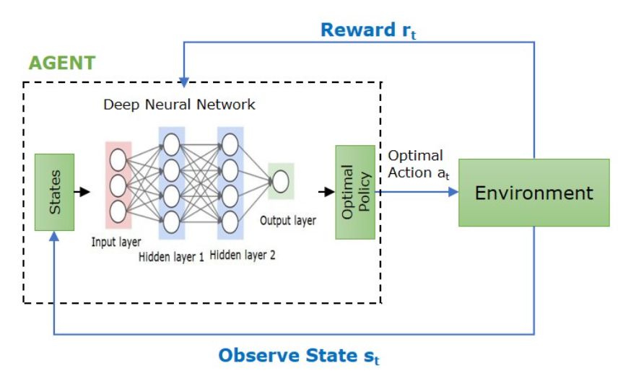
DEEP Q-NETWORK
Gives the ability to compute Q-values for all possible actions in a given state with only a single forward pass through the network.
Q-Value for action a₁
DQN
S
Q-Value for action a₂
…
Q-Value for action a_{n}
Q(s, a; w) ≈ Q*(s, a)

Slide 2
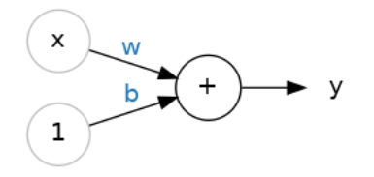
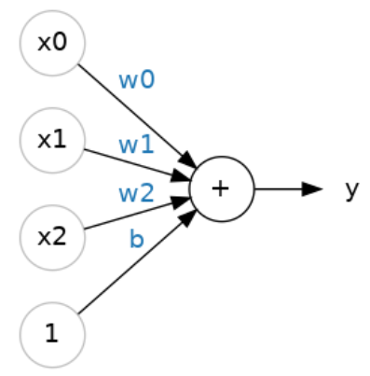
Neuron
Input(x) :- numeric features given
Weight(w) :- determines how much influence the information from the previous neuron has on the next one.
Initial weights : Xavier Initialization
w = random_uniform(-1/√n, +1/√n)
Where n : number of inputs to this layer
Bias(b) :- enables the neuron to modify the output independently of its inputs.
Output(y) :- Output layer carries Q-values generated per action.
y = wx + b
y = w0x0 + w1x1 + w2x2 + b

Slide 3

Layers in Neural Network Architecture
Input Layer : Receives input data. Each input in the layer corresponds to a feature in the input data.
Hidden Layers : It performs nonlinear transformations on input data allowing the network to learn complex patterns and features.
Output Layer :
Generates Q-value for each action.
5 Input Features
7 O/P (Q-Value
per action)
64 Neurons

Slide 4
1. State Vector
represents the environment's current situation as a numerical array
Neural network input layer has a fixed number of neurons — decided at architecture design time and never changes.
Range : 0 to 1
For e.g;
state = [ mac_table_entries, flood_pressure. port_traffic, entry_age, new_mac_rate]
S1 = [0.60, 0.10, 0.20, 0.95, 0.05]
 | State Name | What it is | What it Represents | Why Agent Needs It | Decision Signals | Normalization | Critical Meaning
1 | MAC Table Entries | Current fill percentage of MAC table | How full the switch memory is | Primary indicator of flooding risk | High value → take action to reduce entries | current_entries / max_capacity | >0.85 warning, >0.95 emergency
2 | Flood Pressure | Rate of packets being flooded | Direct measurement of flooding problem | Detects flooding even before table is full | High flood + high table → critical | current_flood_rate / max_flood_rate | High = switch already flooding
3 | Port Traffic | Overall bandwidth usage | Traffic volume entering switch | Distinguishes heavy traffic vs stale entries | High traffic + high table → traffic surge | current_bandwidth / max_bandwidth | High = more MAC learning incoming
4 | Entry Age | Average age of MAC entries | Indicates stale entries in table | Helps decide eviction vs blocking | High age + high table → evict stale | avg_age / max_age | High = table clogged with stale entries
5 | New MAC Rate | Rate of new MAC arrivals | Growth speed of table | Predicts future overflow | High rate → possible MAC flood attack | current_rate / max_rate | High = table filling fast

Slide 5
3. Action selection via Epsilon Greedy
2. Forward Pass
List of All Actions :-
LEARN_MAC
EVICT_ENTRY
FLOOD
BLOCK_PORT
UNBLOCK_PORT
INCREASE_AGING_TIMER
DECREASE_AGING_TIMER
the computation that happens inside the network when you give it a state vector and ask for Q-values.
Data Flow : input → Hidden layers → Output
Linear Transformation :-
Z = w₁​x₁​ +w₂x₂​ +…+ w_{n}x_{n}​+b
2. Activation Function :-
decides whether a neuron should “fire”.
ReLU (Rectified Linear Unit) is used.
f(x)=max(0, Z)
0<epsilon<1
Exploration
Exploitation
- Explore unknown knowledge
Choose Random action
Epsilon close to 1
Exploit current knowledge
Choose Argmax{Q(S,A,w)}
Epsilon close to 0
Start with ε = 1.0
End with ε = 0.01
Every episode ε shrinks by 0.5%. Agent explores less and less as it gets smarter.

Slide 6
4. Reward
5. Experience Replay Buffer/Replay Buffer
Situation | Reward
Correct MAC lookup and delivery | +1.0
Flooding Avoided | +0.8
Preventive entry removal before table overflow | +0.3
Necessary flooding (Unknown MAC) | −0.1
Unnecessary flooding of frame | −1
Wrong port delivery due to stale entry | −0.5
Early removal of active entry (useful entry) | −0.3
Table overflow | −0.7
Replay Buffer : a fixed-size memory store that holds last N experience tuples (s, a, r, s’, done_flag) from prior episodes.
- Works like a circular queue.
Problems with Q-Learning :-
1. Correlation :
Training over consecutive identical states makes network obsess over recent patterns and unlearn older ones.
2. Catastrophic Forgetting :
When new experiences come in, gradient updates overwrite what was learned from older experiences.
The network has no memory of the past.
Reward generated based upon the performed action.
New state is observed.(S’)

Slide 7
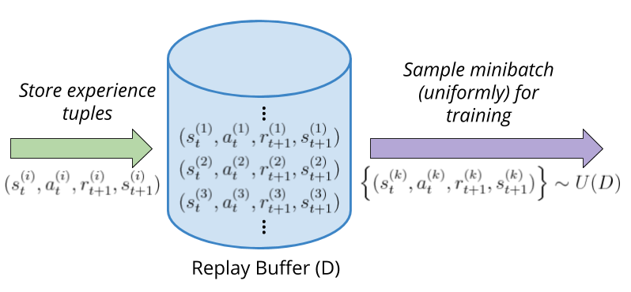


6. Mini Batch Training
7. Target Network
For each of 64 transitions, calculate target y_{i} using Target Network
If episode continues (done = false):
If episode ended (done = true):
Working :-
Every switch simulation step pushes one tuple into the buffer
Random mini-batch (32–64 tuples) uncorrelated transitions sampled at each training step
Random sampling guarantees mix of all situation classes in every batch
Discount Factor(Gamma) : 0.9

Slide 8
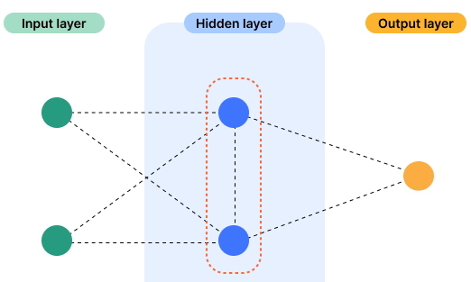




8. Loss Function/ MSE(Mean Square Error)
Quantifies the difference between the predicted outputs of a machine learning algorithm and the actual target values.
w₁₁
o₁₁
b₁₁
w₂₁
L = 1/n * ∑​(y_{i}​−$\hat{y}$​)²
w₁₂
o₂₁
b₂₁
$\hat{y}$​
w₁₃
n = 64
w₁₄
w₂₂
L = ​(y_{i}​−$\hat{y}$​)²
b₁₂
o₁₂
Can inc. or dec.
$\hat{y}$​ = o₁₁w₂₁ + o₁₂w₂₂ + b₂₁
Depends upon
Depends upon
weights
bias

Slide 9

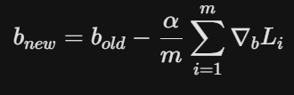


9. Backpropogation
A Neural Network update changes all weights simultaneously to minimise loss via backpropagation. Every weight in every layer shifts a little.
w₁₁
o₁₁
b₁₁
w₂₁
w₁₂
o₂₁
Where
m = 64
Learning Rate(alpha) : 0.1
b₂₁
$\hat{y}$​
w₁₃
w₁₄
w₂₂
b₁₂
o₁₂
$\hat{y}$​ = o₁₁w₂₁ + o₁₂w₂₂ + b₂₁

Slide 10
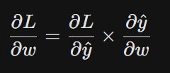
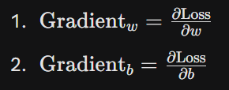


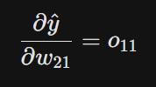


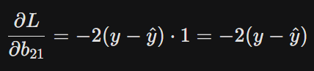


10. Gradient Descent
For w₂₁ :-
For b₂₁ :-
L = ​ 1/n * ∑​(y_{i}​−$\hat{y}$​)²
$\hat{y}$​ = o₁₁w₂₁ + o₁₂w₂₂ + b₂₁

Slide 11
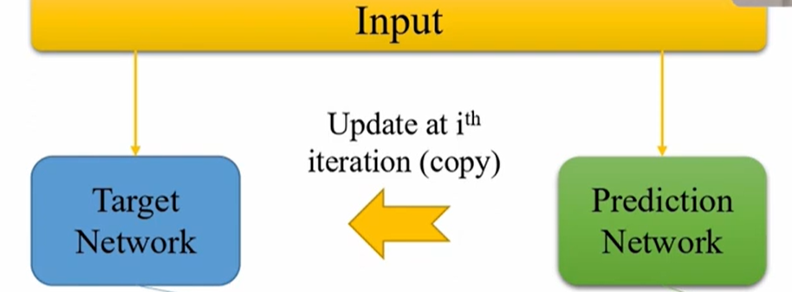
11. Target Network
Initially,
W11_predicted_network = W11_target_network … all weights are same
Problem: the target for Q-values is derived from the Predicted-network
If we use the same network to:
Compute the current Q-values.
Predict the next-state Q-values (targets).
The network updates itself using its own rapidly changing predictions, which can lead to:
Oscillations - Using a single Q-network for both action selection and target estimation can lead to overestimation of Q-values.
Divergence in Q-value estimation.
Solution : Copy Prediction Network weights to target network every N steps
if current_step % N == 0:
target_network.weights = copy(prediction_network.weights)
else:
do nothing, target network stays frozen
N = 300

Slide 12
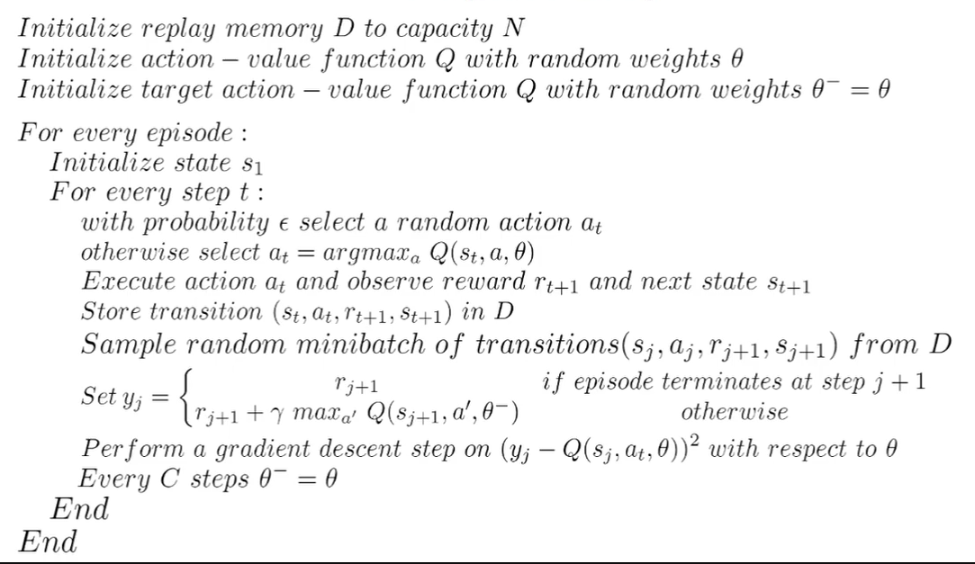
The Algorithm

