Slide 1
The Mathematical Models
Model 1 — Dynamic TTL Adjustment (Shrink or Extend Expiry
Instead of a fixed aging timer (e.g., always 300s), compute TTL per entry using a formula:
TTL(mac) = TTL_base × α × F_activity × F_stability × F_pressure
TTL_base = baseline timer (e.g., 300 seconds)
F_activity = activity factor = 1 + log(1 + tx_count) higher tx_count → entry stays longer
F_stability = stability factor = 1 / (1 + flap_count) flapping MAC → TTL shrinks fast
F_pressure = table pressure factor = 1 - (occupied / capacity) full table → TTL shrinks to free space α = normalizing constant (e.g., 0.5)

Slide 2

Adaptive Activity Control States
The activity level of each MAC entry is determined using the transmission count $\left(tx_{count}\right)$. Based on this, an activity factor $\left(F_{activity}\right)$is assigned, which influences the lifetime of the entry.
Higher transmission counts indicate frequent usage, resulting in longer retention in the MAC table.
$S\left(t\right)=\left\{\begin{matrix}\text{Active} & \text{if} {tx}_{count}≥16 \\ \text{Idle} & \text{if} 1<tx_count≤15 \\ \text{Inactive} & \text{if} {tx}_{count}=0\end{matrix}\right.$
INACTIVE
tx_count = 0
F_activity = 1.000
No frames ever seen
IDLE
tx_count = 1 – 15
F_activity = 1.001 – 2.773
Seen but unconfirmed
ACTIVE
tx_count ≥ 16
F_activity ≥ 2.833
Confirmed, earns full TTL

Slide 3

MAC Entry Stability Conditions
The stability of a MAC entry is determined using the flap count $\left(flap_{count}\right)$, which measures how often the MAC address changes ports.
STABLE
flap_count = 0
F_stability = 1.000
No penalty — full TTL
FLAPPING
flap_count = 1 – 9
F_stability = 0.500 – 0.100
TTL cut 50% → 90%
UNSTABLE
flap_count ≥ 10
F_stability ≤ 0.091
TTL >91% suppressed
MAC Table Pressure Conditions
The flood pressure state is determined using the MAC table occupancy ratio $\left(occ\right)$, which reflects how full the table is. Based on this, the pressure factor $\left(F_{pressure}\right)$dynamically controls entry expiration behavior.
NOT FULL
0% < occ < 65%
0 < occupied/cap < 0.65
F_pressure > 0.350
Table not full — TTL runs freely
NEARLY FULL
65% ≤ occ < 85%
0.65 ≤ occupied/cap < 0.85
0.150 < F_pressure ≤ 0.350
TTL compression begins
FULL
85% ≤ occ < 100%
0.85 ≤ occupied/cap < 1.0
F_pressure ≤ 0.150
eviction active

Slide 4
Examples:
tx_count=50, flap_count=0, occupancy=40%
TTL = 300 × 0.5 × (1+log51) × (1/1) × (1-0.4)
= 300 × 0.5 × 4.93 × 1.0 × 0.6
= 443 seconds → EXTEND (active, stable, table not full)
The high TTL of 443 seconds indicates that the MAC entry is highly active and stable, making it important to retain. With low table occupancy (40%), the system allows extended lifetime, ensuring efficient and reliable communication.
tx_count=2, flap_count=4, occupancy=90%
TTL = 300 × 0.5 × (1+log3) × (1/5) × (1-0.9)
= 300 × 0.5 × 1.48 × 0.2 × 0.1
= 4.4 seconds → SHRINK FAST (inactive, flapping, table nearly full)
The very low TTL of 4.4 seconds shows that the MAC entry is low-activity and unstable, making it unreliable to retain. Due to high table occupancy (90%), the system will aggressively reduce its lifetime to quickly free space and prevent congestion.

Slide 5

Model 2 — Flood Suppression Score (Avoid Flooding)
FloodScore(mac) = w1×P_seen + w2×(1 - P_table_full) + w3×(1 - P_high_traffic)
P_seen = probability MAC was seen before (0 if new, 1 if known)
P_table_full = occupied / capacity
P_high_traffic = current_pps / max_pps (packets per second ratio)
w1, w2, w3 = weights (e.g., 0.5, 0.3, 0.2)
Favorable Conditions $\left(FloodScore>0.6\right)$
$P_{seen}=1, P_{table_full}≈0, P_{high_traffic}≈0$
$FloodScore=w_{1}P_{seen}+w_{2}\left(1−P_{table_full}\right)+w_{3}\left(1−P_{high_traffic}\right)>0.6$
Flood allowed; low cost and minimal network impact
Unfavorable Conditions $\left(FloodScore≤0.6\right)$
$P_{seen}=0, P_{table_full}→1, P_{high_traffic}→1$
$FloodScore≤0.6$due to high load and low confidence
Flood suppressed; prevents congestion and table instability

Slide 6
Example:
New MAC (P_seen=0), table 80% full, traffic 70% of max:
FloodScore = 0.5×0 + 0.3×(1-0.8) + 0.2×(1-0.7)
= 0 + 0.06 + 0.06 = 0.12 → SUPPRESS flood
Known MAC recently (P_seen=0.8), table 30% full, low traffic:
FloodScore = 0.5×0.8 + 0.3×0.7 + 0.2×0.9
= 0.4 + 0.21 + 0.18 = 0.79 → FLOOD allowed

Slide 7
Model 3 — Entry Priority Score (Who Gets Evicted First?)
When the table is full, instead of evicting randomly or by oldest-first, compute an eviction priority score per entry:
Priority(mac) = w1×(age/TTL_max) + w2×(1/tx_count) + w3×flap_count
Higher Priority = evict this entry first
age/TTL_max → older entries score higher
1/tx_count → rarely used entries score higher
flap_count → flapping entries score higher (they're unstable anyway)
Example:
MAC-A: age=280s, tx=1, flaps=3 → Priority = 0.93 + 1.0 + 0.3 = 2.23 ← evict first
MAC-B: age=150s, tx=20, flaps=0 → Priority = 0.5 + 0.05 + 0.0 = 0.55
MAC-C: age=290s, tx=5, flaps=1 → Priority = 0.97 + 0.2 + 0.1 = 1.27 ← evict second

Slide 8


Model-4 : Flap Detection using Z-Score
We check how unusual a MAC address’s port changes are compared to others.
Z_score(mac) = (flap_rate_mac - μ_flap) / σ_flap
flap_rate_mac = how many times a MAC changes ports per minute
μ_flap = average flap rate across all MACs
σ_flap = standard deviation of flap rates
$flap_rate_{mac}>μ_{flap}$& small $σ$ ⇒ $Z$becomes very high → Even a small increase looks abnormal → BLOCK likely
$flap_rate_{mac}>μ_{flap}$​ & large $σ$ ⇒ $Z$increases slowly → Difference is tolerated → May still be allowed
$flap_rate_{mac}<μ_{flap}$​ & small $σ$ ⇒ $Z$becomes more negative → Clearly stable → ALLOW
$flap_rate_{mac}<μ_{flap}$& large $σ$ ⇒ $Z$slightly negative → Still normal → ALLOW
Final Threshold Condition
If $Z>2$→ occurs when (high difference + low deviation) → BLOCK
If $Z≤2$→ occurs when (small difference or high deviation) → ALLOW

Slide 9
Why Our Mathematical Model Beats Q-Learning for MAC Table Management
Our mathematical model solves flapping by directly shrinking TTL via F_stability as flap_count rises, making unstable MACs self-evicting without any learning phase.
It controls flooding intelligently through FloodScore, which weighs MAC knowledge, table pressure, and traffic load together to suppress unnecessary broadcasts while preserving legitimate ones.
Model 3 ensures the least valuable entries (old, inactive, flapping) are always evicted first. Unlike Q-Learning, which requires exploration time, a reward function, and significant compute, our model delivers deterministic, auditable, line-rate decisions from deployment day one — making it practically superior for real network hardware.

Slide 10
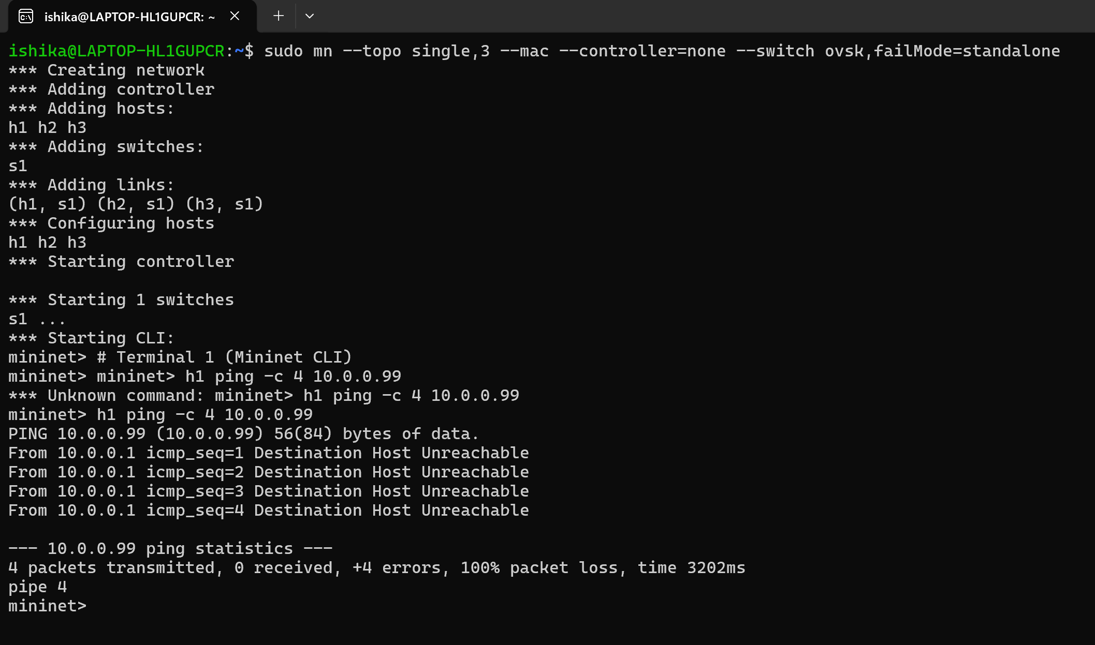
FLOODING
Traffic Flooding
Created topology: 1 switch (s1) with 3 hosts (h1, h2, h3)
Sent ping from h1 to unknown IP (10.0.0.99)
Switch has no MAC/IP entry for destination
Frame is flooded to all ports except incoming port
tcpdump run on switch interface (s1-eth) to capture traffic
Observed repeated broadcast packets across interfaces
Ping result: 100% packet loss (Destination Host Unreachable)

Slide 11
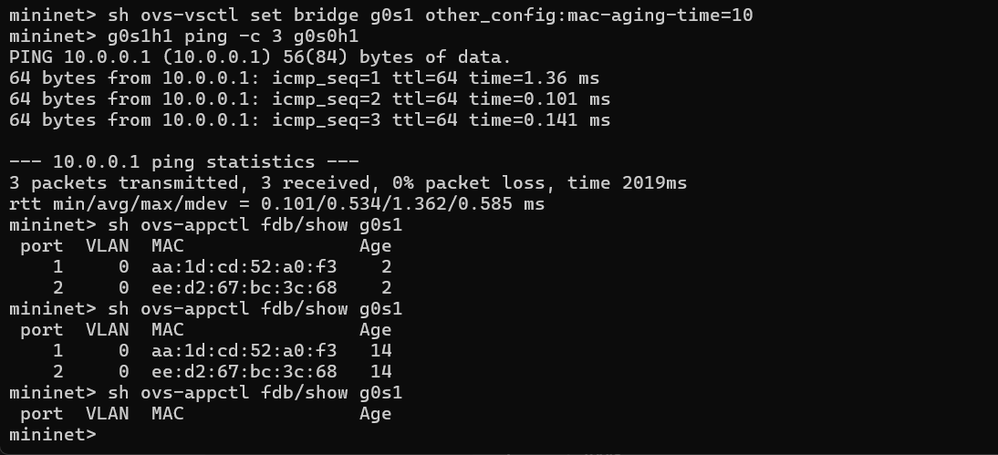
MAC Aging :

Slide 12
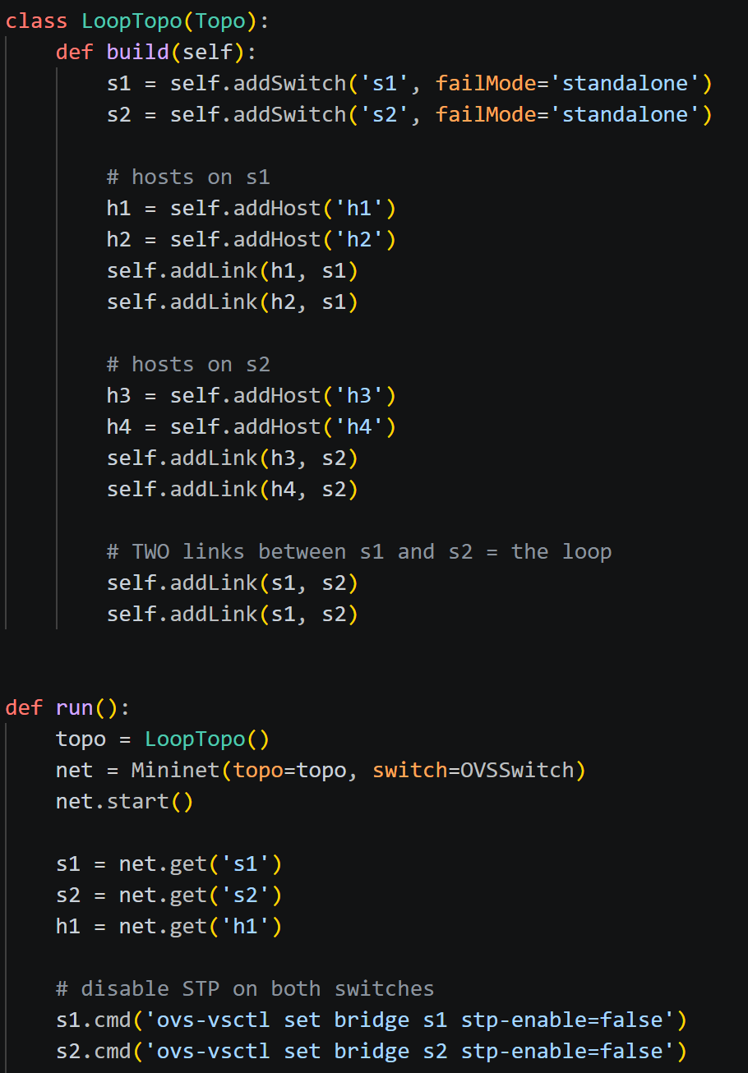
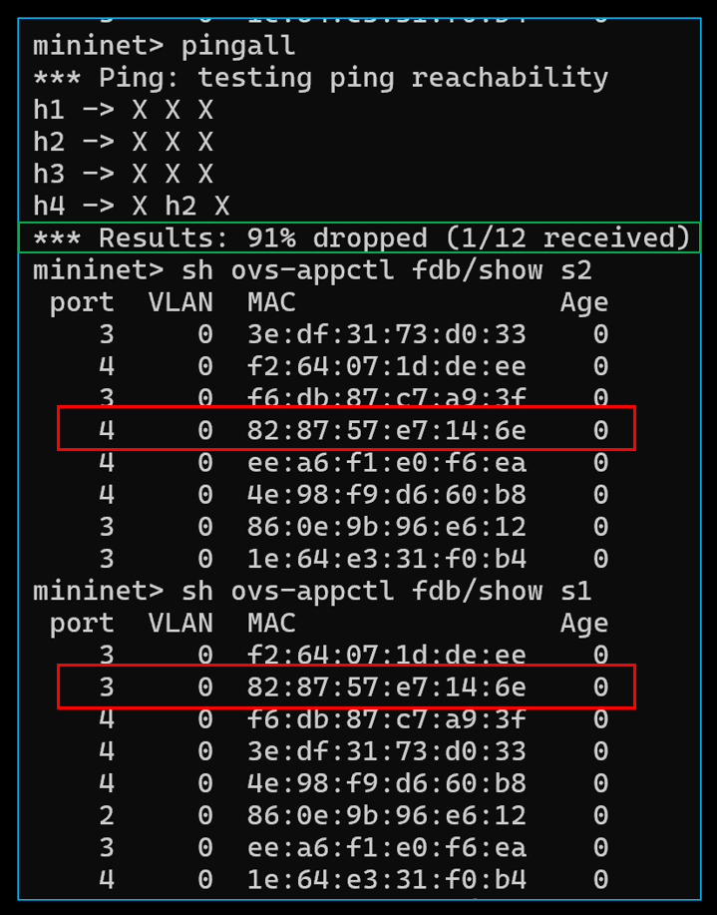
FLAPPING
MAC Address Flapping (Loop Scenario)
Topology: 2 switches (s1, s2) and 4 hosts, with two parallel links between switches creating a loop
STP is disabled, so the loop is not blocked
During pingall, 91% packet loss occurs due to broadcast storms and instability
In the MAC tables, the same MAC address appears on different ports repeatedly
Switches keep updating the MAC entry because frames arrive from multiple paths → MAC flapping

Slide 13
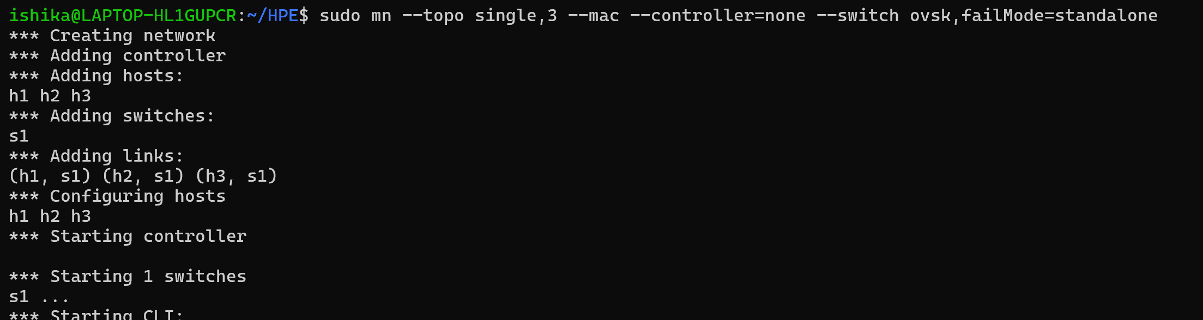
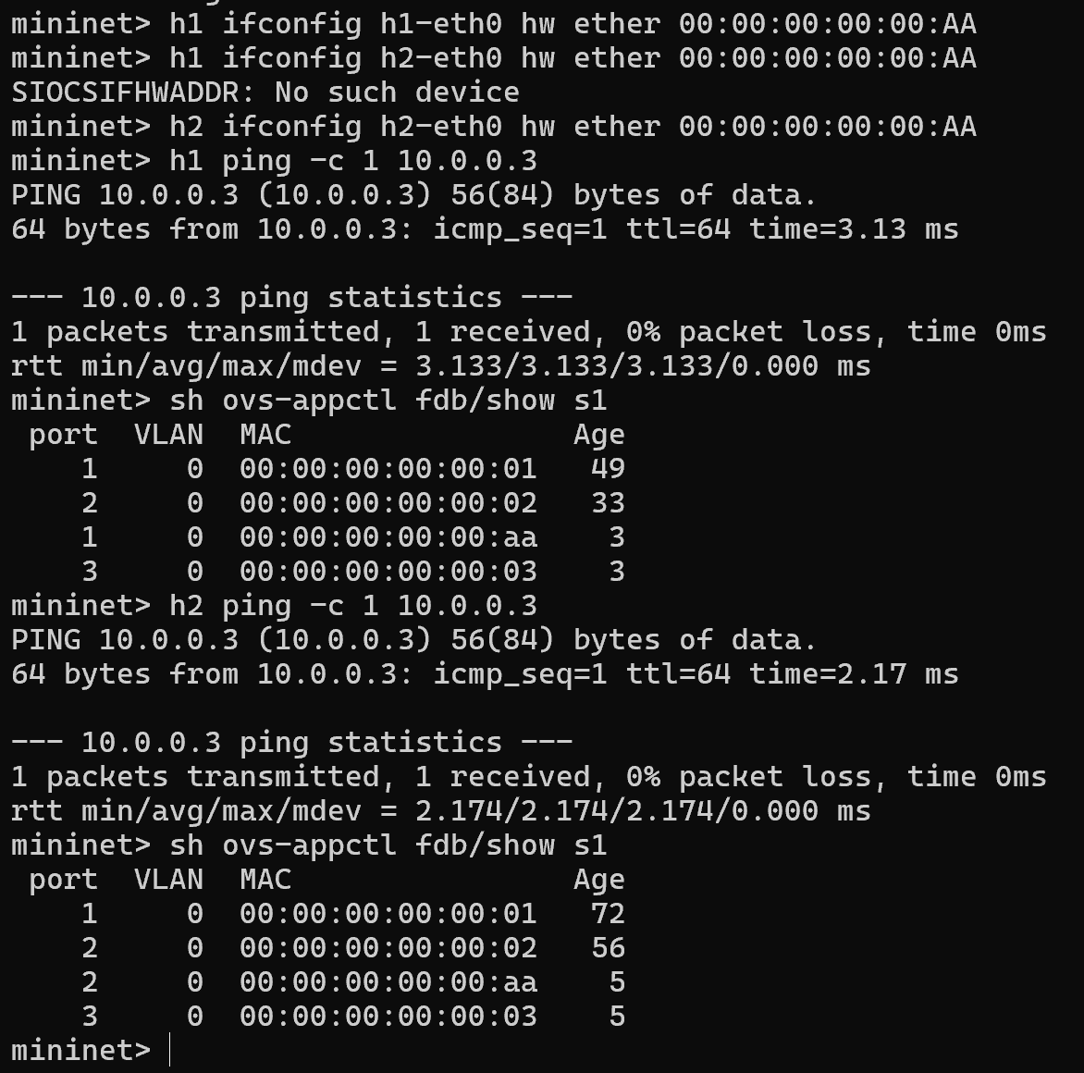
FLAPPING
MAC Flapping (Same MAC on Multiple Hosts)
Mininet topology: 1 switch (s1) with multiple hosts
Manually assigned same MAC address (00:00:00:00:00:AA) to different hosts
Both hosts send traffic (ping), making switch learn MAC from different ports
In MAC table (fdb/show s1), same MAC appears on different ports alternately
Entry keeps changing → MAC flapping occurs
Network may face instability, incorrect forwarding, and packet confusion

