Slide 1
Network Monitoring Dashboard
Monitoring switch health and device activity in real-time

Slide 2
WEEK – 4 Tasks Completed
—
Improved dashboard with more graphical visualizations for better visibility.
—
Successful integration with Prometheus database for data collection.
—
Enhanced MAC entry counting mechanism for better accuracy.
—
Refined monitoring pipeline to ensure consistent data reporting.

Slide 3
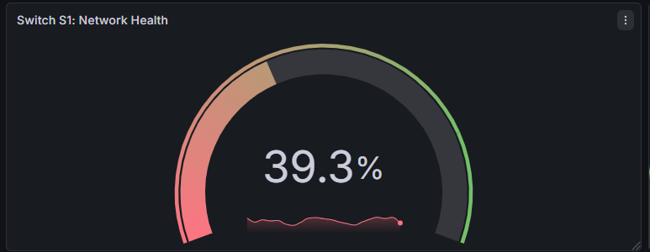
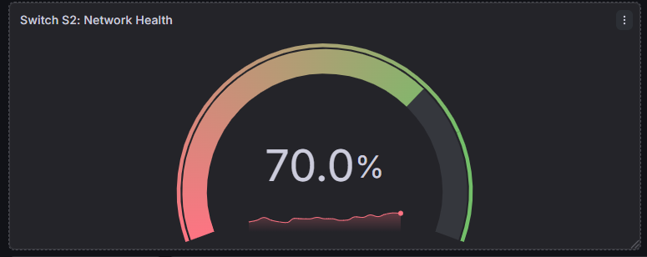
Network Health Analysis
These gauges show how well each switch is working by checking success rates.
—
A higher percentage means the switch is working correctly.
—
A lower percentage shows that packets are being dropped.
—
It compares total packets received against packets dropped.

Slide 4
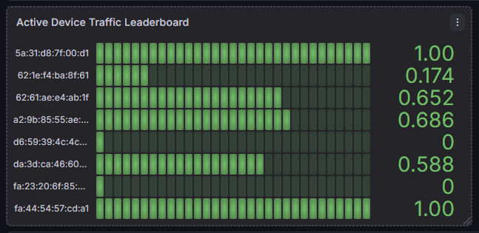
Traffic Leaderboard
This list identifies every unique device (MAC address) found on the network.
—
The green bars show how much data a device is sending right now.
—
If a device stops sending data, the bar shrinks to zero.
—
This allows us to see which hosts are the most active in the network.

Slide 5
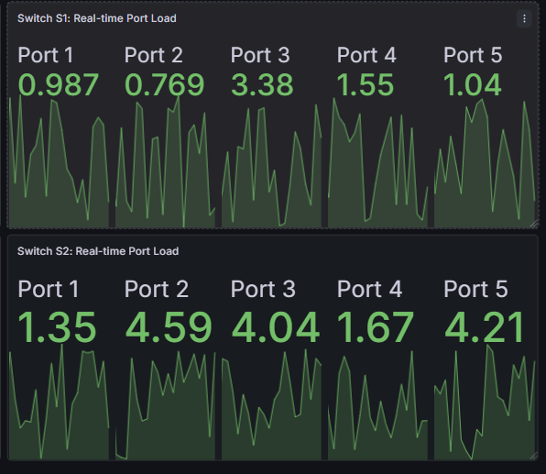
Port Traffic Load
These panels show the current speed of every individual port on the switches.
—
The numbers represent packets per second moving through the port.
—
The small lines below show if traffic is steady or spiking.
—
Helps in checking activity over the last 5 minutes.

Slide 6
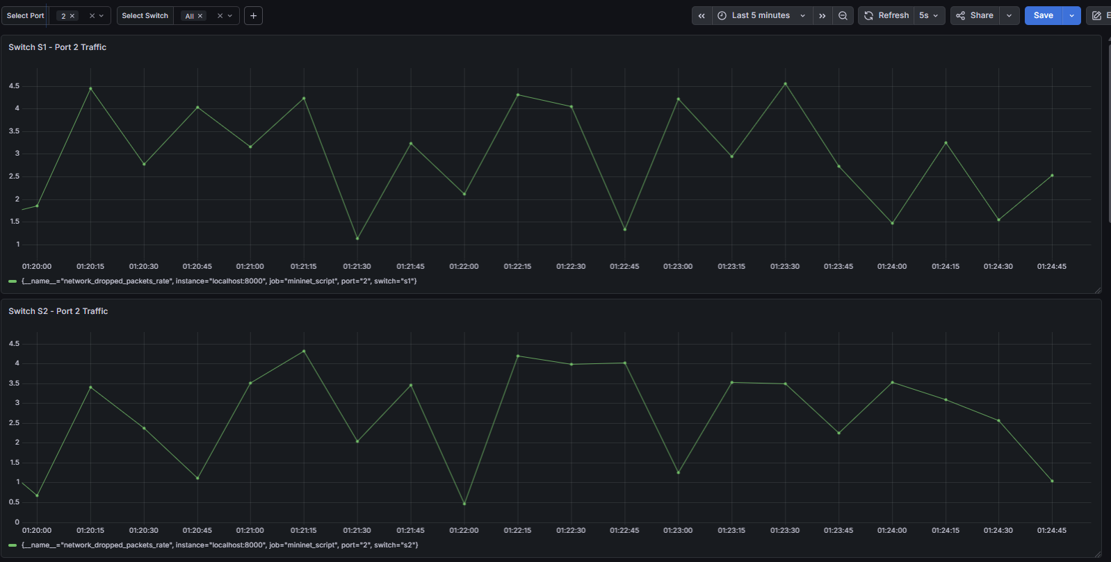
Historical Traffic Trends
These graphs show the history of traffic for a selected switch port.
—
Allows us to look back in time to see host activity.
—
Compares Switch 1 and Switch 2 activity levels.
—
Ensures data is recorded consistently across the path.

Slide 7
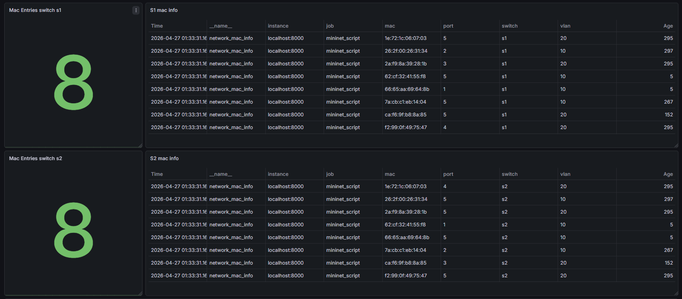
MAC Address Entries
—
Displays the full MAC address table for each switch, showing which device is connected to which port, VLAN, and when it was last seen.
Both S1 and S2 show 8 MAC entries each — confirming all devices are visible from both switches across VLANs 10 and 20.
—

