Slide 1
LEXILEARN
01
University learning at your pace
LexiLearn
A reading and practice companion designed with dyslexic university students in mind.
The moment: a dense machine-learning lecture, scattered notes, and an exam approaching.
Notes:
0:00–1:00. Problem and target. A student understands a concept in class but struggles to revisit a dense lecture transcript alongside slides. Reading effort competes with reasoning. LexiLearn lets the student change the route into the same material. We do not claim a dyslexia treatment or measured attainment improvements. Scenario is illustrative. Source: supplied Student Tech Clash 2026 brief; repository reading preferences, ingestion, and study-reader components.

Slide 2
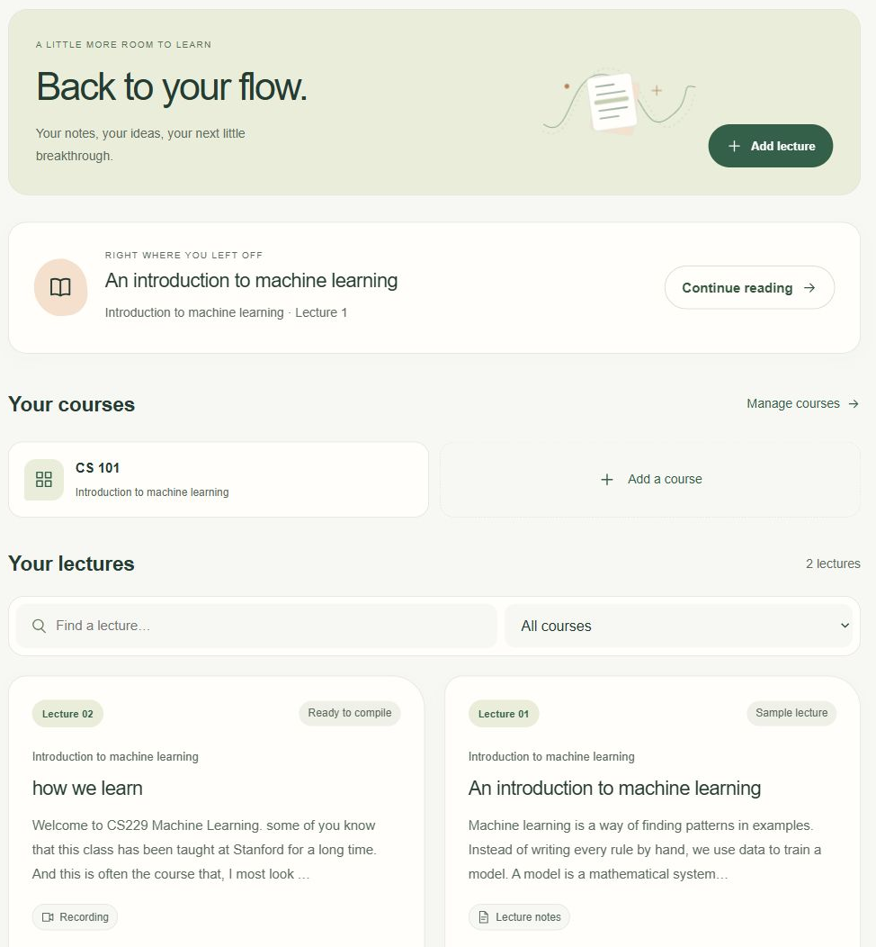
LEXILEARN
02
One lecture, several ways to learn
Real lecture material
Import slides, notes, or a captioned recording. Compile connected notes with source links.
Active study
Read or listen. Try a problem, ask for a hint, then check your reasoning against the lecture.
Notes:
1:00–2:15. Demonstrate import or open the sample, choose sentence guide and narration, then Practice. The backend holds the expected answer until the learner submits an attempt. This is an action beyond conversational replies. Existing exam questions validate evidence against supplied text. Sources: src/server/ai/compilation.ts, study.ts, exam-practice.ts; tests/study.test.ts. The sample is illustrative, not an actual university document. Real uploaded content still requires a demonstration.

Slide 3
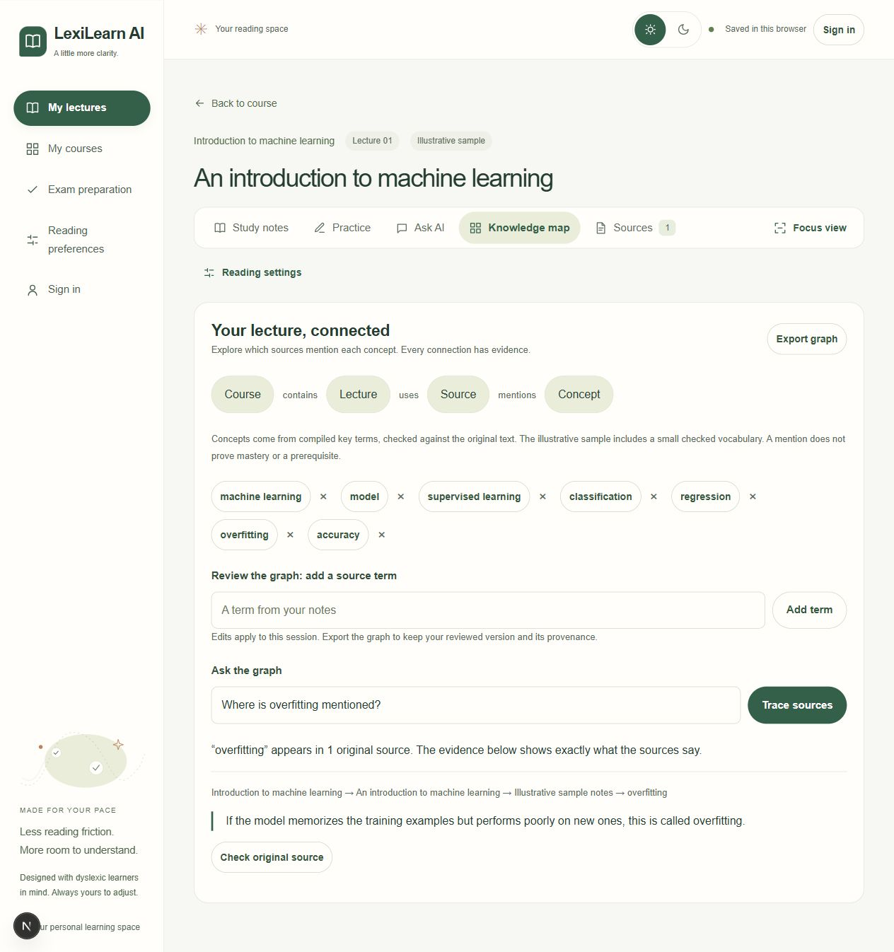
LEXILEARN
03
An agent that shows its evidence
Knowledge map
Course contains lecture. Lecture uses source. Source mentions concept.
Select a concept to see its source path and exact passage. Review terms and export the graph.
Missing relationships receive an explicit “not found” response.
Notes:
2:15–3:30. Open Knowledge map, select overfitting, inspect the path and original quotation. Ask what prerequisite comes before overfitting: the graph explicitly abstains. AI compilation proposes concept names; literal source matching validates mentions. This is a small provenance graph. It does not infer prerequisites, grading criteria, causal relationships, or learner mastery. Edits are session-only unless exported. Sources: src/lib/knowledge-graph.ts, tests/knowledge-graph.test.ts, deliverables/knowledge-graph.json and graph-examples.json. Level 3 Path B is a partial, working implementation.

Slide 4
LEXILEARN
04
Learning impact is the next test
Proposed pilot
Success measures
Compare ordinary lecture review with LexiLearn on matched material, with dyslexic student volunteers.
Comprehension and next-day recall
Time to find supporting evidence
Reported effort and independent use
Built: a working learning prototype. Next: student testing and accessibility review.
Cloud AI needs connectivity and funding. Original-text reading remains available when AI fails.
Notes:
3:30–4:45, leaving 15 seconds for handoff. These measures are proposed, not observed. Recruit 8–12 consenting dyslexic volunteers as a usability pilot, not an efficacy trial. Counterbalance review order and use matched questions. Check errors, keyboard use, screen-reader use and whether students consult original sources. Inclusion limits: language, digital access, readable PDF extraction, cloud cost and voice/microphone availability. Original reading works without an AI key; no full offline mode. No diagnosis or mastery score. Ask judges for feedback and a small university pilot. Based on supplied evaluation criteria and repository boundaries.

