Slide 1


Krishna School of Emerging
Technology & Applied Research
Department :Computer Science
Semester: 7th
Capstone Project – I ()
Title: CROP CULTIVATION ANALYSIS
Prepared by: Aman Gupta, Kush Patel Internal Guide: Ms. Manisha Makwana
Enrollment No : 2101201014, 2101201102 Designation : Assistant Professor
Academic Year – 2024-25
Notes:
<<Enrollment No>>

Slide 2
Presentation Outline
Introduction of the Research domain
Comparative Analysis
Identified Research Gap
Problem Statement
Objectives of the work
Proposed Methodology
Implementation Work
Timeline Chart
Conclusion and Future Work
Enrollment No: 2101201014,2101201102
Academic Year – 2024-25
Notes:
<<Enrollment No>>

Slide 3
Introduction to Crop Cultivation in India
India, with its diverse agro-climatic zones, is one of the largest agricultural producers in the world. The country's agricultural landscape is shaped by varying soil types, climatic conditions, and traditional practices. This presentation analyzes the major crops cultivated in India, their significance, and the challenges faced in crop production.
Major Crops Grown in India
India cultivates a wide range of crops categorized into food and non-food crops. The major crops include:Food Crops: Rice, wheat, maize, pulses, and millets.
Commercial Crops: Cotton, jute, sugarcane, tea, and coffee.
Key Points:
Rice is the staple food for a majority of the population and is predominantly grown in regions with high rainfall.
Wheat, the second most important crop, thrives in northern and northwestern India during the Rabi season.
Maize serves both as food and fodder and is adaptable to various climatic conditions.
Enrollment No: 2101201014,2101201102
Academic Year – 2024-25
Notes:
<<Enrollment No>>

Slide 4
Literature Review
Sr. No. | Paper Title
1. | India’s Crop cultivation Analysis Using Power BI
Objective:-
To investigate crop cultivation trends across various states in India.
To identify high-yield crops and their influencing factors, such as climate and land usage.
Research outcomes:-
The analysis revealed significant variations in crop yields across different states, highlighting the impact of agricultural productivity.
Utilizing data analytics can empower policymakers and farmers to make informed decisions that enhance crop production and sustainability.
Encouraging farmers to diversify crops can mitigate risks associated with climate change and market fluctuations, leading to more resilient agricultural systems.
Enrollment No: 2101201014,2101201102
Academic Year – 2024-25
Notes:
<<Enrollment No>>

Slide 5
Comparative Analysis
Table 1: Comparative Analysis Table
Sr No. | Crop Type | Major States | Yield Characteristics
1. | Kharif Seasoon : Monsoon | West Bengal, Punjab | High water requirement; yields depend on monsoon.
2. | Rabi Season: Winter | Uttar Pradesh, Haryana | Requires cooler climate; high yield from HYVs
Enrollment No: 2101201014,2101201102
Academic Year – 2024-25
Notes:
<<Enrollment No>>

Slide 6
Comparative Analysis (Cont.)
Table 2: Comparative Analysis Table
Sr No. | Crop Type | Major States | Yield Chyarcteristics
3. | Zaid Season : Summer | Varies | Short duration; depends on warm weather
Enrollment No: 2101201014,2101201102
Academic Year – 2024-25
Notes:
<<Enrollment No>>

Slide 7
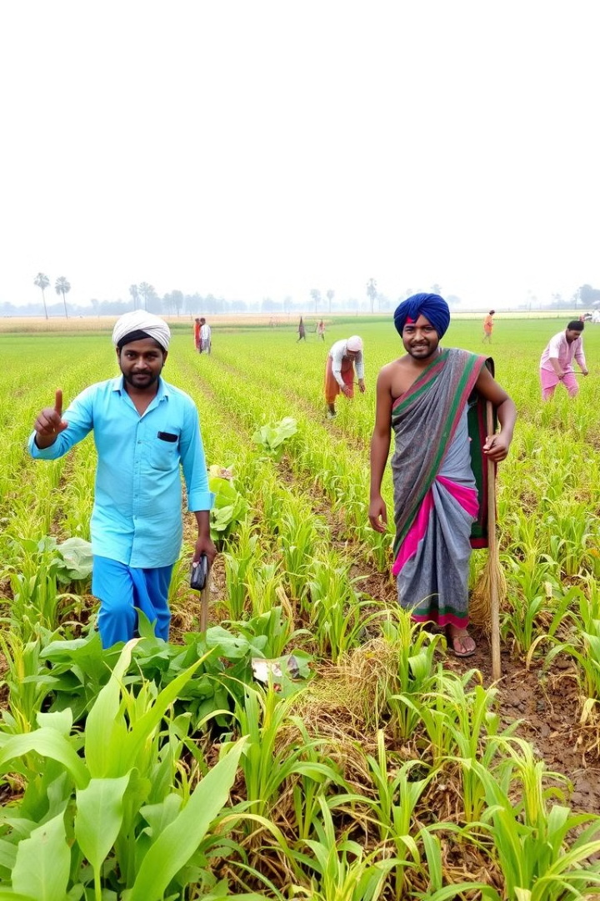
Identified Research Gap
Despite extensive studies on crop production in India, there is a lack of comprehensive analysis focusing on sustainable practices that can enhance productivity while conserving resources. Additionally, the impact of climate change on crop yields remains under-explored.
Problem Statement:
Context
Importance
Indian agriculture faces challenges like climate change, water scarcity, and crop diversification.
Analyzing crop cultivation patterns is crucial for informing policy decisions, improving yield predictions, and ensuring food security.
Enrollment No: 2101201014, 2101201102
Academic Year – 2024-25
Notes:
<<Enrollment No>>

Slide 8

Data Source and Methodology
Data Sources
Data Variables
Government agricultural databases, crop production reports, and satellite data.
Crop type, yield, area cultivated, rainfall, and other relevant factors.
Data Cleaning
Power BI Tools
Power Query for data cleaning, Power BI Desktop for visualization, and DAX for calculations.
Removing missing values, handling outliers, and transforming data for analysis.
Enrollment No: 2101201014, 2101201102
Academic Year – 2024-25
Notes:
<<Enrollment No>>

Slide 9
Proposed Methodology & Implementation Work
Data Collection: Gather data from government reports, agricultural surveys, and field studies.
Analysis Techniques: Use statistical methods to analyze yield data and assess factors influencing productivity.
Case Studies: Examine successful sustainable farming practices in various states.
Implementation Work:
The implementation phase will involve:Conducting field surveys in selected states to collect primary data.
Collaborating with local agricultural experts for insights on best practices.
Analyzing collected data to draw conclusions about crop performance and sustainability.
Enrollment No: 2101201014, 2101201102
Academic Year – 2024-25
Notes:
<<Enrollment No>>

Slide 10




Key Findings From Data Analysis
Highest Yield Crops
State-Wise Production
Seasonal Trends
Climate Impact
Identify the crops with the highest production volumes.
Analyze which states produce the most of specific crops.
Understand how seasonal factors influence crop cultivation.
Explore the relationship between rainfall, temperature, and crop yields.
Enrollment No: 2101201014, 2101201102
Academic Year – 2024-25
Notes:
<<Enrollment No>>

Slide 11
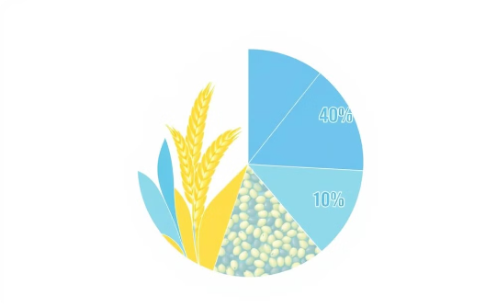
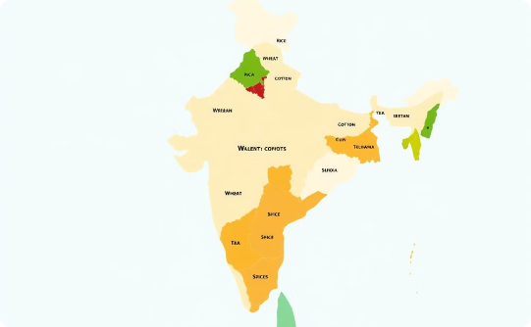
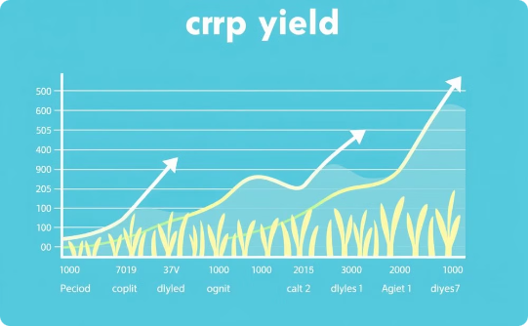
Visualization In Power BI
Crop Distribution Map
Crop Yield Trends
Crop Composition
Visualize the geographical distribution of various crops across India.
Analyze crop yield trends over the years or seasons, identifying any upward or downward patterns.
Show the proportion of different crops cultivated in India.
Enrollment No: 2101201014, 2101201102
Academic Year – 2024-25
Notes:
<<Enrollment No>>

Slide 12
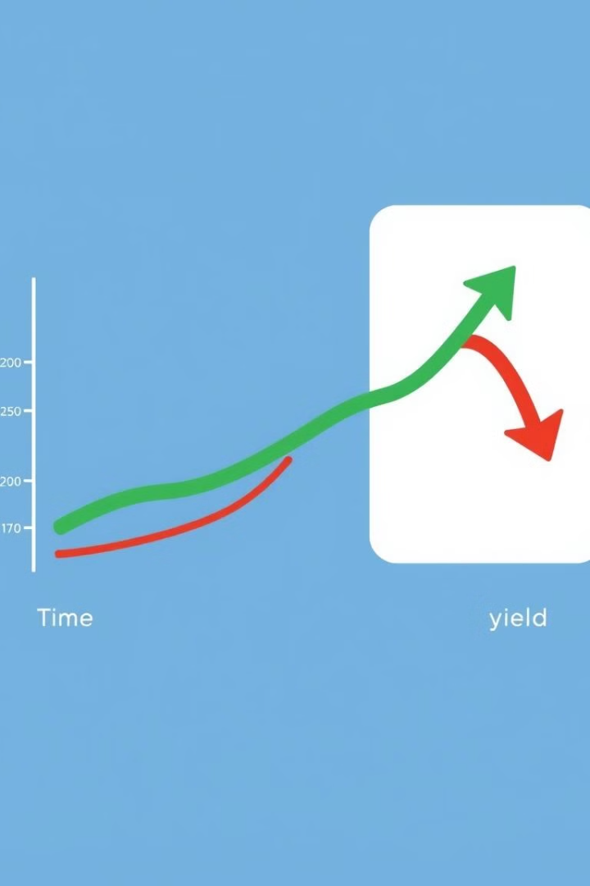
Analysis of Crop Production Trends
1
Yield Trends
Analyze crop yield trends over the years or seasons, identifying any upward or downward patterns.
2
Factors
Explore potential reasons behind observed trends, such as climate change, technological advancements, or policy changes.
3
Regional Differences
Compare trends across different states or regions to highlight variations in crop production.
Enrollment No: 2101201014, 2101201102
Academic Year – 2024-25
Notes:
<<Enrollment No>>

Slide 13



Geographical Insights
Crop Distribution
1
Visualize the geographical distribution of various crops across India.
High Yield States
2
Identify states with high yields for specific crops.
Geographical Patterns
3
Analyze any geographical patterns observed, such as rice cultivation in the Northeast or wheat in the North.
Enrollment No: 2101201014, 2101201102
Academic Year – 2024-25
Notes:
<<Enrollment No>>

Slide 14
Key Challenges Identified
Climate Variability
1
Analyze the impact of inconsistent rainfall on crop production.
Water Scarcity
2
Explore the impact of water scarcity on irrigation and crop yields.
Soil Health
3
Discuss the role of soil quality and fertility in crop performance.
Pest and Disease
4
Highlight crops vulnerable to pests or diseases and their impact on production.
Enrollment No: 2101201014, 2101201102
Academic Year – 2024-25
Notes:
<<Enrollment No>>

Slide 15
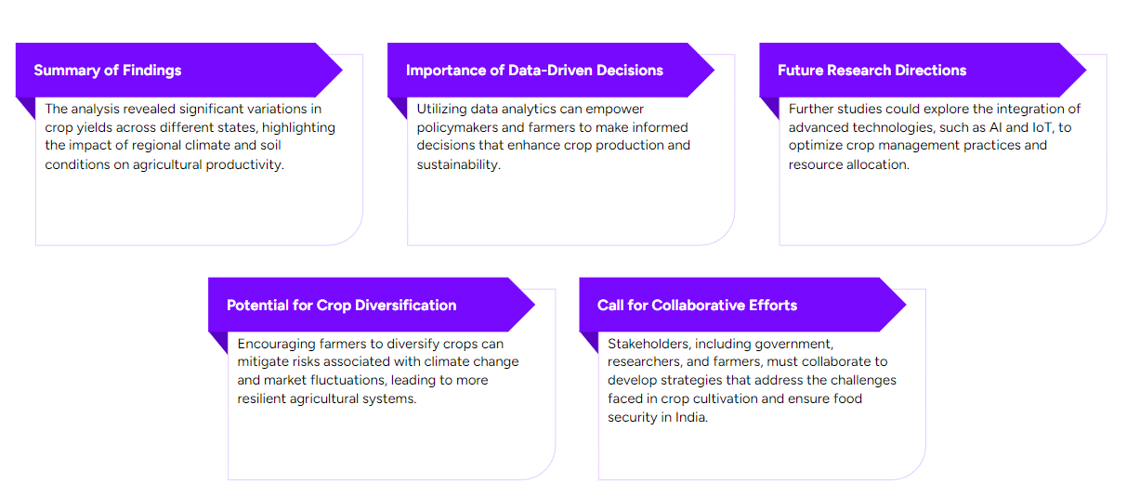
Conclusion and Future Work
Enrollment No: 2101201014, 2101201102
Academic Year – 2024-25
Notes:
<<Enrollment No>>

Slide 16
Timeline Chart
Table 4: Timeline Chart
Month | Week | Tasks
Month – 1 : Research and Planning | Week : 1-2 | Define objectives and gather requirements. Select datasets across tools.
 | Week : 3-4 | Finalize project architecture
Month – 2 : Data Collection and Data Preparation | Week : 1-2 | Preprocess data. Implement Data Integration.
 | Week : 3-4 | Check For error and Missing Values.
Enrollment No: 2101201014, 2101201102
Academic Year – 2024-25
Notes:
<<Enrollment No>>

Slide 17
Timeline Chart
Table 4: Timeline Chart
Month | Week | Tasks
Month – 3 : Data Analysis in Power BI | Week : 1-2 | Define graphs for trends. Uncovering Insights from data.
 | Week : 3-4 | Finding future aspect
Month – 4 : Draft Findings and Conclusion. | Week : 1-2 | Key Insights finalizing.
 | Week : 3-4 | Check for slicer and filter use. Concluding power BI report.
Enrollment No: 2101201014, 2101201102
Academic Year – 2024-25
Notes:
<<Enrollment No>>

