Slide 1
ARTIFICIAL INTELLIGENCE - 18CSC305J
SRM Institute of Science and Technology
Tic Tac Toe using Mini-Max Algorithm
Mohammed Taqi Ahmed – RA1911033010148
Aman Kumar Singh – RA1911033010153
Sejal Gupta – RA1911033010157

Slide 2
INTRODUCTION
Tic Tac Toe is a simple game we used to play as kids. The rules are quite simple, its a 1v1 game between two different entities.
Each entity takes turns one by on to compete, the first player uses the ‘X’ symbol meanwhile the second uses the ‘O’ symbol.
The first person to complete a line (connected line with 3 elements in a row) whether it is horizontally, vertically or diagonally, wins the game.
The game is quite popular and has also been implemented to be used by the computer in many different ways

Slide 3
How?
We will be using a very basic Algorithm going forward – Mini-Max Algorithm.
Its a simple Algorithm that can also be applied to other complicated games as well, such as Checkers, Chess, Go etc.
We would want the Computer Player to look at the board intelligently and play the most efficient move.
In this demo, we would like to explore a common method of searching for moves by building game trees that represent the space of possible moves and select the best move possible.

Slide 4
Mini-Max Algorithm
Mini-max is a kind of backtracking algorithm that is used in decision making and game theory to find the optimal move for a player, assuming that your opponent also plays optimally.
In Mini-max the two players are called maximizer and minimizer. The maximizer tries to get the highest score possible while the minimizer tries to do the opposite and get the lowest score possible.
Every board state has a value associated with it. In a given state if the maximizer has upper hand then, the score of the board will tend to be some positive value. If the minimizer has the upper hand in that board state then it will tend to be some negative value. The values of the board are calculated by some heuristics which are unique for every type of game.

Slide 5
Applying the Algorithm in Tic Tac Toe
Lets design a perfect game, the hardest level where the Computer; obviously programmed to make the best move can either Win or have a draw.
If we play the game perfectly, we can either win or draw the game too.
Lets assign a score to the ‘end-game condition’
1) We win, hurray! We get 10 points!
2) We lose, lost 10 points (because the other player gets 10 points)
3) Draw, whatever. I get zero points, nobody gets any points.

Slide 6
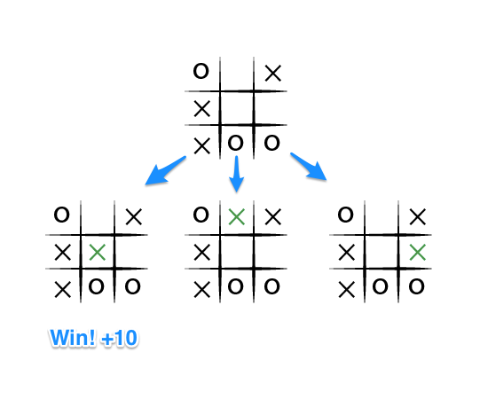
Applying the Algorithm in Tic Tac Toe
To apply the Algorithm, let's take an example from near the end of a game, where it is ourt urn. We chose ‘X’. The goal here, obviously, is to maximize the end game score.

Slide 7
The previous image represented the state of the game. Now that it is our turn, we have three blank spaces where we can put our next move.
In the above figure, I will definetly win if choose the first option, giving me 10 points.
The other options might give a different result but having no one win in that particular move gives the other two options 0 points.
So the best score in the least number of moves is picked.

Slide 8
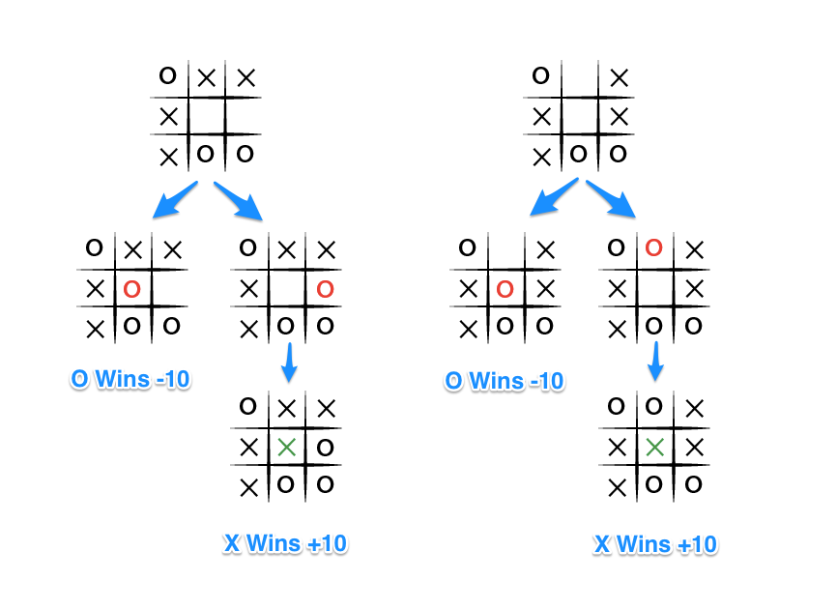
Now considering from the O player’s perspective, it would obviously choose the move that results in the worst score for us.

Slide 9
Thus from the Computer Player level’s perspective,it would choose the worst possible result that is -10.
The key to the Mini-max algorithm is a back and forth between the two players, where the player whose "turn it is" desires to pick the move with the maximum score. In turn, the scores for each of the available moves are determined by the opposing player deciding which of its available moves has the minimum score. And the scores for the opposing players moves are again determined by the turn-taking player trying to maximize its score and so on all the way down the move tree to an end state.
You'll notice that this algorithm is recursive, it flips back and forth between the players until a final score is found.
The instant winning move with the full tree:

Slide 10
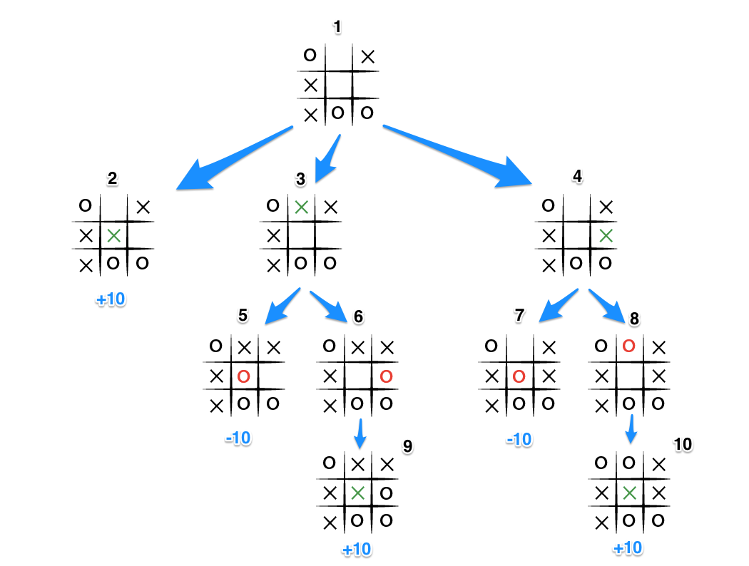

Slide 11
It's X's turn in state 1. X generates the states 2, 3, and 4 and calls minimax on those states.
State 2 pushes the score of +10 to state 1's score list, because the game is in an end state.
State 3 and 4 are not in end states, so 3 generates states 5 and 6 and calls minimax on them, while state 4 generates states 7 and 8 and calls minimax on them.
State 5 pushes a score of -10 onto state 3's score list, while the same happens for state 7 which pushes a score of -10 onto state 4's score list.
State 6 and 8 generate the only available moves, which are end states, and so both of them add the score of +10 to the move lists of states 3 and 4.

Slide 12
Because it is O's turn in both state 3 and 4, O will seek to find the minimum score, and given the choice between -10 and +10, both states 3 and 4 will yield -10.
Finally the score list for states 2, 3, and 4 are populated with +10, -10 and -10 respectively, and state 1 seeking to maximize the score will chose the winning move with score +10, state 2.

Slide 13
Least number of Moves
The key improvement to this algorithm, such that, no matter the board arrangement, the perfect player will play perfectly unto its demise, is to take the "depth" or number of turns till the end of the game into account. Basically the perfect player should play perfectly, but prolong the game as much as possible.
So each time we invoke mini-max, depth is incremented by 1 and when the end game state is ultimately calculated, the score is adjusted by depth. This is how it looks in our tree:

Slide 14
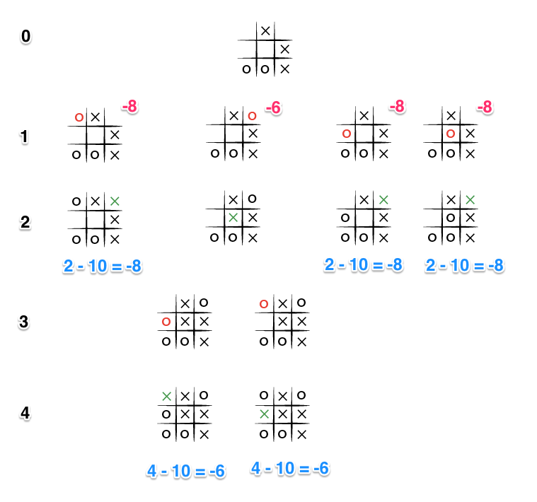

Slide 15
This time the depth (Shown in black on the left) causes the score to differ for each end state, and because the level 0 part of mini-max will try to maximize the available scores (because O is the turn taking player), the -6 score will be chosen as it is greater than the other states with a score of -8. And so even faced with certain death, our trusty, perfect player now will chose the blocking move, rather than commit honor death.

Slide 16
Conclusion
Thus we can come to a conclusion that a simple Algorithm such as Mini-Max can be applied in many games ranging from simple to complex ones.
Following all the steps of Mini-Max would not only give us a perfect player which will always either Win or Draw but will also try to win in as less moves as possible.

Slide 17
Thank you

