Slide 1

Extraction and Description of the Narrative Structure from TV-Series
Aman BERHE

Slide 2
Content

Slide 3
Objectives of Thesis
Originality
Automatically extracting the narrative structure from TV Series
Solution :
  Finding a way to answer the question Who, Where, What, When and How all together.
Barrier
  Semantic Gap between what is extracted and the storyline convoyed

Slide 4
Terminology

Slide 5
Background: NS
Narratives : exited since stone age
Narrative structure: Story and Discourse (Plot)
  Lots of people have studied narratives and narratology as literature
    Aristotle : Beginning, Middle, and an End
    Propp : 31 elements, into 4 spheres (introduction, the body of the story, the donor sequence and the hero’s return )
      seven character types (Villain, Dispatcher, Helper, Princess, Donor, Hero, False hero )
    Tezveton Todrov : Five steps
      Equilibrium ,Disruption, Realization, Restored order, equilibrium again
      Narrative into histoir and discours
    Claude Lévi-Strauss : binary opposites (E.g. good vs evil, man vs woman, peace vs war, wisdom vs ignorance, etc)
      Narratives are organized around the conflict of between such opposites

Slide 6
Background researches
N. Chambers el al learn narrative schemas and narrative event chain
M. R. et al tried to learn event scripts from list of actions, their technique is a variation of the multiple sequence alignment technique
Finlayson focused his job on annotated folktale’s narrative structure learning
Finlayson and Valls-Vargas worked on the Propps’ folktales and propp,s morphology
D.K. Elison [10] focused his study on narrative discourse

Slide 7
Background: Studies
Analysis of emotional arcs. By Andrew J. et al. (The emotional arcs of stories are dominated by six basic shapes)
  Stories from Gutenberg’s fiction collection
  Seven narrative structures ()
Social Network Analysis (SNA) of TV Drama Characters via Deep Concept Hierarchies (DCH) by Nan, Chang-Jun et al.
  Purpose: analyze the r/ship of characters
  DCH inspired the process of child
  SNA capable of capturing visual-linguistic concept
Extraction and Analysis of Dynamic Conversational Networks from TV Series by Xavier et al.
  Study SN of interactions
  Character interactions are well structured into stable communities

Slide 8
Computational Narratives
  Links the daily human activities (narratives) and the computing world (machines computations).
  modeling existing narratives
    In order to study literature or in order to validate narrative theories
    On representing narratives and story generation algorithms or interactive story telling or study computational creativity

Slide 9
MPST: A corpus of movie plot synopses with tags by Sudita Kar et al.
  Social tagging of movie reveals information (genre, plot structure, etc)
  Flow of emotions
Learning Video Story Composition Via RNN by Zhong et al.
  Compose a video-story from a group of video clips
  RNN learns Coherence between video-clips
  Sub-modular ranking to improve video story composition

Slide 10
Why Narratives?
They include higher level themes related to deeper human emotions
  Trust and honesty,
  Love and friendship
  Good and evil,
  Valuing people and tackling challenges
Ability to capture audiences (narrative hook)

Slide 11
Narrative structure
A narrative structure is made up two components, the plot and story

Slide 12
Definitions
Narrative: the way how a character’s life is disrupted by an event or change in his/her situation.
  In general it is a way movies tell stories
  Many approaches (Todrove (like Shakespeare used), Propp, Levi-strauss, Aristotle)
Narrative structure: the content of a story and the form used to tell the story (Story and Plot respectively)
Narrative Complexity: The intertwinedness of the narrative due to many reasons
  Number of characters
  Number of narrative threads
  etc

Slide 13
Terms and Definitions
Scene(s_{j}^{i}): set of sentences/Dialogues/Shots, that which focus on one specific unit/content of a story or events and can happen on the mostly same location and with same person or set of same people.
s = {τ₁,τ₂ ..., τ_{t}} or s = {v₁ , v₂ ..., v_{v} }
where τ is a texts and v is the shots in a scene.
Event: is a sentence or couple of sentences or a visual happening that disrupt the characters.
  It create a big issue between characters.
  It has high sentiment measure value. It could be positive or negative sentiment
e = {t₁,t₂ …, t_{e}} or e = {v₁ , v₂ ..., v_{e} }
where t is a sentence and v is the shots in a an event

Slide 14
Terms and Definitions
Episode(E): a video/subtitle/audio focuses on one full story which lead for a new story or continuation of a story
  E= {s₁ ,s₂...s_{n} }
Where n is the number of scenes in an episode
Temporal Scene Segmentation (S(s, δ)): a set of pair of a scene and its elapsed time based on temporal segmentation of an episode with non overlapping starting and end time.
  S(e) = {(s₁ , δ₁ ), (s₂ , δ₂ ), ..., (s_{c} ,δ_{c} )}
  where δ_{s} =[t_{s} (s), t_{e} (s)]
i.e s_{i}∩s _{j} =Ǿ and δ_{i}∩δ_{j} = Ǿ where δ is time span of a scene and t_{s}(s)is the start time, and t_{e}(s) is the end time
Scene Linking: The story/unit similarity or degree of connectivity of two or more scenes (i.e, s_{j}^{i}→s_{j}^{k} , scene i is linked with scene k )

Slide 15
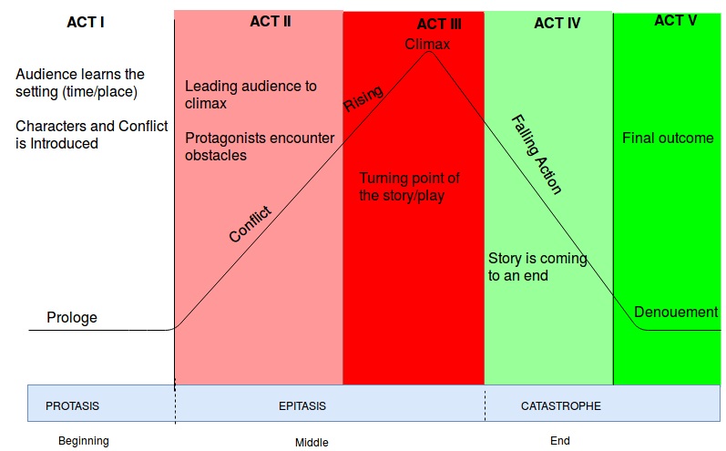
Narrative Structure
Patterns of drama in a play(Movie or Episode)
  Three-Act structure (Aristotle)
  Five-Act structure (Shakespeare was famous by this)

Slide 16
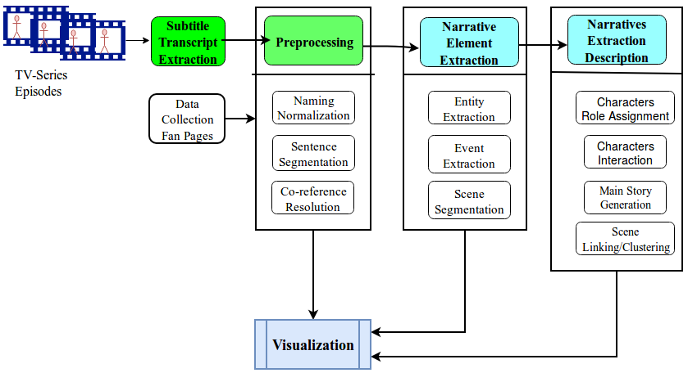
Pipeline

Slide 17
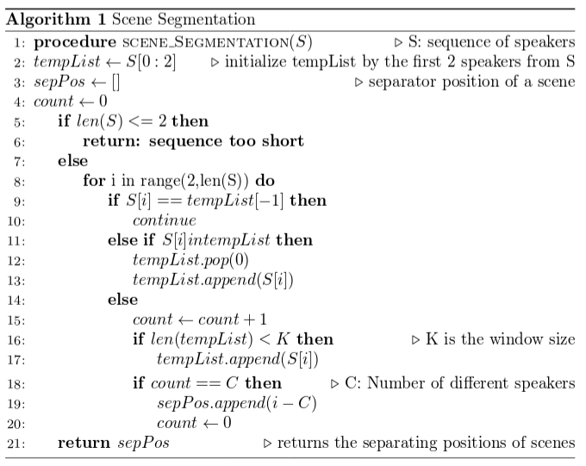
Segmentation

Slide 18
Scene Linking
Identifying scenes that are similar is important for understanding and defining independent parallel stories
There are many ways to do this, but here are my ideas
  In case of Video:Taking the last few shots of scene s_{j}^{i} and the the shots at the beginning of next scene s_{j}^{i+1} and compare them for similarity
    Color histogram and object identification using different ML techniques
  In case of Text: Taking the last few sentences of s_{j}^{i} and the few starting sentences of s_{j}^{i+1}
    Sentence embedding (doc2vec) and compare for similarity
    Summarizing the two scenes and compare the summaries

Slide 19
Cont...
Link Categorization as proposed by Rémi Bois et al.
      Reacts/In reaction
      Summary/Development
      Anterior/Posterior
      Near duplicate
  Their idea was based on handcrafted decision trees
  We can do NN based with enough annotated data to model the categories
Graph based (Bipartite and ANN )
  Graph based community detection by hérve et al
  ANN that creates news graphs with good exploratory properties by Rémi Bois et al.

Slide 20
Results and Examples
Examples:

