Slide 1
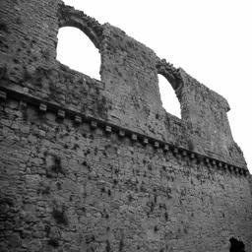
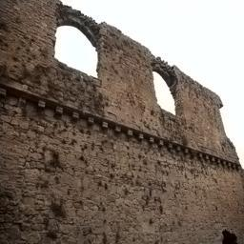
Image Coloring
Top 5 Classification with confidence
"aqueduct": 32%,
"ruin": 17%,
"arch": 9%,
"rock arch": 8%,
"castle": 7%

Slide 2
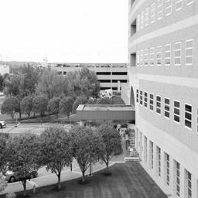
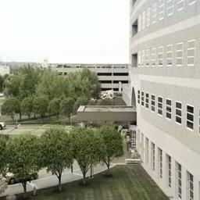
Image Coloring
Top 5 Classification with confidence
"roof garden": 7%,
"courtyard": 6%,
"balcony": 5%,
"hospital": 5%,
"balcony": 5%

Slide 3
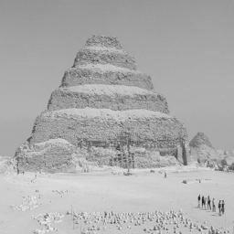
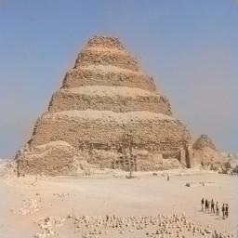
Image Coloring
Top 5 Classification with confidence
"butte": 37%,
"ruin": 8%,
"badlands": 6%,
"desert sand": 6%,
"rock arch": 4%

Slide 4
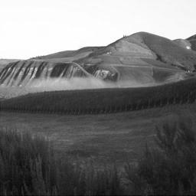
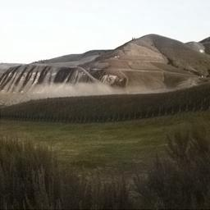
Image Coloring
Top 5 Classification with confidence
"badlands": 12%,
"hayfield": 8%,
"wheat field": 7%,
"butte": 7%,
"desert sand": 6%

Slide 5
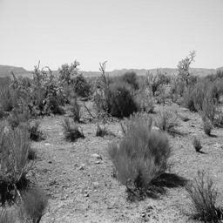
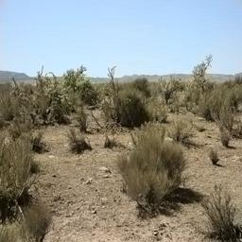
Image Coloring
Top 5 Classification with confidence
"desert vegetation": 47%,
"tree farm": 8%,
"vineyard": 5%,
"orchard": 4%,
"mountain path": 2%

Slide 6
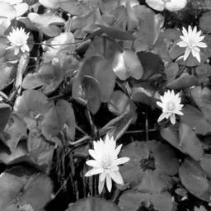
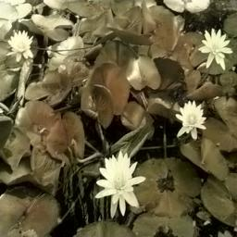
Image Coloring
Top 5 Classification with confidence
"florist shop": 34%,
"botanical garden": 12%,
"vegetable garden": 11%,
”fishpond": 10%,
"orchard": 4%

Slide 7
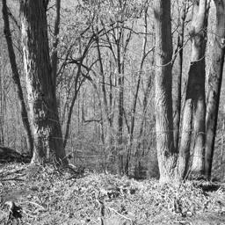
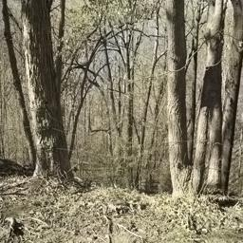
Image Coloring
Top 5 Classification with confidence
"forest broadleaf": 57%,
"forest path": 14%,
"rainforest": 9%,
"bamboo forest": 6%,
"swamp": 3%

Slide 8
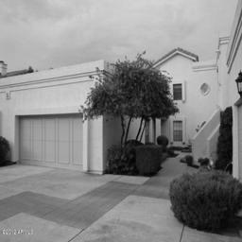
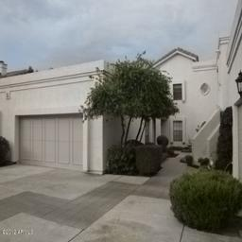
Image Coloring
Top 5 Classification with confidence
"garage outdoor": 57%,
"manufactured home": 14%,
"driveway": 9%,
"loading dock": 6%,
"doorway outdoor": 3%

Slide 9
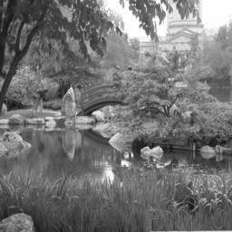
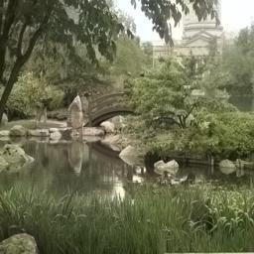
Image Coloring
Top 5 Classification with confidence
"japanese garden": 25%,
"fishpond": 18%,
"ruin": 5%,
"moat water": 4%,
"fountain": 4%

Slide 10
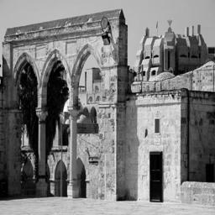
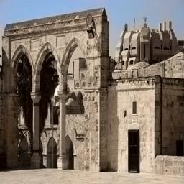
Image Coloring
Top 5 Classification with confidence
"kasbah": 22%,
"aqueduct": 19%,
"ruin": 11%,
"arch": 6%,
"mausoleum": 5%

Slide 11
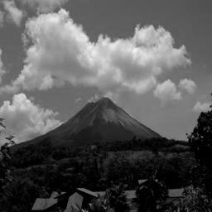
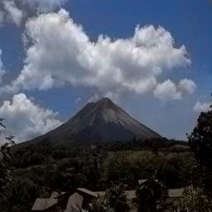
Image Coloring
Top 5 Classification with confidence
"mountain snowy": 18%,
"mountain": 14%,
"volcano": 12%,
"village": 12%,
"valley": 7%

Slide 12
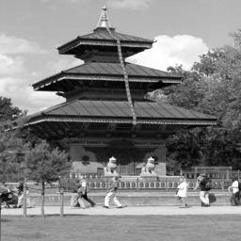
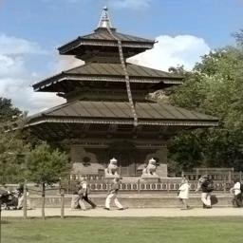
Image Coloring
Top 5 Classification with confidence
"pagoda": 57%,
"temple-asia": 17%,
"gazebo-exterior": 7%,
"pavilion": 2%,
"mausoleum": 1%

Slide 13
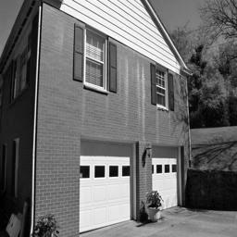
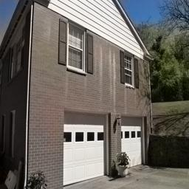
Image Coloring
Top 5 Classification with confidence
"garage-outdoor": 25%,
"manufactured home": 18%,
"driveway": 5%,
"house": 5%,
"shed": 3%

Slide 14
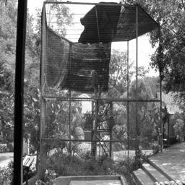
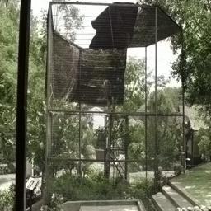
Image Coloring
Top 5 Classification with confidence
"gazebo-exterior": 13%,
"pavilion": 10%,
"tree_house": 5%,
"greenhouse outdoor": 3%,
"porch": 2%

Slide 15
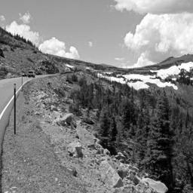
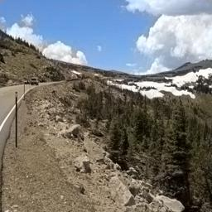
Image Coloring
Top 5 Classification with confidence
"mountain snowy": 15%,
"mountain": 10%,
"canyon": 10%,
"mountain path": 9%,
"glacier": 7%

Slide 16
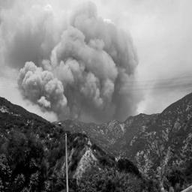
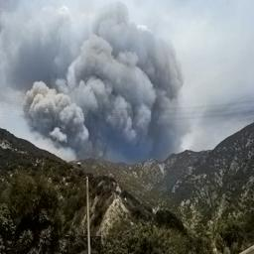
Image Coloring
Top 5 Classification with confidence
"volcano": 44%,
"mountain": 12%,
"mountain snowy": 11%,
"valley": 4%,
"glacier": 3%

