Slide 1

Akamai CDN
An Overview of Akamai’s Features and Use Cases

Slide 2

Contents
Introduction to Akamai
Use Cases
Working of Akamai’s Features

Slide 3
Introduction to Akamai
Delivering Secure and Fast Digital Experiences

Slide 4
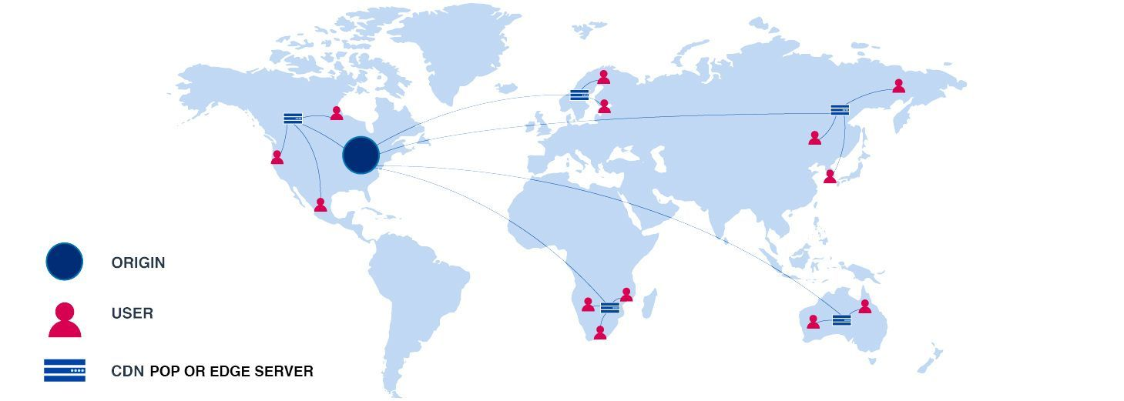
What is Akamai ?
Akamai is a content delivery network (CDN) and cloud services provider that helps businesses deliver, optimize, and secure their online content.
It was founded in 1998 and is headquartered in Cambridge, Massachusetts.
Akamai has over 300,000 servers in more than 135 countries and delivers up to 30% of all web traffic.

Slide 5
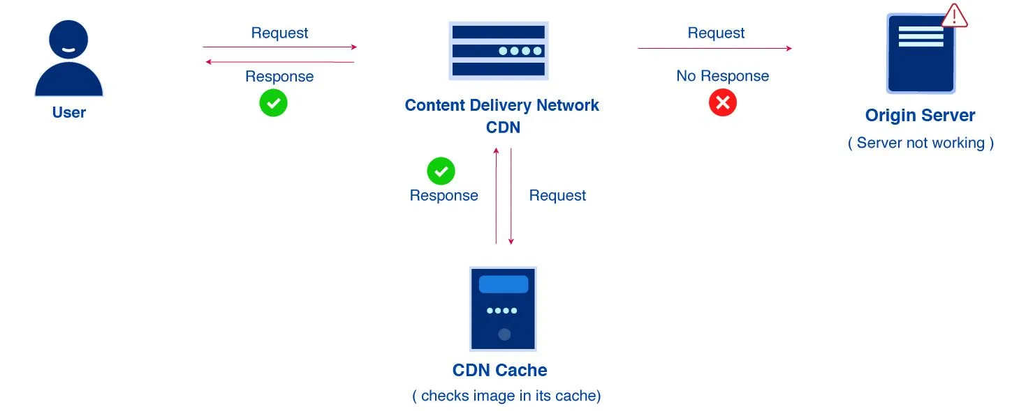
Why Use Akamai ?
Akamai’s CDN helps businesses deliver their content faster and more reliably to users around the world.
It also provides a range of cloud services that help businesses optimize their online presence and protect against cyber threats.
Some of the benefits of using Akamai include faster page load times, improved website performance, better security, and reduced bandwidth costs.

Slide 6
How Akamai Works
Akamai works by using a network of servers called edge servers that are distributed across the globe.
When a user requests content from a website that uses Akamai, the request is routed to the nearest edge server that has a copy of the content.
The edge server then delivers the content to the user, reducing latency and congestion on the internet.
Akamai also uses IP acceleration and edge caching to speed up the delivery of web content.
IP acceleration is a technique that optimizes the TCP/IP protocol to reduce packet loss and improve throughput.
Edge caching is a technique that stores replicas of static text, image, audio, and video content in multiple edge servers, so that user requests can be served by a nearby edge server rather than by a far-off origin server.

Slide 7
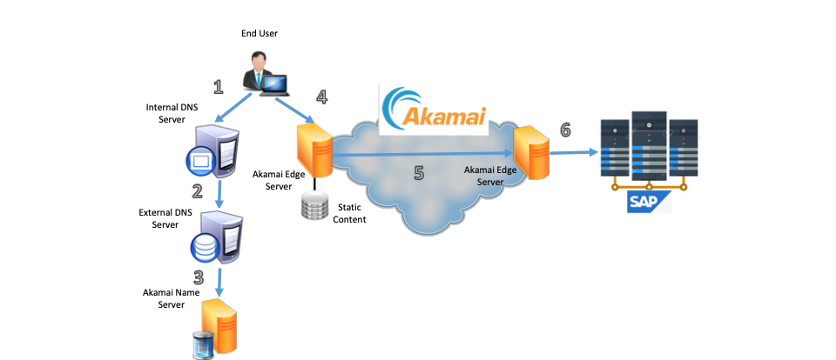
How Akamai Works

Slide 8
Akamai’s Features and Use Cases
How Akamai Helps Deliver Secure and Fast Digital Experiences

Slide 9



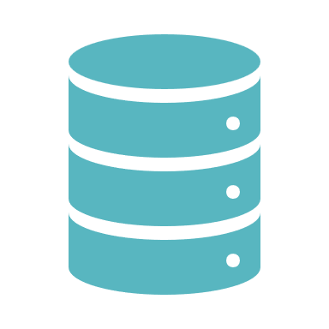
Features
Web Application Firewall
Global Traffic Manager
Application Load Balancer
Bot Manager
NetStorage

Slide 10

Features
Web Application Firewall
Global Traffic Manager
Application Load Balancer
Bot Manager
NetStorage
Edge Logic Cloudlets

Slide 11
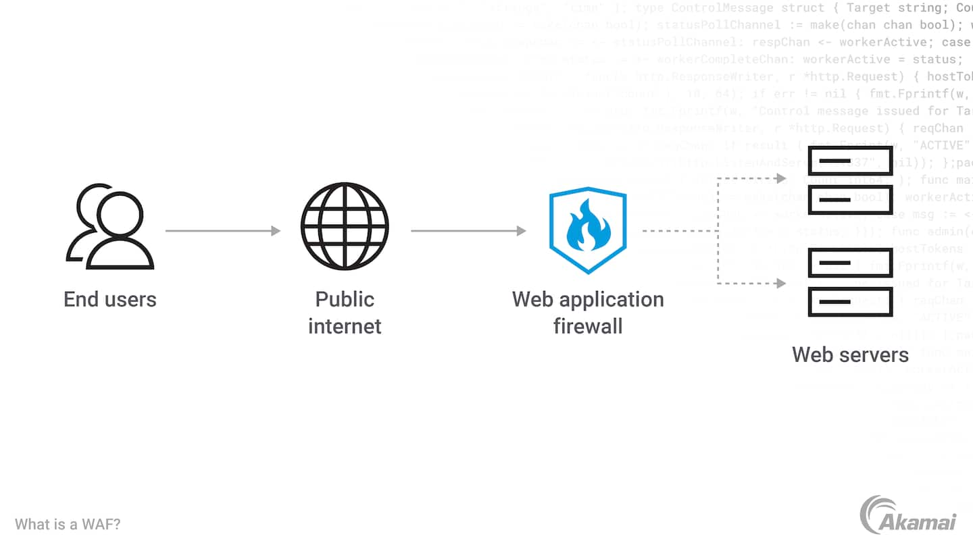
Web Application Firewall (WAF)
WAF protects web applications from common attacks such as SQL injections, cross-site scripting, and remote file inclusion.
WAF uses anomaly detection, threat intelligence, and a cloud platform to provide always-on and scalable protection.
WAF helps businesses improve their website security and reduce the risk of data breaches.

Slide 12
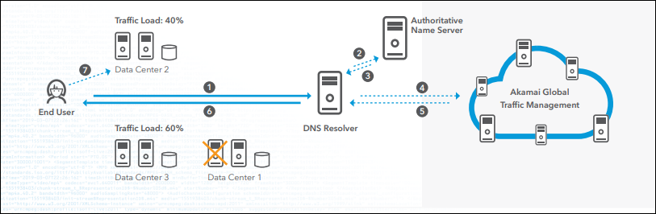
Global Traffic Management (GTM)
GTM is a DNS-based load balancing service that distributes user requests to the optimal data center or cloud environment.
GTM uses real-time data to route user requests based on network latency, server load, and user location.
GTM helps businesses improve their website performance and reliability.

Slide 13
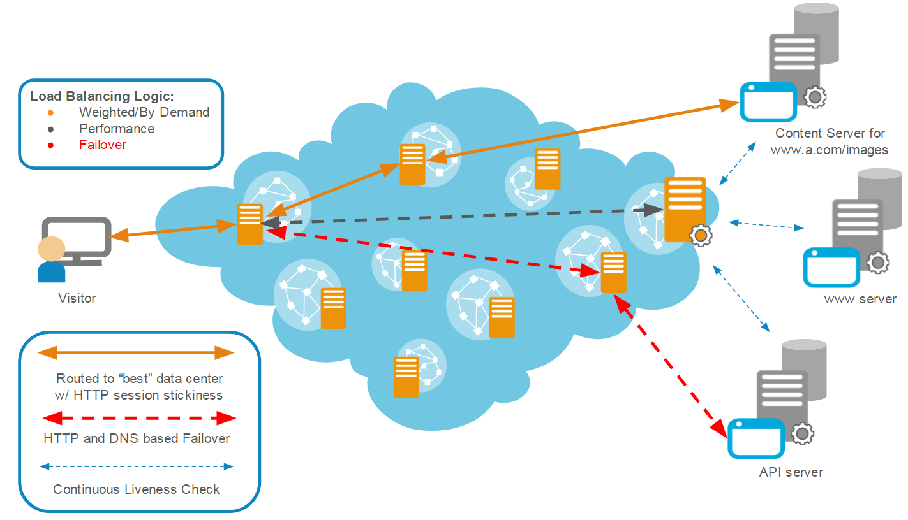
Application Load Balancer (ALB)
ALB is a cloud-based load balancing service that distributes incoming traffic across multiple targets such as EC2 instances, containers, and IP addresses.
ALB supports advanced routing features such as path-based routing, host-based routing, and URL-based routing.
ALB helps businesses optimize their cloud infrastructure and scalability.

Slide 14

Application Load Balancer (ALB)

Slide 15
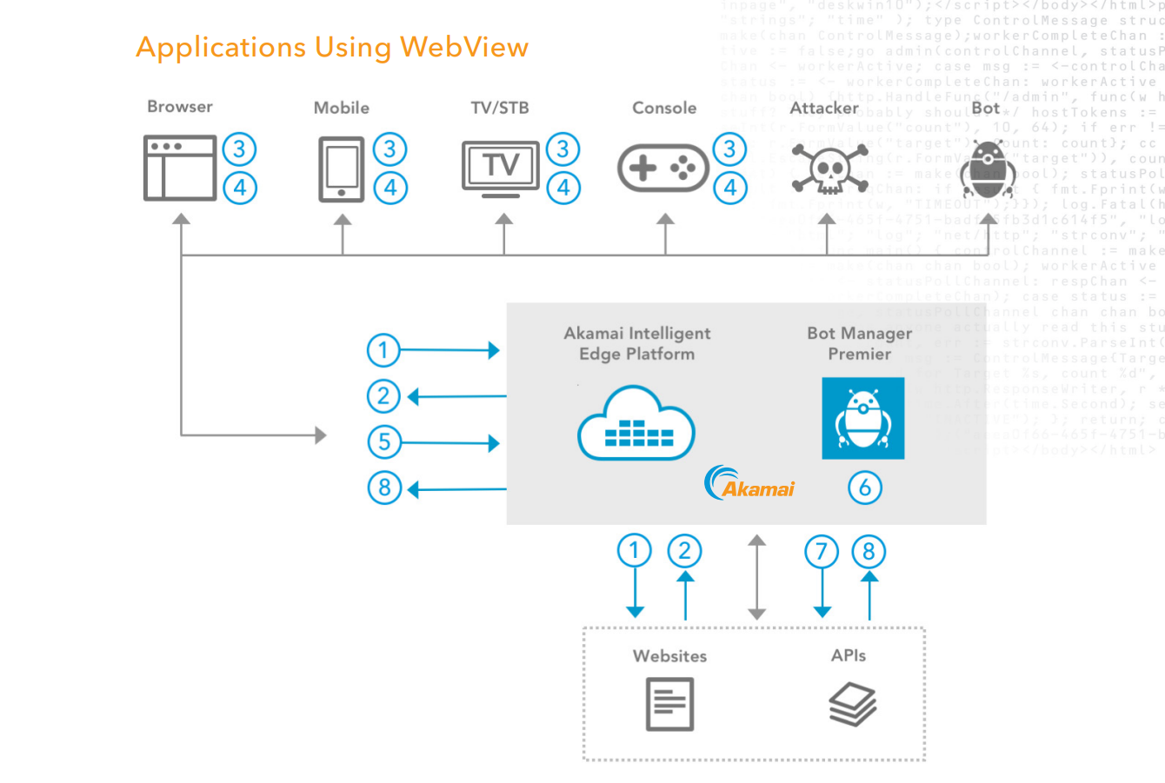
Bot Manager
Bot Manager is a cloud-based service that detects and mitigates bot traffic on websites and web applications.
Bot Manager uses machine learning algorithms to identify bots based on their behavior patterns and provides granular controls for blocking or allowing specific types of bots.
Bot Manager helps businesses protect their website resources and reputation.

Slide 16
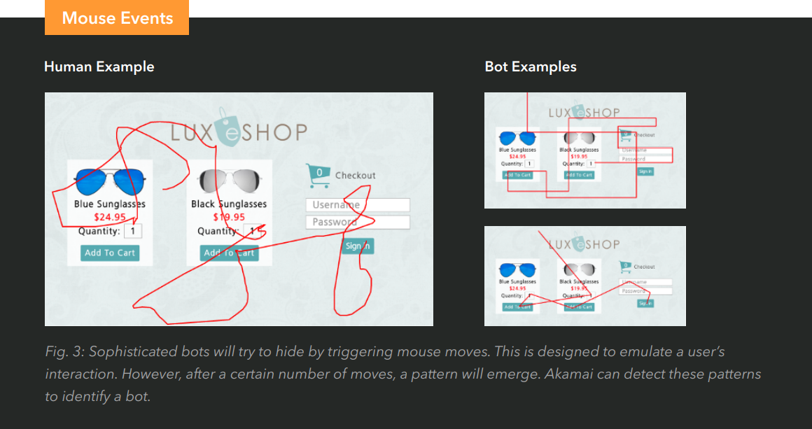
Bot Manager

Slide 17
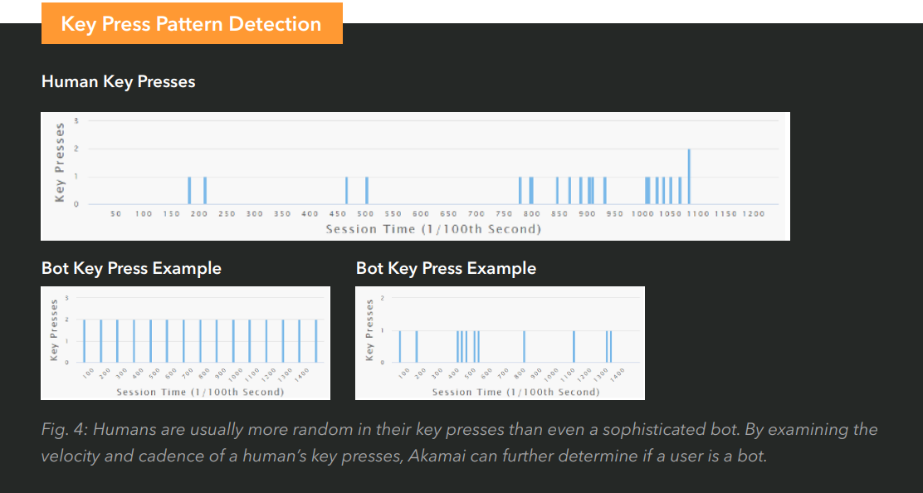
Bot Manager

Slide 18
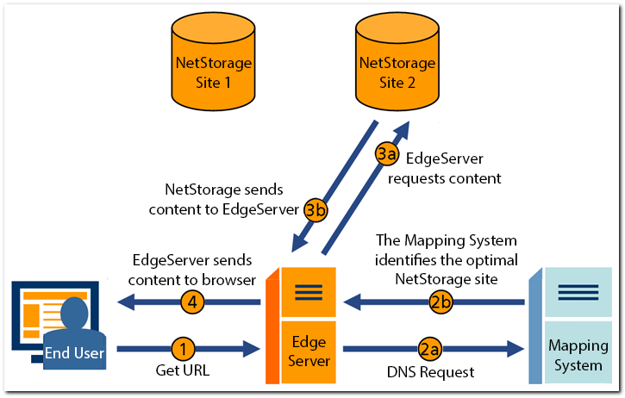
NetStorage
NetStorage is a cloud-based storage service that stores and delivers large files such as images, videos, and software updates.
NetStorage provides high availability, scalability, and security features such as encryption at rest and in transit.
NetStorage helps businesses manage their content delivery and storage needs.

Slide 19
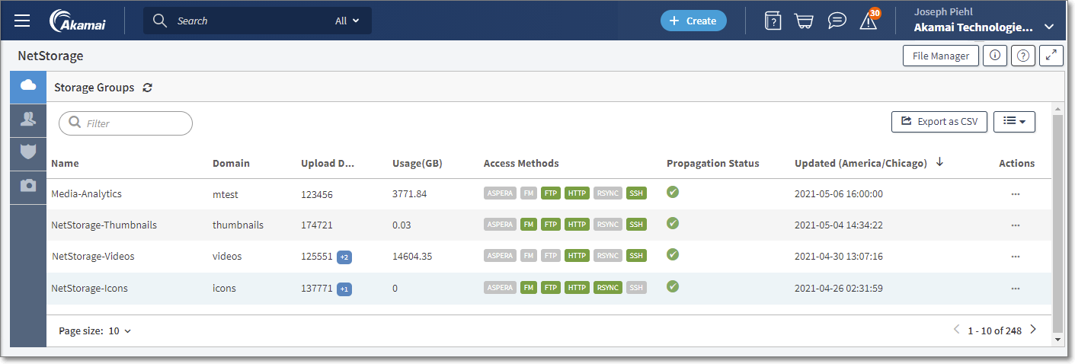
NetStorage

Slide 20
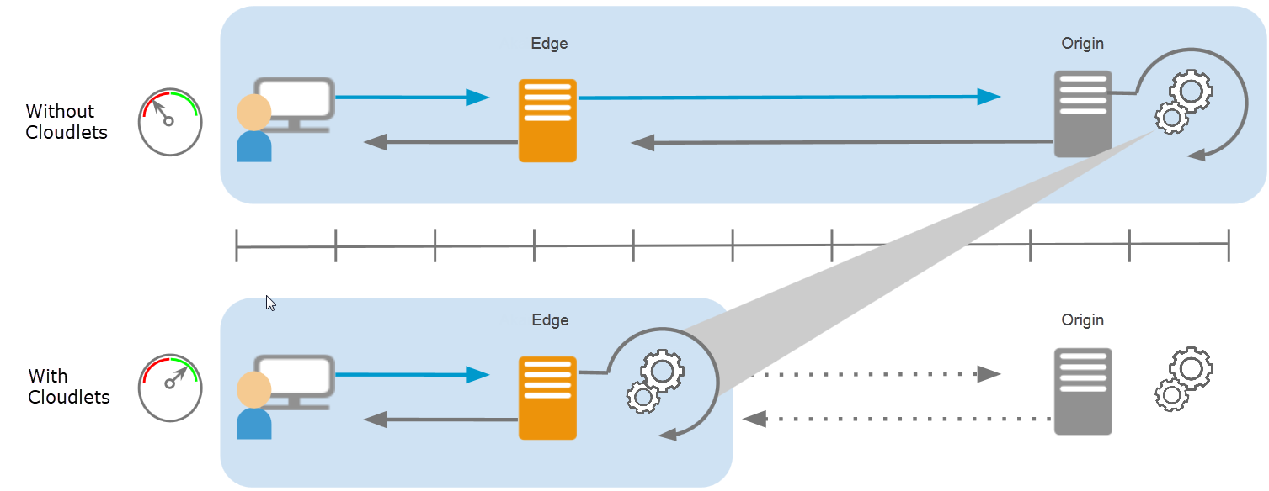
Edge Logic Cloudlets
Edge Logic Cloudlets is a cloud-based service that runs custom code at the edge of the Akamai network.
Edge Logic Cloudlets provides a serverless environment for running lightweight JavaScript code that can modify HTTP requests and responses in real-time.
Edge Logic Cloudlets helps businesses customize their online experiences and functionality.

Slide 21
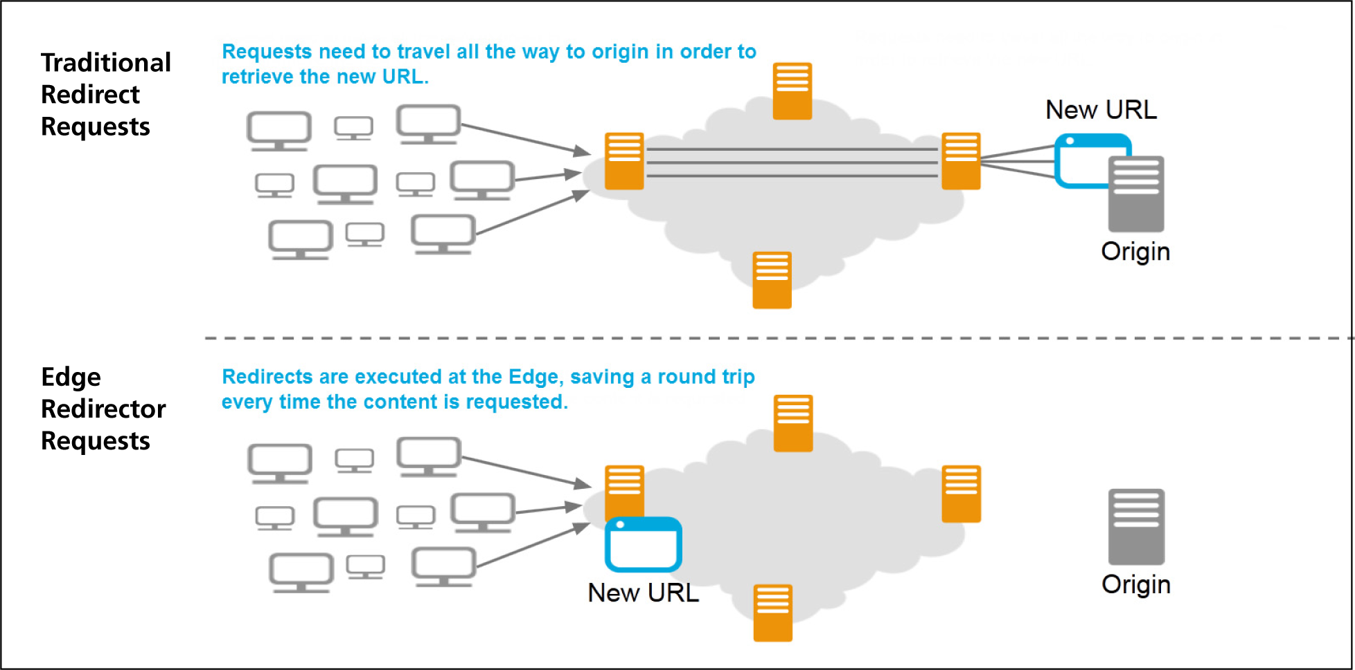
Edge Redirector

Slide 22
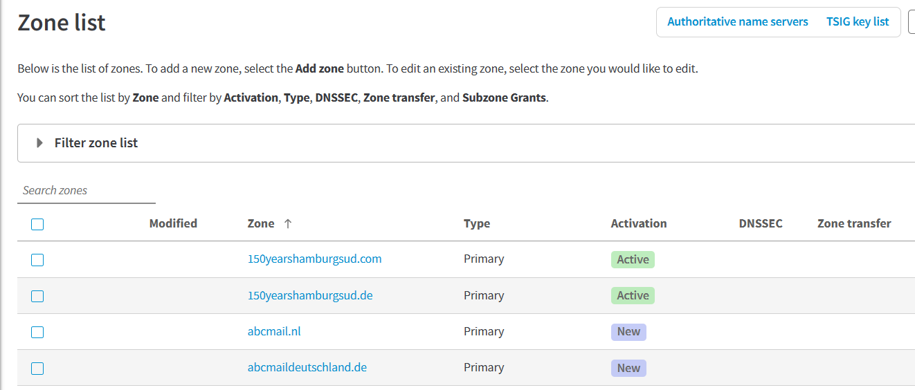
Edge DNS
Edge DNS is an authoritative DNS service that provides a secure, high-performance, scalable, and highly available edge service for authoritative DNS12.
Edge DNS uses Akamai’s global deployment of thousands of name servers across multiple networks, uses IP Anycast, and relies on a proprietary implementation of the DNS protocol as a common component of the Akamai Intelligent Platform34.
Edge DNS helps businesses deliver fast and reliable online experiences to users around the world by connecting them with their desired destination5.

Slide 23
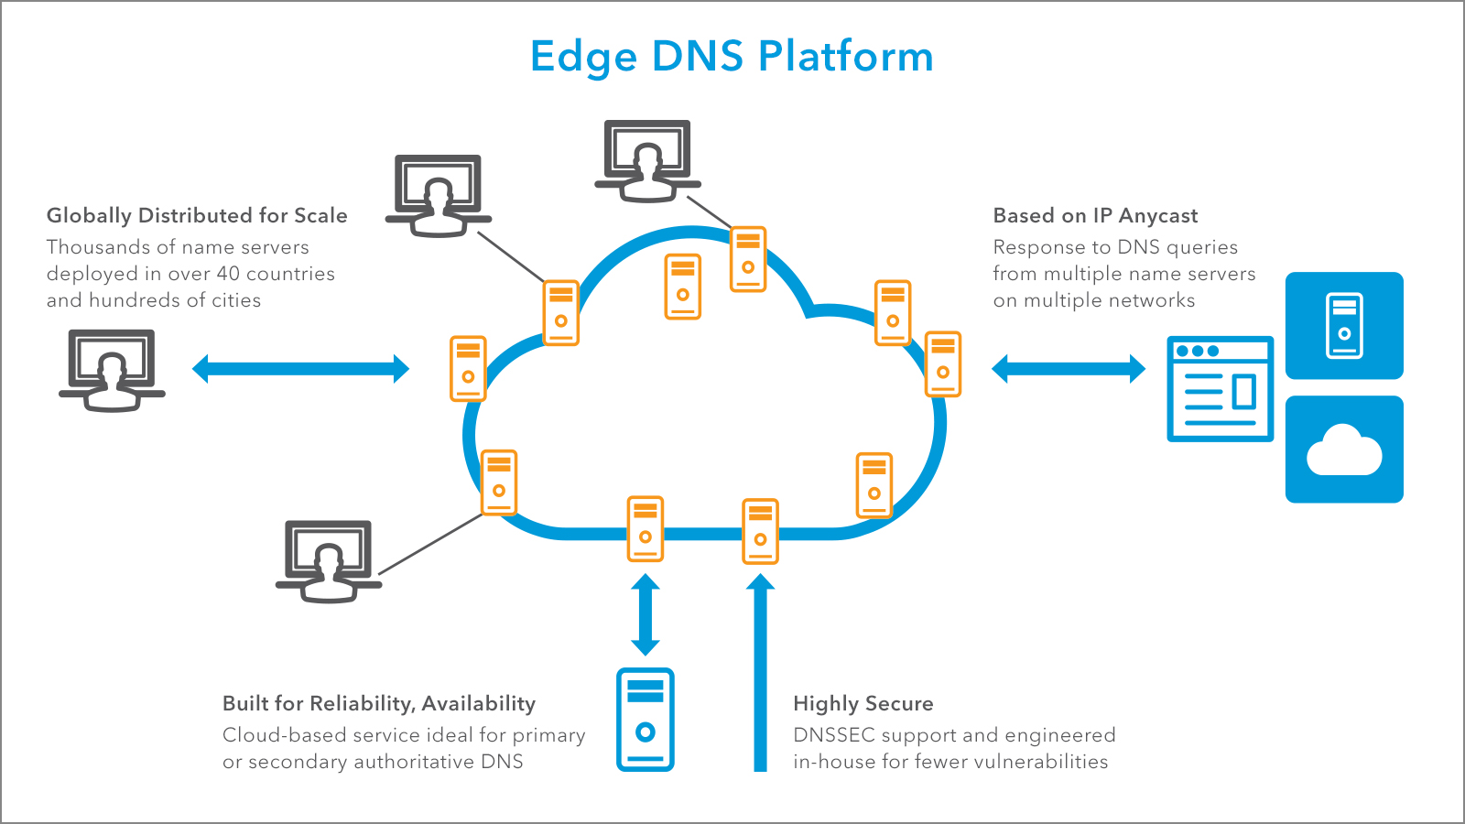
Edge DNS

Slide 24
Akamai Use Cases
Redirecting URLs: Utilize Akamai's Edge Redirector Cloudlets to efficiently redirect URLs and manage traffic flow.
Protection Against Spam and Bot Traffic: Akamai's Bot Manager is your ally in safeguarding your web applications from spam and malicious bot traffic.
Caching for Performance Improvement: Leverage Akamai's caching capabilities to enhance website and application performance by serving content from edge servers.
Load Balancing and Traffic Distribution: Akamai helps in load balancing and distributing traffic across multiple servers or data centers, ensuring high availability and optimal resource utilization.
Web Security and DDoS Mitigation: Protect your online presence with Akamai's DDoS mitigation and web security services, keeping your applications safe from cyber threats.
Application Acceleration: Speed up application delivery by utilizing Akamai's services for content acceleration and optimization.
Content Protection and Digital Rights Management (DRM): Ensure the security of your digital content, including media, documents, and intellectual property, using Akamai's content protection and DRM solutions.
API Management: Manage and secure your APIs, controlling access, usage, and ensuring the best possible performance.

Slide 25
Akamai Use Cases
Global Server Load Balancing: Employ Akamai's Global Traffic Management (GTM) to efficiently distribute traffic to the nearest and most responsive servers worldwide.
Video Streaming Optimization: Improve the delivery and quality of video streaming content through Akamai's streaming optimization solutions.
Edge Computing for IoT: Utilize Akamai's edge computing capabilities for IoT applications, enabling real-time processing and decision-making at the edge.
Image and Video Optimization: Automatically optimize images and videos for the best performance, reduced bandwidth usage, and faster page load times.
DNS Management: Akamai's DNS services ensure optimal routing and management of DNS traffic, reducing latency and improving reliability.
Cloud Security: Secure your cloud-hosted applications and data, guaranteeing their safety and compliance with security standards.
Content Delivery and Acceleration: Accelerate content delivery to users across the globe, reducing latency and enhancing website and application performance.

Slide 26
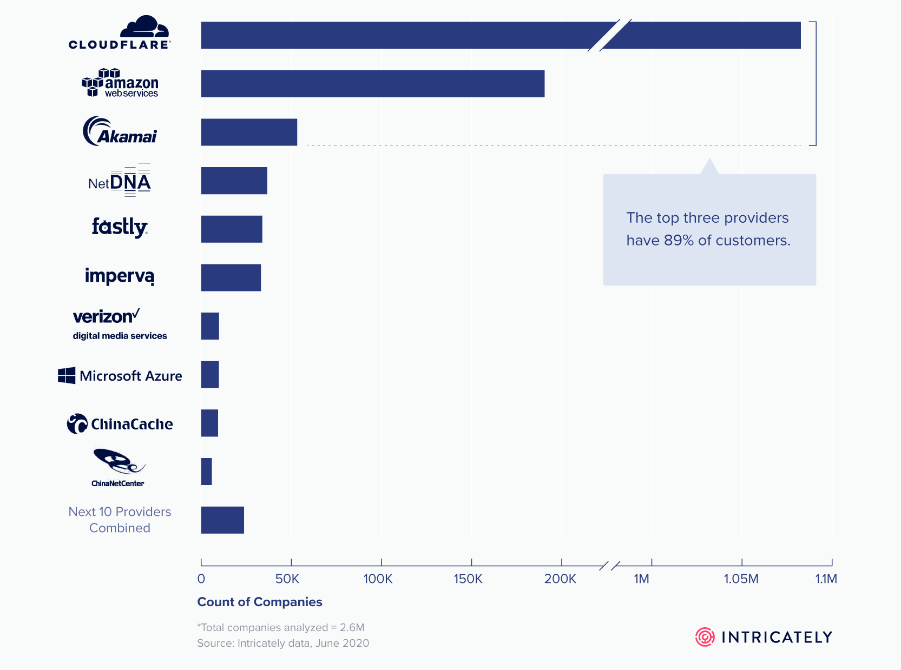
Customer Count by CDN Providers

Slide 27
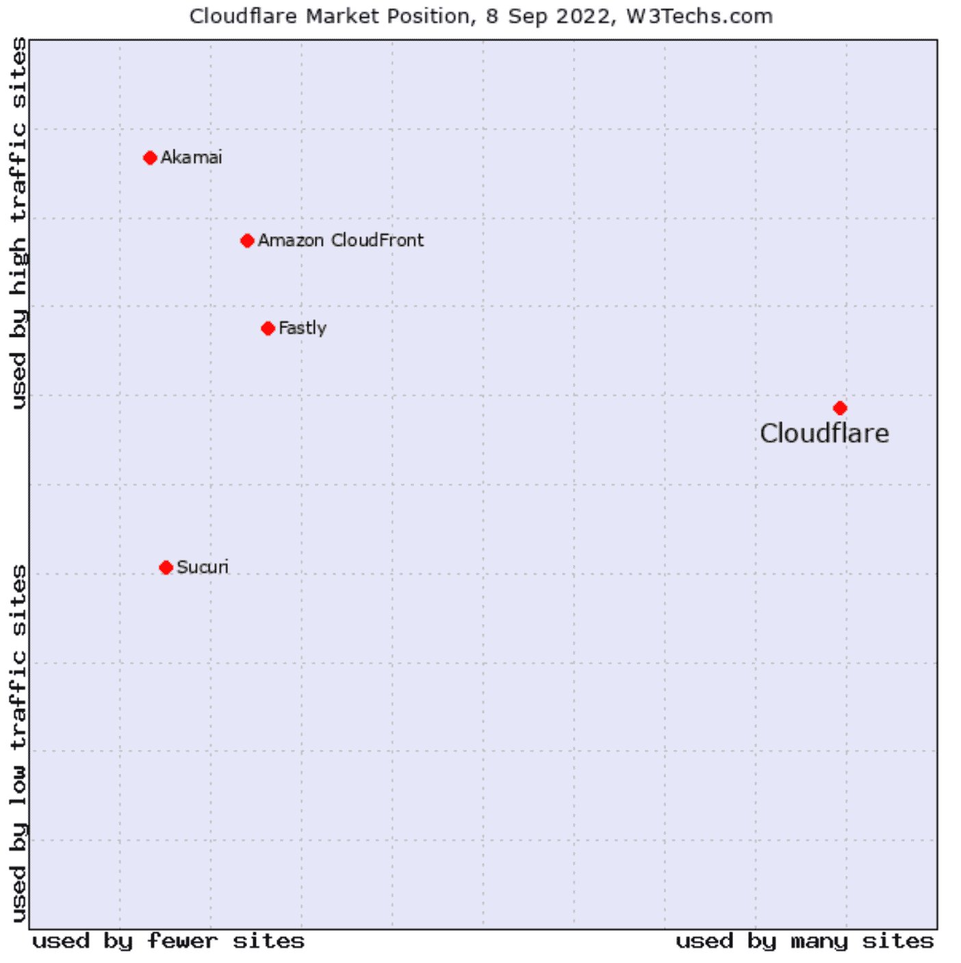
Market Position 8 Sep 2022

Slide 28
CDNs: Bridging the Digital Divide, One Byte at a Time. -Internet

Slide 29
Thank You

