Slide 1


Machine learning application
Presented by
Sunny Savita
Satyanarayana Patro

Slide 2

Forest Cover Type
Pipeline of Machine Learning Project
Data Ingestion
Exploratory data analysis(EDA)
Data Preprocessing
Model Building
Evaluation of model
Prediction Data Pipelines
Model Deployment

Slide 3
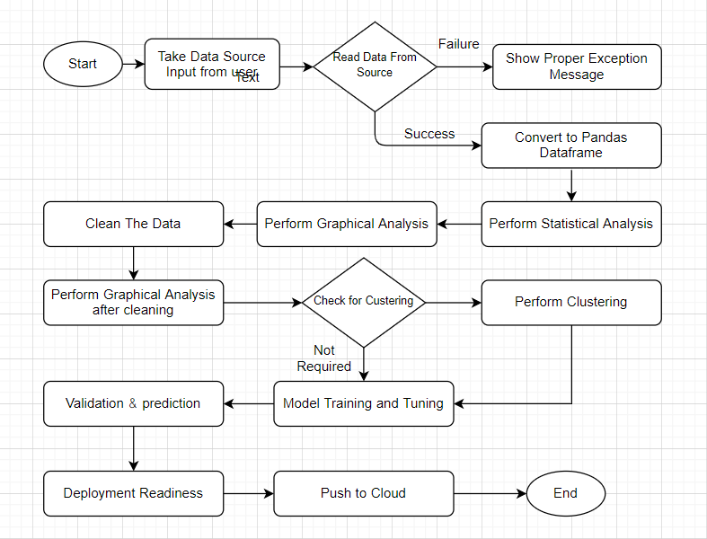
Work Flow of Project

Slide 4

Problem Statement
We have been given a total of 54 attributes, these attributes contain Binary and Quantative attributes , and we to predict which Forest Cover-Type is it from the given features.
Each observation is 30m x 30m forest cover type determined from US Forest Service (USFS) Region 2 Resource Information System (RIS) data.
The target variable has 7 different classes hence making this a Multi-Class Classification problem.

Slide 5
Forest Cover Type Classes
Spruce / Fir
Lodgepole Pine
Ponderosa Pine
Cottonwood / Willow
Aspen
Douglas-fir
Krummholz

Slide 6
Dataset Attribute Info
No. of Instances 581,011
No. of Attributes (Features)¹ 54
Associate Task Classification Dataset
Characteristic Multivariate Attribute Characteristic Categorical, Integer
Missing Value None
Area Life
Target Variable Forest Cover Type
Downloaded From UCI: Visit Site

Slide 7

Hardware requirements
Requirements for model training
The minimum configuration should be:
8 GB RAM
2 GB of Hard Disk Space
Intel Core i5 Processor
Requirements for model testing
The minimum configuration should be:
4 GB RAM
2 GB of Hard Disk Space
Intel Core i5 Processor

Slide 8
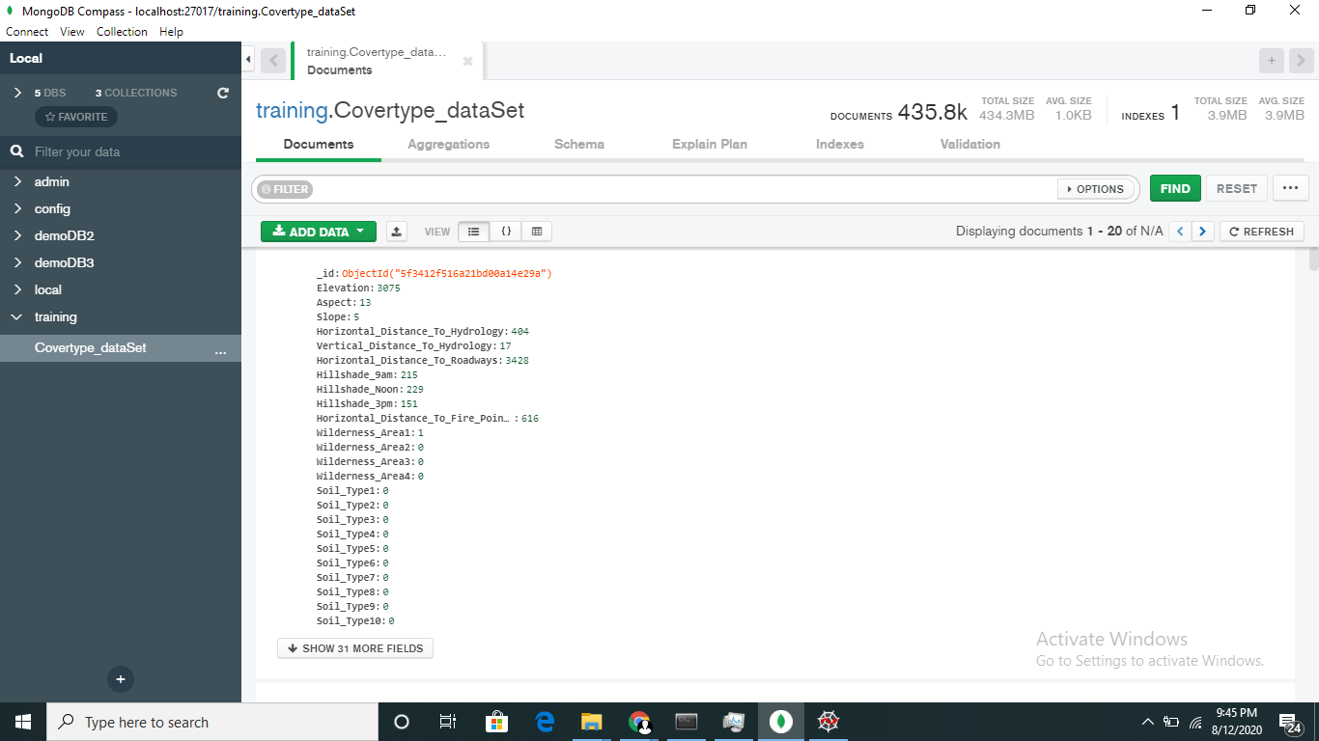
Data Ingestion
After Collect, the data from the client first we perform data validation.
After the data validation we store the data into the data bases like SQL databases and No-Sql databases for integration of data.

Slide 9
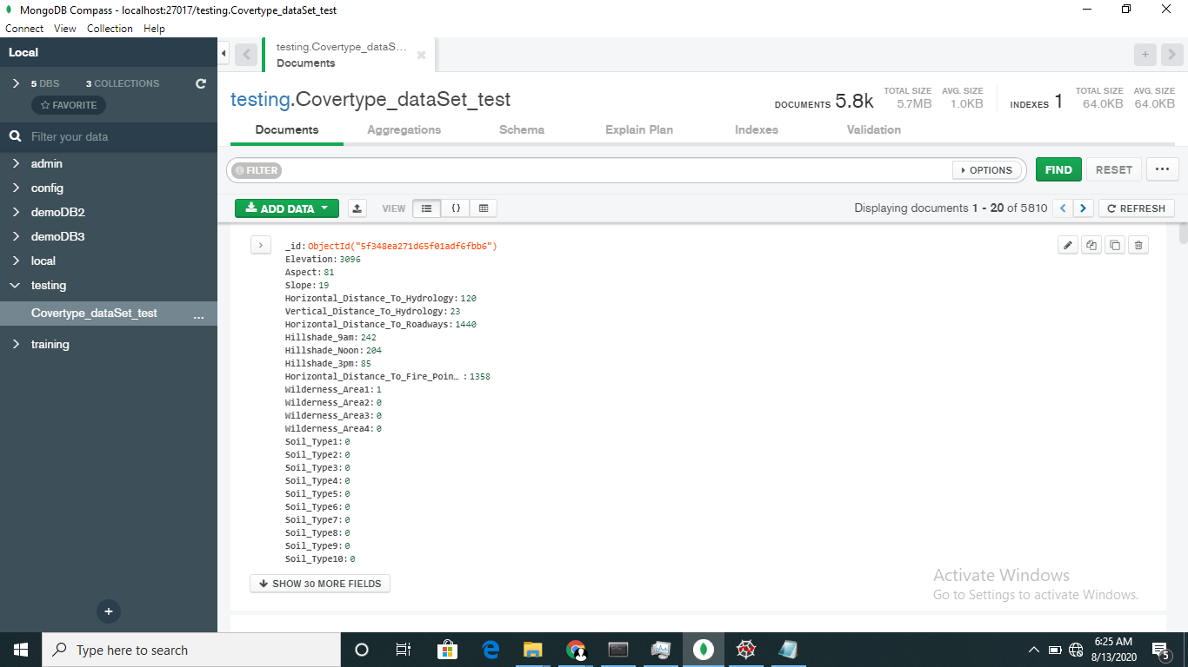
Data Ingestion
In our project we have used No-Sql database Mongo Db. In the data base server, we have created Train and Test database and for each data base we have define a Collection.

Slide 10
Exploratory Data Analysis
In data science , exploratory data analysis is an approach to analyzing data sets to summarize their main characteristics, often with visual methods.
It is a good practice to understand the data first and try to gather as many insights from it. EDA is all about making sense of data in hand, before getting them dirty with it.
Generally we divide the EDA into 3 parts.
Data profiling
Statics based EDA
Graph based EDA

Slide 11
Exploratory Data Analysis
Data Profiling
The number of rows
The number of columns
Number of missing values per column and their percentage
Total missing values and it’s percentage
Number of categorical columns and their list
Number of numerical columns and their list
Number of duplicate rows
Number of columns with zero standard deviation and their list
Size occupied in RAM

Slide 12
Exploratory Data Analysis
Stats based analysis
Column contributions/ importance
Check skewness of data
Check correlation between the variable
Check mean ,median, mode, standard deviation and variation of the variable

Slide 13
Exploratory Data Analysis
Graph based analysis
Univariate analysis
Distribution plot
Boxplot
Histogram
Bar chart
KDE
Bivariate analysis
Scatter plot
Line plot
Box plot
Multivariate analysis
Pair plot
Correlation with heatmap

Slide 14
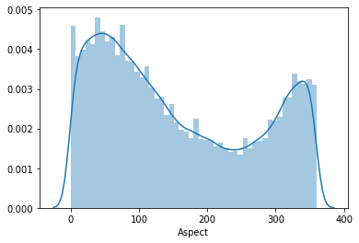
Exploratory Data Analysis
Univariate Analysis
Distribution plot: seaborn.distplot(data, bins=None , hist=True , kde=True)
Seaborn distplot lets you show a histogram with a line on it. This can be shown in all kinds of variations. We use seaborn in combination with matplotlib, the Python plotting module

Slide 15
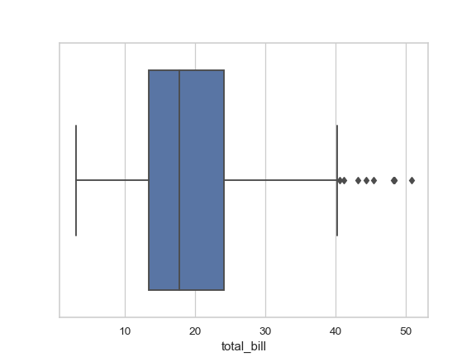
Exploratory Data Analysis
Univariate Analysis
Distribution plot: seaborn. Boxplot(x , y hue=None , data=data frame , kde=True)
A box plot (also known as box and whisker plot) is a type of chart often used in explanatory data analysis to visually show the distribution of numerical data and skewness through displaying the data quartiles (or percentiles) and averages.

Slide 16
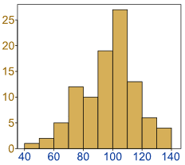
Exploratory Data Analysis
Univariate Analysis
histogram plot: matplotlib.pyplot.hist(x ,bins=None, hue=None , data=data frame , kde=True)
A histogram is a graphical display of data using bars of different heights. In a histogram, each bar groups numbers into ranges. Taller bars show that more data falls in that range. A histogram displays the shape and spread of continuous sample data.

Slide 17
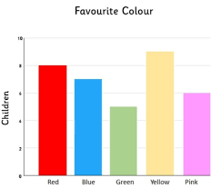
Exploratory Data Analysis
Univariate Analysis
histogram plot: matplotlib.pyplot.bar(x ,bins=None, hue=None , data=data frame , kde=True)
A bar chart or bar graph is a chart or graph that presents categorical data with rectangular bars with heights or lengths proportional to the values that they represent. The bars can be plotted vertically or horizontally.

Slide 18
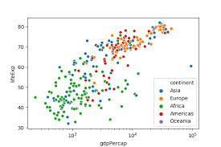
Exploratory Data Analysis
Bivariate Analysis
scatter plot: seaborn. Scatter(x , y , hue=None , data=data frame )
A scatterplot is a type of data display that shows the relationship between two numerical variables. Each member of the dataset gets plotted as a point whose x-y coordinates relates to its values for the two variables.

Slide 19
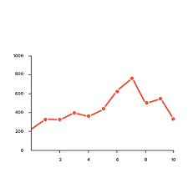
Exploratory Data Analysis
Bivariate Analysis
scatter plot: seaborn. line plot(x , y , hue=None , size=None, data=data frame )
A line plot is a graph that shows frequency of data along a number line. It is best to use a line plot when comparing fewer than 25 numbers. It is a quick, simple way to organize data.

Slide 20
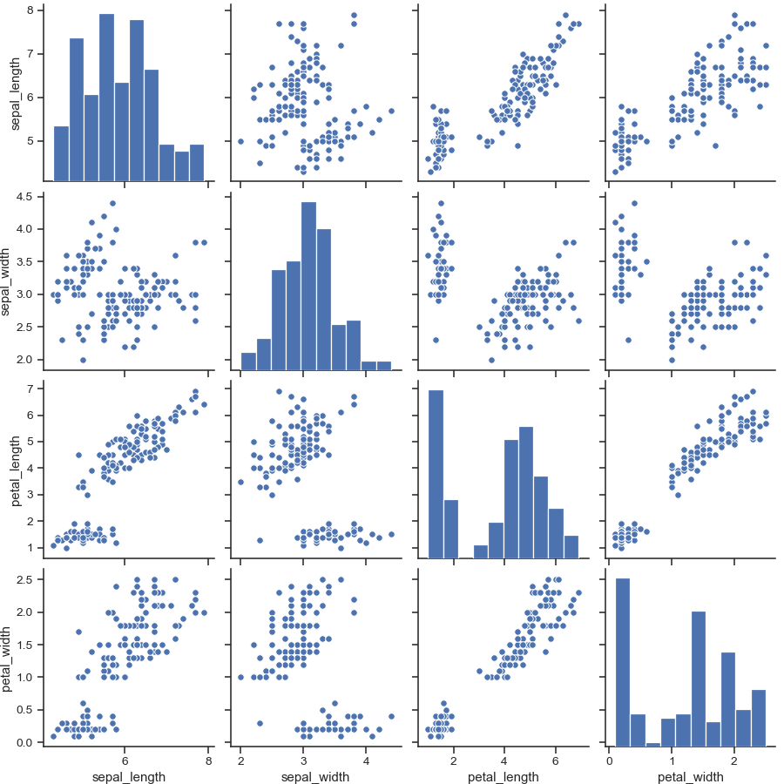
Exploratory Data Analysis
Pair plot: seaborn.pairplot(data=data, hue=True,paltte=True,vars=None)

Slide 21
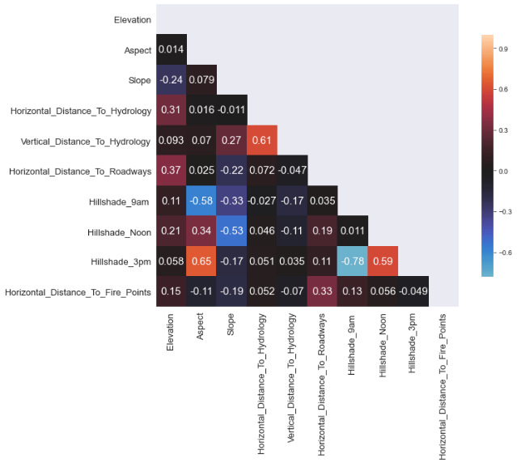
Exploratory Data Analysis
Correlation heatmap: seaborn. Heatmap(data, vmin=None, vmax=None, cmap=None, center=None, robust=False)

Slide 22
Data Pre-processing
What is Data pre-processing?
Why is Data pre-processing?
Steps to take for data pre-processing?

Slide 23
Data Pre-processing
What is Data pre-processing?
Data preprocessing is an important step in the data mining process. The phrase "garbage in, garbage out" is particularly applicable to data mining and machine learning projects. Data-gathering methods are often loosely controlled, resulting in out-of-range values, impossible data combinations, missing values, etc.

Slide 24
Data Pre-processing
Why data preprocessing?
Data in the real world is dirty
incomplete: lacking attribute values, lacking certain attributes of interest, or containing only aggregate data
noisy: containing errors or outliers
inconsistent: containing discrepancies in codes or names No quality data, no quality mining results!
Quality decisions must be based on quality data
Data warehouse needs consistent integration of quality data
A multi-dimensional measure of data quality
accuracy, completeness, consistency, timeliness, believability, value added, interpretability, accessibility Broad categories intrinsic, contextual, representational, and accessibility

Slide 25
Data Pre-processing
Steps to take for data preprocessing?
Handle the missing values
Handle the outliers
Transformation of the data
Scaling of the data
Encoding of the variable

Slide 26
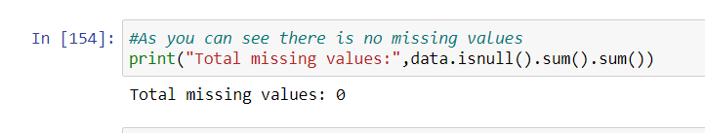
Data Pre-processing
So in my project I have used these many steps:
Handling the missing value:
Ignore the tuple: usually done when class label is missing (assuming the task is classification—not effective in certain cases)
Fill in the missing value manually: tedious + infeasible?
Use a global constant to fill in the missing value: e.g., “unknown”, a new class?!
Use the attribute mean to fill in the missing value
Use the attribute mean for all samples of the same class to fill in the missing value: smarter
We have no missing values in dataset itself
But fortunately in our data set we don’t have a missing values

Slide 27
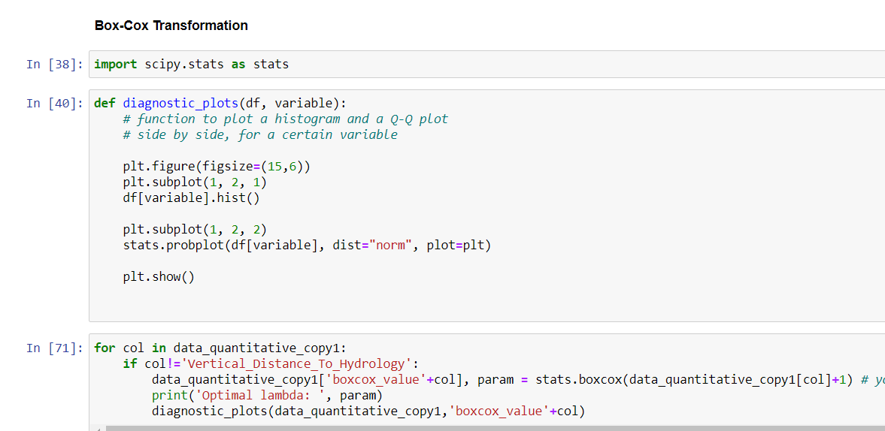
Data Pre-processing
Handling the Outliers:
Outlier handling ,transform data into Box-Cox Transformation.A Box Cox transformation is a way to transform non-normal dependent variables into a normal shape. Normality is an important assumption for many statistical techniques; if your data isn't normal, applying a Box-Cox means that you are able to run a broader number of tests.

Slide 28
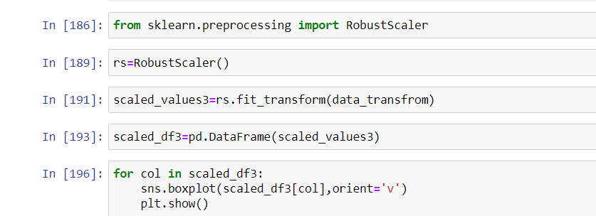
Data Pre-processing
Scaling the data
To get a data into a certain range
Most of the times, your dataset will contain features highly varying in magnitudes, units and range. But since, most of the machine learning algorithms use Euclidian distance between two data points in their computations, this is a problem.so we use data scaling.
In our project we have used a robust scaler to getting data into a certain scale

Slide 29
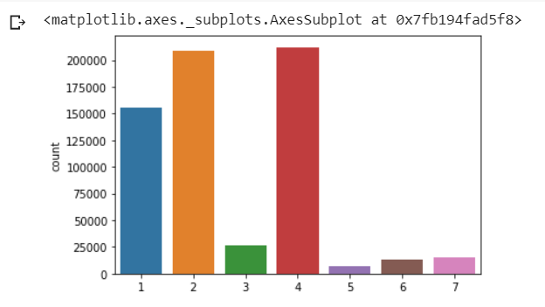
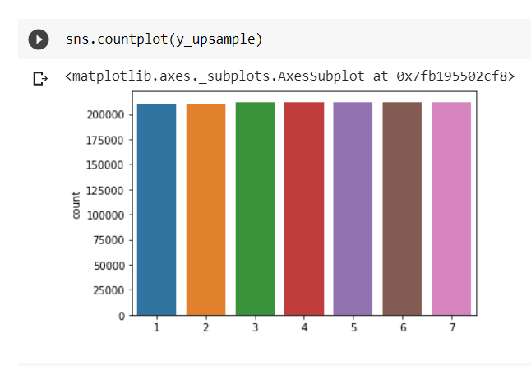
Data Pre-processing
Handling imbalanced dataset
Dealing with imbalanced datasets entails strategies such as improving classification algorithms or balancing classes in the training data (data preprocessing) before providing the data as input to the machine learning algorithm. The later technique is preferred as it has wider application.
In the dataset target we have total 7 classes but it is imbalance we can clearly see in the count plot so we have to handle it

Slide 30
Feature Engineering
Feature selection with Extra Tree Classifier:
We have used a ETC(Extra Trees Classifier) and RFC(Random Forest Classifier) We can see that RFC and ETC show similar results, yes there are features which show-up different ranks but not of a great difference. Each feature show a little similar numbers.
ETC
Elevation | 0.197048
Horizontal_Distance_To_Roadways | 0.109549
Horizontal_Distance_To_Fire_Points | 0.103660
Horizontal_Distance_To_Hydrology | 0.064404
Vertical_Distance_To_Hydrology | 0.059156
Aspect | 0.052901
Hillshade_Noon | 0.046417
Hillshade_9am | 0.044147
Hillshade_3pm | 0.043711
Slope | 0.038203

Slide 31
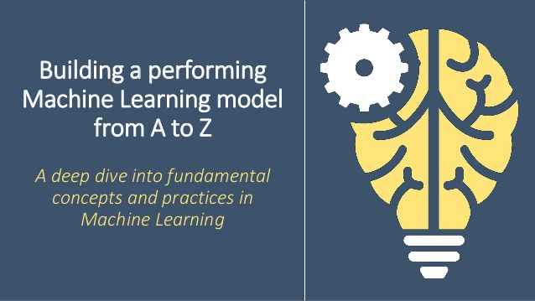
Model Building

Slide 32
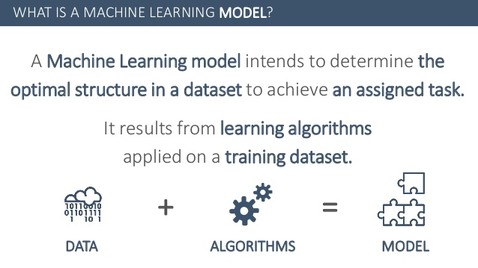
Model Building

Slide 33
Model Building
Model Building with Hyperparameter Optimization:
After the pre-processing of the data we go towards to model building so we implemented a different type of models along with hyperparameter optimization but before applying the model building we make a cluster of data and apply a model building over the each and every cluster and found a model with respect to greater accuracy or a greater AUC score.
Applying K-means :Firstly, you will want to determine what the optimal k is given the dataset. In our case, because we used the The Elbow Method. Therefore, we do not need to determine the optimal k; however, we do need to identify the clusters!
Calculate the Within-Cluster-Sum of Squared (WCSS) for different values of k and choose the k for which WCSS becomes first starts to diminish. In the plot of WCSS-versus-k, this is visible as an elbow.

Slide 34
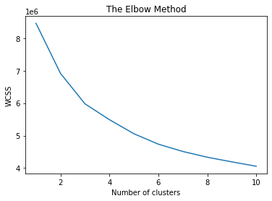
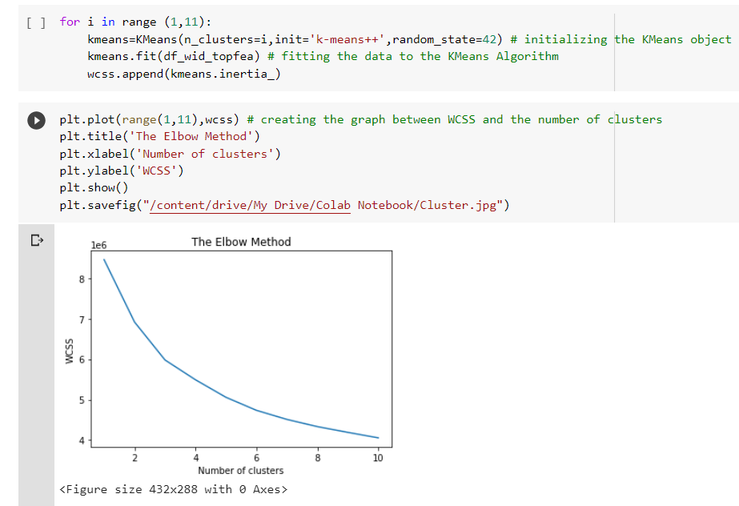
Model Building
After the applying clustering we started a model building for each and every cluster.
We implemented two models for this study, a Bagging technique Random Forest classifier and a Boosting technique XGBoost classifier. The overall objectives of this research were to first construct the se t two predictive models, and second to compare and evaluate their respective classification accuracy or AUC score.
We perform a hyperparameter optimization technique for a model building. hyperparameter optimization or tuning is the problem of choosing a set of optimal hyperparameters for a learning algorithm. A hyperparameter is a parameter whose value is used to control the learning process. There are various technique to choose a hyperparameter like:
Manual Search
Random Search
Grid Search
For performing hyperparameter optimization We used Grid Search along with cross-validation. There is class available in sklearn library called GridSearchCV

Slide 35
Model Building
Model Evaluations:
After feeding our data and train the models to see how each model performs using 2 different evaluation technique
performance matrices
probabilistic method auc-roc curve
Accuracy Score: Accuracy is the measure of the correct predicted data divided by total number of observations hence giving a value ranging between 0 and 1, while 0 is no correctly predicted class whereas 1 is all correctly predicted class. We can multiply the result by 100 to get the accuracy score in terms of percent.
Roc-Auc Score: A receiver operating characteristic curve, or ROC curve, is a graphical plot that illustrates the diagnostic ability of a binary classifier system as its discrimination threshold is varied. The method was developed for operators of military radar receivers, which is why it is so named.

Slide 36
Model Building
We have a 3 cluster, so we apply XGBoost Classifier and Random Forest Classifier each and very cluster.
Cluster-0
XGB0 Accuracy Score 0.7866507747318237
XGB0 Auc-Roc Score 0.9632743219235567
Random Forest0 Accuracy Score 0.6698450536352801
Random Forest0 Auc-Roc Score 0.9275703524425395
Final model=XGBoost0
Cluster-1
XGB1 Accuracy Score 0.8019281332164768
XGB1 Auc-Roc Score 0.9600465872028704
Random Forest1 Accuracy Score 0.6695880806310254
Random Forest1 Accuracy Score 0.9414377950468683
Final model=XGBoost1
Cluster-2
XGB2 Accuracy Score 0.7621951219512195
XGB2 Auc-Roc Score 0.9574533517694802
Random Forest2 Accuracy Score 0.5975609756097561
Random Forest2 Accuracy Score 0.9093521904980139
Final model=XGBoost2

Slide 37
Model Building
Choosing Model:
Out of 2 Models evaluated above model, which performs better? Lets see all the scores of all the given models scores: So to pick one model I would consider not only having best accuracy score but also having a best roc -auc score since roc-auc score is more important as they give us relation between sensitivity and specificity and regarding area under curve and whatever area under curve is more we select that model.
So with that said, I will be picking XGBoost Classifier as my final model to evaluate on the validation set and saw its performance on it.

Slide 38
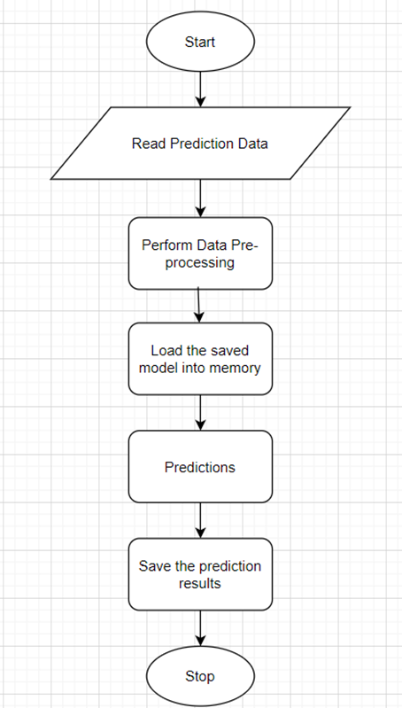
Prediction
Prediction Pipeline:

Slide 39
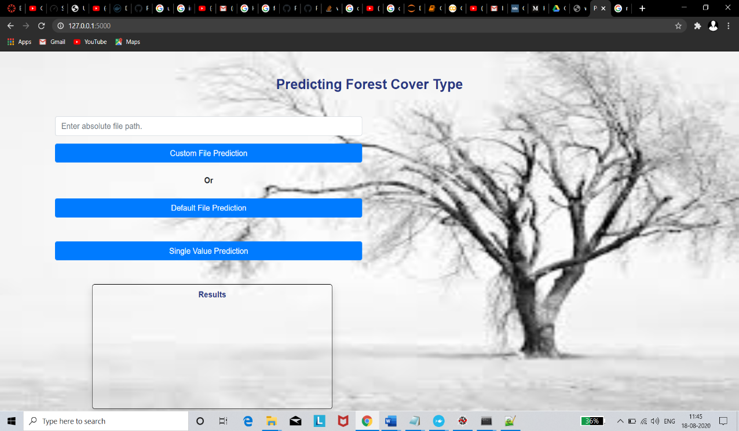
Prediction
predictions from UI
Home.html: It can be used for bulk prediction.

Slide 40
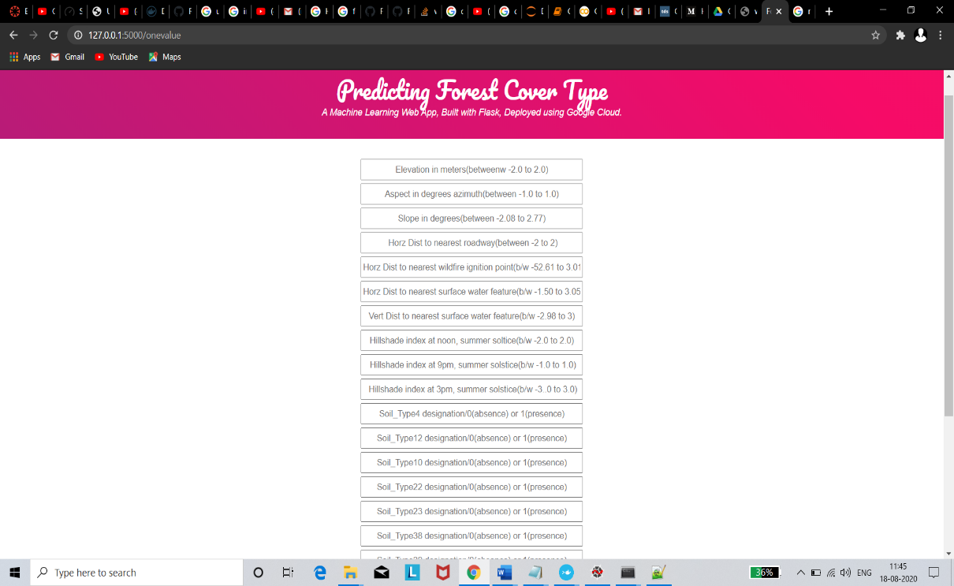
Prediction
predictions from UI
single_value_prediction.html: it can be used for single value prediction.

Slide 41
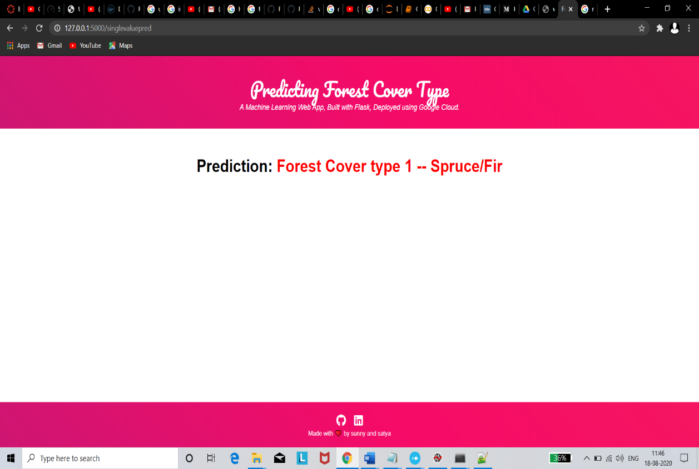
Prediction
predictions from UI
Result.html: it is used for showing the result or prediction.

Slide 42
Deployment

Slide 43
Deployment
Pre-requisites:
Basic knowledge of flask framework.
Any Python IDE installed(we are using PyCharm).
A Google Cloud Platform account.
Basic understanding of HTML.

Slide 44
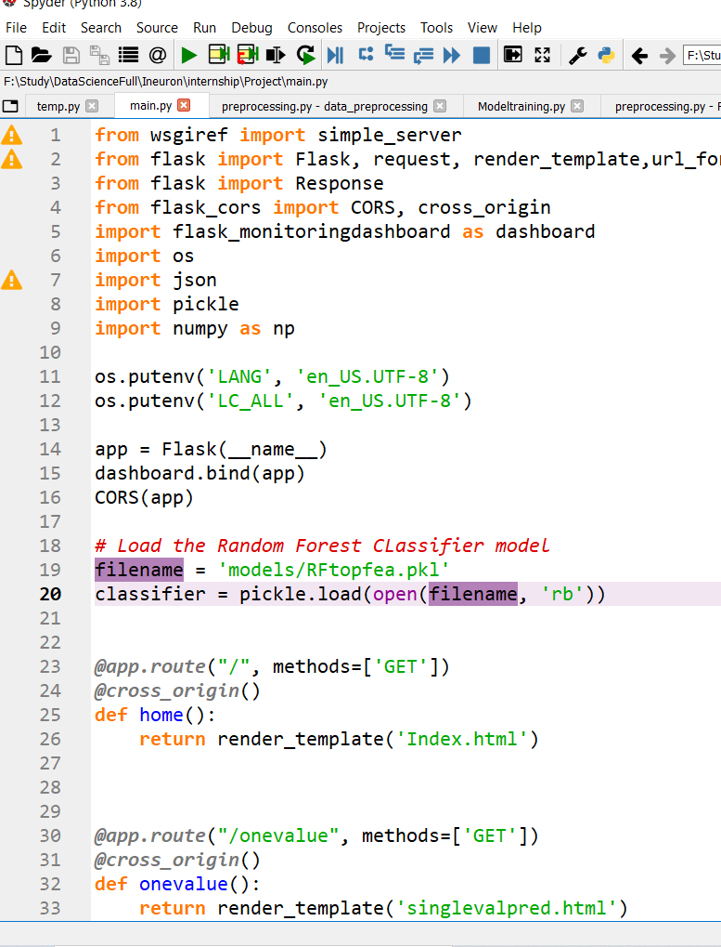
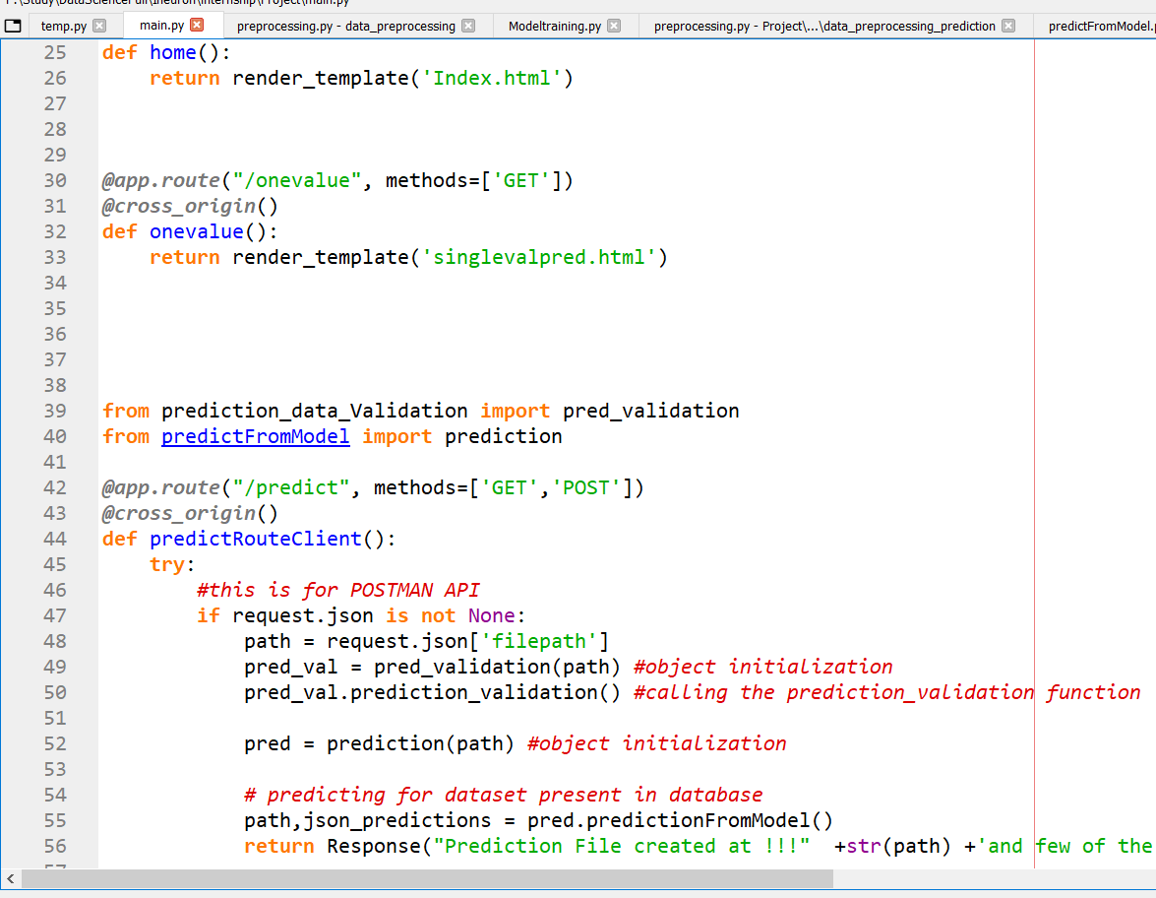
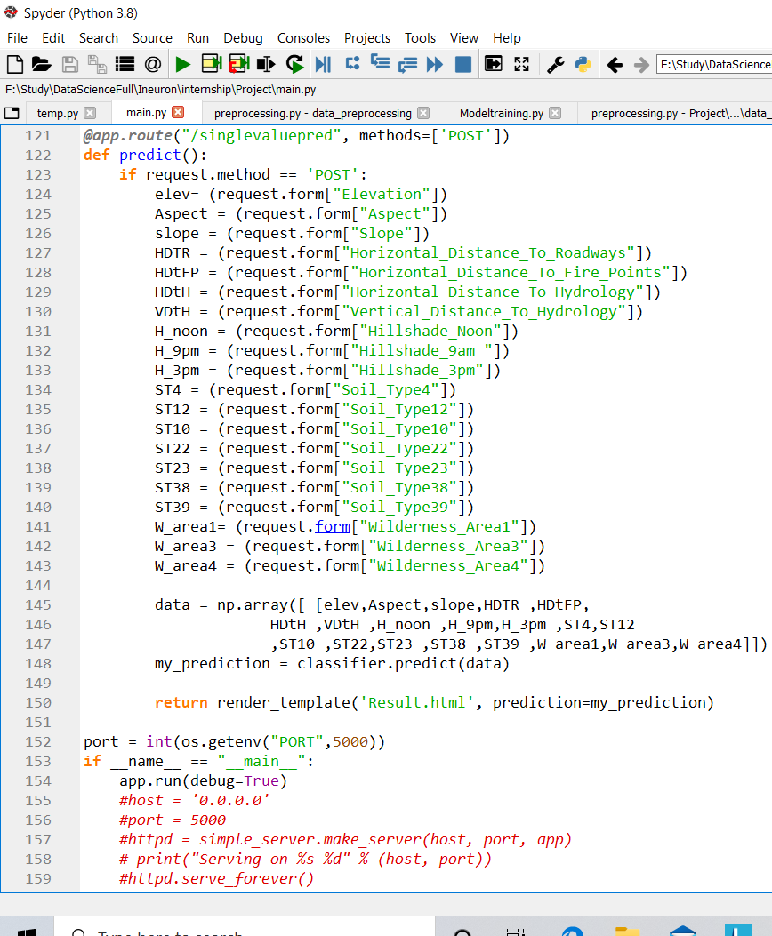
Deployment
Flask App:
As we’ll expose the created model as a web API to be consumed by the client/client APIs, we’d do it using the flask framework.
The flow of our flask app will be:

Slide 45
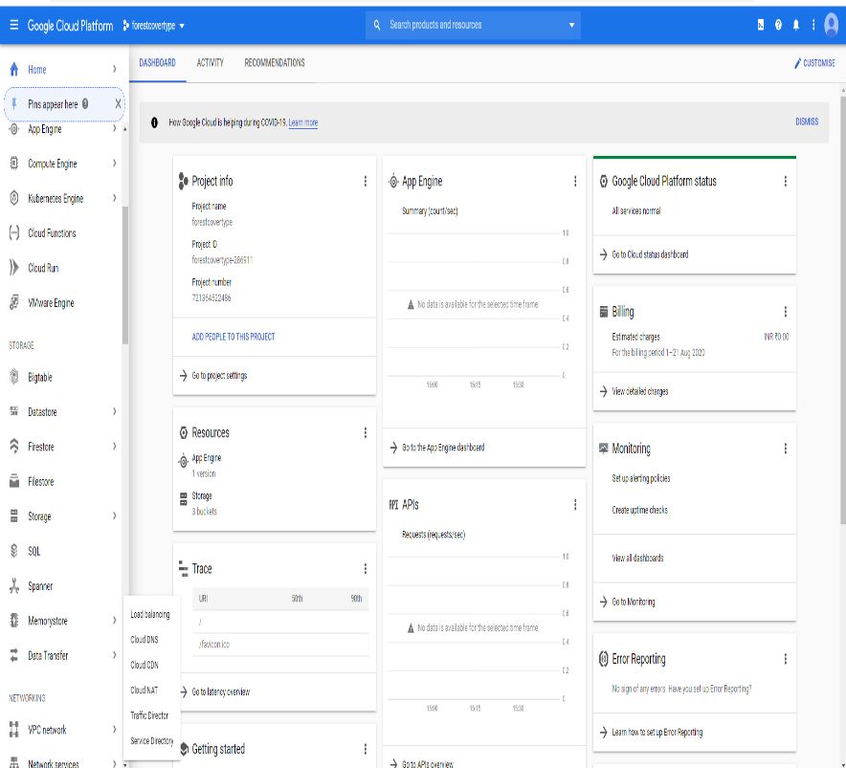
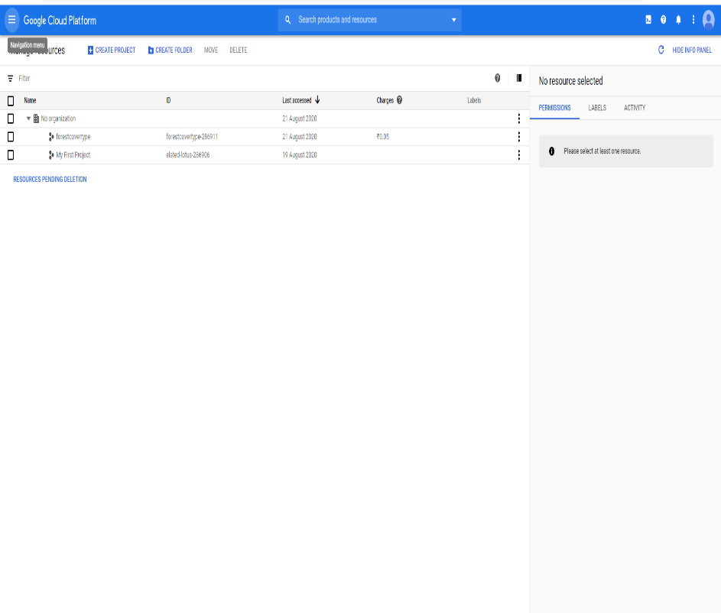
Deployment
Deploy to Google Cloud Platform(GCP)
Go to the https://console.cloud.google.com/ and create a account over there.
After creating a account(free trail account) over the gcp google gives a 300$ free credit with one year validation .
Then go to the iAM & admin option and go over manage recourse and create a new project.

Slide 46
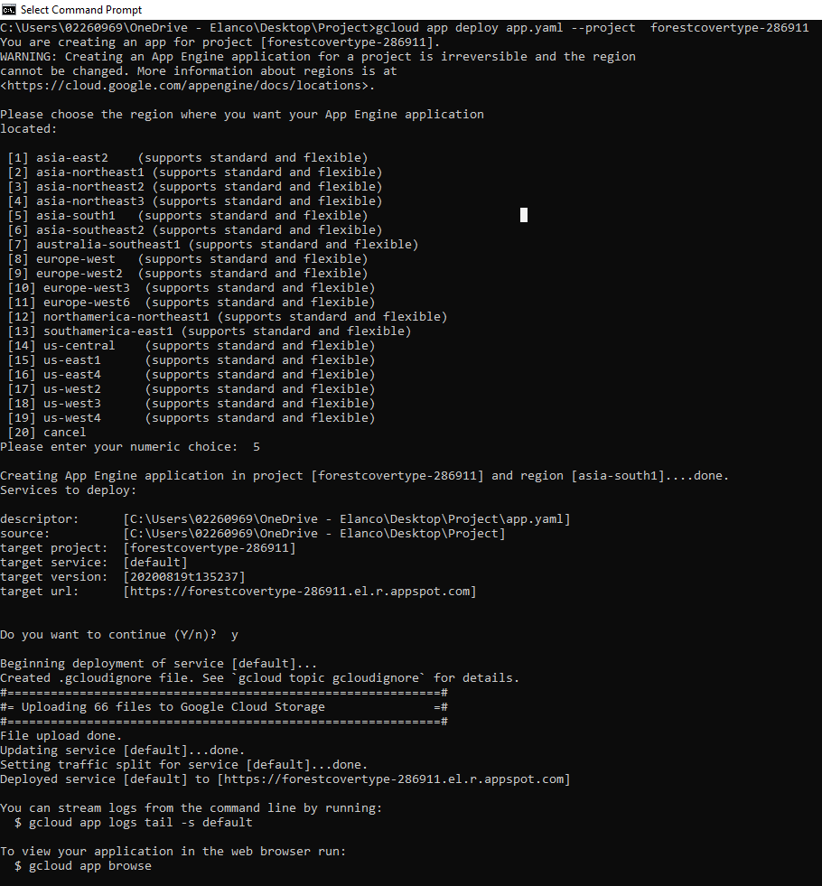
Exploratory Data Analysis
Go to the App engine and start a engine .
Download a google SDK installer.
Run a command gcloud init.
Select a project and deploy it
Got Link after a deploy: https://forestcovertype286911.el.r.appspot.com/

Slide 47
Dockerization of application
Dockerizing an application is the process of converting an application to run within a Docker container. While Dockerizing most applications is straight-forward, there are a few problems that need to be worked around each time.
Because Docker containers encapsulate everything an application needs to run (and only those things), they allow applications to be shuttled easily between environments. Any host with the Docker runtime installed—be it a developer's laptop or a public cloud instance—can run a Docker container.

Slide 48
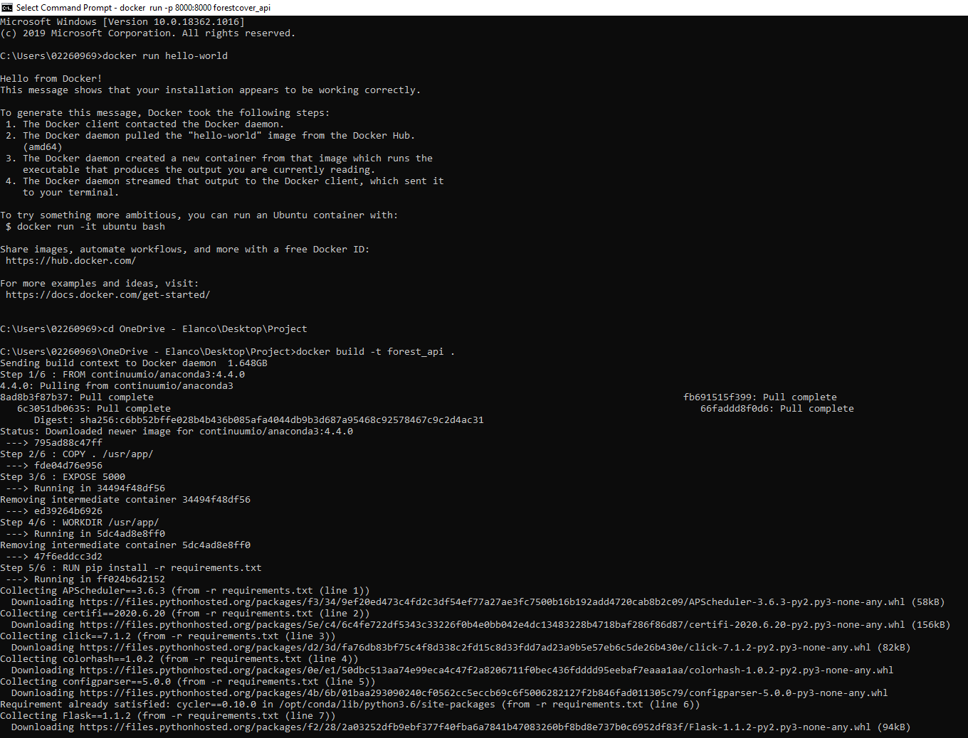
Dockerization of application

Slide 49
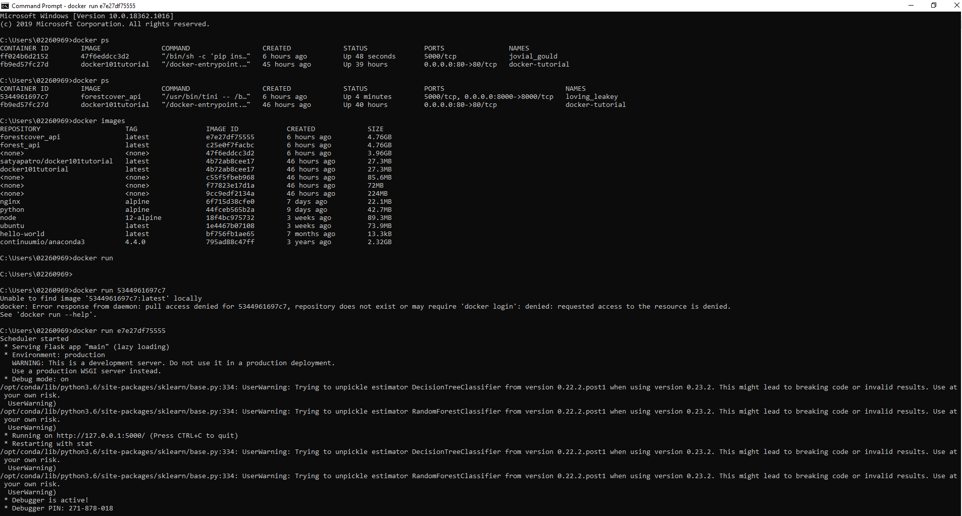
Dockerization of application

Slide 50
Dockerization of application
FROM continuumio/anaconda3:4.4.0COPY
COPY ./usr/app/
EXPOSE 5000
WORKDIR /usr/app/
RUN pip install –r requirements.txt
CMD python main.py
Link after the Containerized the application:http://127.0.0.1:5000/

Slide 51
Logging
we must create a logging framework for monitoring our application logs have been an essential part of troubleshooting application and infrastructure performance. They help provide visibility into how our applications are running on each of the various infrastructure components. Log data contains information such as out of memory exception or hard disk errors. There are some steps for logging.
from datetime import datetime class App_Logger: def __init__(self): pass
def log(self, file_object, log message self. Now = datetime.now() self. Date = self.now.date() self.current_time = self.now.strftime("%H:%M:%S") file_object. Write( str(self. Date) + "/" + str(self.current_time) + "\t\t" + log message +"\n")

Slide 52
Retraining approach
In a simple word retraining means periodically train your Machine leaning model as per your need.
When designing a machine learning system, it is important to understand how your data is going to change over time.
A well-architected system should take this into account, and a plan should be put in place for keeping your models updated. One way to maintain models with fresh data is to train and deploy your models using the same process you used to build your models in the first place.
As you can imagine this process can be time-consuming. How often do you retrain your models? Weekly? Daily?
So answer is it is depend on the client requirement or as per our model need.

Slide 53
Retraining approach
One way, as you are manually retraining your models:
you may discover a new algorithm
With using a feature engineering techniques(different set of features that provide improved accuracy).
With regularization techniques like ridge(L1) and lasso(L2)

Slide 54
Retraining approach
Another way to keep your models up to date is to have an automated system to continuously evaluate and retrain your models. This type of system is often referred to as continuous learning, and may look something like this:
Save new training data as you receive it. For example, if you are receiving updated prices of houses on the market, save that information to a database.
When you have enough new data, test its accuracy against your machine learning model.
If you see the accuracy of your model degrading over time, use the new data, or a combination of the new data and old training data to build and deploy a new model.
Reference Link: visit link

Slide 55

Project under the guidance of:
Mr. Virat Sagar
Mr. Mohit Kashyap

