Slide 1

PLANTONE
GROUP 12
Client team group 10
Sarthak Pandit B00900388
Jay Patel B00906433
Sahil Parekh B00900956
Fenil Parmar B00895684
Aman Patel B00888136

Slide 2
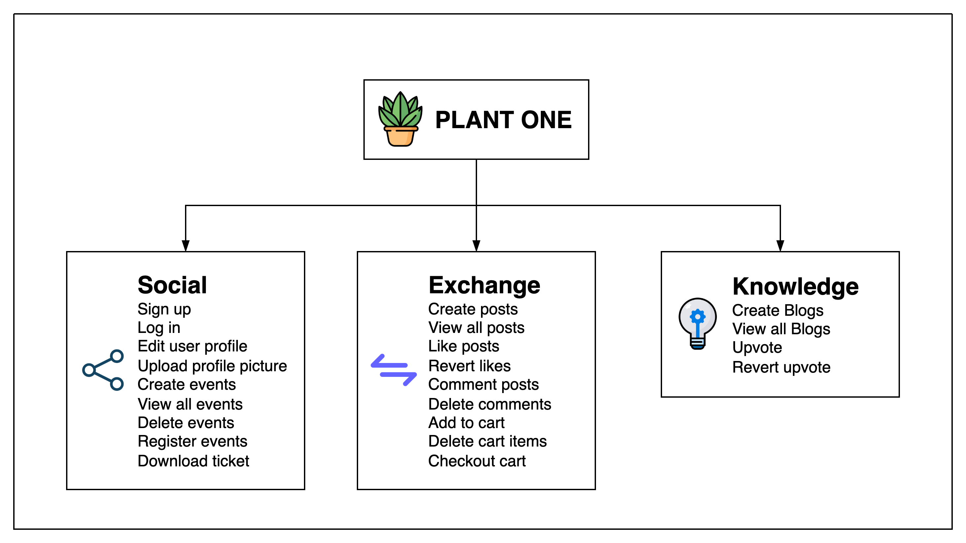
FEATURE SUMMARY
PLANTONE aims to create awareness and accessibility to plantation.
With this application,
  Social - Users can host events and participate in plantation drives and connect with people of similar interests in this area.
  Exchange - Users will also be able to sell plants at an economical prices, donate or adopt plants from other buyers, and exchange plants between buyers and sellers.
  Knowledge - Users can write blogs and express their thoughts and get higher visibility from other users.

Slide 3
MEETING STATS
MEETING TYPE | MEETING NUMBER
INTERNAL TEAM | 35
CLIENT TEAM | 14
CLIENT TEAM AND TA | 10

Slide 4
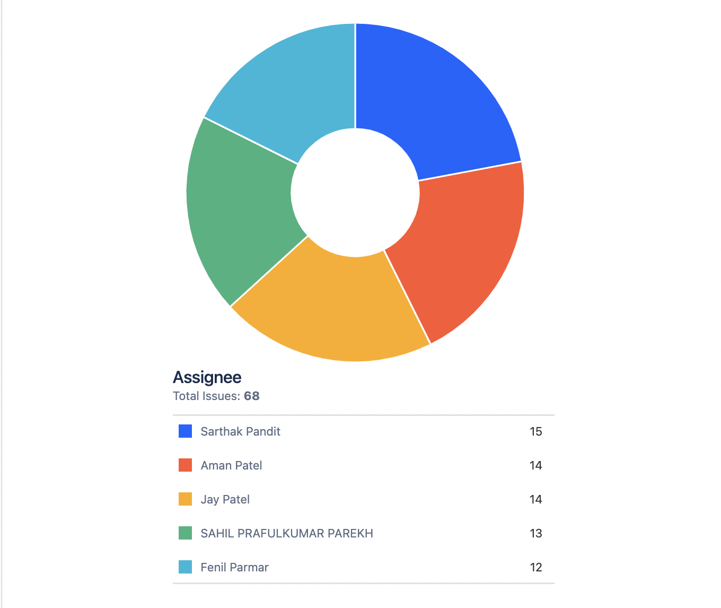
PROJECT DASHBOARD
MEMBER | # OF TASKS
AMAN PATEL | 14
FENIL PARMAR | 12
JAY PATEL | 14
SAHIL PAREKH | 13
SARTHAK PANDIT | 15
GRAND TOTAL | 68

Slide 5
PROJECT STATUS
# | Module Name | Client Expectation | Client Expectation | Final Status
1 | Social | Sign up | YES | Completed
 |  | Log in | YES | Completed
 |  | Edit user profile | YES | Completed
 |  | FORGET PASSWORD | YES | COMPLETED
 |  | Upload profile picture | YES | Completed
 |  | Create events | YES | Completed
 |  | View all events | YES | Completed
 |  | Delete events | YES | Completed
 |  | Register events | YES | Completed
 |  | Download ticket | NO – Extra feature | Completed
2 | Exchange | Create posts | YES | Completed
 |  | View all posts | YES | Completed
 |  | Like posts | NO – extra feature | Completed
 |  | Revert likes | NO – extra feature | Completed
 |  | Comment posts | YES | Completed
 |  | Delete comments | YES | Completed
 |  | Add to cart | YES | Completed
 |  | Delete cart items | YES | Completed
 |  | Checkout cart | YES | Completed
 |  | Parallel checkout cart | NO – extra feature | Completed
3 | Knowledge | Create Blogs | YES | Completed
 |  | View all Blogs | YES | Completed
 |  | Upvote | NO – extra feature | Completed
 |  | Revert upvote | NO- – extra feature | Completed

Slide 6
DEMO

Slide 7
LEARNINGS
After successfully completing the project, our main learnings include –
  Understanding the root cause of Implementation, Design and Architecture smells and how to resolve them
  Understanding the importance of TDD approach and in parallel refactoring of source code.
  Writing unit tests using JUnit & Mockito and integrations tests using MockMvc.
  Configuring CI/CD pipeline using GitLab and deploying application on Heroku.
what would we do next time if WE get a chance to repeat this project
  AVOID DEPENDENCY ON SERVER BY CREATING A LOCAL RUNNER FOR CI/CD.
  MADE THE APPLICATION MORE ROBUST ACCOUNTING REAL-WORLD EDGE CASES
  FOCUS A BIT MORE ON IMPROVING UI/UX

Slide 8
GLOBAL WARMING IS REAL!
PLEASE PLANT MORE TREES

