Slide 1

Autonomous Car Using Li-Dar
IMS ENGINEERING COLLEGE
Electronics and Communcation
Submitted to :
Dr. Neeraj Jain
Submitted By :
Aman Saifi (1814331010)
Anirudh Manoj (1814331011)
Ashish Chaudhary (1814331018)

Slide 2
Contents:
Project overview.
Block diagram.
Components used
Microcontroller.
Power supply board
Arduino.
Lidar sensor.
Ultrasonic sensor.
DC motor.
Software used.
Arduino IDE
Circuit diagram.
Working.
Applications.
Future scope.
Conclusion.

Slide 3
Project Overview:
The project is developed with the motive that no external commands are given to the robot.
All the processing from detecting the object to making turns is done by an Arduino.
The distance value from the sensor is processed by the Arduino for making decisions.
Sensors commanded and the dc motor are also sent the signal for changing directions if an obstacle is detected.
It measures the distance between the car and the obstacle through the Lidar and display it to the LCD present.

Slide 4
Block diagram:
Start
LI-DAR & ULTRASONIC SENSOR
LCD 16X2
Arduino
Motor Driver
DC Motor

Slide 5
Microcontroller used – AVR:
AVR is a family of microcontrollers developed by Atmel. These are modified Harvard architecture & 8 bit RISC single-chip microcontrollers.
AVR was one of the first microcontroller families to use on-chip flash memory for program storage, as opposed to one-time programmable ROM, EPROM, or EEPROM used by other microcontrollers at the time.
AVR microcontrollers used in the Arduino board designs.
The 8-bit Arduino used in this project is Atmega328p.

Slide 6
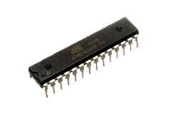
Atmega328p :
Arduino/Genuino Uno is a microcontroller board based on the ATmega328p
It has 14 digital input/output pins (of which 6 can be used as PWM outputs).
6 analog inputs are also available for input or output.
Atmega328p runs at a 16 MHz clock cycle.

Slide 7
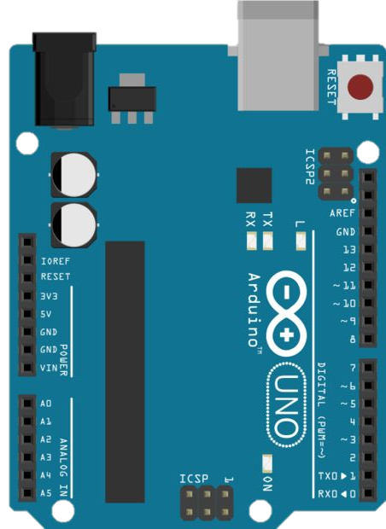
Arduino:
Arduino is a open source electronics community.
It focuses on using microcontrollers in advance electronics by building microcontroller boards.
These boards uses AVR series microcontrollers for processing and controlling.
You can blink an LED or control an servo motor or even send or receive your twitter messages.

Slide 8
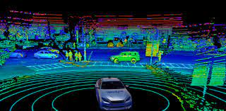
Li-DAR sensor
Li-Dar, which stands for Light Detection and Ranging, is a remote sensing method that uses light in the form of a pulsed laser to measure ranges (variable distances) to the Earth
LiDAR is an active remote sensing system which uses pulsed laser beams to accurately map out an environment.
The laser precision of LiDAR can visually map individual features of a vehicle or an environment in what is known as a “point cloud,” a map of individual laser measurements so densely populated that it appears on a display as solid physical objects.

Slide 9
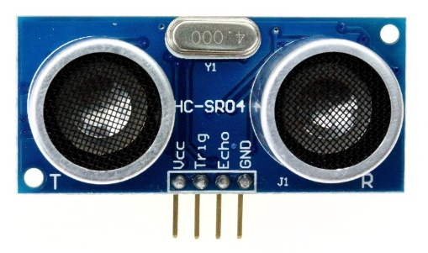
Ultrasonic Sensor:
As the name suggests, ultrasonic waves are used in this sensor. Also known as HC SR-04 ultrasonic sensor.
An Ultrasonic sensor is a device that can measure the distance to an object by using sound waves.
It measures distance by sending out a sound wave at a specific frequency and listening for that sound wave to bounce back.
By recording the elapsed time the distance is calculated.

Slide 10
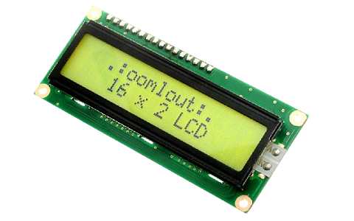
LCD:
The utilization of current is 1mA with no backlight.
It includes two rows where each row can produce 16-characters.
The operating voltage of this LCD is 4.7V-5.3V
These are obtainable in Blue & Green Backlight
Pin15 (+ve pin of the LED): This pin is connected to +5V
Pin 16 (-ve pin of the LED): This pin is connected to GND.

Slide 11
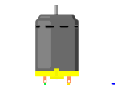
DC Motors:
A motor is an electrical machine which converts electrical energy into mechanical energy.
The principle of working of a DC motor is that "whenever a current carrying conductor is placed in a magnetic field, it experiences a mechanical force".
Electrical motors are everywhere around us. Almost all the electro-mechanical movements we see around us used them,
Additional sensors and electronics control the dc motors.

Slide 12
Software used:
Microcontrollers mostly use different software's from compiling code or to creating a ‘hex file’ till making its PCB( Printed Circuit Board ).
Unlike them the Arduino software is an all-in-one design.
The Arduino Integrated Development Environment - or Arduino Software (IDE) - contains a text editor for writing code, a graphic window (Serial Monitor), a text console, a toolbar with buttons for compiling the code .
Also, it connects to the Arduino hardware to upload programs and communicate with them.

Slide 13
Working:
The Arduino used here is connected here with sensors and motors.
The sensor receives a signal whenever an obstacle is detected. This signal is then sent as a feedback to change direction . While the DC motors are stopped.
And then it’s checked that the path is clear. If it is then the DC motors are turned ON.
The obstacle detection check occurs repeatedly to avoid collision this is possible due to the sophisticated algorithm used in it.

Slide 14
Application:
Spy Robot
Patrolling Robot.
For self driven taxies and Transportation vehicle .
Distance Measuring Robot.

Slide 15
Future Scope:
Traffic-sign recognition (TSR) is a technology by which a vehicle is able to recognize the traffic signs put on the road e.g. "speed limit" or "children" or "turn ahead". This is part of the features collectively called ADAS.
It uses image processing techniques to detect the traffic signs.
Large private tele location or AVL systems send data from GPS receivers in vehicles to a dispatch center over their private, user-owned radio backbone. These systems are used for businesses like parcel delivery and ambulances.

Slide 16
Conclusion:
Many drivers are ready for the arrival of self-driving cars, which will cut down on the frustration and irritation of having to constantly pay attention in traffic or on long road trips, among other benefits.
This self-driven can also be used as patrol cars, distance measurement at big level, spy robot and many more different and amazing features — including some in our own auto.

Slide 17
THANK YOU

