Slide 1
Accident alert and notification system
Group members:
Aman Prajapati
Neel Patel
Chirag Narang
Guided by : Dipixa mam

Slide 2
Abstract
Most accidents do happen on the roads nowadays due to increased traffic and also due to the driver's reckless driving.
In many cases, family members or the ambulance and police are not kept informed on time. This results in delaying the assist provided to the injured person by accident. Road accidents are the crux of the incident.

Slide 3
Introduction
Our project is totally hardware based. This project will help to decrease deaths happening due to accidents.
we use Arduino , gps and gsm. Through this it will send live location of the victim

Slide 4
Objective
The project aims at finding the vehicle where it is and locating the vehicle using a computer within the vehicle system to send a message.
Our Real Time Vehicle Tracking and Accident Detection project with GPS is designed to avoid these circumstances.

Slide 5
Scope
The scope of our project is to reduce the death ratio.
Through gps the live location of the accident will be sent to the police and ambulance and to the relatives of the victim so that the medical help can rech on time .

Slide 6
Backend Technology
C++
C++ is an object-oriented computer language created by notable computer scientist Bjorne Stroustrop as part of the evolution of the C family of languages. C++ is pronounced "see-plus-plus." It was developed as a cross-platform improvement of C to provide developers with a higher degree of control over memory and system resources.
Some call C++ “C with classes” because it introduces object-oriented programming principles, including the use of defined classes, to the C programming language framework. Over time, C++ has remained a very useful language not only in computer programming itself, but in teaching new programmers about how object-oriented programming works. However, it does not support only object-oriented, but also procedural and functional. Thanks to its high flexibility and scalability, C++ can be used to develop a broad range of software, applications, browsers, Graphical User Interfaces (GUIs), operating systems, and games.

Slide 7
Arduino UNO-
Arduino is an open-source platform used for building electronics projects. Arduino consists of both a physical programmable circuit board (often referred to as a microcontroller) and a piece of software, or IDE (Integrated Development Environment) that runs on your computer, used to write and upload computer code to the physical board.
The Arduino platform has become quite popular with people just starting out with electronics, and for good reason. Unlike most previous programmable circuit boards, the Arduino does not need a separate piece of hardware (called a programmer) in order to load new code onto the board -- you can simply use a USB cable. Additionally, the Arduino IDE uses a simplified version of C++, making it easier to learn to program. Finally, Arduino provides a standard form factor that breaks out the functions of the micro-controller into a more accessible package.

Slide 8
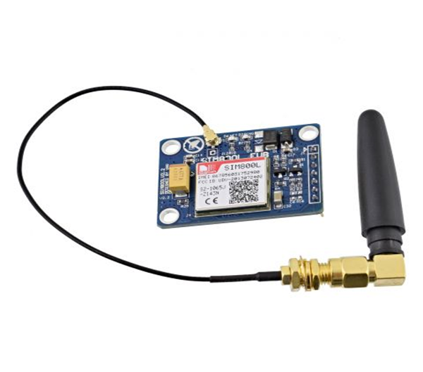
GSM sim 800l-
GSM (Global System for Mobile communication) is a digital mobile network that is widely used by mobile phone users in Europe and other parts of the world. GSM uses a variation of time division multiple access (TDMA) and is the most widely used of the three digital wireless telephony technologies: TDMA, GSM and code-division multiple access (CDMA). GSM digitizes and compresses data, then sends it down a channel with two other streams of user data, each in its own time slot. It operates at either the 900 megahertz (MHz) or 1,800 MHz frequency band.

Slide 9
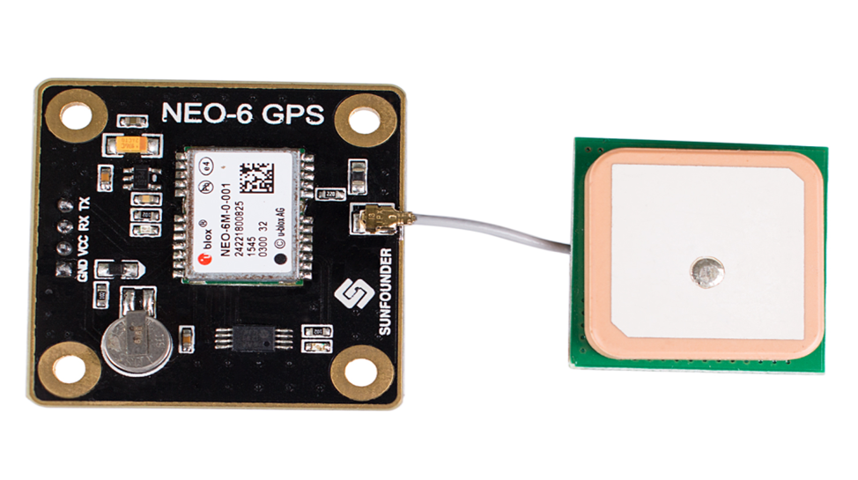
GPS 6MV2-
The Global Positioning System (GPS) has been developed in order to allow accurate determination of geographical locations by military and civil users. It is based on the use of satellites in Earth orbit that transmit information which allow to measure the distance between the satellites and the user. If the signals from three or more satellites are received, simple triangulation will make it possible to determine unambiguously the location of the user.

Slide 10
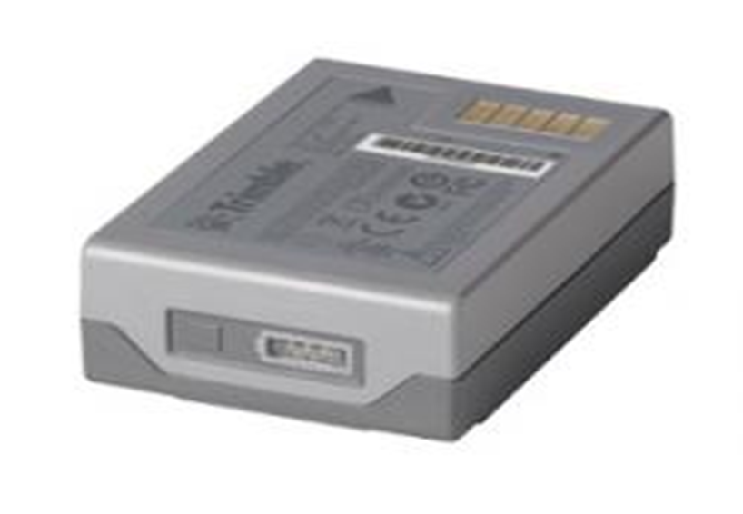
7.4v 1A battery-
Batteries are a collection of one or more cells whose chemical reactions create a flow of electrons in a circuit. All batteries are made up of three basic components: an anode (the '-' side), a cathode (the '+' side), and some kind of electrolyte (a substance that chemically reacts with the anode and cathode).

Slide 11
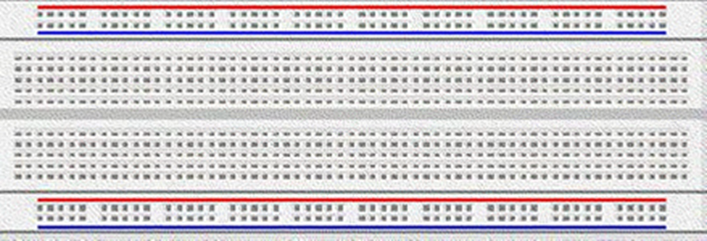
Solderless Breadboard-
A breadboard is used to build and test circuits quickly before finalizing any circuit design. The breadboard has many holes into which circuit components like ICs and resistors can be inserted. The holes are most commonly spaced 0.1“ apart to accommodate standard DIP components. A typical breadboard that includes top and bottom power distribution rails is shown below:

Slide 12
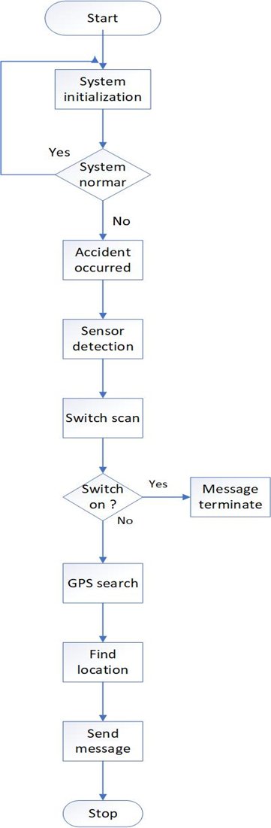
Flowchart

Slide 13
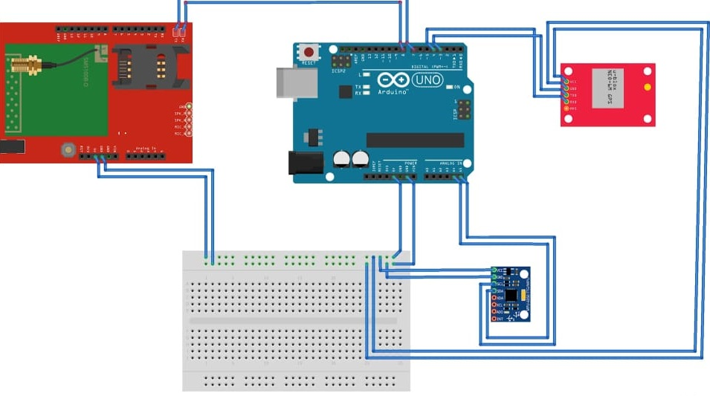
Circuit diagram

Slide 14
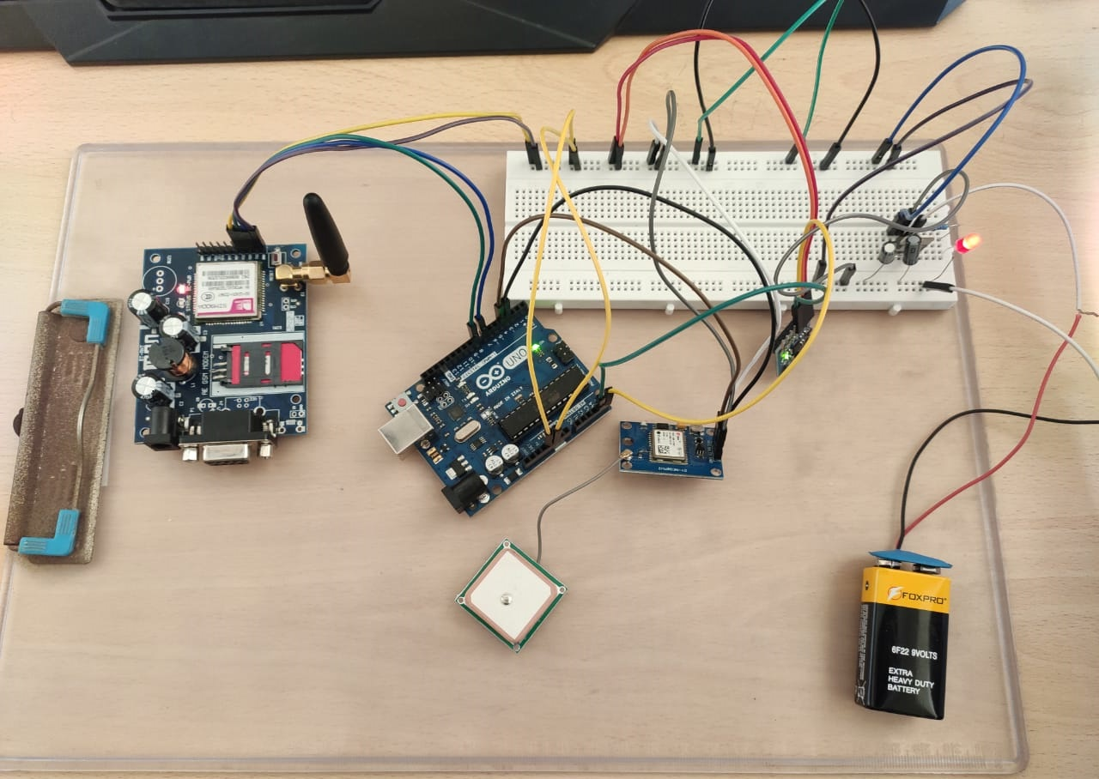
Overview of hardware

Slide 15
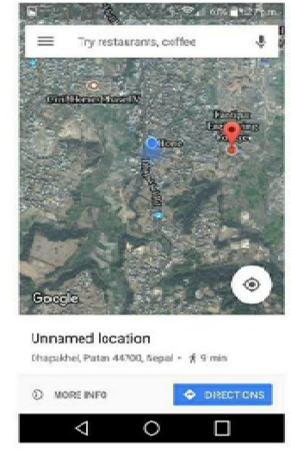
Designing

Slide 16
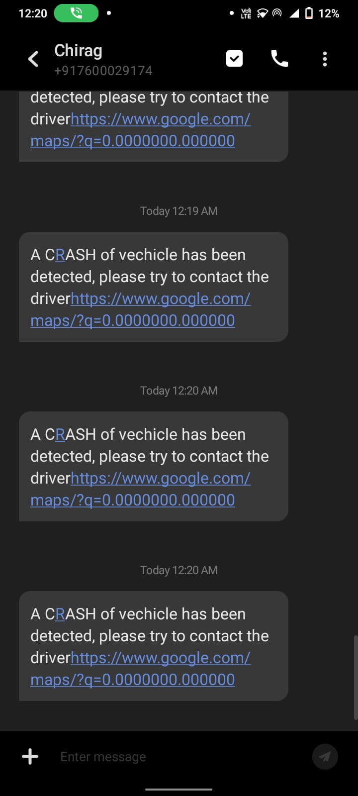

Slide 17
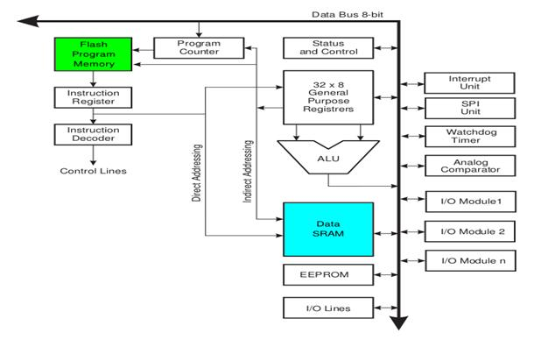
Arduino Architecture

Slide 18
ADVANTAGES & DISAVANTAGES OF PROJECT
Advantages
Alert messages are sent to the nearby hospital and ambulance.
It is an affordable system.
Can be used in any kind of vehicle.
The alert message regarding the accident is automatically sent.
It does not need any operation manually.
Disadvantages
No GPS signal at the time of the crash

Slide 19
Future work
Alarm
Create website
CONCLUSION
The full device configuration is installed on the target vehicle. There is one handheld GSM phone connected to the port at the other end (main vehicle station). The GPS system will transmit longitudinal and latitude values corresponding to the position of a vehicle to GSM modem when a discrepancy in the sensor occurs. Whenever the sensor shifts, the system detects vehicle accidents and sends a message via the GSM module. This message is transmitted through another module of GSM.
Google map shows the static location of the incident and its details. It receives specific SMS from where the accident happened.

Slide 20
Advantages of Arduino
it is open source electronics platform based on easy to use hardware and software. It means normal people can also use it.
It is less expensive as compare to raspberry pi and other electronic platforms.
Also arduino is small hence, it requires less space and can be installed in a vehicle easily.

