Slide 1

B.Tech Project Evaluation, VIIIth Sem
Project Analysis
Project Title - Scam-free Election using Blockchain
Presented by :-
Harshit Garg - (2019587586)
Arpit Pahwa - (2019557429) Aman Verma – (2019007415)
Under the Supervision of:-
Mr. Bal Saraswat
Asst. Professor
Sharda University
DEPARTMENT OF COMPUTER SCIENCE & ENGINEERING
SCHOOL OF ENGINEERING AND TECHNOLOGY

Slide 2
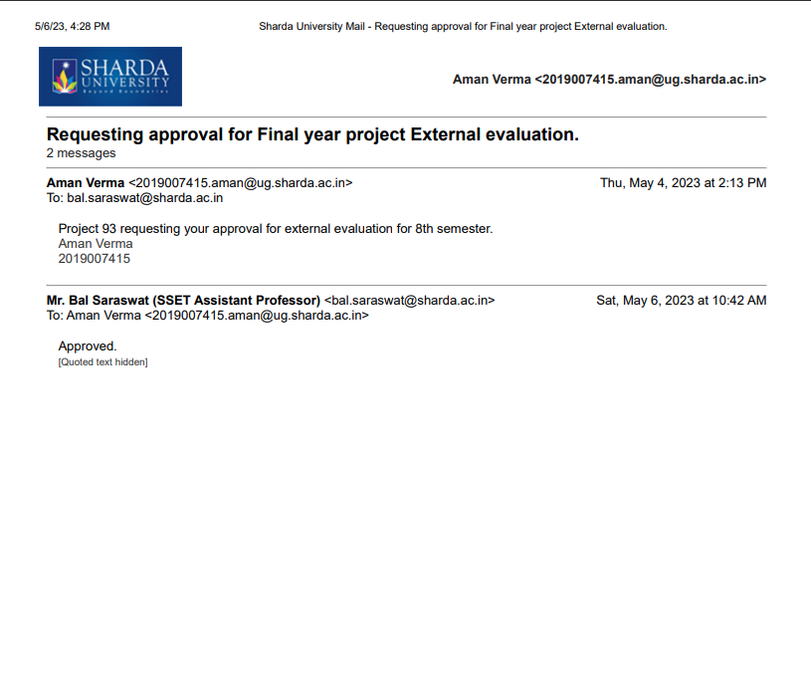
APPROVAL OF GUIDE

Slide 3
Contents
Abstract
Introduction to the project
Motivation for the project
Literature Review
Workload Distribution/Teamwork
Working of Scam-Free Election using Blockchain
Benefits of Voting on the Blockchain
Proposed System vs Existing System
Advantages
Screenshot of Approval from guide for the evaluation
Methodology Used
Conclusion
Screenshots of Working of Project
References

Slide 4
Abstract
In modern democracy, elections are very important but large sections of society around the world do not trust their election system which is a major concern for democracy.
Even the world’s largest democracies like India, United States, still suffer from a flawed electoral system. Vote rigging, hacking of EVM (Electronic voting machine), election manipulation, and polling booth capturing are the major issues in the current voting system.
The blockchain is said as emerging, decentralized, and distributed technology that promises to enhance different aspects of many industries. Expanding e-voting into blockchain technology could be the solution to eliminate the present concerns in e-voting system.

Slide 5
Blockchain is a powerful tool because of its smarts contracts and many features which overcomes traditional systems.
The blockchain with the smart contracts, emerges as a good candidate to use in developments of safer, cheaper, more secure, more transparent, and easier-to-use e-voting systems. Due to its consistency, widespread use, and provision of smart contracts logic, Ethereum and its network is one of the most suitable ones

Slide 6
Introduction TO THE PROJECT
A blockchain is a database that stores encrypted blocks of data then chains them together to form a chronological single-source-of-truth for the data.
Digital assets are distributed instead of copied or transferred, creating an immutable record of an asset.
The asset is decentralized, allowing full real-time access and transparency to the public.
A transparent ledger of changes preserves integrity of the document, which creates trust in the asset.
Blockchain’s inherent security measures and public ledger make it a prime technology for almost every single sector.

Slide 7
Motivation for THE PROJECT
Will of people forms the basis of democracy. However is of utmost importance to protect the anonymity of voters and allow complete privacy to cast their votes.
The current methodology may sometimes fail to protect the fundamental right of privacy of the voters.
The master key to build an electronic voting system is to find out a secure underlying VATSHAYAN platform which provides the required features that overcomes the drawbacks of the current system.

Slide 8
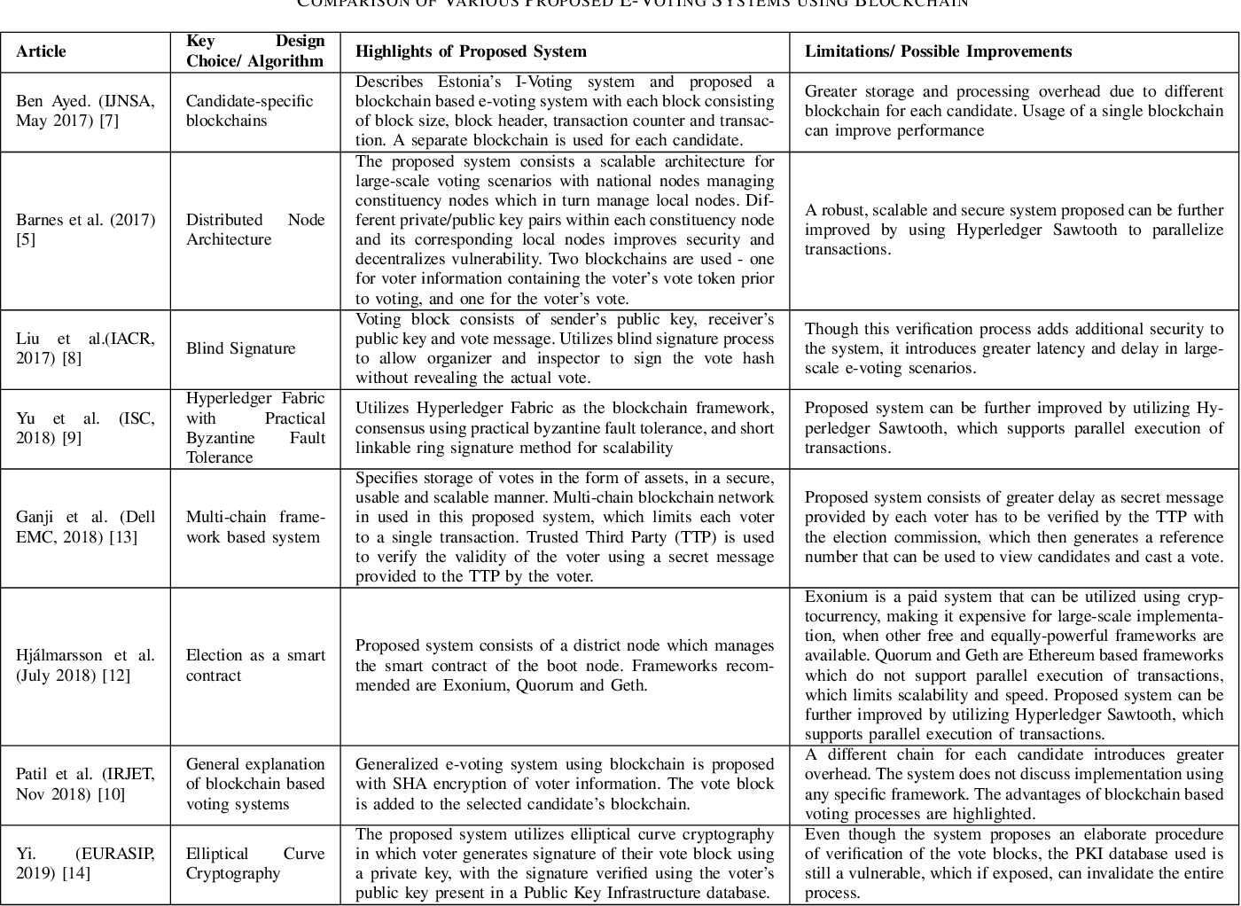
Literature Review

Slide 9
Workload Distribution/ Teamwork
Harshit Garg
Development of Smart Contract
Testing and Auditing of Smart Contract
Arpit Pahwa
Development of Dapp (Decentralized Application)
UI\UX Designing
Aman Verma
Web3(Smart Contract) Integration
Deployment on Test net

Slide 10
Working of Scam-free election on blockchain
Blockchain voting mechanism work on a smart contract which is capable of handling millions of transaction at a time. Implementing the voting system is not always been an easy task in the blockchain. Still, it's possible to implement and keep supreme the authenticity of the voter and determine the eligibility of the voter to cast their ballot. The user would receive a key or a token. This token will help the voter to exactly cast his/her vote for a single time. That means no multiple voting is allowed under blockchain voting practice. We can surely say that blockchain technology stops 'double spending'. Blockchain allows secure management of public ledger.
Another thing is that it decentralizes no central authority to track or maintain the voting system. Voting can be tracked by anyone without breaching the security and authenticity of the voting system.

Slide 11
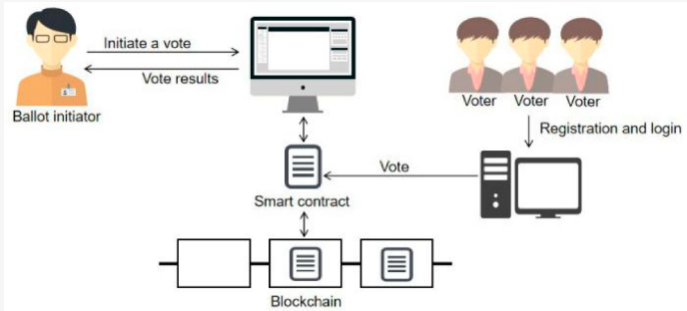
Working Diagram

Slide 12
Benefits of voting on the blockchain
The advantages of blockchain in voting are large as it brings in great transparency and integrity in the voting process. As the blockchain technology exists as a tamper-proof model, under blockchain in voting, no individual shall be prone to manipulate the election data. The system remains trustful throughout the election process. Also, blockchain in voting makes it possible for a voter to clarify his vote that it goes to the right candidate he intended to, which is a major threat in the current electronic voting machine.

Slide 13
Proposed System v/s Existing System
Election could be a crucial event for a democratic country however massive sections of society round the world don’t trust their election system which is a major concern.
Vote rigging, hacking of the EVM (Electronic vote machine), election manipulation, and booth capturing square measure are some unfair practices within the current electoral system.
Our objective is to solve the issues of current voting systems using this Blockchain powered model, which could reduce voting fraud and increase voter’s access and transparency.

Slide 14
ADVANTAGES
You can vote anytime/anywhere
Enhanced Security
Immutability
Faster
Makes voting process more cost-effective and time-saving.
Transparency
High Availability
Verifiability
Distributed Ledgers
Decentralised

Slide 15
Approval from guide for the evaluation

Slide 16








Methodology Used
Hardware Requirements
PC/Laptop
Computer Languages Used
Solidity
React.js & JavaScript
Node.js
Tools Used
Truffle
Hardhat
Ganache
Metamask

Slide 17
Conclusion
It is vital for a democracy to have a transparent voting system that must have the least number of obstacles for a voter to vote.
The proposed system not only handles voter privacy and auditability but also provides a transparent system for verification of the election.
The proposed system is shown to be highly cost efficient as compared to other countries and can be implemented with existing infrastructure owned by a nation.
Keeping all these factors in mind the proposed system is a comprehensive solution that satisfies all the requirements requested by the client.

Slide 18
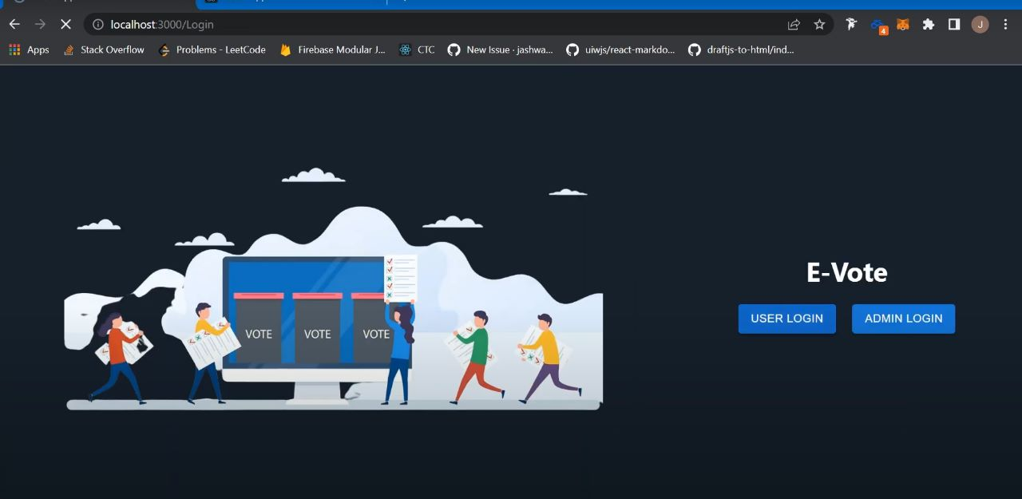
Working of Project

Slide 19
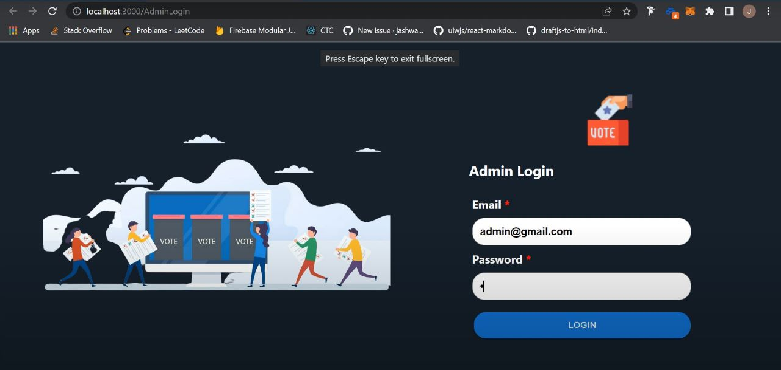

Slide 20
References
K. Patidar and S. Jain, "Decentralized E-Voting Portal Using Blockchain," 2019 10th International Conference on Computing, Communication and Networking Technologies (ICCCNT), 2019, pp. 1-4, doi: 10.1109/ICCCNT45670.2019.8944820.
K. Garg, P. Saraswat, S. Bisht, S. K. Aggarwal, S. K. Kothuri and S. Gupta, "A Comparitive Analysis on E-Voting System Using Blockchain," 2019 4th International Conference on Internet of Things: Smart Innovation and Usages (IoT-SIU), 2019, pp. 1-4, doi: 10.1109/IoT-SIU.2019.8777471.
Yi, H. Securing e-voting based on blockchain in P2P network. J Wireless Com Network 2019, 137 (2019). https://doi.org/10.1186/s13638-019-1473-6
Benny, Albin, Blockchain based E-voting System (July 11, 2020). Available at SSRN: https://ssrn.com/abstract=3648870 or http://dx.doi.org/10.2139/ssrn.3648870
G. Rathee, R. Iqbal, O. Waqar and A. K. Bashir, "On the Design and Implementation of a Blockchain Enabled E-Voting Application Within IoT-Oriented Smart Cities," in IEEE Access, vol. 9, pp. 34165-34176, 2021, doi: 10.1109/ACCESS.2021.3061411.

Slide 21
References (cont.)
https://www.pwc.ch/en/publications/2017/Xlos_Etude_Blockchain_UK_2017_Web.pdf
L. V. Thuy, K. Cao-Minh, C. Dang-Le-Bao and T. A. Nguyen, "Votereum: An Ethereum-Based E-Voting System," 2019 IEEE-RIVF International Conference on Computing and Communication Technologies (RIVF), 2019, pp. 1-6, doi: 10.1109/RIVF.2019.8713661.
Geth.ethereum.org. (2018). Go Ethereum. Available at: https://geth. ethereum.org/
F. Þ. Hjálmarsson, G. K. Hreiðarsson, M. Hamdaqa and G. Hjálmtýsson, "Blockchain-Based E-Voting System," 2018 IEEE 11th International Conference on Cloud Computing (CLOUD), 2018, pp. 983-986, doi: 10.1109/CLOUD.2018.00151.
S. K. Vivek, R. S. Yashank, Y. Prashanth, N. Yashas and M. Namratha, "E-Voting Systems using Blockchain: An Exploratory Literature Survey," 2020 Second International Conference on Inventive Research in Computing Applications (ICIRCA), 2020, pp. 890-895, doi: 10.1109/ICIRCA48905.2020.9183185.
S. Al-Maaitah, M. Qatawneh and A. Quzmar, "E-Voting System Based on Blockchain Technology: A Survey," 2021 International Conference on Information Technology (ICIT), 2021, pp. 200-205, doi: 10.1109/ICIT52682.2021.9491734.

Slide 22
THANK YOU

