Slide 1
Capstone Project Sports Analytics

Slide 2


Slide 3


Slide 4


Slide 5

ER Diagram

Slide 6
Power BI Problem Statement

Slide 7
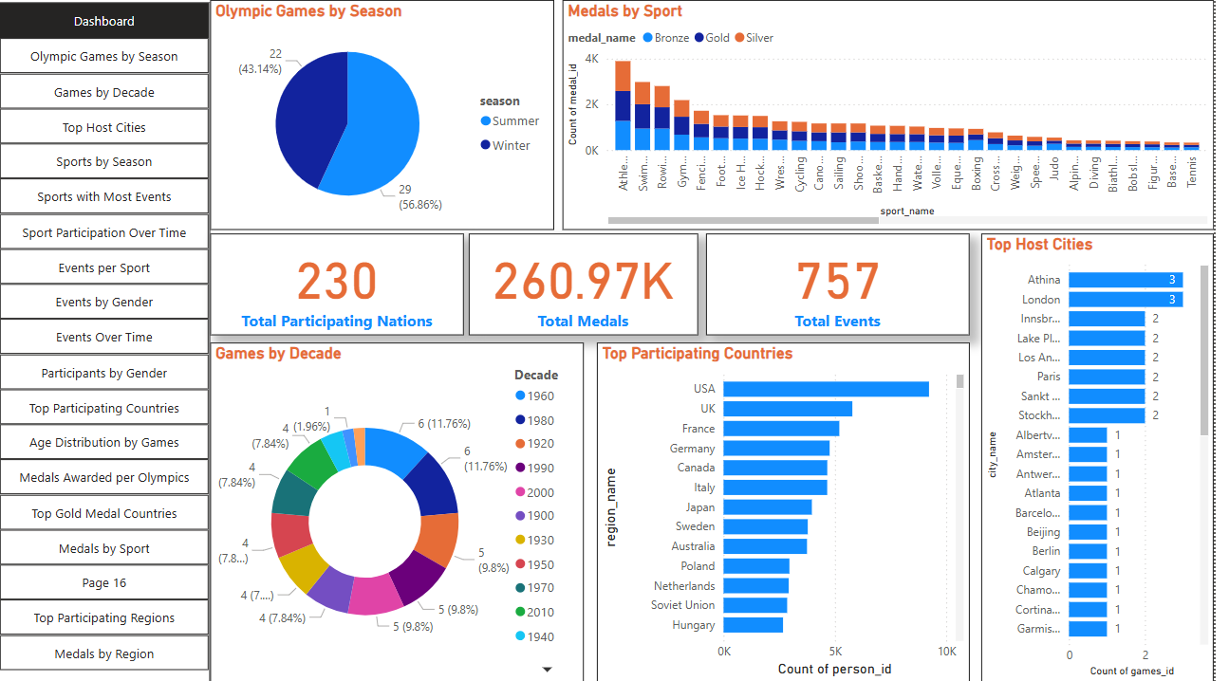

Slide 8
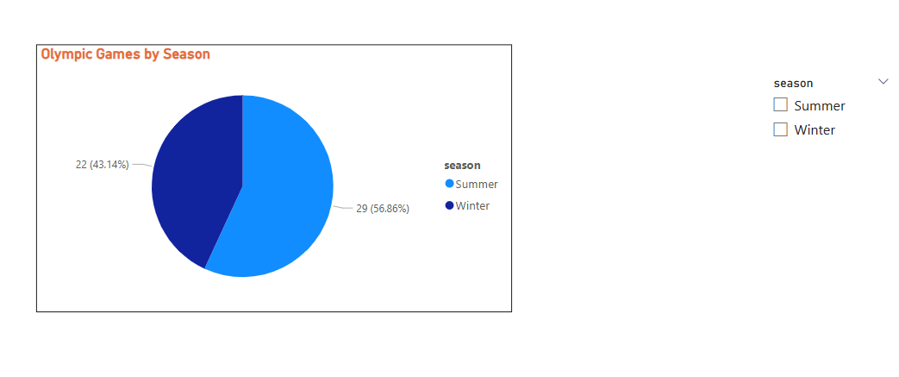
How many Olympic Games have been held in each season (Summer vs. Winter)?
Conclusion: The Summer Olympics have been held more frequently than the Winter Olympics, with 29 editions compared to 22. This highlights the longer history and greater global reach of the Summer Games.

Slide 9
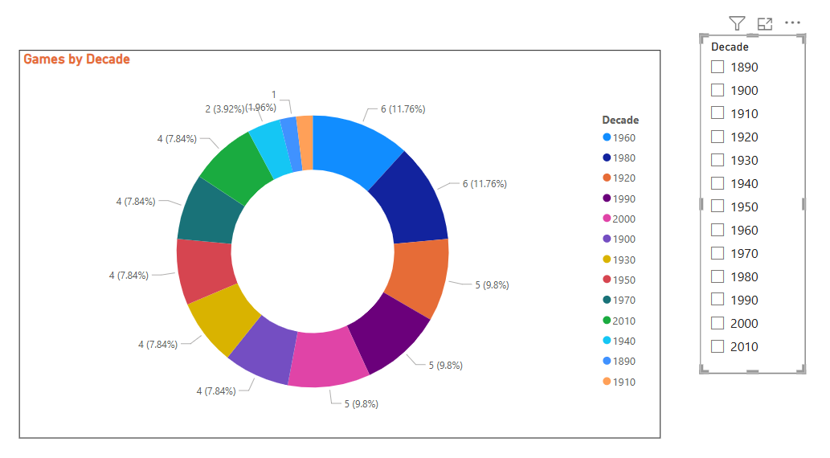
What is the distribution of games across different decades?
Conclusion: The donut chart shows that the Olympic Games have been distributed fairly evenly across decades, with most decades hosting 4 to 6 Olympic Games each. The 1960s and 1980s saw the highest number, with 6 Games per decade (about 12% each), while the earliest decades had fewer Games due to the Olympics' later start and interruptions from world wars.

Slide 10
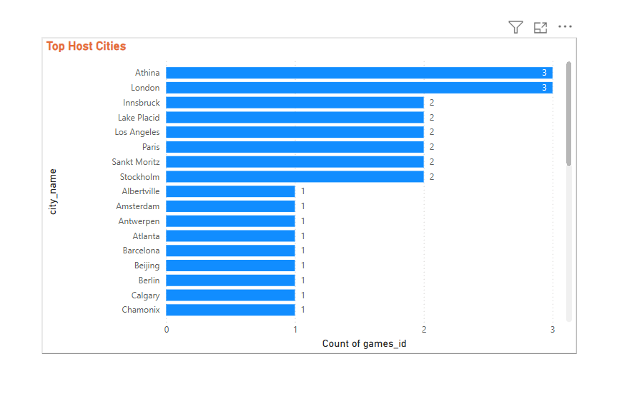
Which cities have hosted the most Olympic Games?
Conclusion: The bar chart shows that London and Athens have each hosted the Olympic Games three times, making them the top host cities in Olympic history. Several other cities—including Innsbruck, Lake Placid, Los Angeles, Paris, Sankt Moritz, and Stockholm—have each hosted the Games twice. Most other cities have hosted only once, reflecting the Olympic tradition of rotating host locations globally.

Slide 11

What is the distribution of sports between Summer and Winter Olympics?
Conclusion: The treemap visual clearly shows that the Summer Olympics feature a much wider variety of sports compared to the Winter Olympics. Major Summer sports like athletics, swimming, and cycling occupy the largest areas, reflecting their prominence and the number of events. In contrast, Winter Olympics include fewer sports, mainly focused on ice and snow disciplines such as skiing, skating, and biathlon.

Slide 12
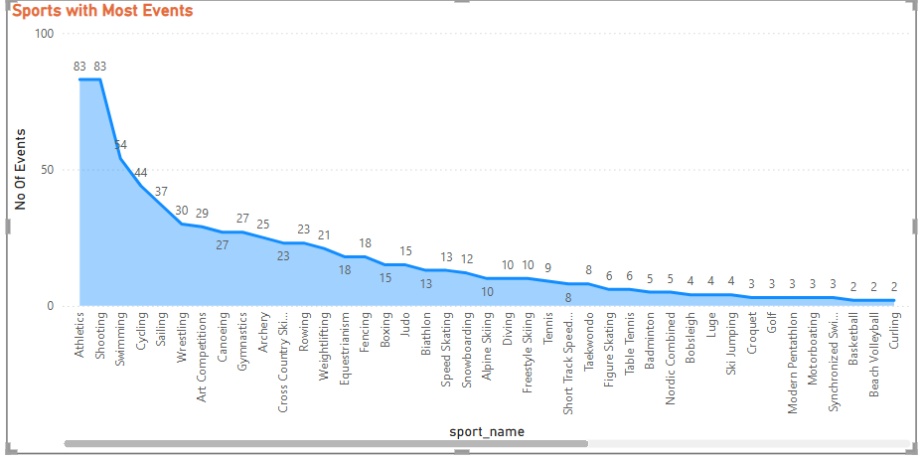
Which sports have the highest number of events in the Olympics?
Conclusion: The visual clearly shows that Athletics and Swimming have the highest number of events in the Olympics, each with 83 events, followed by Shooting (54) and Cycling (44). These sports offer the most medal opportunities and contribute significantly to the overall event count. The step drop after the top sports highlights how a few disciplines dominate the Olympic program in terms of event variety.

Slide 13
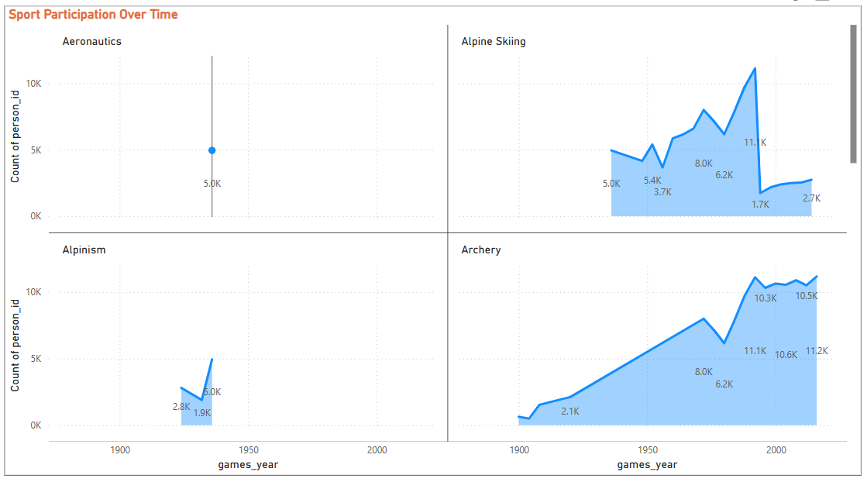
How has the participation in each sport evolved over time?
Conclusion: The visual shows that sport participation in the Olympics has generally increased over time, especially in sports like Archery and Alpine Skiing, which display steady and significant growth in athlete numbers. Some sports, such as Aeronautics and Alpinism, had brief appearances with limited participation, while others have seen fluctuating or declining trends.

Slide 14
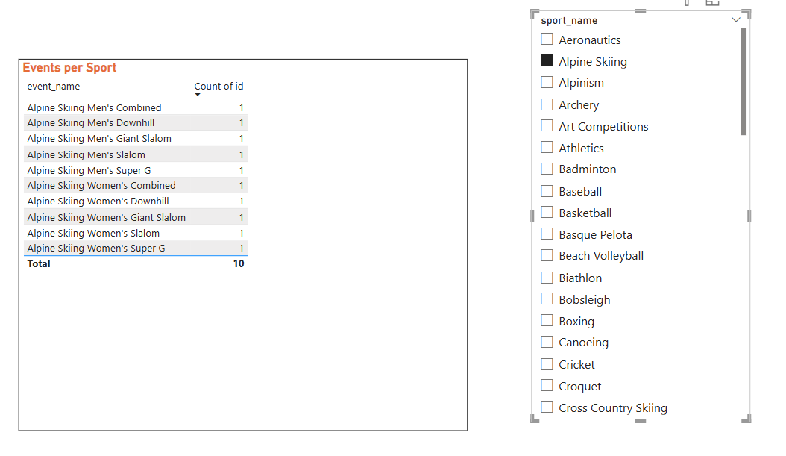
How many events are there in each sport?
Conclusion: The visual shows that Alpine Skiing includes 10 distinct events, evenly split between men’s and women’s competitions such as Downhill, Slalom, and Super G. This event breakdown demonstrates the diversity within a single Olympic sport, offering multiple medal opportunities for athletes. The filter on the right allows users to select any sport and instantly view the number and types of events it contains.

Slide 15
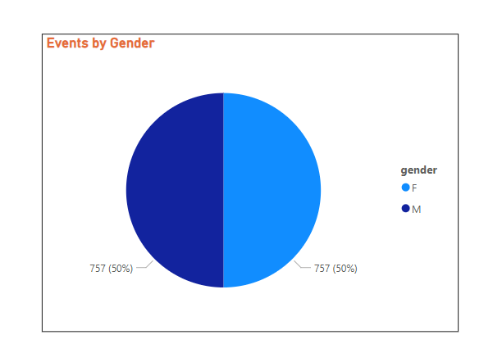
What is the distribution of events by gender (Men, Women, Mixed)?
Conclusion: The pie chart shows perfect gender balance in Olympic events, with 757 (50%) for men and 757 (50%) for women. This reflects the IOC’s recent efforts to achieve full gender parity in the competition schedule, a milestone reached at Paris 2024. Over the past century, the number of women’s events has steadily increased, narrowing the gap with men’s events and promoting equality. Mixed-gender events have also been introduced, further supporting diversity and inclusion in the Olympics.

Slide 16
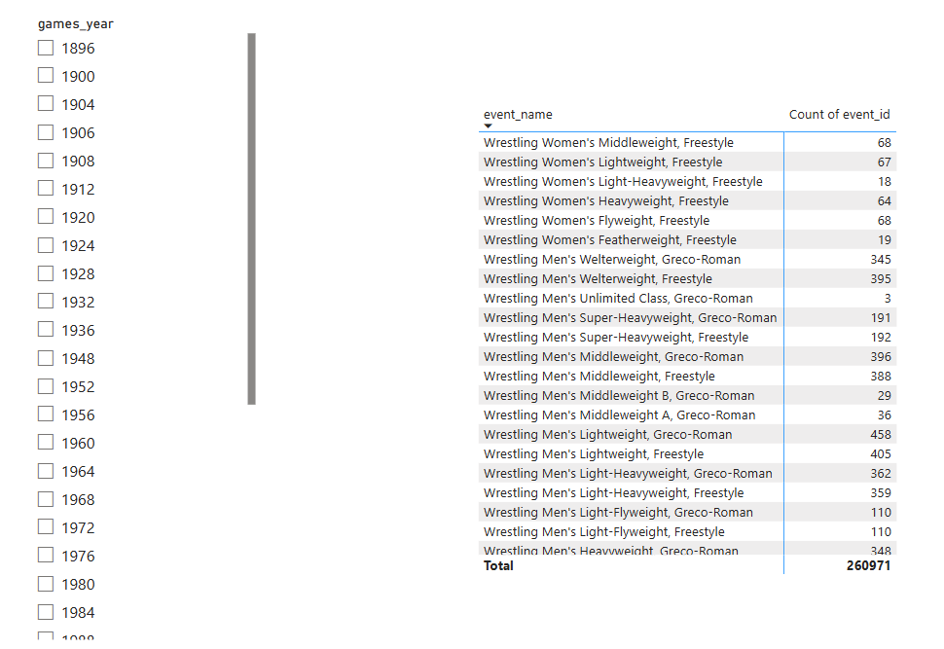
How has the number of events changed over time?
Conclusion: The data table and historical records show that the number of Olympic events has steadily increased over time, with significant growth in recent decades for both Summer and Winter Games. Early Olympics featured only a handful of events, while recent editions include hundreds, reflecting the addition of new sports and greater gender inclusion. The expansion is especially notable in sports like wrestling, which now offers numerous weight classes for both men and women, as seen in the visual.

Slide 17
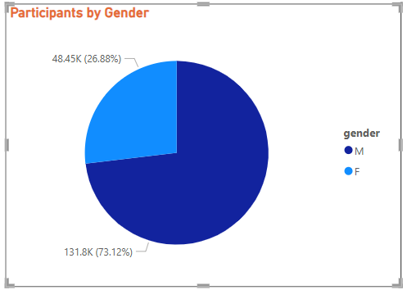
What is the distribution of participants by gender?
Conclusion: The pie chart reveals that 73% of Olympic participants have been men (131.8K), while 27% have been women (48.45K). This highlights a historical gender gap in Olympic participation, though recent Games have seen significant progress toward equality. Efforts by the IOC have steadily increased female participation, culminating in full gender parity at the Paris 2024 Olympics.

Slide 18
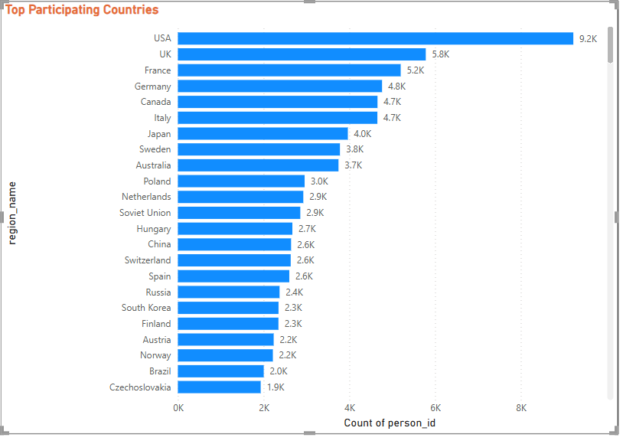
Which countries have the highest number of participants in the Olympics?
Conclusion: The bar chart reveals that the United States has participated with the highest number of athletes in Olympic history, followed by the UK, France, Germany, and Canada. These countries consistently send large delegations, reflecting their strong sports infrastructure and long-standing Olympic traditions. Other nations such as Italy, Japan, Sweden, and Australia also have high participation rates, underscoring their active roles in the Games.

Slide 19
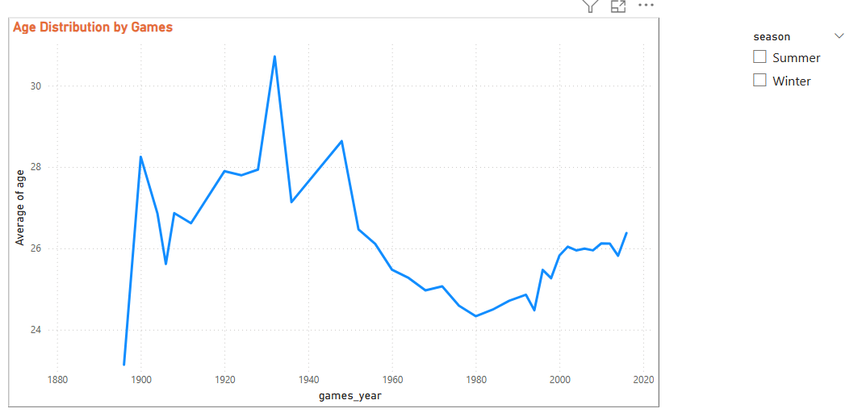
How does the age distribution of participants vary across different games?
Conclusion: The visual shows that the average age of Olympic participants varies across different Games, generally ranging from 24 to 30 years old. Earlier Olympics saw higher average ages, while recent Games have stabilized around the mid-20s. Some sports attract younger athletes, while others feature older competitors..

Slide 20
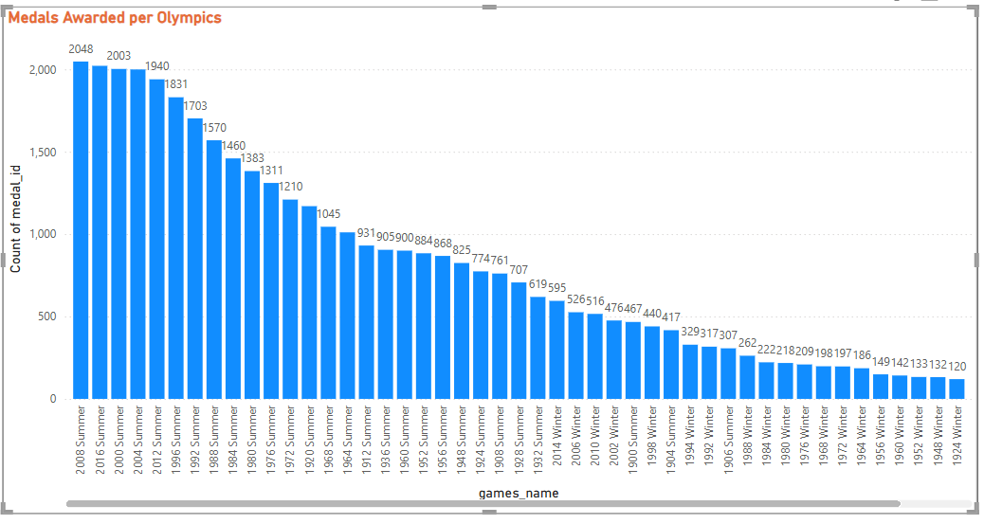
How many medals have been awarded in each Olympics?
Conclusion: The bar chart shows that the number of medals awarded per Olympics has generally increased over time, with recent Summer Games like 2008 and 2016 awarding over 2,000 medals each1. Summer Olympics consistently have higher medal counts than Winter Games, reflecting more sports and events.

Slide 21
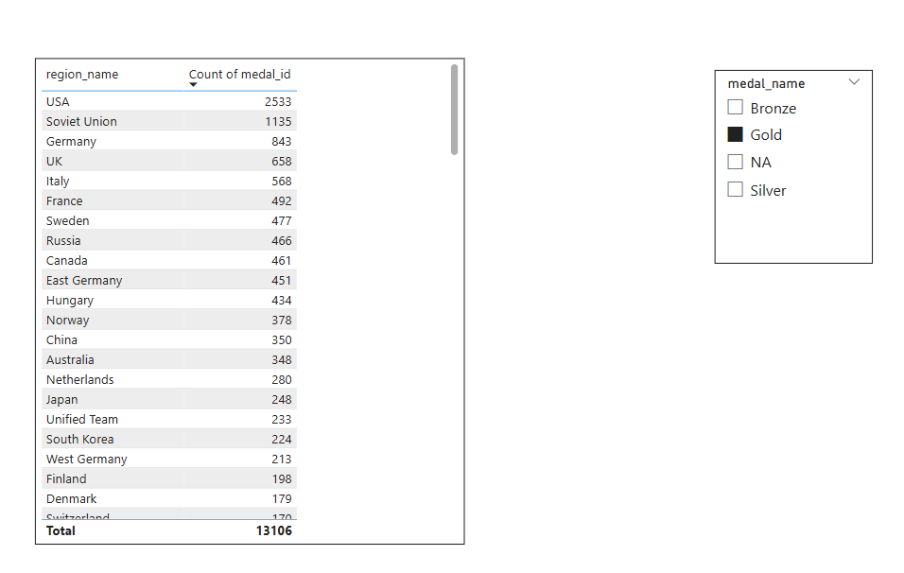
Which countries have the highest number of gold medals?
Conclusion: The table shows that the United States has won the highest number of gold medals in Olympic history, with 2,533 golds, far surpassing all other countries. The Soviet Union, Germany, and the UK follow as the next most successful nations in terms of gold medal counts. This dominance reflects strong sports infrastructure, investment, and a long Olympic tradition in these countries. Overall, the data highlights the USA’s exceptional legacy and leadership in Olympic gold medal achievements

Slide 22
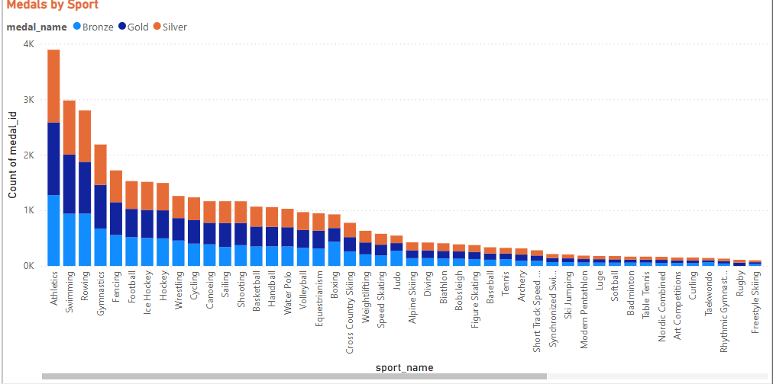
How does the medal distribution vary across different sports?
Conclusion: The stacked bar chart shows that Athletics and Swimming have by far the highest total medal counts, with each sport awarding over 3,000 medals, followed by Rowing, Gymnastics, and Fencing1. These sports offer the most medal opportunities due to their large number of events and categories.

Slide 23
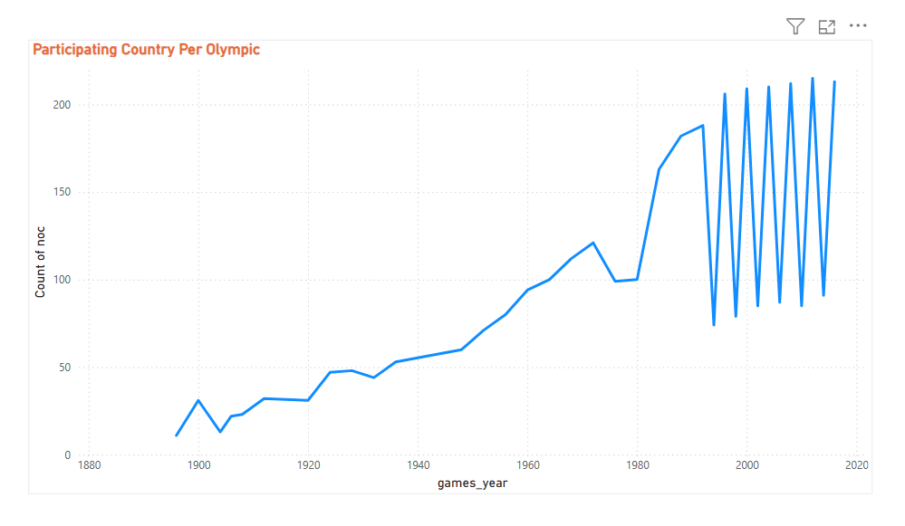
How many regions or NOCs participate in each Olympic Games?
Conclusion: The line chart shows a steady increase in the number of participating regions (NOCs) at each Olympic Games, rising from fewer than 20 in the early years to over 200 in recent editions. This growth reflects the expanding global reach and inclusivity of the Olympics. The sharp jumps in participation align with post-war periods and the addition of new countries and territories.

Slide 24
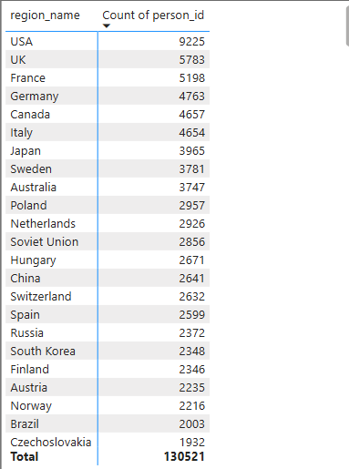
Which regions have the highest number of participants in the Olympics?
Conclusion: The table shows that the USA has the highest number of Olympic participants with 9,225 athletes, followed by the UK, France, Germany, and Canada. These regions consistently send large delegations, reflecting strong sports traditions and investment in athlete development..

Slide 25
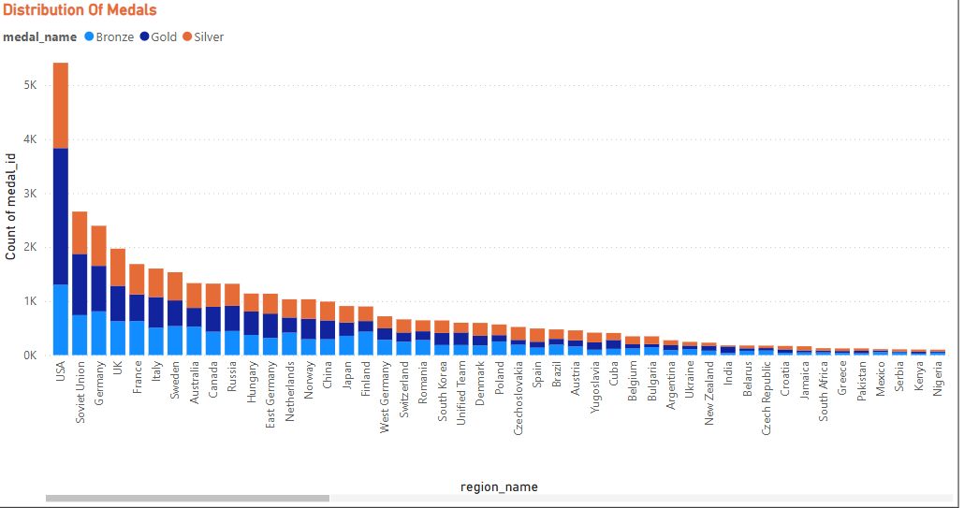
What is the distribution of medals among different regions?
Conclusion: The stacked bar chart shows that the United States has won the most Olympic medals by a large margin, followed by the Soviet Union, Germany, the UK, and France. These regions consistently secure high counts of gold, silver, and bronze medals, reflecting their strong sporting traditions and investment.

Slide 26
Excel Problem Statement

Slide 27
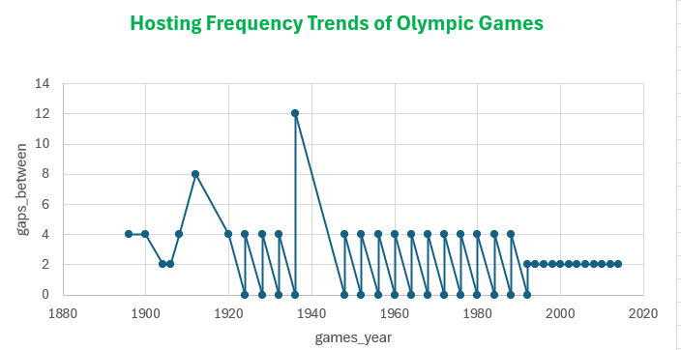
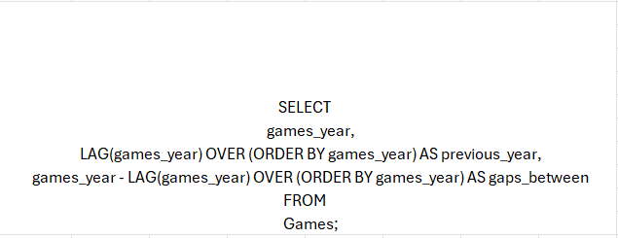
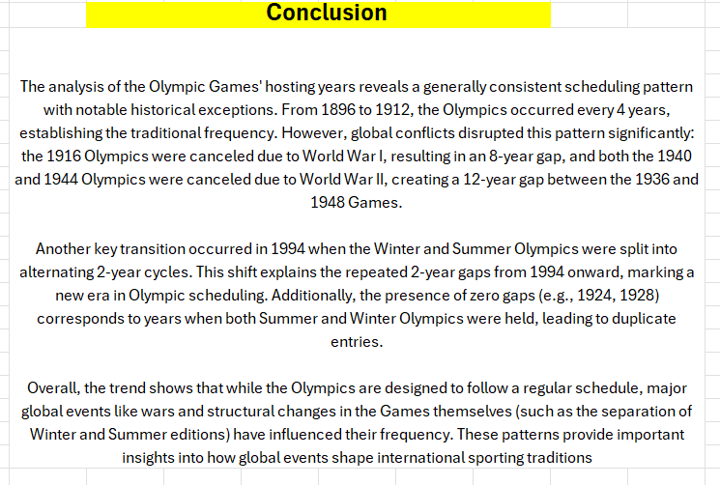
Are there any trends or patterns in the frequency of hosting Olympic Games?

Slide 28
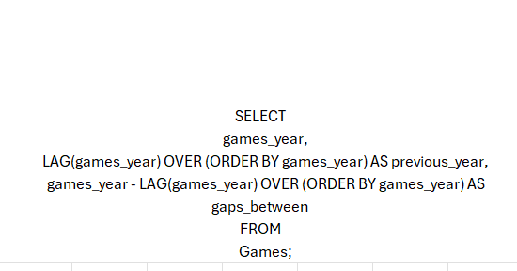
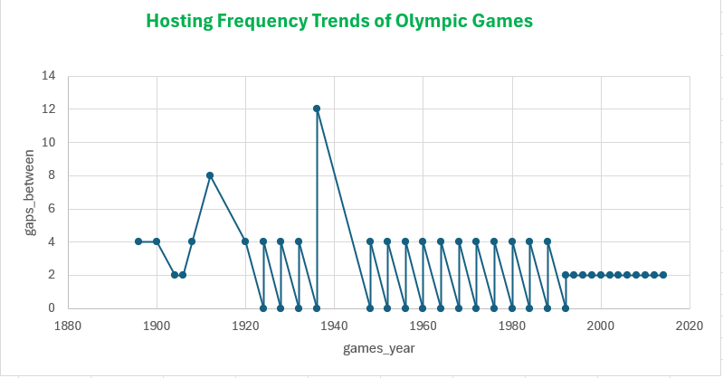
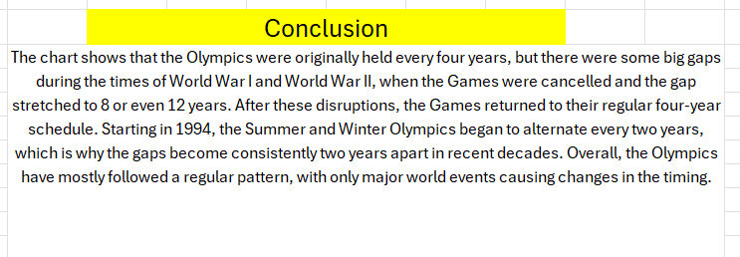
How has the duration of Olympic Games changed over time?

Slide 29
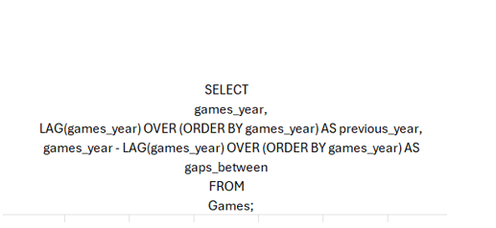
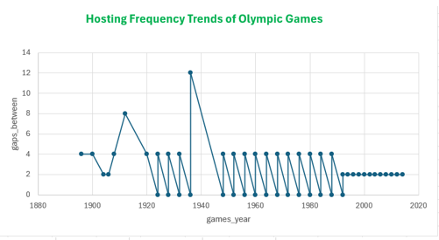
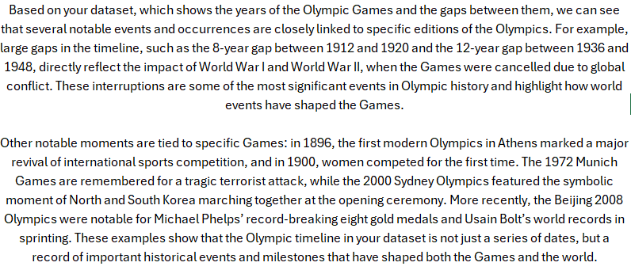
Are there any notable events or occurrences associated with specific Olympic Games?

Slide 30
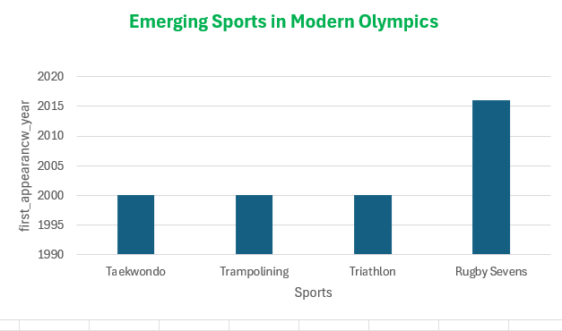


Are there any emerging sports that have been recently added to the Olympics?

Slide 31

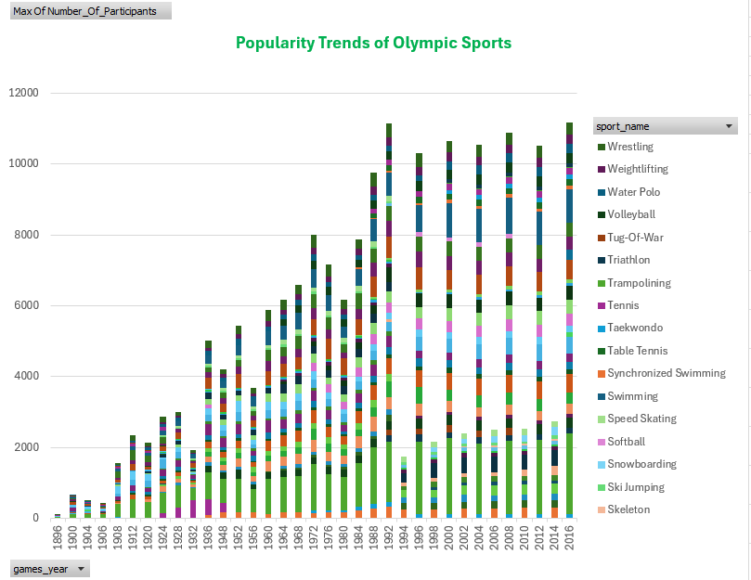
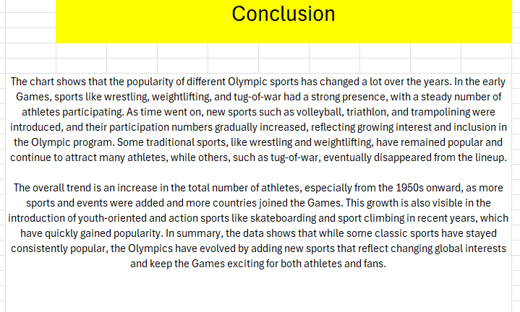
How has the popularity of certain sports changed over the years?

Slide 32
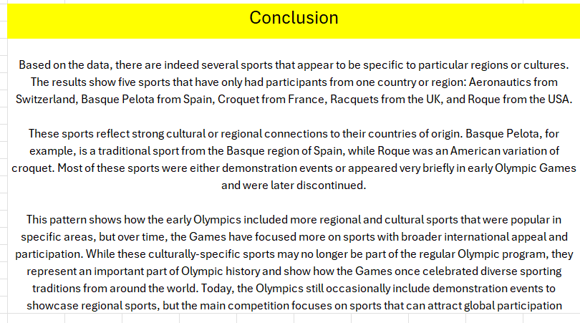
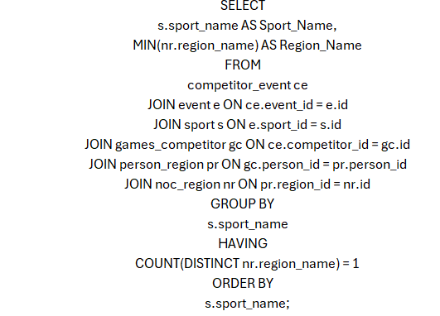
Are there any sports that are specific to a particular region or culture?

Slide 33
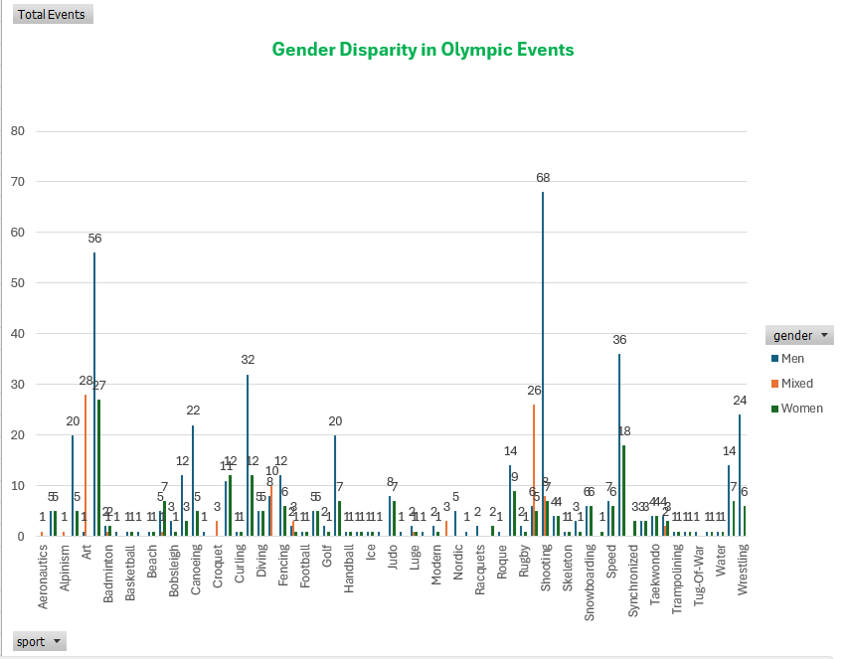
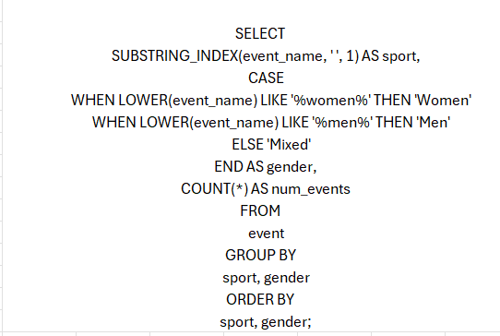
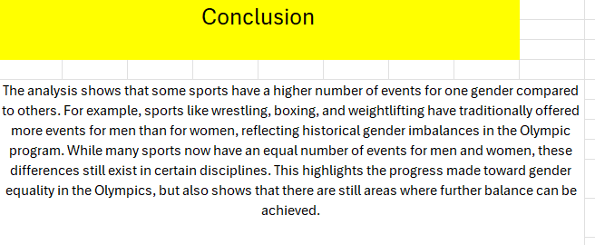
Are there any sports that have a higher number of events for one gender compared to others?

Slide 34
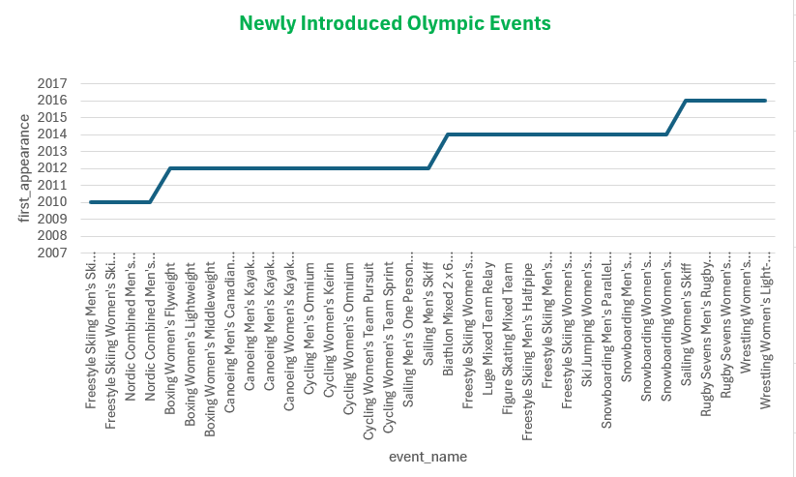

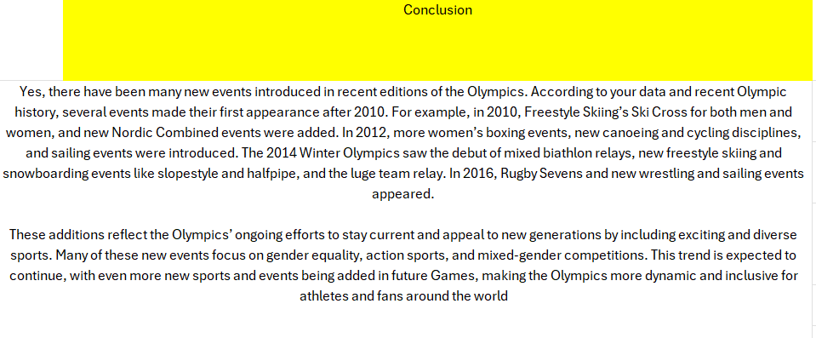
Are there any new events that have been introduced in recent editions of the Olympics?

Slide 35
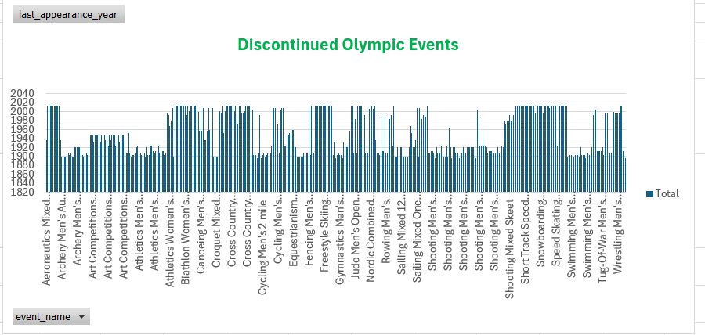
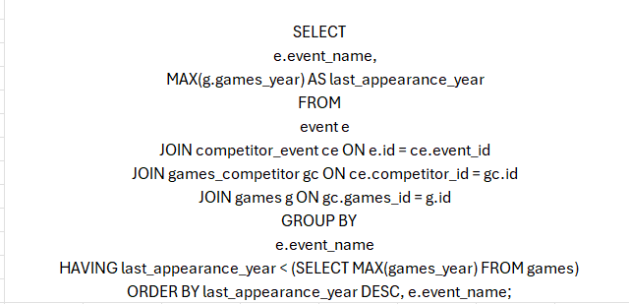
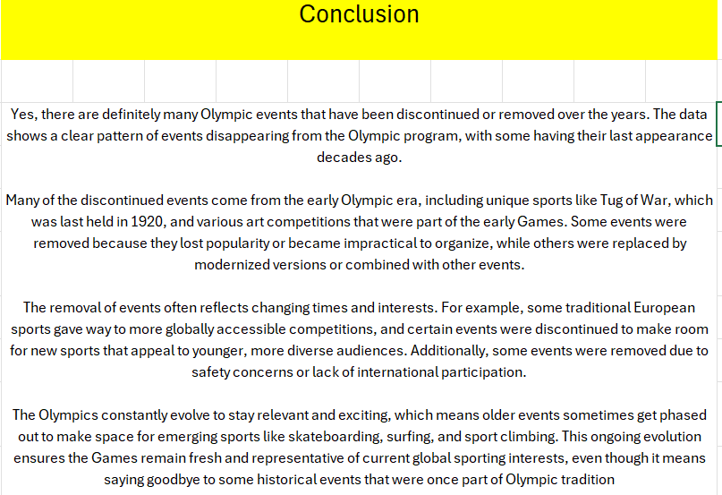
Are there any events that have been discontinued or removed from the Olympics?

Slide 36
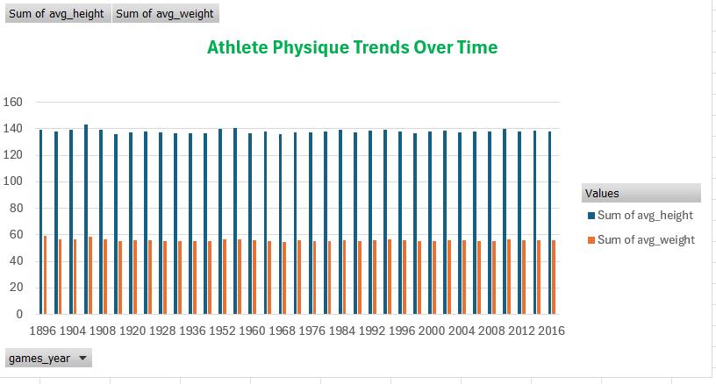
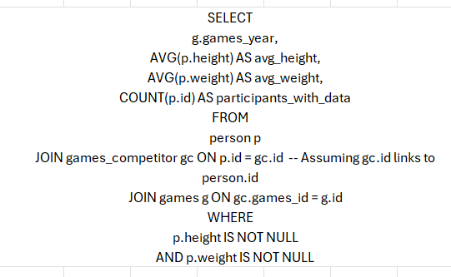
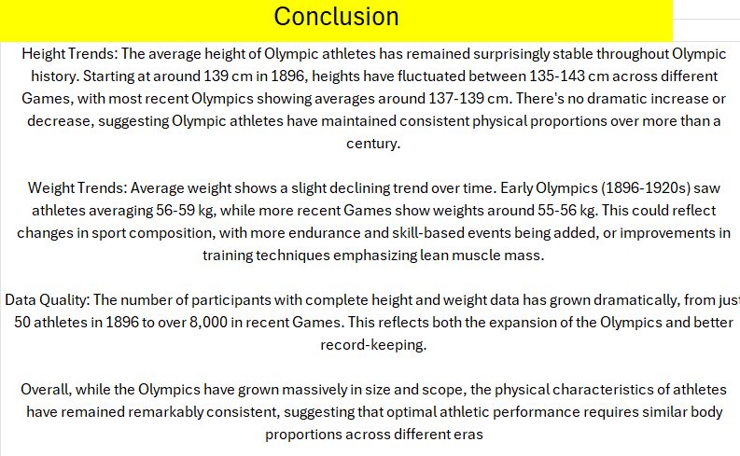
Are there any notable trends in the height and weight of participants over time?

Slide 37
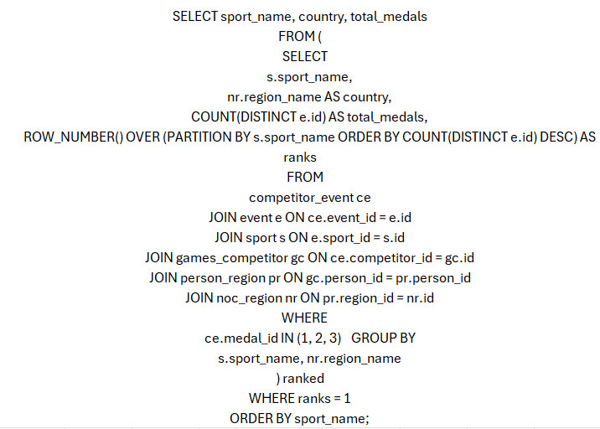
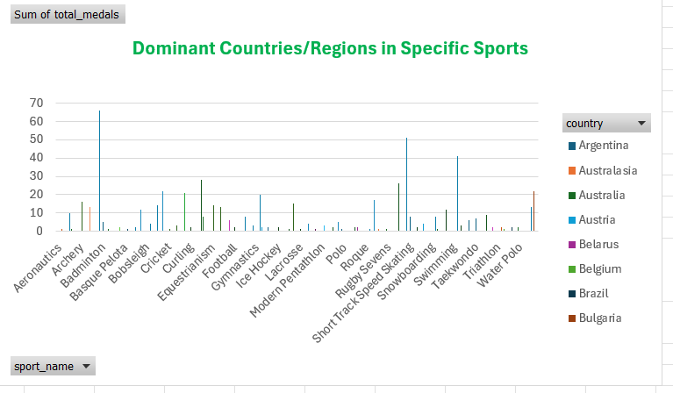
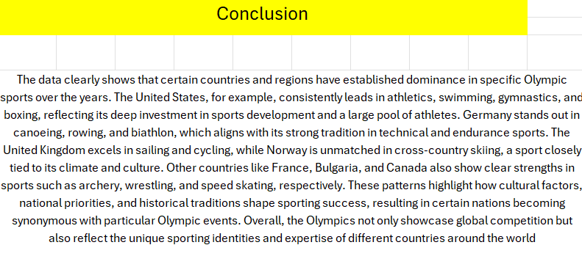
Are there any dominant countries or regions in specific sports or events?

Slide 39
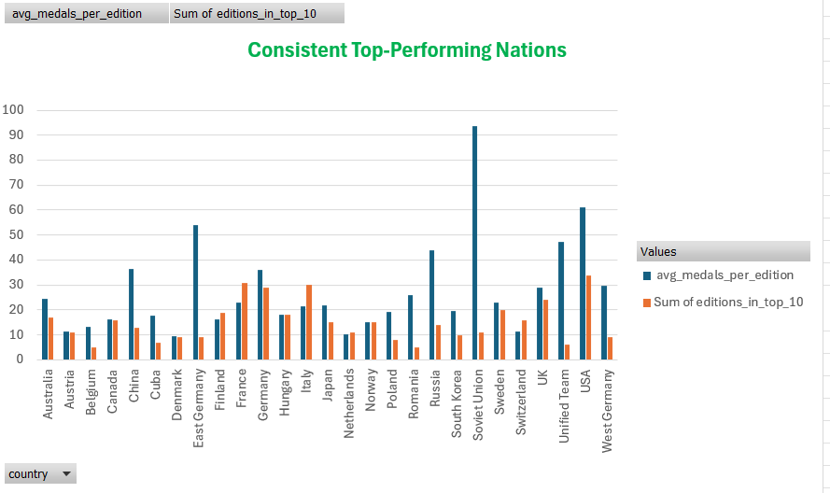

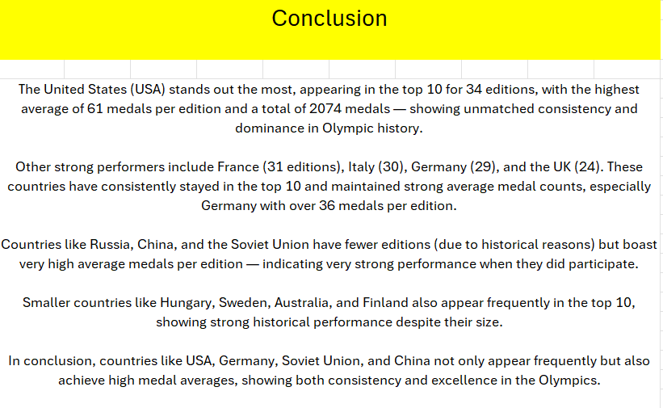
Are there any countries that consistently perform well in multiple Olympic editions?

Slide 40
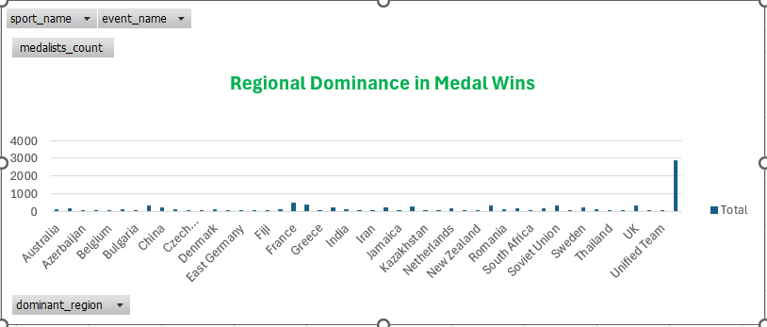
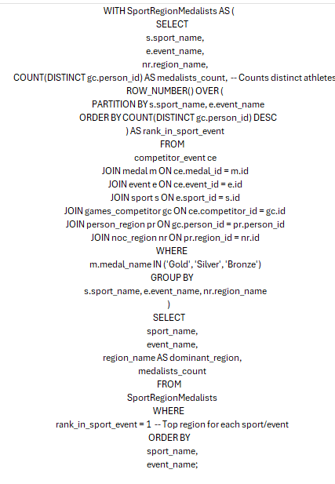

Are there any sports or events that have a higher number of medalists from a specific region?

Slide 41



What are some notable instances of unexpected or surprising medal wins?

Slide 42



Are there any regions that have experienced significant growth or decline in Olympic participation?

Slide 43



How do cultural or geographical factors influence the performance of regions in specific sports?

Slide 44



Are there any regions that have had a notable impact on the overall medal tally?

