Slide 1

BLOGS ARTICLES
Submitted by : AMAN KUMAR PATEL
BATCH NO ; 1838

Slide 2


TOPIC -Insurance Claims- Fraud Detection

Slide 3

Introduction :
Insurance fraud is a very major issue in the United State at 21st century. It has so many reason , but one major reason is that when an insurance company , agent , adjuster, consumers commits a deliberate deception in order to obtain an illegitimate gain. So Insurance fraud has many categories to among them automobiles insurance fraud is the major fraud type.
But now question is that how will we predict that the insurance climbed is fraudulent or not. For prediction , I have built a Machine learning model which can claim about the fraudulent. I have used many feature like INSURED INFORMATION, INSURED PERSON DETAILS and the INCIDENT INFORMATION. I have used totally 38 feature in the dataset. After the using of all features and the analysing the data, I got 82 % accuracy , Which is good accuracy score. So now let’s start the how I did reach on this good accuracy .
LIBRARY USED :
PYTHON
NUMPY
MATPLOTLIB
SEABORN
DATETIME
WARNINGS

Slide 4
PROBLEM DEFINATION :
Insurance fraud is a huge problem in the industry. It's difficult to identify fraud claims. Machine Learning is in a unique position to help the Auto Insurance industry with this problem.
In this project, we are provided a dataset which has the details of the insurance policy along with the customer details. It also has the details of the accident on the basis of which the claims have been made.
In this example, we will be working with some auto insurance data to demonstrate how you can create a predictive model that predicts if an insurance claim is fraudulent or not.
In this particular problem we have to look into the insured person details and incident details and analyse the samples to know wheather the claim is fraudulent or not..
Let’s do it step by step firstly analysing the dataset and doing exploratory data analysis, data visualization, data cleaning, pre-processing, model building, model saving and finally predictions.

Slide 5

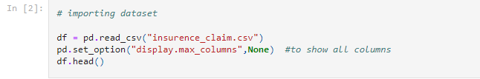
Data Analysis:
Firstly , we will import the dataset. I have got $0 columns in that given dataset , And I can also use PCA to reduced Dataset but every data analyst has first work is that to avoid the data loss. So I just avoid data loss ,and now since we have 40 columns now , I will proceed with the next step. Now Looking into our target columns , which is ‘FRAUD_REPORTED’ . And I have to start my analysing journey with the target columns to decide to decide the type of problem.
Here we can see our target variable Is having string values with the the categorial columns , and it is clear that it is all have particular problem which is ‘’CLASSIFICATION PROBLEM’’ and I have to use all classification algorithm s while building that model.
And I am using ‘’pd.set option’’ which is help to show all columns .

Slide 6
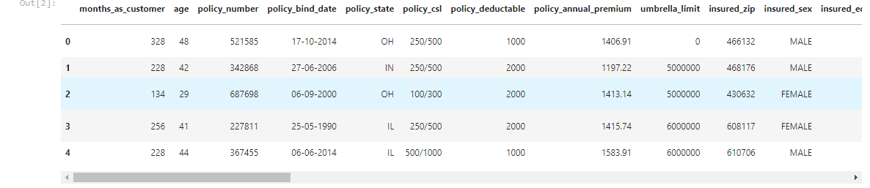
Firstly I have imported the dataset which was in csv format as df. Below is how the dataset looks.
Above here we can see our dataset after calling , it is having some categorical columns and numerical values also with the lots of unnecessary and unwanted entries , and many more.
So, firstly we will remove / clean our dataset.

Slide 7
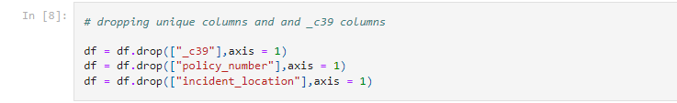
DATA CLEANING
* Firstly , we have to do some statistical analysis like checking shape , Nunique data , value Counts , info , dtypes of columns and many more…..
After reading the values counts of columns if we find any type of unnecessary data in columns , then we can easily drop these columns.
After seeing the value counts of each column policy_number and incident_location has 1 element with 1000 value counts which means all the values are unique. These features will not help us in model building so I have dropped them.
Presently I found _c39 column whose entries are all NaN. Keeping all entries NaN is useless so let me drop that column.
And I also noticed that insured zip is the zip-ID given to insurance person and this also will not help us in model building so I’m going to drop this column.

Slide 8

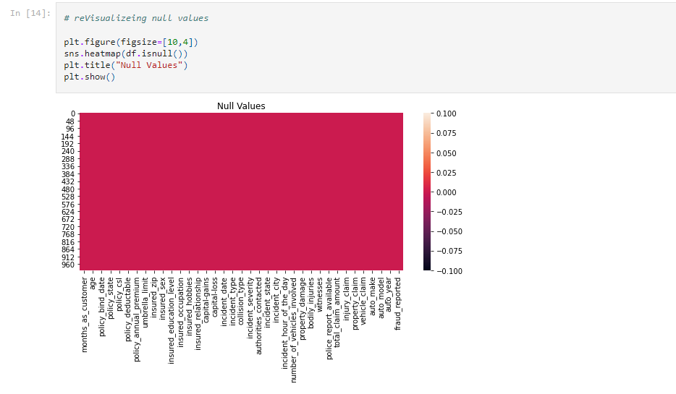
CHECKING NULL VALUES:
There was some null values were present in dataset . After checking on heatmap and also on the another method . Then first of all we will drop the null values. Then we can procced ahead.
And the observation was that , there are getting some null values in some columns , then I Erase all the null values with help of “imputation technique to remove null values” then after cleaning the data , now I rechecked my dataset with the help of Heatmap.
Then after that I found not any null values in columns , then I can proceed my next step.

Slide 9
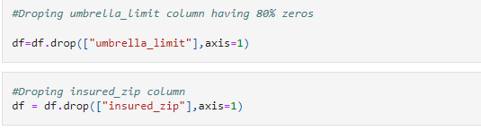
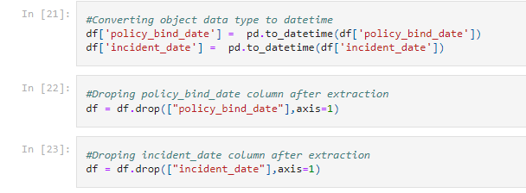
By looking into the value counts of each column i can say that there is 80% zeros in umbrella_limit, 50% zeros in capital-gains and 47.5% zeros in capital-loss so i have to replace these zeros or else they will create skewness in data.But zeros in capital-gains and capital loss has some meaning so let me keep those zeros as it is but let me drop umbrella_limit column since this column has 80% zeros which is not acceptable.
Feature extraction:

Slide 10
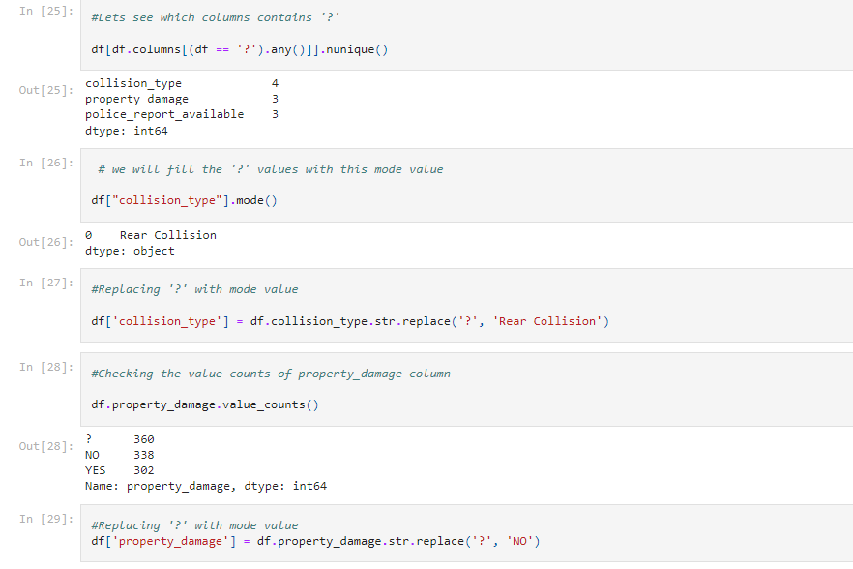
I have also extracted auto_age from auto_year by taking difference of insurance climbed year to auto year. I felt auto age may help us more in prediction than auto year.
I just had a look into value count of extracted columns I found single unique entries in incident_year column which means all the entrices in this column are same so I don’t want to keep this unnecessary column in the dataset, so I have droped it.
After extracting all the necessary columns from the old columns we have to drop old columns. If we don’t drop those columns they will behave as duplicate columns and create multicolinearity issue.

Slide 11
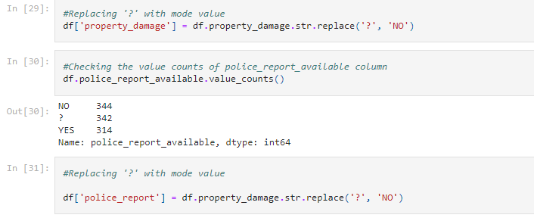
I have noticed some unnecessary entries in the dataset like ‘ ? ’. It may be because of some tying errors or some technical error we got some entries as ‘?’. So now it’s time to replace those unwanted entries.
Checking for ‘ ? ’ entries in all the columns. I found these entries in 3 columns.
In police_report_available column NO has maximum count so I have to replace ‘?’ with NO.
Now all the feature extraction is complete and the data is set for analysis.

Slide 12
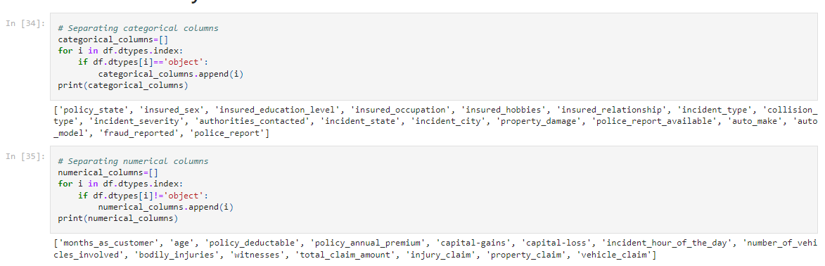
VISUALIZATION:
Here ourn first will be that , we have to sepreate all NUMERICAL COLUMNS and CATEGORICAL COLUMNS .

Slide 13
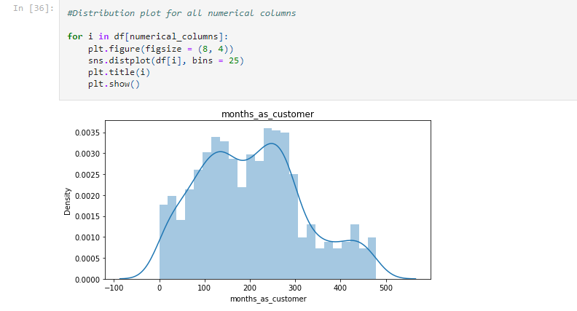
ill
Here we can see, we are visualizing the displot of all the columns which is having Numerical Values . and in above picture , you can see the list of Columns which id having Numerical values. That all are present here but unable to see because it Is Screenshot. And it is part of Univariate Analysis.

Slide 14
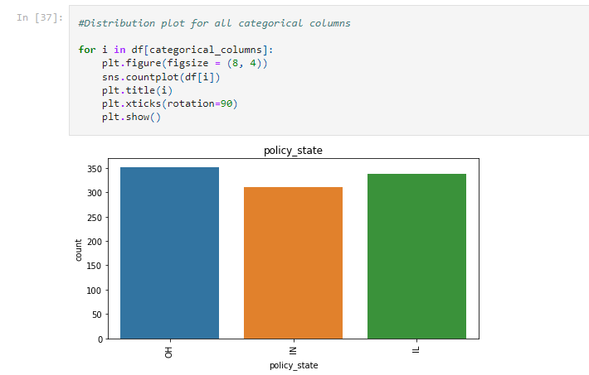
Here we can see, we are visualizing the Countplot of all the columns which is having Categorical Values . and in above picture , you can see the list of Columns which id having Categorical values. That all are present here but unable to see because it Is Screenshot. And it is also a part of Univariate Analysis.

Slide 15
Here we can see the observation of all plots:
* OH policy_state count is high.
* Female insured are more in number.
* JD High school qualified insured are more in number.
* Machine-op-inspct are high in number.
* Most of the insured persons are having reading as there hobbies.
* own-child has maximum count in insured_relationship.
* Multi-vehicle-collision and single-vehicle-collision are more in number.
* Rather than front and side collision Rear Collision has maximum count.
* Minor damage has maximum count compared to Trivial damage.
* Police are the mejority authorities contacted.
* In NY state most of the cases are registered.
* In all the cities the insuered climb are almost same.
* There is very less count for property damage.
* Very less cases have police_report_available.
* Both 250 and 100 have same count in cls_per_person.
* Both 500 and 300 have same count in cls_per_accident.

Slide 16
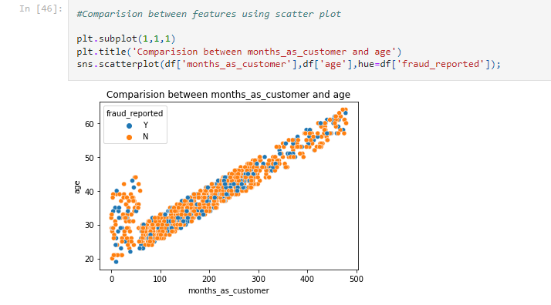
I have used scatter plot to know the relation between age and month_as_customer. I have observed a linear curve with less count of fraud. Which means as the month_as_customer is increasing, age is also increasing and the person is getting older the density of both Y and N are decreasing. Which means younger people has the high rate of frauduling. It is a part of Bivariate Analysis.

Slide 17
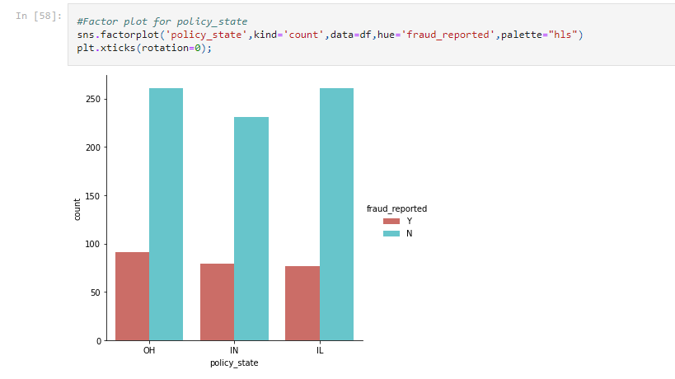
Here , we can see in the above plot , we crate a plot of Policy_state and with the respect of Fraud_reported. And we got an observation is that all no fraud_reported are something same in all condition but the yes condition is very low counts.

Slide 18
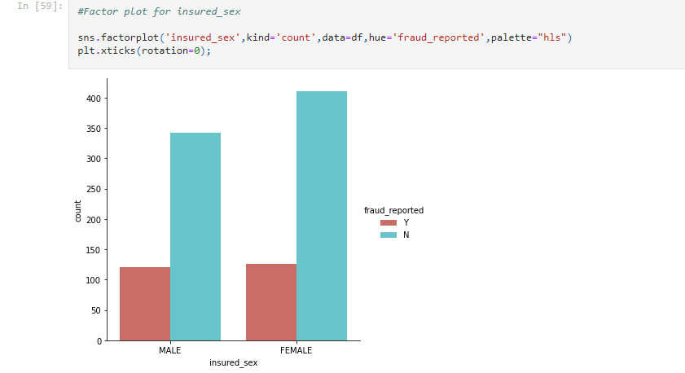
Here in the Above is the factor plot for Insured sex I noticed that in both the genders the count of fraud reported is same. But the fraud not reported is high with females. Which means females are more trust worthy than men.

Slide 19
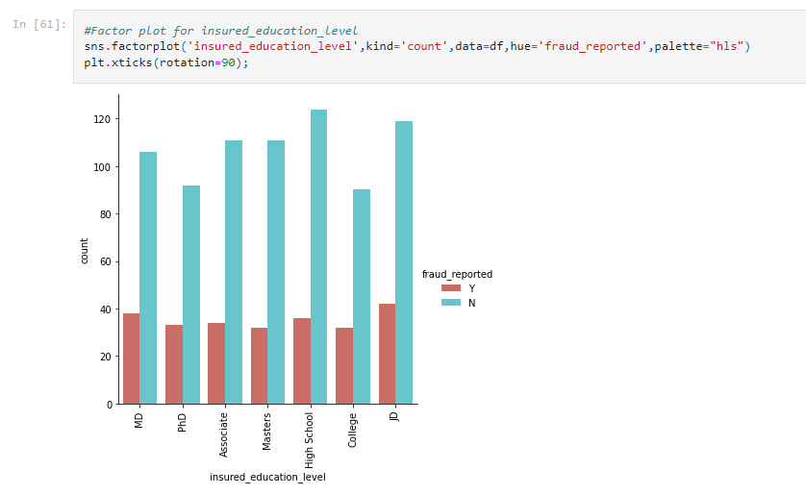
Here in Above is the factor plot for Insured_education_levels I noticed that In high_school there is maximum which don’t have fraud_. But the fraud reported is high with p. Which Means that In high school has no so much fraud_report.

Slide 20
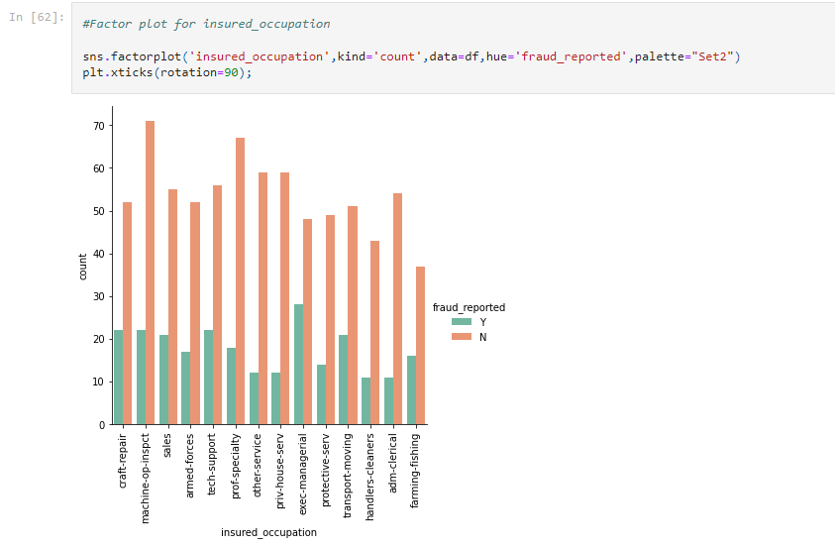
Above plot is for insured occupation column. And the fraud count is more for exec-manegerial persons and fraud not reported count is high for machine-op-inspct. Which means good occupated persons looks most fraudulent.

Slide 21
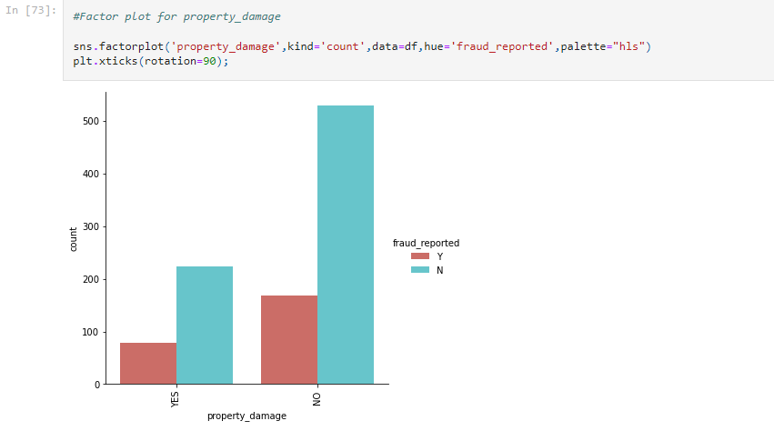
Look at the factor plot for property_damage . Here we can see there is not so much property_damage which has fraud_reported. And in yes part , we can observe a less reported
For frauding

Slide 22
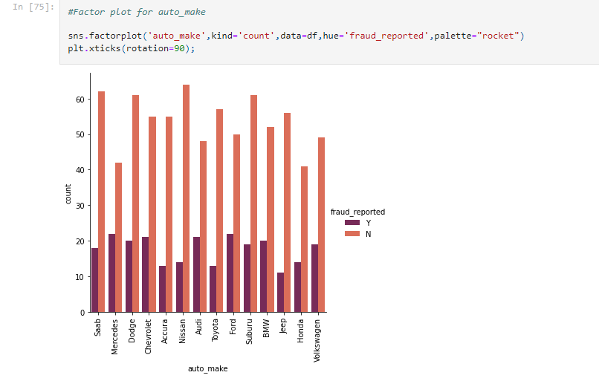
Look at this plot of AUTO MAKE , then we got very highly fraud report with the Mercedes and also
Observing that chervolet is also getting similar , but these don’t have report in Mercedes. Means that Mercedes have both maximum and minimum in both yes report and no report.

Slide 23
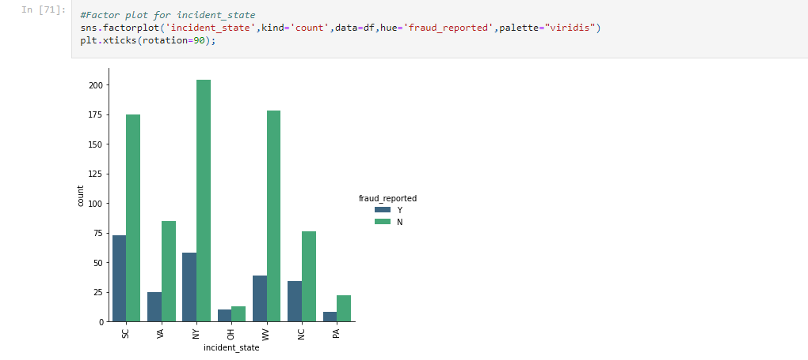
Now take a consider on the above factor plot. In this plot we can see the new York is that city which have no more report of fraudluing and t he incident_city SC is that city which have more reported in frauding

Slide 24
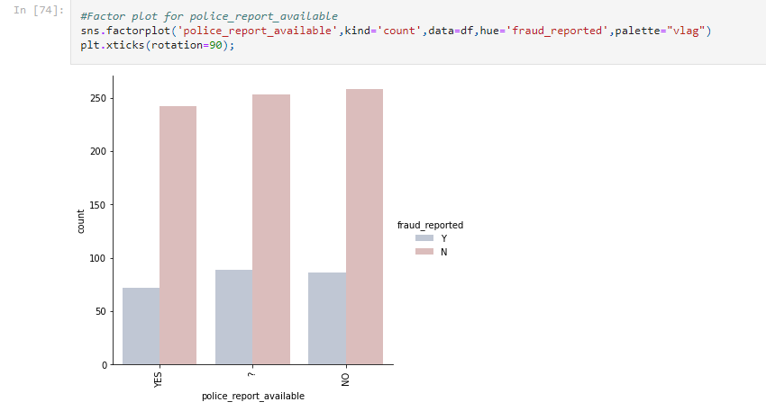
If the police report is not available then the chances of fraudulent is high. So while assuring the claim checking police report may help the insurance company.

Slide 25
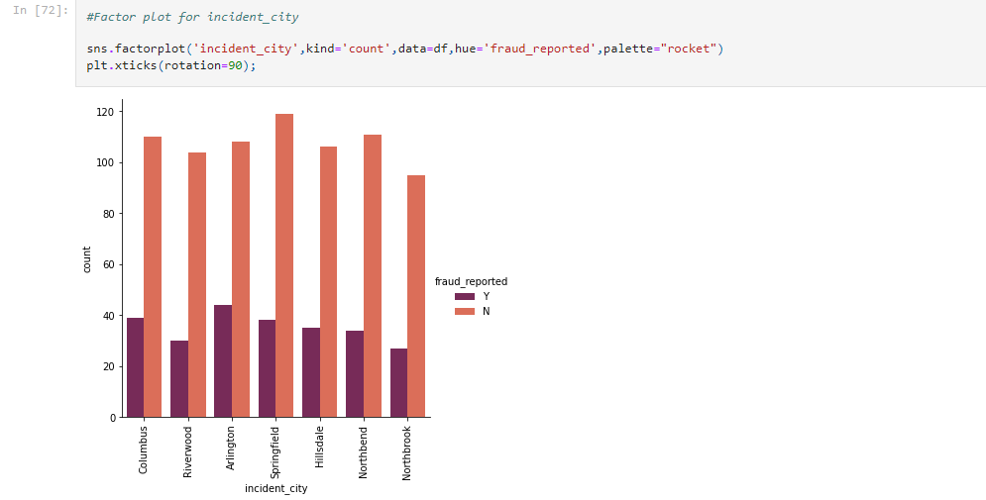
in this above plot we can see , springfield city is that city which has not higher reported but the Arlington is that city which have highly reported city ..

Slide 26
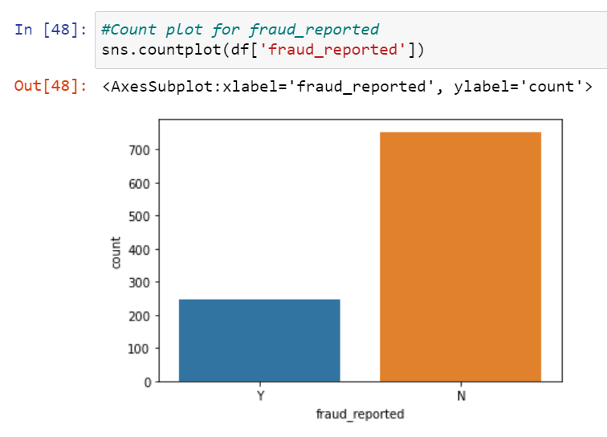
Since our problem was classification. And the target column fraud_reported is imbalanced. The count of Y is less compared to N. We have to balance these counts to get a good model.
Since our problem was classification. And the target column fraud_reported is imbalanced. The count of Y is less compared to N. We have to balance these counts to get a good model.

Slide 27
3.EDA Concluding Remark:
I have checked for NaN values and I found there was no missing values in the dataset.
I have extracted the necessary features from existing features to get better accuracy and dropped the old columns to avoid multicolinearity. If I keep the old columns as it is then they will act as duplicates in the model.
I have also dropped the unnecessary columns. And also I replaced the ‘?’ entries with there suitable values.
I have used both matplotlib and seaborn to visualize the data.
To get better insight on the features I have used distplot, barplot, scatterplot and boxplot since most of my columns were categorical I have used all categorical plots. For numerical columns I have used numerical ploting but I did not get any good pattern with numerical columns.

Slide 28
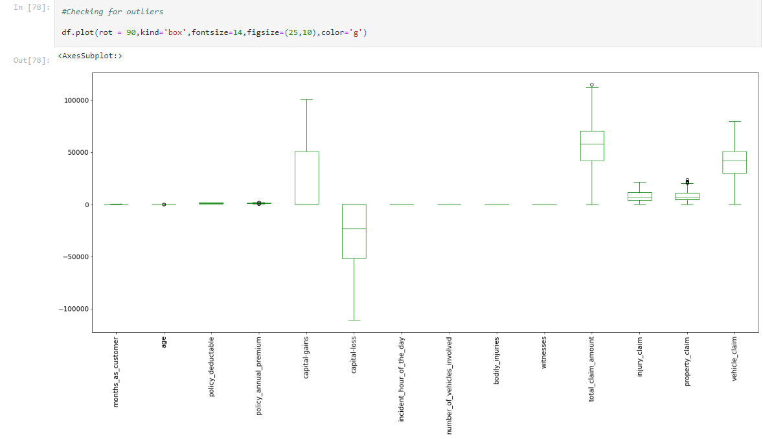
I have used box plot to check outliers. And I found outliers in age, policy_annual_premium, total_claim_amount, property_claim and . Now I have to remove outliers in these columns.
To remove outliers I have chosen zscore with 0.4% dataloss. And also I have gone through IQR but IQR was giving me 5.8% dataloss which was greater than zscore method. So I came to a conclusion to use zscore. After removing the outliers using zscore I have saved the dataset as df_new.

Slide 29
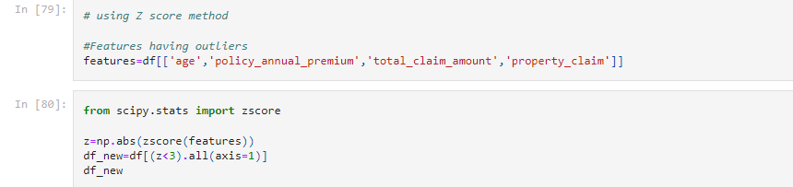
In the above plot where we were looking for outliers . So in this plot we can see the how does we remove all outliers , we remove all outliers with the help of ZSCORE METHOD , as shown in plot .. With the help of ZSCORE MEWTHOD we have removed all of outliers.

Slide 30
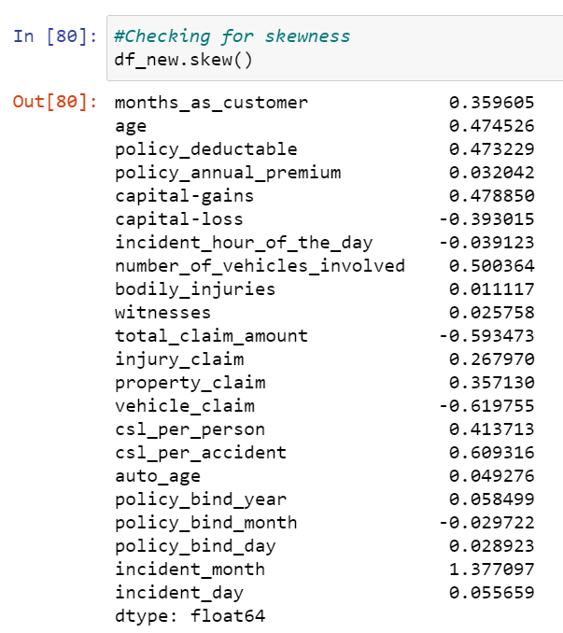
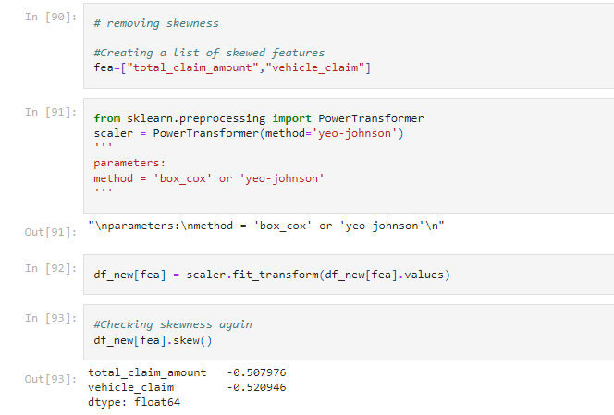
I can notice skewness in total_claim_amount, vehicle_claim, csl_per_accident and incident month.
To remove skewness I have used Yeo-johson method. I have also tried working on log, log1p, cbrt, sqrt but skewness was not at all reducing. After removing the skewness the distplot of skewed columns is shown below
Now the skewness has reduced in almost all the columns. It looks good to proceed now .

Slide 31
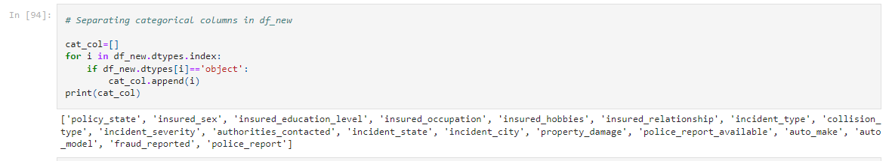
Now it’s time to Label encode our categorical columns. For this process we have to separate categorical columns from cleaned df_new.
For all the categorical columns in cleaned dataset df_new I have applied label encoding (Also tried with ordinal encoder but it decreased the model accuracy).
After checking the correlation, to get better insight on the corr values I have plotted heat map. And this correlation has to be checked for cleaned dataset.

Slide 32
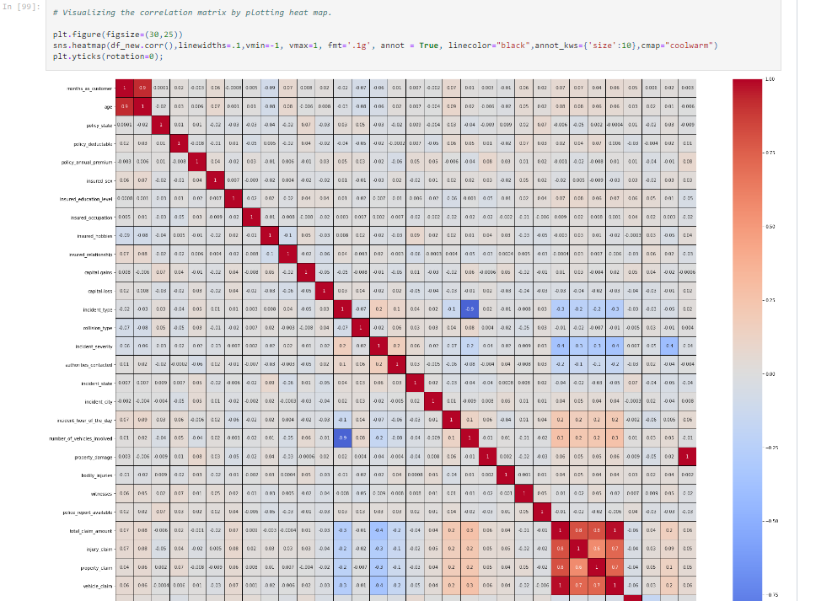
Checking for correlation using heat map:
Looking into the heat map I can say that there is multicolinearity issue and to get better insight on targets correlation with other features I have ploted bar graph.

Slide 33
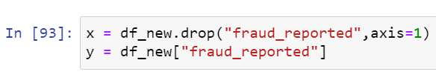
Policy_bind_year, auto_model, insured_occupation, auto_age and incident_hour_of_the_day are very less correlation with target but let me keep the columns and build the model. Since I don’t want to loose any data so first keeping all the columns let me build the model. After looking into the accuracy if I feel I can increase the accuracy by deleting these less correlated columns then again let me come back and delete these columns.
Now my dataset is ready for preprocessing.
4.Preprocessing Pipeline:
As a first step I have to separate the dependent and independent features.
I have taken x as all independent features and y as dependent/target feature.
Then I have to scale my independent features to get the same range in all the columns. If I don’t scale my independent columns then there is a chance that my model may get baised. So In this perticular case I have used Standard scaling as I have removed all outliers and skewness from the dataset it is good to use standard scaling else we have MinMax scaler.

Slide 34
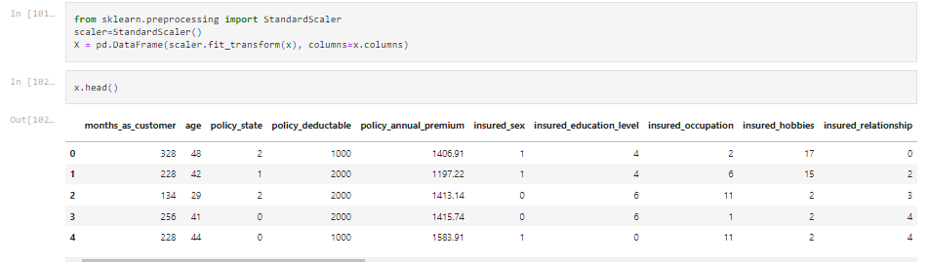
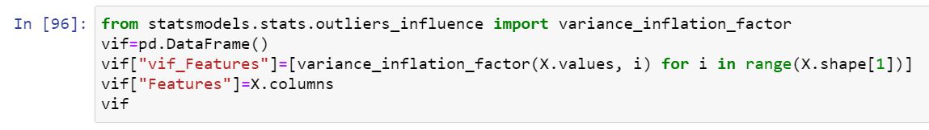
SEPRATING FEATURE AND LABELS
Now scaling part is done. But I have left out with multicolinearity. I have to check VIF(variance inflation factor) now.

Slide 35
I can notice a high VIF for total_claim_amount, so I have dropped this column first. After that again I checked for VIF and got the highest value for csl_per_accident so I dropped this column. Then my multicolinearity issue was solved.
Now , My data is all set for model building. Let’s go ahead with classification algorithms since this is a Classification Problem.
5.Building Machine Learning Models:
Importing all important libraries to see the accuracy score and the random state

Slide 36
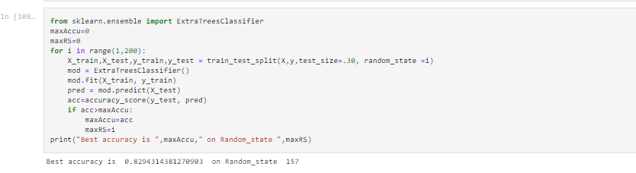
FINDING BEST ACCURACY SCORE AND RANDOM STATE
Let’s see the best accuracy score and the Random State
I got best random state = 157 and accuracy = 83 % Now the task is to find the best fitting model.
Created train and test data as X_train, X_test and y_train, y_test.

Slide 37
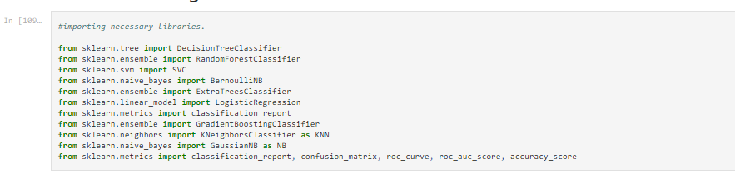
2. CLASSIFICATION ALGORITHM
I have used Cross validation as model evaluation metrics for all the algorithms. And I have used accuracy_score, Confusion metrics as metrics in model building.
* I have imported all necessary libraries to see the all accuracy and all score.

Slide 38
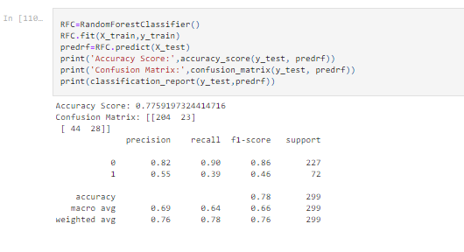
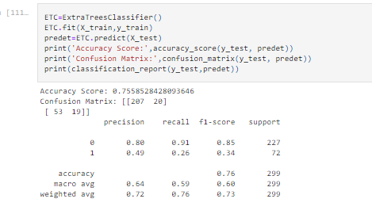
RANDOM FOREST CLASSIFIER
Random Forest Classifier model is giving me 78% accuracy_score . RFC is working good but I can not conclude it as good model before looking into multiple models.
EXTRA TREE CLASSIFIER
Extra Tree Classifier model is giving me 76% accuracy_score . ETC is working good but I can not conclude it as good model before looking into multiple models.

Slide 39
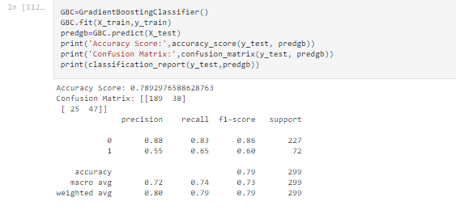
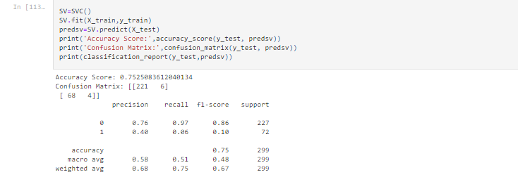
GRADIENT BOOSTING CLASSIFIER:
Gradient Boosting Classifier model is giving me 79% accuracy_score . GBC is working good but I can not conclude it as good model before looking into svc models.
svc
SVC model is giving me 75% accuracy_score . GBC is working good but I can not conclude it as good model

Slide 40
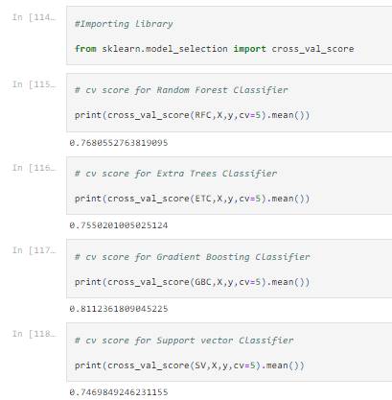
CROSS VALIDATION SCORE:
Cross validation score of RFC is 76 %
Cross validation score of ETC is 75%
Cross Validation Score of GBC is 81.1 %
Cross Validation score of SVC is 74.6 %
I choose Gradient Boosting Classifier as a model I will also use GBC in for HYPER TUNNING .

Slide 41


HYPER PARAMETER TUNNING
Using the above parameters list I’m tuning my best model i.e., GRADIENT BOOSTING CLASSIFIE. And I have to choose the best parameters in above parameter list, with those parameters I have to build the best model.
After knowing the above best parameters I have to run for improving model accuracy.

Slide 42
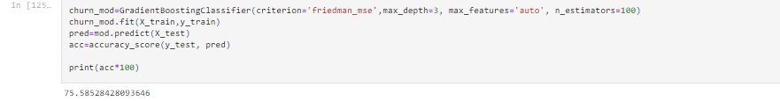
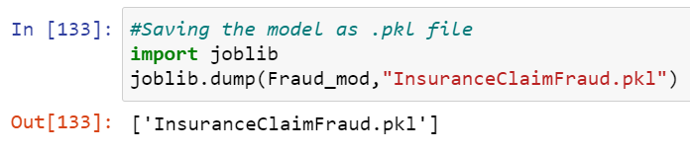
Even after tunning the model accuracy is same which means the default parameters used by the model were giving the best accuracy. And the model is now ready with 75.54% accuracy which looks good!!!!.
After getting this best model I have saved it using .pkl. As InsuranceClaimFraud.

Slide 43
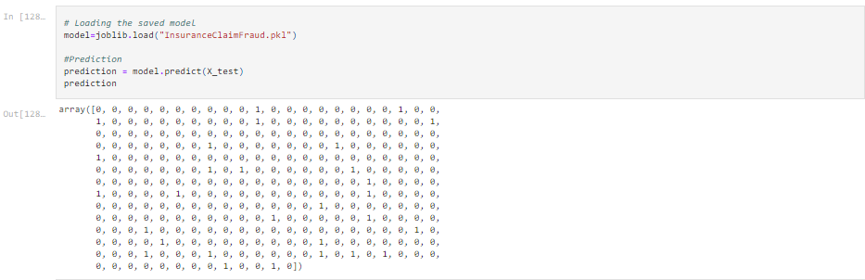
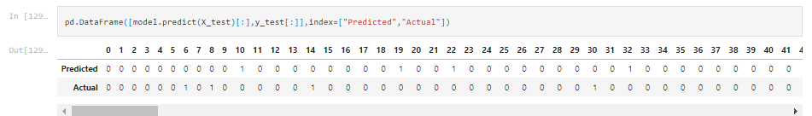
PREDICTION:
Now using the saved model I can predict wheather the insurance claim is fraudulent or not.

Slide 44
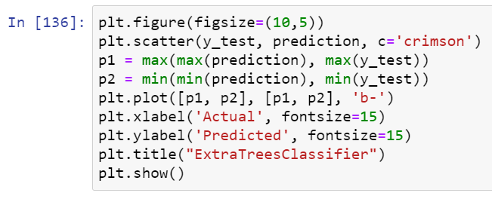
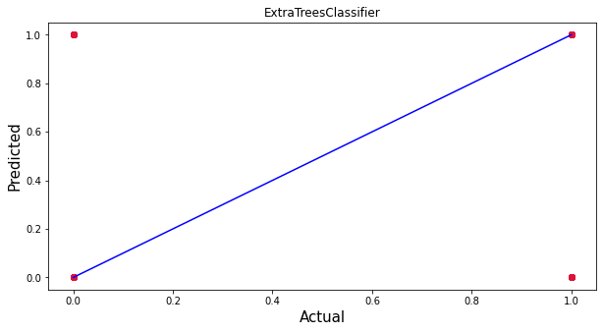
After saving the best model we have to load it and check the actual verses predicted values
Blue line is the actual values and red dots are predicted values and it’s pleasure to see my model is working good!!!

Slide 45

CONCLUSION
This perticular problem needs a good vision on data, and in this problem Feature Engineering is the most crucial thing.
You can see how we have handled numerical and categorical data and also how we build different machine learning models on the same dataset.
Using hyper parameter tunning we can improve our model accuracy, for instance in this model the accuracy remained same.
Using this machine Learning Model we people can easily predict the insurance claim is fraudulent or not and we could reject those application which will be considered as fraud claims.

Slide 46


