Slide 1

PROJECT NAME = HOUSING PROJECT
PRESENTED BY = AMAN KUMAR PATEL

Slide 2
AGENDA
Overview.
Problem Statement.
Problem Understanding.
What is Housing Price Prediction?
Exploratory data analysis.
Visualizations.
Analysis.
Data cleaning steps.
Model Building.
Hyper Parameter Tunning.
Saving the model and predictions from saved best model.
Conclusion.

Slide 3
OVERVIEW
IN this presentation you will be see the
How to analyze the dataset of Housing price prediction.
What are the EDA steps in steps in dataset to cleaning the dataset.
Analyzing on the problem.
Model building on from the train dataset.
Predicting the housing price for test dataset.
Accuracy of the dataset.

Slide 4
Problem Statement
Houses are one of the necessary need of each and every person around the globe and therefore housing and real estate market is one of the markets which is one of the major contributors in the world’s economy. It is a very large market and there are various companies working in the domain. Data science comes as a very important tool to solve problems in the domain to help the companies increase their overall revenue, profits, improving their marketing strategies and focusing on changing trends in house sales and purchases. Predictive modelling, Market mix modelling, recommendation systems are some of the machine learning techniques used for achieving the business goals for housing companies. Our problem is related to one such housing company. A US-based housing company named Surprise Housing has decided to enter the Australian market. The company uses data analytics to purchase houses at a price below their actual values and flip them at a higher price. For the same purpose, the company has collected a data set from the sale of houses in Australia. The data is provided in the CSV file below. The company is looking at prospective properties to buy houses to enter the market. You are required to build a model using Machine Learning in order to predict the actual value of the prospective properties and decide whether to invest in them or not. For this company wants to know:
• Which variables are important to predict the price of variable?
• How do these variables describe the price of the house?

Slide 5
PROBLE UNDERSTANDING :
Housing price prediction is understandable thing , like it will help in many ways :
House price prediction can help the developer to determine the selling of a house. And
It also helps the customer to get a right time to buy a new house. . As earlier, House prices were determined by calculating the acquiring and selling price in a locality. Therefore, the House Price prediction model is very essential in filling the information gap and improve Real Estate efficiency. The aim is to predict the efficient house pricing for real estate customers with respect to their budgets and priorities. By analysing previous market trends and price ranges, and also upcoming developments future prices will be predicted. ... cost of property depending on number of attributes considered. Now as a data scientist our work is to analyse the dataset and apply our skills towards predicting house price.

Slide 6
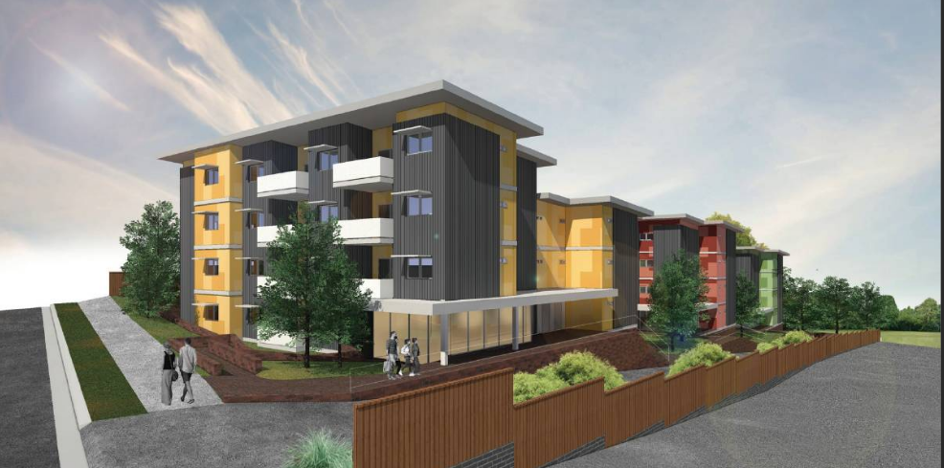
What is Housing Price Prediction ?
Housing Price prediction is very Important thing as you can see, first of all it helps understand the purchasing the location of house and and also help to the planning to buy a house. So they can se easily understand the future price range , and that will they will also able to understand their financial well.
Apart of this ,Housing price prediction is also beneficial for the property investors to real estate workers can be understand the trend of housing price , and also they grow their market and many more.

Slide 7
Exploratory data analysis
As a first step I have imported required libraries and I have imported both the datasets which were in csv format
Then I did all the statistical analysis like checking shape, nunique, value counts, info etc…..
While checking the info of the datasets I found some columns with more than 80% null values, so these columns will create skewness in datasets so I decided to drop those columns.
Then while looking into the value counts I found some columns with more than 85% zero values this also creates skewness in the model and there are chances of getting model bias so I have dropped those columns with more than 85% zero values.

Slide 8
Exploratory data analysis
First of all I checked all of my dataset, and I found very easy Like shape, and the types of columns and also I checked info of columns . and I dropped some columns there. And while checking null values , I found null values in some columns and I removed all of my null values with the help of imputation method.
And after that I dropped two columns , 1st one was ID and the 2nd one was UTILITIES .. Because while I was checking the unique values then I found the that two columns is having all unique values and as we also know all in id there is always particular asset. So , I decided to drop these two columns.
Now after the checking of unique values I did take as a part of feature extraction I converted all of the year columns in respective age
and also that all process done in both dataset train and test dataset separately , because we had to maintain all of data equally otherwise we will get error.
.

Slide 9
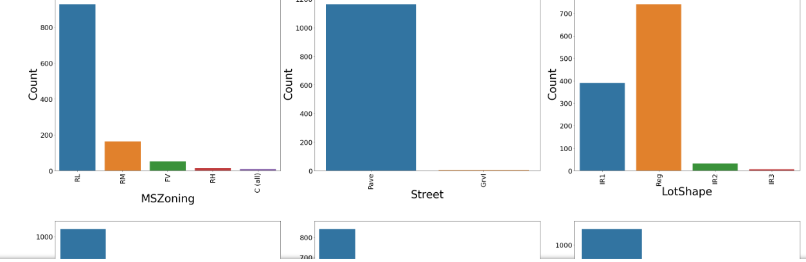
visualization OF CATEGORICAL COLUMNS OF TRAIN DATASET:

Slide 10
OBSERVATION
It is found that Residential Low Density zoning has maximum count, for the feature general zoning classification of the sale(MSZoning). In Paved streets we can observe maximum count, for the feature Type of road access to property(Street).
Regular shaped property has maximum count, for the feature General shape of property(LotShape). Near Flat/Level property has maximum count, for the feature Flatness of the property(LandContour).
Inside lot configured property has maximum count, for the feature Lot configuration(LotConfig). Gentle sloped property has maximum count, for the feature Slope of property(LandSlope).
If the property is located in North Ames then count is good compared to other locations, for the feature Physical locations within Ames city limits(Neighborhood).
If the Proximity to various conditions-1 is normal then count is high for the feature Proximity to various conditions(Condition1). If the Proximity to various conditions-2 is normal then count is high for the feature Proximity to various conditions (if more than one is present)(Condition2). Single-family Detached dwelling has maximum count for the feature Type of dwelling(BldgType).
One story dwelling housestyle has maximum count for the feature Style of dwelling(HouseStyle). For Gable roof style the count is high for the feature Type of roof(RoofStyle).
For Standard (Composite) Shingle roof material the count is high for the feature Roof material(RoofMatl).
For Vinyl Siding exterior-1 covering on house has maximum counts for the feature Exterior covering on house(Exterior1st).
For Vinyl Siding exterior-2 covering on house has maximum counts for the feature Exterior covering on house (if more than one material)(Exterior2nd).
For Masonry veneer type(MasVnrType) None has maximum count.
17.For Typical/Average(TA) quality of the material on the exterior has maximum count, for the feature Evaluates the quality of the material on the exterior (ExterQual).
For Typical/Average(TA) condition of the material on the exterior has maximum count for the feature Evaluates the present condition of the material on the exterior(ExterCond).

Slide 11
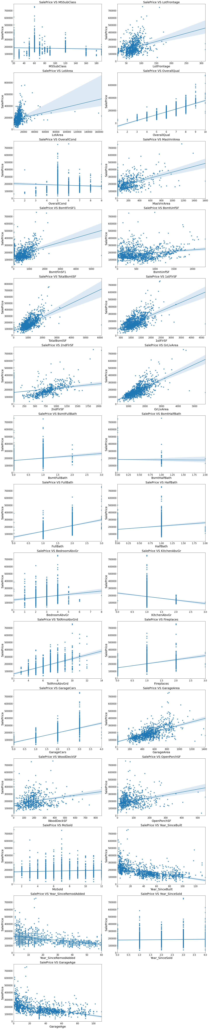
visualization OF nuMERICAL COLUMNS OF TRAIN DATASET:

Slide 12
OBSERVATION
1.As Linear feet of street connected to property(LotFrontage) is increseing sales is decreasing and the SalePrice is rangeing between 0-3 lakhs.
2.As Lot size in square feet(LotArea) is increseing sales is decreasing and the saleprice is in between 0-4 lakhs.
3.As Masonry veneer area in square feet(MasVnrArea) is increasing sales is decreasing and saleprice is rangeing between 0-4 lakhs.
4.As Type 1 finished square feet(BsmtFinSF1) is increseing sales is decreasing and the saleprice is in between 0-4 lakhs.
5.As Unfinished square feet of basement area(BsmtUnfSF) is increseing sales is decreasing and the saleprice is in between 0-4 lakhs. There are some outliers also.
6.As Total square feet of basement area(TotalBsmtSF) is increseing sales is decreasing and the saleprice is in between 0-4 lakhs.
7.As First Floor square feet(1stFlrSF) is increseing sales is decreasing and the saleprice is in between 0-4 lakhs.
8.As Second floor square feet(2ndFlrSF) is increseing sales is increasing in the range 500-1000 and the saleprice is in between 0-4 lakhs.
9.As Above grade (ground) living area square feet(GrLivArea) is increseing sales is decreasing and the saleprice is in between 0-4 lakhs.

Slide 13
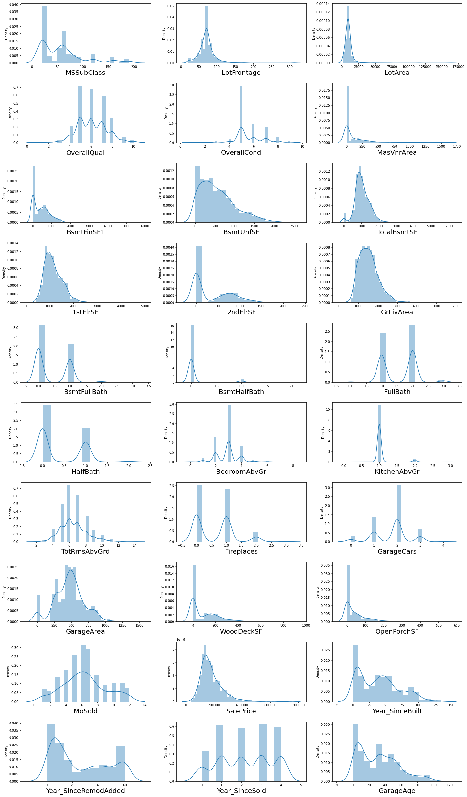
DISTRIBUTION PLOTS FOR ALL NUMERICAL COLUMNS

Slide 14
ANALYSIS:
I have use so many plots and like scatterplot , barplot and regplot for each pair of categorical features that can easily show the relation between our target variable sale price for all the sub categorical in each categorical features.
After that I also used regplot for continuous numerical variable that showed the relation between continuous numerical variable and target variable.
Then after the plotting I get that there is a relation between continuous numerical variable and salesprices.

Slide 15
DATA CLEANING STEPS
In all of the dataset I found null values , outliers , and the also skewness.
I have used imputation method to erase all null values . To remove outliers I have also used IQR method, and for removing the skewness I have used yeo-johnson method
I have used ORDINAL ENCODING for encode categorical columns.
Use of pearson’s colleration coefficient to check the correlation between dependent and independent features.

Slide 16
Model Building:
Since SalePrice was my target and it was a continuous column so this perticular problem was regression problem. And I have used all regression algorithms to build my model. By looking into the difference of r2 score and cross validation score I found GradientBoostingRegressor as a best model with least difference. Also to get the best model we have to run through multiple models and to avoid the confusion of overfitting we have go through cross validation. Below are the list of regression algorithms I have used in my project.
RandomForestRegressor
ExtraTreesRegressor
GradientBoostingRegressor
DecisionTreeRegressor

Slide 17
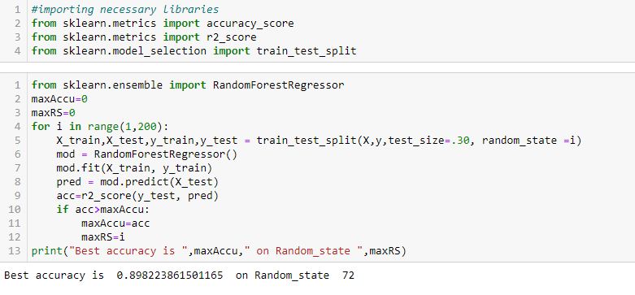
Model Building.
* I got 90 % accuracy as you can see… which is good !!

Slide 18
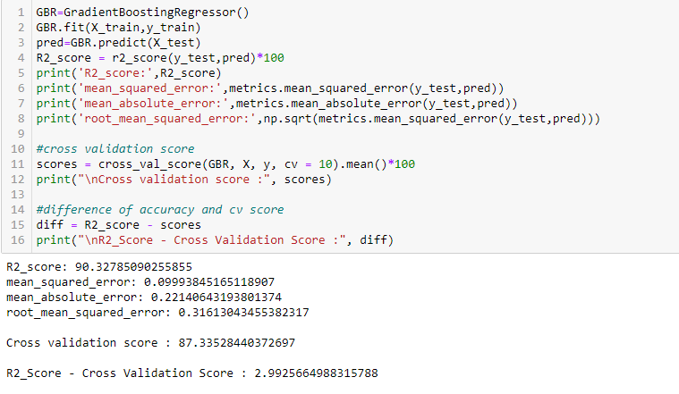
* I have already mentioned I have used GRADIENTBOOSTINGREGRESSOR as a best model , becaues it is giving me best accuracy as compare to another algorithm.

Slide 19
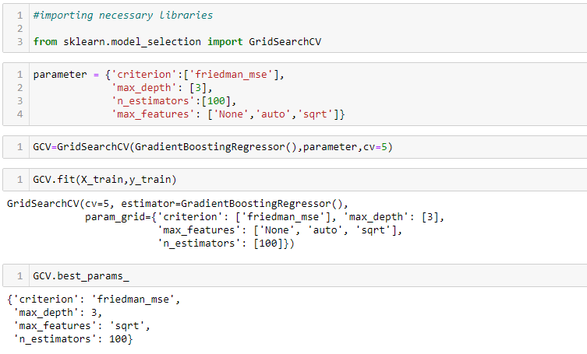
Hyper Parameter Tunning
I have choosed all parameters of GradientBoostingRegressor, after tunning the model with best parameters I have incresed my model accuracy from 87.6% Also mse and rmse values has reduced which means error has reduced.

Slide 20
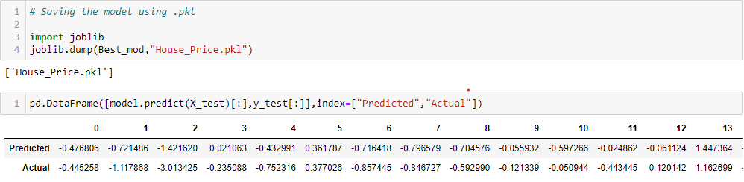
Saving the model and predictions from saved best model.
I have predicted the SalePrice for test dataset using saved model of train dataset, and the predictions look good. I have also saved my predictions for further analysis.

Slide 21
Conclusion:
In this project report, we have used machine learning algorithms to predict the house prices.
We have mentioned the step by step procedure to analyze the dataset and finding the correlation between the featuers. Thus we can select the features which are not correlated to each other and are independent in nature.
Those feature sets were then given as an input to five algorithms and a csv file was generated consisting of predicted house prices.
Hence we calculated the performance of each model using different performance metrics and compared them based on these metrics. Then we have also saved the dataframe of predicted prices of test dataset.
To conclude, the application of machine learning in property research is still at an early stage. We hope this study has moved a small step ahead in providing some methodological and empirical contributions to property appraisal, and presenting an alternative approach to the valuation of housing prices.
Future direction of research may consider incorporating additional property transaction data from a larger geographical location with more features, or analysing other property types beyond housing development.

Slide 22

THANK
YOU

